Slide 1
Authority

Slide 2
Authority
Luke 4 ⁵ And the devil took him up and showed him all the kingdoms of the world in a moment of time, ⁶ and said to him, “To you I will give all this authority and their glory, for it has been delivered to me, and I give it to whom I will.

Slide 3
Authority
Luke 4 ³¹ And he went down to Capernaum, a city of Galilee. And he was teaching them on the Sabbath, ³² and they were astonished at his teaching, for his word possessed authority.
Matthew 7:28-29
“not as their scribes”
Typical Rabbinical Teaching:
This Rabbi says…, that Rabbi says…, Another says…
Matthew 5
“You have heard that it was said…. But I say unto you….”

Slide 4
Authority
Luke 4 ³⁶ And they were all amazed and said to one another, “What is this word? For with authority and power he commands the unclean spirits, and they come out!”
Matthew 12:22ff
12:29“how can one enter the house of the strong man and spoil his goods, except he first bind the strong man?”
Demonstrating authority over demons was a precursor to Jesus’ demonstration of authority over the devil
Luke 10:17-18
The Devil’s Chagrin! Even Jesus’ trainees had authority over the devil’s demons!

Slide 5
Authority
Luke 5 ²⁴ But that you may know that the Son of Man has authority on earth to forgive sins”—he said to the man who was paralyzed—“I say to you, rise, pick up your bed and go home.”

Slide 6
Authority
Luke 6 ⁵ And he said to them, “The Son of Man is lord of the Sabbath.”

Slide 7
Authority
Luke 7 ⁸ For I too am a man set under authority, with soldiers under me: and I say to one, ‘Go,’ and he goes; and to another, ‘Come,’ and he comes; and to my servant, ‘Do this,’ and he does it.”

Slide 8
Resisting the Lord’s Authority
Resisting by “Testing” the Lord
Luke 4 ¹² And Jesus answered him, “It is said, ‘You shall not put the Lord your God to the test.’”
Deuteronomy 6 ¹⁶
“You shall not put the Lord your God to the test, as you tested him at Massah.

Slide 9
Resisting the Lord’s Authority
Resisting by “Testing” the Lord
Exodus 17

Slide 10
Resisting the Lord’s Authority
Resisting by “Testing” the Lord
Exodus 17 ⁷ And he called the name of the place Massah and Meribah, because of the quarreling of the people of Israel, and because they tested the Lord by saying, “Is the Lord among us or not?”

Slide 11
Resisting the Lord’s Authority
Resisting by “Testing” the Lord
Exodus 17 ⁷
And he called the name of the place
Massah
And
Meribah,
because of the quarreling of the people of Israel, and
because they tested the Lord by saying,
“Is the Lord among us or not?”
❶
❷
❶
❷

Slide 12
Resisting the Lord’s Authority
Resisting by “Testing” the Lord
Exodus 17 ⁷
And he called the name of the place
Massah
And
Meribah,
because of the quarreling of the people of Israel, and
because they tested the Lord by saying,
“Is the Lord among us or not?”
❶
❷
❷
❶

Slide 13
Resisting the Lord’s Authority
1
2
3
4
5
5
4
3
2
1
Resisting by “Testing” the Lord
Exodus 17 ⁷
And he called the name of the place
Massah
And
Meribah,
because of the quarreling of the people of Israel, and
because they tested the Lord by saying,
“Is the Lord among us or not?”
❶
❷
CHIASM
Χ
“CHI”
❷
❶

Slide 14
Resisting the Lord’s Authority
Resisting by “Testing” the Lord
Exodus 17 ⁷
And he called the name of the place
Massah
And
Meribah,
because of the quarreling of the people of Israel, and
because they tested the Lord by saying,
“Is the Lord among us or not?”

Slide 15
Resisting the Lord’s Authority
Resisting by “Testing” the Lord
[Plague of Flies] Ex 8 ²² But on that day I will set apart the land of Goshen, where my people dwell, so that no swarms of flies shall be there, that you may know that I am the Lord in the midst of the earth.
Exodus 17 ⁷
And he called the name of the place
Massah
And
Meribah,
because of the quarreling of the people of Israel, and
because they tested the Lord by saying,
“Is the Lord among us or not?”
[Plague on Livestock] Ex 9 ⁴ But the Lord will make a distinction between the livestock of Israel and the livestock of Egypt, so that nothing of all that belongs to the people of Israel shall die.
[Plague of Hail] Ex 9 ²⁶ Only in the land of Goshen, where the people of Israel were, was there no hail.
[Plague of Darkness] Ex 10 ²³ but all the people of Israel had light where they lived.
[Death of Firstborn] Ex 11 ⁷ But not a dog shall growl against any of the people of Israel, either man or beast, that you may know that the Lord makes a distinction between Egypt and Israel.’
[Cloud] Ex 14 ¹⁹⁻²⁰ Then the angel of God who was going before the host of Israel moved and went behind them, and the pillar of cloud moved from before them and stood behind them, coming between the host of Egypt and the host of Israel.
[Sea] Ex 14 ³⁰ Thus the Lord saved Israel that day from the hand of the Egyptians, and Israel saw the Egyptians dead on the seashore.
[Water!] Ex 15 ²⁵ and the Lord showed him a log, and he threw it into the water, and the water became sweet.
[Quail! & Manna!] Ex 16 ¹³ quail came up and covered the camp… ¹⁵Moses said to them, “It is the bread that the Lord has given you to eat.”

Slide 16
Resisting the Lord’s Authority
Resisting by “Testing” the Lord
Promise to Abraham, Isaac, Jacob
Prophesies of Isaiah, Micah, etc.
Jesus sent apostles to “all nations”
Acts 10 signs
Peter’s vision
Holy Spirit: Go! I have sent them!
Cornelius’ report of Angel’s words
Holy Spirit comes on Gentiles
Acts 15 ¹⁰ Now, therefore, why are you putting God to the test by placing a yoke on the neck of the disciples that neither our fathers nor we have been able to bear?

Slide 17
Resisting the Lord’s Authority
Contrast with Acceptable “Testing”
Gideon
Judges 6 ³⁹ Then Gideon said to God, “Let not your anger burn against me; let me speak just once more. Please let me test just once more with the fleece. Please let it be dry on the fleece only, and on all the ground let there be dew.”

Slide 18
Resisting the Lord’s Authority
Contrast with Acceptable “Testing”
Revelation 2 ² you have put those who call themselves apostles to the test, and they are not, and you found them to be false [NASB]

Slide 19
Resisting the Lord’s Authority
Resisting by Rejecting his Messengers
Acts 7 Stephen’s Speech
Joseph
⁹ “And the patriarchs, jealous of Joseph, sold him into Egypt; but God was with him

Slide 20
Resisting the Lord’s Authority
Resisting by Rejecting his Messengers
Acts 7 Stephen’s Speech
Moses
²⁵ He supposed that his brothers would understand that God was giving them salvation by his hand, but they did not understand.
²⁵…“Who made you a ruler and a judge over us?”
³⁵ This Moses, whom they rejected, saying, ‘Who made you a ruler and a judge?’—this man God sent as both ruler and redeemer
³⁹ Our fathers refused to obey him, but thrust him aside

Slide 21
Resisting the Lord’s Authority
Resisting by Rejecting his Messengers
Acts 7 Stephen’s Speech
Jesus
⁵¹ “You stiff-necked people, uncircumcised in heart and ears, you always resist the Holy Spirit.
As your fathers did, so do you.
⁵² Which of the prophets did your fathers not persecute?
And they killed those who announced beforehand the coming of the Righteous One, whom you have now betrayed and murdered

Slide 22
Resisting the Lord’s Authority
Resisting by Rejecting his Messengers
The Bible

Slide 23
Resisting the Lord’s Authority
Resisting by Making Exceptions
Saul

Slide 24
Prayer
Tim Driedger

Slide 25
Nearer, Still Nearer
325
Hymn: Lelia N. Morris (1898)
Tune: MORRIS • Lelia N. Morris (1898)

Slide 26
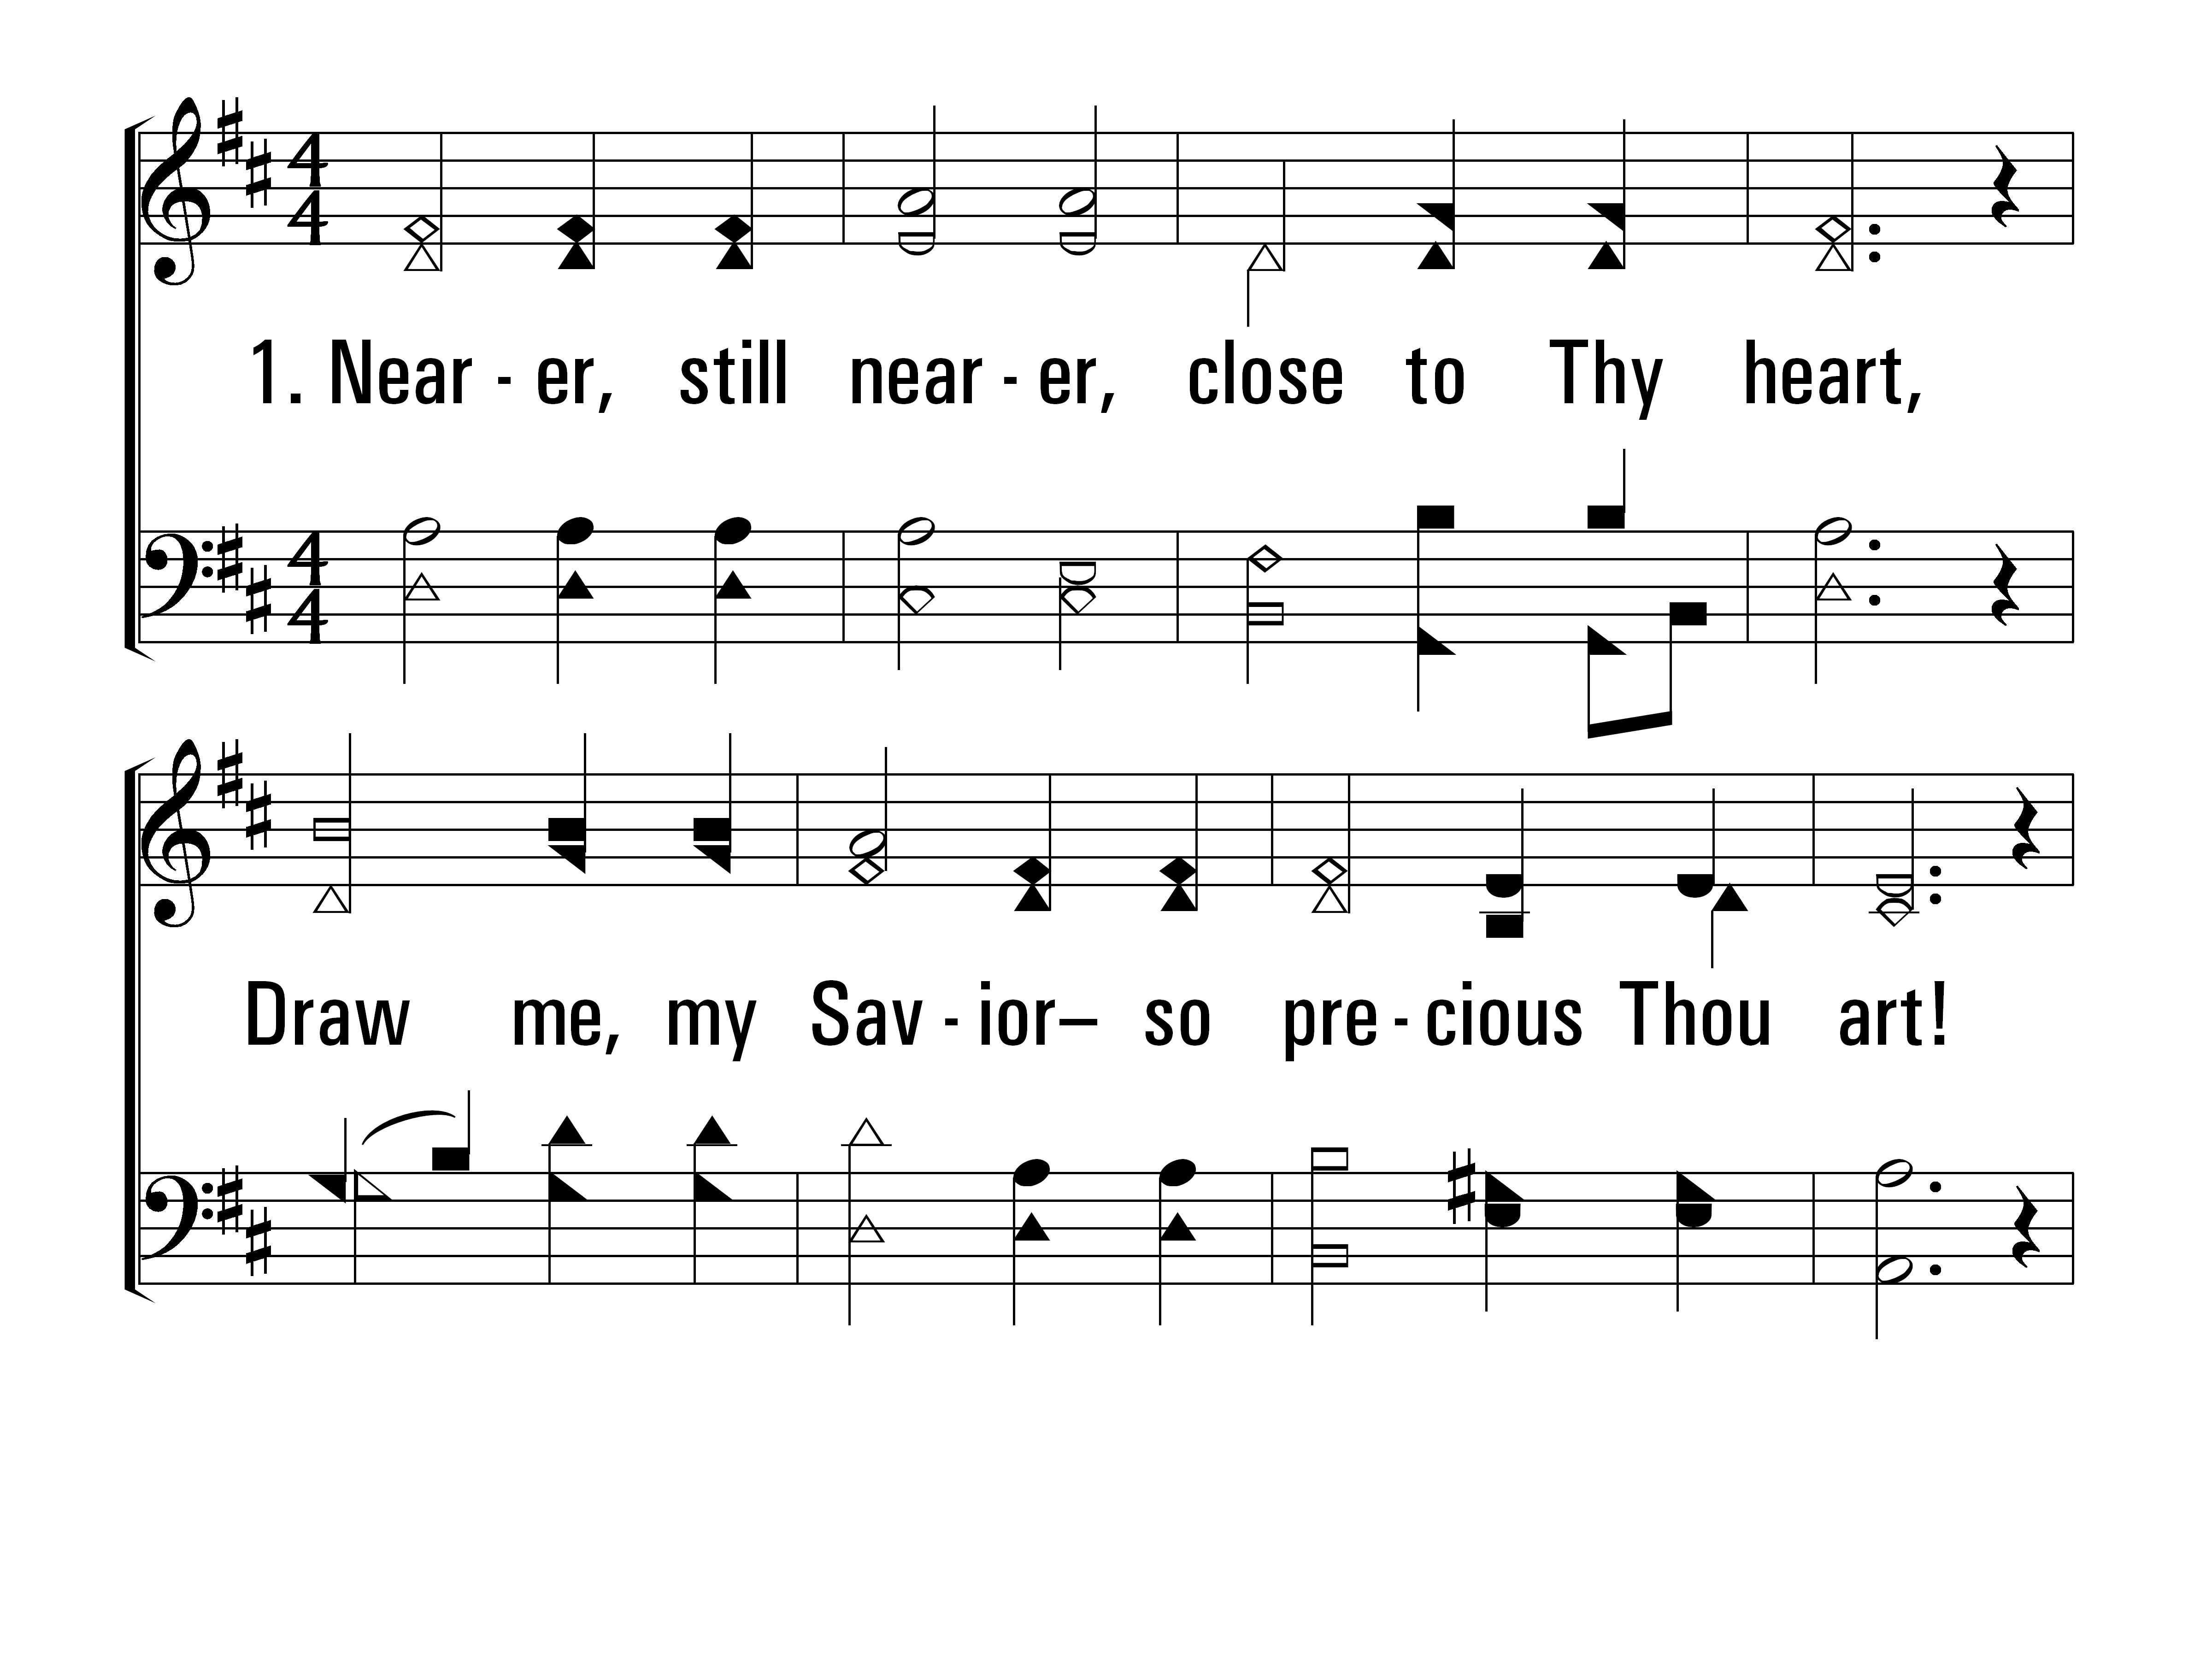
NearerStillNearer_st1_a
Vs 1
© 2014 Sumphonia Productions, LLC

Slide 27
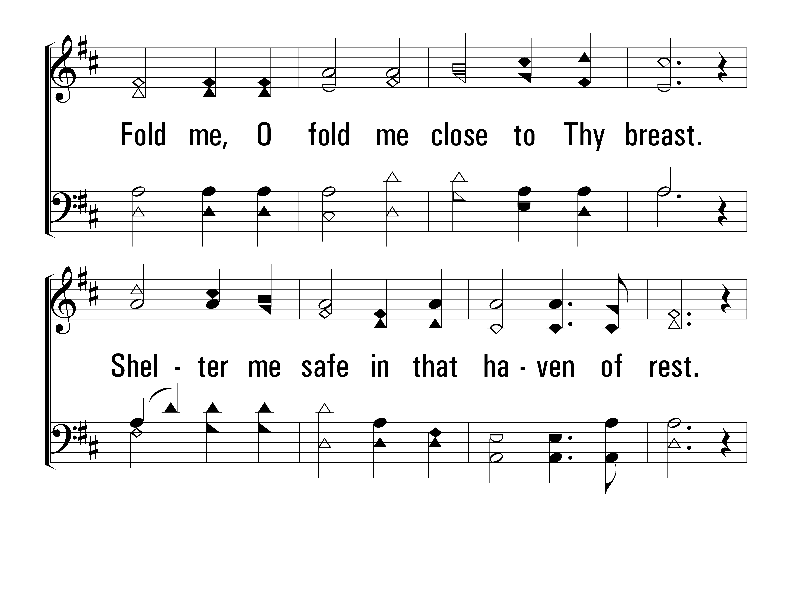
NearerStillNearer_st1_b
Vs 1
© 2014 Sumphonia Productions, LLC

Slide 28
NearerStillNearer_st1_c
Vs 1
© 2014 Sumphonia Productions, LLC

Slide 29
NearerStillNearer_st2_a
Vs 2
© 2014 Sumphonia Productions, LLC

Slide 30
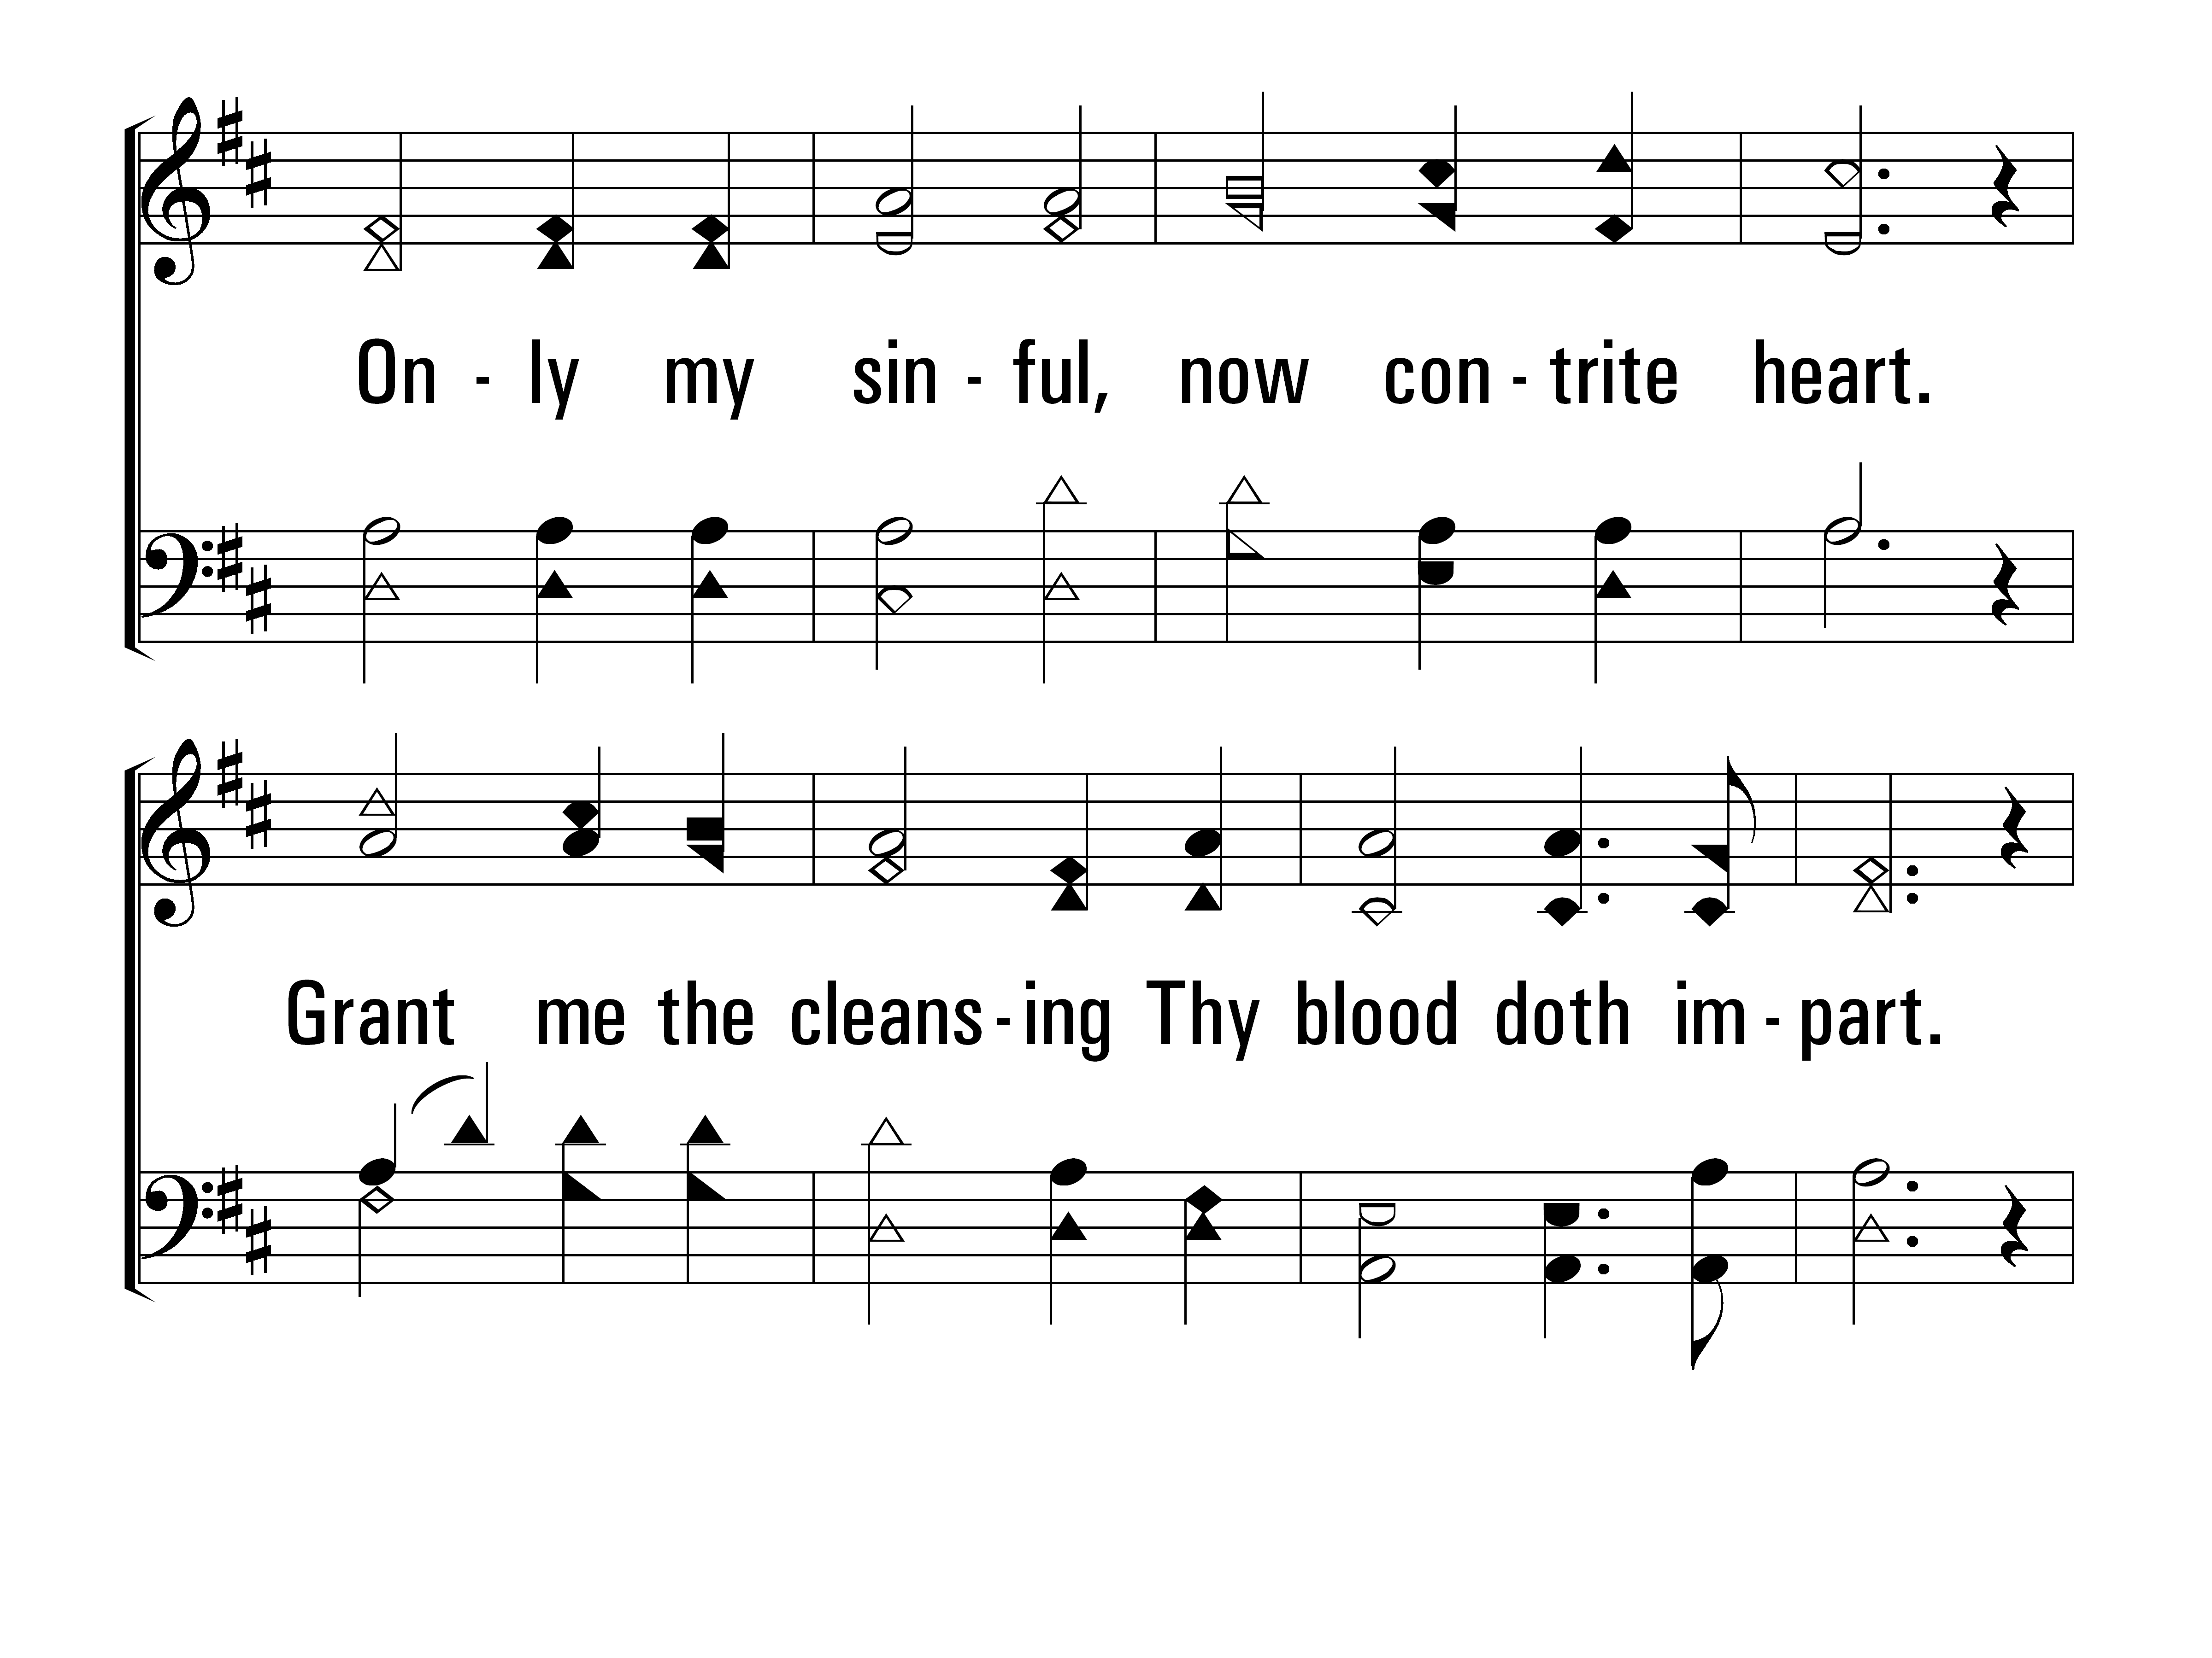
NearerStillNearer_st2_b
Vs 2
© 2014 Sumphonia Productions, LLC

Slide 31
NearerStillNearer_st2_c
Vs 2
© 2014 Sumphonia Productions, LLC

Slide 32
NearerStillNearer_st3_a
Vs 3
© 2014 Sumphonia Productions, LLC

Slide 33
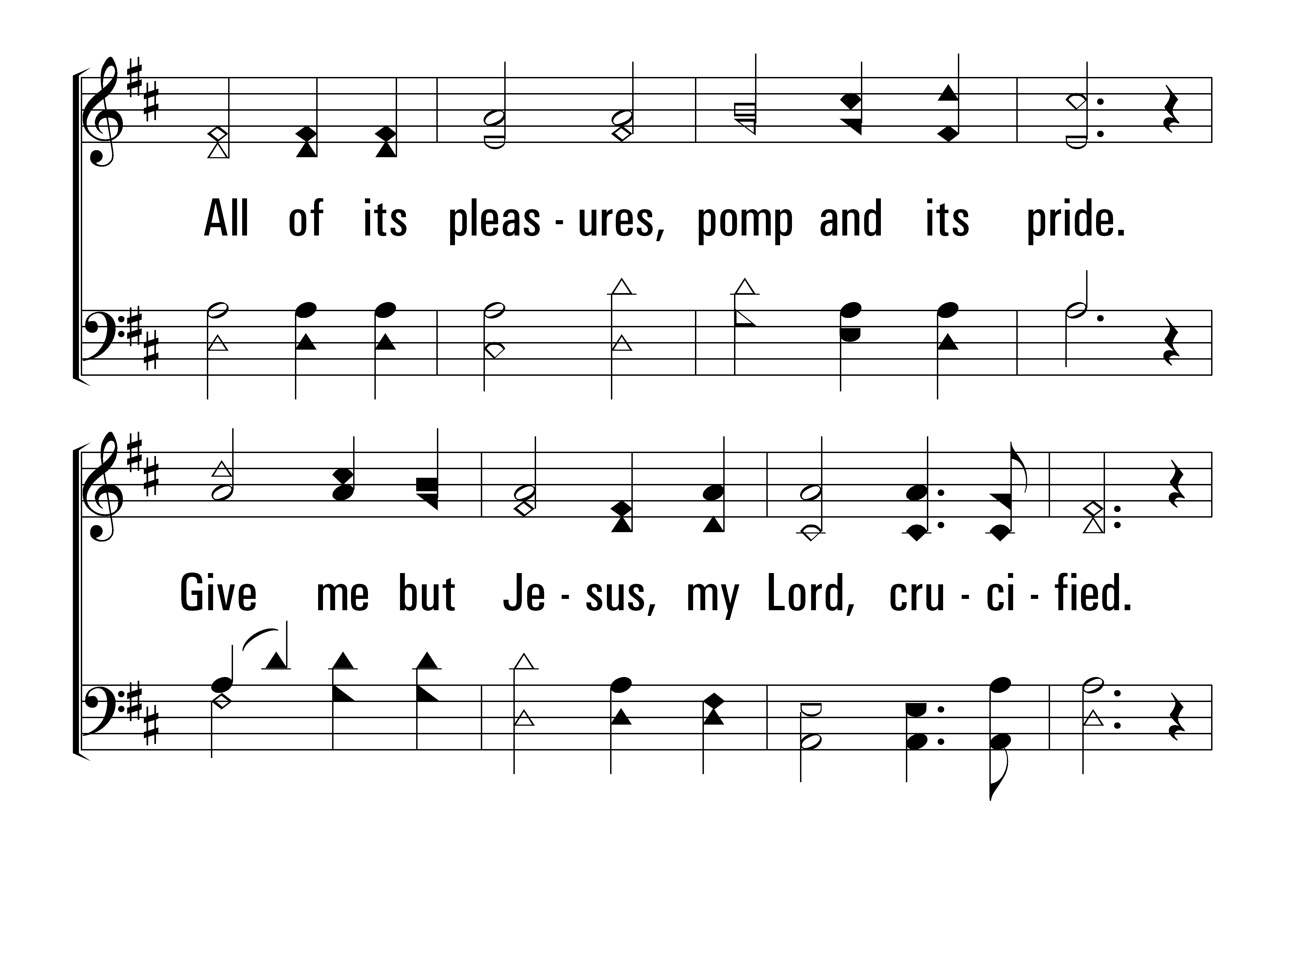
NearerStillNearer_st3_b
Vs 3
© 2014 Sumphonia Productions, LLC

Slide 34
NearerStillNearer_st3_c
Vs 3
© 2014 Sumphonia Productions, LLC

Slide 35
NearerStillNearer_st4_a
Vs 4
© 2014 Sumphonia Productions, LLC

Slide 36
NearerStillNearer_st4_b
Vs 4
© 2014 Sumphonia Productions, LLC

Slide 37
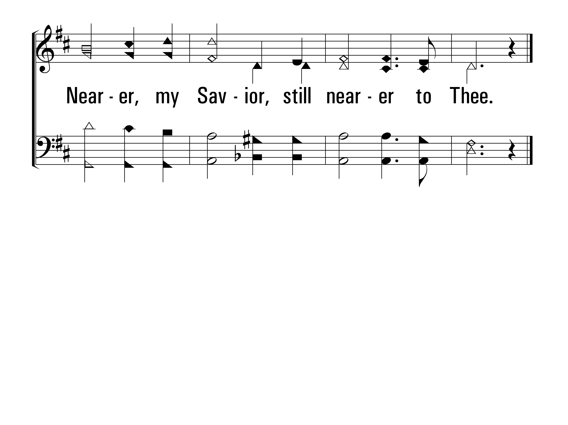
NearerStillNearer_st4_c
Vs 4
© 2014 Sumphonia Productions, LLC
End

Slide 38
His Grace Reaches Me
445
Hymn: Jewell M. Whitey Gleason (1964)
Tune: HIS GRACE • Jewell M. Whitey Gleason (1964)
© 1964 Stamps Quartet Music Co. (admin. by Brentwood-Benson Music Publishing, Inc.)

Slide 39
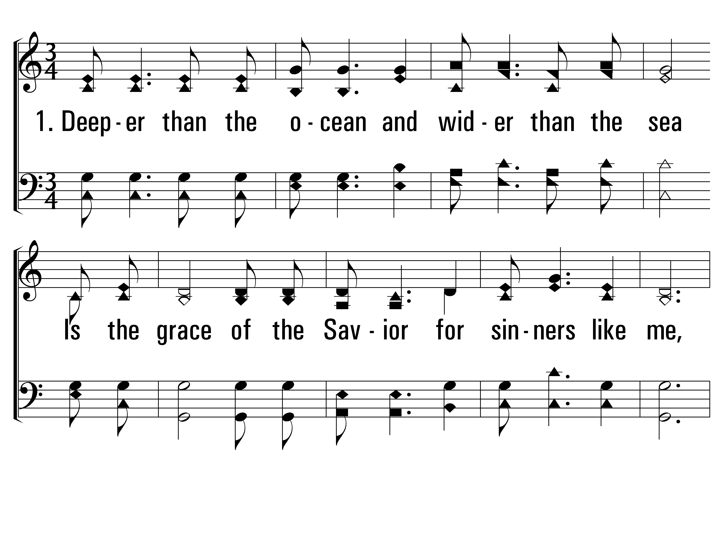
HisGraceReachesMe_st1_a
Vs 1
© 2014 Sumphonia Productions, LLC

Slide 40
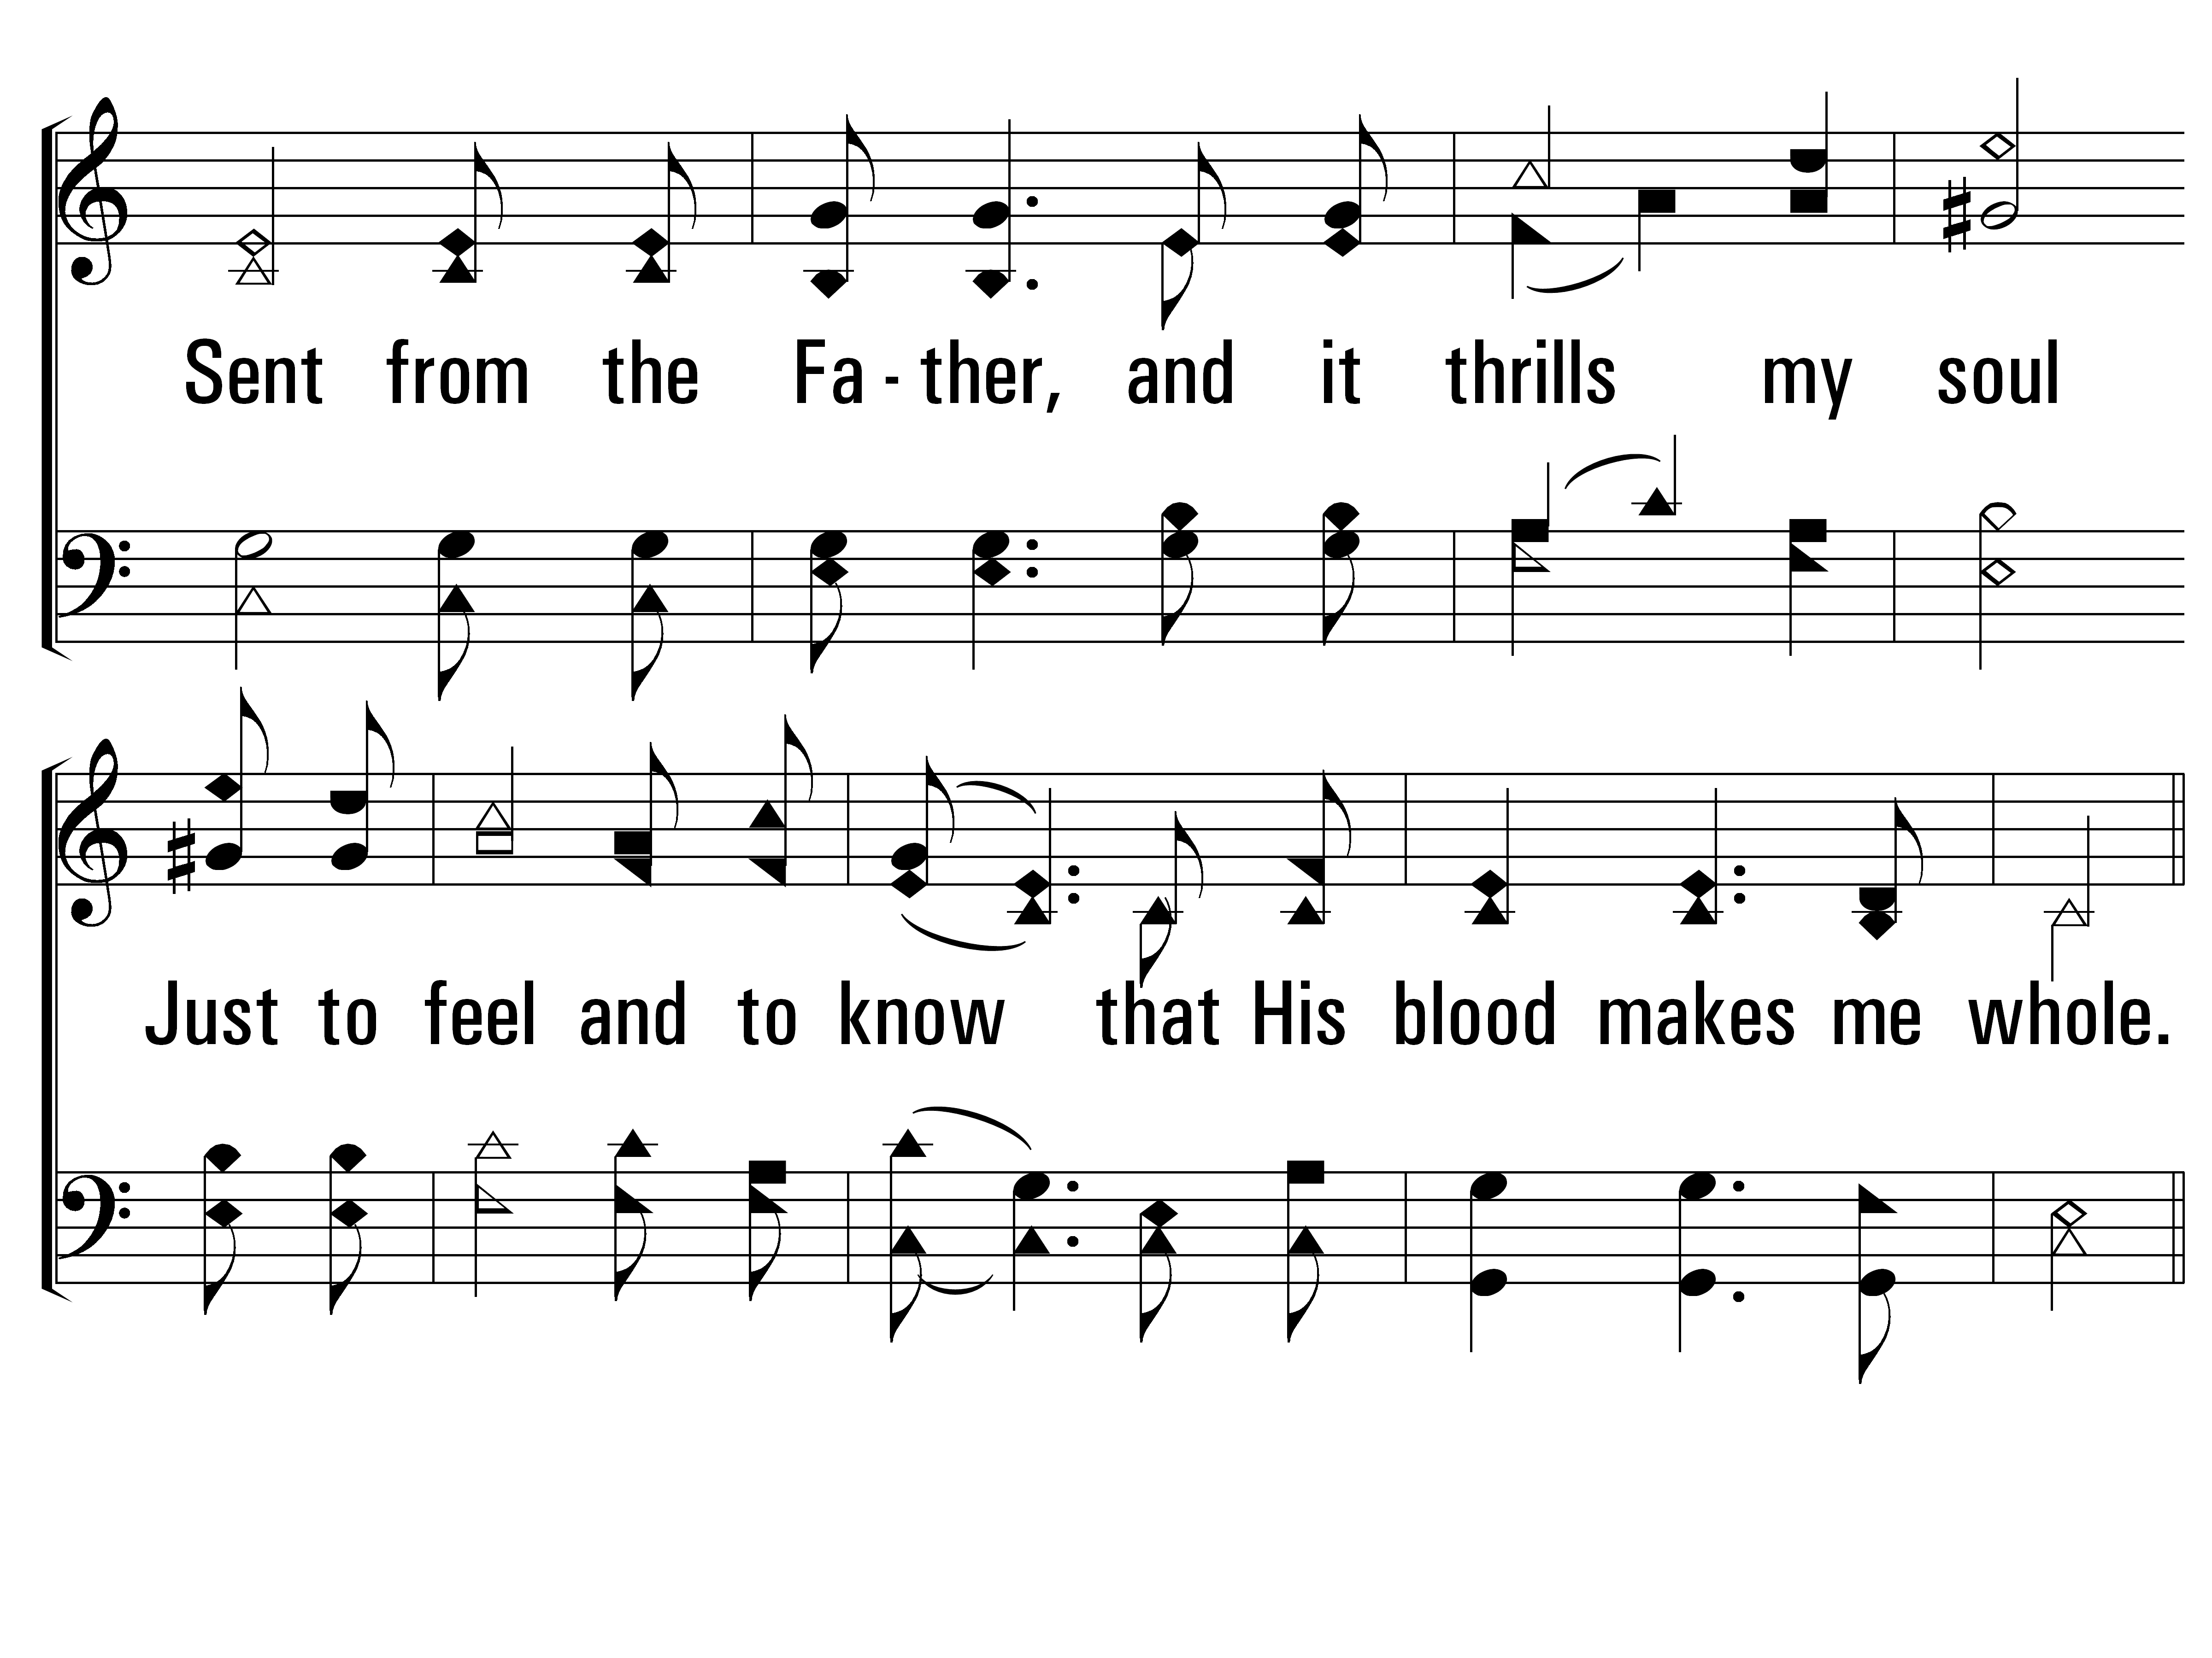
HisGraceReachesMe_st1_b
Vs 1
© 2014 Sumphonia Productions, LLC

Slide 41
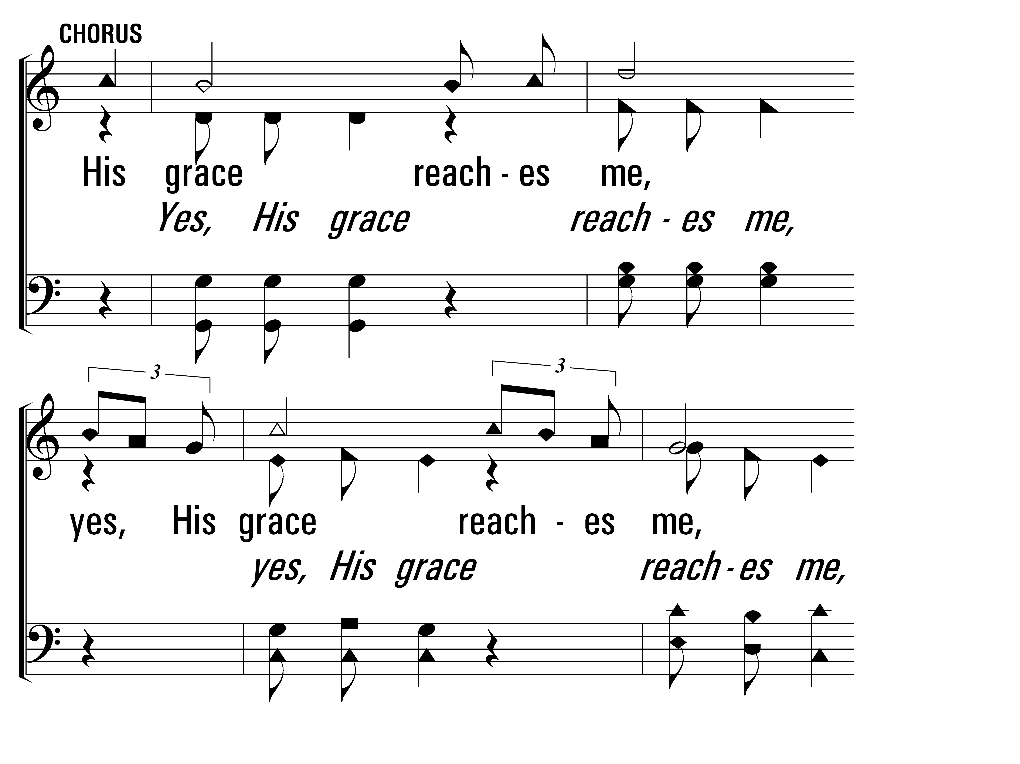
HisGraceReachesMe_cho_a
Chorus
© 2014 Sumphonia Productions, LLC

Slide 42
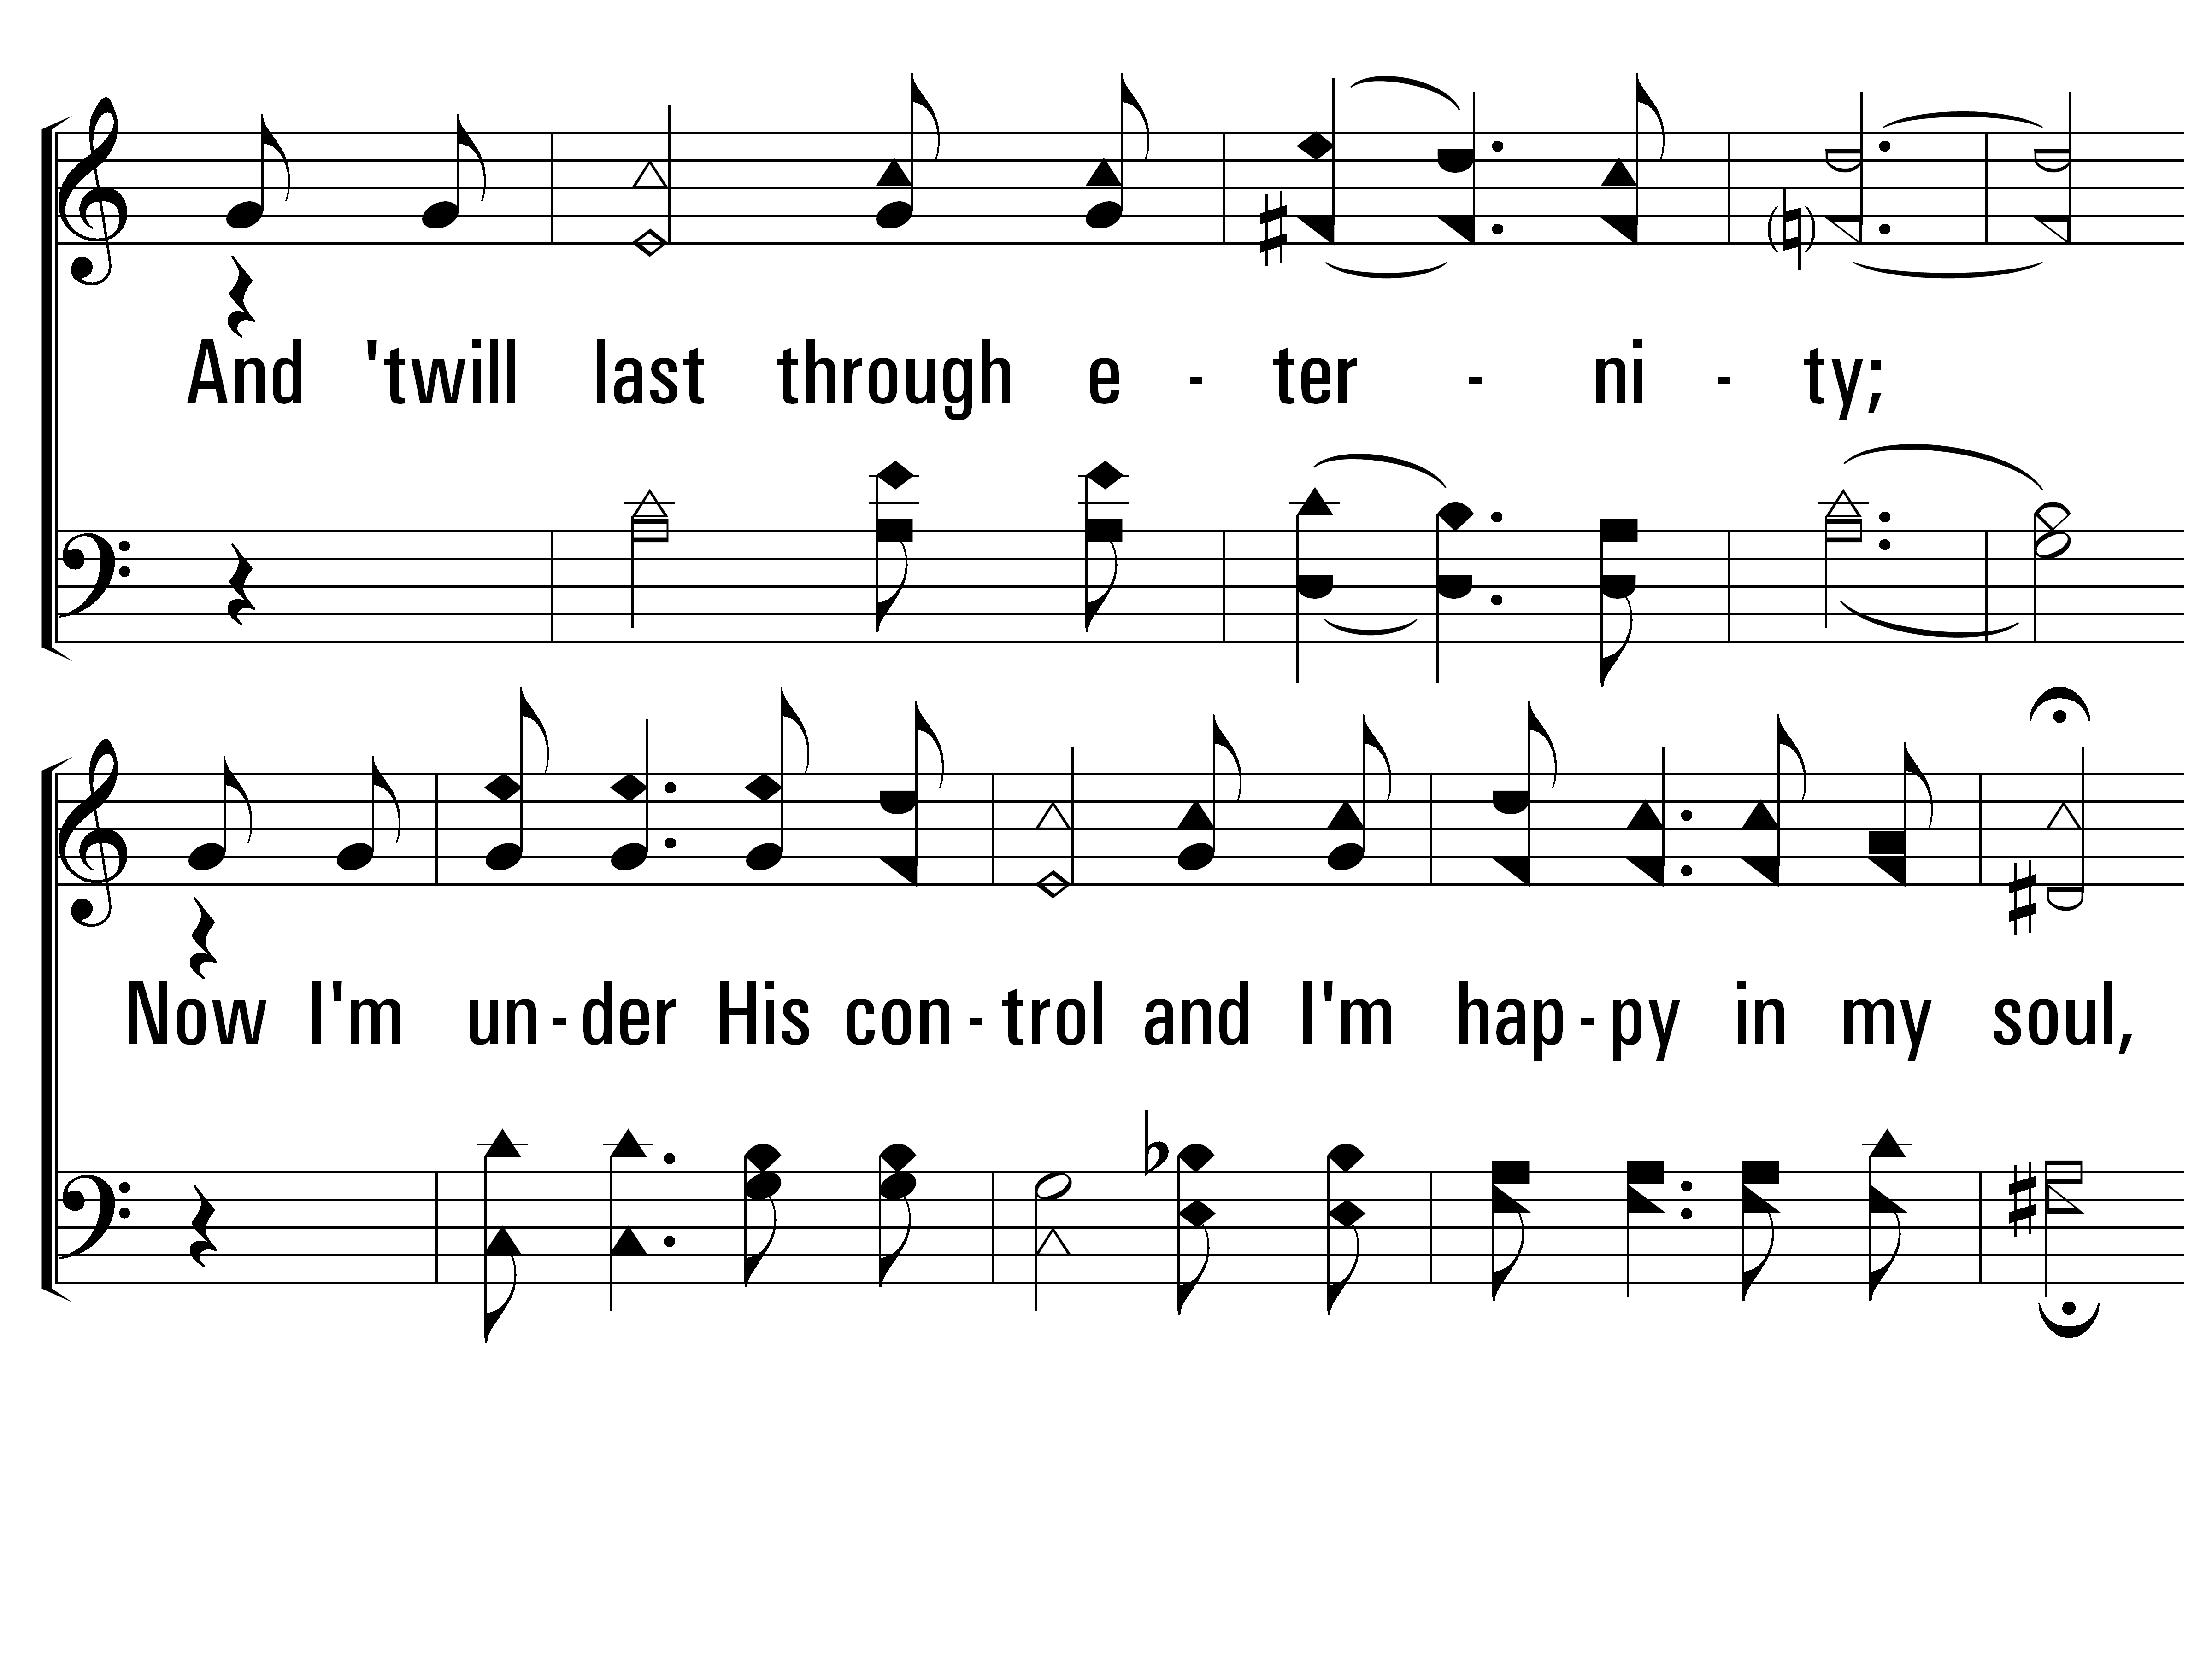
HisGraceReachesMe_cho_b
Chorus
© 2014 Sumphonia Productions, LLC

Slide 43
HisGraceReachesMe_cho_c
Chorus
© 2014 Sumphonia Productions, LLC

Slide 44
HisGraceReachesMe_st2_a
Vs 2
© 2014 Sumphonia Productions, LLC

Slide 45
HisGraceReachesMe_st2_b
Vs 2
© 2014 Sumphonia Productions, LLC

Slide 46
HisGraceReachesMe_cho_a
Chorus
© 2014 Sumphonia Productions, LLC

Slide 47
HisGraceReachesMe_cho_b
Chorus
© 2014 Sumphonia Productions, LLC

Slide 48
HisGraceReachesMe_cho_c
Chorus
© 2014 Sumphonia Productions, LLC
End

Slide 49
In Christ Alone
306
Hymn: Keith Getty (2001); Stuart Townend (2001)
Tune: Keith Getty (2001); Stuart Townend (2001); arr. D. J. Bulls
© 2001 Thankyou Music (admin. by EMI Christian Music Publishing)

Slide 50
InChristAlone_st1_a
Vs 1
© 2014 Sumphonia Productions, LLC

Slide 51
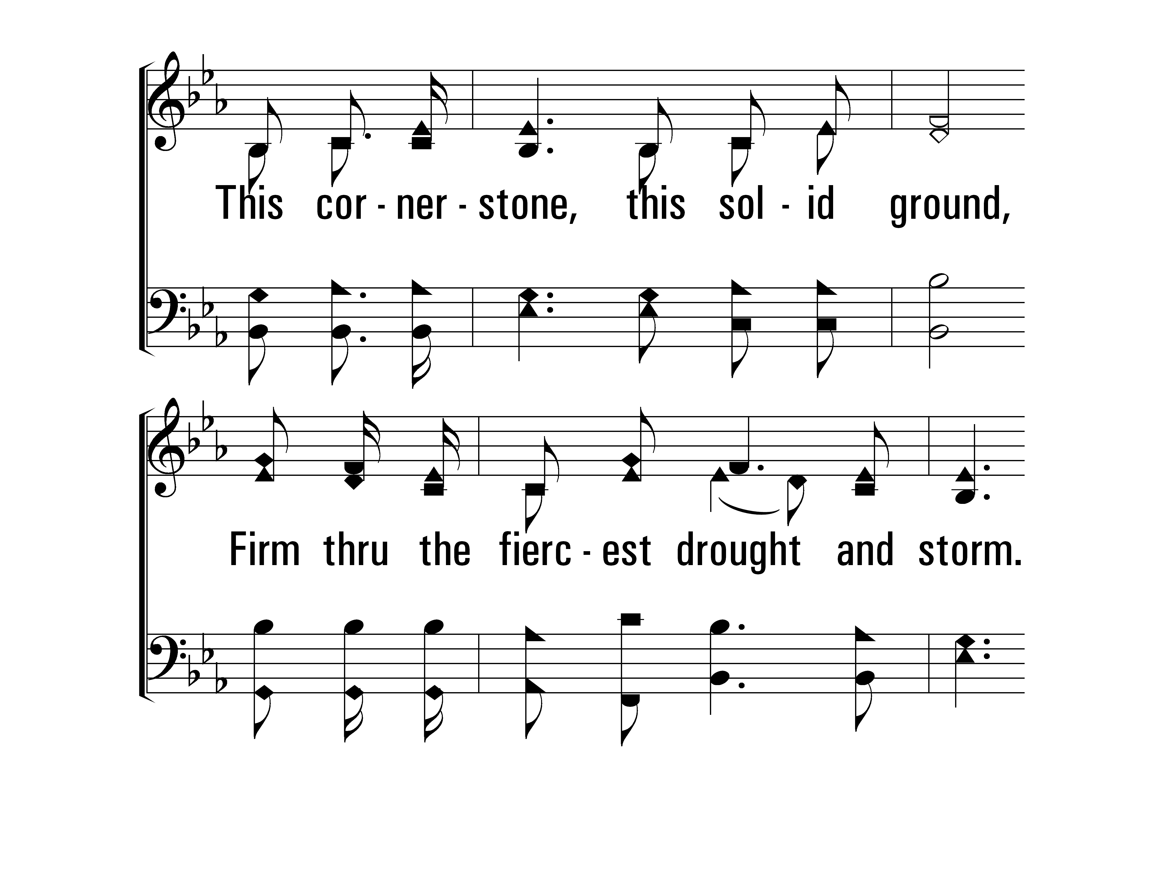
InChristAlone_st1_b
Vs 1
© 2014 Sumphonia Productions, LLC

Slide 52
InChristAlone_st1_c
Vs 1
© 2014 Sumphonia Productions, LLC

Slide 53
InChristAlone_st1_d
Vs 1
© 2014 Sumphonia Productions, LLC

Slide 54
InChristAlone_st2_a
Vs 2
© 2014 Sumphonia Productions, LLC

Slide 55
InChristAlone_st2_b
Vs 2
© 2014 Sumphonia Productions, LLC

Slide 56
InChristAlone_st2_c
Vs 2
© 2014 Sumphonia Productions, LLC

Slide 57
InChristAlone_st2_d
Vs 2
© 2014 Sumphonia Productions, LLC

Slide 58
InChristAlone_st3_a
Vs 3
© 2014 Sumphonia Productions, LLC

Slide 59
InChristAlone_st3_b
Vs 3
© 2014 Sumphonia Productions, LLC

Slide 60
InChristAlone_st3_c
Vs 3
© 2014 Sumphonia Productions, LLC

Slide 61
InChristAlone_st3_d
Vs 3
© 2014 Sumphonia Productions, LLC

Slide 62
InChristAlone_st4_a
Vs 4
© 2014 Sumphonia Productions, LLC

Slide 63
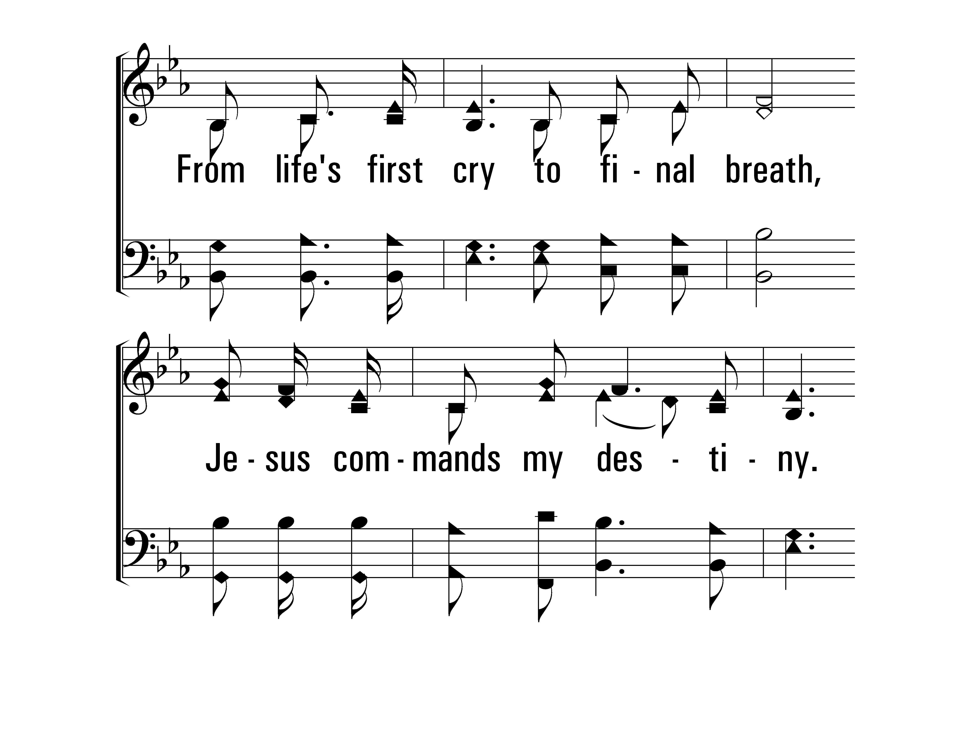
InChristAlone_st4_b
Vs 4
© 2014 Sumphonia Productions, LLC

Slide 64
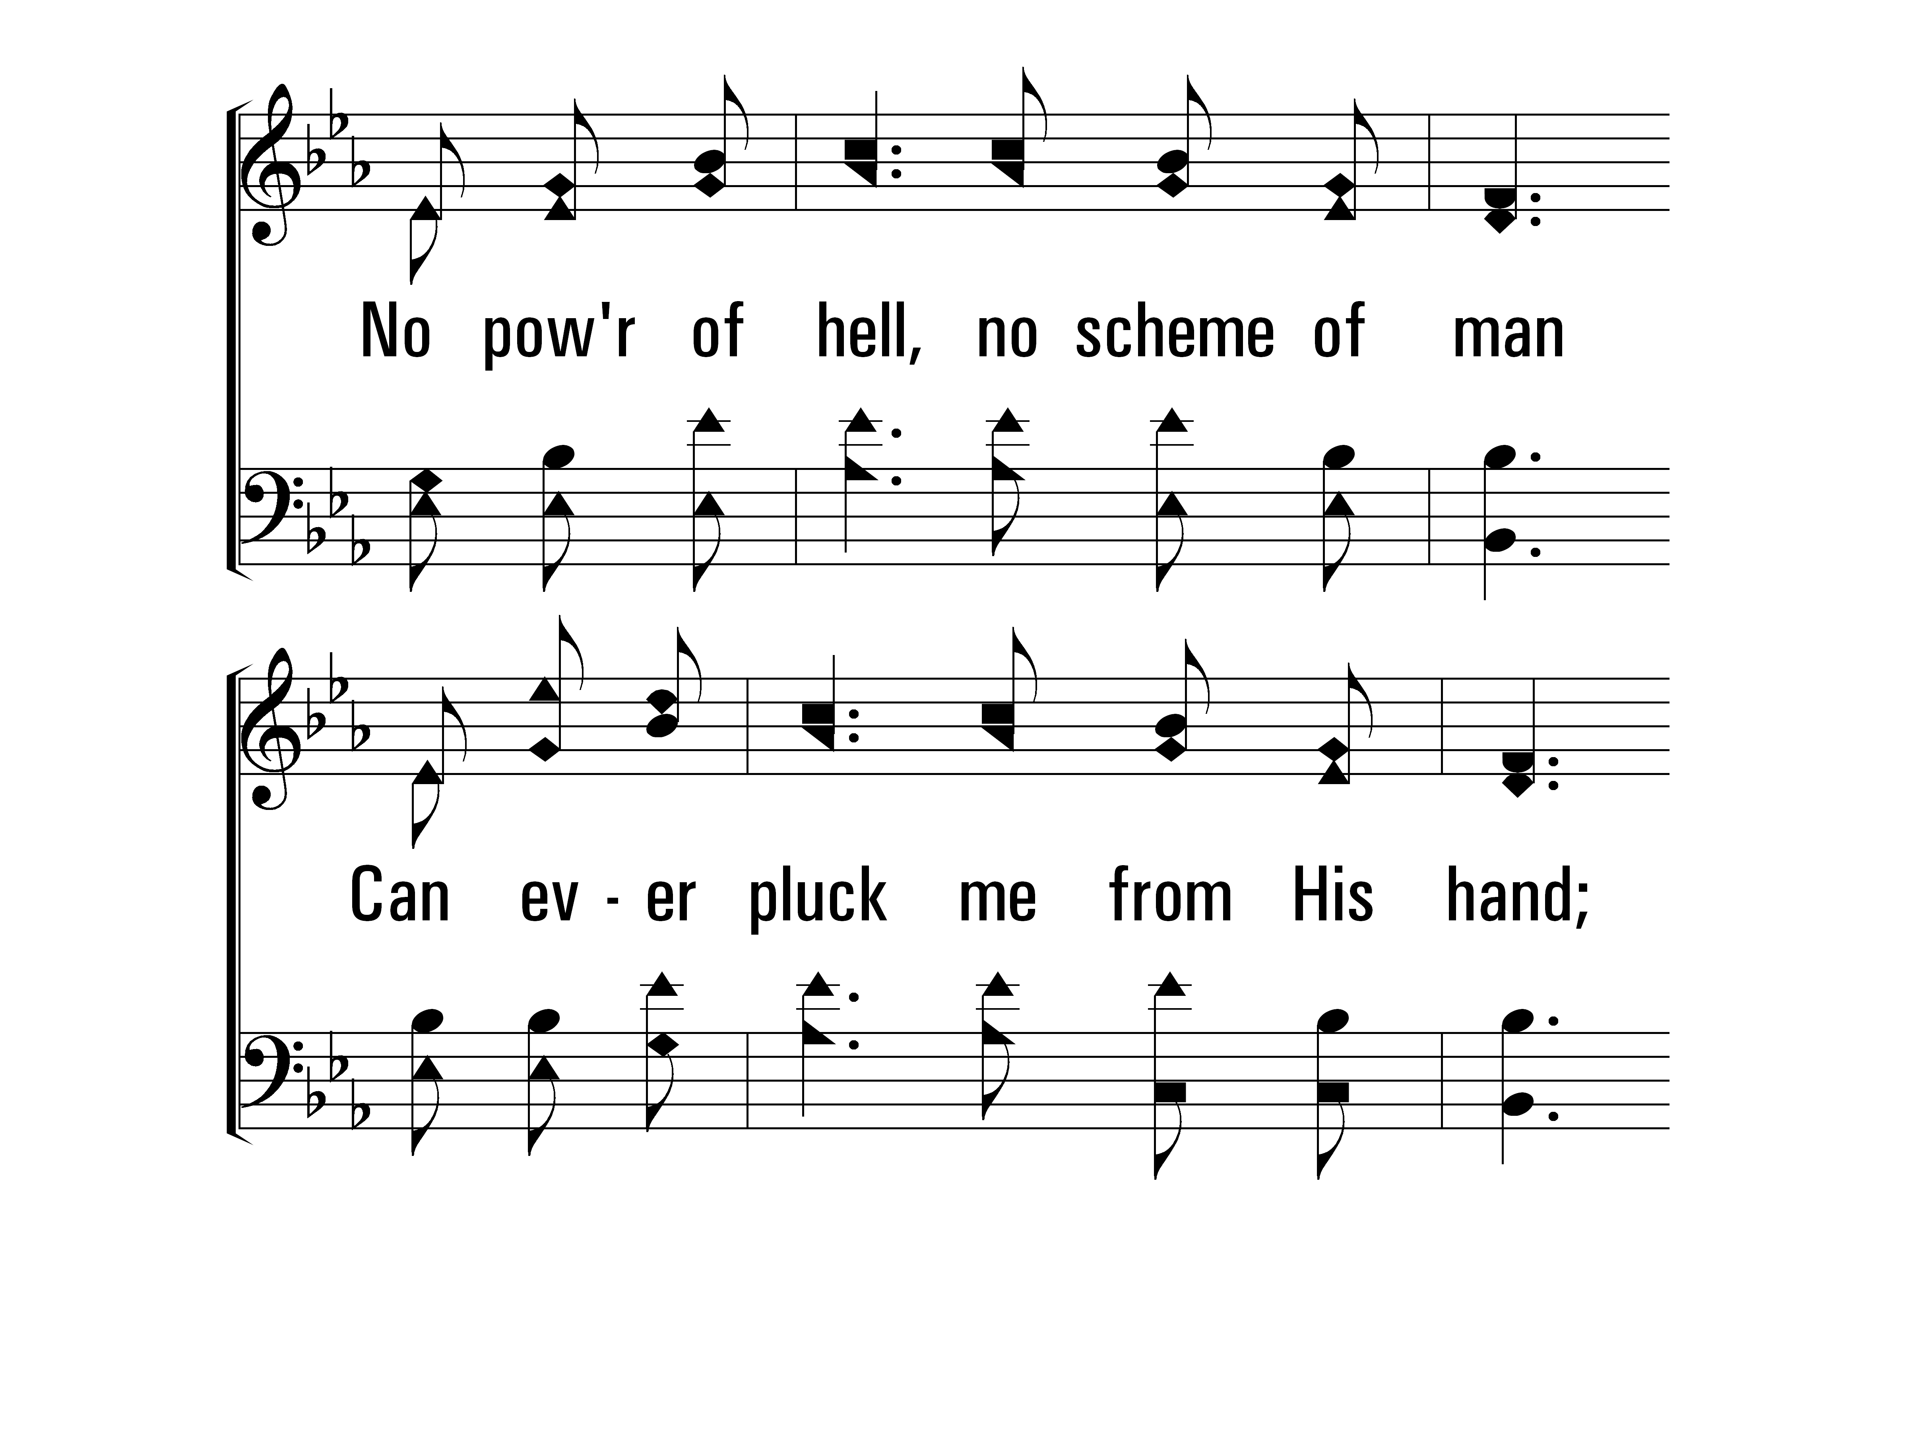
InChristAlone_st4_c
Vs 4
© 2014 Sumphonia Productions, LLC

Slide 65
InChristAlone_st4_d
Vs 4
© 2014 Sumphonia Productions, LLC
End

Slide 66
in Preparation for the Lord’s Supper…
Ethan Hulsey

Slide 67
The Lord’s Supper
Give thanks for the bread: Brent Richardson
Give thanks for the cup: Josh Gurtler

Slide 68
Announcements

Slide 69
The LORD Is My Light
6
Hymn: arr. C. E. Couchman (1986); Psalm 27:1, 4, 7, 9, 11, 13-14
Tune: PSALM 27 • C. E. Couchman (1986)
© 1986 C. E. Couchman

Slide 70
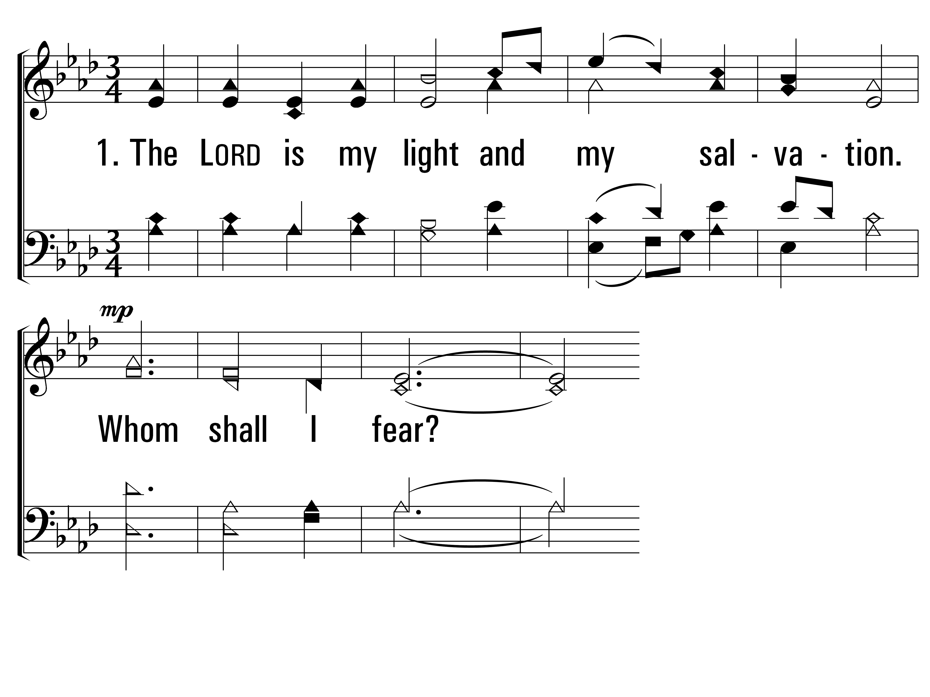
TheLordIsMyLight_st1_a
Vs 1
© 2014 Sumphonia Productions, LLC

Slide 71
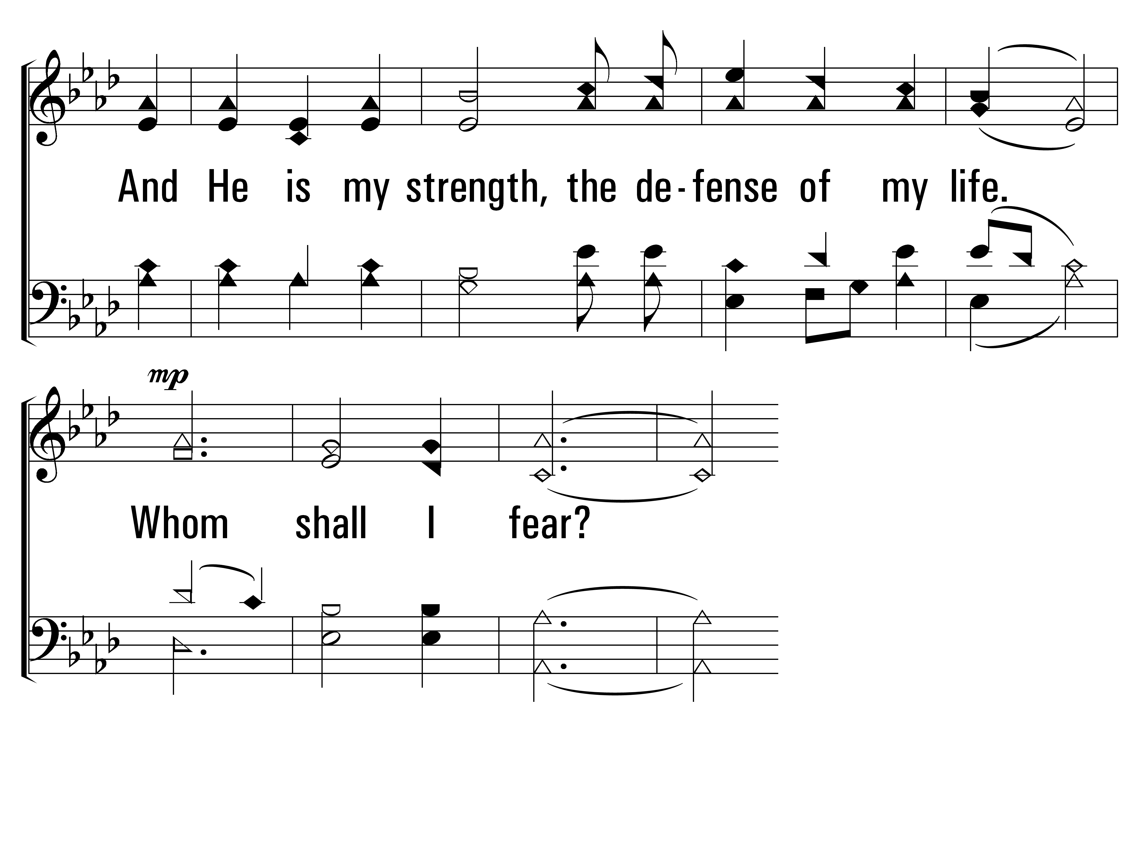
TheLordIsMyLight_st1_b
Vs 1
© 2014 Sumphonia Productions, LLC

Slide 72
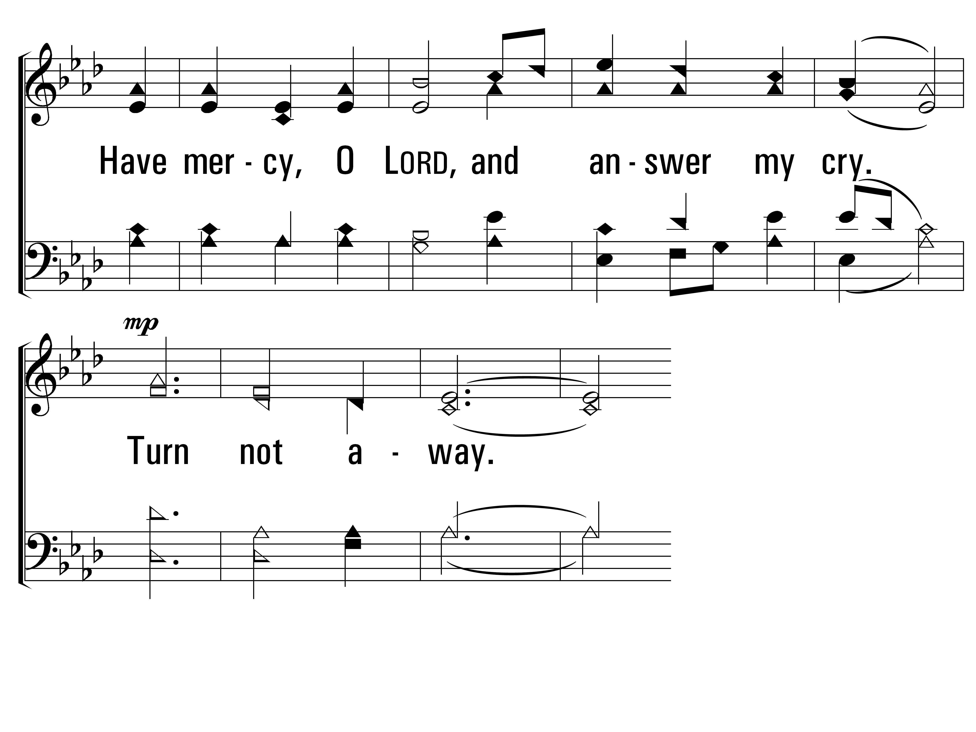
TheLordIsMyLight_st1_c
Vs 1
© 2014 Sumphonia Productions, LLC

Slide 73
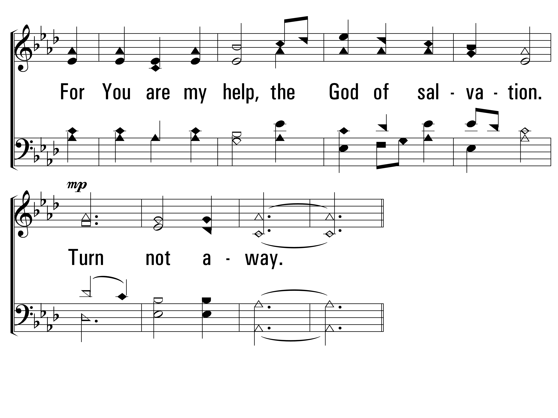
TheLordIsMyLight_st1_d
Vs 1
© 2014 Sumphonia Productions, LLC

Slide 74
TheLordIsMyLight_cho_a
Chorus
© 2014 Sumphonia Productions, LLC

Slide 75
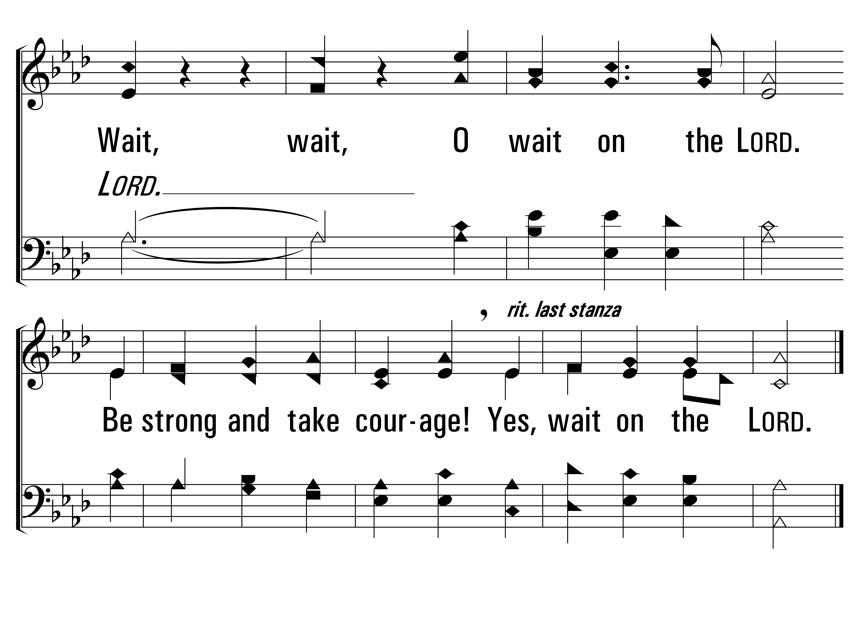
TheLordIsMyLight_cho_b
Chorus
© 2014 Sumphonia Productions, LLC

Slide 76
TheLordIsMyLight_st2_a
Vs 2
© 2014 Sumphonia Productions, LLC

Slide 77
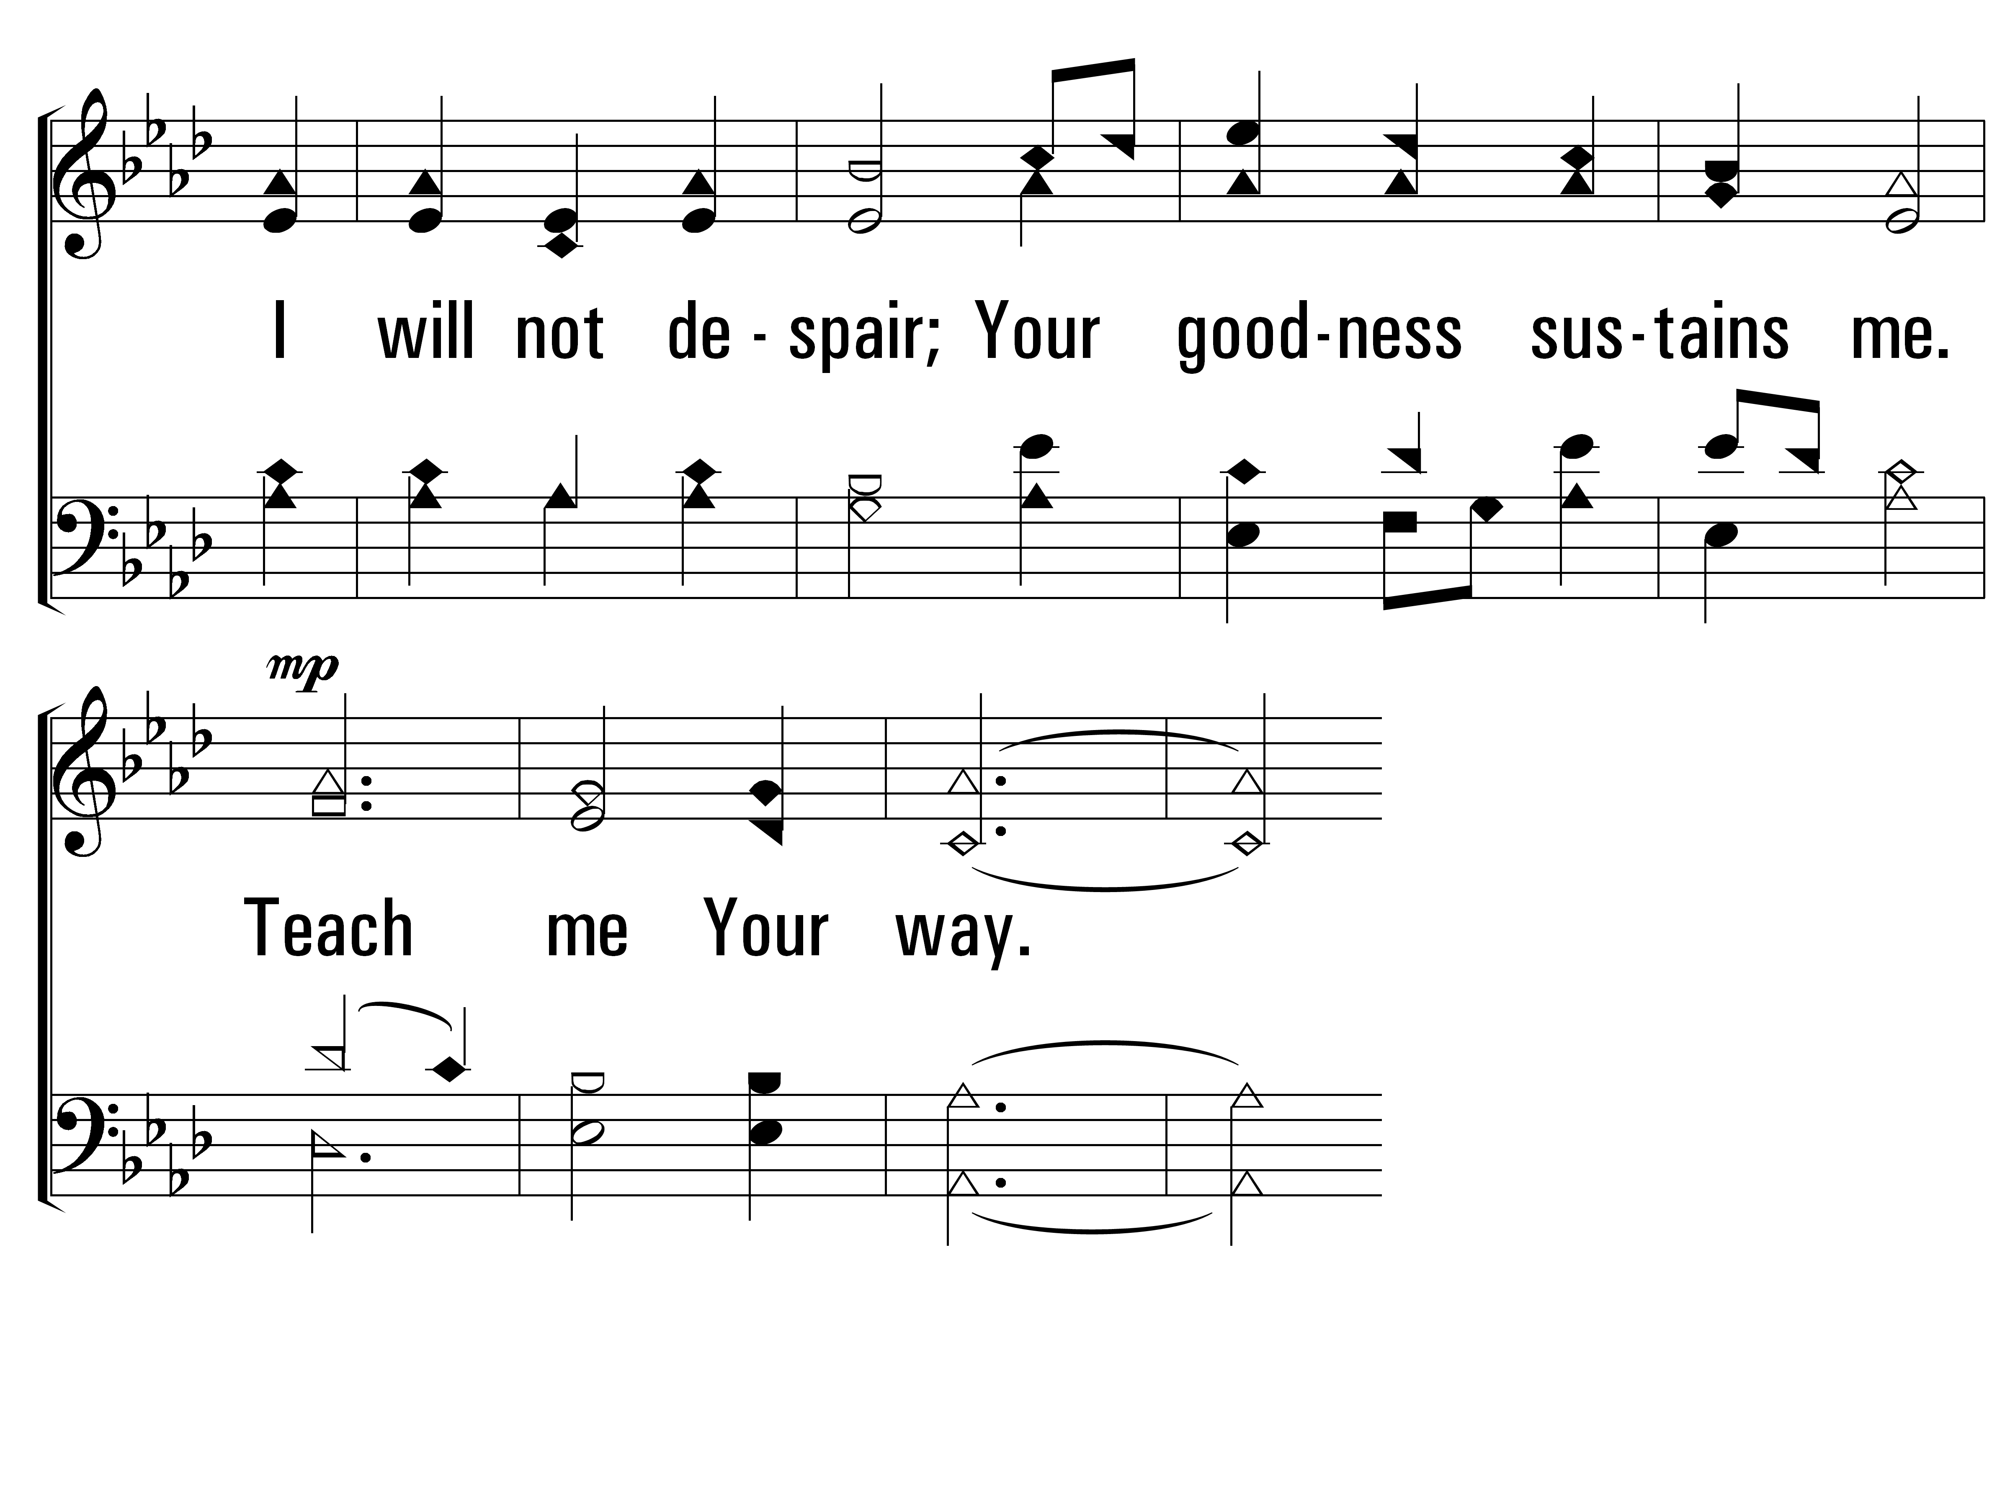
TheLordIsMyLight_st2_b
Vs 2
© 2014 Sumphonia Productions, LLC

Slide 78
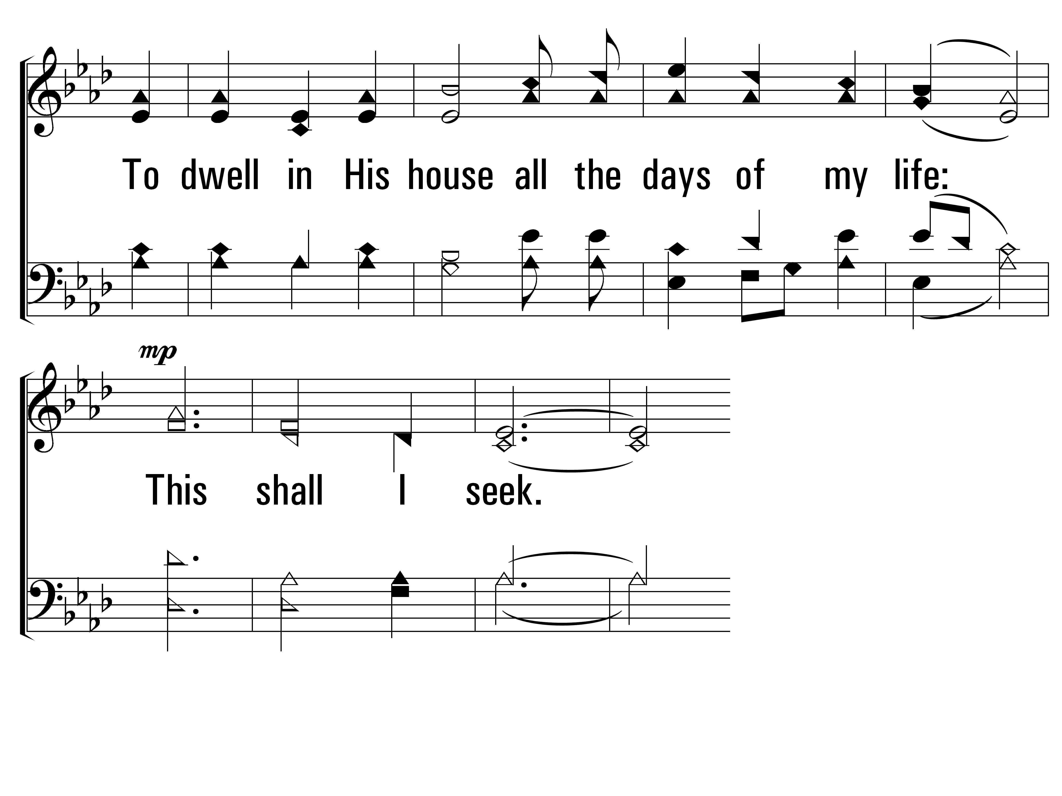
TheLordIsMyLight_st2_c
Vs 2
© 2014 Sumphonia Productions, LLC

Slide 79
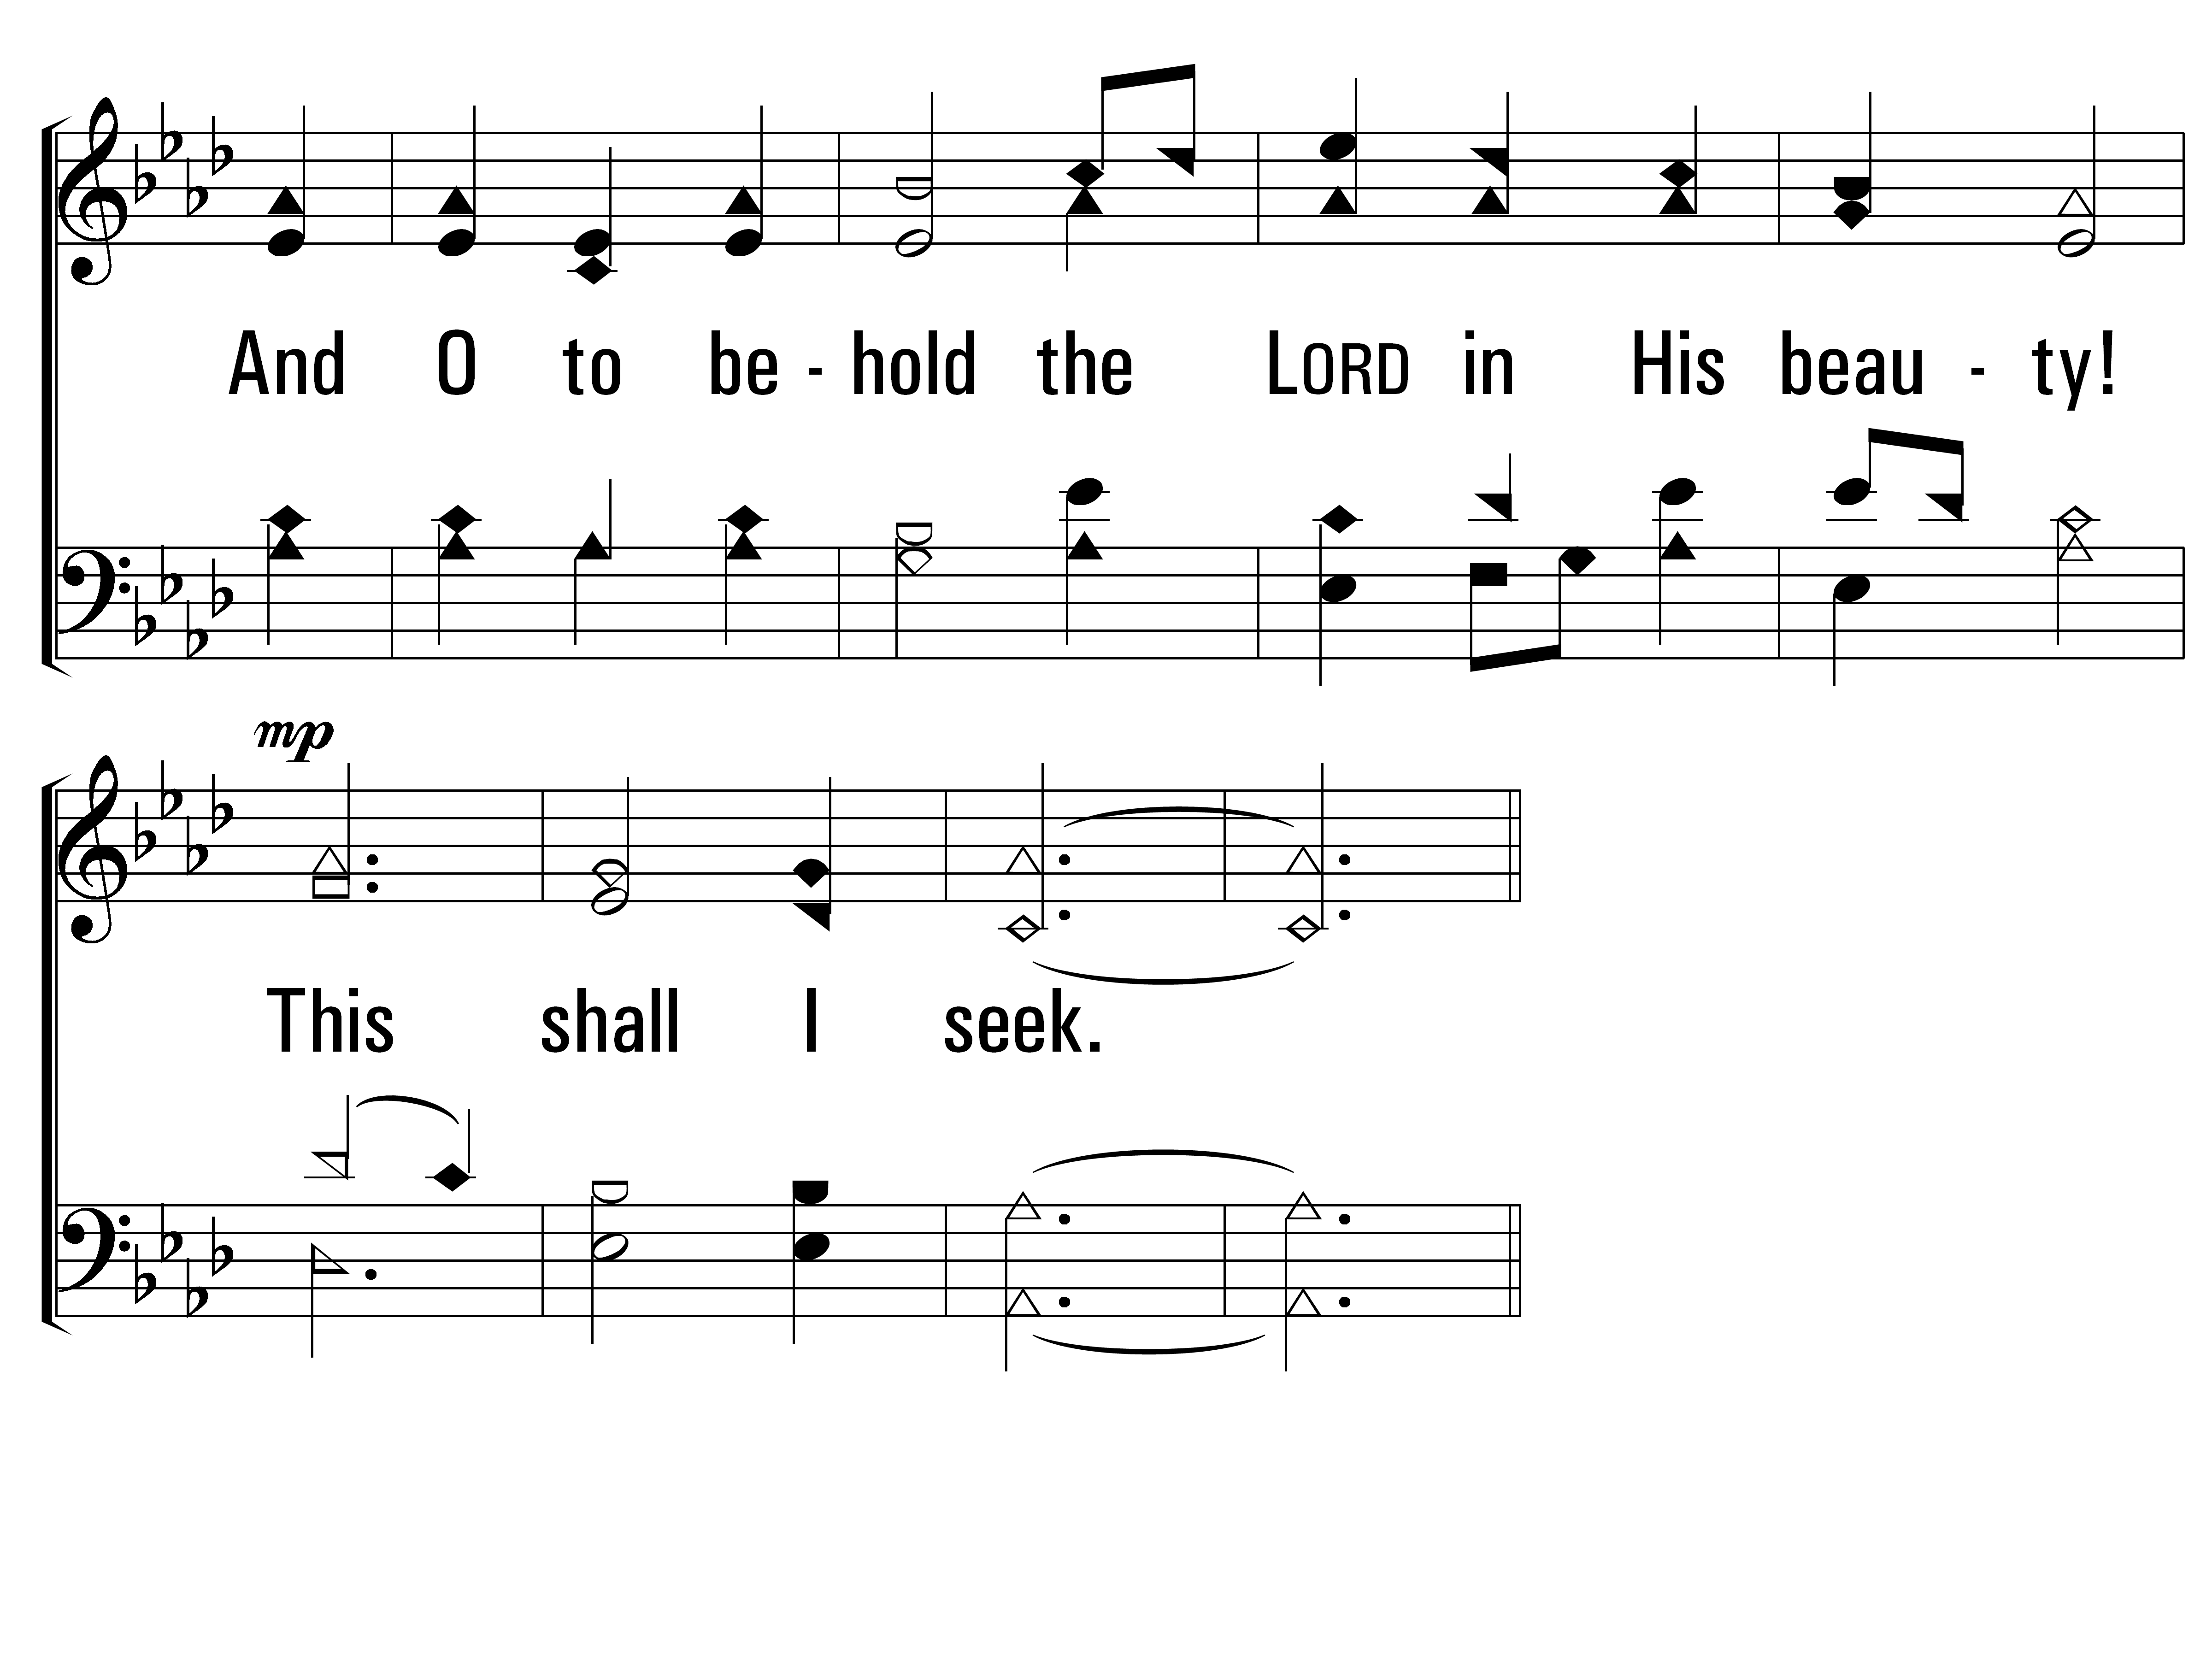
TheLordIsMyLight_st2_d
Vs 2
© 2014 Sumphonia Productions, LLC

Slide 80
TheLordIsMyLight_cho_a
Chorus
© 2014 Sumphonia Productions, LLC

Slide 81
TheLordIsMyLight_cho_b
Chorus
© 2014 Sumphonia Productions, LLC
End

Slide 82
Closing Prayer
Vince Robey

