Slide 1
OBADIAH

Slide 2
What is a Prophet?

Slide 3
What is a Prophet?
A Prophet was someone who spoke by direct revelation
Prophecy was not necessarily telling the future
But because God knows the future, a prophet may tell the future

Slide 4
The authority of God’s word
A wife for Isaac
“The matter comes from the Lord, so we cannot speak to you bad or good.” (Genesis 24:50)
A prophetic word is God’s word
“Then Jeremiah called Baruch the son of Neriah, and Baruch wrote on a scroll at the dictation of Jeremiah all the words of the Lord which He had spoken to him.” (Jeremiah 36:4)

Slide 5
The authority of God’s word
A wife for Isaac
“The matter comes from the Lord, so we cannot speak to you bad or good.” (Genesis 24:50)
A prophetic word is God’s word
“Then Jeremiah called Baruch the son of Neriah, and Baruch wrote on a scroll at the dictation of Jeremiah all the words of the Lord which He had spoken to him.” (Jeremiah 36:4)
5 times in ch 36
1 Time in ch 45

Slide 6
The authority of God’s word
A wife for Isaac
“The matter comes from the Lord, so we cannot speak to you bad or good.” (Genesis 24:50)
A prophetic word is God’s word
“Then Jeremiah called Baruch the son of Neriah, and Baruch wrote on a scroll at the mouth of Jeremiah all the words of the Lord which He had spoken to him.” (Jeremiah 36:4)

Slide 7
What is a Prophet?
Exodus 4:14-16
… “Is there not your brother Aaron the Levite?... So you are to speak to him and put the words in his mouth; and I Myself will be with your mouth and his mouth, and I will instruct you in what you are to do. He shall speak for you to the people; and he will be as a mouth for you and you will be as God to him.”

Slide 8
What is a Prophet?
Exodus 4:14-16
… “Is there not your brother Aaron the Levite?... So you are to speak to him and put the words in his mouth”

Slide 9
What is a Prophet?
Exodus 4:14-16
… “Is there not your brother Aaron the Levite?... So you are to speak to him and put the words in his mouth; and I Myself will be with your mouth and his mouth, and I will instruct you in what you are to do. He shall speak for you to the people”

Slide 10
What is a Prophet?
Exodus 4:14-16
… “Is there not your brother Aaron the Levite?... So you are to speak to him and put the words in his mouth; and I Myself will be with your mouth and his mouth, and I will instruct you in what you are to do. He shall speak for you to the people; and he will be as a mouth for you and you will be as God to him.”

Slide 11
What is a Prophet?
Exodus 4:14-16
Moses (as God)
Aaron (Moses’ mouth)
The people
Exodus 7:1-2
“See, I have made you as God to Pharaoh, and your brother Aaron shall be your prophet...Aaron shall speak to Pharaoh”

Slide 12
What is a Prophet?
Exodus 4:14-16
Moses (as God)
Aaron (Moses’ mouth)
The people
Exodus 7:1-2
you as God
Aaron your prophet
shall speak to Pharaoh

Slide 13
What is a Prophet?
Exodus 4:14-16
Moses (as God)
Aaron, Moses’ mouth =
The people
Exodus 7:1-2
you as God
Moses’ prophet
shall speak to Pharaoh

Slide 14
What is a Prophet?
Moses, a special prophet
Numbers 12:1-8
“Now hear My words: If there is a prophet among you, I, the Lord, will make Myself known to him in a vision. I will speak with him in a dream. It is not this way for My servant Moses; He is faithful in all My household; With him I speak mouth to mouth…

Slide 15
What is a Prophet?
Moses, a special prophet
Numbers 12:1-8
“Now hear My words: If there is a prophet among you, I, the Lord, will make Myself known to him in a vision. I will speak with him in a dream. It is not this way for My servant Moses; He is faithful in all My household; With him I speak mouth to mouth…
Other Prophets

Slide 16
What is a Prophet?
Numbers 12:1-8
“Now hear My words: If there is a prophet among you, I, the Lord, will make Myself known to him in a vision. I will speak with him in a dream. It is not this way for My servant Moses; He is faithful in all My household; With him I speak mouth to mouth
a figure of speech

Slide 17
There were False Prophets
Jeremiah 23:
“Do not listen to the words of the prophets who are prophesying to you.
They are leading you into futility; They tell a vision of their own imagination, Not from the mouth of the Lord.”.”

Slide 18
There were False Prophets
1 Kings 13:18
“I too am a prophet like you, and an angel spoke to me by the word of the Lord, saying, ‘Bring him back with you to your house, so that he may eat bread and drink water.” But he lied to him.

Slide 19
The Importance of KNOWING it is GOD’S Word
Judges 6:12-17 And the angel of the Lord appeared to him and said to him, “The Lord is with you, valiant warrior.”

Slide 20
The Importance of KNOWING it is GOD’S Word
Judges 6:12-17 And the angel of the Lord appeared to him and said to him, “The Lord is with you, valiant warrior.” Then Gideon said to him, “O my lord, if the Lord is with us, why then has all this happened to us?

Slide 21
The Importance of KNOWING it is GOD’S Word
Judges 6:12-17 And the angel of the Lord appeared to him and said to him, “The Lord is with you, valiant warrior.” Then Gideon said to him, “O my lord, if the Lord is with us, why then has all this happened to us? …And the Lord looked at him and said, “Go in this strength of yours and save Israel from the hand of Midian. Have I not sent you?” But he said to Him, “O Lord, how am I to save Israel? Behold, my family is the least in Manasseh, and I am the youngest in my father’s house.”

Slide 22
The Importance of KNOWING it is GOD’S Word
Judges 6:12-17 And the angel of the Lord appeared to him and said to him, “The Lord is with you, valiant warrior.” Then Gideon said to him, “O my lord, if the Lord is with us, why then has all this happened to us? …And the Lord looked at him and said, “Go in this strength of yours and save Israel from the hand of Midian. Have I not sent you?” But he said to Him, “O Lord, how am I to save Israel? Behold, my family is the least in Manasseh, and I am the youngest in my father’s house.” Yet the Lord said to him, “I will certainly be with you, and you will defeat Midian as one man.”

Slide 23
The Importance of KNOWING it is GOD’S Word
Judges 6:12-17 And the angel of the Lord appeared to him and said to him, “The Lord is with you, valiant warrior.” Then Gideon said to him, “O my lord, if the Lord is with us, why then has all this happened to us? …And the Lord looked at him and said, “Go in this strength of yours and save Israel from the hand of Midian. Have I not sent you?” But he said to Him, “O Lord, how am I to save Israel? Behold, my family is the least in Manasseh, and I am the youngest in my father’s house.” Yet the Lord said to him, “I will certainly be with you, and you will defeat Midian as one man.” So Gideon said to Him, “If now I have found favor in Your sight, then perform for me a sign that it is You speaking with me.

Slide 24
The Importance of KNOWING a Prophet is a TRUE PROPHET OF GOD
Signs
Moses
Elijah
1 Kings 18:36
“Lord, God of Abraham, Isaac, and Israel, today let it be known that You are God in Israel and that I am Your servant, and that I have done all these things at Your word.”

Slide 25
God did not speak (directly/by dreams/by visions) to everyone
God spoke to prophets
Saul and his servant looking for the donkeys
1 Samuel 9:6,9
“Behold now, there is a man of God in this city, and the man is held in honor; everything that he says definitely comes true. Now let’s go there, perhaps he can tell us about our journey on which we have set out.”
(Previously in Israel, when a man went to inquire of God, he used to say, “Come, and let’s go to the seer”; for he who is called a prophet now was previously called a seer.)

Slide 26
God did not speak (directly/by dreams/by visions) to everyone
God spoke to prophets
Saul and his servant looking for the donkeys
1 Samuel 9:6,9
“Behold now, there is a man of God in this city, and the man is held in honor; everything that he says definitely comes true. Now let’s go there, perhaps he can tell us about our journey on which we have set out.”
(Previously in Israel, when a man went to inquire of God, he used to say, “Come, and let’s go to the seer”; for he who is called a prophet now was previously called a seer.)

Slide 27
God did not speak (directly/by dreams/by visions) to everyone
God spoke to prophets
Saul and his servant looking for the donkeys
1 Samuel 10:10-11
…a group of prophets met him; and the Spirit of God rushed upon him, so that he prophesied among them. And it came about, when all who previously knew him saw that he was indeed prophesying with the prophets, that the people said to one another, “What is this that has happened to the son of Kish? Is Saul also among the prophets?”

Slide 28
God did not speak (directly/by dreams/by visions) to everyone
God spoke to prophets
“But God spoke to others, didn’t he?”
Abraham
Genesis 20:7 “for he is a prophet”
David
Acts 2:30 “he was a prophet”
Others?
What about Amos?
Amos 7:14
“I am not a prophet, nor am I the son of a prophet; for I am a herdsman and a grower of sycamore figs.”

Slide 29
God did not speak (directly/by dreams/by visions) to everyone
God spoke to prophets
“But God spoke to others, didn’t he?”
Abraham
Genesis 20:7 “for he is a prophet”
David
Acts 2:30 “he was a prophet”
Others?
What about Amos?
Amos 7:15
“…the Lord said to me, ‘Go prophesy to My people Israel.’”

Slide 30
OBADIAH

Slide 31
OBADIAH
2 Chronicles 21:8-17
2 Kings 8:20
Psalm 137:7

Slide 32
Edom
Genesis 25:23Genesis 25:23
“Two nations are in your womb; And two peoples will be separated from your body; And one people will be stronger than the other; And the older will serve the younger.”

Slide 33
Edom
Genesis 25:29-30
When Jacob had cooked a stew one day, Esau came in from the field and he was exhausted; and Esau said to Jacob, “Please let me have a mouthful of [q]that red stuff there, for I am exhausted.” Therefore he was called Edom by name.

Slide 34
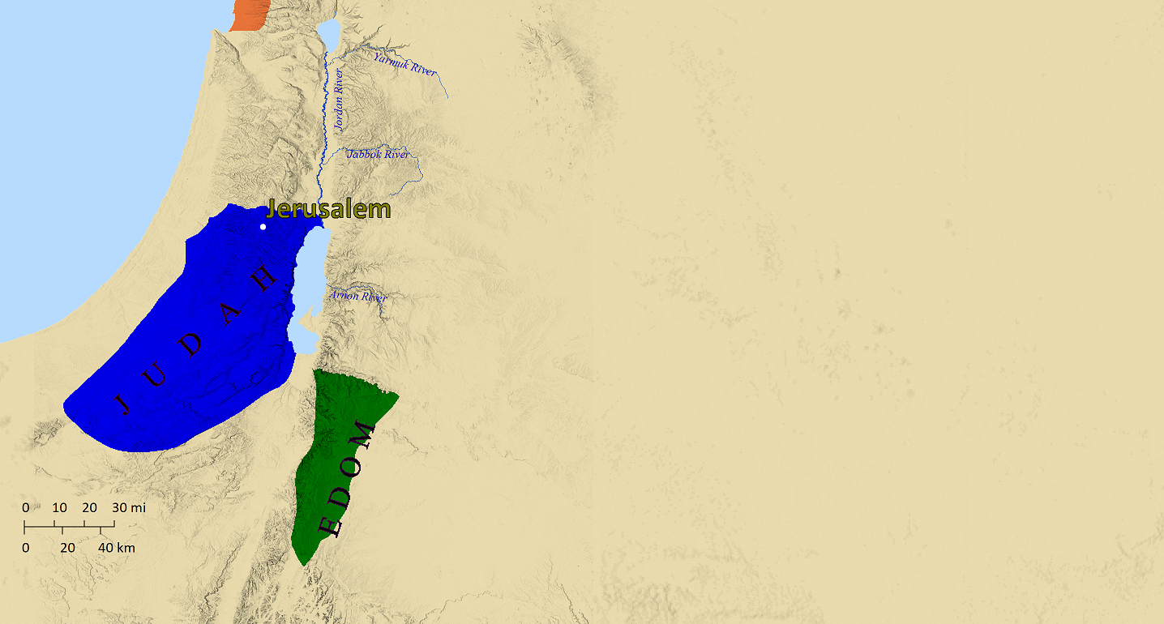
Three Points
God Opposes Arrogance
Obadiah 3-9
Edom is rebuked for gloating over Judah’s punishment
Obadiah 12
The Kingdom of the World is become the Kingdom of our Lord
Obadiah 17-21
Genesis 25:23
“Two nations are in your womb; And two peoples will be separated from your body; And one people will be stronger than the other; And the older will serve the younger.”

