Slide 1
“History Repeats Itself”
Those that fail to learn from history are doomed to repeat it
“Those who fail to learn from history are condemned to repeat it.”
Winston Churchill, 1948 speech
to the House of Commons

Slide 2
God Works in Repeated Themes

Slide 3
“Out of Egypt”

Slide 4
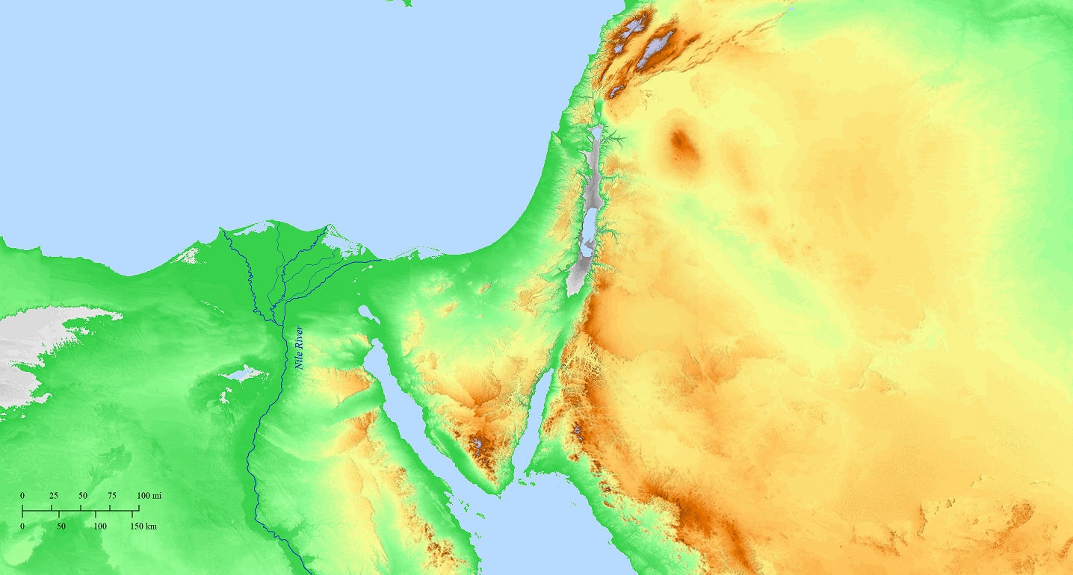
Genesis 12:10
Now there was a famine in the land; so Abram went down to Egypt to live there for a time, because the famine was severe in the land.
Canaan
Egypt

Slide 5
Genesis 12:17
But the Lord struck Pharaoh and his house with great plagues because of Sarai, Abram’s wife.
Canaan
Egypt

Slide 6
Genesis 13:1
So Abram went up from Egypt to the Negev, he and his wife and all that belonged to him, and Lot with him.
Canaan
Egypt

Slide 7
Genesis 13:1
So Abram went up from Egypt to the Negev, he and his wife and all that belonged to him, and Lot with him. Now Abram was very rich in livestock, silver, and gold.
Canaan
Egypt

Slide 8
Genesis 15:13-14
Then God said to Abram, “Know for certain that your descendants will be strangers in a land that is not theirs, where they will be enslaved and oppressed for four hundred years. ¹⁴ But I will also judge the nation whom they will serve, and afterward they will come out with many possessions.
Canaan
Egypt

Slide 9
Genesis 15:13-14
Then God said to Abram, “Know for certain that your descendants will be strangers in a land that is not theirs, where they will be enslaved and oppressed for four hundred years. ¹⁴ But I will also judge the nation whom they will serve, and afterward they will come out with many possessions.
Canaan
Egypt

Slide 10
Genesis 15:13-14
Then God said to Abram, “Know for certain that your descendants will be strangers in a land that is not theirs, where they will be enslaved and oppressed for four hundred years. ¹⁴ But I will also judge the nation whom they will serve, and afterward they will come out with many possessions.
Canaan
Egypt

Slide 11
Genesis 15:13-14
Then God said to Abram, “Know for certain that your descendants will be strangers in a land that is not theirs, where they will be enslaved and oppressed for four hundred years. ¹⁴ But I will also judge the nation whom they will serve, and afterward they will come out with many possessions.
Canaan
Egypt

Slide 12
Canaan
Exodus 1-14
Egypt

Slide 13
Canaan
Out of Babylon
Isaiah 43:16
This is what the Lord says,
He who makes a way through the sea And a path through the mighty waters
Egypt

Slide 14
Canaan
Hosea 11:1
When Israel was a youth I loved him, And out of Egypt I called My son.
Egypt
Hosea 11:11
They will come trembling like birds from Egypt, And like doves from the land of Assyria

Slide 15
Canaan
Matthew 2:15
…This happened so that what had been spoken by the Lord through the prophet would be fulfilled: “Out of Egypt I called My Son.”
Egypt

Slide 16
All of this is about God’s ability
to bring us out of our bondage…
John 9:34
“Truly, truly I say to you, everyone who commits sin is a slave of sin.”
Canaan
1 Corinthians 10:1-5
For I do not want you to be unaware, brothers and sisters, that our fathers were all under the cloud and they all passed through the sea; and they all were baptized into Moses in the cloud and in the sea; and they all ate the same spiritual food, and all drank the same spiritual drink, for they were drinking from a spiritual rock which followed them; and the rock was Christ. Nevertheless, with most of them God was not pleased; for their dead bodies were spread out in the wilderness.
Egypt

Slide 17
Canaan
1 Corinthians 10:11
Now these things happened to them as an example, and they were written for our instruction upon whom the ends of the ages have come.
Egypt

Slide 18
Day of the Lord
Isaiah speaks of a Day of the Lord in which Babylon was judged
Ezekiel speaks of a Day of the Lord in which Egypt was judged
Joel & Zephaniah speak of a Day of the Lord in which Judah would be judged
Peter talks about a Day of the Lord in which the whole world will be judged
The Wickedness & Condemnation of Sodom and Gomorrah
In Isaiah, regarding Judah
In 2 Peter, regarding false teachers
In Revelation, regarding the Roman Empire
Marking and Protecting of God’s People
Exodus 12, Israel in Egypt
Ezekiel 9, the Faithful in Jerusalem
Revelation 7, the Faithful in the earth

Slide 19
Lessons
Human ingenuity & governance won’t change the course of history
God is in control and always has been
The lessons from this 2000 year old book are still relevant today

