Slide 1
The Kingdom of our Lord
and of His Christ
Revelation 11:15 Then the seventh angel sounded; and there were loud voices in heaven, saying, “The kingdom of the world has become the kingdom of our Lord and of His Christ; and He will reign forever and ever.”

Slide 2
1 Samuel 8
Judges

Slide 3
1 Samuel 8:1-3
Now it came about, when Samuel was old, that he appointed his sons as judges over Israel. ² The name of his firstborn was Joel, and the name of his second, Abijah; they were judging in Beersheba. ³ His sons, however, did not walk in his ways but turned aside after dishonest gain, and they took bribes and perverted justice.
Why Beersheba?

Slide 4
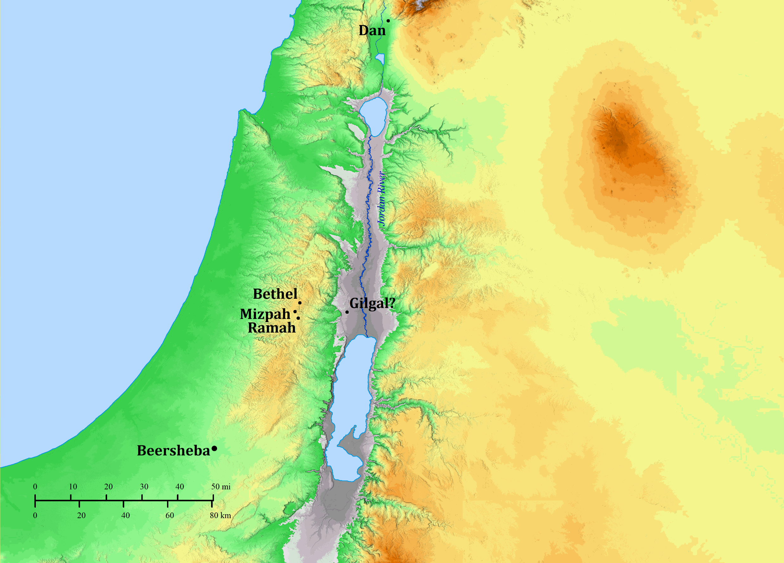
Dan
1 Samuel 7
¹⁵ Now Samuel judged Israel all the days of his life. ¹⁶ And he used to go annually on a circuit to Bethel, Gilgal, and Mizpah, and he judged Israel in all these places. ¹⁷ Then he would make his return to Ramah, because his house was there, and there he also judged Israel.
Beersheba

Slide 5
¹¹ …“This will be the practice of the king who will reign over you: he will take your sons and put them in his chariots for himself and among his horsemen, and they will run before his chariots. ¹² He will appoint for himself commanders of thousands and commanders of fifties, and some to do his plowing and to gather in his harvest, and to make his weapons of war and equipment for his chariots. ¹³ He will also take your daughters and use them as perfumers, cooks, and bakers. ¹⁴ He will take the best of your fields, your vineyards, and your olive groves, and give them to his servants. ¹⁵ And he will take a tenth of your seed and your vineyards and give it to his high officials and his servants. ¹⁶ He will also take your male servants and your female servants, and your best young men, and your donkeys, and use them for his work. ¹⁷ He will take a tenth of your flocks, and you yourselves will become his servants.”

Slide 6
¹¹ …“This will be the practice of the king who will reign over you: he will take your sons and put them in his chariots for himself and among his horsemen, and they will run before his chariots. ¹² He will appoint for himself commanders of thousands and commanders of fifties, and some to do his plowing and to gather in his harvest, and to make his weapons of war and equipment for his chariots. ¹³ He will also take your daughters and use them as perfumers, cooks, and bakers. ¹⁴ He will take the best of your fields, your vineyards, and your olive groves, and give them to his servants. ¹⁵ And he will take a tenth of your seed and your vineyards and give it to his high officials and his servants. ¹⁶ He will also take your male servants and your female servants, and your best young men, and your donkeys, and use them for his work. ¹⁷ He will take a tenth of your flocks, and you yourselves will become his servants.”
Deuteronomy 1:15
So I took the heads of your tribes, wise and informed men, and appointed them as heads over you, commanders of thousands, hundreds, fifties, and tens, and officers for your tribes.

Slide 7
¹¹ …“This will be the practice of the king who will reign over you: he will take your sons and put them in his chariots for himself and among his horsemen, and they will run before his chariots. ¹² He will appoint for himself commanders of thousands and commanders of fifties, and some to do his plowing and to gather in his harvest, and to make his weapons of war and equipment for his chariots. ¹³ He will also take your daughters and use them as perfumers, cooks, and bakers. ¹⁴ He will take the best of your fields, your vineyards, and your olive groves, and give them to his servants. ¹⁵ And he will take a tenth of your seed and your vineyards and give it to his high officials and his servants. ¹⁶ He will also take your male servants and your female servants, and your best young men, and your donkeys, and use them for his work. ¹⁷ He will take a tenth of your flocks, and you yourselves will become his servants.”
Numbers 18:12
All the best of the fresh oil and all the best of the fresh wine and of the grain, the first fruits of what they give to the Lord, I have given them to you.

Slide 8
¹¹ …“This will be the practice of the king who will reign over you: he will take your sons and put them in his chariots for himself and among his horsemen, and they will run before his chariots. ¹² He will appoint for himself commanders of thousands and commanders of fifties, and some to do his plowing and to gather in his harvest, and to make his weapons of war and equipment for his chariots. ¹³ He will also take your daughters and use them as perfumers, cooks, and bakers. ¹⁴ He will take the best of your fields, your vineyards, and your olive groves, and give them to his servants. ¹⁵ And he will take a tenth of your seed and your vineyards and give it to his high officials and his servants. ¹⁶ He will also take your male servants and your female servants, and your best young men, and your donkeys, and use them for his work. ¹⁷ He will take a tenth of your flocks, and you yourselves will become his servants.”
Leviticus 27:30
‘Now all the tithe of the land, of the seed of the land or of the fruit of the tree, is the Lord’s; it is holy to the Lord.

Slide 9
¹¹ …“This will be the practice of the king who will reign over you: he will take your sons and put them in his chariots for himself and among his horsemen, and they will run before his chariots. ¹² He will appoint for himself commanders of thousands and commanders of fifties, and some to do his plowing and to gather in his harvest, and to make his weapons of war and equipment for his chariots. ¹³ He will also take your daughters and use them as perfumers, cooks, and bakers. ¹⁴ He will take the best of your fields, your vineyards, and your olive groves, and give them to his servants. ¹⁵ And he will take a tenth of your seed and your vineyards and give it to his high officials and his servants. ¹⁶ He will also take your male servants and your female servants, and your best young men, and your donkeys, and use them for his work. ¹⁷ He will take a tenth of your flocks, and you yourselves will become his servants.”
Numbers 18:21
“To the sons of Levi, behold, I have given all the tithe in Israel as an inheritance, in return for their service which they perform, the service of the tent of meeting.

Slide 10
POINT:
God was their king
1 Samuel 8 ⁷ And the Lord said to Samuel, “Listen to the voice of the people regarding all that they say to you, because they have not rejected you, but they have rejected Me from being King over them
Judges 17:6, 18:1, 19:1, 21:25
Judges → 1 Samuel
The folly of trusting in fallible men rather than infallible God
Dominion Theology
John 18³⁶ Jesus answered, “My kingdom is not of this world. If My kingdom were of this world, My servants would be fighting so that I would not be handed over to the Jews; but as it is, My kingdom is not of this realm.”

Slide 11
God’s Christ is our King
Psalm 2
2:1-3 The Rebellion of the Kings of the Earth
2:4 The Futility of the Their Rebellion
2:5 The Anger of the Lord
2:6 The Lord has Installed his King
2:7-9 The Lord’s anointed speaks
The Lord’s king is not in the White House, or Kremlin
Acts 4:25ff
Revelation 2:27, 12:5, 19:15
The folly of trusting fallible men rather than infallible God
The Lord’s king is not in the Rome, or any earthly city
Human Authority in Religion
2:10-12
Proverbs 14:34

