Slide 1
Sermon
Jeff Smelser

Slide 2
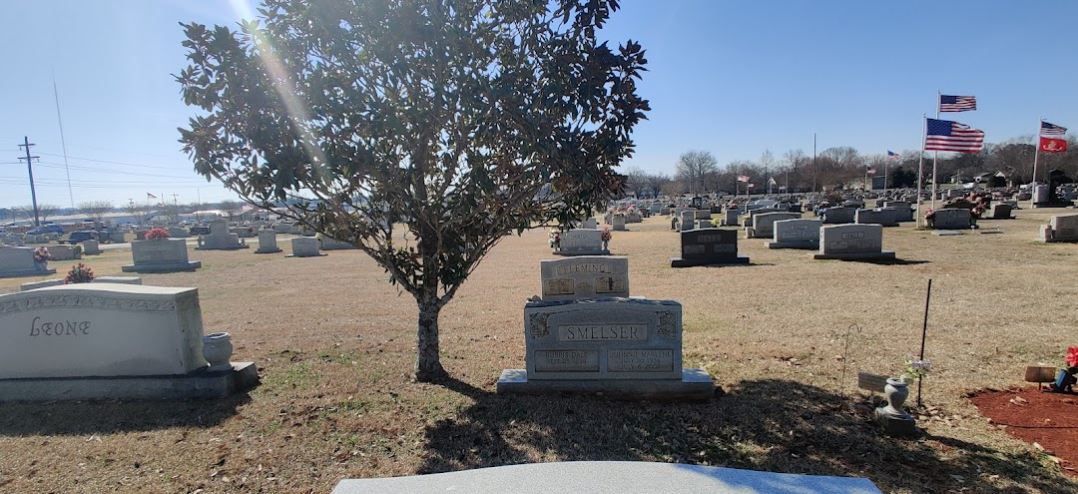

Slide 5
Joy Siota
Sewell
Hall
Caneta
Hall
Charlotte
Hall
Bruce
Hall
Bill
Hall

Slide 6
John 5 ²⁸ Do not be amazed at this; for a time is coming when all who are in the tombs will hear His voice, ²⁹ and will come out: those who did the good deeds to a resurrection of life, those who committed the bad deeds to a resurrection of judgment.

Slide 7
Resurrection
one of the most fundamental doctrines in the Bible
yet neglected, misunderstood, or forgotten

Slide 8
We Rightly Focus on…
the journey
the life of holiness
the challenges
but it’s also good to focus on the goal

Slide 9
Resurrection was the Goal
for the 12 tribes
Acts 24 ²⁰ “Or else have these men themselves declare what violation they discovered when I stood before the Council, ²¹ other than in regard to this one declaration which I shouted while standing among them, ‘For the resurrection of the dead I am on trial before you today!’”
Acts 26 ⁶ And now I am standing trial for the hope of the promise made by God to our fathers; ⁷ the promise to which our twelve tribes hope to attain, as they earnestly serve God night and day. For this hope, O king, I am being accused by Jews. ⁸ Why is it considered incredible among you people if God raises the dead?

Slide 10
Resurrection was the Goal
for the 12 tribes
Acts 24 ²⁰ “Or else have these men themselves declare what violation they discovered when I stood before the Council, ²¹ other than in regard to this one declaration which I shouted while standing among them, ‘For the resurrection of the dead I am on trial before you today!’”
Acts 26 ⁶ And now I am standing trial for the hope of the promise made by God to our fathers; ⁷ the promise to which our twelve tribes hope to attain, as they earnestly serve God night and day. For this hope, O king, I am being accused by Jews. ⁸ Why is it considered incredible among you people if God raises the dead?

Slide 11
Resurrection was the Goal
for the 12 tribes
Acts 23 ⁶ “I am on trial for the hope and resurrection of the dead!”
Acts 26 ⁶ And now I am standing trial for the hope of the promise made by God to our fathers; ⁷ the promise to which our twelve tribes hope to attain, as they earnestly serve God night and day. For this hope, O king, I am being accused by Jews. ⁸ Why is it considered incredible among you people if God raises the dead?

Slide 12
Resurrection was the Goal
for the 12 tribes
Acts 24 ²⁰ “Or else have these men themselves declare what violation they discovered when I stood before the Council, ²¹ other than in regard to this one declaration which I shouted while standing among them, ‘For the resurrection of the dead I am on trial before you today!’”
Acts 26 ⁶ And now I am standing trial for the hope of the promise made by God to our fathers; ⁷ the promise to which our twelve tribes hope to attain, as they earnestly serve God night and day. For this hope, O king, I am being accused by Jews. ⁸ Why is it considered incredible among you people if God raises the dead?

Slide 13
Resurrection was the Goal
for the 12 tribes
Acts 24 ²⁰ “Or else have these men themselves declare what violation they discovered when I stood before the Council, ²¹ other than in regard to this one declaration which I shouted while standing among them, ‘For the resurrection of the dead I am on trial before you today!’”
Acts 26 ⁶ And now I am standing trial for the hope of the promise made by God to our fathers; ⁷ the promise to which our twelve tribes hope to attain, as they earnestly serve God night and day. For this hope, O king, I am being accused by Jews. ⁸ Why is it considered incredible among you people if God raises the dead?

Slide 14
Resurrection was the Goal
for the 12 tribes
Acts 24 ²⁰ “Or else have these men themselves declare what violation they discovered when I stood before the Council, ²¹ other than in regard to this one declaration which I shouted while standing among them, ‘For the resurrection of the dead I am on trial before you today!’”
Acts 26 ⁶ And now I am standing trial for the hope of the promise made by God to our fathers; ⁷ the promise to which our twelve tribes hope to attain, as they earnestly serve God night and day. For this hope, O king, I am being accused by Jews. ⁸ Why is it considered incredible among you people if God raises the dead?

Slide 15
Resurrection was the Goal
for the 12 tribes
Acts 24 ²⁰ “Or else have these men themselves declare what violation they discovered when I stood before the Council, ²¹ other than in regard to this one declaration which I shouted while standing among them, ‘For the resurrection of the dead I am on trial before you today!’”
Acts 26 ⁶ And now I am standing trial for the hope of the promise made by God to our fathers; ⁷ the promise to which our twelve tribes hope to attain, as they earnestly serve God night and day. For this hope, O king, I am being accused by Jews. ⁸ Why is it considered incredible among you people if God raises the dead?

Slide 16
Resurrection was the Goal
for the 12 tribes

Slide 17
Resurrection was the Goal
for the apostle Paul
Philippians 3 ⁸ More than that, I count all things to be loss in view of the surpassing value of knowing Christ Jesus my Lord, for whom I have suffered the loss of all things, and count them mere rubbish, so that I may gain Christ, ⁹ and may be found in Him, not having a righteousness of my own derived from the Law, but that which is through faith in Christ, the righteousness which comes from God on the basis of faith, ¹⁰ that I may know Him and the power of His resurrection and the fellowship of His sufferings, being conformed to His death; ¹¹ if somehow I may attain to the resurrection from the dead.

Slide 18
Resurrection was the Goal
for the apostle Paul
Philippians 3 ⁸ More than that, I count all things to be loss in view of the surpassing value of knowing Christ Jesus my Lord, for whom I have suffered the loss of all things, and count them mere rubbish, so that I may gain Christ, ⁹ and may be found in Him, not having a righteousness of my own derived from the Law, but that which is through faith in Christ, the righteousness which comes from God on the basis of faith, ¹⁰ that I may know Him and the power of His resurrection and the fellowship of His sufferings, being conformed to His death; ¹¹ if somehow I may attain to the resurrection from the dead.

Slide 19
Not everyone’s goal, even among “Christians”
Some have a worldly focus
70 A.D. doctrine – “the resurrection is past already”
We talk of the loved one who has passed as having already attained the goal
Sorrow not for them (1 Thessalonians 4:13)
With the Lord (Philippians 1:23, Psalm 139)
Rest (Revelation 6:11)
Comforted (Luke 16:25)
But still awaiting the resurrection!

Slide 20
Resurrection, A Theme throughout the Bible
1 Kings 17 the son of the widow of Zarephath
2 Kings 4 the son of the Shunamite woman
2 Kings 13 the man thrown in Elisha’s tomb
Mark 5 Jairus’ daughter
Luke 7 the son of the woman at Nain
John 11 Lazarus
Matthew 27 those in Jerusalem after Jesus’ resurrection
Acts 9 Tabitha
Acts 20 Eutychus

Slide 21
Resurrection, A Theme throughout the Bible
1 Kings 17 the son of the widow of Zarephath
2 Kings 4 the son of the Shunamite woman
2 Kings 13 the man thrown in Elisha’s tomb
Mark 5 Jairus’ daughter
Luke 7 the son of the woman at Nain
John 11 Lazarus
Matthew 27 those in Jerusalem after Jesus’ resurrection
Acts 9 Tabitha
Acts 20 Eutychus
Elisha

Slide 22
Resurrection, A Theme throughout the Bible
1 Kings 17 the son of the widow of Zarephath
2 Kings 4 the son of the Shunamite woman
2 Kings 13 the man thrown in Elisha’s tomb
Mark 5 Jairus’ daughter
Luke 7 the son of the woman at Nain
John 11 Lazarus
Matthew 27 those in Jerusalem after Jesus’ resurrection
Acts 9 Tabitha
Acts 20 Eutychus
Elisha
Jesus

Slide 23
Resurrection, A Theme throughout the Bible
1 Kings 17 the son of the widow of Zarephath
2 Kings 4 the son of the Shunamite woman
2 Kings 13 the man thrown in Elisha’s tomb
Mark 5 Jairus’ daughter
Luke 7 the son of the woman at Nain
John 11 Lazarus
Matthew 27 those in Jerusalem after Jesus’ resurrection
Acts 9 Tabitha
Acts 20 Eutychus
“I am the
resurrection
and the life”

Slide 24
BUT OURS WON”T BE LIKE THOSE WILL IT?
Resurrection, A Theme throughout the Bible
1 Kings 17 the son of the widow of Zarephath
2 Kings 4 the son of the Shunamite woman
2 Kings 13 the man thrown in Elisha’s tomb
Mark 5 Jairus’ daughter
Luke 7 the son of the woman at Nain
John 11 Lazarus
Matthew 27 those in Jerusalem after Jesus’ resurrection
Acts 9 Tabitha
Acts 20 Eutychus

Slide 25
Resurrection, A Theme throughout the Bible
1 Kings 17 the son of the widow of Zarephath
2 Kings 4 the son of the Shunamite woman
2 Kings 13 the man thrown in Elisha’s tomb
Mark 5 Jairus’ daughter
Luke 7 the son of the woman at Nain
John 11 Lazarus
Matthew 27 those in Jerusalem after Jesus’ resurrection
Acts 9 Tabitha
Acts 20 Eutychus
YES,
but..
1 Corinthians 15 ⁵⁰ Now I say this, brothers and sisters, that flesh and blood cannot inherit the kingdom of God; nor does the perishable inherit the imperishable. ⁵¹ Behold, I am telling you a mystery; we will not all sleep, but we will all be changed, ⁵² in a moment, in the twinkling of an eye, at the last trumpet; for the trumpet will sound, and the dead will be raised imperishable, and we will be changed. ⁵³ For this perishable must put on the imperishable, and this mortal must put on immortality.

Slide 26
Resurrection, A Theme throughout the Bible
1 Kings 17 the son of the widow of Zarephath
2 Kings 4 the son of the Shunamite woman
2 Kings 13 the man thrown in Elisha’s tomb
Mark 5 Jairus’ daughter
Luke 7 the son of the woman at Nain
John 11 Lazarus
Matthew 27 those in Jerusalem after Jesus’ resurrection
Acts 9 Tabitha
Acts 20 Eutychus
YES,
but..
1 Corinthians 15 ⁵⁰ Now I say this, brothers and sisters, that flesh and blood cannot inherit the kingdom of God; nor does the perishable inherit the imperishable. ⁵¹ Behold, I am telling you a mystery; we will not all sleep, but we will all be changed, ⁵² in a moment, in the twinkling of an eye, at the last trumpet; for the trumpet will sound, and the dead will be raised imperishable, and we will be changed. ⁵³ For this perishable must put on the imperishable, and this mortal must put on immortality.

Slide 27
“Why is it considered incredible among you people
if God raises the dead?”
From a human perspective, it is hard to believe
Sadducees didn’t believe it
70 A.D. doctrine advocates don’t believe it
Many Christians seem to doubt a literal resurrection
Do we believe Jesus was raised from the dead?

Slide 28
“Why is it considered incredible among you people
if God raises the dead?”
From a human perspective, it is hard to believe
Sadducees didn’t believe it
70 A.D. doctrine advocates don’t believe it
Many Christians seem to doubt a literal resurrection
Do we believe Jesus was raised from the dead?
1 Thessalonians 4
¹⁴ For if we believe that Jesus died and rose from the dead, so also God will bring with Him those who have fallen asleep through Jesus.
¹⁶...the dead in Christ will rise

Slide 29
“Why is it considered incredible among you people
if God raises the dead?”
From a human perspective, it is hard to believe
Sadducees didn’t believe it
70 A.D. doctrine advocates don’t believe it
Many Christians seem to doubt a literal resurrection
Do we believe Jesus was raised from the dead?
Romans 8
¹¹ But if the Spirit of Him who raised Jesus from the dead dwells in you, He who raised Christ Jesus from the dead will also give life to your mortal bodies through His Spirit who dwells in you.

Slide 30
“Why is it considered incredible among you people
if God raises the dead?”
From a human perspective, it is hard to believe
Sadducees didn’t believe it
70 A.D. doctrine advocates don’t believe it
Many Christians seem to doubt a literal resurrection
Do we believe Jesus was raised from the dead?
1 Corinthians 15
¹³ But if there is no resurrection of the dead,
then not even Christ has been raised.

Slide 31
1 Corinthians 15
³⁵ But someone will say, “How are the dead raised? And with what kind of body do they come?”
not flesh and blood
changed
immortal, imperishable
“like him”

Slide 32
One Reason this is important…
“Will we know each other?”
Concept of life hereafter as nebulous spirits lost in one vast spirituality
Samuel
Moses & Elijah
Lazarus, the Rich Man, and Abraham
Yes, it’s hard to imagine. Seems at odds with all we know about physics, chemistry, biology, and even common sense.
“We walk by faith and not by sight.”

