Slide 1
Daniel, Chapter 5

Slide 2
Did Nebuchadnezzar experience Madness?
"Nebuchadnezzar is one of those characters in the Bible for whom we have an enormous amount of data from non-biblical sources," says Eckart Frahm, a professor of Near Eastern languages and civilizations at Yale University. "There's just a tremendous amount of material…"Among [these texts] are many, many inscriptions written in Nebuchadnezzar's own name," says Frahm, "and obviously in these texts he presents himself not as a villain, but as the 'great builder.' He's very eager to indicate that he built these massive temples and palaces, and that he's also very pious. He confesses that he's constantly thinking of the gods when building temples to them…Nebuchadnezzar doesn't write anything about his political or military exploits.” Dan. 4:29-30

Slide 3
There was a Babylonian King who experienced such
Prayer of Nabonidus, from Dead Sea Scrolls
“I was afflicted [with an evil ulcer] for seven years...and an exorcist pardoned my sins. He was a Jew from among the [children of the exile of Judah, and said,] "Recount this in writing to [glorify and exalt] the Name of the [Most High God]."
Rather than Nabonidus, this better reflects Dan. 4:34, 37

Slide 4
From “I Nebuchadnezzar,” 4:2 7, to “Belshazzar the king….”5:1
Nebuchadnezzar son of Nabopolasser who died 605 BC, Before,
Neb co-regent with Nabopolasser
561 B.C., Evil-Merodach, Son of Nebuchadnezzar – Jer: 52:31
559, Neriglissar, brother-in-law to Evil-Merococh
556, Laborosoarchod, a child, murdered
556 Nabonidus, formed connection To Nebuchadnezzar by marrying descendent of Nebuchadnezzar
His son, Belshazzar, thus a descendant of Nebuchadnezzar through
Queen Mother, to 539

Slide 5
Your Father: Dan. 5:2, 11
It is usual in scripture to call the grandfather, by the name of father (see 2Sa 9:7; 2Ki 8:26 compared with Da 5:18; 2Ch 15:16 compared with Da 11:20; Zec 1:1 with Ezr 6:14).

Slide 6
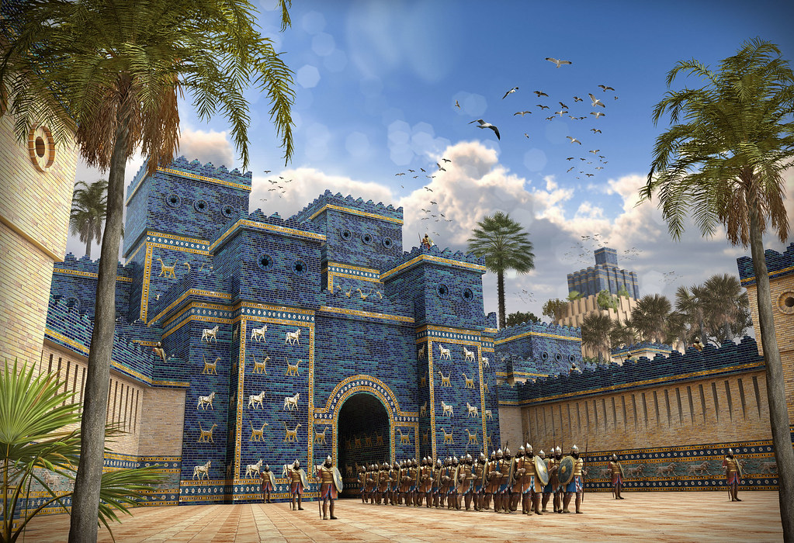

Slide 7
