Slide 1
“What is Christianity”

Slide 2
The word “Christianity” is not in the Bible
“Christian” only occurs 3 times
Acts 11:26 “disciples first called Christians”
Acts 26:28 “almost persuade me to be a Christian”
1 Peter 4:16 “if anyone suffers as a Christian”
Indicates identity
Identity with Christ
Compare Galatians 2:20
“Crucified with Christ, and it is no longer I that live, but Christ lives in me”
Compare 2 Corinthians 5:17
“If any man is in Christ, he is a new creature”
Compare Galatians 3:27
“as many as have been baptized into Christ have put on Christ”
A “Christian” is not merely someone who goes to church
A “Christian” is not merely someone who believes Jesus is a good teacher
A “Christian” is someone whose identity is in Christ

Slide 3
What about “Christianity”?
I’ll define it as the practice of being a Christian
A Conviction, leading to a Conviction
A Commencement
A Commitment
A Community

Slide 4
Acts 2
“The Beginning”

Slide 5
A Conviction leading to a Conviction
³⁶ “Therefore let all the house of Israel know for certain that God has made Him both Lord and Christ—this Jesus whom you crucified.”
³⁷ Now when they heard this, they were pierced to the heart, and said to Peter and the rest of the apostles, “Brothers, what are we to do?”

Slide 6
A Conviction leading to a Conviction
³⁶ “Therefore let all the house of Israel know for certain that God has made Him both Lord and Christ—this Jesus whom you crucified.”
³⁷ Now when they heard this, they were pierced to the heart, and said to Peter and the rest of the apostles, “Brothers, what are we to do?”
“Conviction”

Slide 7
A Conviction leading to a Conviction
³⁶ “Therefore let all the house of Israel know for certain that God has made Him both Lord and Christ—this Jesus whom you crucified.”
³⁷ Now when they heard this, they were pierced to the heart, and said to Peter and the rest of the apostles, “Brothers, what are we to do?”
“Conviction”

Slide 8
A Commencement
⁴¹ So then, those who had received his word were baptized; and that day there were added about three thousand souls.
Baptism into Christ is the Beginning Point
New Creature
New Birth
New Life

Slide 9
A Commitment
⁴² They were continually devoting themselves to the apostles’ teaching and to fellowship, to the breaking of bread and to prayer.
Compared to Marriage, Ephesians 5:25ff
Growth is expected, Hebrews 5:11ff
Service to One Another, 1 Peter 5:5

Slide 10
A Community
⁴⁴ And all the believers were together and had all things in common; ⁴⁵ and they would sell their property and possessions and share them with all, to the extent that anyone had need. ⁴⁶ Day by day continuing with one mind in the temple, and breaking bread from house to house, they were taking their meals together with gladness and sincerity of heart, ⁴⁷ praising God and having favor with all the people.

Slide 11
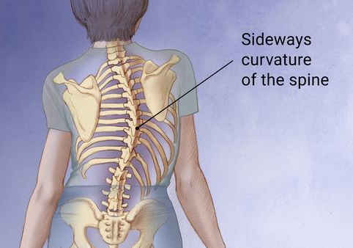
A Community
⁴⁴ And all the believers were together and had all things in common; ⁴⁵ and they would sell their property and possessions and share them with all, to the extent that anyone had need. ⁴⁶ Day by day continuing with one mind in the temple, and breaking bread from house to house, they were taking their meals together with gladness and sincerity of heart, ⁴⁷ praising God and having favor with all the people.
⁴⁰ And with many other words he solemnly testified and kept on urging them, saying, “Be saved from this perverse generation!”
“perverse”
think of scoliosis

Slide 12
A Community
⁴⁴ And all the believers were together and had all things in common; ⁴⁵ and they would sell their property and possessions and share them with all, to the extent that anyone had need. ⁴⁶ Day by day continuing with one mind in the temple, and breaking bread from house to house, they were taking their meals together with gladness and sincerity of heart, ⁴⁷ praising God and having favor with all the people.

Slide 13
A Community
⁴⁴ And all the believers were together and had all things in common; ⁴⁵ and they would sell their property and possessions and share them with all, to the extent that anyone had need. ⁴⁶ Day by day continuing with one mind in the temple, and breaking bread from house to house, they were taking their meals together with gladness and sincerity of heart, ⁴⁷ praising God and having favor with all the people.

Slide 14
A Conviction, leading to a Conviction
A Commencement
A Commitment
A Community

