Slide 1
Let marriage be had in honor among all and let the bed be undefiled: for fornicators and adulterers
God will judge.
HEB. 13.4
1 COR 7:
7; 32

Slide 2
a Healthy marriage:
involves so much much more than
“don’t commit Adultery”
a Healthy
body:
Involves so much more than
“don’t commit suicide”

Slide 3

HEB.13:4
Let marriage be had in honor among all

Slide 4
Building
Better
Homes

Slide 5
Q?
What kind
of homes
do our
children
need?

Slide 6
The crying need in our culture is not better houses… it’s better homes.

Slide 7
This is under attack:
SEXUAL REV.
DIVORCE
family brkdn.
PORN
LGBT
BETRAYAL
Gen.
2:24
GENDER ID
SELF DESTR.

Slide 8
This is under attack:
DIVORCE
PORN
BETRAYAL
Gen.
2:24
SELF DESTR.

Slide 9
“disposable-marriage” in a disposable culture
“I think God wants me to be happy”
“I thought things would be different”
“I want to do what I want to do”
“It’s not good for the kids to see us unhappy”
“I’m not in love anymore”
Luke 16.18; Mark 10; Matt. 19
1 Cor. 7; Malachi 2:13-16

Slide 10

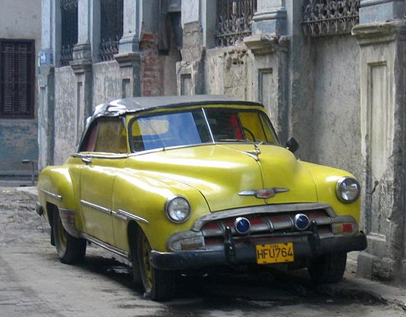
a lesson from cuban cars
By Zahav511 - Own work, CC BY-SA 3.0, https://commons.wikimedia.org/w/index.php?curid=23452995
CC BY-SA 3.0, https://commons.wikimedia.org/w/index.php?curid=1042507
By MiltonPoint - Own work, CC BY-SA 4.0, https://commons.wikimedia.org/w/index.php?curid=38351278

Slide 11
Pr. 18.22
“He who finds a wife finds a good thing”

Slide 12
“Being frustrated with your spouse
is no more a good reason to get divorced
anymore than
being frustrated with your children
is a good reason to put them up for adoption.”
-Dave Willis
davewillis.com

Slide 13
Gen. 2.18, 24 -leave & cleave
Gen.3.13-19
  provide for physical needs
Deut.6.1-9; Eph.6.4
  provide spiritual leadership
Eph. 5.25, 28-29
  provide leadership generally
  a sacrificial & serving leader : Eph. 5.25
husbands

Slide 14
  BE A MAN
  BE A MAN OF GOD
  BE HER MAN OF GOD
husbands

Slide 15
Eph 5:25, 28-31, 33 ESV
25 Husbands, love your wives, as Christ loved the church and gave himself up for her, ...
28-31 In the same way husbands should love their wives as their own bodies. He who loves his wife loves himself. For no one ever hated his own flesh, but nourishes and cherishes it, just as Christ does the church, because we are members of his body.
31 "Therefore a man shall leave his father and mother and hold fast to his wife, and the two shall become one flesh." ... 33 However, let each one of you love his wife as himself, and let the wife see that she respects her husband.
husbands

Slide 16
Eph 5:25, 28-31, 33 ESV
25 Husbands, love your wives, as Christ loved the church and gave himself up for her, ...
28-31 In the same way husbands should love their wives as their own bodies. He who loves his wife loves himself. For no one ever hated his own flesh, but nourishes and cherishes it, just as Christ does the church, because we are members of his body.
31 "Therefore a man shall leave his father and mother and hold fast to his wife, and the two shall become one flesh." ... 33 However, let each one of you love his wife as himself, and let the wife see that she respects her husband.
husbands

Slide 17
Eph 5:25, 28-31, 33 ESV
25 Husbands, love your wives, as Christ loved the church and gave himself up for her, ...
28-31 In the same way husbands should love their wives as their own bodies. He who loves his wife loves himself. For no one ever hated his own flesh, but nourishes and cherishes it, just as Christ does the church, because we are members of his body.
31 "Therefore a man shall leave his father and mother and hold fast to his wife, and the two shall become one flesh." ... 33 However, let each one of you love his wife as himself, and let the wife see that she respects her husband.
husbands

Slide 18
REMEMBERING YOUR VOWS:
“love and cherish” Eph.5.28-29
“honor” 1Ptr.3.7
“to her and her alone” Job.31.1; Pr.5; Mt.5
husbands

Slide 19
pornography
Matt. 5.27-30

Slide 20
wife
Eph. 5.22-24
  Wives, submit to your own husbands, as to the Lord. For the husband is the head of the wife even as Christ is the head of the church, his body, and is himself its Savior. Now as the church submits to Christ, so also wives should submit in everything to their husbands.

Slide 21
wife
Titus 2.3-5
  older women teach the younger women:
  “to love their husbands, to love their children, to be sensible, pure, workers at home, kind, being subject to their own husbands”
Gen.3:16-19; Prov.31
1Tim.5.14; Titus 2.5

Slide 22
wife
Proverbs 31.10-31
an excellent wife, her worth is far above rubies [10]
the heart of her husband trusts in her [11]
she does him good and not evil [12]
she stretches out her hands to the needy [20]
she looks well to the ways of her household [27]
strength and dignity are her clothing [25]
law of kindness is on her tongue [26]

Slide 23
HEB.13:4
Let marriage be had in honor among all

Slide 24
MARRIAGES DECAYING
FROM INTERNAL
ATTACK, DECAY, AND NEGLECT

Slide 25
Prov. 14.1 nasb
The wise woman builds her house, But the foolish tears it down with her own hands.

Slide 26
STRESS
STRAIN
&
STRIFE

Slide 27
tension,
frustration,
irritableness
effectiveness

Slide 28
communication
communication
Col.
3.19
Prov. 21.9
27.15

Slide 29
speaking with kindness
Eph. 4.15 speaking the truth in love
Prov.25:15 a soft tongue breaks the bone
Prov.15:1 A soft answer turneth away wrath: but grievous words stir up anger
Prov. 31:26
Col. 3:19
Mt. 7:12
PROVERBS 18:21

Slide 30
“Let no corrupt speech proceed out of your mouth, but such as is good for edifying as the need may be, that it may give grace to them that hear.”
Eph.4:29 asv

Slide 31
throwing jabs
“My mistake. I should have learned by now not to expect too much.”
“I shouldn’t blame you. You get it honestly enough from your [Dad/Mom/brother/sister].”
“I should have listened to my mother when she warned me about you.”
Prov.12:18 nasb
“There is one who speaks rashly
like the thrusts of a sword,
But the tongue of the wise brings healing.”

Slide 32
Nurture? Or Neglect?
Build up? Or tear down?
Grow together? Or grow cold?

Slide 33

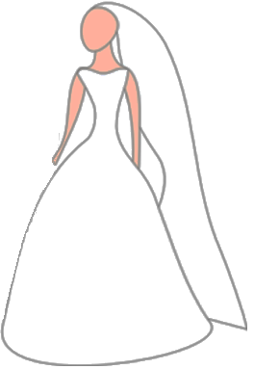

Slide 35

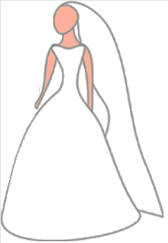


PhP.
2.1-8

Slide 38
husband & wife
1Cor.7.
defraud not one another
husband
wife
“one flesh” God’s plan / fund. & beneficial
considerate (1 Cor.7; Mt. 7.12; Php.2 )
secure (Pr.31 / Pr.5-7)
impassioned (Prov.5)
loving (Eph.5/ Titus 2)

Slide 39
a Healthy marriage:
involves so much much more than
“don’t commit Adultery”
a Healthy
body:
Involves so much more than
“don’t commit suicide”

Slide 40
BAD IDEAS:
50 / 50
I would try if he / she would try giving up refusing to apologize refusing to forgive

Slide 41
ignoring
avoiding
resenting
begrudging
Do you take
this man-
to love, honor, and obey,
to have and to hold,
For better or for worse,
For richer or for poorer,
In sickness and in health,
and to keep yourself to him, and him alone- so long as you both shall live?
Do you take
this woman-
to love, honor, and cherish,
to have and to hold,
For better or for worse,
For richer or for poorer,
In sickness and in health,
and to keep yourself to her, and her alone- so long as you both shall live?

Slide 42
specific area …
“sorry apologies“ vs. sorrow & apology

Slide 43
apologies
Perhaps I made a mistake
the minimizing apology
the accusation apology
the “hypothetical” apology
the “I’m sorry, but…” apology
the angry apology
Maybe my reaction wasn’t the best
Well, no one’s perfect after all
i.o.w.:
NO BIG DEAL. MAYBE I WASN’T PERFECT.

Slide 44
apologies
I’m sorry you got so upset over that
the minimizing apology
the accusation apology
the “hypothetical” apology
the “I’m sorry, but…” apology
the angry apology
I’m sorry you were so bothered by that
I’m sorry you took it the wrong way
i.o.w.: HERE’S YOUR APOLOGY: SORRY YOU MESSED UP, BUT IT’S YOUR FAULT

Slide 45
apologies
If I may have made a mistake
the minimizing apology
the accusation apology
the “hypothetical” apology
the “I’m sorry, but…” apology
the angry apology
If I did anything that may have appeared to be wrong
i.o.w.: I’M ADMITTING NOTHING (and likely did nothing). BUT SUPPOSING EVEN IF I DID, LET’S CONSIDER IT APOLOGIZED FOR

Slide 46
apologies
Well I’m sorry, BUT IF YOU HADN’T…
the minimizing apology
the accusation apology
the “hypothetical” apology
the “I’m sorry, but…” apology
the angry apology
I’m sorry, BUT YOU WERE THE ONE…
I’m sorry, BUT I ONLY
REACTED THAT WAY
BECAUSE YOU…
i.o.w.: OK, there’s your apology. NOW TO THE REAL PROBLEM: YOU.

Slide 47
apologies
So I’m sorry,
OK???
the minimizing apology
the accusation apology
the “hypothetical” apology
the “I’m sorry, but…” apology
the angry apology
FINE! I’m sorry then. Are you satisfied?
i.o.w.:
Ok- I said the words. Now get off my back!

Slide 48
apologies
the minimizing apology
the accusation apology
the “hypothetical” apology
the “I’m sorry, but…” apology
the angry apology
the apology of the prodigal son
Lk.15:21

Slide 49

PROTECT
YOUR
CASTLE

Slide 50
“for better or for worse…”

