Slide 1
Let marriage be had in honor among all and let the bed be undefiled: for fornicators and adulterers God will judge.
HEB. 13.4
1 COR 7:
7; 32

Slide 2
Josh. 24.15
Gen.
2:24
Matt. 7.24-26

Slide 3
This is under attack:
SEXUAL REV.
DIVORCE
family brkdn.
PORN
LGBT
BETRAYAL
Gen.
2:24
GENDER ID
SELF DESTR.

Slide 4
This is under attack:
SEXUAL REV.
family brkdn.
LGBT
Gen.
2:24
GENDER ID

Slide 5
[Gen 1:27 ESV] So God created man in his own image, in the image of God he created him; male and female he created them. [Gen 2:24 ESV] Therefore a man shall leave his father and his mother and hold fast to his wife, and they shall become one flesh.

Slide 6
1 Cor. 6 & perversion: fornication adultery homosexuality
CELEBRATED

Slide 7
Romans 1.26-27 “against nature”

Slide 8
http://faculty.clintoncc.suny.edu/faculty/michael.gregory/files/bio%20101/bio%20101%20lectures/Natural%20Selection/natural.htm
Fitness
We often hear natural selection described as "survival of the fittest." The word "fitness" used in a biological context means "reproductive."

Slide 9
survival of the fittest … fitness denotes an individual’s OVERALL ABILITY TO PASS COPIES OF HIS GENES ON TO SUCCESSIVE GENERATIONS. For example, a woman who rears six healthy offspring has greater fitness than one who rears just two. britannica.com/EBchecked/topic/25597/
animal-behaviour#ref497943
What would be more unsuccessful at passing on copies of it’s genes –
than an organism prewired to never pass on it’s genes?
survival
of the
fittest

Slide 10
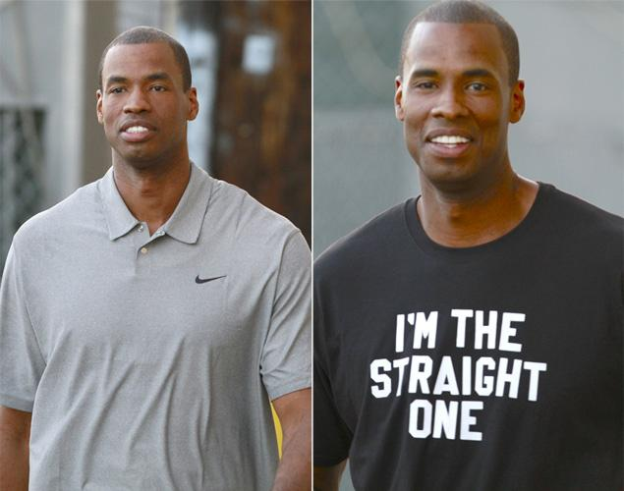
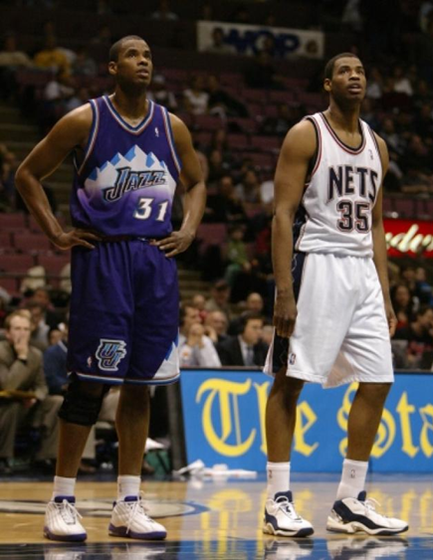
homosexuality: born that way?
nydailynews.com/sports/basketball/gay-jarron-collins-t-shirt-ends-confusion-article-1.1345977
Jason Collins Jarron Collins

Slide 11
1 Cor. 6 & perversion: fornication adultery homosexuality

Slide 12
Think back to the “me too movement”

Slide 13
4 yrs ago - top news story of the year:

Slide 14
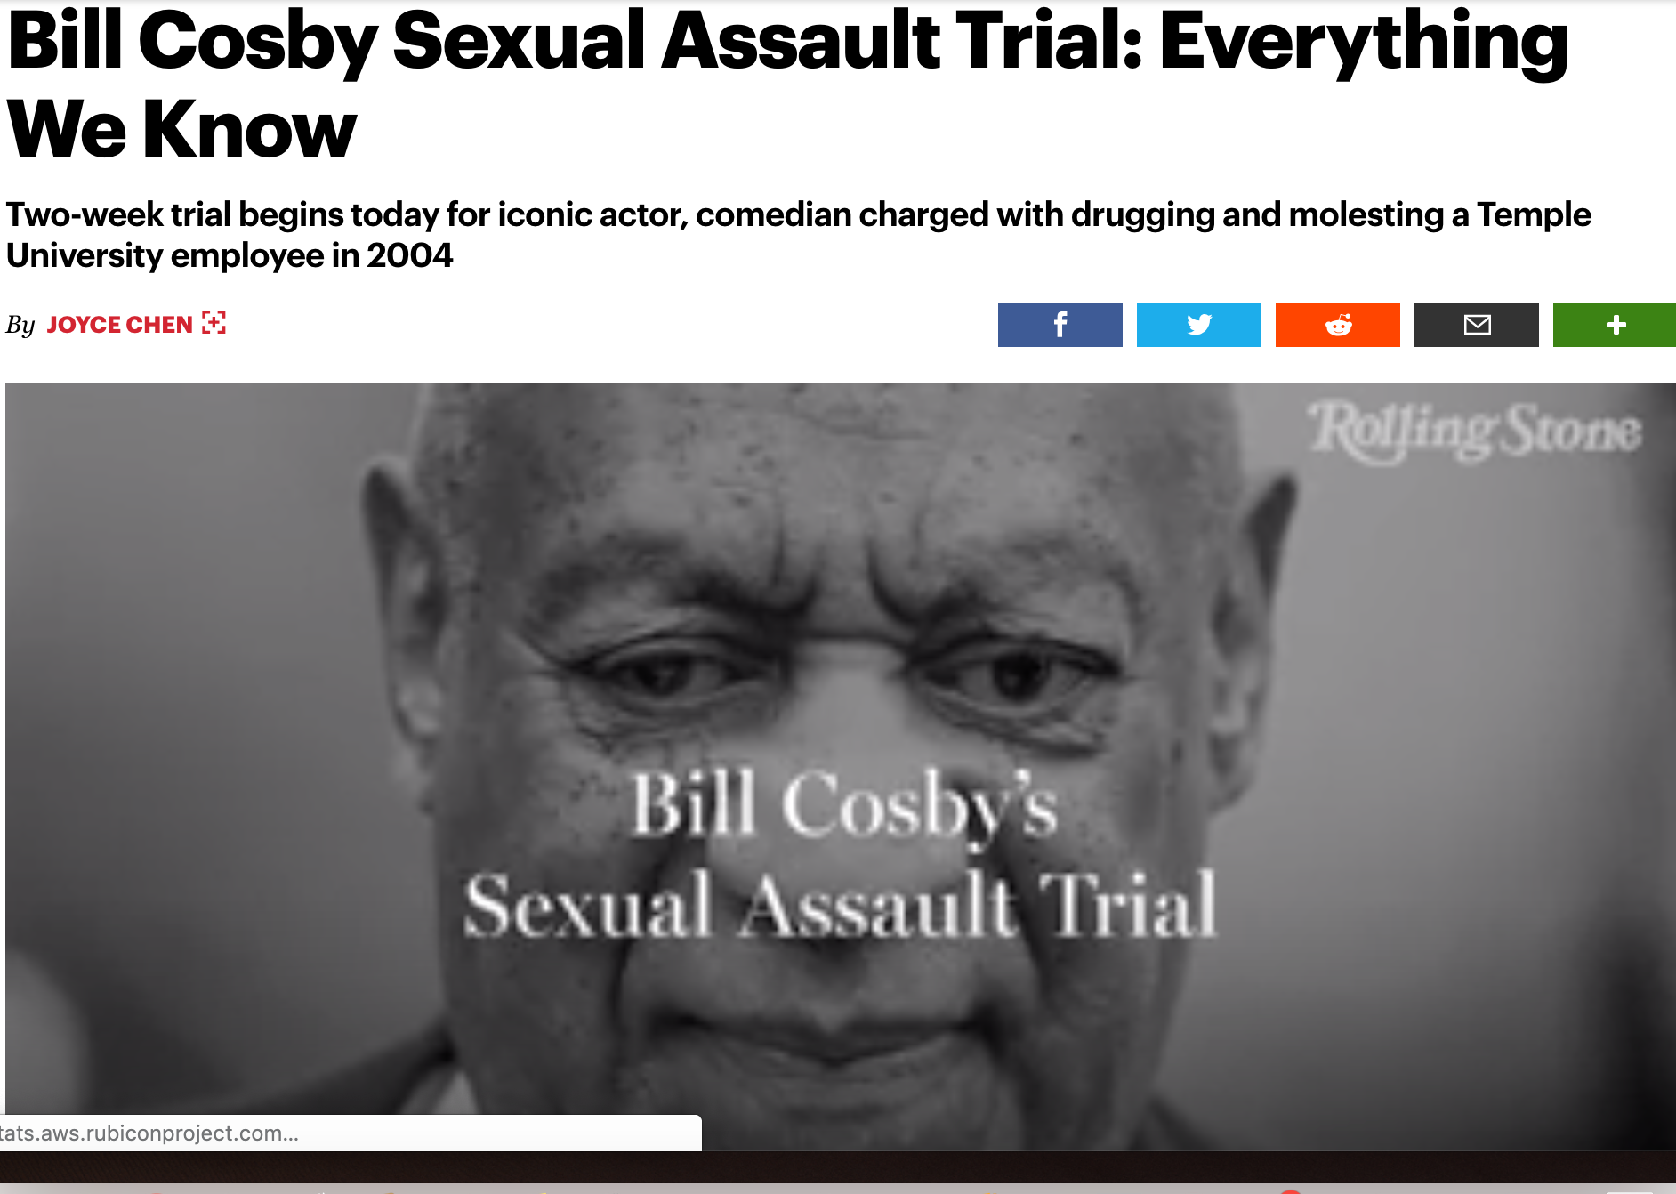
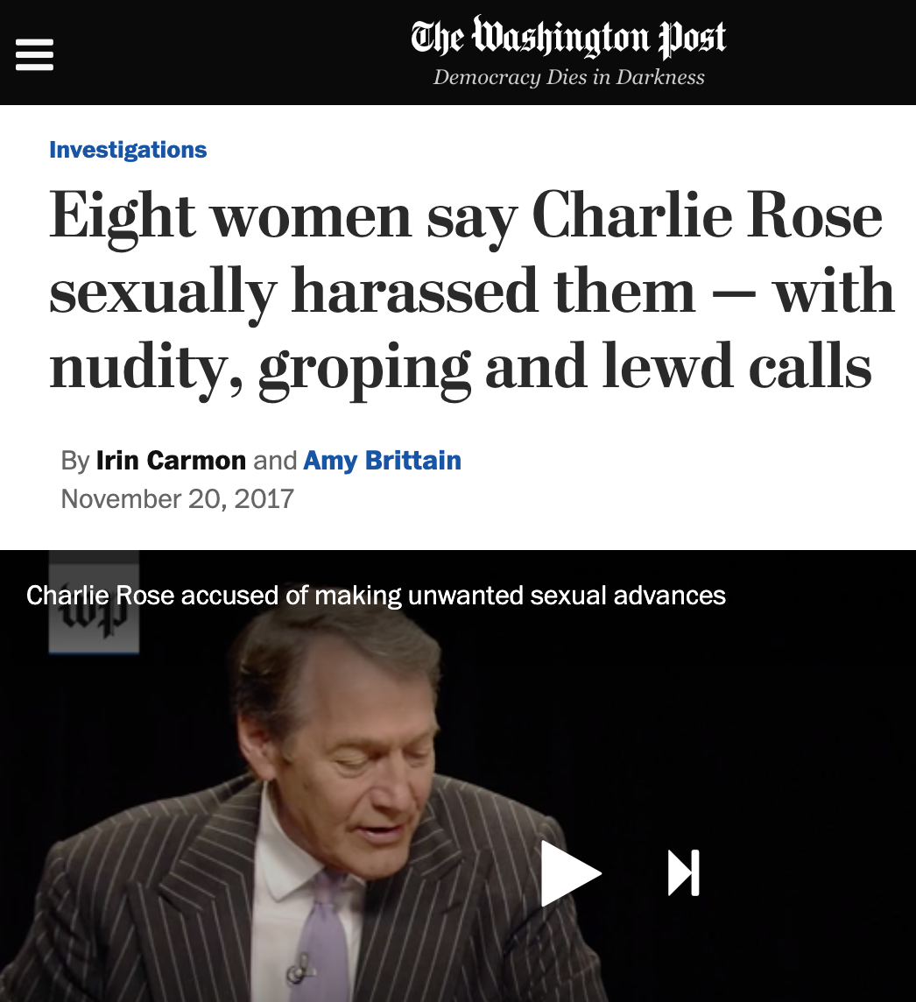
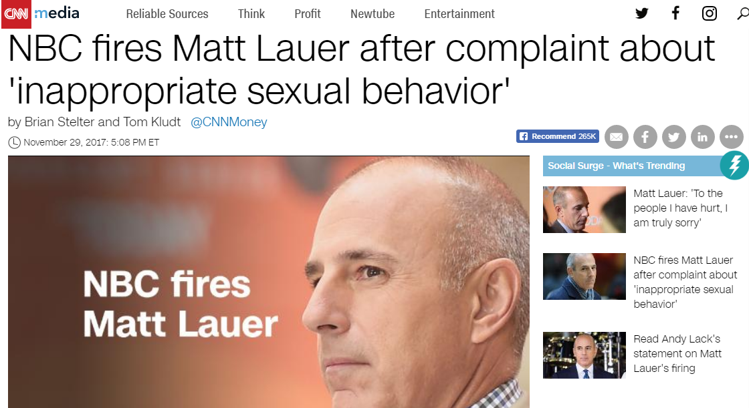

Slide 15
a lot of men behaving badly

Slide 16
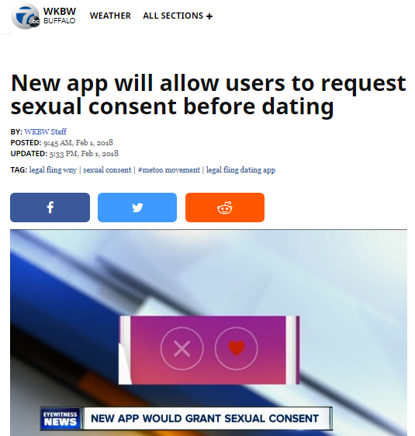
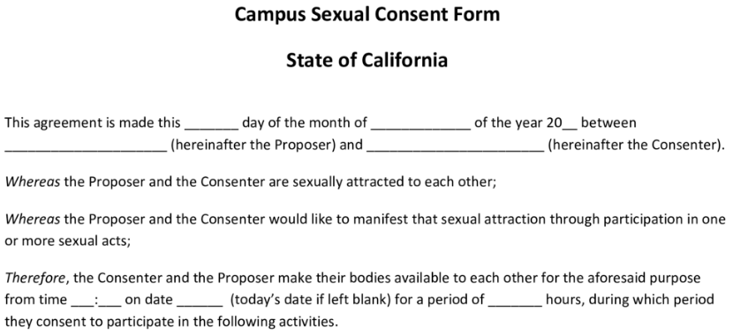
a recurring defense:
“consensual”

Slide 17
Here’s a much
better consensual
agreement:

Slide 18
Do you take this
woman / man
to be your lawfully wedded
wife /husband?
To have and to hold, and to keep yourself to
her/ him alone?
So long as you both shall live?
I do.
I do.

Slide 19
Thou shalt have no other gods before me.
Thou shalt not make
a graven image
Thou shalt not take the name of the LORD thy God in vain
Remember the sabbath
Honour thy father and thy mother
Thou shalt not
kill.
Thou shalt not commit adultery
Thou shalt not
steal.
Thou shalt not
bear false witness
Thou shalt not
covet

Slide 20
PROTECT YOUR MARRIAGE

Slide 22
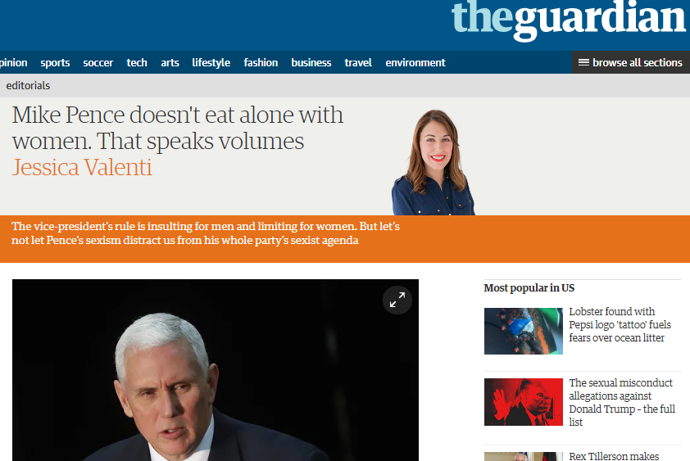
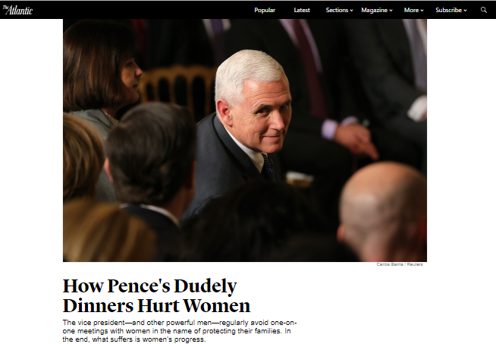
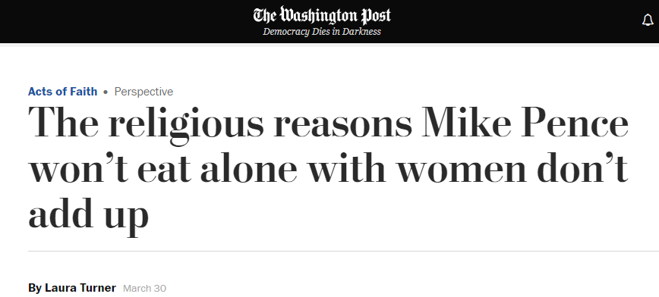

Slide 24
PROTECT YOUR MARRIAGE

Slide 25
RESPECTING
BOUNDARIES
clothing
communication
compliments
contact
companionship
closeness
imagination
intimacy
love
desire
loyalty

Slide 26
1. You’re having conversations you wouldn’t want your spouse to see.
If you’re ever in a position where you think, “I’m glad my husband/wife isn’t seeing this,” then you’re already out of bounds...
2. You’re dressing to impress a specific individual other than your spouse. When we’re trying to be visually attractive for an individual other than our spouse, we’re opening a very dangerous door.
3. You try to create opportunities to be alone with someone other than your spouse.
If you’re going out of your way to “run into” someone so you can have one-on-one conversations, that’s a huge red flag.
4. You delete text messages or emails from someone, because you don’t want your spouse to see them. If you’re ever hiding messages, texts or calls, then you’ve crossed an obvious line..
5. You’re having consistent romantic and/or sexual fantasies about someone other than your spouse.
Affairs don’t start in the bedroom, they always start in the mind!
6. You’re constantly comparing your spouse to this other individual.
…the mental tendency is to see this new person as nearly flawless and, by comparison, your spouse’s flaws become much more obvious. If you’re more critical of your spouse while mentally comparing them to this other person, you’re falling into a toxic trap.
7. You’re planning a new life together with this other person.
Once you start planning and romanticizing a new life with this other person, you’re in a very dangerous place...
7 SIGNS YOU’RE HAVING AN EMOTIONAL AFFAIR: patheos.com / Dave Willis
Read more at http://www.patheos.com/blogs/davewillis/7-signs-youre-having-an-emotional-affair/#dpbyiHYp7bXGRMGT.99

Slide 27
Adultery:
the Selfishness
the foolishness
The violation of Covenant
THE BETRAYAL
The Entanglement
THE CONSEQUENCES
THE VICTIMS

Slide 28
HEB.13:4 Let marriage be had in honor among all and let the bed be undefiled: for fornicators and adulterers God will judge.

Slide 29
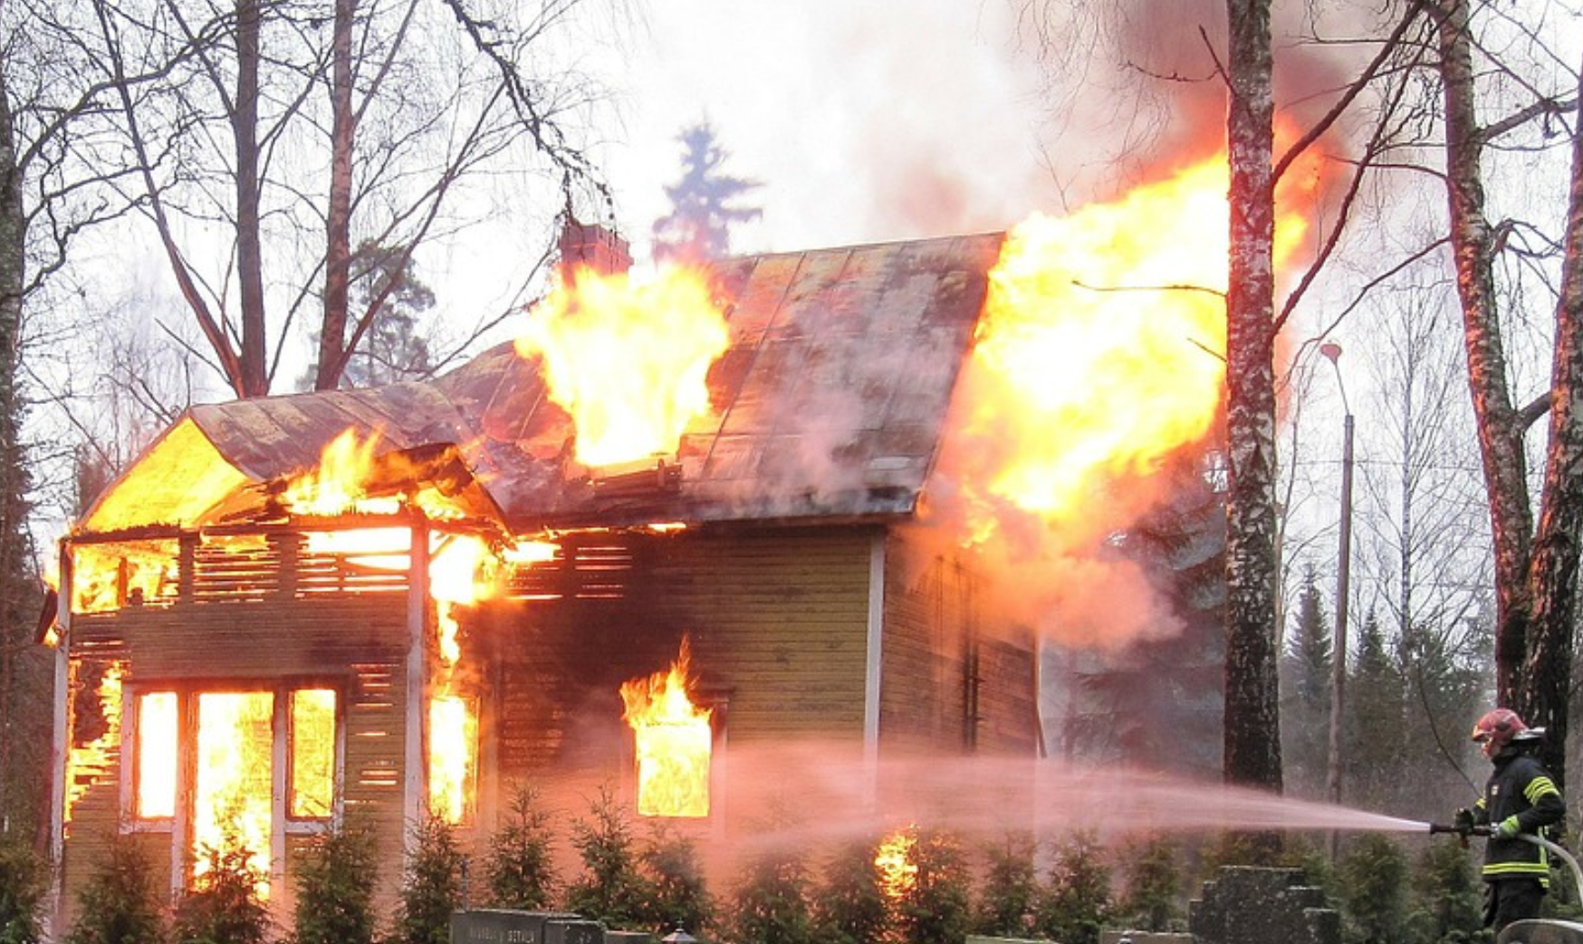

Slide 30
Proverbs
5
6
7

Slide 31
a Healthy marriage: involves so much much more than
“don’t commit Adultery”
a Healthy
body:
Involves so much more than
“don’t commit suicide”

