Slide 1
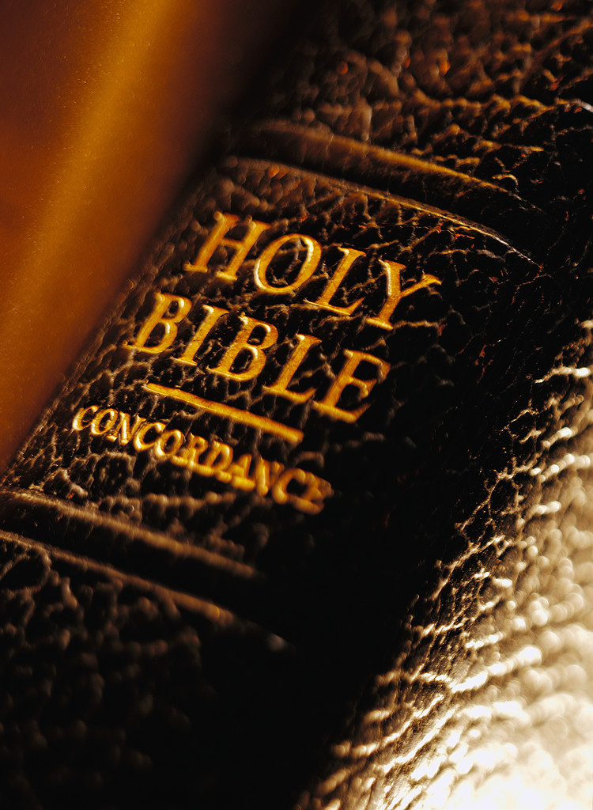
Adoption in Christ
Notes:
9-5-21 – Exton church
- As we’ve stated in previous lessons, numerous descriptive terms and analogies are used in the N.T. and O.T. by the H.S. to broaden our understanding into the saving work of Jesus on the cross.

Slide 2
I. Redeem:
“To release, free, deliver by paying a ransom.”
A. EXAGORAZO =
Agora – Market Place
Ex – Out of

Slide 3
B. Apolutrosis = To set free, to make free, to loose by a purchase price Thayer – “To let one go free on receiving the price. . . A releasing effected by paying a ransom.” Thus, in redemption, the sinner stands before God as a slave on the auction block, is purchased and is declared a freedman from sin.

Slide 4
I Pet. 1:18-20
“knowing that you were not redeemed with perishable things like silver or gold from your futile way of life inherited from your forefathers, but with precious blood, as of a lamb unblemished and spotless, the blood of Christ. For He was foreknown before the foundation of the world, but has appeared in these last times for the sake of you.”

Slide 5
B. Apolutrosis = To set free, to make free, to loose by a purchase price Thayer – “To let one go free on receiving the price. . . A releasing effected by paying a ransom.” Thus, in redemption, the sinner stands before God as a slave on the auction block, is purchased and is declared a freedman from sin.

Slide 6
II. Katallasso = Reconciliation Thayer – “To bring back to a former state of harmony”
Notes:
I Cor. 7:11

Slide 7
Col. 1:21,22 “And you, who once were alienated and enemies in your mind by wicked works, yet now He has reconciled 22in the body of His flesh through death, to present you holy, and blameless, and above reproach in His sight

Slide 8
II. Katallasso = Reconciliation In reconciliation, the sinner stands before God an enemy and in Jesus is made a friend.

Slide 9
III. Huiothesia = Adoption In N.T. = Adoption, Sonship, Children of God - In adoption the sinner stands before God an outsider/stranger and is declared a son and heir of the kingdom of God.
Notes:
Few things more beautiful in this life than adopting a child, wherein a family takes an orphaned child at the mercy of the world and invites them into the shelter and protection of their home to be part of their family.
We were orphaned and at the mercy of Satan – but by our own doing.
We see a picture of this in God’s adoption and love for the nation of Israel.

Slide 10
Ezek. 16:3-14
“Again the word of the Lord came to me, saying, 2“Son of man, cause Jerusalem to know her abominations, 3and say, ‘Thus says the Lord God to Jerusalem: “Your birth and your nativity are from the land of Canaan; your father was an Amorite and your mother a Hittite. 4As for your nativity, on the day you were born your navel cord was not cut, nor were you washed in water to cleanse you; you were not rubbed with salt nor wrapped in swaddling cloths. 5No eye pitied you, to do any of these things for you, to have compassion on you; but you were thrown out into the open field, when you yourself were loathed on the day you were born. 6“And when I passed by you and saw you struggling in your own blood, I said to you in your blood, ‘Live!’ Yes, I said to you in your blood, ‘Live!’”
Notes:
-

Slide 11
Ezek. 16:1-14
“7I made you thrive like a plant in the field; and you grew, matured, and became very beautiful. Your breasts were formed, your hair grew, but you were naked and bare. 8“When I passed by you again and looked upon you, indeed your time was the time of love; so I spread My wing over you and covered your nakedness. Yes, I swore an oath to you and entered into a covenant with you, and you became Mine,” says the Lord God. 9“Then I washed you in water; yes, I thoroughly washed off your blood, and I anointed you with oil. 10I clothed you in embroidered cloth and gave you sandals of badger skin; I clothed you with fine linen and covered you with silk. 11I adorned you with ornaments, put bracelets on your wrists, and a chain on your neck.”

Slide 12
Ezek. 16:1-14
“12And I put a jewel in your nose, earrings in your ears, and a beautiful crown on your head. 13Thus you were adorned with gold and silver, and your clothing was of fine linen, silk, and embroidered cloth. You ate pastry of fine flour, honey, and oil. You were exceedingly beautiful, and succeeded to royalty. 14Your fame went out among the nations because of your beauty, for it was perfect through My splendor which I had bestowed on you,” says the Lord God.”
Notes:
Thus Israel’s adoption may present a picture of our salvation of Jesus. We were adopted by God and received all the rights, privileges and blessings of a son to the Father.
Also see a picture of sonship and adoption in book Ben-Hur where Judah Ben-Hur saves the senator and warship commander Quintus Arrius from death at sea and was adopted into the senator’s family as a son, made an heir and became a citizen of Rome.
In like manner we were as the orphaned babe in Ezek. 16, uncared for, wallowing in our own blood, until Jesus reached down, and cleansed us, adopting us into his kingdom to become sons, fellow heirs and citizens.
Three references are made to our adoption by God as sons in the N.T.

Slide 13
Rom. 8:15
“12Therefore, brethren, we are debtors—not to the flesh, to live according to the flesh. 13For if you live according to the flesh you will die; but if by the Spirit you put to death the deeds of the body, you will live. 14For as many as are led by the Spirit of God, these are sons of God. 15For you did not receive the spirit of bondage again to fear, but you received the Spirit of adoption by whom we cry out, “Abba, Father.”
Notes:
Three references to our adoption by God as sons in the N.T.
Abba Father – There’s that tender affectionate reference of the father-child relationship.

Slide 14
Gal. 4:4-7
“4But when the fullness of the time had come, God sent forth His Son, born of a woman, born under the law, 5to redeem those who were under the law, that we might receive the adoption as sons. 6And because you are sons, God has sent forth the Spirit of His Son into your hearts, crying out, “Abba, Father!” 7Therefore you are no longer a slave but a son, and if a son, then an heir of God through Christ.”

Slide 15
Eph. 1:3-5
“3Blessed be the God and Father of our Lord Jesus Christ, who has blessed us with every spiritual blessing in the heavenly places in Christ, 4just as He chose us in Him before the foundation of the world, that we should be holy and without blame before Him in love, 5having predestined us to adoption as sons by Jesus Christ to Himself, according to the good pleasure of His will,.”
Notes:
An heir of God – entitled to the inheritance of the Father.
But that’s not the end – Israel forgot their adoption into the Kingdom and was unfaithful to the Lord.

Slide 16
Ezek. 16:15-22
“15“But you trusted in your own beauty, played the harlot because of your fame, and poured out your harlotry on everyone passing by who would have it. 16You took some of your garments and adorned multicolored high places for yourself, and played the harlot on them. Such things should not happen, nor be. 17You have also taken your beautiful jewelry from My gold and My silver, which I had given you, and made for yourself male images and played the harlot with them. 18You took your embroidered garments and covered them, and you set My oil and My incense before them. “

Slide 17
Ezek. 16:15-22
“19Also My food which I gave you—the pastry of fine flour, oil, and honey which I fed you—you set it before them as sweet incense; and so it was,” says the Lord God. 20“Moreover you took your sons and your daughters, whom you bore to Me, and these you sacrificed to them to be devoured. Were your acts of harlotry a small matter, 21that you have slain My children and offered them up to them by causing them to pass through the fire? 22And in all your abominations and acts of harlotry you did not remember the days of your youth, when you were naked and bare, struggling in your blood.”
Notes:
It is possible for us to forget our adoption and the meaningfulness of Christ’s sacrifice for us. Forget the great emotional and physical torment that he went through for us.
Let us not “trample on the Son of God and consider the blood of the covenant by which we were sanctified a common thing.”
As we partake of the Lord’s Supper, let us consider the preciousness and sacredness of His sacrifice.
Let us now commemorate and honor that blood and that body as we partake.

