Slide 1
The Exclusivity of Christianity

Slide 2
Christianity under the Roman Empire
Toleration of new religions as such was far greater under the Roman Empire than it has been in modern times:
Religious Freedom is Good
But not every religion is good

Slide 3
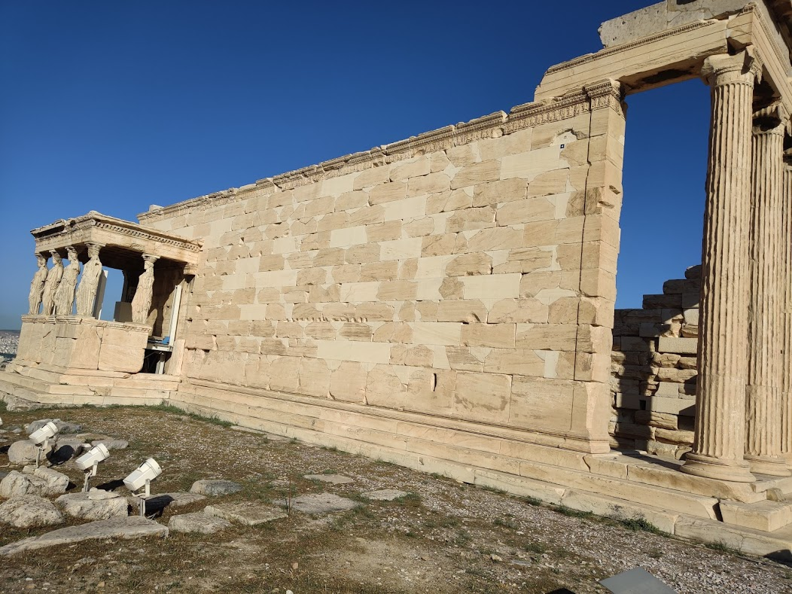
Christianity under the Roman Empire
Toleration of new religions as such was far greater under the Roman Empire than it has been in modern times: in the multiplicity of religions and gods that existed in the same city, a single new addition was a matter of almost perfect indifference.
Eastern section: Athena Polias
Western section:
Poseidon-Erechtheus
Hephaistus
Boutes

Slide 4
Christianity under the Roman Empire
Arrogant
or
Accurate?
Toleration of new religions as such was far greater under the Roman Empire than it has been in modern times: in the multiplicity of religions and gods that existed in the same city, a single new addition was a matter of almost perfect indifference.
But the aggressiveness of Christianity, the change in social habits and every-day life which it introduced, and the injurious effect that it sometimes exercised on trades which were encouraged by paganism, combined with the intolerance that it showed for other religions, made it detested among people who regarded with equanimity, or even welcomed, the introduction into their cities the gods of Greece, of Rome, of Egypt, of Syria.
- Ramsay, The Church in the Roman Empire before A.D. 170

Slide 5
John 14⁶
Jesus said to him, “I am the way, and the truth, and the life; no one comes to the Father except through Me.”
Arrogant
or
Accurate?

Slide 6
Acts 4¹²
And there is salvation in no one else; for there is no other name under heaven that has been given among mankind by which we must be saved.”
Arrogant
or
Accurate?

Slide 7
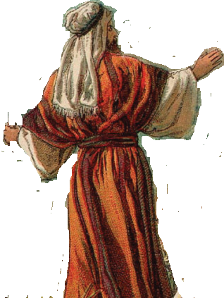
If we listen to an imaginary god,
where do the values associated with that god come from?
Is it a surprise if imagined gods say things like…
“listen to the voice within”?
¹ Then God spoke all these words, saying,
² “I am the Lord your God, who brought you out of the land of Egypt, out of the house of slavery.
³ “You shall have no other gods before Me.
⁴ “You shall not make for yourself an idol, or any likeness of what is in heaven above or on the earth beneath, or in the water under the earth. ⁵ You shall not worship them nor serve them; for I, the Lord your God, am a jealous God…”

Slide 8
The God who spoke at
Mt. Sinai made it clear:
this was not man’s own inner voice…
(Exodus 19:16-20, 20:18-23, Deut 5:4-7)
¹ Then God spoke all these words, saying,
² “I am the Lord your God, who brought you out of the land of Egypt, out of the house of slavery.
³ “You shall have no other gods before Me.
⁴ “You shall not make for yourself an idol, or any likeness of what is in heaven above or on the earth beneath, or in the water under the earth. ⁵ You shall not worship them nor serve them; for I, the Lord your God, am a jealous God…”

Slide 9
¹ Then God spoke all these words, saying,
² “I am the Lord your God, who brought you out of the land of Egypt, out of the house of slavery.
³ “You shall have no other gods before Me.
⁴ “You shall not make for yourself an idol, or any likeness of what is in heaven above or on the earth beneath, or in the water under the earth. ⁵ You shall not worship them nor serve them; for I, the Lord your God, am a jealous God,
inflicting the punishment of the fathers on the children, on the third and the fourth generations of those who hate Me, ⁶ but showing favor to thousands, to those who love Me and keep My commandments.

Slide 10
SERVING OTHER GODS = IDOLATRY
DISOBEDIENCE = SERVING ANOTHER GOD
Satan
Self

Slide 11
1 Kings 18
²¹ Then Elijah approached all the people and said, “How long are you going to struggle with the two choices? If the Lord is God, follow Him; but if Baal, follow him.”

Slide 12
Acts 17³¹ “He has set a day on which He will judge the world in righteousness through a Man whom He has appointed, having furnished proof to all people by raising Him from the dead.”
GOD

