Slide 1
Forever
Before the mountains were brought forth, Or ever you had formed the earth and the world, even from everlasting to everlasting
You are God (Psm. 90:2)

Slide 2
Entropy

Slide 3
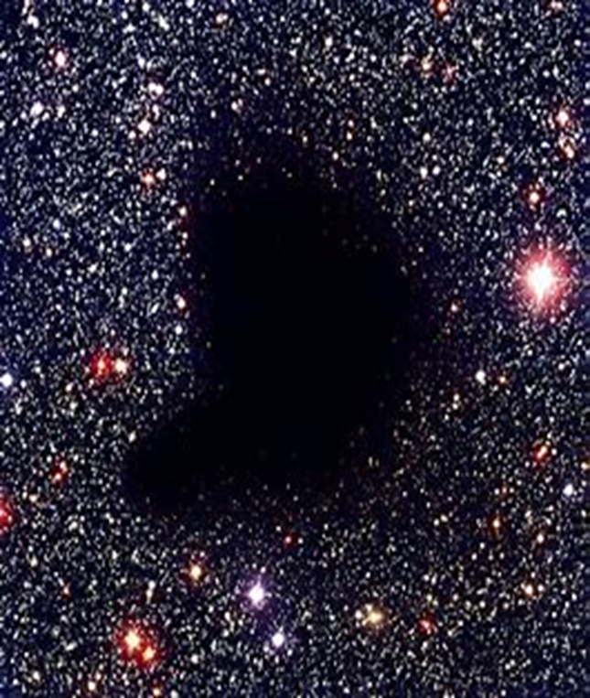
Bootes Void

