Slide 1
The God of the Mountain
Climbing the Mountain of Holiness
Is Holy
Great is the LORD, and greatly to be praised in the city of our God, in the Mountain of His Holiness. (Psalm 48:1)

Slide 2
Be Holy…
Hosea 11:9
“I am God,
and not man…the Holy One…”
Psalm 46:10
“I am God…
I will be exalted…”
i.e. to be set apart, sacred; set apart by (or for) God; properly, different or unlike, with the implications of being God-like or different from the world; something venerated, revered; distinctly identified with God
Isaiah 55:8-9
“My thoughts are not your thoughts…
My ways are higher than your ways”
…For I Am Holy
1 Peter 1:16
“Be holy…I Am Holy”

Slide 3
Be Holy…
God’s people are told to be – or become – holy (1 Peter 1:16).
~ Isaiah 2:2-5 ~
~ Hosea 4:1-9 ~
Typically, however, the Lord’s people tend toward not being so…
For I Am Holy

Slide 4
God is Holy
But Am I?
“The God of the Mountain”

Slide 5
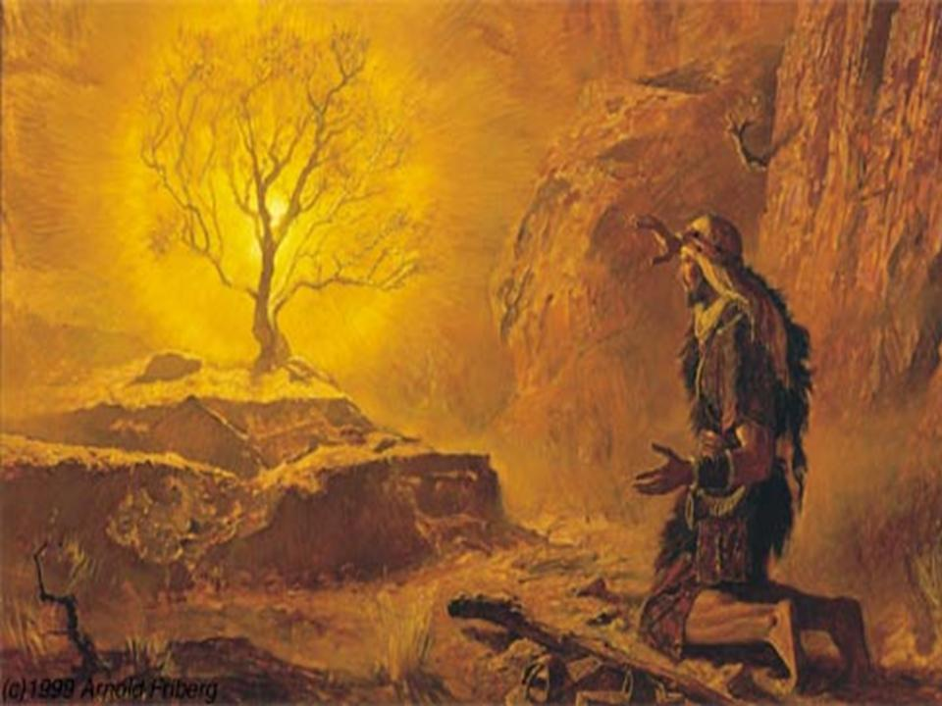
The God of the Mountain
Exodus 3:1-6, 14
Moses saw himself as inadequate, not good enough, but God assured him He would be with him (3:12; 4:12)
Moses approached God on the mountain and encountered His holiness. Everything around him was holy, for God was there (:5). Moses “hid his face, for he was afraid to look upon God” (:6, natural reaction, cp. Matt 17:5-6).

Slide 6
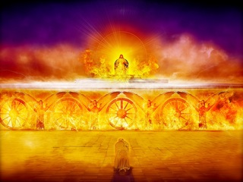
The God of the Mountain
Isaiah 6:1-8
Realization of the Holiness, the infinite greatness, of God makes one ashamed, feel completely unworthy  “Woe is me! For I am undone…a man of unclean lips” (cp. Luke 5:8, “Depart from me, for I am a sinful man, O Lord.”)
That I may apprehend that for which also I am apprehended of Christ Jesus… (Phil 3:8-14)
God reaches down for us and assures us of our worth. Whom shall I send? He says…

Slide 7
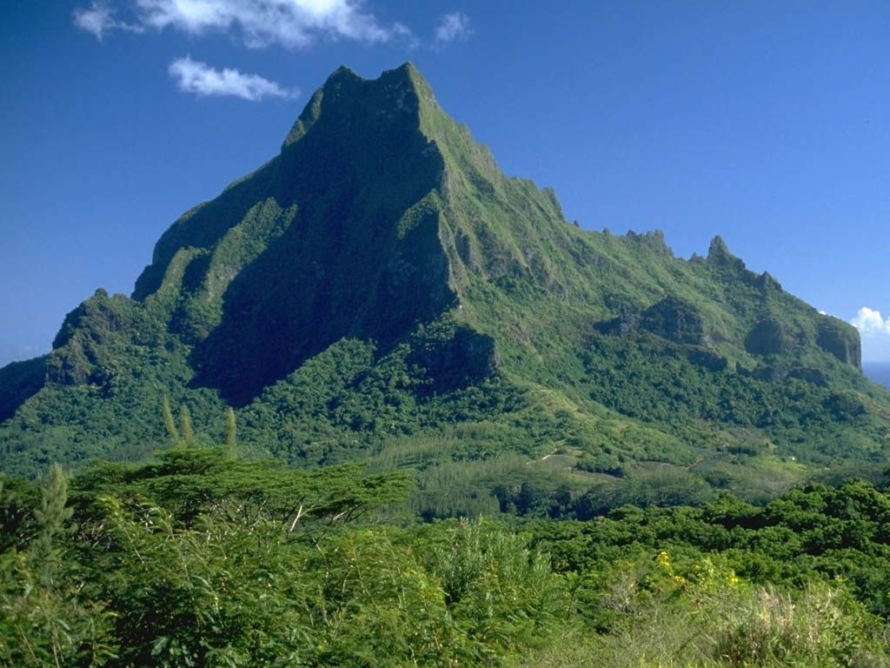
God
So, how do even the best reach God?
Isaiah 6:1-3
Because, I am not holy; I’m not “high and lifted up” where God is.
“The God of the Mountain”

Slide 8
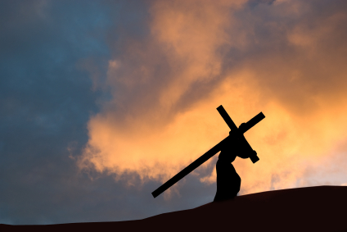
Be Holy…
The journey up the mountain to God begins with the first step. We must be “washed…sanctified…justified in the Name of our Lord.” (1 Corinthians 6:9-11)
Put the Lord “before all things” (Col 1:17-18), put Him first, “count all things but loss” for Him (Phil 3:7-8); “He must increase, but I must decrease” (John 3:30); and, He will be “my life” (Col 3:1-4).
For I Am Holy

Slide 10
A Mountain Between Us
Climbing the Mountain of Holiness
Great is the LORD, and greatly to be praised in the city of our God, in the Mountain of His Holiness. (Psalm 48:1)

Slide 11
God
1 Peter 1:16
Isaiah 2:2-3; James 4:8
God’s people often recognize this separation and want to build a better relationship with Him.
But, how do even the best reach God?
I am a “saint,” but I want to be “more holy.”
We have to accept God’s call to come to Him; but, “coming up to meet God” takes time, and it takes a concerted effort  i.e. following a practical plan to bridge this separation
The journey up the mountain is a process in which I am perfecting my personal holiness so I can be more like God, holy in all behavior (2 Corinthians 7:1; 1 Peter 1:13-17).
A Mountain Between Us

Slide 12
Who is your “best friend”? Why?
It takes time and diligent effort to build and maintain a lasting holy relationship (different, special, that you keep)
Chances are your answers include:
We like the same things or We have things in common
We spend a lot of time together (or we once did, and now as much as we can) and we really enjoy our time together
It makes me feel good to be with, to be around this individual
(Perhaps we even acknowledge) The time I spend, the relationship we have, makes me a better person
If God is to be our friend, if we are to be close to God  it will require the same kind of time – “It takes time to be holy”

Slide 13
God
Respondent (2 Cor 5:14-15)
Affectionate (1 Cor 16:22)
The Christian also builds and maintains an intimate relationship with God  one of emotional and physical intimacy. God loved us with a “great love” (Ephesians 2:4; cf. 1 John 3:1) and, we grow to reciprocate such love (1 John 4:19; cp. brother to brother, parent-child, husband & wife, etc.)
Our love for God may begin with a foundational response to God from an active good will (variously motivated by fear, etc.); but, it will grow to include a deep affection, an affectionate familial response to a Father Who has adopted us through Jesus to Himself (Eph 1:4-6; Rom 8:14-17)
A Mountain Between Us

Slide 14
God
The Christian’s goal is to build and maintain an interpersonal relationship with God  a deep and strong association; a close connection; an enduring bond between the two of us.
Based on Commitment
(true “BFF’s”)
(Jam 2:20-24; John 15:9-16)
Based on Covenant
(Mutual Agreement; Contractual)
(Jer 50:4-5; Heb 8:6-13)
Our relationship is built and maintained in Jesus  We “come to God” and we “abide in Him” through Jesus (John 6:44-45; 14:6, 23). Too, we relate to God through Jesus (Heb 12:22-24; Eph 3:16-19).
A Mountain Between Us

Slide 15
So we spend (invest) valuable time in building and maintaining a close relationship with God. We effect this through communication with Him  “me with God sessions”
Time in Meditation←
(God talking to me)
←Atypical Prayer
Time in Prayer ←
(me talking to God)
←Not just reading or even study
A Mountain Between Us

Slide 16
←Complete (1 Timothy 2:1)
←Practical (Philippians 4:4-13; e.g. Psalm 42 & 43)
←Consistent (Romans 12:12;
1 Thessalonians 5:17-18)
Time in Meditation←
(God talking to me)
←Atypical Prayer
Time in Prayer ←
(me talking to God)
←Not just reading or even study
←To Mull Over; Feed On (Psalm 143 (esp. :5a); 1:2; Philippians 4:8)
←Muse; Reflect; Introspect (143:5b; 1 Timothy 4:15)
Matthew 6:6-13
A Mountain Between Us

Slide 17
It takes time and diligent effort to build and maintain a lasting holy relationship (different, special, that you keep)
Frequent communication allows us to:
Learn about the person
Make a ‘connection’ with the person
Grow close to the person
Become ‘friends’ (love) the person
If God is to be our friend, if we are to be close to God  it will require the same kind of time – “It takes time to be holy”
Climbing the Mountain Between Us

Slide 18
God
Hosea 11:9
“I am God,
and not man…”
God’s people often recognize this separation and want to build a better relationship with Him.
Isaiah 2:2-3
Psalm 46:10
“I am God…
I will be exalted…”
We must accept God’s call to come to Him (and come up to Him)
Isaiah 55:8-9
“My thoughts are not your thoughts…
My ways are higher than your ways”
“Coming up to meet God” takes time and it takes a concerted effort  we need to be dedicated to a practical plan if we are to bridge this separation, this mountain between us…
A Mountain Between Us

Slide 20
Climbing a Mountain
Climbing the Mountain of Holiness
Great is the LORD, and greatly to be praised in the city of our God, in the Mountain of His Holiness. (Psalm 48:1)

Slide 21
God
Isaiah 2:2-4
The journey of a thousand miles begins with one step – Lao Tzu
The process to becoming holy - as God is Holy - requires an orderly, daily walk, climbing step by step up the mountain
Climbing a Mountain

Slide 22
God calls me to “come up,” “come near,” to Him and I need to know how to do that. For, in my weakness, I can…
Climbing a Mountain
Do less and settle for that;
Live a life of futility, struggling but never becoming more holy;
Acknowledge my weakness - my inability to climb the holy mountain - and quit trying because I’m not strong enough
OR, I can begin the process of becoming stronger, of climbing the mountain.
Matthew Childs, developed a list of Simple Rules for Mountain Climbing after 30 successful years of climbing.

Slide 23
Rule #1: Don’t Let Go!
Let us not grow weary while doing good, for in due season we shall reap if we do not let go.
Stating the obvious, but…
Letting go begins in the mind long before you actually lose the strength to go on [true physically or Spiritually]  Gal 6:9
 weary, disheartened, exhausted, dispirited …
People convince themselves they can’t go on, can’t continue; when, in reality, with the Lord’s strength, they can.  One must determine to remain mentally strong; take that next step; don’t let go. The climb up the mountain is taken one step at a time (Phil 4:13).
I may not think I can climb the mountain  ok, but I just need to believe I can take the next step…
Climbing a Mountain

Slide 24
Rule #2: Hesitation Is Bad!
Momentum is good; hesitation is a killer. As Childs says simply, Don’t stop climbing. He talks of situations in which you can easily lose your grip because of a lack of forward movement and begin to slip.
That is equally true of Christians  If we hesitate in our daily walk – thinking the top of the mountain is too far, or I’m making good time – if we are not moving forward, neglectful, we can easily lose our grip and begin to slip back (Heb 2:1-3; Phil 3:12-14).
I may hesitate for various reasons but I need to stay on pace and keep making progress…
Climbing a Mountain

Slide 25
Rule #3: Have a Plan.
Map out your entire climb. The “unexpected” is going to happen. When the obstacle [unexpected hindrance] has not been thoughtfully planned for, it is much easier to quit.
Childs observed that climbers are often successful through some of the most challenging parts of a climb only to fail at an easy step (because they didn’t expect it or plan for it).
A successful Christian will “map out” his life  Expecting the “unexpected” (1 Pet 5:8-9; 1 Thess 2:18).
Satan will use anything to obstruct my journey so I need to expect the unexpected and plan for it…
Climbing a Mountain

Slide 26
Rule #4: Execute Every Opportunity to Move Forward.
To reach the top you have to be able to complete each move in-between the executed steps…
The Christian’s moves in-between include things like daily prayers, Bible reading, and meditation; membership and involvement in a local congregation, with regular attendance of Bible classes and worship services; activities with other Christians (get-togethers; socializing); building resistance to temptation ...  1 Cor 9:24-27
It’s not just the “big steps” that make a successful climb  I need to execute the moves in-between…
Climbing a Mountain

Slide 27
Rule #5: Know How to Rest.
“I Am with you.”
The best climbers are the ones that can find a restful body position to calm themselves and refocus. In the most extreme situations, you have to know how to regroup and start the climb over...
Anxiety about the next move is counterproductive. Christians need to relax [a “restful body position”; “breathe”] and “calm themselves,” holding to the promise of the Lord (cf. Heb 13:5-6; see the example of Elijah,1 Kings 19:1-15)  Go, return on your way…when you arrive…
I need to “hold on,” calm myself and refocus  to believe the Lord’s promise in extreme situations…
Climbing a Mountain

Slide 28
Rule #6: Fear Really Stinks!
Fear means you are not focusing on what you are doing, rather you have turned your attention instead to the consequences of failing. It really stinks; it ruins your climb.
Serving God deserves our best concentration (ideally, total). Fear detracts and can even preempt our daily walk with our Lord  Fear not, for I Am with you; Be not dismayed, for I Am your God; I will strengthen you, Yes, I will help you; I will uphold you… (Isaiah 41:10)
There are legitimate threats, reasons to fear but I need to stay focused because the Lord is with me…
Climbing a Mountain

Slide 29
Rule #7: Know How to Let Go.
Once you get to the point where you know you can’t hang on to something, then you need to start thinking about how you are going to let go in such a way that it minimizes the hurt, but maximizes your progress.
There are things in life that Christians need to release, let go (it’s the wrong step, wrong direction…)  Whether situations, activities, or sometimes even people, we must let go if we are to minimize our hurt and maximize our progress (Matt 5:27-30; Phil 3:7-9).
Perhaps no decision is harder at times than letting go  but I need to know how to make the climb…
Climbing a Mountain

Slide 30
God
Isaiah 2:2-4
The journey of a thousand miles begins with one step – Lao Tzu
The process to becoming holy - as God is Holy - requires an orderly, daily walk, climbing step by step up the mountain
Climbing a Mountain

Slide 32
I Just Keep Falling
Climbing the Mountain of Holiness
Great is the LORD, and greatly to be praised in the city of our God, in the Mountain of His Holiness. (Psalm 48:1)

Slide 33
God
The journey of a thousand miles begins with one step – Lao Tzu
The process to becoming holy - as God is Holy - requires an orderly, daily walk, climbing step by step up the mountain
Christians know they need to keep going, keep climbing up the mountain.
I just keep falling, Lord…

Slide 34
God
Let us not grow weary while doing good, for in due season we shall reap if we do not lose heart. - Galatians 6:9
?
The journey of a thousand miles begins with one step – Lao Tzu
(sometimes, over and over again)
In reality, the lifelong journey up the mountain resembles something more like this for most of us…
I just keep falling, Lord…

Slide 35
I Just Keep Falling, Lord…
The humble admission that you keep falling (stumbling, quitting, starting), the genuine remorse (guilt) over it, the will to get up and go on is a mark of great strength!
A righteous man falls 7 times, but he rises up again; a wicked man simply stumbles into adversity.
Proverbs 24:16
Forgetting those things that are behind me  “I chase after that I may apprehend…I reach for (stretch)…I press toward (chase)” (Phil 3:12-14)

Slide 36
I just
keep
falling,
Lord…
We can get discouraged, even despondent, that we keep falling –
¹not making fast enough progress;
²not progressing in a straight, upward move
A great truth we realize is that we do not progress in a straight line up the mountain toward perfect glory!
We ascend by persevering – we stumble, we crawl, we fall, and we get up again – that’s how most of us climb a mountain.
The journey up the mountain is a process in which I am perfecting my personal holiness (2 Corinthians 7:1; 1 Peter 1:13-17).

Slide 37
Romans 12:1-3
It takes “transformation”…
“Transformation”  by its very definition, implies the lack of perfection; and, therefore, presses upon us the need to progress, to “perfect our holiness,” to “press toward” greater strength. We must embrace that fact to keep from losing heart on the way up the mountain.
I just keep falling, Lord…

Slide 38
Paul
David
Would we consider these strong or weak?
Peter
Abraham
Accurately! They were strong; they had their weaknesses. With God’s help they overcame the weaknesses and continue to this day to serve as great examples of strength.
How did God see them?
Each in his own right is a great example of faith and strength and we would quickly acknowledge them to be – BUT, each had, and demonstrated, glaring weaknesses.
I just keep falling, Lord…

Slide 39
Scripture speaks of Spiritual strength and weakness re the knowledge of the Word of God, the application of It, including both the ability and the success or failure of doing so…
Even the strong are weak
(Ps 6:1-4;
Matt 26:41;
2 Cor 11:29)
We tend to categorize people as strong or weak. Yet, it is a disservice to Scripture and ourselves to overly generalize…
The strong are weak at times, have their weaknesses;
The weak are strong at times, have their strengths
I just keep falling, Lord…

Slide 40
It is God’s intent to “perfect” us, to draw strength from us even during our weakest times. God wants our commitment to climb even as we fall, and our endurance when we slip, as He refines us through the process of climbing the mountain.
²⁹For whom He foreknew, He also predestined to be conformed to the image of His Son, that He might be the firstborn among many brethren. ³⁰Moreover whom He predestined, these He also called; whom He called, these He also justified; and whom He justified, these He also glorified. - Romans 8:29-30
I just keep falling, Lord…

Slide 41
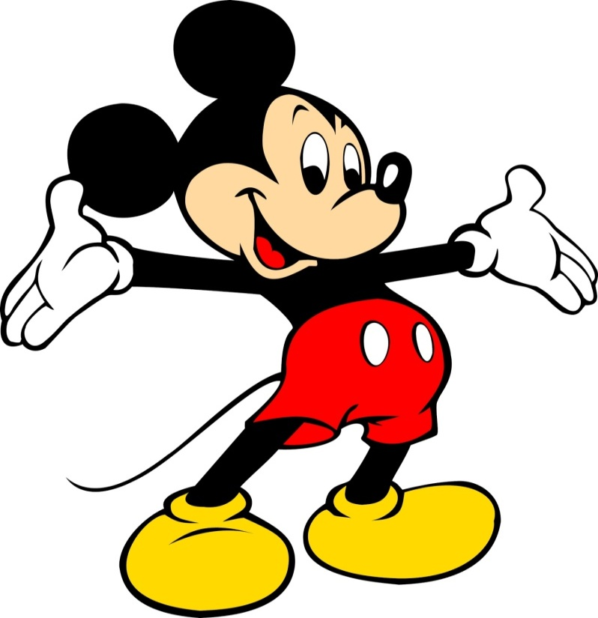
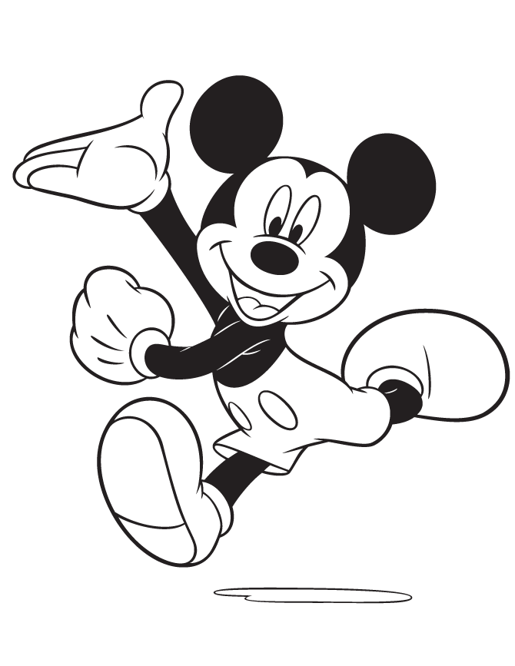
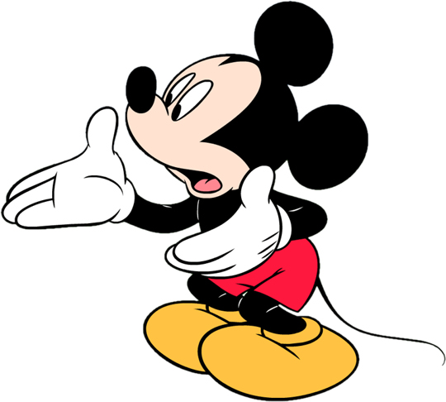
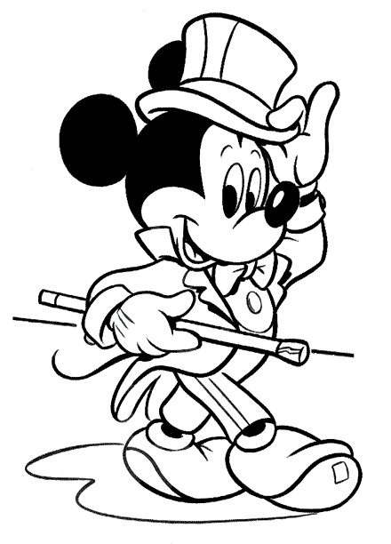
o
?
X
~
0

Slide 43
Too Much Weight to Climb
Climbing the Mountain of Holiness
Great is the LORD, and greatly to be praised in the city of our God, in the Mountain of His Holiness. (Psalm 48:1)

Slide 44
When I look in the mirror, what do I see?
How Do I climb this mountain?
Am I where I want to be? (Physically, Emotionally, Financially, Romantically, Spiritually)
How do I
reach God?
Do I often remind myself I am a saint?
I can make it?

Slide 45
I must remember who I am. When I look in the mirror, I should see a “saint,” a holy person. I am Spiritually alive in Christ and my life each day reflects who I am.
Ephesians 1:4-6, 12-14; 2:21-22; 5:1-18;
2 Timothy 2:19-21; 1 Corinthians 6:19-20
I have been “holy” since the day I was “born again”
I am a saint!
The Holy Spirit set me apart in the body of Christ
My body is a temple, the “habitation (home) of God”
I am “sealed (marked)” by God, His “vessel of honor”
I “walk with Christ” and we are the “light of the world”
I am a “son of glory,” accepted and favored by God

Slide 46
“I
Am a Saint…”
One of the greatest strengths I have is acknowledging who (what) I am
Operant Conditioning involves the use of positive reinforcement – discriminative stimuli added to increase the likelihood that certain behavior or favorable action will occur in the future … One’s behavior may be enhanced, even controlled by it
Gal 2:20
1 Cor 15:10
Reminding myself – meditating on who/what I am steers me (and keeps me) in a positive direction
Phil 1:17
3:12-14
4:13
Rom 1:16
Acts 27:23
Positive Reinforcement

Slide 47
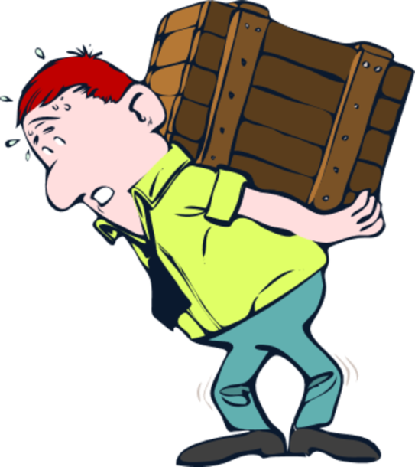
God
Hebrews 12:1
It is a daunting task to climb a mountain…
Yet it is an impossible task to climb it as some try to do!
My burden
Too Much Weight to Climb

Slide 48
Repairing; Adjusting; Mending; Restoring…
We must face the struggle to climb the mountain with endurance, “having laid aside ¹every weight, and ²the easily entangling sin…looking unto Jesus…” (Hebrews 12:1b-2a).
Lay aside
that sin
Lay aside
every weight
Too Much Weight to Climb

Slide 49
Ever feel the weight of the world is on your shoulders?
We have to lay it aside…
Finances?
Relationships?
Family Issues?
Discouragement?
Personal Problems?
Personal Weaknesses?
Guilt?
By removing it, correcting it, dealing with it
Too Much Weight to Climb

Slide 50
1 John 3:9
And the sin…
⁹Whoever is born of God does not go on sinning, because His Seed (the Word) abides in him, and he cannot go on sinning, because he is born of God
Sin that wraps around me, hindering, entangling me, so I can’t climb
Sin I stay in or keep returning to, keep repeating
Sin that I am prone to (my weakness)
Sin that Satan continues to provide opportunities for me to engage in and fail

Sin is diametrically opposed to the Word  they cannot co-exist (1 John 3:9)
I must be removing sin and “living” the Word; or, I’ve given up the climb, rejecting it to live in sin.
Just as I must lay aside the situations of life that weigh me down, so I must lay aside sin.
Too Much Weight to Climb

Slide 51
God
Isaiah 41:10
1 Peter 5:7; 1:3-7
5:8 5:9-10
God gives us exactly what we need for “praise, honor and glory.”
Satan wants to take that away from us!
Whom resist, steadfast in the Faith…
“perfect”  God will help us to complete the journey, successfully finish the struggle; repair; adjust; mend; restore; condition us; He will help us to keep our weakness from becoming something that destroys us
“establish”  confirm; direct us toward; support; fix firmly; God firmly grounds us so that we may steadily move in the right direction
My burden
“strengthen”  invigorate; empower; give or increase mobility so one may achieve the goal in the most effective way
“settle”  lit. to lay a basis or foundation; stabilize; ground

Slide 53
For, in my weakness, I can…
Climbing a Mountain…
The most important thing necessary to reach the top of the mountain is to never stop climbing.
(Walking the Highway of Holiness Daily)
2 Corinthians 12:9-10
Do less and settle for that;
Live a life of futility, struggling but never becoming more holy;
Acknowledge my weakness - my inability to climb the holy mountain - and quit trying because I’m not strong enough
OR, I can begin the process of becoming stronger, of climbing the mountain.

Slide 54
Matthew Childs, developed a list of Simple Rules for Mountain Climbing after 30 successful years of climbing.
Let us not grow weary while doing good, for in due season we shall reap if we do not lose heart.
Rule #1: Don’t Let Go!  Take the next step
Rule #2: Hesitation Is Bad!  Keep up the momentum
I need a plan!
Rule #3: Have a Plan  Map out your entire climb
Rule #4: Execute Every Opportunity to Move Forward
Rule #5: Know How to Rest  Relax and Refocus
Rule #6: Fear Stinks!  Acknowledge but stay focused
Rule #7: Learn How to Let Go  Of all that obstructs

