Slide 1
144,000 Sealed
Exton
Sunday, 6 pm
June 17, 2018

Slide 2
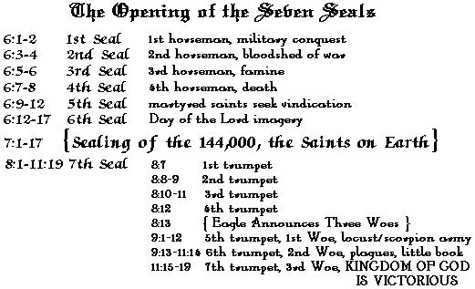
144,000 Sealed

Slide 3
144,000 Sealed

Slide 4
144,000 Sealed

Slide 5
144,000 Sealed

Slide 6
144,000 Sealed

Slide 7
144,000 Sealed

Slide 8
144,000 Sealed

Slide 9
144,000 Sealed

Slide 10
144,000 Sealed

Slide 11
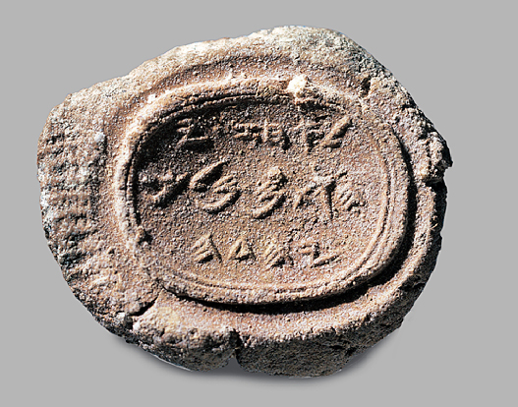
144,000 Sealed
Sealing
3 ideas
identification
“Belonging to Ahaz
son of Yehotam
king of Judah”

Slide 12
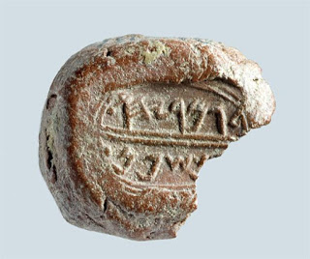
144,000 Sealed
Sealing
3 ideas
identification
Shaphan the son of Gemariah
(Jer. 36:10)

Slide 13
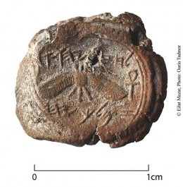
144,000 Sealed
Sealing
3 ideas
identification
“Belonging to Hezekiah, of Ahaz, king of Judah.”

Slide 14
144,000 Sealed
Sealing
3 ideas
identification
1 Ki 21:8, Est 3:10-12, 8:8, 8:10 et al.
Rev. 14:1
contrast Rev. 14:1 with 13:15-18
The question: To whom do you belong?
closed, secured
Mt 27:66
protection
Rev 7:3f

Slide 15
144,000 Sealed
144,000 Sealed
God’s identification & protection of his people in time of judgment
10 Plagues
Genesis 15:14
Exodus 11-12
Destruction of Jerusalem
Ezekiel 9:1-6
Revelation 7

Slide 16
144,000 Sealed
 | Numbers 2 | Numbers 26
Reuben | 46,500 | 43,730
Simeon | 59,300 | 22,200
Gad | 45,650 | 40,500
Judah | 74,600 | 76,500
Issachar | 54,400 | 64,300
Zebulun | 57,400 | 60,500
Manasseh | 32,200 | 52,700
Ephraim | 40,500 | 32,500
Benjamin | 35,400 | 45,600
Dan | 62,700 | 64,400
Asher | 41,500 | 53,400
Naphtali | 53,400 | 45,400
TOTAL | 603,550 | 601,730
Levi | 22,000 | 23,000
144,000 Sealed
Not Literal
Imagery of Rev. 4:6-7
Imagery of Rev. 5:5-6
Imagery of Rev. 5:8
Numbers are symbolic
Rev 12:1 “12 stars”
Rev 12:6 “1,260 days”
Rev. 12:14 “time, times, ½ time”
Rev 12:5 “42 months”
Luke 4:25, James 5:17
Daniel 7:25
12,000 for each tribe?!
No Dan, Ephraim
Revelation 14:1
So Why 144,000?

Slide 17
144,000 Sealed
144,000 Sealed
God’s People on Earth
Contrasted with the innumerable host in heaven
Given a number because they are defined
Why this particular number?
Rev. 4:4
24 elders on 24 thrones

