Slide 1
“An Exquisite Environment”
Exton
Sunday 11 am
April 29, 2018

Slide 2
“An Exquisite Environment”
The Goldilocks Planet
Jupiter prevents asteroids, large meteors from hitting earth by attracting them with its strong gravity.
The craters across the moon's surface demonstrate the frequency something has collided with the moon instead of earth. The moon's South Pole—Aitken basin—is the largest known crater in our solar system. It is eight miles deep and 1500 miles across.
“Un Ambiente Exquisito”
El Planeta Goldilocks
Júpiter evita que los asteroides, grandes meteoritos golpeen la Tierra al atraerlos con su fuerte gravedad.
Los cráteres a través de la superficie de la luna demuestran la frecuencia con la que algo colisionó con la luna en lugar de la tierra. La cuenca del Polo Sur-Aitken de la luna-es el cráter más grande conocido en nuestro sistema solar. Tiene ocho millas de profundidad y 1500 millas de ancho.

Slide 3
“An Exquisite Environment”
The Church
Ephesians 5 ²⁵ Husbands, love your wives, just as Christ also loved the church and gave Himself up for her, ²⁶ so that He might sanctify her, having cleansed her by the washing of water with the word, ²⁷ that He might present to Himself the church in all her glory, having no spot or wrinkle or any such thing; but that she would be holy and blameless.
“Un Ambiente Exquisito”
La Iglesia
Efeseos 5 ²⁵ Maridos, amad a vuestras mujeres, así como Cristo amó a la iglesia y se entregó a sí mismo por ella, ²⁶ para santificarla, habiéndola purificado en el lavamiento del agua por la palabra, ²⁷ a fin de presentársela a sí mismo, una iglesia gloriosa, que no tuviera mancha ni arruga ni cosa semejante, sino que fuera santa y sin mancha.

Slide 4
“An Exquisite Environment”
The Church
Ephesians 5 ²⁵ Husbands, love your wives, just as Christ also loved the church and gave Himself up for her, ²⁶ so that He might sanctify her, having cleansed her by the washing of water with the word, ²⁷ that He might present to Himself the church in all her glory, having no spot or wrinkle or any such thing; but that she would be holy and blameless.
“Un Ambiente Exquisito”
La Iglesia
Efeseos 5 ²⁵ Maridos, amad a vuestras mujeres, así como Cristo amó a la iglesia y se entregó a sí mismo por ella, ²⁶ para santificarla, habiéndola purificado en el lavamiento del agua por la palabra, ²⁷ a fin de presentársela a sí mismo, una iglesia gloriosa, que no tuviera mancha ni arruga ni cosa semejante, sino que fuera santa y sin mancha.

Slide 5
“An Exquisite Environment”
The Church
no spot or wrinkle,
holy and blameless.
“Un Ambiente Exquisito”
La Iglesia
no mancha ni arruga,
santa y sin mancha.

Slide 6
“An Exquisite Environment”
The Church
no spot or wrinkle,
holy and blameless.
Sanctified, Cleansed
set apart from sin
“Un Ambiente Exquisito”
La Iglesia
no mancha ni arruga,
santa y sin mancha.
Santificado, Purificado
apartado del pecado

Slide 7
“An Exquisite Environment”
The Church
The World
no spot or wrinkle,
holy and blameless.
Sanctified, Cleansed
set apart from sin
Genesis 6 ⁵ Then the Lord saw that the wickedness of man was great on the earth, and that every intent of the thoughts of his heart was only evil continually.
“Un Ambiente Exquisito”
La Iglesia
El Mundo
no mancha ni arruga,
santa y sin mancha.
Santificado, Purificado
apartado del pecado
Génesis 6 ⁵ Vio Jehová que la maldad de los hombres era mucha en la tierra, y que todo designio de los pensamientos de su corazón sólo era de continuo el mal;

Slide 8
“An Exquisite Environment”
The Church
The World
no spot or wrinkle,
holy and blameless.
Sanctified, Cleansed
set apart from sin
2 Peter 2 ⁷⁻⁸
Lot: “oppressed by the sensual conduct of unprincipled men”
“tormented day after day by their lawless deeds”
“Un Ambiente Exquisito”
La Iglesia
El Mundo
no mancha ni arruga,
santa y sin mancha.
Santificado, Purificado
apartado del pecado
2 Pedro 2 ⁷⁻⁸
Lot: “abrumado por la conducta pervertida de los malvados”
“afligía cada día…los hechos inicuos de ellos”

Slide 9
“An Exquisite Environment”
The Church
The World
no spot or wrinkle,
holy and blameless.
Sanctified, Cleansed
set apart from sin
“The majority of America’s 73.7 million children under age 18 live in families with two parents (69 percent)”
https://www.census.gov/newsroom/press-releases/2016/cb16-192.html
“Un Ambiente Exquisito”
La Iglesia
El Mundo
no mancha ni arruga,
santa y sin mancha.
Santificado, Purificado
apartado del pecado
"La mayoría de los 73,7 millones de estado unidenses menores de 18 años viven en familias con dos padres (69 por ciento)”
https://www.census.gov/newsroom/press-releases/2016/cb16-192.html

Slide 10
“An Exquisite Environment”
The Church
The World
no spot or wrinkle,
holy and blameless.
Sanctified, Cleansed
set apart from sin
“The majority of America’s 73.7 million children under age 18 live in families with two parents (69 percent)”
https://www.census.gov/newsroom/press-releases/2016/cb16-192.html
“Un Ambiente Exquisito”
La Iglesia
El Mundo
no mancha ni arruga,
santa y sin mancha.
Santificado, Purificado
apartado del pecado
"La mayoría de los 73,7 millones de estado unidenses menores de 18 años viven en familias con dos padres (69 por ciento)”
https://www.census.gov/newsroom/press-releases/2016/cb16-192.html

Slide 11
“An Exquisite Environment”
The Church
The World
no spot or wrinkle,
holy and blameless.
Sanctified, Cleansed
set apart from sin
31% of children under age 18 don’t live in a family with two parents
“Un Ambiente Exquisito”
La Iglesia
El Mundo
no mancha ni arruga,
santa y sin mancha.
Santificado, Purificado
apartado del pecado
31% de los niños menores de 18 años no viven en una familia con dos padres

Slide 12
“An Exquisite Environment”
The Church
The World
no spot or wrinkle,
holy and blameless.
Sanctified, Cleansed
set apart from sin
People who say they don’t want to bring children into this world
“Un Ambiente Exquisito”
La Iglesia
El Mundo
no mancha ni arruga,
santa y sin mancha.
Santificado, Purificado
apartado del pecado
Las personas que dicen que no quieren traer niños a este mundo

Slide 13
“An Exquisite Environment”
The Church
Mark 10 ²⁹ Jesus said, “Truly I say to you, there is no one who has left house or brothers or sisters or mother or father or children or farms, for My sake and for the gospel’s sake, ³⁰ but that he will receive a hundred times as much now in the present age, houses and brothers and sisters and mothers and children and farms, along with persecutions; and in the age to come, eternal life.
Family
“Un Ambiente Exquisito”
La Iglesia
Marcos 10 ²⁹ Respondió Jesús y dijo:—De cierto os digo que no hay nadie que haya dejado casa, o hermanos, o hermanas, o padre, o madre, o mujer, o hijos, o tierras, por causa de mí y del evangelio, ³⁰ que no reciba cien veces más ahora en este tiempo: casas, hermanos, hermanas, madres, hijos y tierras, aunque con persecuciones, y en el siglo venidero la vida eterna.
Familia

Slide 14
“An Exquisite Environment”
The Church
Mark 10 ²⁹ Jesus said, “Truly I say to you, there is no one who has left house or brothers or sisters or mother or father or children or farms, for My sake and for the gospel’s sake, ³⁰ but that he will receive a hundred times as much now in the present age, houses and brothers and sisters and mothers and children and farms, along with persecutions; and in the age to come, eternal life.
Family
“Un Ambiente Exquisito”
La Iglesia
Marcos 10 ²⁹ Respondió Jesús y dijo:—De cierto os digo que no hay nadie que haya dejado casa, o hermanos, o hermanas, o padre, o madre, o mujer, o hijos, o tierras, por causa de mí y del evangelio, ³⁰ que no reciba cien veces más ahora en este tiempo: casas, hermanos, hermanas, madres, hijos y tierras, aunque con persecuciones, y en el siglo venidero la vida eterna.
Familia

Slide 15
“An Exquisite Environment”
The Church
Mark 10 ²⁹ Jesus said, “Truly I say to you, there is no one who has left house or brothers or sisters or mother or father or children or farms, for My sake and for the gospel’s sake, ³⁰ but that he will receive a hundred times as much now in the present age, houses and brothers and sisters and mothers and children and farms, along with persecutions; and in the age to come, eternal life.
Family
“Un Ambiente Exquisito”
La Iglesia
Marcos 10 ²⁹ Respondió Jesús y dijo:—De cierto os digo que no hay nadie que haya dejado casa, o hermanos, o hermanas, o padre, o madre, o mujer, o hijos, o tierras, por causa de mí y del evangelio, ³⁰ que no reciba cien veces más ahora en este tiempo: casas, hermanos, hermanas, madres, hijos y tierras, aunque con persecuciones, y en el siglo venidero la vida eterna.
Familia

Slide 16
“An Exquisite Environment”
The Church
Family
Love
John 13 ³⁵ By this all men will know that you are My disciples, if you have love for one another.
“Un Ambiente Exquisito”
La Iglesia
John 13 ³⁵ En esto conocerán todos que sois mis discípulos, si tenéis amor los unos por los otros.
Familia
Amor

Slide 17
“An Exquisite Environment”
The Church
Family
Love
Care
“Un Ambiente Exquisito”
La Iglesia
Familia
Amor
Cuidado

Slide 18
“An Exquisite Environment”
The Church
Family
Love
Care
Acts 4
Acts 6
Acts 11
1 Corinthians 16
“Un Ambiente Exquisito”
La Iglesia
Familia
Amor
Cuidado
Hechos 4
Hechos 6
Hechos 11
1 Corintios 16

Slide 19
“An Exquisite Environment”
The Church, the Congregation: A Work in Progress
Family
Love
Care
Spots & Blemishes in the Local Church
Ananias & Sapphira
1 Corinthians 11:21-22
Hebrews 10:25
“Un Ambiente Exquisito”
La Iglesia, la Congregación, un Trabajo en Progreso
Familia
Amor
Cuidado
Manchas y arrugas en la iglesia local
Ananias y Safira
1 Corintios 11: 21-22
Hebreos 10:25

Slide 20
“An Exquisite Environment”
The Church, the Congregation: My Role
Family
Love
Care
“Un Ambiente Exquisito”
La Iglesia, la Congregación: Mi Parte
Familia
Amor
Cuidado

Slide 21
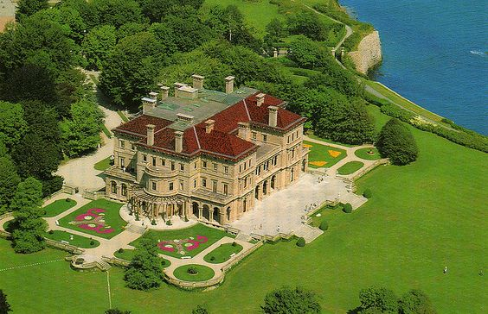
“An Exquisite Environment”
The Church, the Congregation: My Role
Family
Love
Care

Slide 22
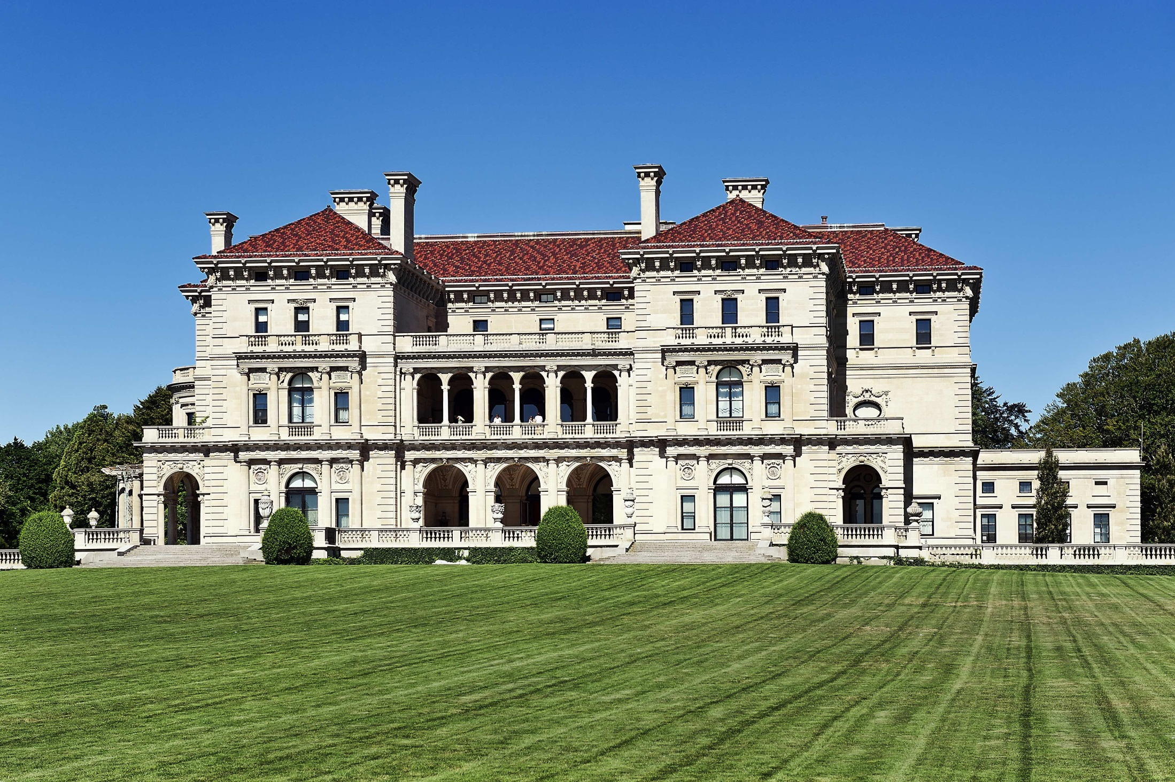
“An Exquisite Environment”
The Church, the Congregation: My Role
Family
Love
Care

Slide 23
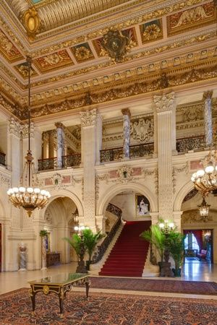
“An Exquisite Environment”
The Church, the Congregation: My Role
Family
Love
Care

Slide 24
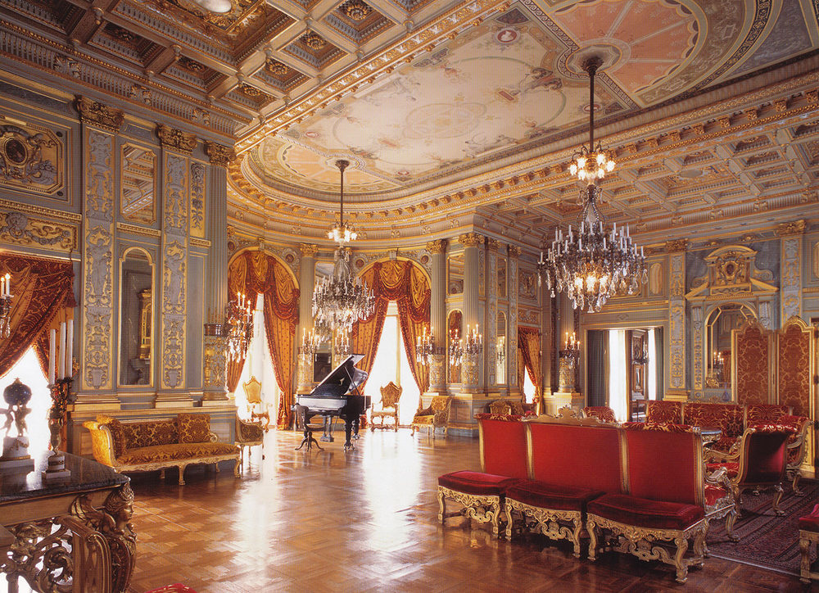
“An Exquisite Environment”
The Church, the Congregation: My Role
Family
Love
Care

Slide 25
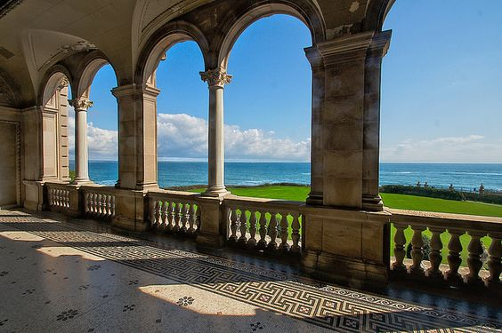
“An Exquisite Environment”
The Church, the Congregation: My Role
Family
Love
Care

Slide 26
“An Exquisite Environment”
The Church, the Congregation: My Role
Family
Love
Care
“Un Ambiente Exquisito”
La Iglesia, la Congregación: Mi Parte
Familia
Amor
Cuidado

