Slide 1
Thoughts on Stewardship
Nov 12, 2017

Slide 2
“Granddaddy Swimming Hole” – Outside Bunker MO on the West Fork of the Black River

Slide 3
“Sutton’s Bluff” – Outside Centerville MO on the Black River

Slide 4
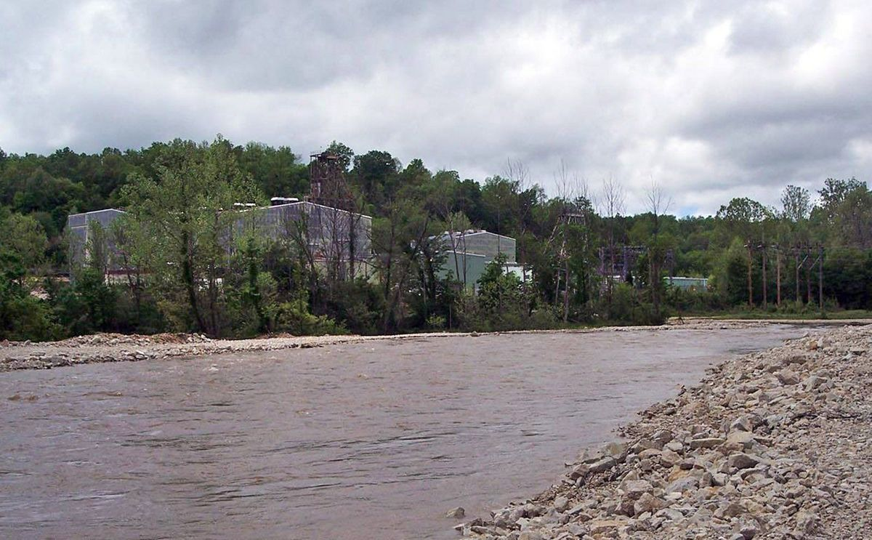
The Re-Routed West Fork River Channel

Slide 5
GRANDDADDY SWIMMING HOLE
The Re-Routed West Fork River Channel

Slide 6
RE-ROUTED WEST FORK CHANNEL
GRANDDADDY SWIMMING HOLE
DOE RUN WEST FORK MINE FROM SPACE

