Slide 1
False trust in God

Slide 2
The Ark of the Covenant
1 Samuel 4:1-11
In the days of Eli and Samuel, the Philistines meet the Israelites in battle.
This predates the time of kings by four chapters and roughly 42 years.

Slide 3
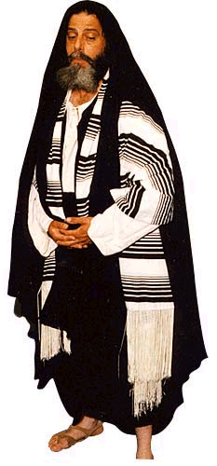
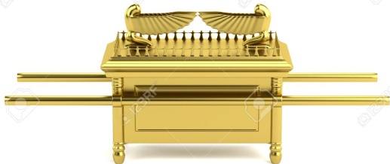
PHILISTINES
ISRAELITES

Slide 4
PHILISTINES
ISRAELITES

Slide 5
PHILISTINES
ISRAELITES

Slide 6
Taking of the Ark
Reason: 1 Samuel 2:12-17, 22-25
Expectations
Reality
Israel thought the battle was in the bag – 1 Sam. 4:3,5
They were confident in the presence of God.
Philistia thought they would be destroyed – 1 Sam 4:6-8
God allowed the Ark, His dwelling among the people, to be taken!
This went against everyone’s assumptions.

Slide 7
The Temple
Israel was taken captive in 722 BC, and Jeremiah prophesies starting around 626 BC during Josiah’s reign.
There is about 96 years between Israel’s capture and Jeremiah’s commission.
Israel has been taken captive and Judah is not even worried. They continue living their lives and do not seek redemption to God.

Slide 8
Temple is Destroyed and Burned
Expectation
Reality
Jeremiah 7:1-7
They were confident in the presence of God’s temple and the location of their homes.
They saw themselves polarized from Israel.
God had other plans.
2 Chronicles 36:15-19, 2 Kings 25:8-11, 13-17
God wreaked havoc, on His own people! Even His own temple!

Slide 9
Similarities
Both of these places were the designated place that God dwelt among His people.
Both were made for good and when used properly would be one of the greatest blessings to the people.
In both cases this was reliant on the people’s obedience to God.

Slide 10
The church of Christ
The church of Christ is no different.
The church is ordained and given authority from God – Matthew 16:18
The church is the Bride of Christ – Eph. 5:22-25, 26, 32

Slide 11
We can’t afford the same mistakes!
The church in Laodicea – Revelation 3:14-22
The church in Corinth – 1 Cor. 1:10-12, 5:1-2, 6:1-6
Contemporary examples – institutionalism, instrumental music - all sharing our name!

Slide 12
Self Reflection
Psalm 119:9, 105
2 Corinthians 13:5
James 1:21-25
This isn’t just an “other church” problem.
We must search ourselves, our doctrine and our belief to test it, since we are just as capable of failing!
The standard: God’s word.

Slide 13
Summary
The Ark of the Covenant wasn’t able to deliver Israel.
The Temple wasn’t able to deliver Judah.
The name “church of Christ” isn’t able to deliver us.
Obedience and faith in God is what we will be judged by, not our title.
John 12:48, Romans 2:6

Slide 14
False trust in God

