Slide 1
Joel 2:15-17
An Antidote for Complacency
Exton
Sunday, 11:00 am
June 4, 2017

Slide 2
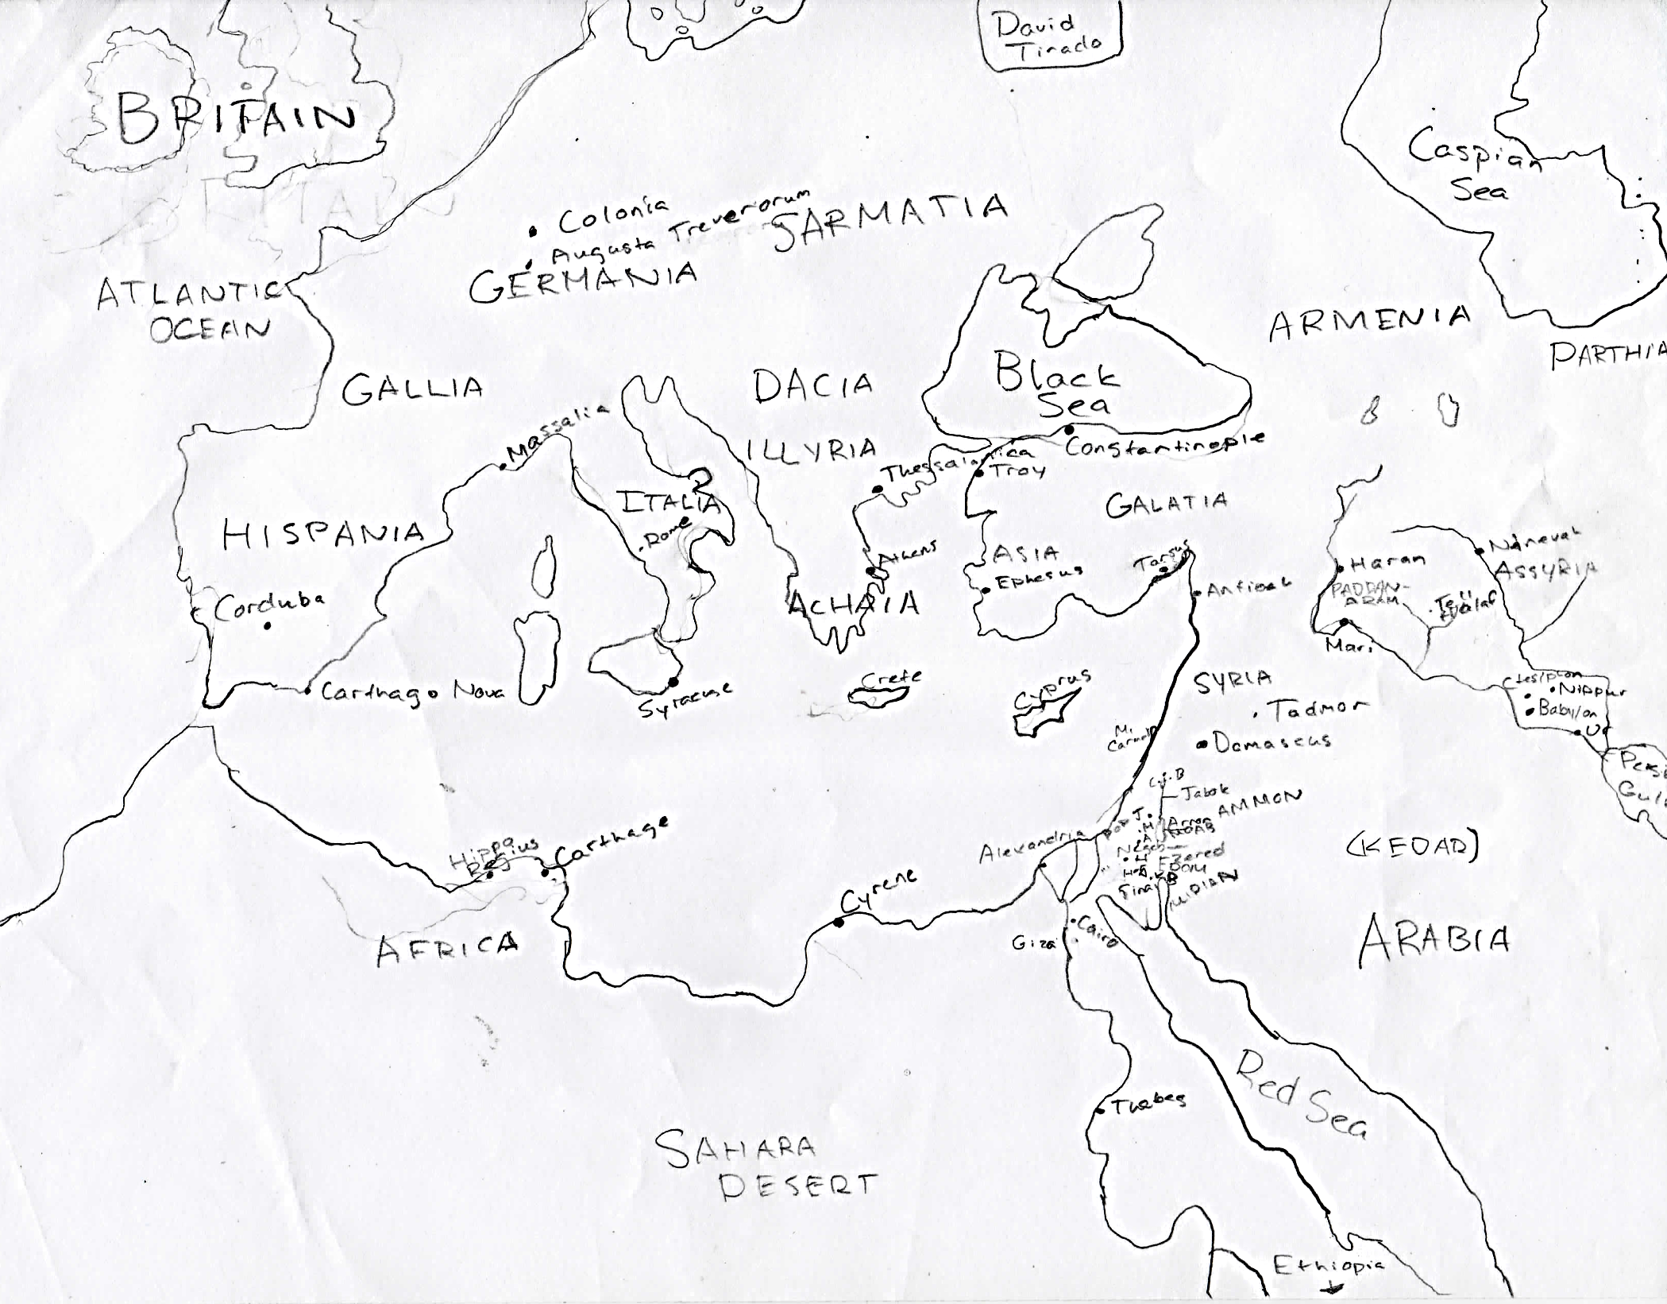

Slide 3
Joel 2:1-11 A Coming Day of the Lord
¹Blow a trumpet in Zion, And sound an alarm on My holy mountain! Let all the inhabitants of the land tremble, For the day of the Lord is coming; Surely it is near

Slide 4
Joel 2:1-11 A Coming Day of the Lord
¹⁰ Before them the earth quakes, The heavens tremble, The sun and the moon grow dark And the stars lose their brightness. ¹¹ The Lord utters His voice before His army; Surely His camp is very great, For strong is he who carries out His word. The day of the Lord is indeed great and very awesome, And who can endure it?

Slide 5
Joel 2:12-14
Repent and Possibly Avoid Destruction
¹² “Yet even now,” declares the Lord, “Return to Me with all your heart, And with fasting, weeping and mourning;
¹³ And rend your heart and not your garments.” Now return to the Lord your God, For He is gracious and compassionate, Slow to anger, abounding in lovingkindness And relenting of evil.
¹⁴ Who knows whether He will not turn and relent And leave a blessing behind Him, Even a grain offering and a drink offering For the Lord your God?
Is this relevant to us?

Slide 6
The Danger of Being Self-Satisfied
The Pharisee in the Temple
The Rich Man perhaps
Paul wasn’t
1 Corinthians 4:4
⁴ For I am conscious of nothing against myself, yet I am not by this acquitted; but the one who examines me is the Lord.

Slide 7
The Danger of Being Self-Satisfied
The Pharisee in the Temple
The Rich Man perhaps
Paul wasn’t
1 Corinthians 4:4
1 Corinthians 9:27
²⁷ but I discipline my body and make it my slave, so that, after I have preached to others, I myself will not be disqualified.

Slide 8
The Danger of Being Self-Satisfied
The Pharisee in the Temple
The Rich Man perhaps
Paul wasn’t
1 Corinthians 4:4
1 Corinthians 9:27
self-satisfaction is no guarantee of justification,
may actually result in condemnation!
The Self-Satisfied Church
Laodicea, Revelation 3:15ff
¹⁵ ‘I know your deeds, that you are neither cold nor hot; I wish that you were cold or hot. ¹⁶ So because you are lukewarm, and neither hot nor cold, I will spit you out of My mouth.
¹⁷ Because you say, “I am rich, and have become wealthy, and have need of nothing,” and you do not know that you are wretched and miserable and poor and blind and naked, ¹⁸ I advise you to buy from Me gold refined by fire…

Slide 9
The Danger of Being Self-Satisfied
The Pharisee in the Temple
The Rich Man perhaps
Paul wasn’t
1 Corinthians 4:4
1 Corinthians 9:27
self-satisfaction is no guarantee of justification,
may actually result in condemnation!
The Self-Satisfied Church
Laodicea, Revelation 3:15ff
Shared Accountability
Daniel 9
⁸ Open shame belongs to us, O Lord, to our kings, our princes and our fathers, because we have sinned against You. ⁹ To the Lord our God belong compassion and forgiveness, for we have rebelled against Him; ¹⁰ nor have we obeyed the voice of the Lord our God, to walk in His teachings which He set before us through His servants the prophets.

Slide 10
The Danger of Being Self-Satisfied
The Pharisee in the Temple
The Rich Man perhaps
Paul wasn’t
1 Corinthians 4:4
1 Corinthians 9:27
self-satisfaction is no guarantee of justification,
may actually result in condemnation!
The Self-Satisfied Church
Laodicea, Revelation 3:15ff
Shared Accountability
Daniel 9
¹⁵ “And now, O Lord our God, who have brought Your people out of the land of Egypt with a mighty hand and have made a name for Yourself, as it is this day—we have sinned, we have been wicked.

Slide 11
The Danger of Being Self-Satisfied
The Pharisee in the Temple
The Rich Man perhaps
Paul wasn’t
1 Corinthians 4:4
1 Corinthians 9:27
self-satisfaction is no guarantee of justification,
may actually result in condemnation!
The Self-Satisfied Church
Laodicea, Revelation 3:15ff
Shared Accountability
Daniel 9
²⁰ Now while I was speaking and praying, and confessing my sin and the sin of my people Israel…

Slide 12
The Danger of Being Self-Satisfied
The Pharisee in the Temple
The Rich Man perhaps
Paul wasn’t
1 Corinthians 4:4
1 Corinthians 9:27
self-satisfaction is no guarantee of justification,
may actually result in condemnation!
The Self-Satisfied Church
Laodicea, Revelation 3:15ff
Shared Accountability
Daniel 9
Ezra 9:1-6
Not justified by identification with a congregation, but share accountability for the congregation
⁵ But at the evening offering I arose from my humiliation, even with my garment and my robe torn, and I fell on my knees and stretched out my hands to the Lord my God;
⁶ and I said, “O my God, I am ashamed and embarrassed to lift up my face to You, my God, for our iniquities have risen above our heads and our guilt has grown even to the heavens.”

Slide 13
Joel 2:15-17
¹⁵ Blow a trumpet in Zion, Consecrate a fast, proclaim a solemn assembly, ¹⁶ Gather the people, sanctify the congregation, Assemble the elders, Gather the children and the nursing infants. Let the bridegroom come out of his room And the bride out of her bridal chamber. ¹⁷ Let the priests, the Lord’s ministers, Weep between the porch and the altar, And let them say, “Spare Your people, O Lord, And do not make Your inheritance a reproach, A byword among the nations. Why should they among the peoples say, ‘Where is their God?’”

Slide 14
Joel 2:15-17
¹⁵ Blow a trumpet in Zion, Consecrate a fast, proclaim a solemn assembly, ¹⁶ Gather the people
A communal response to God’s word
1 Thessalonians 1:8-10
Requires that we be on the same page
Acts 2:46
Relevance of Romans 14
1 Corinthians 1:10
We should see our assemblies as a means of growing closer together

Slide 15
Joel 2:15-17
¹⁵ Blow a trumpet in Zion, Consecrate a fast, proclaim a solemn assembly, ¹⁶ Gather the people, sanctify the congregation
How?
John 17:17
Sanctify them in the truth, thy word is truth

Slide 16
Joel 2:15-17
¹⁵ Blow a trumpet in Zion, Consecrate a fast, proclaim a solemn assembly, ¹⁶ Gather the people, sanctify the congregation, Assemble the elders

Slide 17
Joel 2:15-17
¹⁵ Blow a trumpet in Zion, Consecrate a fast, proclaim a solemn assembly, ¹⁶ Gather the people, sanctify the congregation, Assemble the elders, Gather the children and the nursing infants
Growing up in the church vs. Growing up on a pew
Let’s not underestimate value of growing up on a pew
Some complain about certain things being taught from the pulpit “with children present”
Ezra 9-10.
Note the grown up subject (9:1-2)
Note the audience (10:1)

Slide 18
Joel 2:15-17
¹⁵ Blow a trumpet in Zion, Consecrate a fast, proclaim a solemn assembly, ¹⁶ Gather the people, sanctify the congregation, Assemble the elders, Gather the children and the nursing infants. Let the bridegroom come out of his room And the bride out of her bridal chamber.
Deuteronomy 24:5 allowed for exemption from military service for newlyweds.
But this occasion doesn’t!
How often does someone stay home because family or friends are visiting?

Slide 19
Joel 2:15-17
¹⁵ Blow a trumpet in Zion, Consecrate a fast, proclaim a solemn assembly, ¹⁶ Gather the people, sanctify the congregation, Assemble the elders, Gather the children and the nursing infants. Let the bridegroom come out of his room And the bride out of her bridal chamber. ¹⁷ Let the priests, the Lord’s ministers, Weep between the porch and the altar, And let them say, “Spare Your people, O Lord, And do not make Your inheritance a reproach
A byword among the nations.

Slide 20
Joel 2:15-17
¹⁵ Blow a trumpet in Zion, Consecrate a fast, proclaim a solemn assembly, ¹⁶ Gather the people, sanctify the congregation, Assemble the elders, Gather the children and the nursing infants. Let the bridegroom come out of his room And the bride out of her bridal chamber. ¹⁷ Let the priests, the Lord’s ministers, Weep between the porch and the altar, And let them say, “Spare Your people, O Lord, And do not make Your inheritance a reproach, A byword among the nations. Why should they among the peoples say, ‘Where is their God?’”
Laodicea had lost it’s saltiness
Consider the demise of “Christianity”
It happened as churches became dead, materialistic, self satisfied
And the world can say, “where is their God?”

