Slide 1
Exton
SUNDAY
5/21/2017
6:00 p.m.

Slide 2
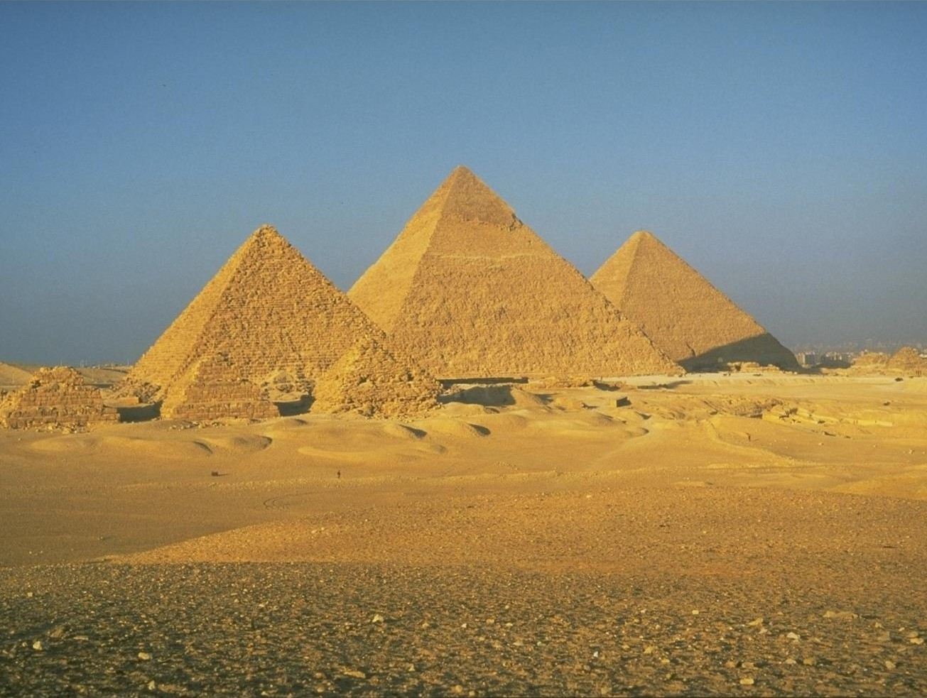
Joseph & the Christ

Slide 5
Slave to Potiphar
Over Potiphar’s house
Prisoner
Over all the prisoners
Over all Egypt

Slide 6
10 brothers
Benjamin is kept home
“You are spies!”

Slide 7
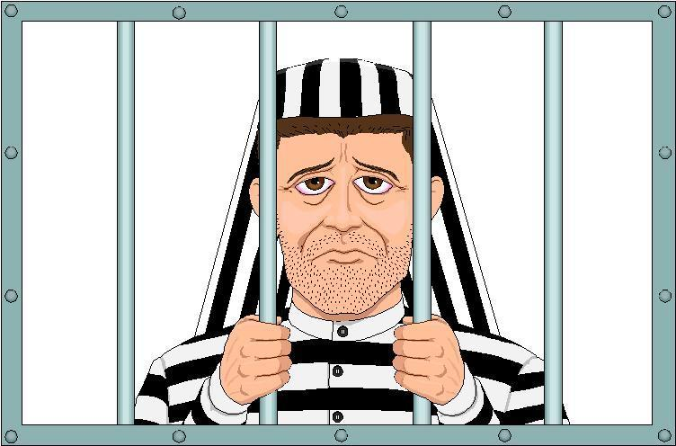
9 brothers
Simeon

Slide 8
10 brothers
Benjamin included
Dinner at Joseph’s house

Slide 9
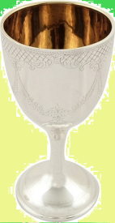

Slide 10
BROTHERS RETURN WITH
Good News
Gifts
Invitation

Slide 11
Jacob & all (75 people) go to live in Egypt

Slide 12
Joseph: A Type of the Christ
Sold by Judah/Judas, one of the 12, for 20/30 pieces of silver
Mt. 26:14-15
Then one of the twelve, who was called Judas Iscariot, went unto the chief priests, and said, “What are ye willing to give me and I will deliver him unto you?” And they weighed unto him thirty pieces of silver.
Gen. 37:26-28
Judah said to his brothers, “…Come and let us sell him…”
so they pulled him up and lifted Joseph out of the pit, and sold him to the Ishmaelites for twenty shekels of silver.

Slide 13
Joseph: A Type of the Christ
He who was “dead” appears to 10 and then to 11
Jesus crucified
Gen. 42:3
ten brothers went down to buy grain from Egypt and saw Joseph.
John 20:19-24
Appeared to ten apostles
Gen. 44:20
"We said to my lord, 'We have an old father and a little child of his old age. Now his brother is dead...’”
Gen. 43:23ff
Joseph dined with eleven

Slide 14
Joseph: A Type of the Christ
He who was “dead” appears to 10 and then to 11
Jesus crucified
John 20:19-24
Appeared to ten apostles
John 20:26ff
Appeared to eleven

Slide 15
Joseph: A Type of the Christ
Mocked by unbelieving brothers
Gen. 37:8
Then his brothers said to him, "Are you actually going to reign over us? Or are you really going to rule over us?" So they hated him even more for his dreams and for his words.
Jn. 7:3-5
His brethren therefore said unto him, “…. If thou doest these things, manifest thyself to the world.” For even his brethren did not believe on him.

Slide 16
Joseph: A Type of the Christ
SENT by his father
Gen. 37:14
Israel said to Joseph, "Are not your brothers pasturing the flock in Shechem? Come, and I will send you to them.”
Jn. 6:38
“I came down from heaven not to do mine own will but the will of him that sent me.”

Slide 17
Joseph: A Type of the Christ
SEEKING his brothers
Gen. 37:16
He said, "I am looking for my brothers; please tell me where they are pasturing the flock.”
Lu. 19:10
“For the son of man came to seek and to save that which was lost.”

Slide 18
Joseph: A Type of the Christ
HATED by those to whom he was sent
Gen. 37:8
So they hated him even more for his dreams and for his words.
Jn. 15:18
“If the world hateth you, ye know that it hath hated me before it hated you.”

Slide 19
Joseph: A Type of the Christ
FALSELY ACCUSED
Gen. 39:17-18
“The Hebrew slave, whom you brought to us, came in to me to make sport of me…”
Mt. 26:59
Now the chief priests and whole council sought false witness against Jesus, that they might put him to death.

Slide 20
Joseph: A Type of the Christ
An INNOCENT MAN with TWO WRONGDOERS
Genesis 40:1
Luke 23:33
…the criminals, one on the right and the other on the left.
Joseph to the Cupbearer
“Remember me”
(Gen. 40:14 “literal” reading from margin)
The Thief to Jesus:
“Remember me”
(Luke 23:42)
the cupbearer and the baker for the king of Egypt offended their lord, the king of Egypt
Gen. 40:15
Luke 23:33
…but this man has done nothing wrong.
I have done nothing that they should have put me into the dungeon

Slide 21
Joseph: A Type of the Christ
A SERVANT EXALTED
Gen. 41:40
You shall be over my house
Hebrews 3:6
…Christ as a Son over His house

Slide 22
Joseph: A Type of the Christ
A SERVANT EXALTED
Gen. 41:41-44
Pharaoh said to Joseph, “See, I have set you over all the land of Egypt.”
Then Pharaoh took off his signet ring from his hand and put it on Joseph's hand, and clothed him in garments of fine linen and put the gold necklace around his neck.
He had him ride in his second chariot; and they proclaimed before him, “Bow the knee!”
And he set him over all the land of Egypt.
Moreover, Pharaoh said to Joseph, "Though I am Pharaoh, yet without your permission no one shall raise his hand or foot in all the land of Egypt."

Slide 23
Joseph: A Type of the Christ
A SERVANT EXALTED
Gen. 41:41-44
Pharaoh said to Joseph, “See, I have set you over all the land of Egypt.”
Then Pharaoh took off his signet ring from his hand and put it on Joseph's hand, and clothed him in garments of fine linen and put the gold necklace around his neck.
He had him ride in his second chariot; and they proclaimed before him, “Bow the knee!”
And he set him over all the land of Egypt.
Moreover, Pharaoh said to Joseph, "Though I am Pharaoh, yet without your permission no one shall raise his hand or foot in all the land of Egypt."
Philippians 2:7-10
Taking the form of a servant… he humbled himself, becoming obedient….
Wherefore also God highly exalted him, and gave unto him the name which is above every name, that in the name of Jesus every knee should bow…

Slide 24
Joseph: A Type of the Christ
Genesis 44:18
…you are
John 5:18
…making Himself equal with God.
equal to Pharaoh

Slide 25
Joseph: A Type of the Christ
Gen. 41:46
Now Joseph was thirty years old when he stood before Pharaoh, king of Egypt.
Luke 3:23
When He began His ministry, Jesus Himself was about thirty years of age

Slide 26
Joseph: A Type of the Christ
He who was “dead” appears to 10 and then to 11

Slide 27
Joseph: A Type of the Christ
He who was “dead” appears to 10 and then to 11
John 20:14
Mary Madalene “knew not that it was Jesus”
Luke 24:16
On the road to Emmaus
Luke 24:37
They thought they saw a spirit
Gen. 42:7-8
⁸ But Joseph had recognized his brothers, although they did not recognize him.

Slide 28
Joseph: A Type of the Christ
He who was “dead” appears to 10 and then to 11
Gen. 45:3
³ And Joseph said unto his brethren, I am Joseph; doth my father yet live? And his brethren could not answer him;
for they were troubled at his presence.
Luke 24:36-38
³⁶ While they were telling these things, He Himself stood in their midst and said to them, “Peace be to you.” ³⁷ But they were startled and frightened and thought that they were seeing a spirit. ³⁸ And He said to them, “Why are you troubled, and why do doubts arise in your hearts?
And he said, “I am your brother Joseph
“See My hands and My feet, that it is I Myself”

Slide 29
Joseph: A Type of the Christ
Gen. 47:23
Then Joseph said to the people, “Behold, I have today bought you and your land for Pharaoh
1 Corinthians 6:19-20
Or do you not know that your body is a temple of the Holy Spirit who is in you, whom you have from God, and that you are not your own? For you have been bought with a price: therefore glorify God in your body.

Slide 30
Joseph: A Type of the Christ
Acts 20:28
…the church of God which He purchased with His own blood.
Gen. 47:23
Then Joseph said to the people, “Behold, I have today bought you and your land for Pharaoh
Revelation 5:9
…for You were slain, and purchased for God with Your blood men from every tribe and tongue and people and nation.

Slide 31
Joseph: A Type of the Christ
Genesis 37
⁵ Then they sat down to eat a meal. And as they raised their eyes and looked, behold, a caravan of Ishmaelites was coming from Gilead, with their camels bearing aromatic gum and balm and myrrh, on their way to bring them down to Egypt. ²⁶ Judah said to his brothers, “What profit is it for us to kill our brother and cover up his blood? ²⁷ Come and let us sell him to the Ishmaelites and not lay our hands on him, for he is our brother, our own flesh.” And his brothers listened to him. ²⁸ Then some Midianite traders passed by, so they pulled him up and lifted Joseph out of the pit, and sold him to the Ishmaelites for twenty shekels of silver. Thus they brought Joseph into Egypt.
³⁶ Meanwhile, the Midianites sold him in Egypt to Potiphar, Pharaoh’s officer, the captain of the bodyguard.
Which is it?
Ishmaelites
Midianites
or
Medanites?
Medanites

Slide 32
Joseph: A Type of the Christ
Genesis 37
⁵ Then they sat down to eat a meal. And as they raised their eyes and looked, behold, a caravan of Ishmaelites was coming from Gilead, with their camels bearing aromatic gum and balm and myrrh, on their way to bring them down to Egypt. ²⁶ Judah said to his brothers, “What profit is it for us to kill our brother and cover up his blood? ²⁷ Come and let us sell him to the Ishmaelites and not lay our hands on him, for he is our brother, our own flesh.” And his brothers listened to him. ²⁸ Then some Midianite traders passed by, so they pulled him up and lifted Joseph out of the pit, and sold him to the Ishmaelites for twenty shekels of silver. Thus they brought Joseph into Egypt.
³⁶ Meanwhile, the Midianites sold him in Egypt to Potiphar, Pharaoh’s officer, the captain of the bodyguard.
Abraham Sarah
Hagar
Keturah
Ishmael
Isaac
Medan
Midian
Medanites

Slide 33
One Explanation
Midianites had kings, and a territory
Numbers 31:8
Ishmaelites were nomads
Genesis 16:12, “wild donkey of a man”
Ishmaelites moved about among Midianites
Names became somewhat interchangeable
Judges 8:5-24, Gideon defeated “Midian,” but the plunder was from “Ishmaelites”
Joseph: A Type of the Christ
Genesis 27
⁵ Then they sat down to eat a meal. And as they raised their eyes and looked, behold, a caravan of Ishmaelites was coming from Gilead, with their camels bearing aromatic gum and balm and myrrh, on their way to bring them down to Egypt. ²⁶ Judah said to his brothers, “What profit is it for us to kill our brother and cover up his blood? ²⁷ Come and let us sell him to the Ishmaelites and not lay our hands on him, for he is our brother, our own flesh.” And his brothers listened to him. ²⁸ Then some Midianite traders passed by, so they pulled him up and lifted Joseph out of the pit, and sold him to the Ishmaelites for twenty shekels of silver. Thus they brought Joseph into Egypt.
³⁶ Meanwhile, the Midianites sold him in Egypt to Potiphar, Pharaoh’s officer, the captain of the bodyguard.
Medanites

Slide 34
Another Explanation
Jewish commentators see a series of transactions…
Joseph: A Type of the Christ
Genesis 37
⁵ Then they sat down to eat a meal. And as they raised their eyes and looked, behold, a caravan of Ishmaelites was coming from Gilead, with their camels bearing aromatic gum and balm and myrrh, on their way to bring them down to Egypt. ²⁶ Judah said to his brothers, “What profit is it for us to kill our brother and cover up his blood? ²⁷ Come and let us sell him to the Ishmaelites and not lay our hands on him, for he is our brother, our own flesh.” And his brothers listened to him. ²⁸ Then some Midianite traders passed by, so they pulled him up and lifted Joseph out of the pit, and sold him to the Ishmaelites for twenty shekels of silver. Thus they brought Joseph into Egypt.
³⁶ Meanwhile, the Midianites sold him in Egypt to Potiphar, Pharaoh’s officer, the captain of the bodyguard.
Medanites

Slide 35
Another Explanation
Jewish commentators see a series of transactions…
Joseph: A Type of the Christ
They saw ISHMAELITES in the area and at Judah’s suggestion
purposed to sell Joseph to them
Judas agreed to sell Jesus to the chief priests
MIDIANITES showed up, pulled Joseph out of the pit, and sold him to the ISHMAELITES
The Mob showed up and took Jesus to the chief priests
Genesis 39:1 says Potiphar “bought him from the ISHMAELITES”
Jesus was delivered to Pilate by the
chief priests

Slide 36
Joseph: A Type of the Christ
Gen. 50:20
And as for you, ye meant evil against me; but God meant it for good, to bring to pass, as it is this day, to save much people alive.

Slide 37
Beloved son
Brothers scoffed that he would rule over them
Sent from the father
“Here I am” -obedient
Sought his brothers
Hated by those to whom he was sent
Brothers conspired against him
They stripped Joseph of his garment
Cast into a pit, later raised
Judah (one of 12) proposed to sell Joseph
Joseph was sold for silver
Was falsely accused, “I have done nothing”
Was condemned with two criminals
One criminal saved
Joseph was put over all Egypt
Prominence 30 years old
“Though I am Pharaoh, yet without your permission no one shall raise his hand or foot in all the land of Egypt.”
They proclaimed before him, “Bow the knee!”
He who was “dead” appeared to ten
…then appeared to eleven
Joseph's brothers did not recognize him
Ate with 12 brothers
“They were dismayed at his presence”
“And he said, ‘I am your brother, Joseph’”
“God sent me before you to preserve life”
“You shall dwell in the land of Goshen, and you shall be near me”
“I have…bought you”
“You have saved our lives…We will be servants”

Slide 38
Forgiveness 2 Words:
cancel a debt (Matthew 6:12, 18:27)
It’s the debt/sin that is forgiven, not the sinner
Extend a favor
Related to the word for “grace”
Associated w/ “kindness & compassion” Col. 3:12-13, Eph. 4:32
Christ toward us, us toward others
Jesus’ Compassionate Forgiveness
Luke 23:34
But it was conditional, Acts 2:38
Joseph’s Compassion
Manifested in forgiveness
But was present before the forgiveness
Forgiveness came with repentance
Two Lessons:
Forgiveness & Repentance
The ability to have Compassion for one who wrongs me

Slide 39
PARALLELS IN AND OF THEMSELVES
ARE NOT PROOF OF INSPIRATION

Slide 40
Details that are necessary only if applicable to Jesus
Moriah
Ladder connecting earth to heaven
Brothers were at Dothan rather than Shechem
Blood on the doorposts
Language more appropriate to Jesus
“only son”
“pierced my hands and feet”
“cast lots for my clothing”
Prospective identification as a type
“My Servant David will be King”
“In the mount of the LORD it will be provided”
Pervasiveness

Slide 41
GENESIS
Flood
Melchizedek
Ishmael & Isaac, Hagar and Sarah
Sacrificing Isaac
Jacob’s Dream
Joseph, a Servant Exalted
EXODUS
Saved from Death by the blood of the Lamb
Saved from Slavery Coming Through the Water
The Tabernacle
Pervasiveness

