Slide 1
The Destruction of Sodom and Gomorrah
(and of Admah and Zeboiim)
Sunday
February 12, 2017
11:00 am
Jeff Smelser at Exton

Slide 2
The Destruction of Sodom and Gomorrah
(and of Admah and Zeboiim)
Hosea 11
⁸ How can I give you up, O Ephraim? How can I surrender you, O Israel? How can I make you like Admah? How can I treat you like Zeboiim? My heart is turned over within Me, All My compassions are kindled. ⁹ I will not execute My fierce anger; I will not destroy Ephraim again. For I am God and not man, the Holy One in your midst,
And I will not come in wrath.

Slide 3
The Destruction of Sodom and Gomorrah
(and of Admah and Zeboiim)
Hosea 11
⁸ How can I give you up, O Ephraim? How can I surrender you, O Israel? How can I make you like Admah? How can I treat you like Zeboiim? My heart is turned over within Me, All My compassions are kindled. ⁹ I will not execute My fierce anger; I will not destroy Ephraim again. For I am God and not man, the Holy One in your midst,
And I will not come in wrath.

Slide 4
The Destruction of Sodom and Gomorrah
(and of Admah and Zeboiim)
4 Kings vs. 5 Kings
Amraphel of Shinar
Arioch of Ellasar
Chedorlaomer of Elam
Tidal of Goiim
Bera of Sodom
Birsha of Gomorrah
Shinab of Admah
Shemeber of Zeboiim
The King of Bela (i.e., Zoar)

Slide 5
The Location of Sodom and Gomorrah
Genesis 13
¹⁰ Lot lifted up his eyes and saw all the valley of the Jordan, that it was well watered everywhere
¹¹ So Lot chose for himself all the valley of the Jordan
¹² Abram settled in the land of Canaan, while Lot settled in the cities of the valley, and moved his tents as far as Sodom.

Slide 6
The Location of Sodom and Gomorrah
4 Kings vs. 5 Kings
Amraphel of Shinar
Arioch of Ellasar
Chedorlaomer of Elam
Tidal of Goiim
Bera of Sodom
Birsha of Gomorrah
Shinab of Admah
Shemeber of Zeboiim
The King of Bela (i.e., Zoar)
vs.
Genesis 14
³ All these came as allies to the valley of Siddim (that is, the Salt Sea).

Slide 7
The Location of Sodom and Gomorrah
Zoar
survived when Sodom was destroyed
Genesis 19
²⁰ “now behold, this town is near enough to flee to, and it is small. Please, let me escape there (is it not small?) that my life may be saved.” ²¹ He said to him, “Behold, I grant you this request also, not to overthrow the town of which you have spoken. ²² Hurry, escape there, for I cannot do anything until you arrive there.” Therefore the name of the town was called Zoar.

Slide 8
The Location of Sodom and Gomorrah
Location of Zoar
Deuteronomy 34 (NASB)
¹ Now Moses went up from the plains of Moab to Mount Nebo, to the top of Pisgah, which is opposite Jericho. And the Lord showed him all the land, Gilead as far as Dan, ² and all Naphtali and the land of Ephraim and Manasseh, and all the land of Judah as far as the western sea, ³ and the Negev and the plain in the valley of Jericho, the city of palm trees, as far as Zoar.
Moab

Slide 9
The Location of Sodom and Gomorrah
Location of Zoar
Deuteronomy 34 (NASB)
¹ Now Moses went up from the plains of Moab to Mount Nebo, to the top of Pisgah, which is opposite Jericho. And the Lord showed him all the land, Gilead as far as Dan, ² and all Naphtali and the land of Ephraim and Manasseh, and all the land of Judah as far as the western sea, ³ and the Negev and the plain in the valley of Jericho, the city of palm trees, as far as Zoar.
Nebo?
Moab

Slide 10
The Location of Sodom and Gomorrah
Location of Zoar
Deuteronomy 34 (NASB)
¹ Now Moses went up from the plains of Moab to Mount Nebo, to the top of Pisgah, which is opposite Jericho. And the Lord showed him all the land, Gilead as far as Dan, ² and all Naphtali and the land of Ephraim and Manasseh, and all the land of Judah as far as the western sea, ³ and the Negev and the plain in the valley of Jericho, the city of palm trees, as far as Zoar.
Nebo?
Moab

Slide 11
The Location of Sodom and Gomorrah
Location of Zoar
aka, Dan
Deuteronomy 34 (NASB)
¹ Now Moses went up from the plains of Moab to Mount Nebo, to the top of Pisgah, which is opposite Jericho. And the Lord showed him all the land, Gilead as far as Dan, ² and all Naphtali and the land of Ephraim and Manasseh, and all the land of Judah as far as the western sea, ³ and the Negev and the plain in the valley of Jericho, the city of palm trees, as far as Zoar.
Gilead
Nebo?
Moab

Slide 12
The Location of Sodom and Gomorrah
Location of Zoar
aka, Dan
Deuteronomy 34 (NASB)
¹ Now Moses went up from the plains of Moab to Mount Nebo, to the top of Pisgah, which is opposite Jericho. And the Lord showed him all the land, Gilead as far as Dan, ² and all Naphtali and the land of Ephraim and Manasseh, and all the land of Judah as far as the western sea, ³ and the Negev and the plain in the valley of Jericho, the city of palm trees, as far as Zoar.
Gilead
Western Sea
Nebo?
Moab

Slide 13
The Location of Sodom and Gomorrah
Location of Zoar
aka, Dan
Deuteronomy 34 (NASB)
¹ Now Moses went up from the plains of Moab to Mount Nebo, to the top of Pisgah, which is opposite Jericho. And the Lord showed him all the land, Gilead as far as Dan, ² and all Naphtali and the land of Ephraim and Manasseh, and all the land of Judah as far as the western sea, ³ and the Negev and the plain in the valley of Jericho, the city of palm trees, as far as Zoar.
Gilead
Western Sea
Nebo?
NEGEV
Moab

Slide 14
The Location of Sodom and Gomorrah
Location of Zoar
aka, Dan
Deuteronomy 34 (NASB)
¹ Now Moses went up from the plains of Moab to Mount Nebo, to the top of Pisgah, which is opposite Jericho. And the Lord showed him all the land, Gilead as far as Dan, ² and all Naphtali and the land of Ephraim and Manasseh, and all the land of Judah as far as the western sea, ³ and the Negev and the plain in the valley of Jericho, the city of palm trees, as far as Zoar.
Gilead
Western Sea
Nebo?
NEGEV
Moab

Slide 15
The Location of Sodom and Gomorrah
Location of Zoar
aka, Dan
Deuteronomy 34 (NASB)
¹ Now Moses went up from the plains of Moab to Mount Nebo, to the top of Pisgah, which is opposite Jericho. And the Lord showed him all the land, Gilead as far as Dan, ² and all Naphtali and the land of Ephraim and Manasseh, and all the land of Judah as far as the western sea, ³ and the Negev and the plain in the valley of Jericho, the city of palm trees, as far as Zoar.
Gilead
Western Sea
Nebo?
NEGEV
Moab

Slide 16
The Location of Sodom and Gomorrah
Location of Zoar
aka, Dan
Jeremiah 48 (NASB)
³⁴ From the outcry at Heshbon even to Elealeh, even to Jahaz they have raised their voice, from Zoar even to Horonaim and to Eglath-shelishiyah; for even the waters of Nimrim will become desolate. ³⁵ I will make an end of Moab,” declares the Lord
Gilead
Western Sea
Nebo?
Isaiah 15:5 (NASB)
My heart cries out for Moab; His fugitives are as far as Zoar and Eglath-shelishiyah
NEGEV
Moab

Slide 17
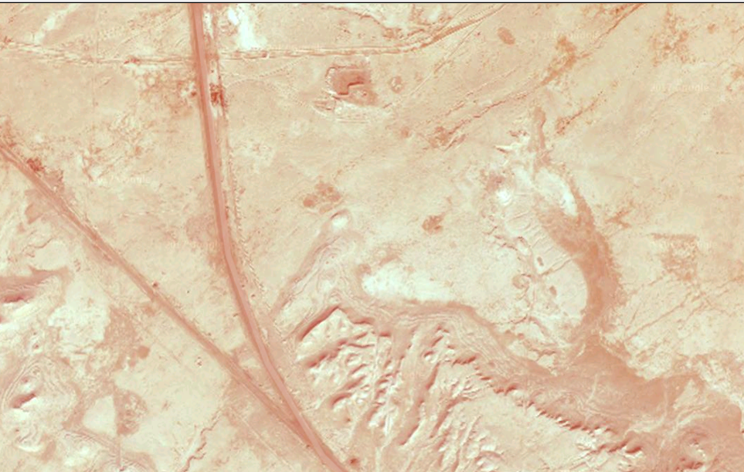
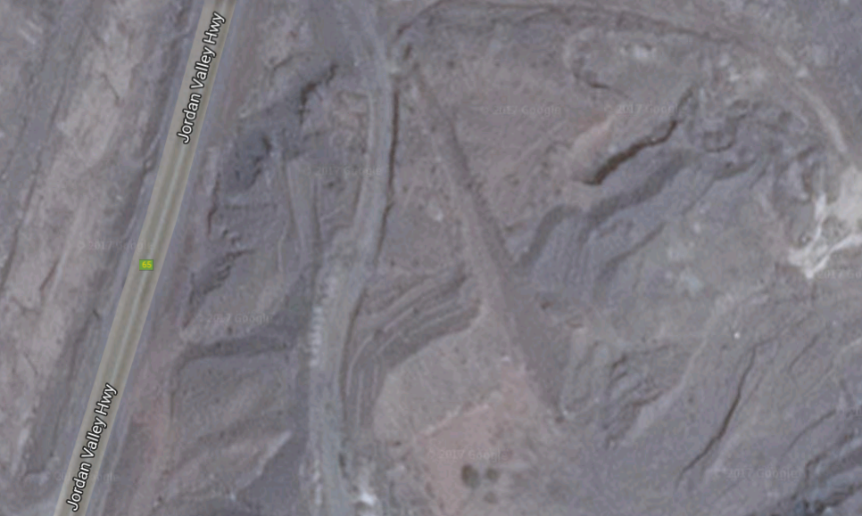
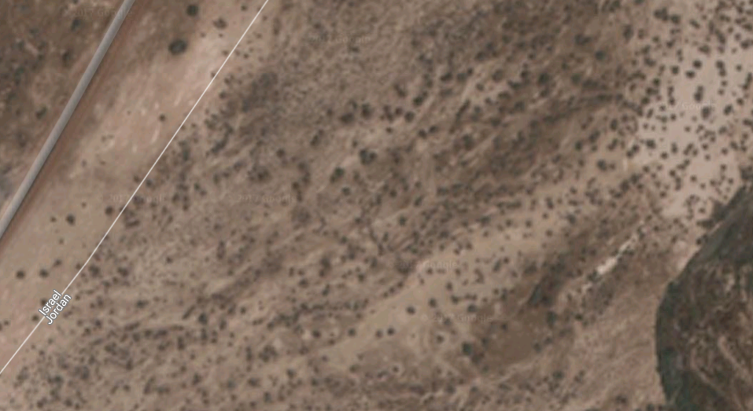
The Location of Sodom and Gomorrah
Location of Zoar
aka, Dan
Gilead
It seems Sodom was in this area (some suppose perhaps even in a location now under water)
Western Sea
Nebo?
Extra-Biblical sources from the 1st century and later
NEGEV
Moab

Slide 18
The Location of Sodom and Gomorrah
Location of Zoar
aka, Dan
Genesis 13
¹⁰ Lot lifted up his eyes and saw all the valley of the Jordan, that it was well watered everywhere
—this was before the Lord destroyed Sodom and Gomorrah—
like the garden of the Lord, like the land of Egypt as you go to Zoar.
Gilead
Western Sea
Nebo?
NEGEV
Moab

Slide 19
The Destruction of Sodom and Gomorrah
Bera of Sodom
Birsha of Gomorrah
Shinab of Admah
Shemeber of Zeboiim
The King of Bela (i.e., Zoar)
Deuteronomy 29
²³ ‘All its land is brimstone and salt, a burning waste, unsown and unproductive, and no grass grows in it, like the overthrow of Sodom and Gomorrah, Admah and Zeboiim, which the Lord overthrew in His anger and in His wrath.’
refers to Genesis 14, or 19?
because Zoar is excluded

Slide 20
The Destruction of Sodom and Gomorrah
Bera of Sodom
Birsha of Gomorrah
Shinab of Admah
Shemeber of Zeboiim
The King of Bela (i.e., Zoar)
Deuteronomy 29
²³ ‘All its land is brimstone and salt, a burning waste, unsown and unproductive, and no grass grows in it, like the overthrow of Sodom and Gomorrah, Admah and Zeboiim, which the Lord overthrew in His anger and in His wrath.’
refers to Genesis 19
because Zoar is excluded

Slide 21
The Destruction of Sodom and Gomorrah
Jude ⁷ just as Sodom and Gomorrah and the cities around them, since they in the same way as these indulged in gross immorality and went after strange flesh, are exhibited as an example in undergoing the punishment of eternal fire.
Deuteronomy 29
²³ ‘All its land is brimstone and salt, a burning waste, unsown and unproductive, and no grass grows in it, like the overthrow of Sodom and Gomorrah, Admah and Zeboiim, which the Lord overthrew in His anger and in His wrath.’
refers to Genesis 19
because Zoar is excluded

Slide 22
The Destruction of Sodom and Gomorrah
Jude ⁷ just as Sodom and Gomorrah and the cities around them, since they in the same way as these indulged in gross immorality and went after strange flesh, are exhibited as an example in undergoing the punishment of eternal fire.
Deuteronomy 29
²³ ‘All its land is brimstone and salt, a burning waste, unsown and unproductive, and no grass grows in it, like the overthrow of Sodom and Gomorrah, Admah and Zeboiim, which the Lord overthrew in His anger and in His wrath.’

Slide 23
The Destruction of Sodom and Gomorrah
(and of Admah and Zeboiim)
Hosea 11
⁸ How can I give you up, O Ephraim? How can I surrender you, O Israel? How can I make you like Admah? How can I treat you like Zeboiim? My heart is turned over within Me, All My compassions are kindled. ⁹ I will not execute My fierce anger; I will not destroy Ephraim again. For I am God and not man, the Holy One in your midst,
And I will not come in wrath.

Slide 24
The Destruction of Sodom and Gomorrah
(and of Admah and Zeboiim)
RETURN
What would happen to Ephraim?
Which one serves as a model for the future day of Judgement?

Slide 25
The Destruction of Sodom and Gomorrah
(and of Admah and Zeboiim)
RETURN
Jude ⁵ Now I desire to remind you, though you know all things once for all, that the Lord, after saving a people out of the land of Egypt, subsequently destroyed those who did not believe. ⁶ And angels who did not keep their own domain, but abandoned their proper abode, He has kept in eternal bonds under darkness for the judgment of the great day, ⁷ just as Sodom and Gomorrah and the cities around them, since they in the same way as these indulged in gross immorality and went after strange flesh, are exhibited as an example in undergoing the punishment of eternal fire.

Slide 26
The Destruction of Sodom and Gomorrah
(and of Admah and Zeboiim)
RETURN
Jude ⁵ Now I desire to remind you, though you know all things once for all, that the Lord, after saving a people out of the land of Egypt, subsequently destroyed those who did not believe. ⁶ And angels who did not keep their own domain, but abandoned their proper abode, He has kept in eternal bonds under darkness for the judgment of the great day, ⁷ just as Sodom and Gomorrah and the cities around them, since they in the same way as these indulged in gross immorality and went after strange flesh, are exhibited as an example in undergoing the punishment of eternal fire.
1

Slide 27
The Destruction of Sodom and Gomorrah
(and of Admah and Zeboiim)
RETURN
Jude ⁵ Now I desire to remind you, though you know all things once for all, that the Lord, after saving a people out of the land of Egypt, subsequently destroyed those who did not believe. ⁶ And angels who did not keep their own domain, but abandoned their proper abode, He has kept in eternal bonds under darkness for the judgment of the great day, ⁷ just as Sodom and Gomorrah and the cities around them, since they in the same way as these indulged in gross immorality and went after strange flesh, are exhibited as an example in undergoing the punishment of eternal fire.
1
2

Slide 28
The Destruction of Sodom and Gomorrah
(and of Admah and Zeboiim)
RETURN
Jude ⁵ Now I desire to remind you, though you know all things once for all, that the Lord, after saving a people out of the land of Egypt, subsequently destroyed those who did not believe. ⁶ And angels who did not keep their own domain, but abandoned their proper abode, He has kept in eternal bonds under darkness for the judgment of the great day, ⁷ just as Sodom and Gomorrah and the cities around them, since they in the same way as these indulged in gross immorality and went after strange flesh, are exhibited as an example in undergoing the punishment of eternal fire.
1
2
3

Slide 29
JUDGMENT
The Destruction of Sodom and Gomorrah
(and of Admah and Zeboiim)
RETURN
2 Thessalonians 1 ⁶ For after all it is only just for God to repay with affliction those who afflict you, ⁷ and to give relief to you who are afflicted and to us as well when the Lord Jesus will be revealed from heaven with His mighty angels in flaming fire, ⁸ dealing out retribution to those who do not know God and to those who do not obey the gospel of our Lord Jesus. ⁹ These will pay the penalty of eternal destruction, away from the presence of the Lord and from the glory of His power, ¹⁰ when He comes to be glorified in His saints on that day, and to be marveled at among all who have believed—for our testimony to you was believed.

Slide 30
The Destruction of Sodom and Gomorrah
(and of Admah and Zeboiim)
RETURN
2 Thessalonians 1 ⁶ For after all it is only just for God to repay with affliction those who afflict you, ⁷ and to give relief to you who are afflicted and to us as well when the Lord Jesus will be revealed from heaven with His mighty angels in flaming fire, ⁸ dealing out retribution to those who do not know God and to those who do not obey the gospel of our Lord Jesus. ⁹ These will pay the penalty of eternal destruction, away from the presence of the Lord and from the glory of His power, ¹⁰ when He comes to be glorified in His saints on that day, and to be marveled at among all who have believed—for our testimony to you was believed.

Slide 31
The Destruction of Sodom and Gomorrah
(and of Admah and Zeboiim)
RETURN
No purgatory,
No short-term punishment,
No 2nd chance

Slide 32
The Day of Judgment
Hebrews 10
²⁶ For if we go on sinning willfully after receiving the knowledge of the truth, there no longer remains a sacrifice for sins, ²⁷ but a terrifying expectation of judgment and the fury of a fire which will consume the adversaries.
²⁸ Anyone who has set aside the Law of Moses dies without mercy on the testimony of two or three witnesses.
²⁹ How much severer punishment do you think he will deserve who has trampled under foot the Son of God, and has regarded as unclean the blood of the covenant by which he was sanctified, and has insulted the Spirit of grace?
³⁰ For we know Him who said, “Vengeance is Mine, I will repay.” And again, “The Lord will judge His people.” ³¹ It is a terrifying thing to fall into the hands of the living God.

Slide 33
“Saved For, not Because of Good Works”
Ephesians 2
⁸ For by grace you have been saved through faith; and that not of yourselves, it is the gift of God; ⁹ not as a result of works, so that no one may boast. ¹⁰ For we are His workmanship, created in Christ Jesus for good works, which God prepared beforehand so that we would walk in them.

Slide 34
“Saved For, not Because of Good Works”
Ephesians 2
⁸ For by grace you have been saved through faith; and that not of yourselves, it is the gift of God; ⁹ not as a result of works, so that no one may boast. ¹⁰ For we are His workmanship, created in Christ Jesus for good works, which God prepared beforehand so that we would walk in them.
Hebrews 6
⁷ For ground that drinks the rain which often falls on it and brings forth vegetation useful to those for whose sake it is also tilled, receives a blessing from God; ⁸ but if it yields thorns and thistles, it is worthless and close to being cursed, and it ends up being burned.

Slide 35
“Saved For, not Because of Good Works”
Ephesians 2
⁸ For by grace you have been saved through faith; and that not of yourselves, it is the gift of God; ⁹ not as a result of works, so that no one may boast. ¹⁰ For we are His workmanship, created in Christ Jesus for good works, which God prepared beforehand so that we would walk in them.
Hebrews 6
⁷ For ground that drinks the rain which often falls on it and brings forth vegetation useful to those for whose sake it is also tilled, receives a blessing from God; ⁸ but if it yields thorns and thistles, it is worthless and close to being cursed, and it ends up being burned.

Slide 36
John 15
“I am the true vine, and My Father is the vinedresser. ² Every branch in Me that does not bear fruit, He takes away; and every branch that bears fruit, He prunes it so that it may bear more fruit.
³ You are already clean because of the word which I have spoken to you. ⁴ Abide in Me, and I in you. As the branch cannot bear fruit of itself unless it abides in the vine, so neither can you unless you abide in Me.
⁵ I am the vine, you are the branches; he who abides in Me and I in him, he bears much fruit, for apart from Me you can do nothing. ⁶ If anyone does not abide in Me, he is thrown away as a branch and dries up; and they gather them, and cast them into the fire and they are burned.

Slide 37
The Destruction of Sodom and Gomorrah
(and of Admah and Zeboiim)
Sunday
February 12, 2017
11:00 am
Jeff Smelser at Exton

