Slide 1
Introduction to the
Psalms
ETDS • April 18, 2022
Unless otherwise indicated, all Scripture quotations are from The ESV® Bible (The Holy Bible, English Standard Version®),
copyright © 2001 by Crossway, a publishing ministry of Good News Publishers. Used by permission. All rights reserved.

Slide 2
The Value of the Psalms
Biblical knowledge
Part of inspired Scripture (Lk 24:44; Ac 1:16; 4:25)
Even the cursing Psalms (Ps 109:8 → Ac 1:16)
Theology—God’s Character
A message to God and from God (1 Chr 25:1)
Balance in the Wisdom Literature

Slide 3
The Wisdom Literature
Job
Psalms
Lamentations
Proverbs
Ecclesiastes
Principles for Wise, Righteous Living
Raw Observations about Life
Tension of Trusting God
An evil man is ensnared by the transgression of his lips, but the righteous escapes from trouble.
- Prov 12:13
Behold, these are the wicked; always at ease, they increase in riches. All in vain have I kept my heart clean and washed my hands in innocence. For all the day long I have been stricken and rebuked every morning. - Ps 73:12-13
Again I saw that under the sun the race is not to the swift, nor the battle to the strong… but time and chance happen to them all. - Ecc 9:11

Slide 4
The Value of the Psalms
Biblical knowledge
Part of inspired Scripture (Lk 24:44; Ac 1:16; 4:25)
Even the cursing Psalms (Ps 109:8 → Ac 1:16)
Theology—God’s Character
A message to God and from God (1 Chr 25:1)
Balance in the Wisdom Literature
Biblical History—Life of David, Exile (Ps 18; Ps 137, 126)

Slide 5
David in 1-2 Samuel & Psalms
1 Sam 19:11-17
1 Sam 21:10–22:1
1 Sam 22:1 (24:1-3)
1 Sam 22:6-23
1 S 23:14-15; 2 S 15-17
1 Sam 23:19; 26:1
2 Sam 8:1-14
2 Sam 11-12
2 Sam 15-17
2 Sam 15:31
2 Sam 22
?
David’s house surrounded
David seized by Achish
David in cave
Doeg the Edomite
Desert of Judah
David betrayed by Ziphites
Victory over several enemies
David’s sin with Bathsheba
Absalom’s revolt
Ahithophel’s treachery
Victory over all enemies Concerning Cush, a Benjamite
Ps 59
Ps 34, 56
Ps 57, 142
Ps 52
Ps 63
Ps 54
Ps 60
Ps 51, (32?)
Ps 3
(Ps 55, 41?)
Ps 18
Ps 7

Slide 6
The Value of the Psalms
Biblical knowledge
Part of inspired Scripture (Lk 24:44; Ac 1:16; 4:25)
Even the cursing Psalms (Ps 109:8 → Ac 1:16)
Theology—God’s Character
A message to God and from God (1 Chr 25:1)
Balance in the Wisdom Literature
Biblical History—Life of David, Exile (Ps 18; Ps 137, 126)
New Testament Connections (Most Quoted: 93+ times)

Slide 7
The Value of the Psalms
Personal devotion
Familiar and foreign - Historically, Culturally, Theologically
Intentionally ambiguous - Designed for personal application

Slide 8
Ambiguity for Personal Application
Psalm 3
Title: David
Text: Ambiguous

Slide 9
The Value of the Psalms
Personal devotion
Familiar and foreign - Historically, Culturally, Theologically
Intentionally ambiguous - Designed for personal application
Public and private worship
Emotional range of spiritual living
Honesty in prayer
Express the heart & lead the heart

Slide 10
Express
the Heart
Fear
Guide
the Heart
Hope
Joy
3
27
98
Regret
Anger
51
GOD
55
Peace
23
45
Love
88
22
Despair
Doubt
8
34
Wonder
38
Gratitude
Grief

Slide 11
The Value of the Psalms
Personal devotion
Familiar and foreign - Historically, Culturally, Theologically
Intentionally ambiguous - Designed for personal application
Public and private worship
Emotional range of spiritual living
Honesty in prayer
Express the heart & lead the heart
Use in New Covenant worship (Eph 5:19; Col 3:16)
Pendulum swings of Psalm usage in English hymnody

Slide 12
Ancient Hebrew Poetry
About 1/3 of the Old Testament is poetry
Sometimes challenging to distinguish, especially in Prophets
No meter (as far as we can tell)
Primary characteristic: Parallelism
Connecting 2-4 lines with similar parallel elements
Synonymous parallelism
A ≠ B - The lines cannot mean the same thing
A = B - The lines mean exactly the same thing
A, what’s more B - The lines compliment & enhance
Why do the nations rage and the peoples plot in vain? (2:1)

Slide 13
Ancient Hebrew Poetry
About 1/3 of the OT is poetry!
Sometimes challenging to distinguish, especially in Prophets
No meter (as far as we can tell)
Primary characteristic: Parallelism
Connecting 2-4 lines with similar parallel elements
Synonymous parallelism
Antithetic parallelism
The wicked borrows but does not buy back,
but the righteous is generous and gives; (37:21)

Slide 14
Ancient Hebrew Poetry
About 1/3 of the OT is poetry!
Sometimes challenging to distinguish, especially in Prophets
No meter (as far as we can tell)
Primary characteristic: Parallelism
Connecting 2-4 lines with similar parallel elements
Synonymous parallelism
Antithetic parallelism
Ellipsis: a word is omitted (usually verb), does “double duty”
Judah became his sanctuary, Israel (…) his dominion. (114:2)

Slide 15
Ancient Hebrew Poetry
Imagery
Simile & Metaphor
Personification
Hyperbole (Psalm 51:5 // 22:9)
Structure
Inclusio (Psalm 8:1,9) (Psalm 146-150: Hallelu-YAH!)
Chiasm / Symmetry (Psalm 1:6; Psalm 2)
Acrostic (22 Hebrew Letters)
Psalm 119, 9-10 (together), 25, 34, 37, 111, 112, 145
Other acrostics: Prov 31:10-31; Lam 1–4

Slide 16
Terms in Psalms
Terms of unknown meaning:
Selah, Higgaion, Maskil, Miktam, Shiggaion, “According to The Sheminith” etc…
Likely musical terms, notes for accompaniment
“To the Choirmaster” (55x) / “To Jeduthun” (3x)
Sheol - or “hades” (or “hell” KJV) - the realm of all the dead, both righteous and wicked (15x in Psalms)
Abaddon - place of destruction/ruin (Ps 88:11)

Slide 17
The Contents of the Psalter
Title of Book:
Psalms (Greek psalmos, translating Heb mizmor, “song”)
Hebrew title: Tellihim, “Praises”
150 Hebrew Poems

Slide 18
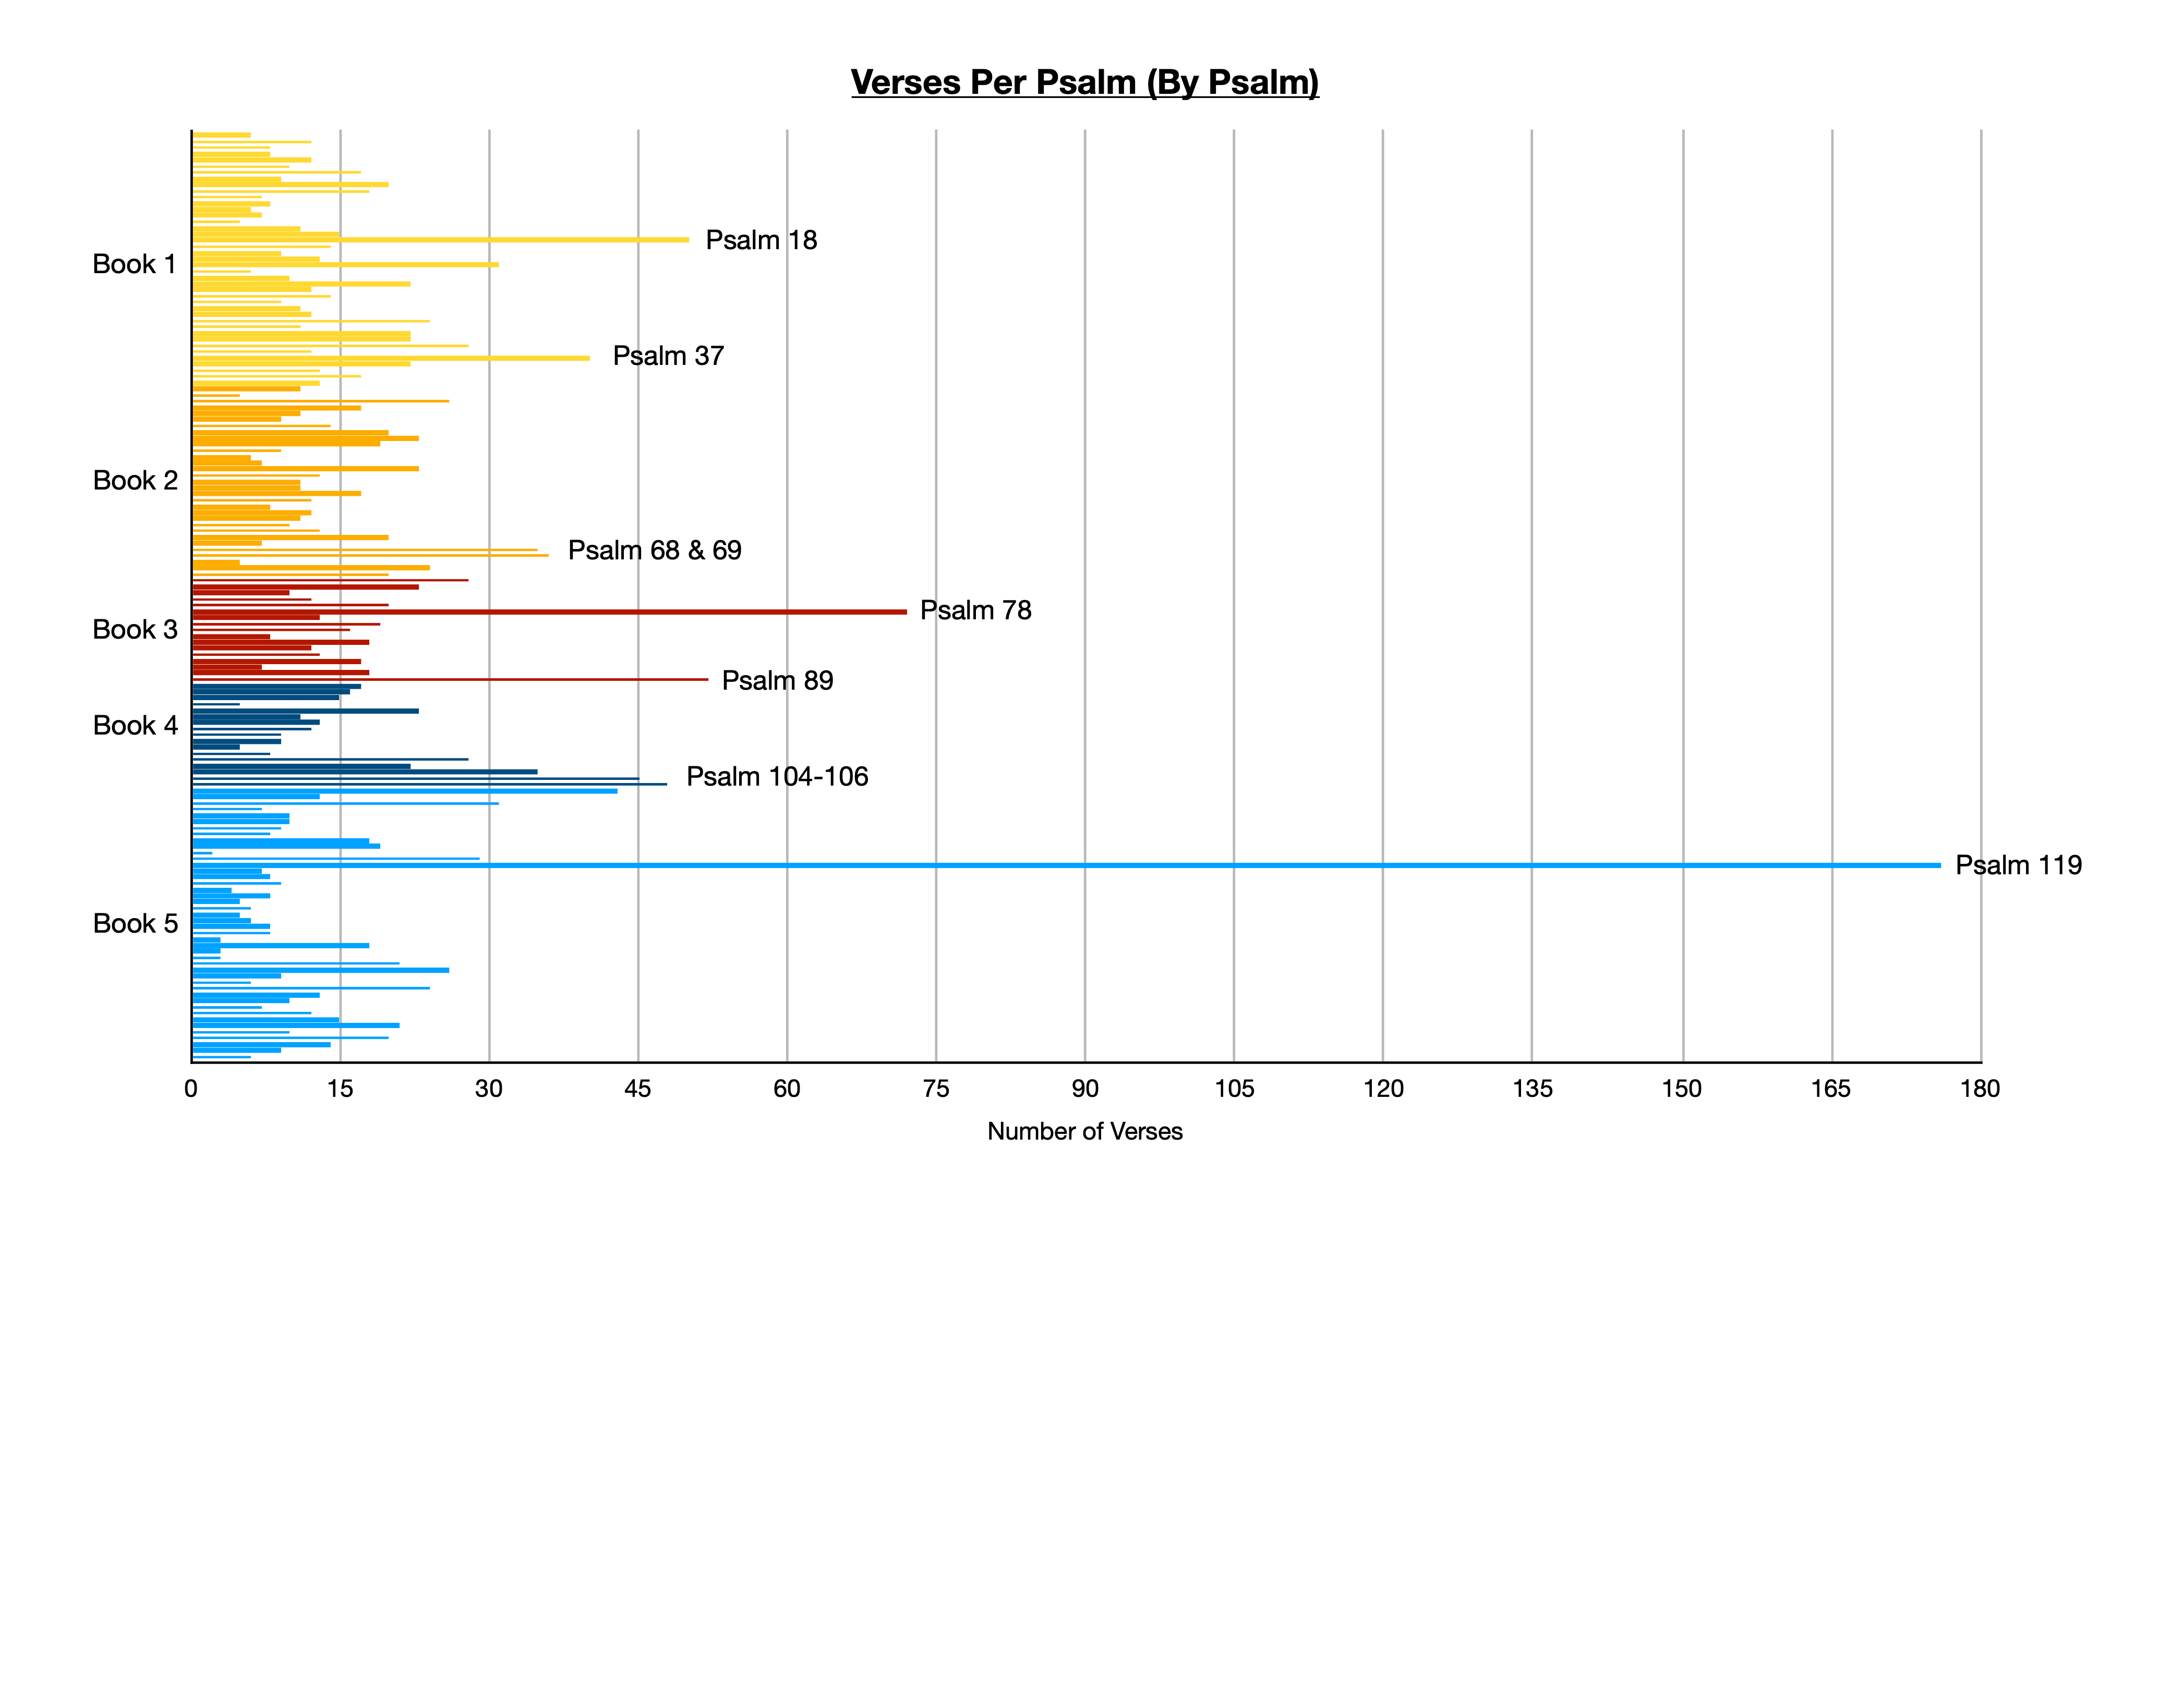

Slide 19
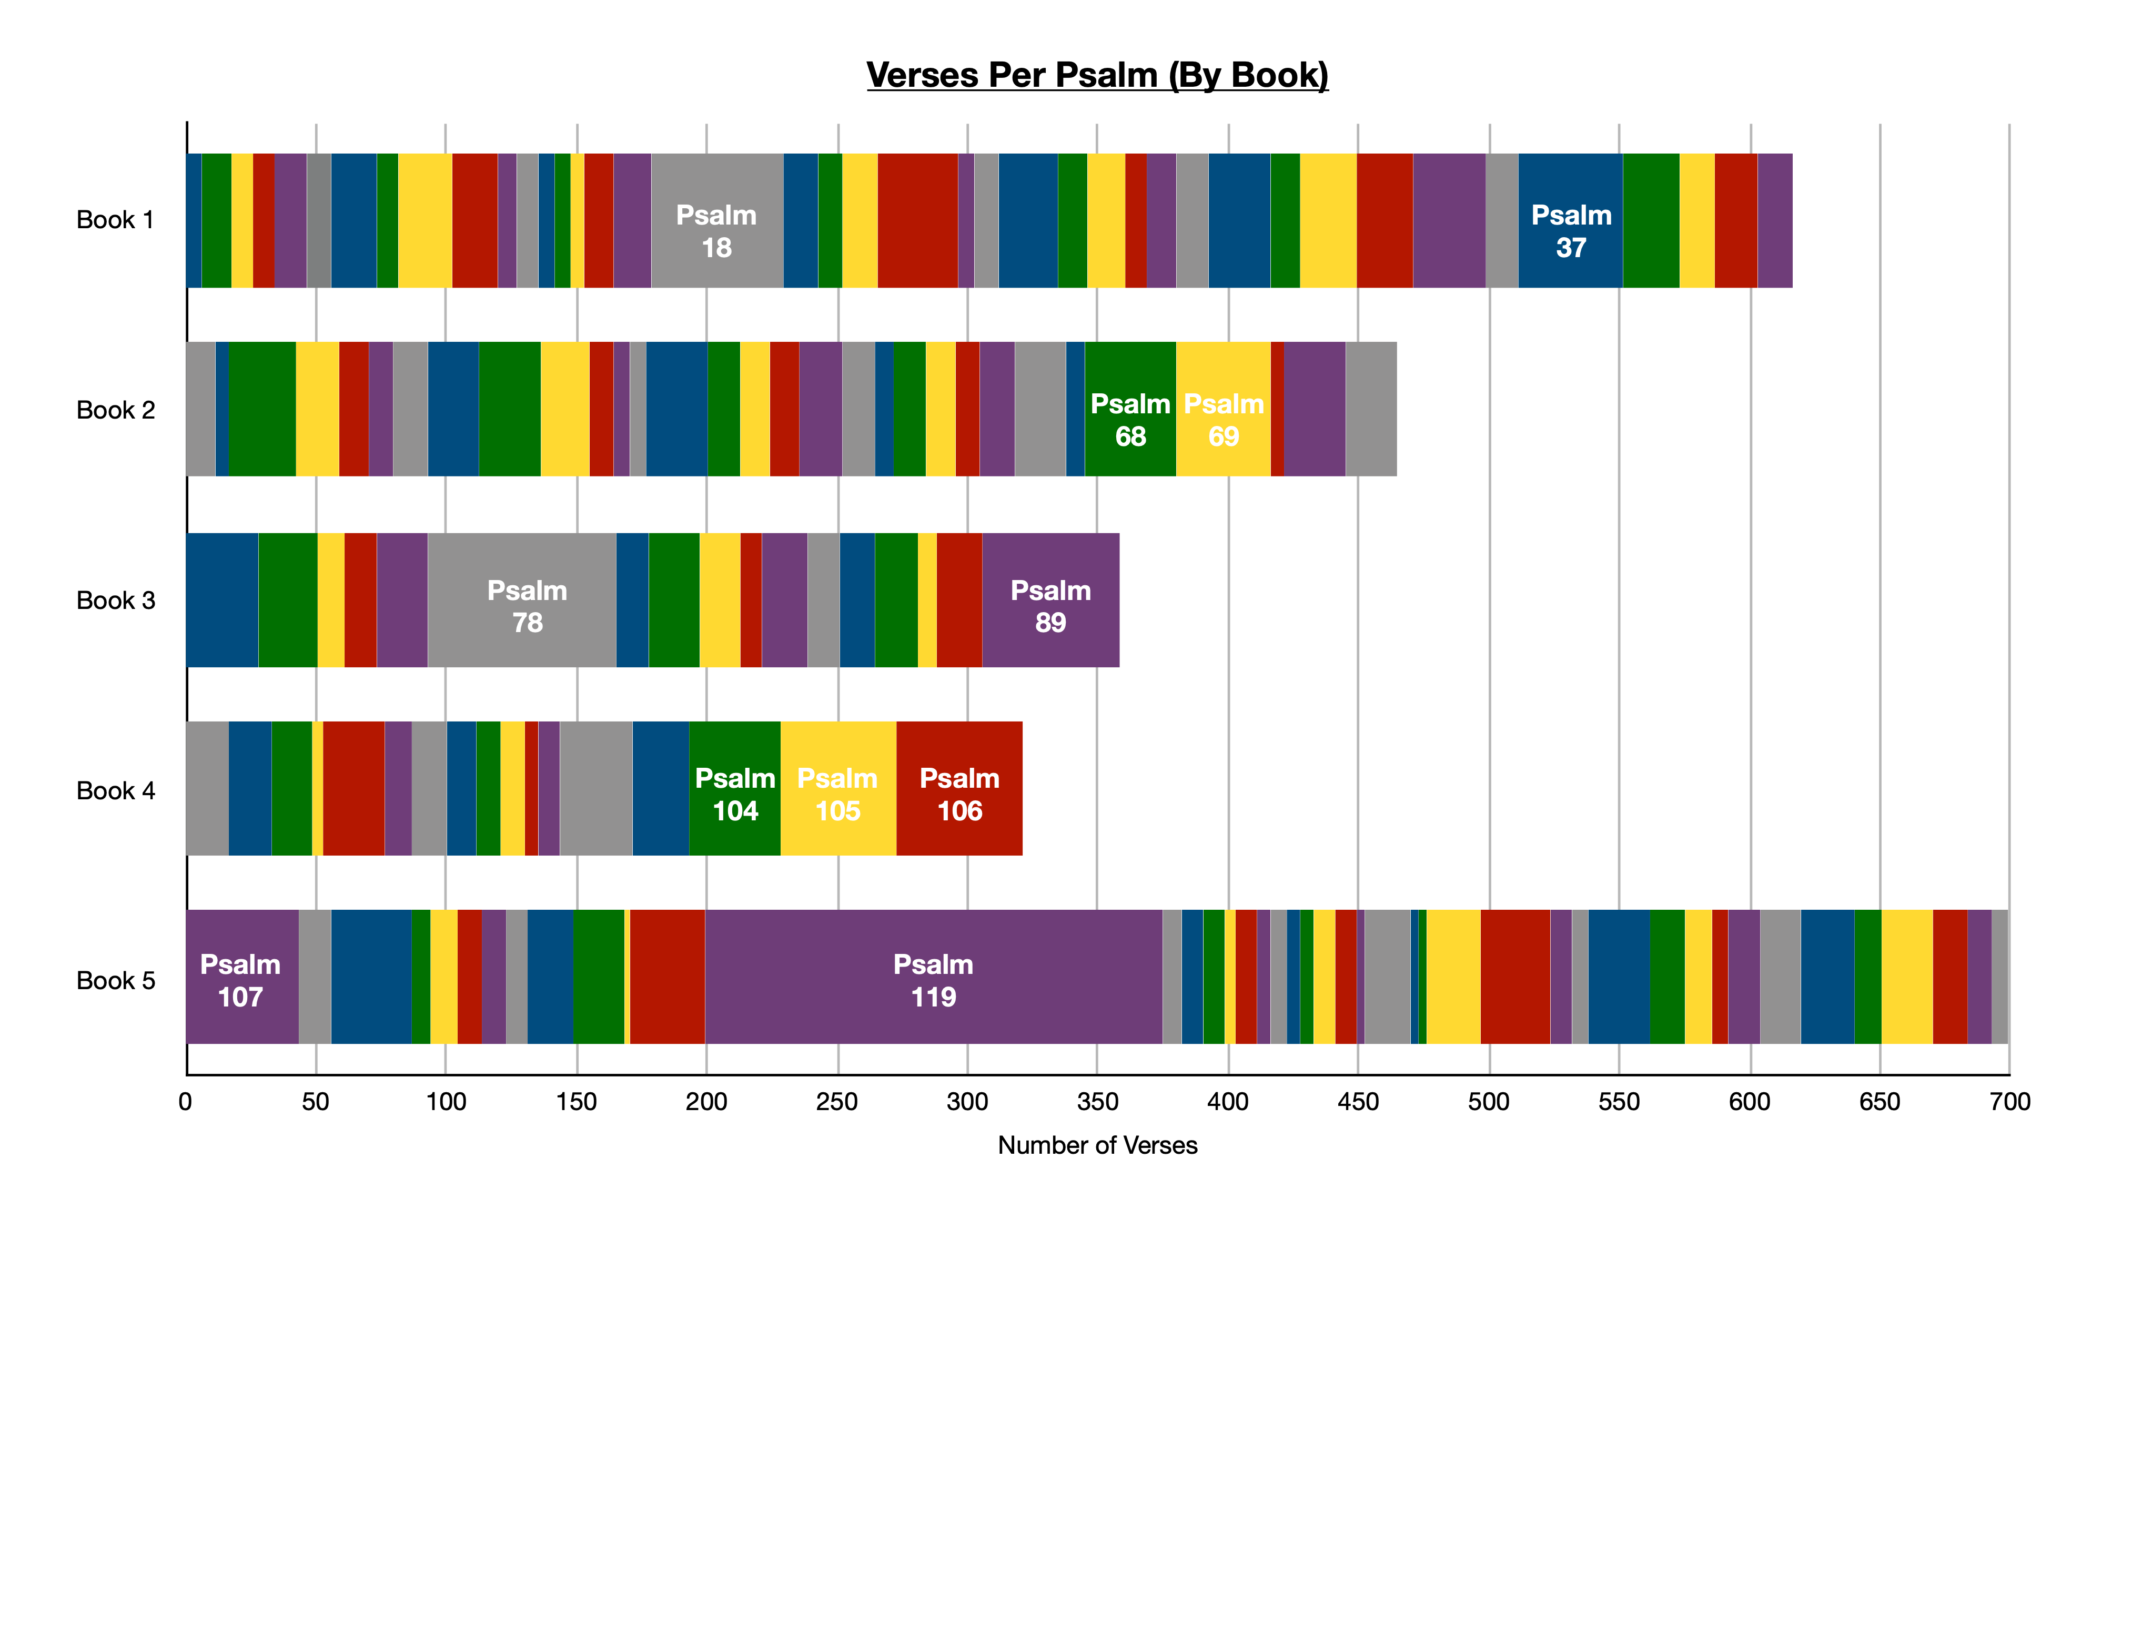

Slide 20
The Contents of the Psalter
Title:
Psalms (Greek psalmos, translating Heb mizmor, “song”)
Hebrew title: Tellihim, “Praises”
150 Hebrew Poems
Songs & Prayers (some both: Ps 4, 18, 42, 88, 142)
Over 2/3 address God directly (prayer)
Not chapters, but individual poems
Ps 9-10 & Ps 42-43 possibly originally one psalm each
Numbering differs in the Septuagint
Ps 9-10 & 114-115 combined; Ps 116 & 147 divided

Slide 21
The Contents of the Psalter
Titles & Authorship
116 Psalms have a title/superscription
Possibly added after composition, but very early on
Editorial processes for other books (e.g. Deut 34)
Authorship: “Of David… Of Asaph… etc.”
Hebrew prefix using lamed has broad semantic range
Of David or By David (indicating authorship)
Concerning David
In the Tradition of David
For David(’s use)
Dedicated to David

Slide 22
The Contents of the Psalter
Criticisms concerning authorship:
Anachronistic references to the temple (5:7, etc.)
Ps 54:3 - “strangers” referring to Saul
Ps 59:6 - “all the nations” referring to Saul’s troops
Content of the Psalm seems to fit another time period
Ex: Ps 74 - Asaph in title; Content sounds like exile
Support concerning authorship:
Ps 18 almost identical to 2 Sam 22 (including title)
Psalms attributed to David in NT: 2,16,32,69,95,109,110
The point of quotation often depends on authorship
“Of…” likely authorship, unless textual reason otherwise

Slide 23
The Contents of the Psalter
Authors:
David (73 Psalms, +2 from NT - Ps 2 & 95)
Fits well the portrait of David as musician in OT
Sons of Korah (11 Psalms)
Same as Korah’s rebellion (Num 26:11; 1 Chr 6:33ff)
Asaph (12 Psalms)
Temple musician at time of David (1 Chr 15-16, etc.)
Solomon (2 Psalms: 72 & 127)
Psalm 72 possibly “for Solomon”
Moses (1 Psalm: 90)
Heman (Ps 88) & Ethan (Ps 89) the Ezrahites

Slide 24
Ethan & Heman the Ezrahites?
1 Ch 2:6
1 Ch 6:31-48
LEVI
Nm 16:1
JUDAH
Levi
Zerah
MERARI
KOHATH
Kohath
GERSHOM
Izhar
Izhar
Zimri, Ethan, Heman, Calcol, Dara
Nm 26:11
KORAH
KORAH
Sons of
Korah:
42-49
84-85
87-88
1 Sam 1:1
Zuph
Zuph
Toah
Tohu
1 Kg 4:31
Eliel
Elihu
39 - David
62- David
77 - Asaph
Jehoram
Jehoram
Solomon wiser than:
Ethan the Ezrahite
Heman,
Calcol, Dara
Elkanah
Elkanah
SAMUEL
SAMUEL
Joel
89?
JEDUTHUN/
ETHAN
HEMAN
ASAPH
88?
89?
88?
Ps 50
73-83

Slide 25
The Contents of the Psalter
Authors:
David (73 Psalms, +2 from NT - Ps 2 & 95)
Fits portrait of David as musician, 13 historical titles
Sons of Korah (11 Psalms)
Same as Korah’s rebellion (Num 26:11; 1 Chr 6:33ff)
Asaph (12 Psalms)
Temple musician at time of David (1 Chr 15-16, etc.)
Solomon (2 Psalms: 72 & 127)
Psalm 72 possibly “for Solomon”
Moses (1 Psalm: 90)
Heman (Ps 88) & Ethan (Ps 89) the Ezrahites
Anonymous (49 Psalms, -2 from NT)

Slide 26
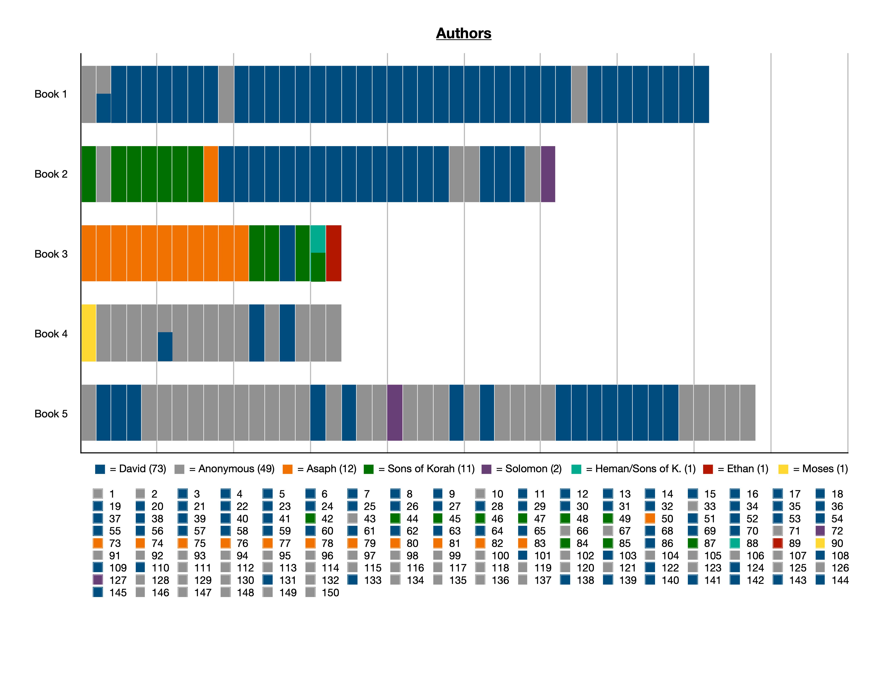

Slide 27
The Contents of the Psalter
Dates of Composition
Spans almost 900 years
c1400 BC: Moses - Psalm 90
c1000 BC: Mostly written in time of David & Asaph
c500 BC: Post Babylonian Exile - Psalm 137
Other possible post-exile: 74,79,80,89,107,126
Compilation and Editing
Book reached its final form after return from exile
Likely multiple collections, added & arranged (72:20)
Unknown editor(s) - like Deut 34
Clear signs of organization

Slide 28
The Genres of the Psalms
One way to study Psalms is categorizing by genre
CAUTION: Not all Psalms fit neatly into one genre!
Praise / Hymn - exuberantly telling God’s goodness
Lament - Individual Lament & National Lament
Thanksgiving - an answered lament: ind. & national
Confidence / Trust - Faith though enemies present
Historical / Remembrance - Recalling God’s past acts
Wisdom / Torah (Law) - like Proverbs, focus on Law
Royal / Kingship - focus on the Lord’s anointed/king

Slide 29
The Genres of the Psalms
Praise
Often begin with a call to worship
Give a reason for praising God
Examples: Psalms 146-150

Slide 30
The Genres of the Psalms
Lament
Largest, broadest genre
Present a problem to God
Confession or innocence
Sometimes includes curses
Usually end in praise
Examples: Ps 13, 22, etc.

Slide 31
The Genres of the Psalms
Thanksgiving
“Past-tense lament,” looks back on past deliverance
Usually begin with praise
May call on congregation, invite other to trust God
Examples: Psalms 18, 30, 32, 34, 40, 48, 66, 116, 118, 124, 126

Slide 32
The Genres of the Psalms
Trust
Expresses confidence in God, though enemies are present
Ex: Psalms 11, 16, 23, 27, 46, 52, 62, 75, 91, 121, 123, 125, 131

Slide 33
The Genres of the Psalms
Historical
Recounting portions of Israel’s history
With purpose: praise, lament (105 vs. 106)
Examples: Psalms 78, 81, 105, 106, 114, 135, 136

Slide 34
The Genres of the Psalms
Wisdom/Torah
Focus on God’s Torah (Law, teaching, instruction)
Or like Proverbs: how to live a wise, God-fearing life
Examples: Psalms 15, 24, 37, 49, 50, (73), 107, 112, 127, 128

Slide 35
The Genres of the Psalms
Royal
Focus on Israel’s king, or God as King
Sometimes both, multiple layers
Examples: Psalm 2, 20, 21, 45, 72, 89, 101, 110, 132
Psalm 2, 89, 132 focus on 2 Sam 7 Promises to David

Slide 36
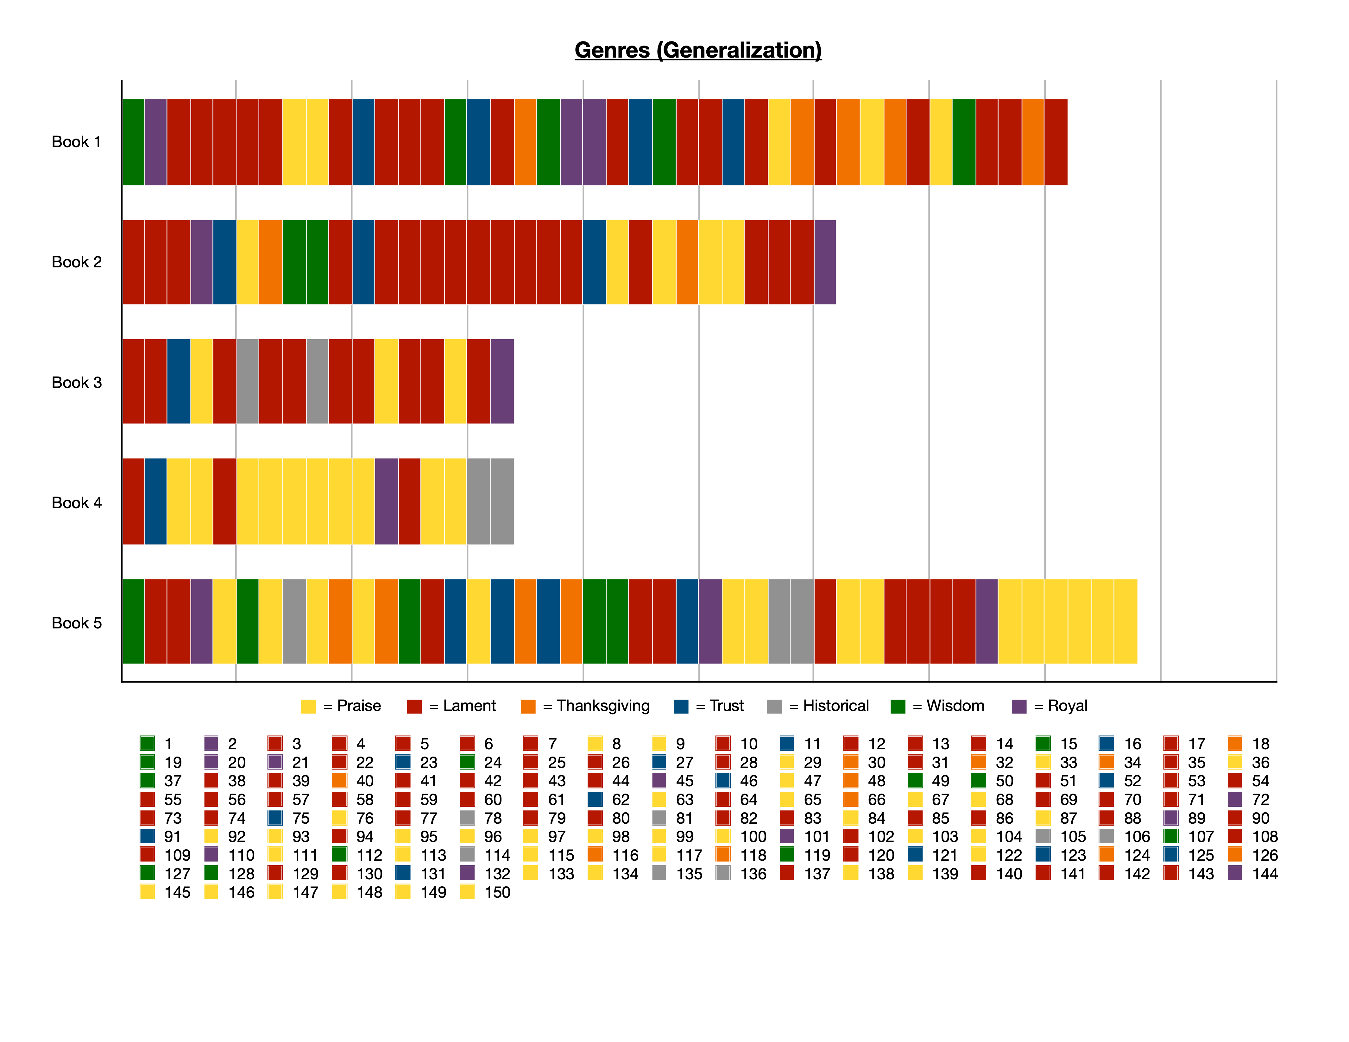

Slide 37
The Genres of the Psalms
Psalms 73, 90
Wisdom Lament

Slide 38
The Genres of the Psalms
Psalm 89
Royal Lament

Slide 39
The Genres of the Psalms
Psalm 101
Royal Wisdom

Slide 40
The Genres of the Psalms
Psalm 22
Lament/
Trust
Praise

Slide 41
“Messianic” Psalms vs. Psalms Applied to Jesus
Psalm 22
David
Jesus

Slide 42
“Messianic” Psalms vs. Psalms Applied to Jesus
Psalm 41
David
Jesus
“…heal me, for I have sinned against you!” (41:4)
“who ate my bread, has lifted his heel against me” (41:9)

Slide 43
“Messianic” Psalms vs. Psalms Applied to Jesus
Psalm 72
Solomon
Jesus

Slide 44
The Structure of the Psalter
Five Book Structure
Books 1-4 end with a doxology, not part of each Psalm
41:13; 72:18-20; 89:52; 106:48
72:20 “The prayers of David, the son of Jesse, are ended.”
Book 5 ended with 5-part praise finale: Ps 146-150
Likely modeled after the Torah, 5 Books of Moses
Different teaching method: praise and prayers of God’s faithful people through the age
Signs of Structure within 5 books
Like organizing a hymnal—not every hymn, but overall

Slide 45
The Flow of the Psalms
Book 1: 3-41
Book 2: 42-72
Book 3: 73-89
Book 4: 90-106
Book 5: 107-145
41:13
72:18-20
89:52
106:48
Blessed be the LORD, the God of Israel, from everlasting to everlasting! Amen and Amen.

Slide 47
The Flow of the Psalms
Book 1: 3-41
Book 2: 42-72
Book 3: 73-89
Book 4: 90-106
Book 5: 107-145
Introduction
1: Torah
2: Messiah
41:13
72:18-20
89:52
106:48
Conclusion
146-150: Hallelu-YAH
Blessed be the LORD, the God of Israel, from everlasting to everlasting! Amen and Amen.

Slide 49
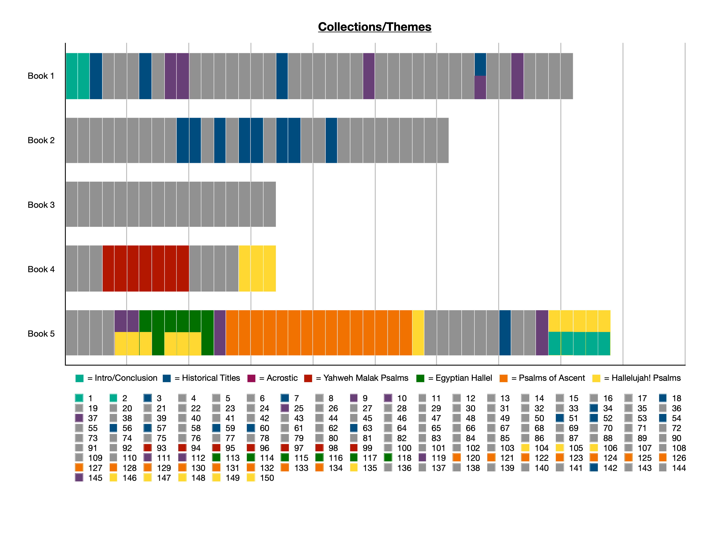

Slide 50
The Flow of the Psalms
Book 1: 3-41
Book 2: 42-72
Book 3: 73-89
Book 4: 90-106
Book 5: 107-145
Introduction
1: Torah
2: Messiah
42-49: Sons of Korah [-43: Anon]
73-83: Asaph
90: Moses
107: God’s Hesed
[Anonymous]
108-110: David
91-106: Anonymous
[-101,103: David]
50: Asaph
84-88: Sons of Korah [-86: David]
111-137: Anonymous
[-122,124,131,133: David]
[-127: Solomon]
3-41: David
[-10,33: Anonymous]
93-99: The LORD Reigns
51-71: David (Historical Titles)
[-66,67,71: Anon]
113-118: Passover
119: Torah
120-134: Ascent
88: Heman
104-106: Historical
Solomon: 72
89: Ethan
138-145: David
41:13
72:18-20
89:52
106:48
Conclusion
146-150: Hallelu-YAH
Blessed be the LORD, the God of Israel, from everlasting to everlasting! Amen and Amen.

Slide 51
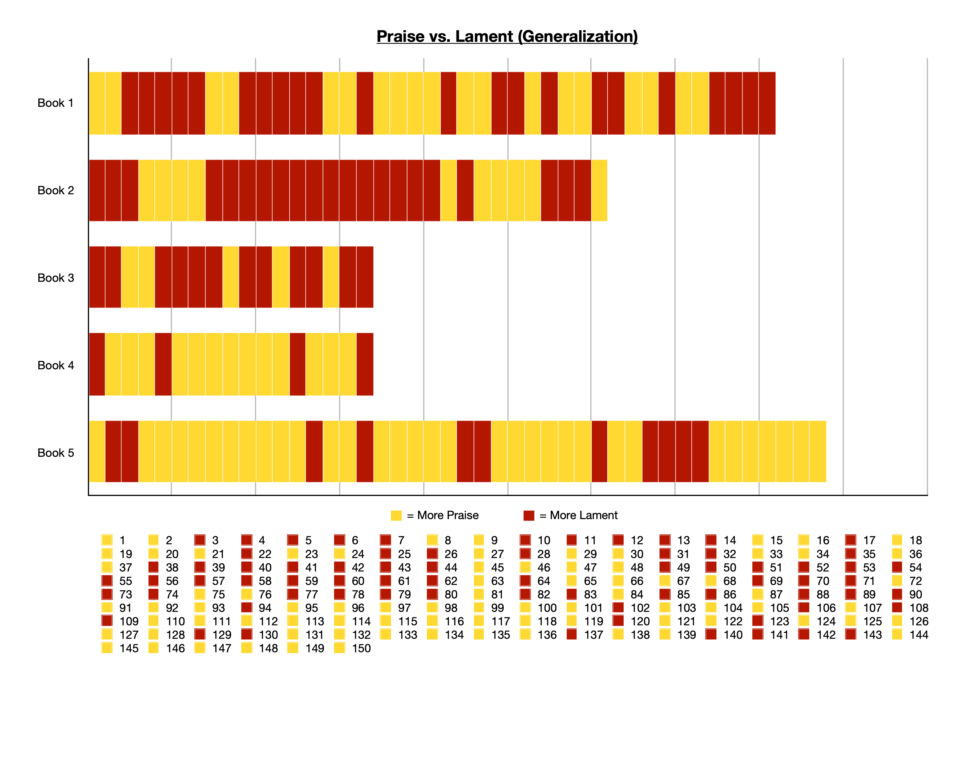

Slide 52
The Flow of the Psalms
Less Praise, Increasing Lament
Less Lament, Increasing Praise
89 & 90
Book 1: 3-41
Book 2: 42-72
Book 3: 73-89
Book 4: 90-106
Book 5: 107-145
Introduction
1: Torah
2: Messiah
42-49: Sons of Korah [-43: Anon]
73-83: Asaph
90: Moses
107: God’s Hesed
[Anonymous]
108-110: David
91-106: Anonymous
[-101,103: David]
50: Asaph
84-88: Sons of Korah [-86: David]
111-137: Anonymous
[-122,124,131,133: David]
[-127: Solomon]
3-41: David
[-10,33: Anonymous]
93-99: The LORD Reigns
51-71: David (Historical Titles)
[-66,67,71: Anon]
113-118: Passover
119: Torah
120-134: Ascent
88: Heman
104-106: Historical
Solomon: 72
89: Ethan
138-145: David
41:13
72:18-20
89:52
106:48
Conclusion
146-150: Hallelu-YAH
Blessed be the LORD, the God of Israel, from everlasting to everlasting! Amen and Amen.

Slide 53
Possible Theme of the Psalter
The Psalms and the Exile
The Psalms reached their final organization after Exile
A major theological struggle of that generation was: “What happened to the promises to David?!”
Psalms and Chronicles
Kings and Chronicles - different purposes
Psalms may have a similar purpose to Chronicles—instill future hope in God keeping His promises to David/Israel

Slide 54
Hesed - God’s Steadfast Love
From Ex 34:6-7 - God reveals His character to Moses
חֶסֶד “Hesed”
“Steadfast Love” (ESV)
“Lovingkindness” (NASB)
“Mercies”
“Faithful Love”
“Loyal Love”
Use in OT:
2nd most: 11x…. Used in Psalms 127 times!

Slide 55
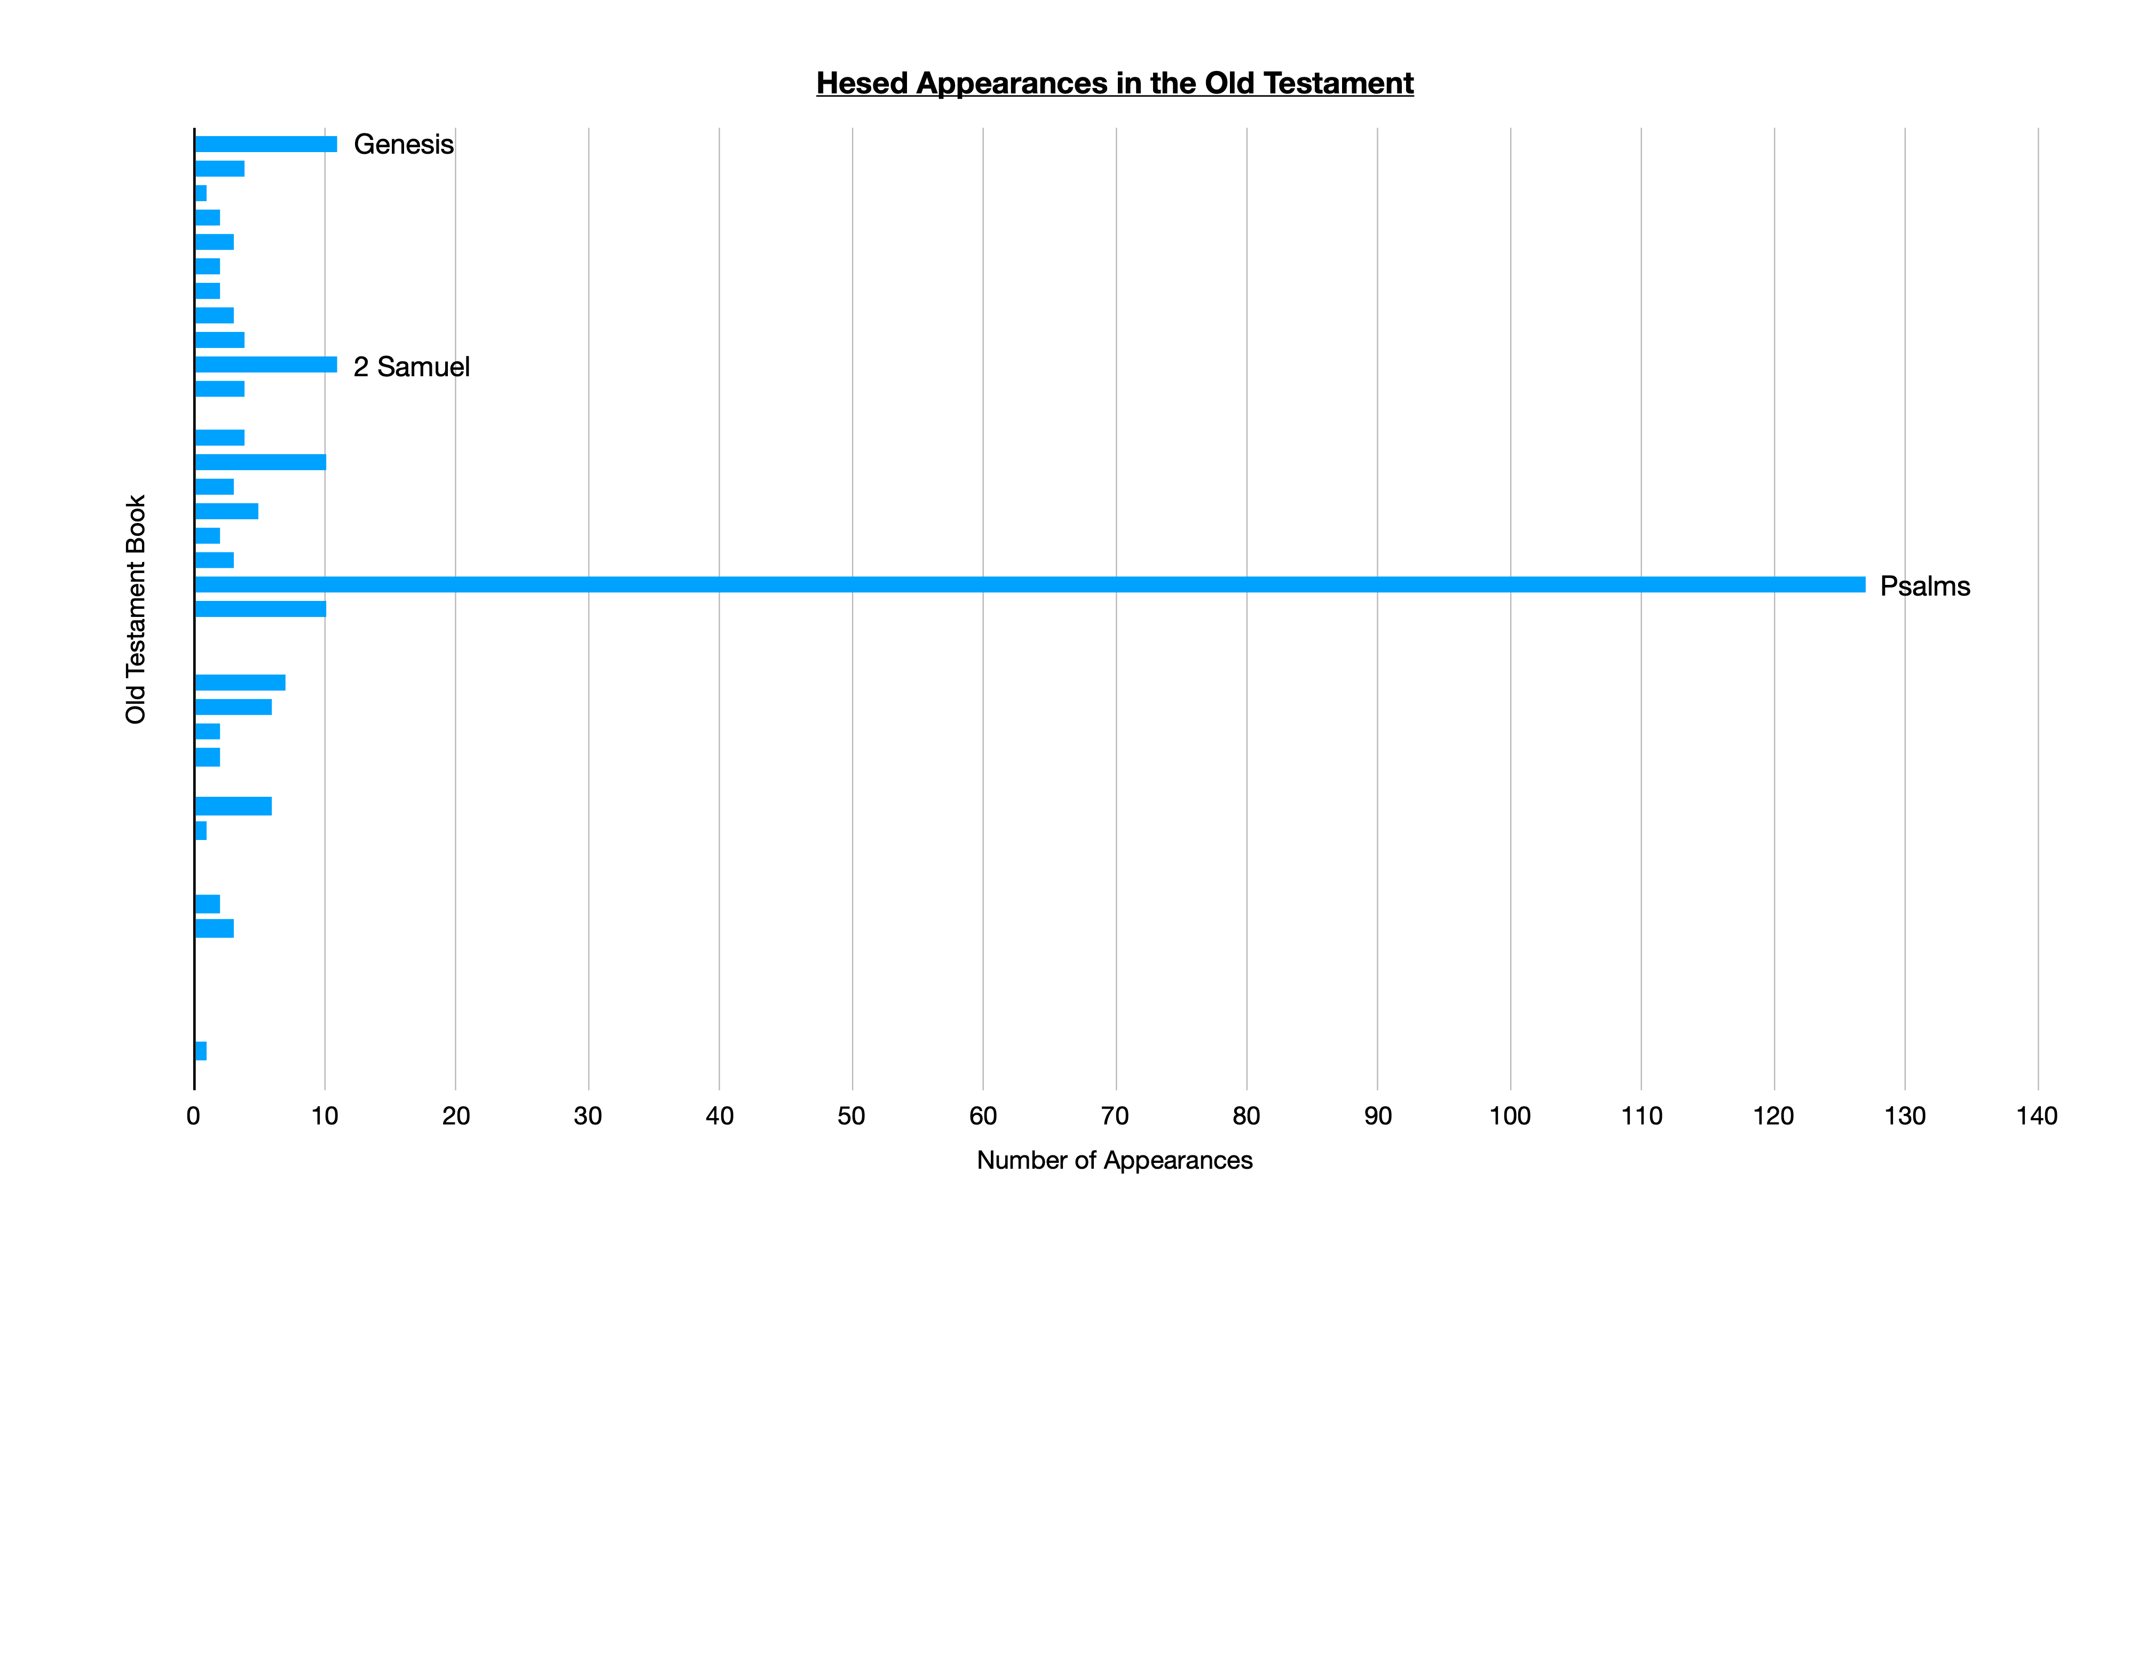

Slide 56
Hesed - God’s Steadfast Love
From
חֶסֶד “Hesed”
“Steadfast Love” (ESV)
“Lovingkindness” (NASB)
“Mercies”
“Faithful Love”
“Loyal Love”
Use in OT:
2nd most: 11x…. Used in Psalms 127 times!
Combines ideas: Love in action, mercy, covenant faithfulness, generosity, enduring commitment
“Give thanks to YHWH, for He is good, His hesed endures forever”

Slide 57
Seams and Themes: Trusting God’s Hesed after Exile
Books 1-2:
The Life, Triumphs and Failures of David (72:20)
Book 3: The Devastation of Exile
Book 4: Renewed Trust in God’s Kingship
Book 5: Anticipating the Lord’s Anointed
Book 1: 3-41
Book 2: 42-72
Book 3: 73-89
Book 4: 90-106
Book 5: 107-145
3: David flees from Absalom
42/43: Longing
for God’s House
73: Why do the wicked prosper?
90: Moses: God has been faithful from everlasting
73,79,80,84: Communal Laments (like exile)
(all David Psalms)
51: David’s Great Failure (1st of historical collection)
88: All darkness, no praise
89: Lament over promises to David:
Where is God’s Hesed?!
41: David betrayed and delivered
72: Hope in Solomon’s Legacy…

Slide 58
PSALM 89 & 90 - PROMISES & PERSPECTIVE
Ps 89 | Connections | Ps 90
v1 | All generations | v1
v1, etc. | Steadfast love | v14
v12 | Mountains/creation | v2
v46-48 | Brevity/frailty | v3-12
v46 | How long? | v13
v2,4,21,37 | Establish | v17

Slide 59
PSALM 89 & 90 - PROMISES & PERSPECTIVE
Psalm 89 - God will keep His promises, but sometimes it looks like He hasn’t.
Don’t let go & give up on God.
Bring your doubts and fears openly to God.
Trust that God will answer, even after the end.
Psalm 90 - God is eternal, and eternally faithful
There is much before and after us—life isn’t about me.
Learn to number our days—life is short, but God is good.
Establish the work of our hands—labor for what matters.

Slide 60
Seams and Themes: Trusting God’s Hesed after Exile
Books 1-2:
The Life, Triumphs and Failures of David (72:20)
Book 3: The Devastation of Exile
Book 4: Renewed Trust in God’s Kingship
Book 5: Anticipating the Lord’s Anointed
Book 1: 3-41
Book 2: 42-72
Book 3: 73-89
Book 4: 90-106
Book 5: 107-145
3: David flees from Absalom
42/43: Longing
for God’s House
73: Why do the wicked prosper?
90: Moses: God has been faithful from everlasting
107: God’s
Hesed delivers in every situation
73,79,80,84: Communal Laments (like exile)
110: David’s Lord as King & Priest
93-99:
The LORD Reigns!
(even without a physical king)
(all David Psalms)
51: David’s Great Failure (1st of historical collection)
113-118: Passover
119: Torah
120-134: Ascents
(Anticipation of Feasts/Law/City being restored)
88: All darkness, no praise
89: Lament over promises to David:
Where is God’s Hesed?!
105-106:
God’s Faithfulness despite Israel’s unfaithful history
41: David betrayed and delivered
72: Hope in Solomon’s Legacy…
145: David praises God forever

Slide 61
Applying the Psalms
Studying the Psalms:
Verse by verse (definitions, poetic devices)
Psalm by psalm (authors, themes, NT quotes)
From psalm to psalm, book to book (in order)
Participating in the Psalms:
Reading - a message to God and from God
Singing - meant to be participated in
Praying - write out prayers based on psalms
Living - relate to current life situations
Being Transformed by the Psalms:
Bringing our whole heart to God - in every season
Trust in God’s steadfast, covenant-keeping love

Slide 62
Oh give thanks to the LORD, for he is good, for his steadfast love endures forever!
Psalm 107:1

