Slide 1
Between the Testaments
c. 400 BC to Birth of Christ
Exton Church
2021
Al McLellan
acm1971@aol.com

Slide 2
The Intertestamental Period
OT
Between the Testaments
NT
430 BC (?)
6-4 BC (?)

Slide 3
Between the Testaments
Was history suspended?
What took place in the “silent centuries”?
Was it significant to the Bible narratives?
How did the events of the “silent centuries” prepare for the events of the New Testament? (John the Baptist, birth of Jesus, Roman rule, etc.?

Slide 4
The Old Testament Ends
The Jews in Palestine (6th cent. BC)
Rebuilt Temple, worship & walls
A remnant in the Promised Land
The world ruled by the Persians
As the New Testament Begins (late 1st cent. BC)
The world ruled by Rome
Political power in priesthood
A king (Herod) over Palestine
Many new and “strange” entities
Tax collectors • Synagogues • Herodians, Sadducees, Pharisees, Sanhedrin, Zealots, etc.

Slide 5
Galatians 4:4-5
“But when the fulness of the time came, God sent forth His Son, born of a woman, born under the Law,
(5) in order that He might redeem those who were under the Law, that we might receive the adoption as sons.”
“The time which God in His infinite wisdom counted best; in which all his counsels were filled up; and the time which His Spirit, by the prophets, had specified; and the time to which He intended the Mosaic institutions should extend, and beyond which they should be of no avail. “ (A. Clarke)

Slide 6
Why does the Intertestamental Period Matter???
God’s Promises Fulfilled
Ex. Book of Daniel, Malachi
History of Jewish People (their attitudes and aspirations in 1st cent. AD)
God’s providence to produce “fullness of times” (Gal. 4:3-7)
Background of New Testament Writings
Rise of Greece and Rome (Greek culture, Roman rule)
Samaritans
Pharisees
Sadducees
Herodians
Tax Collectors and Zealots
Adoption
Salvation
Epicureans and Stoics
ETC., ETC., ETC.

Slide 7
Historical Context
Israel’s United Kingdom (1037 BC) (?)
Saul
David
Solomon
The Divided Kingdom (930 BC)(?)
Israel (10 tribes) as Northern Kingdom under Jeroboam I
Succession of BAD kings (Ahab, etc.)
Fell to Assyria in 722 BC
People killed, captured, and many re-settled in other nations
Judah (2 tribes) as Southern Kingdom
Some good, some bad kings
Fell to Babylonia, from 606 BC to 586 BC
Many captives taken to Babylonia (Daniel, Shadrach, Meshack, Abednego, etc.)

Slide 8
Dan. 2:31-45 <Nebuchadnezzar’s Dream
37 “You, O king, are the king of kings. The God of heaven has granted you sovereignty, power, strength, and honor. 38 Wherever human beings, wild animals, and birds of the sky live—he has given them into your power. He has given you authority over them all. You are the head of gold, 39 Now after you another kingdom (note: with chest and arms of silver, v. 32 ) will arise, one inferior to yours. Then a third kingdom, one of bronze, will rule in all the earth. 40 Then there will be a fourth kingdom, one strong like iron. Just like iron breaks in pieces and shatters everything, and as iron breaks in pieces all these metals, so it will break in pieces and crush the others. 41 In that you were seeing feet and toes partly of wet clay and partly of iron, so this will be a divided kingdom. Some of the strength of iron will be in it, for you saw iron mixed with wet clay. 42 In that the toes of the feet were partly of iron and partly of clay, the latter stages of this kingdom will be partly strong and partly fragile. 43 And in that you saw iron mixed with wet clay, so people will be mixed with one another without adhering to one another, just as iron does not mix with clay. 44 In the days of those kings the God of heaven will raise up an everlasting kingdom that will not be destroyed and a kingdom that will not be left to another people. It will break in pieces and bring about the demise of all these kingdoms. But it will stand forever. 45 You saw that a stone was cut from a mountain, but not by human hands; it smashed the iron, bronze, clay, silver, and gold into pieces. The great God has made known to the king what will occur in the future. The dream is certain, and its interpretation is reliable.” <NET Bible>

Slide 10
Babylonian Period (606-536 BC)
Dan. 2:37-38 (Daniel, to Nebuchadnezzar, King of Babylon)
“You, O king, are the king of kings, to whom the God of heaven has given the kingdom, the power, the strength, and the glory; <38> and wherever the sons of men dwell, or the beasts of the field, or the birds of the sky, He has given them into your hand and has caused you to rule over them all. You are the head of gold.

Slide 11
Chapter 2 |  | Interpretation
Head of Gold |  | Babylon deported Judah’s king in 605 BC
Chest and Arms of Silver |  | Medo-Persian Empire defeated Babylon in 539 BC.
Belly and Thighs of Bronze |  | Greece defeats Persians in 331 BC Ptolemies and Seleucids
Legs of Iron |  | Rome assimilated former Greek holdings—later divided into multiple entities.
Rock Against Feet of Clay |  | Kingdom of God

Slide 12
God’s Final O.T. Instructions
Malachi 3:1-2
“Behold, I am going to send My messenger, and he will clear the way before Me. And the Lord, whom you seek, will suddenly come to His temple, and the messenger of the covenant, in whom you delight, behold, He is coming,” says the LORD of hosts. <NASB>
Malachi 4: 4-6
Remember the law of Moses My servant, even the statutes and ordinances which I commanded him in Horeb for all Israel. <5> Behold, I am going to send you Elijah the prophet before the coming of the great and terrible day of the LORD. <6> And he will restore the hearts of the fathers to their children, and the hearts of the children to their fathers, lest I come and smite the land with a curse. <NASB>

Slide 13
Major Periods within Second Temple Judaism Second Temple Judaism developed as political authority changed hands from the Persians to the Greeks, to the Jewish Hasmoneans, and finally to the Romans.
539–331 BC | 331–164 BC | 164–63 BC | 63 BC–AD 70
The Persian Period | The Hellenistic Period Ptolemaic (Egyptian) Period (320–198) Seleucid (Syrian) Period (198–164) | The Hasmonean (Maccabean) Period | The Roman Period

Slide 14
The Periods Between the Testaments
The Persian Period (539-331 BC)
Remnant of Jews returned to Jerusalem
The Grecian Period (331-164 BC)
Septuagint translation in Alexandria
The Jewish Independence Period (164-63 BC)
“Hasmonean” fused civil and religious rule
The Roman Period (63 BC – Matt. 1)

Slide 15
Apocrypha
14 books written between the O.T. and N.T.
Included in Catholic bibles
E.g., I & II Maccabees, I & II Esdras, Tobit, Judith, etc.
Were never accepted as canonical by Jews
Cf. Rom 3:2
Were never quoted in N.T.
No inspired writers spoke of them
Do provide some uninspired history (e.g., Maccabees)

Slide 16
Old Testament was Translated
Septuagint
Translation of Old Testament into Greek (280-180 BC)
Also called “LXX” (The “Seventy) from number of scholars who worked on it in Alexandria, Egypt
Often quoted in New Testament (about 300 times)
Note: The Septuagint was prepared long before birth of Jesus
Proves the many prophecies about Him were written long before their fulfillment in N.T. times!
Provided Greek translation to Jews and Gentile proselytes (cf. “God fearers” and later Gentile Christians, e.g. Cornelius)

Slide 17
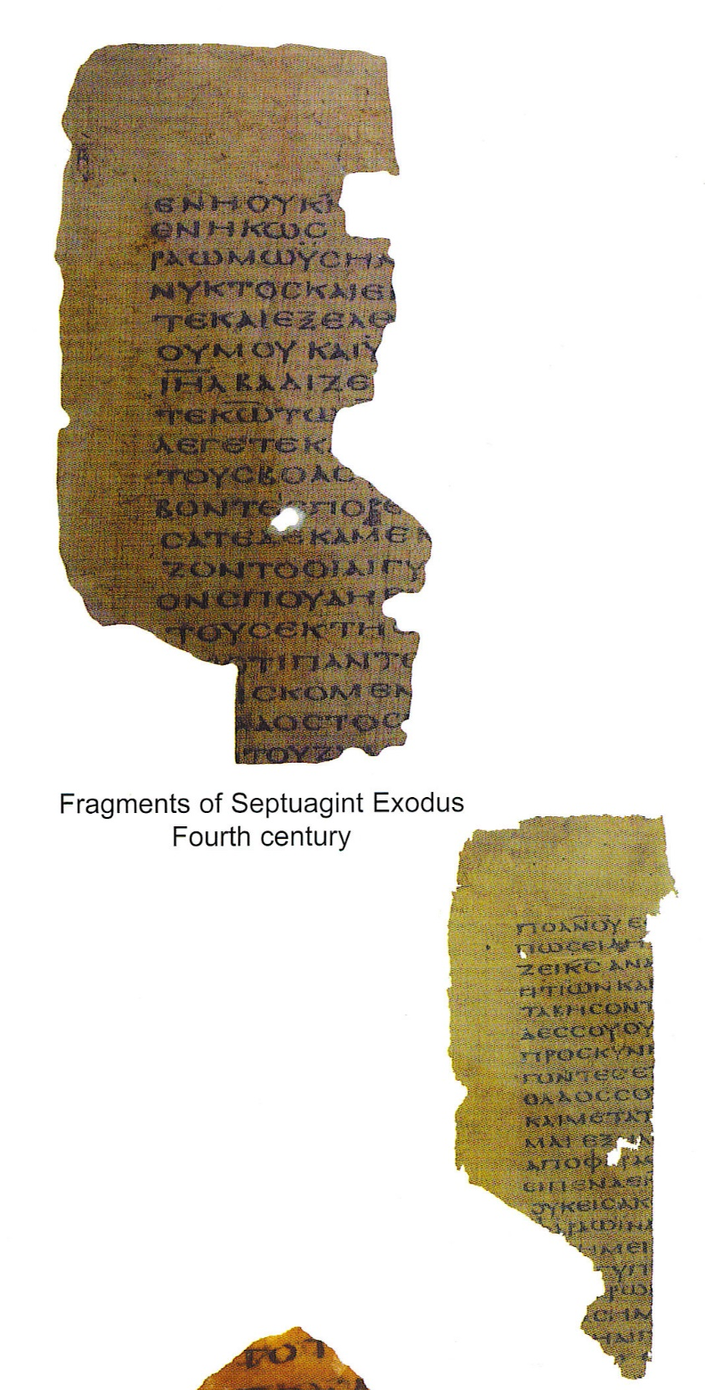
Legend of a Name
The name derives from a legend that 72 (70?) scholars from all 12 tribes of Israel translated the first 5 books (The Pentateuch) in 72 days. However, the northern tribes were dispersed by the Assyrians in 722 B.C. and only three tribes were likely present and accounted for in the 3rd Century. Most scholars believe Greek speaking Jews in Alexandria, Egypt performed this translation between the 3rd and 1st centuries B.C.

Slide 18
Three Centers of Jewish Life
Jerusalem
Appearance of 2 important sects
Pharisees & Sadducees
Babylon
Jews returned to monotheism (one God)
Rise of rabbis and scribes
Alexandria
Large population of Jews
Center of learning (libraries) under Ptolemy and successors
Production of the LXX (Septuagint)

Slide 19
Between the Testaments (Dan. 8:3-6)
3 Then I lifted my eyes and saw, and there, standing beside the river, was a ram which had two horns, and the two horns were high; but one was higher than the other, and the higher one came up last. 4 I saw the ram pushing westward, northward, and southward, so that no animal could withstand him; nor was there any that could deliver from his hand, but he did according to his will and became great. 5 And as I was considering, suddenly a male goat came from the west, across the surface of the whole earth, without touching the ground; and the goat had a notable horn between his eyes. 6 Then he came to the ram that had two horns, which I had seen standing beside the river, and ran at him with furious power.

Slide 20
Between the Testaments (Dan. 8:3-8)
7 And I saw him confronting the ram; he was moved with rage against him, attacked the ram, and broke his two horns. There was no power in the ram to withstand him, but he cast him down to the ground and trampled him; and there was no one that could deliver the ram from his hand. 8 Therefore the male goat grew very great; but when he became strong, the large horn was broken, and in place of it four notable ones came up toward the four winds of heaven.

Slide 21
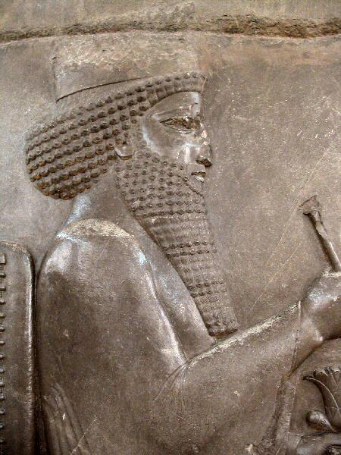
The Persian Post-Exilic Period 536-331 B.C.
Aramaic language (Semitic)
Possibly synagogue (no temple or sacrifices)
Book of Daniel
Chest and Arms of Silver
Bear
Ram

Slide 22
Cyrus Cylinder (538 BC)
Now in British Museum: Records the decree of Cyrus the Great (of Persia) to allow Jews to return to Jerusalem. First return was under Zerubbabel, 538 BC(?).
(Ref. Ezra 1:1-3; 2; 3)

Slide 23
Cyrus Prophecies in Isaiah (c. 740 BC (?))
Isa. 44:28>> “It is I who says of Cyrus, ‘He is My shepherd! And he will perform all My desire.’ and he declares of Jerusalem, “She will be built, and of the temple, ‘Your foundation will be laid.’”
Isa. 45: 1>>Thus says the LORD to Cyrus His anointed, whom I have taken by the right hand, to subdue nations before him, and to loose the lions for kings, to open doors before him so that gates will not be shut: I will go before you and make the rough places smooth; and I will give you the treasures of the darkness, and hidden wealth of secret places, in order that you may know it is I, the LORD, the God of Israel, Who calls you by your name.

Slide 24
Remnant of Israel in Jerusalem
First return lead by Zerubbabel (Ezra 1-3)
Rebuild the temple (Ezra 6, c. 620 BC)
Reading of the Law
Rebuild the walls (Neh. 3-5)
Books of Ezra, Nehemiah, Esther, Haggai

Slide 25
Significant Persian Events
Cyrus (the Great) allows Jews to return (539 BC)
Darius I defeated at Mount Athos and Marathon (490 BC)
Xerxes I (Ahasuerus, Esther 1-2) bridged the Hellespont but defeated at Thermopylae (Spartan 300) and at Salamis (naval battle) (480 BC)
Xerxes I defeated at Mycale and Plataca (479 BC)
Ezra restores the law in Jerusalem (457 BC)
Nehemiah builds walls of Jerusalem (444 BC)
Darius III defeated by Alexander the Great (331 BC)

Slide 26
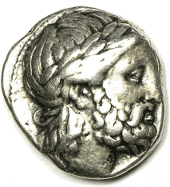
The Rise of Macedonia
The Macedonians were a primitive people from the north of Greece.
Philip II took his throne in 359 BC, and reorganized the army, using great wealth from silver mines.
Perfected the “Macedonian Phalanx”
He greatly admired Greek culture and
wanted to unify the land.
The Macedonians quickly conquered every
major city-state in Greece, many weakened after years of in-fighting.
- Was generous to those who surrendered, allowed local rule
Philip’s conquests might have continued, but he was assassinated in 336 BC by a trusted bodyguard, and his plans for conquest fell to his 20-year old son Alexander.

Slide 27
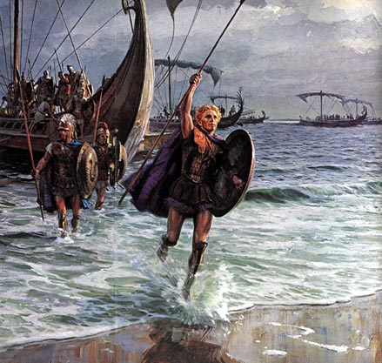
Although some early Greek city states had democracies, a powerful monarchy gained dominance in the 4th century B.C. Under their greatest king Alexander III, the Greeks conquered most of the Middle East. Greek influence and the Greek language spread with it.
Alexander the Great

Slide 28
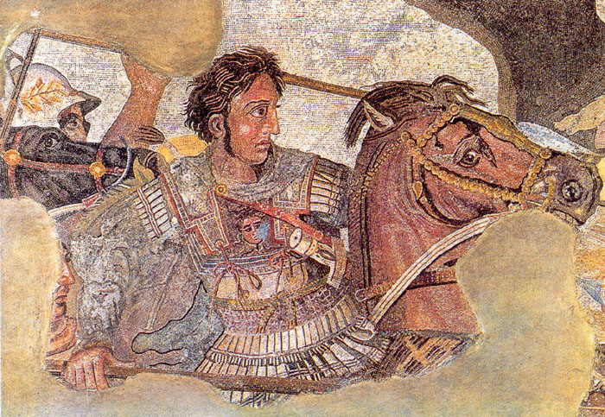
The Hellenistic Period 332 – 63 B.C.
Alexander the Great of Macedon (356 – 323 BC)
Aristotle was his tutor
Inherited kingdom from Phillip II
Mother was Olympias who told him he was a demi-god (of Zeus)
Strong and well-trained army
Defeated Persian Empire
Death at age 33
Kingdom divided into 4 parts among his generals (e.g., Seleucus, Ptolemy)
Book of Daniel
Belt and Thighs of Bronze
Leopard
Goat

Slide 29
Daniel 8:5-8, 21-22 re Alexander
⁵ And as I was considering, suddenly a male goat came from the west, across the surface of the whole earth, without touching the ground; and the goat had a notable horn between his eyes. ⁶ Then he came to the ram that had two horns, which I had seen standing beside the river, and ran at him with furious power. ⁷ And I saw him confronting the ram; he was moved with rage against him, ^{[e]}attacked the ram, and broke his two horns. There was no power in the ram to withstand him, but he cast him down to the ground and trampled him; and there was no one that could deliver the ram from his hand.
⁸ Therefore the male goat grew very great; but when he became strong, the large horn was broken, and in place of it four notable ones came up toward the four winds of heaven.
²⁰ The ram which you saw, having the two horns—they are the kings of Media and Persia. ²¹ And the ^{[i]}male goat is the ^{[j]}kingdom of Greece. The large horn that is between its eyes is the first king. ²² As for the broken horn and the four that stood up in its place, four kingdoms shall arise out of that nation, but not with its power.

Slide 30
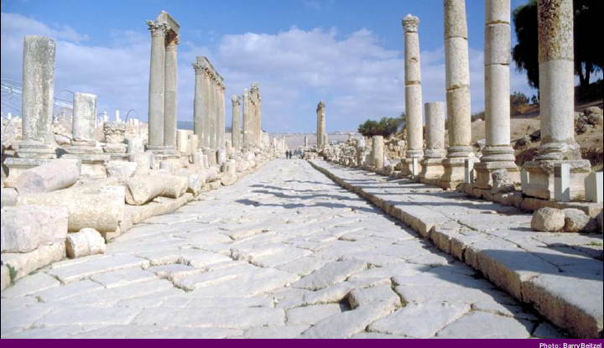
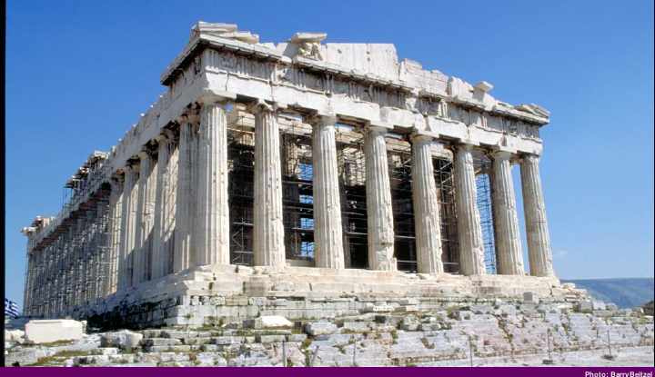
Alexander the Great died mysteriously at the age of 32, but his conquests changed the culture and language of the Mediterranean region. This Greek influence is called Hellenism. You can see the Hellenist influence today as far away as Jerash in modern day Jordan. Alexander was the foremost Hellenist!
Jerash
The Parthenon (447 BC)

Slide 31
Greek Empire “Sub-Kingdoms” (332-167 BC)
Ptolemy dynasty in Egypt
Growth of Alexandria as business and cultural center, its library
Synagogues and large Jewish population
Septuagint (Hebrew to Greek translations)
Seleucid Rulers in Syria
Antiochus Epiphanes
Defeated Egypt
Desecrated the Temple in Jerusalem
Sparked the Maccabean Revolt (Defeated in 67-64 BC)

Slide 32
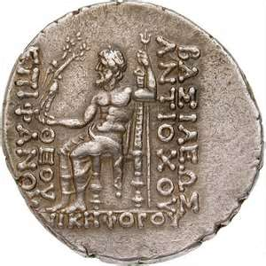
Hellenistic Period 332 – 63 B.C.
Seleucid (Syria) 198 - 167 B.C.
Dynasty began in 313
Alexander’s General Seleucus I Nicator (conqueror)
Antioch capital
Acts 11:19-20
Rule obtained from Ptolemies in 198
Antiochus IV Epiphanes (manifestation, i.e., the revealing of God on earth)
Sought worship of himself
Frustrated with the Jewish people he “turned the temple over to the worship of Zeus and for three years pigs were sacrificed by Greeks on Israel’s holy altar.”

Slide 33
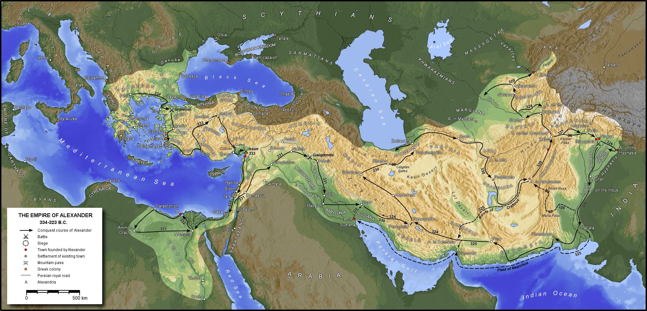
Alexander’s Conquests --4th Century BC

Slide 34
Notice
When a city is conquered and occupied by an invading nation, in time that city will begin to take on the culture and language of the invader. Generally, the cities were targets during an invasion. In this way, Greek became the principal language of commerce, government, and education. Many Jews became “Hellenized” and lost their knowledge of Hebrew. Hellenization of Jews in seen prominently in the N.T. (e.g., Acts 6)

Slide 35
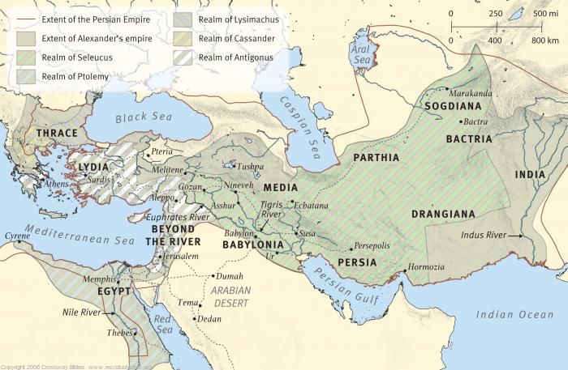
The Greek Empire

Slide 36
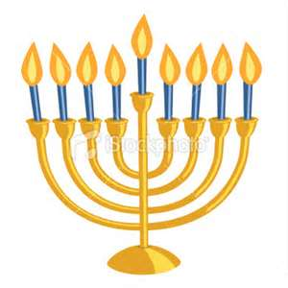
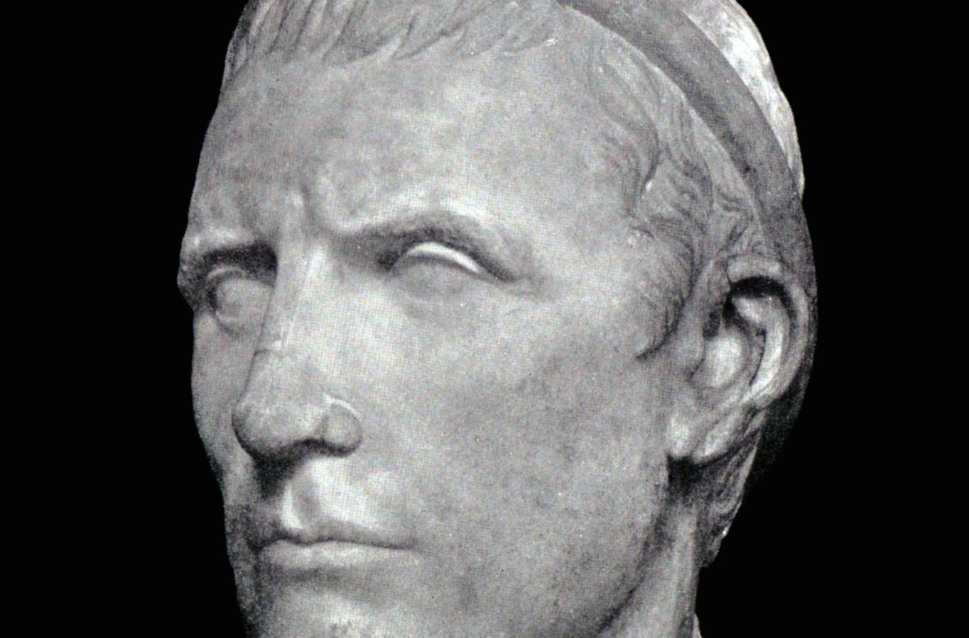
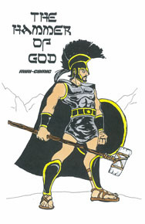
Maccabean War 167 – 141 B.C.
Hassidim (pious ones) passively revolted against Antiochus IV-Epiphanes (Appearance of a god”)
Cf. Dan. 11
Open Warfare
Mattathias and his sons Judas, Simon and Jonathan
Launched guerrilla campaign to expel Greeks from the land
Was also a civil war with ardent “Hellenistic” Jews
Mattathias was killed so Judas led war gaining the nickname “Maccabeus” (hammer)
164 BC, Judas gained the temple precincts and cleansed the sanctuary, inaugurating the feast we know as Hanukkah also referred to as the “festival of lights” or “Feast of Dedication” (cf. John 10:22-23)

Slide 37
Mattathias’ Lament (ref. I Maccabees)
Why was I born to see these terrible things, the ruin of my people and of the holy city? Must I sit here helpless while the city is surrendered to enemies and the Temple falls into the hands of foreigners? ⁸ The Temple is like someone without honor. ⁹ Its splendid furnishings have been carried away as loot. Our children have been killed in the streets, and our young men by the sword of the enemy. ¹⁰ Every nation in the world has occupied the city and robbed her of her possessions. ¹¹ All her ornaments have been stripped away; she is now a slave, no longer free. ¹² Look at our Temple, profaned by the Gentiles, emptied of all its splendor. ¹³ Why should we go on living?

Slide 38
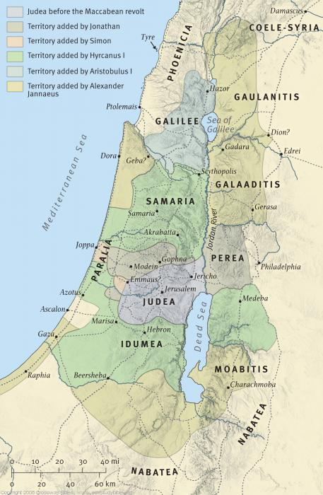
Israel Under the Maccabeans

Slide 39
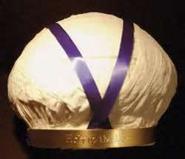
The Hasmonean Dynasty 141 – 63 BC
The family of Mattathias and heirs
In a generation Judaism found itself torn in three ways:
Hellenized Jews
Hasmoneans had power in Jerusalem
The Sadduccees dominant
in the temple
AND…
High Priestly Turban represents the Sadduccees

Slide 40
The Hasmonean Dynasty 141 – 63 BC.
“Hasidim” (pious ones) who called for religious purity and warned of the corruptive dangers of power
The Pharisees: lay movement
Dominant in Synagogues
Precision in study and application
of Scripture
Opposed Hellenization of Jewish culture
Zealots: radical religious sect seeking to overthrow Roman rule through violence. (Luke 6:15)

Slide 41
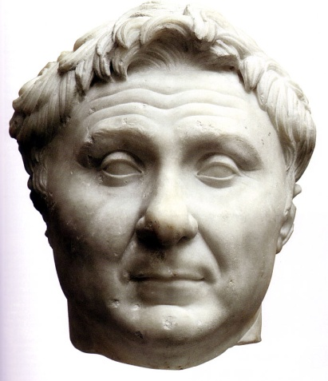
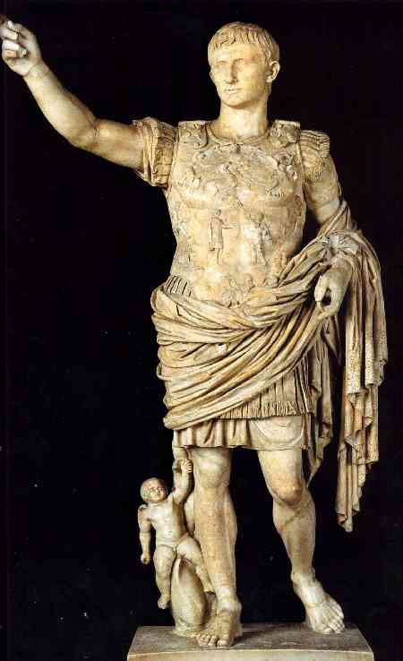
The Roman Period begins 63 BC
Pompey’s Conquest (63 BC)
Freed the Decapolis (League of Ten Cities) region promising they would never have to live under Jewish rule again
Mark 5:1-20
When Jesus entered, he went into a strictly Greek world, hence the presence of pigs
Conquered Jerusalem and entered Most Holy Place
Book of Daniel
Legs of Iron
Terrifying Beast
First Roman Emperor Caesar Augustus
Coins have Latin inscription DIVI FILIUS “of the divine one, the son.”

Slide 42
Rome at its peak (c. 115 AD)

Slide 43
The Periods Between the Testaments
The Persian Period (536-332 BC)
Jews returned to Palestine
Persian rulers were generally tolerant
No idolatry in remnant in Israel
The Grecian Period (332-167 BC)
Alexander the Great (of Macedonia)
Came swiftly from Greece
Defeated the Persians
Conquered the world as far as India
Died at age 33 with no successor
Greek empire divided into 4 “sub-kingdoms” among his generals.

Slide 44
Maccabean Revolt & Jewish Independence (167-63 BC)
Judas Maccabeus (“The Hammer”) fought a “hit & run” war against the Syrians
Syrian King was Antiochus II (or “Epiphanes”)
Tried to destroy Jews, destroyed scriptures, forbid circumcision
Purified the Temple (“Hanukkah”)---”Feast of Dedication (Jn. 10:22-23)
United the civil rule and priesthood—later corrupted both
Much Grecian influence in Jerusalem (Hellenism)
Gymnasium at foot of Temple mount
Revolt of devout Jews
Much political & religious unrest (crime, murders, etc.) before Roman rule

Slide 45
Genealogy of Herod the Great

Slide 46
Roman Era (63 BC)
Pompey conquers Jerusalem
Other Roman Emperors
Augustus “Caesar” (ruled until 14 AD)
Roman road system—allowed easier and safer travel
Roman citizenship (Paul, e.g.)
“Koine” Greek widely used
Roman rule emphasized peace, law and order
Romans were generally tolerant of local religions
Jesus came in “the fullness of times” (Gal. 4:4-7)

Slide 47
Roman Rule from 63 BC
Emperor >>Absolute Ruler (“Caesar”)
Kings –highest rulers in the territories (e.g., Herod, the Great)
In Israel, kings (AKA “Tetrarchs”) were of the Herodian dynasty
E.g. Herod Antipas – king at death of Jesus
E.g. Herod Agrippa II –heard Paul’s testimony in Caesarea
Governors- ruled in various regions
E,g., Pilate, Felix, Festus
Made tax and judicial decisions
Religion among Gentiles was filled with grotesque idolatry, mysticism, and human philosophies. (e.g., Acts 14:11-13)

Slide 48
Jewish Religion (late 1st Cent. BC)
Synagogues (mentioned 57 X in N.T.)
Places for prayers, readings, study of the law
Originated during Babylonian captivity (Probable)
Jerusalem temple had been destroyed
Jesus spoke in many of them as did Paul (Acts 17:1-3)
The Temple in Jerusalem
Animal sacrifices offered
Jews commanded to go there for feast days
Temple remodel begun by Herod the Great in 20 BC but not completed until 64 AD, just 6 years before its destruction in 70 AD by Roman army.

Slide 49
Jewish Feasts & Sanhedrin
3 Primary Feasts
Unleavened Bread & Passover
Pentecost
Tabernacles (or “Booths”)
Purim (@ Esther), Yom Kippur (Day of Atonement), Hanukkah (Dedication)
Sanhedrin – Supreme Jewish ruling body in Jerusalem
71 Jewish elders
Decided civil and religious cases
“Council” > Sanhedrin
Presided over by the High Priest
Disappeared in 70 AD
Condemned Christ, persecuted apostles

Slide 50
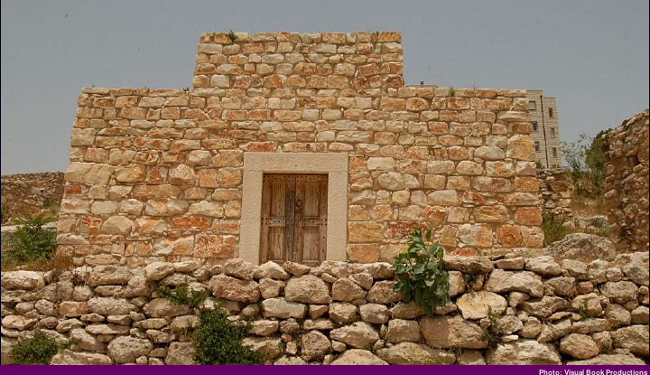
Replica of a Synagogue in Nazareth

Slide 51
Ancient Ruins of Jewish Synagogue on Golan Heights

Slide 52
Jewish Religious & Political Groups
Pharisees (100 X in N.T.)
Prominent in 3rd Cent. BC to protest “Hellenization” of Jewish people
“Pharisee” >>”separated ones” (from profane Jews)
Religious conservatives in 1st Cent. AD
Accepted Jewish traditions
Considered Roman rule as punishment to Jews for sin, but it was to be accepted as God’s will until it was lifted.
Often self-righteous and hypocritical who cared more about external appearances; elevated traditions above Word of God.
Cf. Mark 7:5-9

Slide 53
Jewish Religious & Political Groups
Sadducees (14 X in N.T.)
Accepted Greek culture, greater concern for politics
Name from “Zadok” (?) or “tzadkin” (High Priest during David’s reign)
Low view of God, denied resurrection and angels
Cf. Acts 23:6-9
John Hyrcanus (Hasmonean) thought Pharisees opposed him and switched to become a Sadducee—affected high priest-hood afterwards.
Greater influence in the temple – aristocracy
Religious liberals in days of Jesus
Unbelieving religionists—too sophisticated to believe in spirits, angels, resurrection

Slide 54
Pharisees & Sadducees: A Comparison
PHARISEES | SADDUCEES
- “Separated Ones” | - “Righteous Ones”
- Held to authority of entire Old Test. and oral law (i.e., traditions” ) | - Viewed the Torah as having greater authority
- Believed in miracles, angels, and immortality (cf. Acts 23:6-9) | - Rejected miracles, angels, and immortality (very “Greek-like” views)
- Believed in future resurrection | - Denied any life after death-
- Popular in the synagogues | - Ruled in Temple (priesthood, admin., etc.)
NOTE: MOST JEWS WERE IN NEITHER OF THESE GROUPS!!

Slide 55
Jewish Religious & Political Groups
Zealots (only 1 mention in N.T.)
Apostle Simon “Zelotes” (Lk 6:15)
Sought to overthrow Roman rule, solely focused on political independence
Refused to pay taxes, considered loyalty to Caesar a sin.
On extreme left of Pharisees, they lead a revolt in 66 AD which ended in Romans destroying Jerusalem in 70 AD.
Herodians (3 X in N.T.)
Jews loyal to Herod and Roman rule
Liberal element of Sadducees
Encouraged Hellenizing of Jews even thought Greek culture honored pagan gods and disregarded Jewish law
Pharisees appealed to these political enemies in common cause to destroy Jesus (cf. Mark 3:6)

Slide 57
Jewish Religious & Political Groups
Essenes
Small deeply religious group—prolific copiers of scriptures
Extreme to the right of Pharisees
No mentions directly in the N.T. but recognized by Jews
Monastic people on NW banks of the Dead Sea (Qumran)
Produced Dead Sea Scrolls discovered in 1947
Scribes (67 X in N.T.)
Guardians and teachers of scripture
“Scribes” sometimes used to denote Sadducees and “lawyers”
Intimately familiar with the Law of Moses.
Became a distinguished order in Israel and members of Sanhedrin who joined in condemning Jesus (cf. Mt 26:57)

Slide 58
New Political Geography
Judea –heart of Israel, Jerusalem as the center
Samaria- After fall of N. Kingdom (Israel) in 722 BC, Jews were deported, and in their place the country was colonized by Gentiles with assent of Assyria. Remnant of remaining Jews intermarried with pagans which produced a blend of religions.
After being rejected by Jews of Jerusalem (John4:9) they built their own temple on Mt. Gerizim. (Note: it was destroyed in 128 BC by John Hyrcanus, a Hasmonean)
Galilee, Perea, and Decapolis (Gr. “Ten Cities”)

Slide 59
Israel in Time of Jesus

Slide 60
Dan 2:20-22
So Daniel praised the God of heaven, 20 saying:
“Let the name of God be praised forever and ever,
for wisdom and power belong to him.
21 He changes times and seasons,
deposing some kings
and establishing others.
He gives wisdom to the wise;
he imparts knowledge to those with understanding;
22 he reveals deep and hidden things.
He knows what is in the darkness,
and light resides with him. <NET Bible>

