Slide 1
Sermon
Church Organization
Part 2
Jeff Smelser

Slide 2
Youtube video about “Christian denominations” produced by a Presbyterian…
All Protestants Agree…
“The Bible has MORE authority than the Church”
“Conservative Lutheran”
“Fundamentalist Baptist”
“Progressive”
e.g. “lesbian pastors”
AUTHORITY
AUTHORITY
AUTHORITY
BIBLE
CHURCH
BIBLE
CHURCH
BIBLE
CHURCH

Slide 3
Youtube video about “Christian denominations” produced by a Presbyterian…
Contrasted with Roman Catholicism…
Officially
Reality
TRADITION
TRADITION
AUTHORITY
AUTHORITY
BIBLE
CHURCH
BIBLE
CHURCH

Slide 4
What does the Bible Say?
Officially
Reality
TRADITION
TRADITION
BIBLE
CHURCH
BIBLE
CHURCH

Slide 5
What does the Bible Say?
Jesus Rebuked the Jews for Prioritizing Tradition over God’s Word
Mark 7:1-13
Traditions of Men are Not from Christ
Colossians 2:8-23
The Apostles Were to Bind What Was Bound in Heaven
Matthew 16:19, 18:18

Slide 6
Departures from God’s Word Especially in Church Organization
CHURCH AUTHORITY
TRADITION
Episcopal
Hierarchy of Bishops
Presbyterian
Hierarchy of Councils

Slide 7
What About Us?
Organization is important
Tendency among congregations without elders:
Look to Secular Experience
Business World
Military World
Government World
And so Business Meetings, Committees, etc. are established, often with little or no consultation of God’s word
You see how traditions can get started!

Slide 8
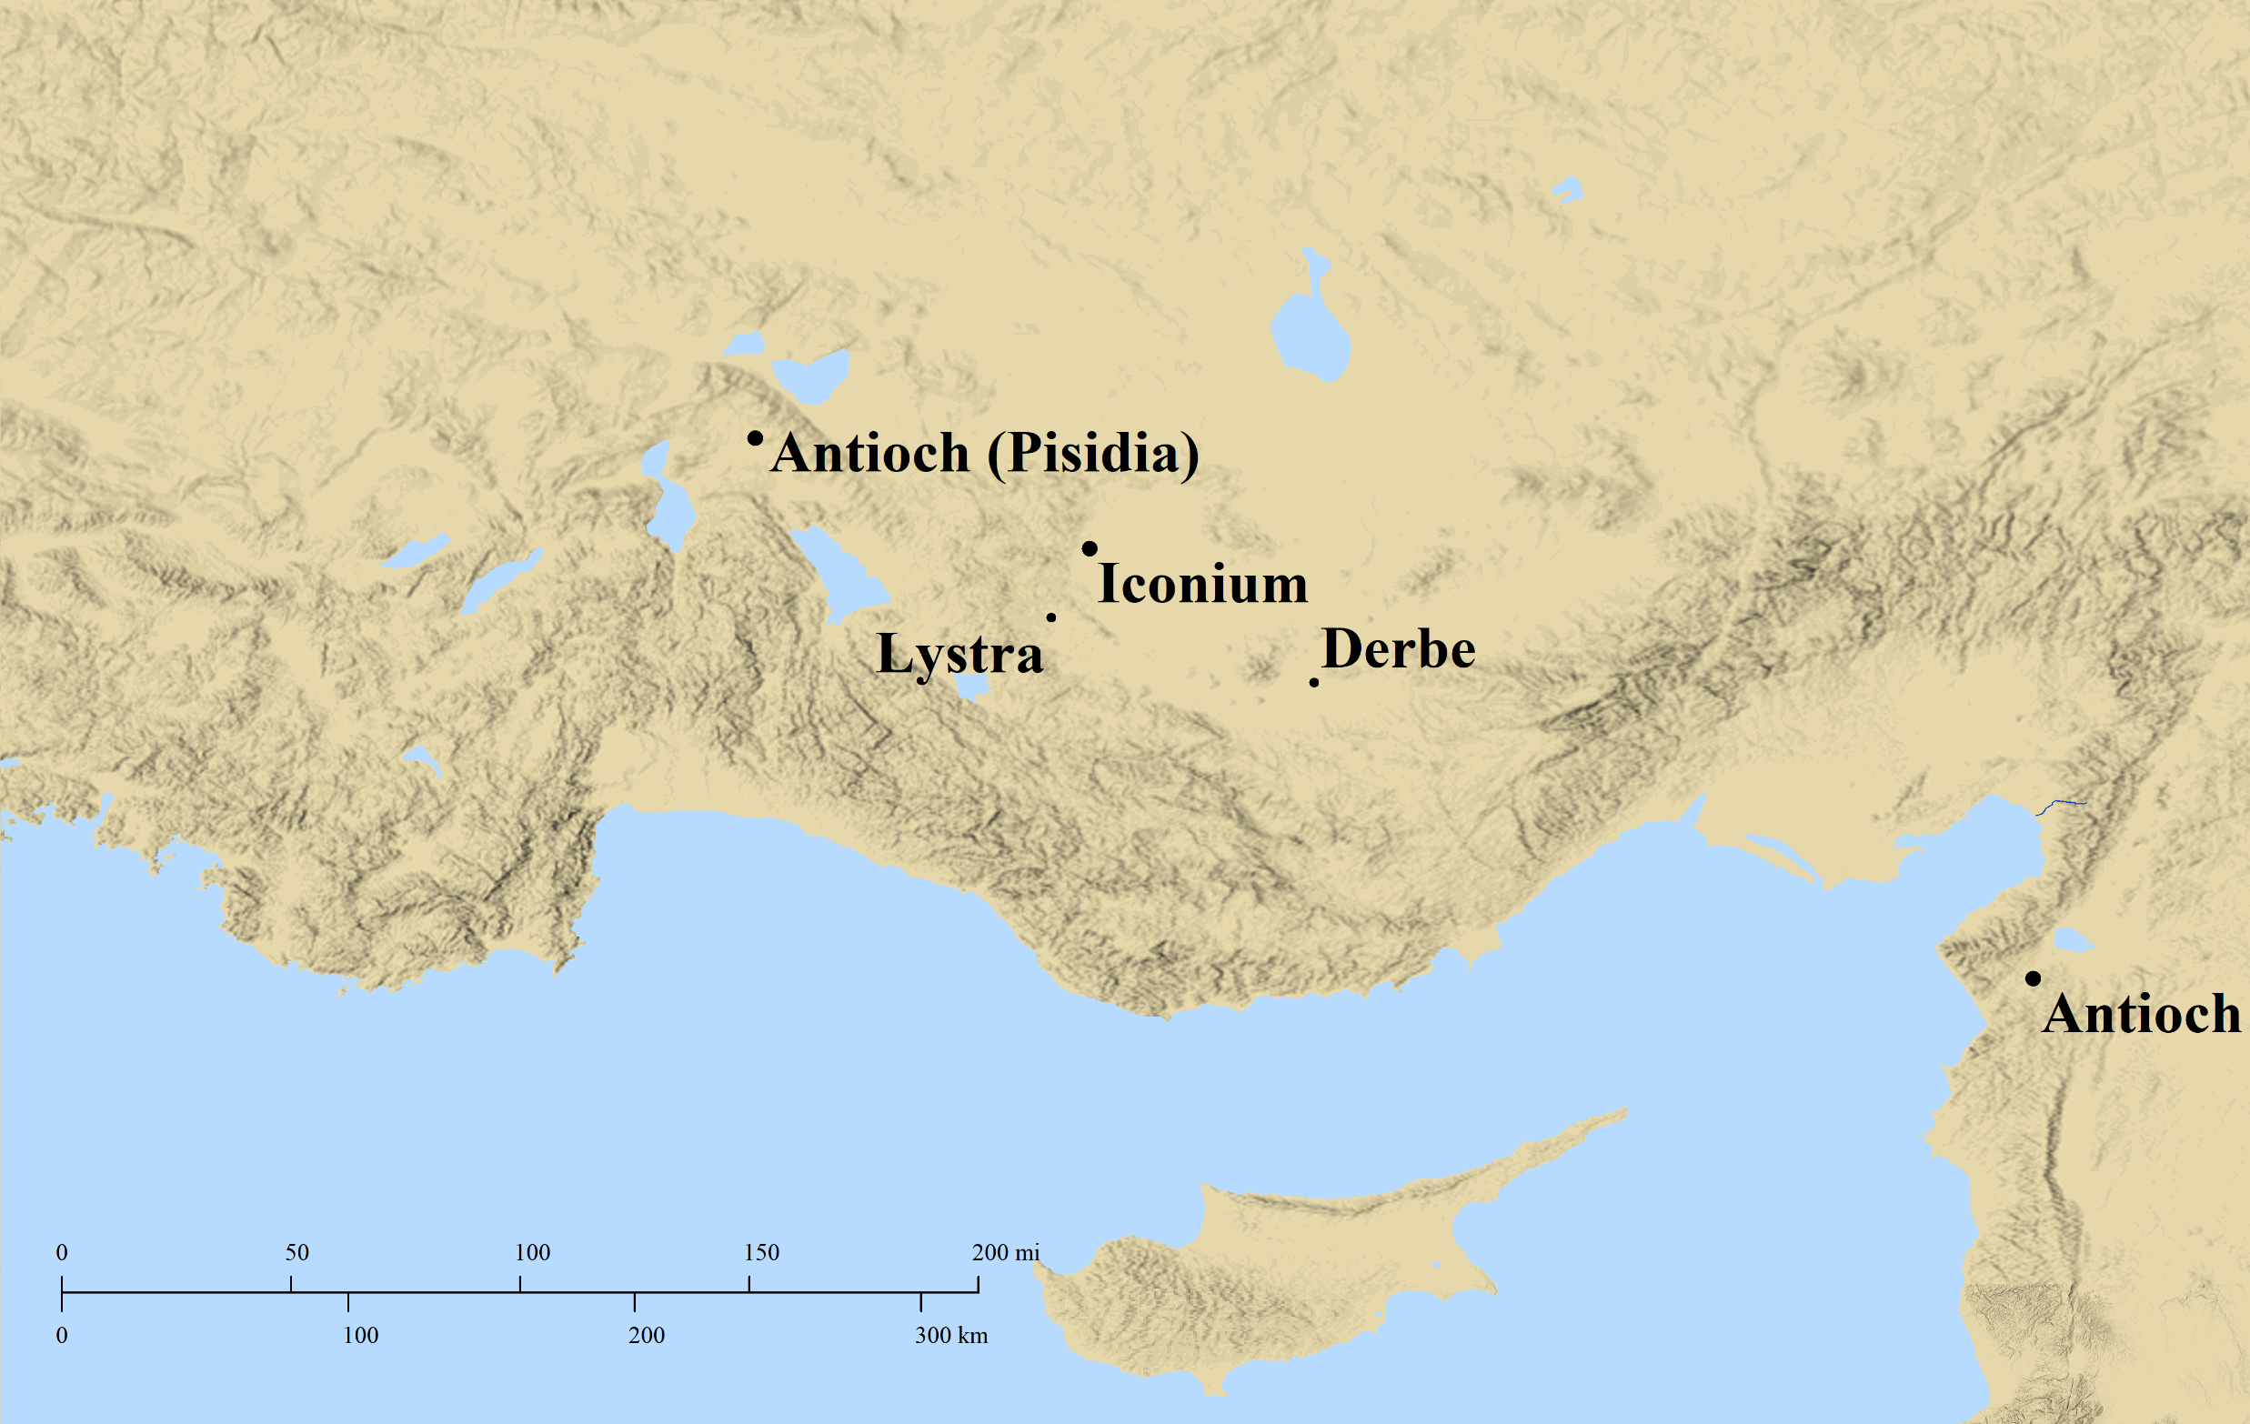
What About Us?
There is Biblical Authority for Churches without Elders
Acts 14:23 And when they had appointed elders for them in every church, having prayed with fasting, they commended them to the Lord in whom they had believed.

Slide 9
What About Us?
There is Biblical Authority for Churches without Elders
There is NO Biblical Authority for Churches to be Content w/o Elders
Apostolic Example (Acts 14:23)
Apostolic Instruction (Titus 1:5)
ESV “put what remained into order”
LSB “set in order what remains”
NET “set in order the remaining matters”
Is it Becoming Traditional to have churches without Elders?
Is it Becoming Traditional to substitute Business Meetings for Elders?
There is Biblical Authority for Churches to function without Elders

Slide 10
There is Biblical Authority for Churches to function without Elders
The New Testament lays out a plan….
The same plan with or without elders
Two passages
One pertaining to material concerns
One pertaining to spiritual concerns
Some think that without elders
we are cut loose from Biblical instruction
we’re on our own and just have to come up with something
That leads to “Church Authority,” “Tradition Authority”
Acts 6
1 Corinthians 5

Slide 11
The New Testament lays out a plan….
The same plan with or without elders
Congregational Meetings
Deacons
Individual Initiative

Slide 12
The New Testament lays out a plan….
The same plan with or without elders
Congregational Meetings
Acts 6 was a congregational meeting
Acts 15 appears to have been a congregational meeting
1 Corinthians 5 calls for a congregational meeting
1 Corinthians 14 applies
14:40 “decently and in order”
14:34-35 “let the women keep silent”

Slide 13
The New Testament lays out a plan….
The same plan with or without elders
Congregational Meetings
Logistics of Receiving and Considering Input?
In Acts 6, did the 12 discuss in advance what they were going to present to the multitude of the disciples?

