Slide 1
Sermon
Church Organization
Jeff Smelser

Slide 2
Youtube video about “Christian denominations” produced by a Presbyterian…
All Protestants Agree…
“The Bible has MORE authority than the Church”
“Conservative Lutheran”
“Fundamentalist Baptist”
“Progressive”
e.g. “lesbian pastors”
AUTHORITY
AUTHORITY
AUTHORITY
BIBLE
CHURCH
BIBLE
CHURCH
BIBLE
CHURCH

Slide 3
Youtube video about “Christian denominations” produced by a Presbyterian…
Contrasted with Roman Catholicism…
Officially
Reality
TRADITION
TRADITION
AUTHORITY
AUTHORITY
BIBLE
CHURCH
BIBLE
CHURCH

Slide 4
What does the Bible Say?
Officially
Reality
TRADITION
TRADITION
BIBLE
CHURCH
BIBLE
CHURCH

Slide 5
What does the Bible Say?
Jesus Rebuked the Jews for Prioritizing Tradition over God’s Word
Traditions of Men are Not from Christ
Raised from the Dead
Exalted
Ascended into Heaven
To Sit at God’s Right Hand
To Rule
As Lord

Slide 6
What does the Bible Say?
Jesus Rebuked the Jews for Prioritizing Tradition over God’s Word
Traditions of Men are Not from Christ
The Apostles Were to Bind What Was Bound in Heaven
Legacy Standard Bible I will give you the keys of the kingdom of heaven; and whatever you bind on earth shall have been bound in heaven, and whatever you loose on earth shall have been loosed in heaven.” Amplified Bible I will give you the keys (authority) of the kingdom of heaven; and whatever you bind [forbid, declare to be improper and unlawful] on earth will have [already] been bound in heaven, and whatever you loose [permit, declare lawful] on earth will have [already] been loosed in heaven.” Christian Standard Bible I will give you the keys of the kingdom of heaven, and whatever you bind on earth will have been bound in heaven, and whatever you loose on earth will have been loosed in heaven.” Holman Christian Standard Bible I will give you the keys of the kingdom of heaven, and whatever you bind on earth is already bound in heaven, and whatever you loose on earth is already loosed in heaven.”

Slide 7
Legacy Standard Bible I will give you the keys of the kingdom of heaven; and whatever you bind on earth shall have been bound in heaven, and whatever you loose on earth shall have been loosed in heaven.” Amplified Bible I will give you the keys (authority) of the kingdom of heaven; and whatever you bind [forbid, declare to be improper and unlawful] on earth will have [already] been bound in heaven, and whatever you loose [permit, declare lawful] on earth will have [already] been loosed in heaven.” Christian Standard Bible I will give you the keys of the kingdom of heaven, and whatever you bind on earth will have been bound in heaven, and whatever you loose on earth will have been loosed in heaven.” Holman Christian Standard Bible I will give you the keys of the kingdom of heaven, and whatever you bind on earth is already bound in heaven, and whatever you loose on earth is already loosed in heaven.”
What does the Bible Say?
Jesus Rebuked the Jews for Prioritizing Tradition over God’s Word
Traditions of Men are Not from Christ
The Apostles Were to Bind What Was Bound in Heaven

Slide 8
Legacy Standard Bible I will give you the keys of the kingdom of heaven; and whatever you bind on earth shall have been bound in heaven, and whatever you loose on earth shall have been loosed in heaven.” Amplified Bible I will give you the keys (authority) of the kingdom of heaven; and whatever you bind [forbid, declare to be improper and unlawful] on earth will have [already] been bound in heaven, and whatever you loose [permit, declare lawful] on earth will have [already] been loosed in heaven.” Christian Standard Bible I will give you the keys of the kingdom of heaven, and whatever you bind on earth will have been bound in heaven, and whatever you loose on earth will have been loosed in heaven.” Holman Christian Standard Bible I will give you the keys of the kingdom of heaven, and whatever you bind on earth is already bound in heaven, and whatever you loose on earth is already loosed in heaven.”
What does the Bible Say?
Jesus Rebuked the Jews for Prioritizing Tradition over God’s Word
Traditions of Men are Not from Christ
The Apostles Were to Bind What Was Bound in Heaven

Slide 9
What does the Bible Say?
Jesus Rebuked the Jews for Prioritizing Tradition over God’s Word
Traditions of Men are Not from Christ
The Apostles Were to Bind What Was Bound in Heaven
Acts 15 and Circumcision Controversy Illustrate This

Slide 10
Departures from God’s Word Especially in Church Organization
Episcopal
Hierarchy of Bishops
Diocese overseen by Bishop
Presbyterian
Hierarchy of Councils
For example…
GENERAL ASSEMBLY
Synod
Presbytery
Session
PCUSA Congregation

Slide 11
Departures from God’s Word Especially in Church Organization
Presbyterian
Hierarchy of Councils
For example…
GENERAL ASSEMBLY
Synod
Presbytery
Session
PCUSA Congregation

Slide 12
Departures from God’s Word Especially in Church Organization
Presbyterian
Hierarchy of Councils
For example…
GENERAL ASSEMBLY
16 Synods
173 Presbyteries
Session
PCUSA Congregation

Slide 13
Departures from God’s Word Especially in Church Organization
Episcopal
Biblical Words
but not
Biblical Meanings
Presbyterian
episkopos
presbuteros
overseer/bishop
elder

Slide 14
Departures from God’s Word Especially in Church Organization
Episcopal
Biblical Words
but not
Biblical Meanings
Presbyterian
elder
shepherd
bishop
episkopos
presbuteros
bishop
Acts 20, Titus 1,
1 Peter 5
overseer/bishop
elder
“It is a fact now generally recognised by theologians of all shades of opinion, that in the language of the New Testament the same officer in the Church is called indifferently ‘bishop’ and ‘elder’ or ‘presbyter’”
- J.B. Lightfoot (Anglican)

Slide 15
Departures from God’s Word Especially in Church Organization
Episcopal
Biblical Words
but not
Biblical Meanings
Presbyterian
WHY???
“It is a fact now generally recognised by theologians of all shades of opinion, that in the language of the New Testament the same officer in the Church is called indifferently ‘bishop’ and ‘elder’ or ‘presbyter’”
- J.B. Lightfoot (Anglican)

Slide 16
Departures from God’s Word Especially in Church Organization
Episcopal
Biblical Words
but not
Biblical Meanings
Presbyterian
Church Authority
AUTHORITY
BIBLE
CHURCH

Slide 17
Departures from God’s Word Especially in Church Organization
Episcopal
Biblical Words
but not
Biblical Meanings
Presbyterian
Church Authority
AUTHORITY
BIBLE
CHURCH

Slide 18
Departures from God’s Word Especially in Church Organization
Episcopal
Biblical Words
but not
Biblical Meanings
Presbyterian
Church Authority
AUTHORITY
BIBLE
CHURCH

Slide 19
Departures from God’s Word Especially in Church Organization
Episcopal
Biblical Words
but not
Biblical Meanings
Presbyterian
TRADITION

Slide 20
What About Us?
Lot of Discussion: How to Function Without Elders
Expectations Unfulfilled
So, how to function without Elders
Organization is important
a tendency among congregations without elders is to look to experience in Business world or Military World, environments in which organization is important
And so Business Meetings, Committees, etc. are established, often with little or no consultation of God’s word
You see how traditions can get started!

Slide 21
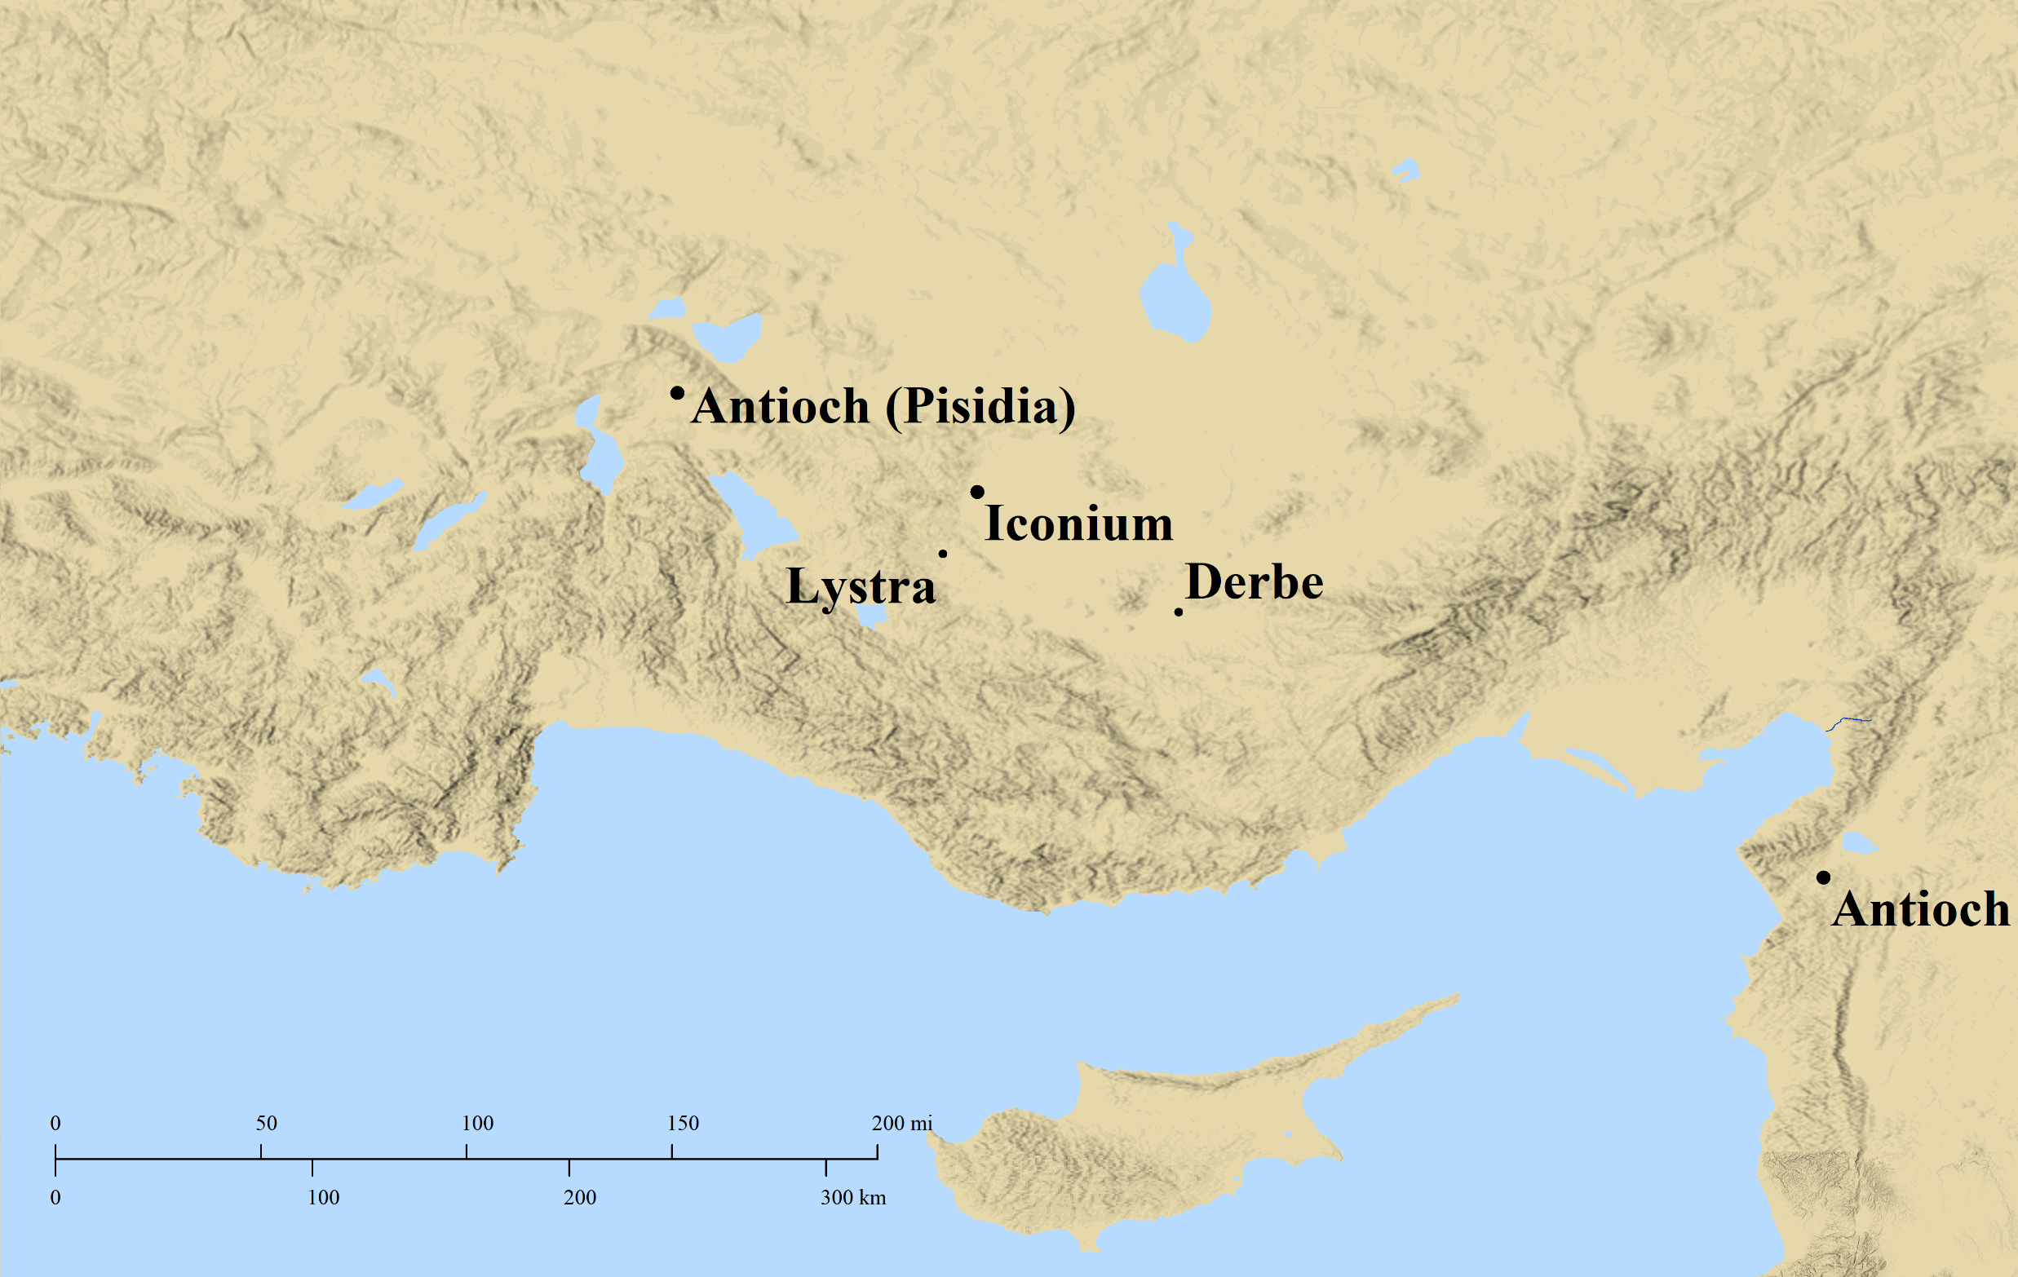
What About Us?
There is Biblical Authority for Churches without Elders
Acts 14:23 And when they had appointed elders for them in every church, having prayed with fasting, they commended them to the Lord in whom they had believed.

Slide 22
What About Us?
There is Biblical Authority for Churches without Elders
There is NO Biblical Authority for Churches to be Content w/o Elders
Apostolic Example (Acts 14:23)
Apostolic Instruction (Titus 1:5)
ESV “put what remained into order”
LSB “set in order what remains”
NET “set in order the remaining matters”
Is it Becoming Traditional to have churches without Elders?
Is it Becoming Traditional to substitute Business Meetings for Elders?
There is Biblical Authority for Churches to function without Elders
Two passages
One pertaining to material concerns
One pertaining to spiritual concerns
Acts 6
1 Corinthians 5

Slide 23
The New Testament lays out a plan….
The same with or without elders
Congregational Action
Deacons
Individual Initiative
It’s a mistake to think that without elders, we are cut loose from Biblical instruction

