Slide 1
Fruits of Faith
We were buried therefore with him by baptism into death, in order that, just as Christ was raised from the dead by the glory of the Father, we too might walk in newness of life. Romans 6:4
*All scripture verses are from the ESV, unless stated otherwise*

Slide 2
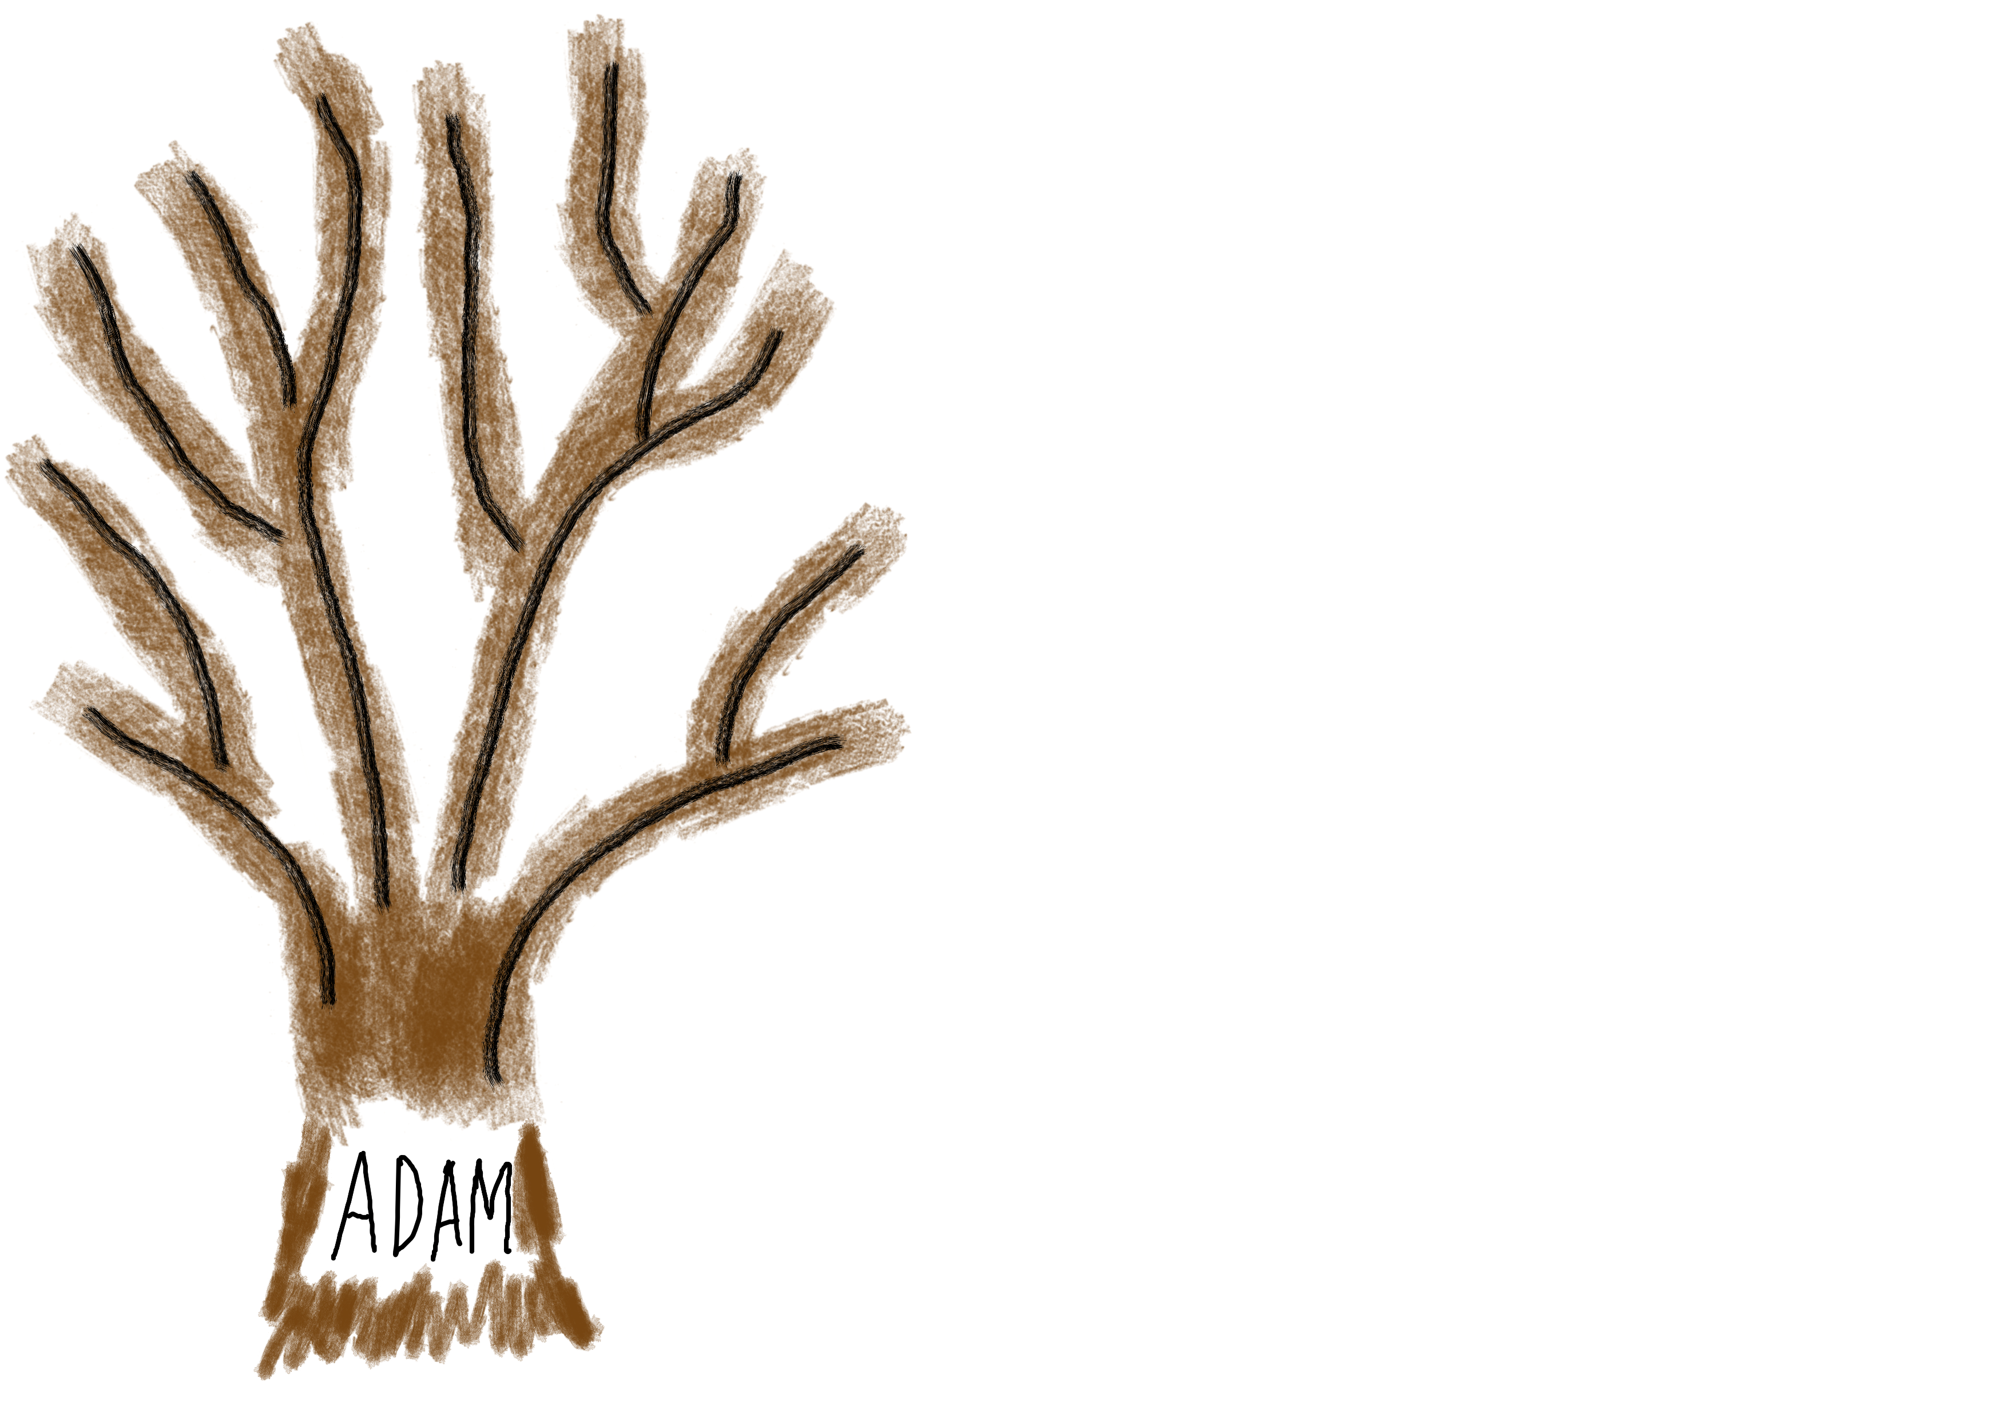
Made in the image of God
Perfect Nature

Slide 3
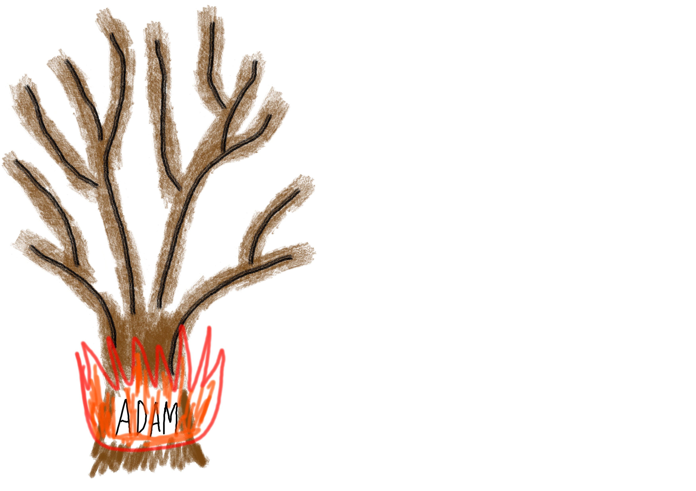
Made in the image of God
Perfect Nature
Sin Nature

Slide 4
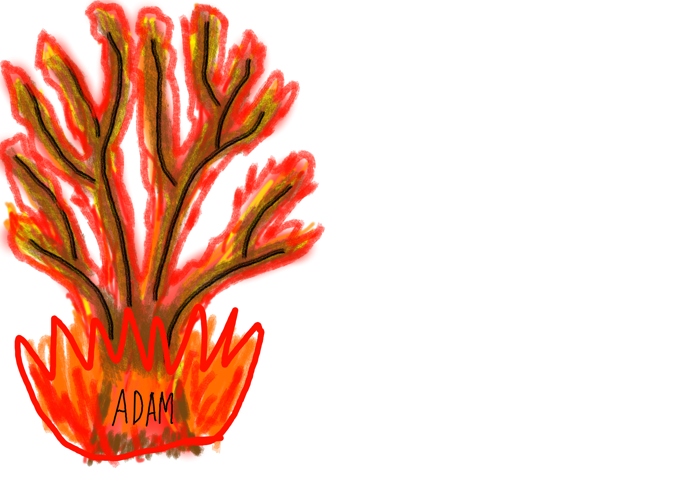
That which is born of the flesh is flesh, and that which is born of the Spirit is spirit.
- John 3:6

Slide 5
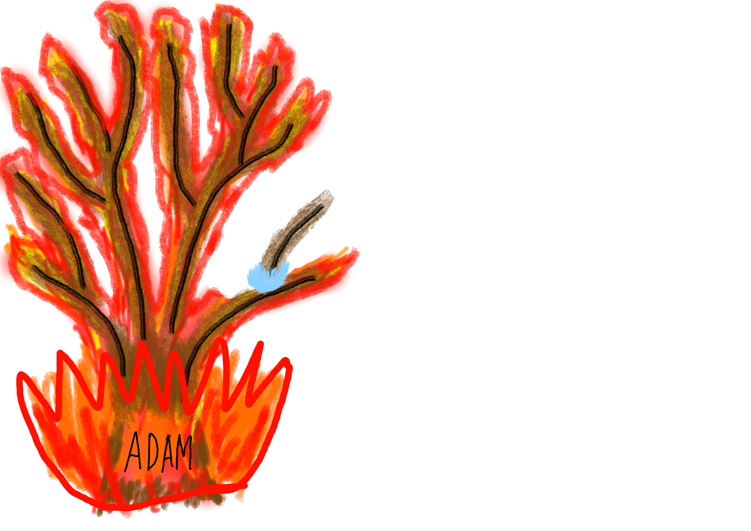
Jesus was born into the pure nature of God, not into the sin nature of Adam.

Slide 6
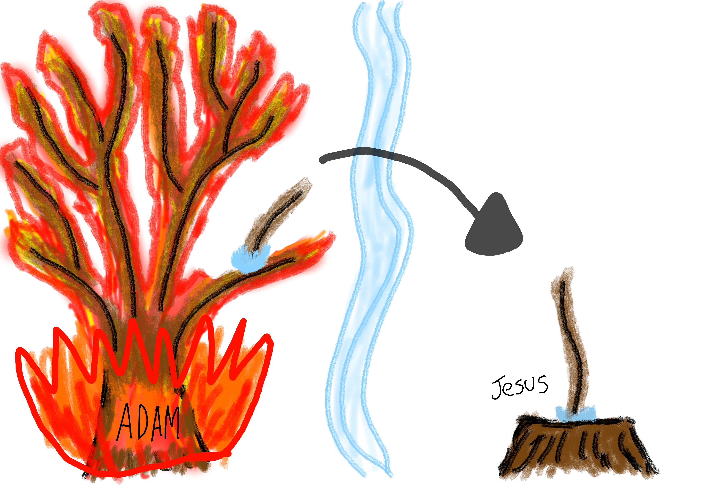
There shall come forth a shoot from the stump of Jesse, and a branch from his roots shall bear fruit. Isaiah 11:1

Slide 7
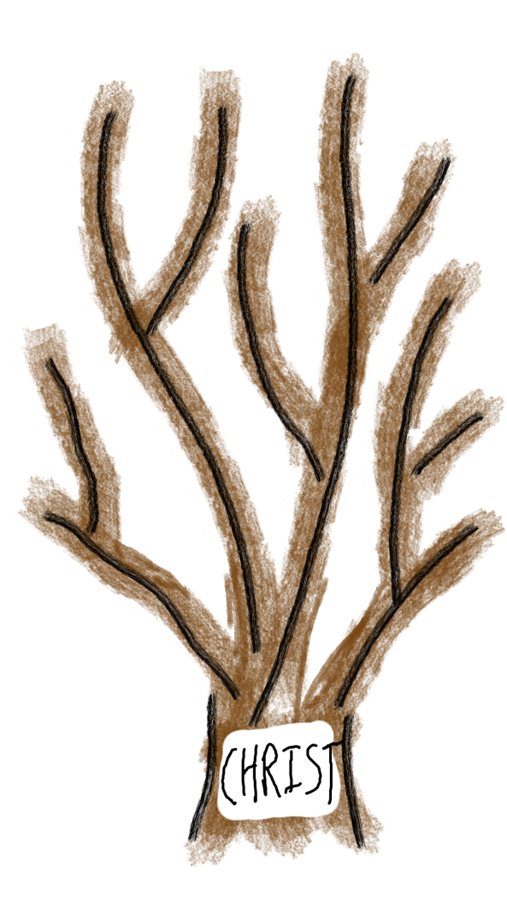
Same Perfect Nature
Yet death reigned from Adam to Moses, even over those whose sinning was not like the transgression of Adam, who was a type of the one who was to come. (Jesus)
- Romans 5:14

Slide 8
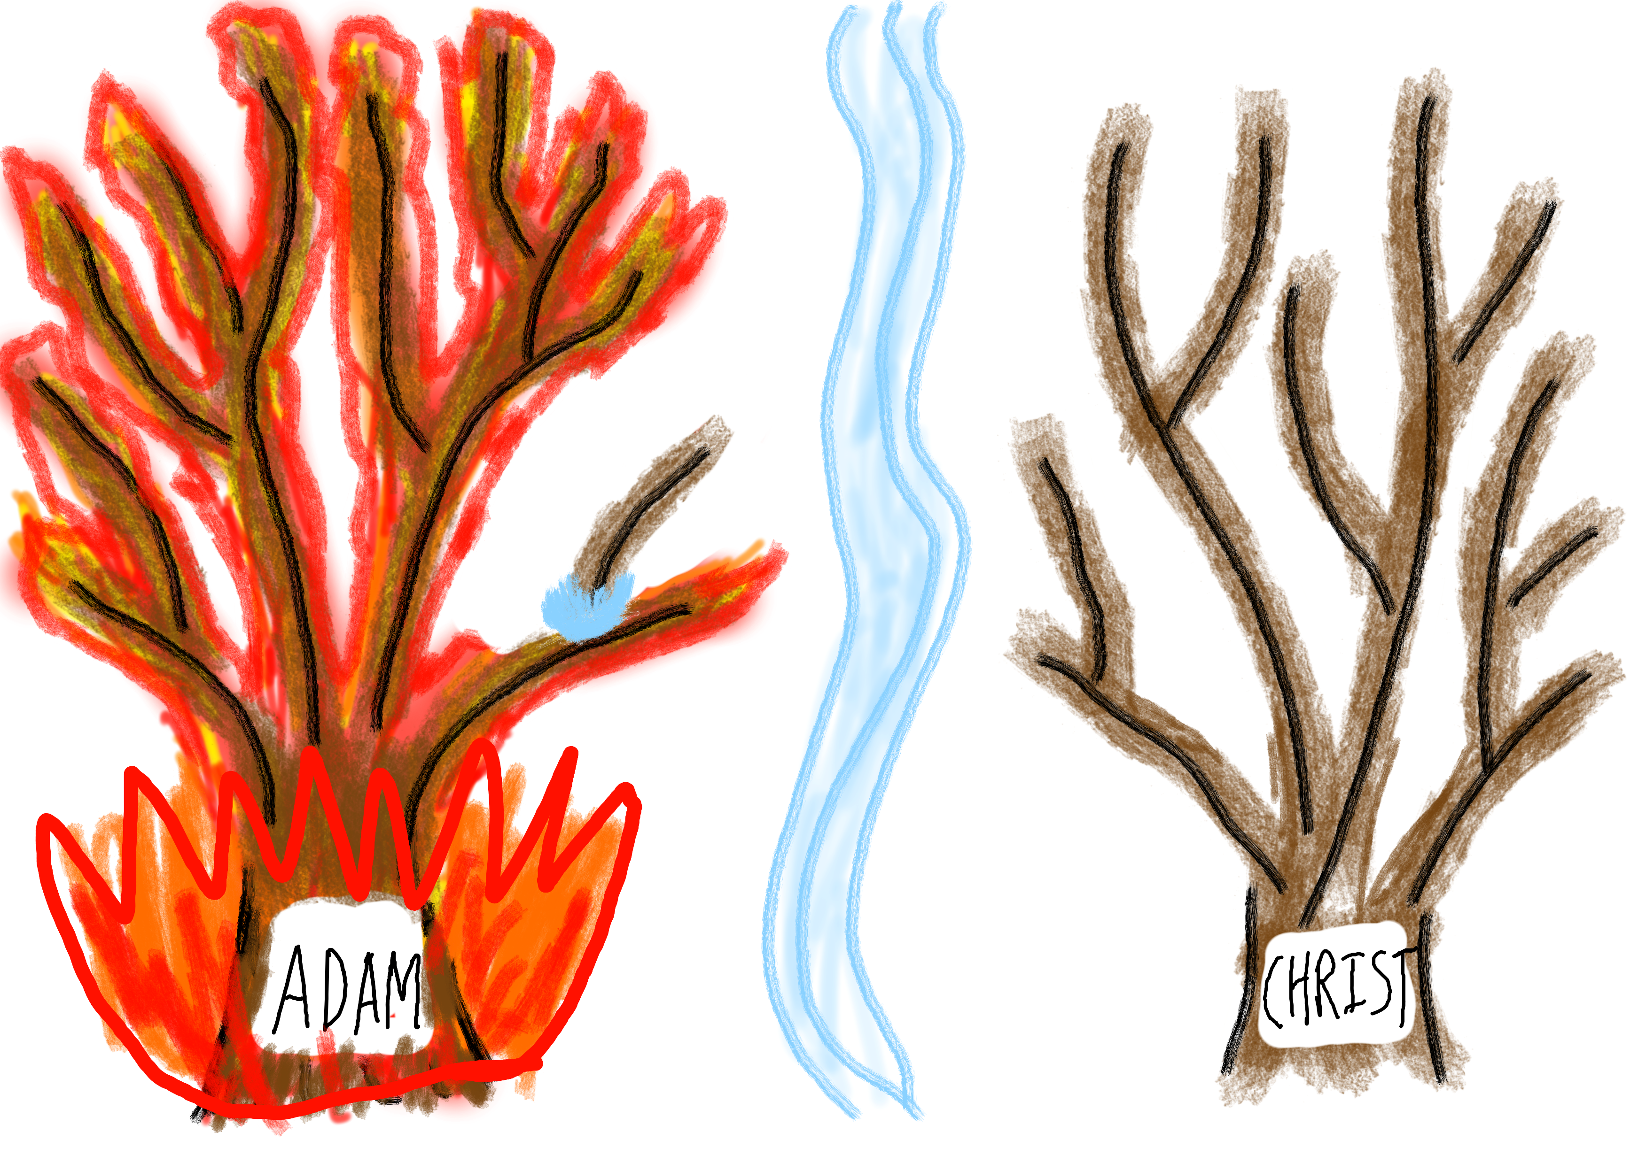
But if some of the branches were broken off, and you, although a wild olive shoot, were grafted in among the others and now share in the nourishing root of the olive tree
- Romans 11:17
That which is born of the flesh is flesh, and that which is born of the Spirit is spirit.
-John 3:6

Slide 9
Then he showed me Joshua the high priest standing before the angel of the LORD, and Satan standing at his right hand to accuse him. 2 And the LORD said to Satan, “The LORD rebuke you, O Satan! The LORD who has chosen Jerusalem rebuke you! Is not this a brand (burning stick) plucked from the fire?”
-Zechariah 3:1-2

Slide 10
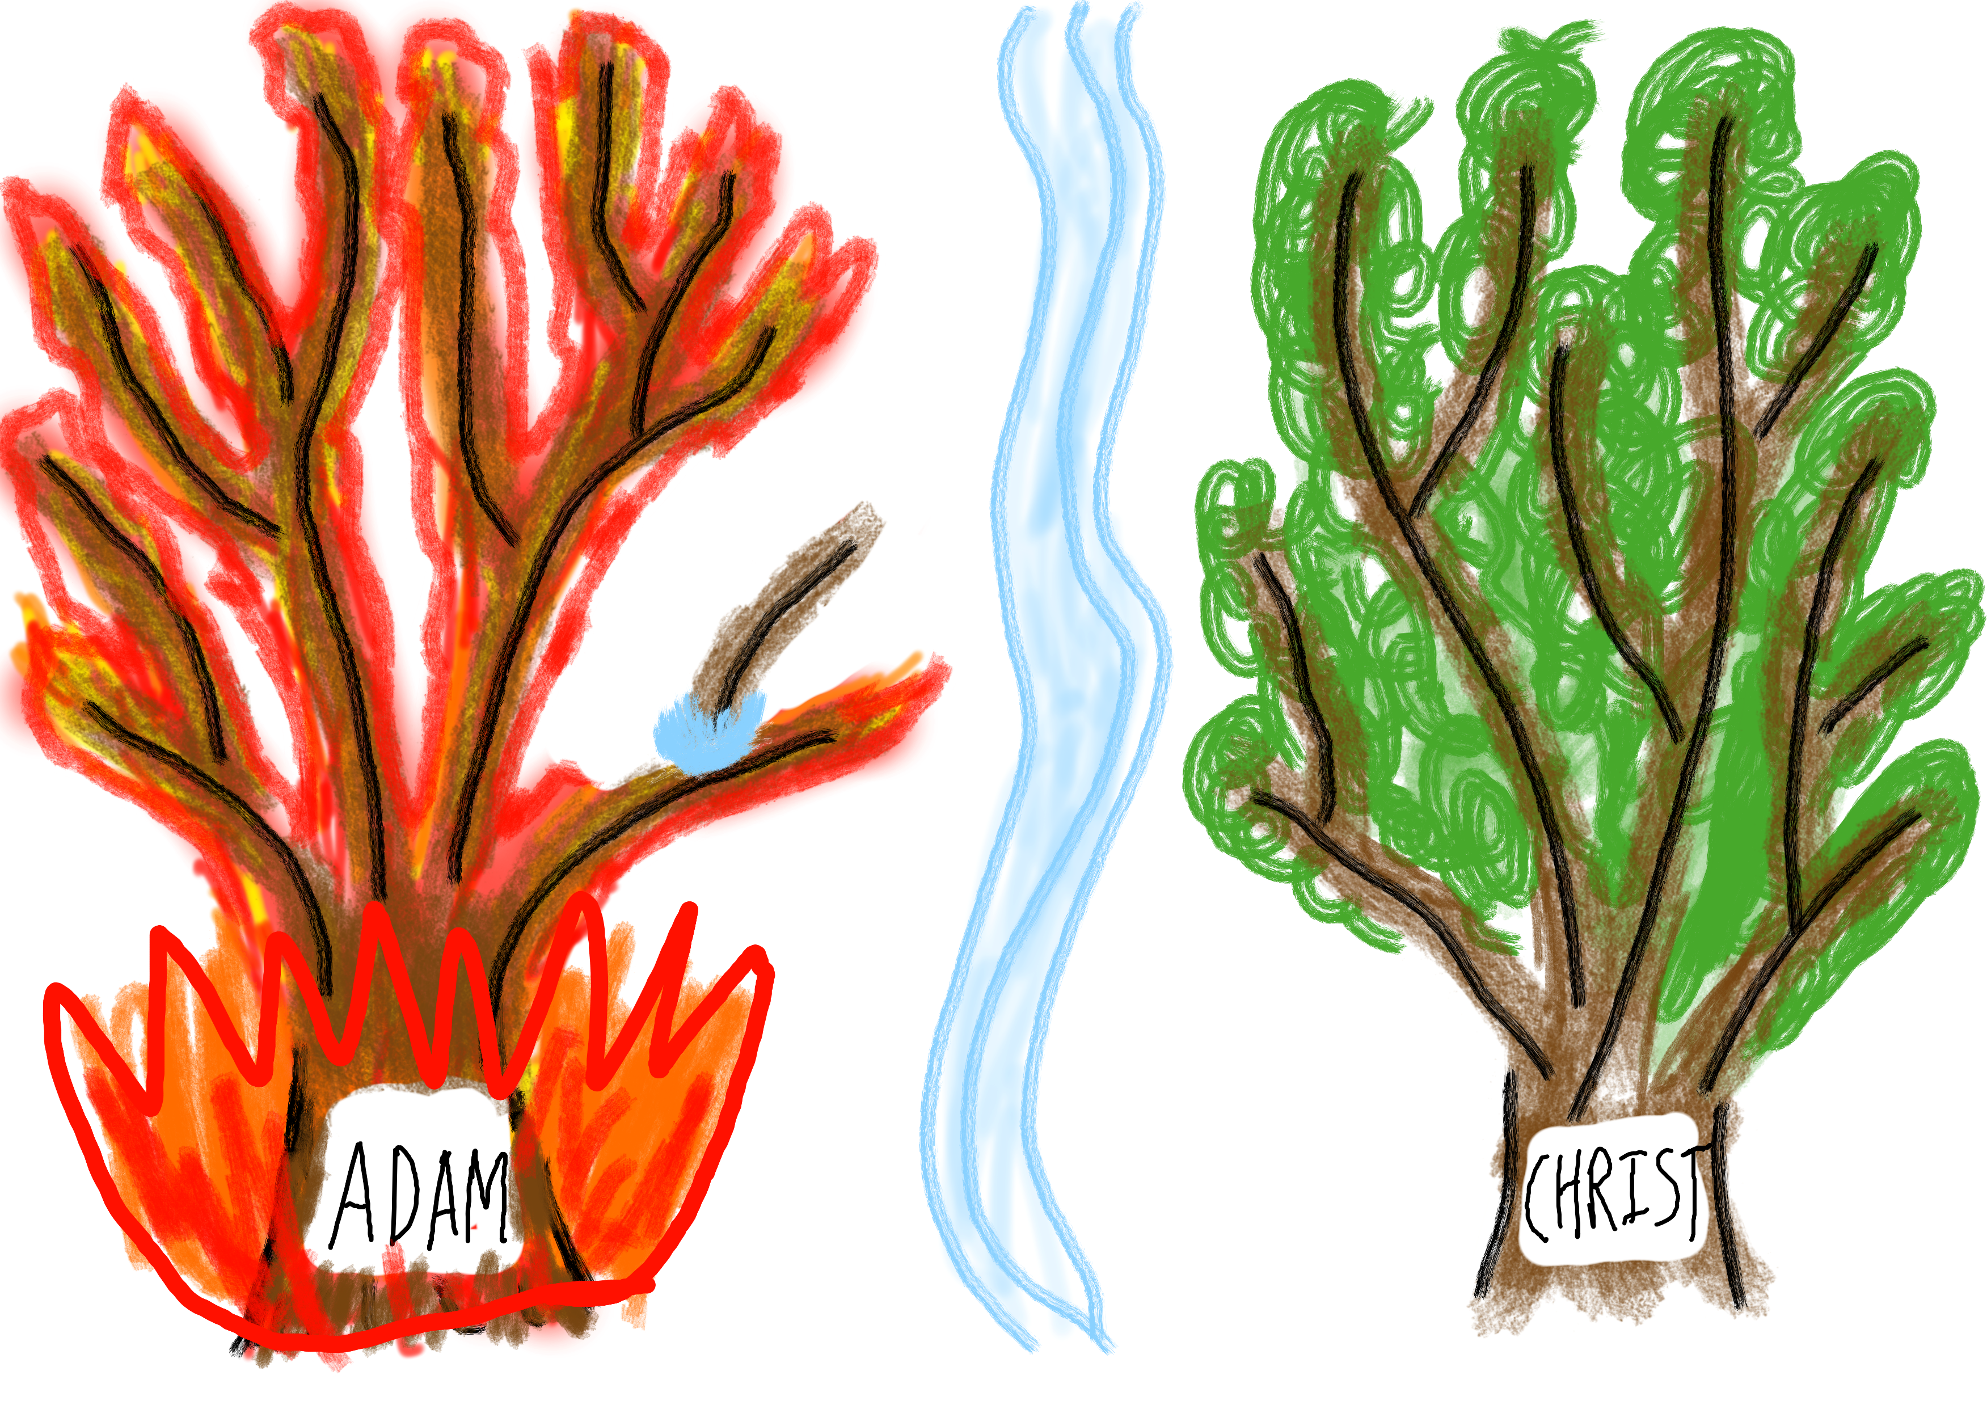
For the desires of the flesh are against the Spirit, and the desires of the Spirit are against the flesh, for these are opposed to each other, to keep you from doing the things you want to do.
- Galatians 5:17
SIN
DEATH
RIGHTEOUSNESS
LIFE
FLESH
SPIRIT

Slide 11
Tree of DEATH
Tree of LIFE
SPIRIT
FLESH
For the one who sows to his own flesh will from the flesh reap corruption, but the one who sows to the Spirit will from the Spirit reap eternal life.
- Galatians 6:8

Slide 12
School
God has written the solution to all the social and economics issues we face today.
God's solution is the simple, elegant, yet it is counted as foolishness to the world.

Slide 13
School
Corporate Social responsibility:
Should profit-centered businesses have social obligations?

Slide 14
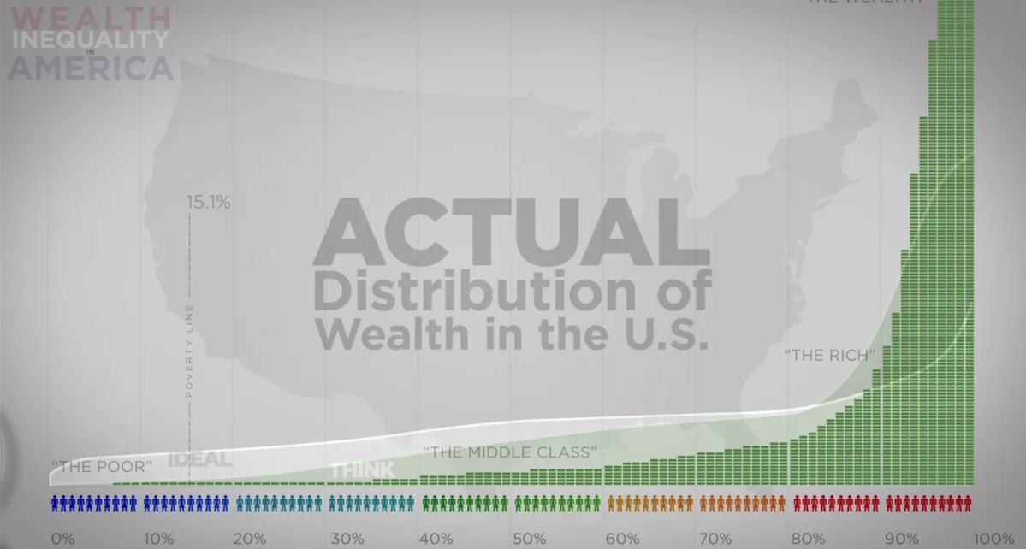
Problem with a Fallen Society

Slide 15
School
Corporate Social responsibility:
Should profit-centered businesses have social obligations?
Progressive Tax system:
Do governments have a right to take the money of the rich for the sake of the poor?

Slide 16
Problem with a Fallen Society
Sense of Morality in all people: “They show that the work of the law is written on their hearts, while their conscience also bears witness”
– Romans 2:15
Unjustified Morality OR Selfish Interests?

Slide 17
God’s Society
Do nothing from selfish ambition or conceit, but in humility count others more significant than yourselves. – Philippians 2:3
They gathered, some more, some less. But when they measured it with an omer, whoever gathered much had nothing left over, and whoever gathered little had no lack. Each of them gathered as much as he could eat. – Exodus 16:17-18

Slide 18
Fallen Society
God’s Society
Self – ISH - ness
Self – LESS - ness

Slide 19
God’s Society
“No one can serve two masters, for either he will hate the one and love the other, or he will be devoted to the one and despise the other. You cannot serve God and money. – Matthew 6:24
If you lend money to any of my people with you who is poor, you shall not be like a moneylender to him, and you shall not exact interest from him. - Exodus 22:25
And if you lend to those from whom you expect to receive, what credit is that to you? Even sinners lend to sinners, to get back the same amount. But love your enemies, and do good, and lend, expecting nothing in return, and your reward will be great, and you will be sons of the Most High, for he is kind to the ungrateful and the evil. – Luke 6:34-35

Slide 20
God’s Society – The first Church
There was not a needy person among them, for as many as were owners of lands or houses sold them and brought the proceeds of what was sold and laid it at the apostles’ feet, and it was distributed to each as any had need. - Acts 4:34-35

Slide 21
Fallen Society
God’s Society
Selfishness
Selflessness
Foolishness

Slide 22
Squash
“Find your identity”
I play squash … so my identity is a Squash Player
But far be it from me to boast except in the cross of our Lord Jesus Christ, by which the world has been crucified to me, and I to the world. - Galatians 6:14
Personal Identity = Worthless

Slide 23
Identity of Self
Identity of Christ
DEATH
LIFE

Slide 24
Squash Rating System
Beginner
Average Squash Player
Varsity High School
College Level
Professionals
Ali Farag
(World #1)
5.1
1.5 2.5 3.5 4.5 5.5 6.5 7.5
Me
Rishi
My Identity
Worthless!

Slide 25
God
Worthy
Worthless
Man
All people are like grass, and all their glory is like the flowers of the field.
- New International Version
All flesh is like grass and all its glory like the flower of grass.
The grass withers, and the flower falls, but the word of the Lord remains forever. - 1 Peter 1:24-25

Slide 26
Paul’s Identity
But whatever gain I had, I counted as loss for the sake of Christ. Indeed, I count everything as loss because of the surpassing worth of knowing Christ Jesus my Lord. For his sake I have suffered the loss of all things and count them as rubbish, in order that I may gain Christ
- Philippians 3:7-8
If Paul can count the law of God as rubbish, how much more should we count as rubbish all our insignificant worldly abilities?

Slide 27
I have been crucified with Christ. It is no longer I who live, but Christ who lives in me. And the life I now live in the flesh I live by faith in the Son of God
- Galatians 2:20
Identity of Self
Identity of Christ
BOASTING IN
DEATH
BOASTING IN
LIFE

Slide 28
Seth and Cain
Lineage of Seth
Worship and serve God
Lineage of Cain
Seek to serve themselves

Slide 29
Purpose in Worldly Activities
Purpose in Christ
Tree of DEATH
Tree of LIFE

Slide 30
If it’s not God, it’s a Distraction!
Distractions
God

Slide 31
Society of Cain
Then Cain went away from the presence of the LORD and settled in the land of Nod, east of Eden. – Genesis 4:16
‌When he built a city, he called the name of the city after the name of his son, Enoch. – Genesis 4:17

Slide 32
Society of Cain
His brother’s name was Jubal; he was the father of all those who play the lyre and pipe. – Genesis 4:21
‌Zillah also bore Tubal-cain; he was the forger of all instruments of bronze and iron. – Genesis 4:22

Slide 33
Society of Cain
Society of Cain
God
Music and Metal Tools
Entertainment and Technology

Slide 34
Ineffective believers in Christ
For this very reason, make every effort to supplement your faith with virtue, and virtue with knowledge, and knowledge with self-control, and self-control with steadfastness, and steadfastness with godliness, and godliness with brotherly affection, and brotherly affection with love. For if these qualities are yours and are increasing, they keep you from being ineffective or unfruitful in the knowledge of our Lord Jesus Christ.
For whoever lacks these qualities is so nearsighted that he is blind, having forgotten that he was cleansed from his former sins.
2 Peter 1:5-11

Slide 35
Death VS Life
Distractions
God
Walk by Sight
Walk By Faith
Pleasure
Sports
Entertainment
Eternal
Infinite
Things of Little Importance
School
Social acceptance
Eternally and infinitely important
Career
Things that are Temporary

Slide 36
Society Today
Biggest industries: Entertainment and Technology
Entertainment: Movies, Music, Sports
Technology: Apple, Amazon, Google, Microsoft

Slide 37
Cain
👀
👀
God
Distractions
WORLD
Development
Entertainment

Slide 38
If we abandon God, all we have left are distractions!
Distractions
God

Slide 39
Last son of Cain
Adah bore Jabal; he was the father of those who dwell in tents and have livestock. – Genesis 4:20
Now Abel was a keeper of sheep, and Cain a worker of the ground. – Genesis 4:2

Slide 40
God’s Provision
God’s daily provision of manna for his people
And the LORD said to Aaron, “You shall have no inheritance in their land, neither shall you have any portion among them. I am your portion and your inheritance among the people of Israel. – Numbers 18:20
To the Levites I have given every tithe in Israel for an inheritance, in return for their service that they do, their service in the tent of meeting – Numbers 18:21

Slide 41
God’s Provision
²⁵ “Therefore I tell you, do not be anxious about your life, what you will eat or what you will drink, nor about your body, what you will put on. Is not life more than food, and the body more than clothing? ²⁶ Look at the birds of the air: they neither sow nor reap nor gather into barns, and yet your heavenly Father feeds them. Are you not of more value than they?
Matthew 6:25-33

Slide 42
God’s Provision
²⁷ And which of you by being anxious can add a single hour to his span of life? ²⁸ And why are you anxious about clothing? Consider the lilies of the field, how they grow: they neither toil nor spin, ²⁹ yet I tell you, even Solomon in all his glory was not arrayed like one of these. ³⁰ But if God so clothes the grass of the field, which today is alive and tomorrow is thrown into the oven, will he not much more clothe you, O you of little faith?
Matthew 6:25-33

Slide 43
God’s Provision
³¹ Therefore do not be anxious, saying, ‘What shall we eat?’ or ‘What shall we drink?’ or ‘What shall we wear?’ ³² For the Gentiles seek after all these things, and your heavenly Father knows that you need them all. ³³ But seek first the kingdom of God and his righteousness, and all these things will be added to you.”
Matthew 6:25-33

Slide 44
Importance of bearing good fruit
the branch cannot bear fruit by itself
Abide in me, and I in you. As the branch cannot bear fruit by itself, unless it abides in the vine, neither can you, unless you abide in me. I am the vine; you are the branches. – John 15:4-5
So, every healthy tree bears good fruit, but the diseased tree bears bad fruit. A healthy tree cannot bear bad fruit, nor can a diseased tree bear good fruit. Every tree that does not bear good fruit is cut down and thrown into the fire. – Matthew 7:17-19
Every branch in me that does not bear fruit he takes away, and every branch that does bear fruit he prunes, that it may bear more fruit. – John 15:2
There shall come forth a shoot from the stump of Jesse, and a branch from his roots shall bear fruit. – Isaiah 11:1
neither can you, unless you abide in me.
healthy tree bears good fruit
diseased tree bears bad
fruit
Every tree that does not bear good fruit is cut down and
thrown into the fire
Every branch in me that
does not bear fruit he takes away
every
branch that
does bear fruit he prunes
There shall come forth a shoot from the stump of Jesse, and a branch from
his roots shall bear fruit.

Slide 45
the branch cannot bear fruit by itself
neither can you, unless you abide in me.
fruit
diseased tree bears bad
healthy tree bears good fruit
Every tree that does not bear good fruit is cut down and
Every branch in me that
does not bear fruit he takes away
thrown into the fire
every
branch that
does bear fruit he prunes
There shall come forth a shoot from the stump of Jesse, and a branch from
his roots shall bear fruit.

Slide 46
How to abide in Christ
His divine power has granted to us all things that pertain to life and godliness, through the knowledge of him who called us to his own glory and excellence, 4 by which he has granted to us his precious and very great promises, so that through them you may become partakers of the divine nature, having escaped from the corruption that is in the world because of sinful desire.
2 Peter 1:3-11

Slide 47
How to abide in Christ
5 For this very reason, make every effort to supplement your faith with virtue, and virtue with knowledge, 6 and knowledge with self-control, and self-control with steadfastness, and steadfastness with godliness, 7 and godliness with brotherly affection, and brotherly affection with love.
2 Peter 1:3-11

Slide 48
How to abide in Christ
8 For if these qualities are yours and are increasing, they keep you from being ineffective or unfruitful in the knowledge of our Lord Jesus Christ. 9 For whoever lacks these qualities is so nearsighted that he is blind, having forgotten that he was cleansed from his former sins. 10 Therefore, brothers, be all the more diligent to confirm your calling and election, for if you practice these qualities you will never fall.
11 For in this way there will be richly provided for you an entrance into the eternal kingdom of our Lord and Savior Jesus Christ.
2 Peter 1:3-11

Slide 49
How to abide in Christ
For the one who sows to his own flesh will from the flesh reap corruption, but the one who sows to the Spirit will from the Spirit reap eternal life. – Galatians 6:8

Slide 50
Thank God for his Salvation!
Let us also lay aside every weight, and sin which clings so closely, and let us run with endurance the race that is set before us,
looking to Jesus, the founder and perfecter of our faith, who for the joy that was set before him endured the cross, despising the shame, and is seated at the right hand of the throne of God.
- Hebrews 12:1-2

