Slide 1
Joel

Slide 2
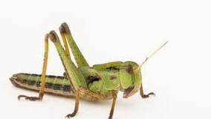
Chapter 1
Locust Invasion?
Chapter 2

Slide 3
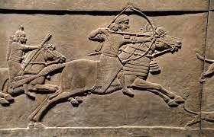
Chapter 1
Military
Invasion?
Chapter 2
Joel 2:17 “…And do not give Your heritage to reproach, That the nations should rule over them”
(NKJB, so also KJV, ASV)

Slide 4
Chapter 1
Military
Invasion?
Chapter 2
Joel 2:17 “…make not your heritage a reproach, a byword among the nations.”
(ESV, most modern translations)

Slide 5
Chapter 1
A recent Locust Invasion
Chapter 2
A future “Day of the Lord”

Slide 6
Chapter 1
A recent Locust Invasion
Chapter 2
A future “Day of the Lord”
Chapter 3
A subsequent Day of Judgment upon the enemies of God’s people
an army is coming and it’s going to be like a locust invasion

Slide 7
Chapter 1
A recent Locust Invasion

Slide 8
1 The word of the Lord that came to Joel, the son of Pethuel:
² Hear this, you elders, And listen, all inhabitants of the land. Has anything like this happened in your days, Or in your fathers’ days? ³ Tell your sons about it, And have your sons tell their sons, And their sons the next generation.
A Memorable Event

Slide 9
⁴ What the gnawing locust has left, the swarming locust has eaten; And what the swarming locust has left, the creeping locust has eaten; And what the creeping locust has left, the stripping locust has eaten.
A Memorable Event

Slide 10
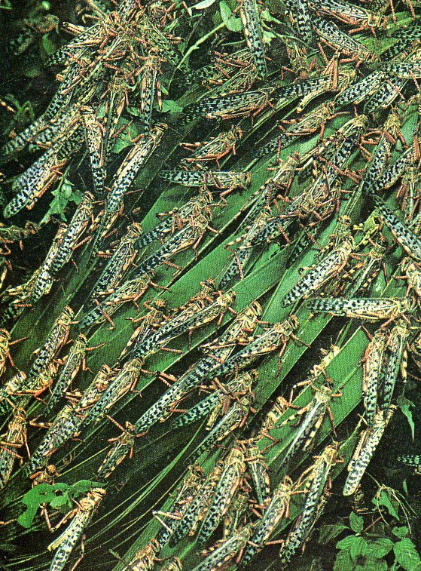
⁴ What the gnawing locust has left, the swarming locust has eaten; And what the swarming locust has left, the creeping locust has eaten; And what the creeping locust has left, the stripping locust has eaten.
Merida, Mexico, 2004

Slide 11
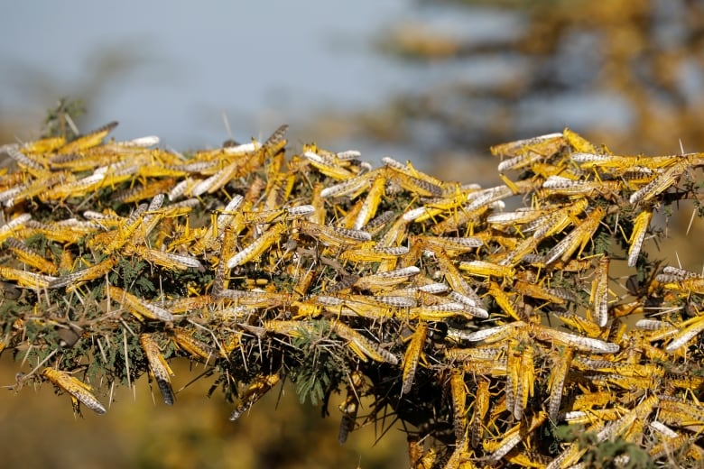
⁴ What the gnawing locust has left, the swarming locust has eaten; And what the swarming locust has left, the creeping locust has eaten; And what the creeping locust has left, the stripping locust has eaten.
Merida, Mexico, 2004

Slide 12
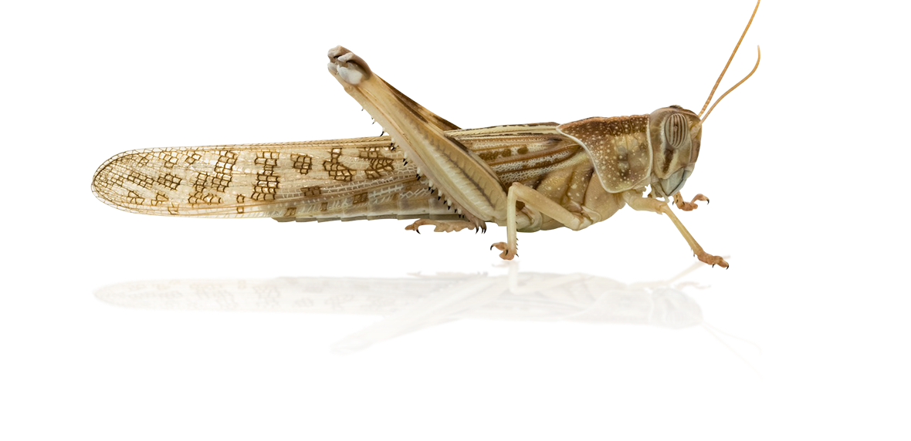
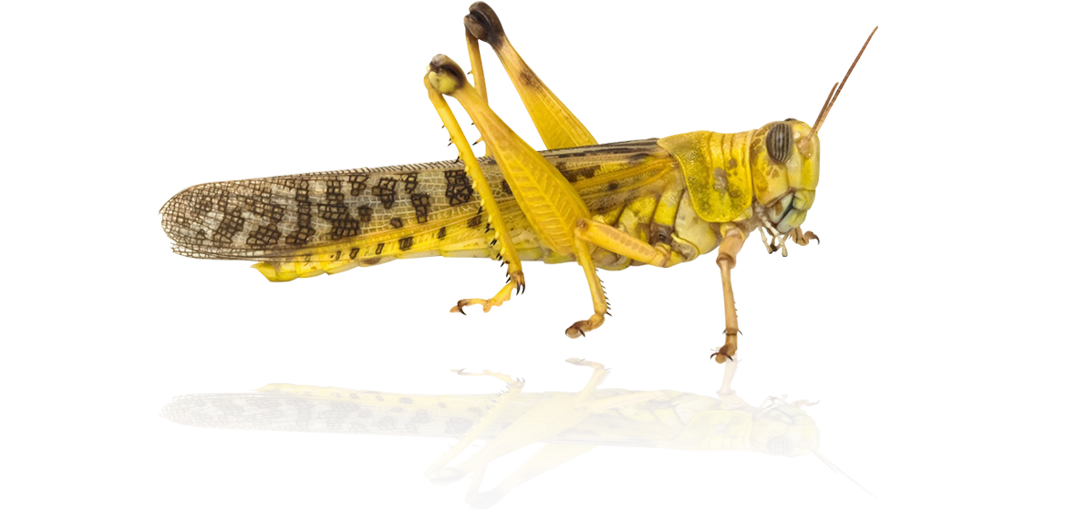
⁴ What the gnawing locust has left, the swarming locust has eaten; And what the swarming locust has left, the creeping locust has eaten; And what the creeping locust has left, the stripping locust has eaten.
https://www.bbc.co.uk/news/resources/idt-84994842-8967-4dfd-9490-10f805de9f68

Slide 13
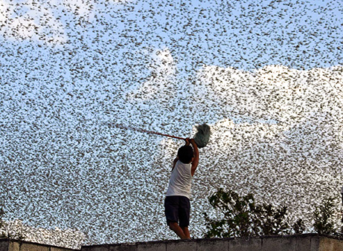
⁴ What the gnawing locust has left, the swarming locust has eaten; And what the swarming locust has left, the creeping locust has eaten; And what the creeping locust has left, the stripping locust has eaten.
“A swarm a mile in width…might take 10 days to pass through an area, utterly destroying a mile-wide belt.” NG Apr. ‘53
Merida, Mexico, 2004

Slide 14
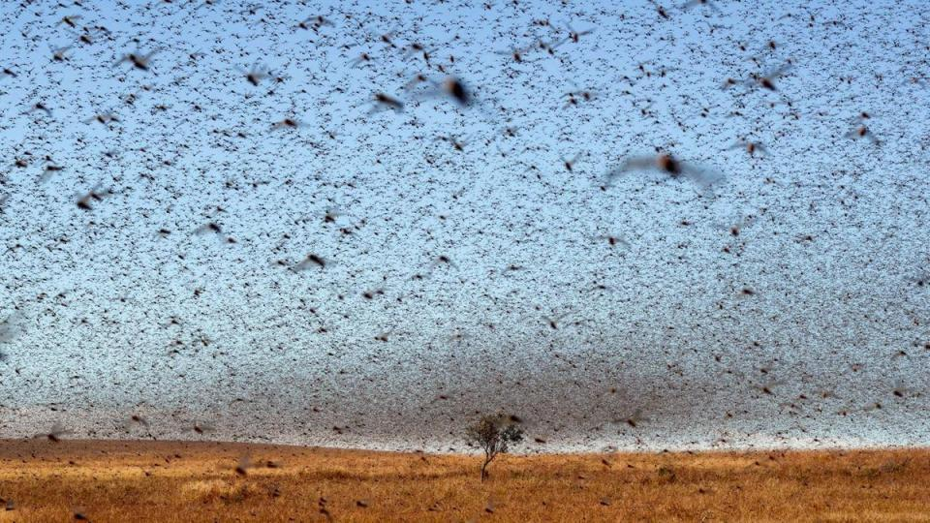
⁴ What the gnawing locust has left, the swarming locust has eaten; And what the swarming locust has left, the creeping locust has eaten; And what the creeping locust has left, the stripping locust has eaten.
“Even an average swarm can destroy crops sufficient to feed 2,500 people for a year”
https://www.bbc.co.uk/news/resources/idt-84994842-8967-4dfd-9490-10f805de9f68
https://www.bethimmanuel.org/audio/nahum-joel-and-locust-plague

Slide 15
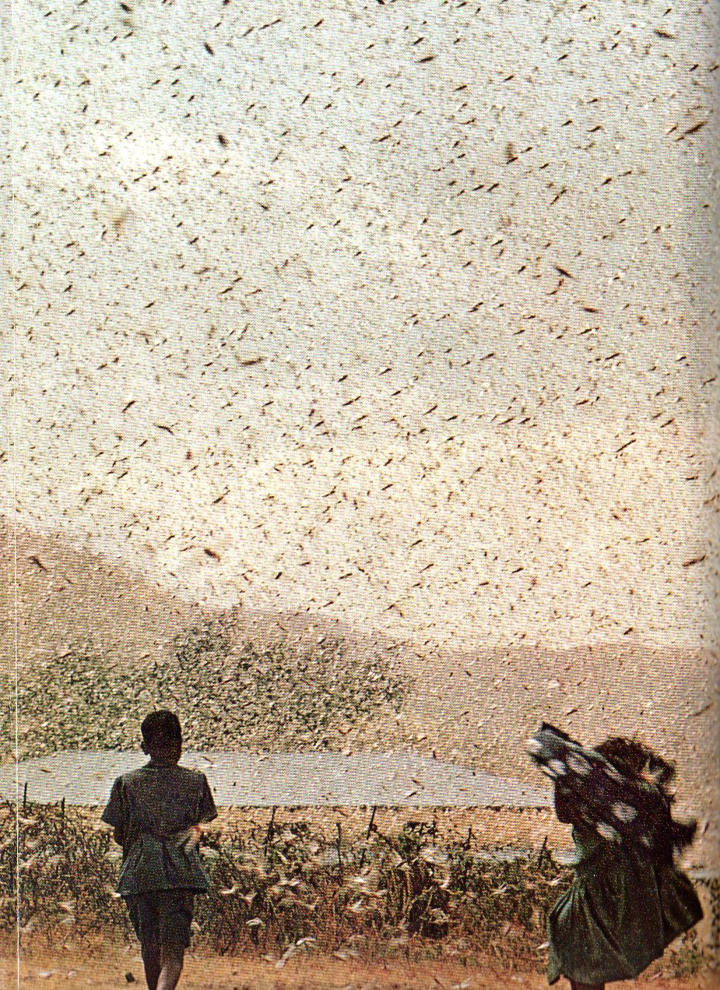
⁴ What the gnawing locust has left, the swarming locust has eaten; And what the swarming locust has left, the creeping locust has eaten; And what the creeping locust has left, the stripping locust has eaten.
Merida, Mexico, 2004

Slide 16
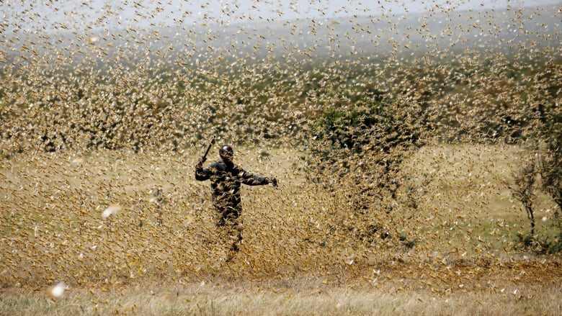
⁴ What the gnawing locust has left, the swarming locust has eaten; And what the swarming locust has left, the creeping locust has eaten; And what the creeping locust has left, the stripping locust has eaten.
https://www.cbc.ca/radio/thecurrent/the-current-for-may-1-2020-1.5552112/facing-covid-19-crumbling-economies-and-locusts-expert-warns-of-another-crisis-famine-1.5552938

Slide 17
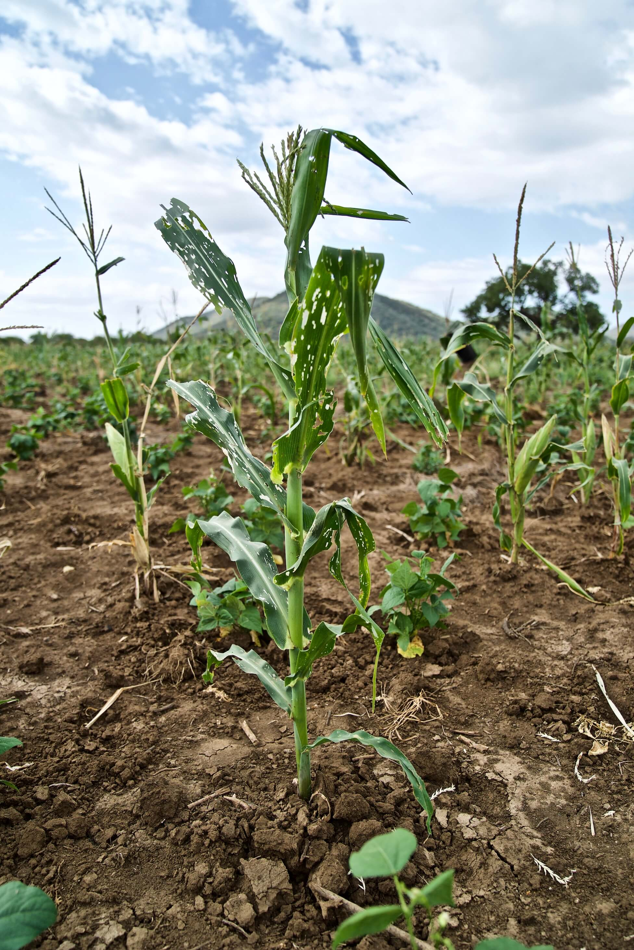
⁵ Awake, you heavy drinkers, and weep; And wail, all you wine drinkers, Because of the sweet wine, For it has been eliminated from your mouth. ⁶ For a nation has invaded my land, Mighty and without number; Its teeth are the teeth of a lion, And it has the jaws of a lioness. ⁷ It has made my vine a waste And my fig tree a stump. It has stripped them bare and hurled them away; Their branches have become white.

Slide 18
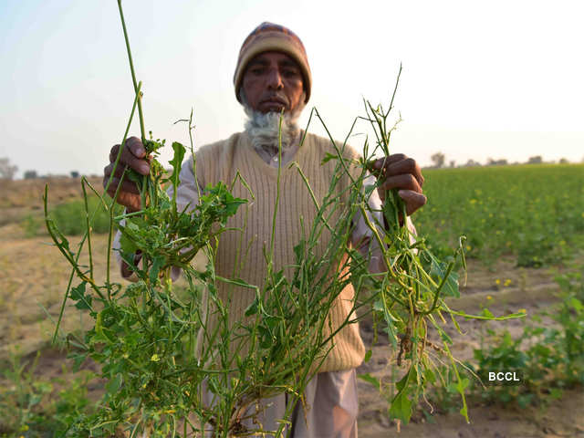
⁵ Awake, you heavy drinkers, and weep; And wail, all you wine drinkers, Because of the sweet wine, For it has been eliminated from your mouth. ⁶ For a nation has invaded my land, Mighty and without number; Its teeth are the teeth of a lion, And it has the jaws of a lioness. ⁷ It has made my vine a waste And my fig tree a stump. It has stripped them bare and hurled them away; Their branches have become white.
https://economictimes.indiatimes.com/news/politics-and-nation/why-the-locust-swarms-pose-a-threat/destruction/slideshow/76031242.cms

Slide 19
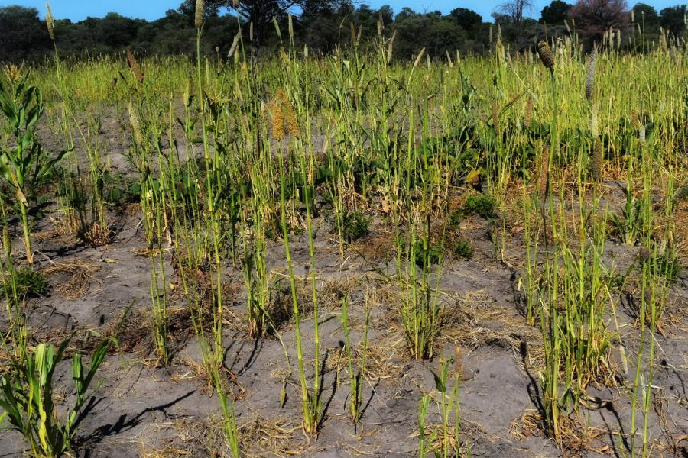
⁵ Awake, you heavy drinkers, and weep; And wail, all you wine drinkers, Because of the sweet wine, For it has been eliminated from your mouth. ⁶ For a nation has invaded my land, Mighty and without number; Its teeth are the teeth of a lion, And it has the jaws of a lioness. ⁷ It has made my vine a waste And my fig tree a stump. It has stripped them bare and hurled them away; Their branches have become white.
Deuteronomy 28:38
“You will bring out a great amount of seed to the field, but you will gather in little, because the locust will devour it.”
https://namibia.un.org/en/129568-frontlines-battling-namibias-worst-locust-crisis

Slide 20
⁸ Wail like a virgin clothed with sackcloth For the groom of her youth. ⁹ The grain offering and the drink offering have been cut off From the house of the Lord. The priests mourn, The ministers of the Lord. ¹⁰ The field is ruined, The land mourns; For the grain is ruined, The new wine has dried up, Fresh oil has failed.

Slide 21
⁸ Wail like a virgin clothed with sackcloth For the groom of her youth. ⁹ The grain offering and the drink offering have been cut off From the house of the Lord. The priests mourn, The ministers of the Lord. ¹⁰ The field is ruined, The land mourns; For the grain is ruined, The new wine has dried up, Fresh oil has failed.
Exodus 29:38-40
“Now this is what you shall offer on the altar: two one-year-old lambs each day, continuously. ³⁹ The one lamb you shall offer in the morning, and the other lamb you shall offer at twilight; ⁴⁰ and there shall be a tenth of an ephah of fine flour mixed with a fourth of a hin of beaten oil, and a fourth of a hin of wine for a drink offering with one lamb.”

Slide 22
⁸ Wail like a virgin clothed with sackcloth For the groom of her youth. ⁹ The grain offering and the drink offering have been cut off From the house of the Lord. The priests mourn, The ministers of the Lord. ¹⁰ The field is ruined, The land mourns; For the grain is ruined, The new wine has dried up, Fresh oil has failed.
Exodus 29:38-40
“Now this is what you shall offer on the altar: two one-year-old lambs each day, continuously. ³⁹ The one lamb you shall offer in the morning, and the other lamb you shall offer at twilight; ⁴⁰ and there shall be a tenth of an ephah of fine flour mixed with a fourth of a hin of beaten oil, and a fourth of a hin of wine for a drink offering with one lamb.”

Slide 23
⁸ Wail like a virgin clothed with sackcloth For the groom of her youth. ⁹ The grain offering and the drink offering have been cut off From the house of the Lord. The priests mourn, The ministers of the Lord. ¹⁰ The field is ruined, The land mourns; For the grain is ruined, The new wine has dried up, Fresh oil has failed.
Exodus 29:38-40
“Now this is what you shall offer on the altar: two one-year-old lambs each day, continuously. ³⁹ The one lamb you shall offer in the morning, and the other lamb you shall offer at twilight; ⁴⁰ and there shall be a tenth of an ephah of fine flour mixed with a fourth of a hin of beaten oil, and a fourth of a hin of wine for a drink offering with one lamb.”

Slide 24
⁸ Wail like a virgin clothed with sackcloth For the groom of her youth. ⁹ The grain offering and the drink offering have been cut off From the house of the Lord. The priests mourn, The ministers of the Lord. ¹⁰ The field is ruined, The land mourns; For the grain is ruined, The new wine has dried up, Fresh oil has failed.
Exodus 29:38-40
“Now this is what you shall offer on the altar: two one-year-old lambs each day, continuously. ³⁹ The one lamb you shall offer in the morning, and the other lamb you shall offer at twilight; ⁴⁰ and there shall be a tenth of an ephah of fine flour mixed with a fourth of a hin of beaten oil, and a fourth of a hin of wine for a drink offering with one lamb.”

Slide 25
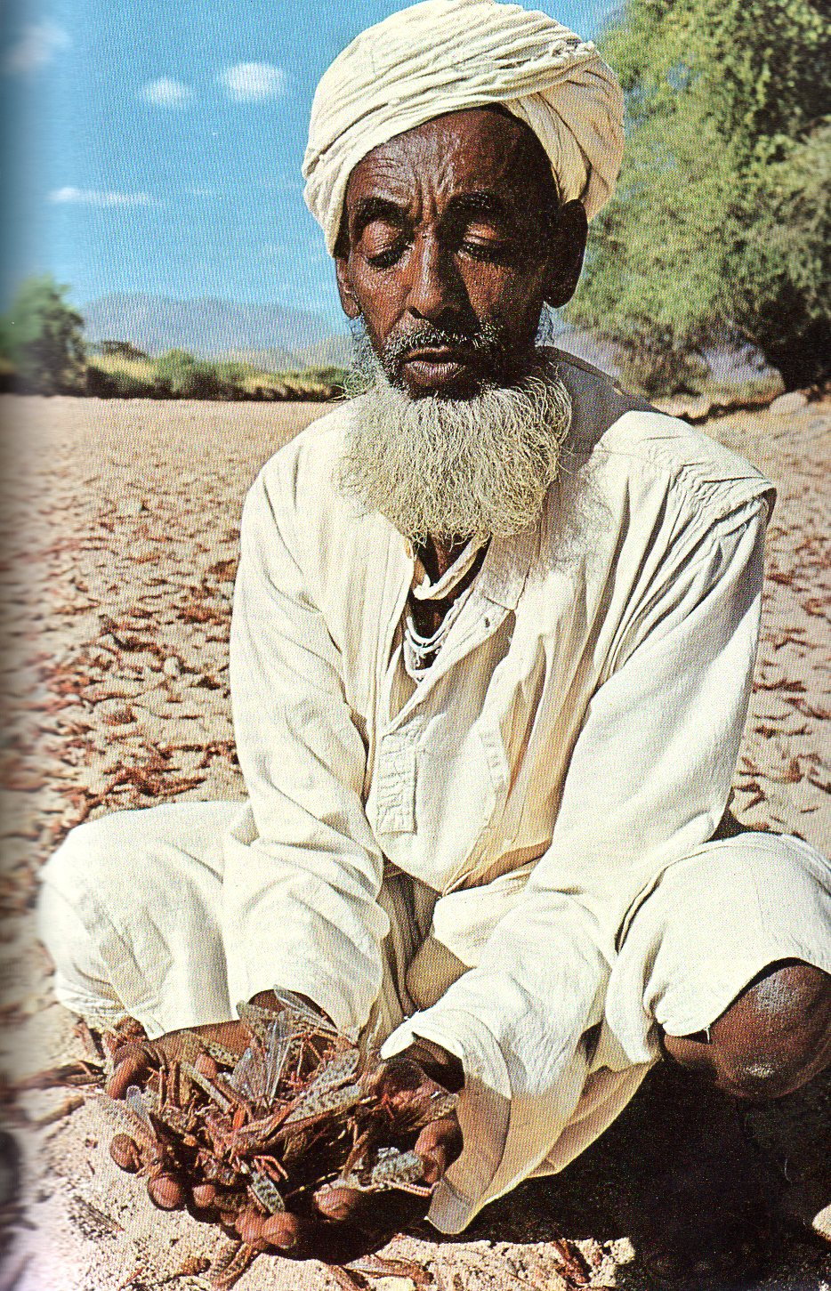
¹¹ Be ashamed, you farm workers, Wail, you vinedressers, For the wheat and the barley; Because the harvest of the field is destroyed. ¹² The vine has dried up And the fig tree has withered; The pomegranate, the palm also, and the apple tree, All the trees of the field have dried up. Indeed, joy has dried up From the sons of mankind.
"Ironically, the final solution, one that stops the locusts from hatching in prolific numbers, is another catastrophe - drought“
(NG Aug ‘69 p. 226).

Slide 26
¹³ Put on sackcloth And mourn, you priests; Wail, you ministers of the altar! Come, spend the night in sackcloth, You ministers of my God, For the grain offering and the drink offering Have been withheld from the house of your God.
¹⁴ Consecrate a fast, Proclaim a solemn assembly; Gather the elders And all the inhabitants of the land To the house of the Lord your God, And cry out to the Lord.

Slide 27
¹⁵ Woe for the day! For the day of the Lord is near, And it will come as destruction from the Almighty. ¹⁶ Has food not been cut off before our eyes, and Joy and rejoicing from the house of our God? ¹⁷ The seeds have dried up under their shovels; The storehouses have become desolate, The grain silos are ruined, Because the grain has dried up. ¹⁸ How the animals have groaned! The herds of cattle have wandered aimlessly Because there is no pasture for them; Even the flocks of sheep have suffered.
Transition
Paragraph

Slide 28
¹⁵ Woe for the day! For the day of the Lord is near, And it will come as destruction from the Almighty. ¹⁶ Has food not been cut off before our eyes, and Joy and rejoicing from the house of our God? ¹⁷ The seeds have dried up under their shovels; The storehouses have become desolate, The grain silos are ruined, Because the grain has dried up. ¹⁸ How the animals have groaned! The herds of cattle have wandered aimlessly Because there is no pasture for them; Even the flocks of sheep have suffered.
Recent events anticipate
a coming
“Day of the Lord”

Slide 29
¹⁹ To You, Lord, I cry out; For fire has devoured the pastures of the wilderness, And the flame has burned up all the trees of the field. ²⁰ Even the animals of the field pant for You; For the stream beds of water are dried up, And fire has devoured the pastures of the wilderness.

Slide 30
¹⁹ To You, Lord, I cry out; For fire has devoured the pastures of the wilderness, And the flame has burned up all the trees of the field. ²⁰ Even the animals of the field pant for You; For the stream beds of water are dried up, And fire has devoured the pastures of the wilderness.
Heavy Rains
Locust Invasion
Drought
Fires

Slide 31
Heavy Rains
Locust Invasion
Drought
Fires
1:4 1:12 1:19
Literal

Slide 32
Chapter 1
A recent Locust Invasion
Chapter 2
A future “Day of the Lord”

Slide 33
Chapter 1
A recent Locust Invasion
Chapter 2
A future “Day of the Lord”

Slide 34
Chapter 2
A future “Day of the Lord”

Slide 35
2 Blow a trumpet in Zion, And sound an alarm on My holy mountain! Let all the inhabitants of the land tremble, For the day of the Lord is coming; Indeed, it is near, ² A day of darkness and gloom, A day of clouds and thick darkness. As dawn is spread over the mountains, So there is a great and mighty people; There has never been anything like it, Nor will there be again after it To the years of many generations.

Slide 36
³ A fire consumes before them, And behind them a flame devours. The land is like the Garden of Eden before them, But a desolate wilderness behind them, And nothing at all escapes them.
Fires
Invasion
Fires
Figurative,
Not Literal

Slide 37
³ A fire consumes before them, And behind them a flame devours. The land is like the Garden of Eden before them, But a desolate wilderness behind them, And nothing at all escapes them.
Figure
of a locust invasion is
now used of an army
Fires
Invasion
Fires

Slide 38
⁴ Their appearance is like the appearance of horses; And like war horses, so they run. ⁵ With a noise as of chariots They leap about on the tops of the mountains, Like the crackling of a flame of fire consuming the stubble, Like a mighty people drawn up for battle. ⁶ Before them the people are in anguish; All faces turn pale. ⁷ They run like warriors, They climb the wall like soldiers; And each of them marches in line, Nor do they lose their way.

Slide 39
⁸ They do not crowd each other, Every warrior of them marches in his path; When they burst through the defenses, They do not break ranks. ⁹ They storm the city, They run on the wall; They climb into the houses, They enter through the windows like a thief. ¹⁰ Before them the earth quakes, The heavens tremble, The sun and the moon become dark, And the stars lose their brightness.
“Homes become fortresses when hoppers mass by thousands and seep in like water if a crack allows.”
NG Apr. ‘53

Slide 40
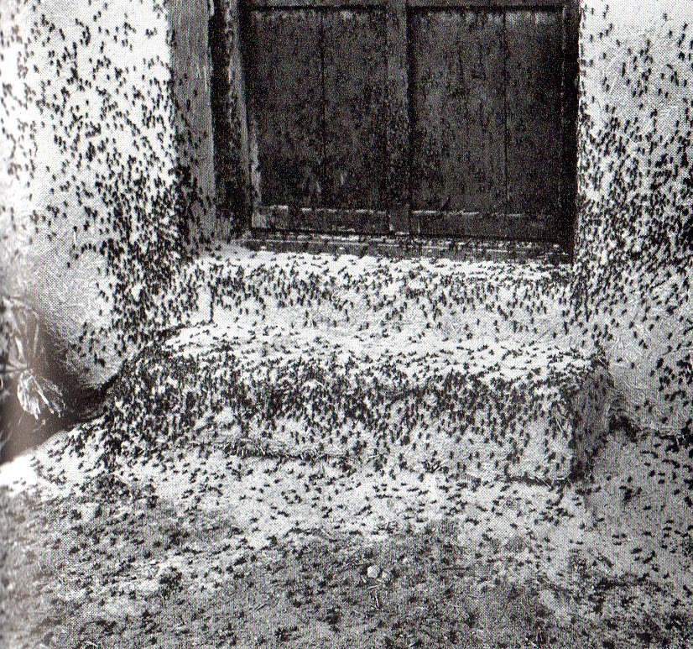
⁸ They do not crowd each other, Every warrior of them marches in his path; When they burst through the defenses, They do not break ranks. ⁹ They storm the city, They run on the wall; They climb into the houses, They enter through the windows like a thief. ¹⁰ Before them the earth quakes, The heavens tremble, The sun and the moon become dark, And the stars lose their brightness.
NG Apr. ‘53

Slide 41
⁸ They do not crowd each other, Every warrior of them marches in his path; When they burst through the defenses, They do not break ranks. ⁹ They storm the city, They run on the wall; They climb into the houses, They enter through the windows like a thief. ¹⁰ Before them the earth quakes, The heavens tremble, The sun and the moon become dark, And the stars lose their brightness.

Slide 42
¹¹ The Lord utters His voice before His army; His camp is indeed very great, For mighty is one who carries out His word. The day of the Lord is indeed great and very awesome, And who can endure it?

Slide 43
¹² “Yet even now,” declares the Lord, “Return to Me with all your heart, And with fasting, weeping, and mourning; ¹³ And tear your heart and not merely your garments.” Now return to the Lord your God, For He is gracious and compassionate, Slow to anger, abounding in mercy And relenting of catastrophe. ¹⁴ Who knows, He might turn and relent, And leave a blessing behind Him, Resulting in a grain offering and a drink offering For the Lord your God.

Slide 44
¹⁸ Then the Lord will be zealous for His land, And will have compassion for His people. ¹⁹ The Lord will answer and say to His people, “Behold, I am going to send you grain, new wine, and oil, And you will be satisfied in full with them; And I will never again make you a disgrace among the nations. ²⁰ But I will remove the northern army far from you, And I will drive it into a dry and desolate land, Its advance guard into the eastern sea, And its rear guard into the western sea. And its stench will ascend and its odor of decay will come up, Because it has done great things.”

Slide 45
¹⁸ Then the Lord will be zealous for His land, And will have compassion for His people. ¹⁹ The Lord will answer and say to His people, “Behold, I am going to send you grain, new wine, and oil, And you will be satisfied in full with them; And I will never again make you a disgrace among the nations. ²⁰ But I will remove the northern army far from you, And I will drive it into a dry and desolate land, Its advance guard into the eastern sea, And its rear guard into the western sea. And its stench will ascend and its odor of decay will come up, Because it has done great things.”
Messianic
Chapter 2 takes us beyond the “Day of the Lord” to the Messianic age

Slide 46
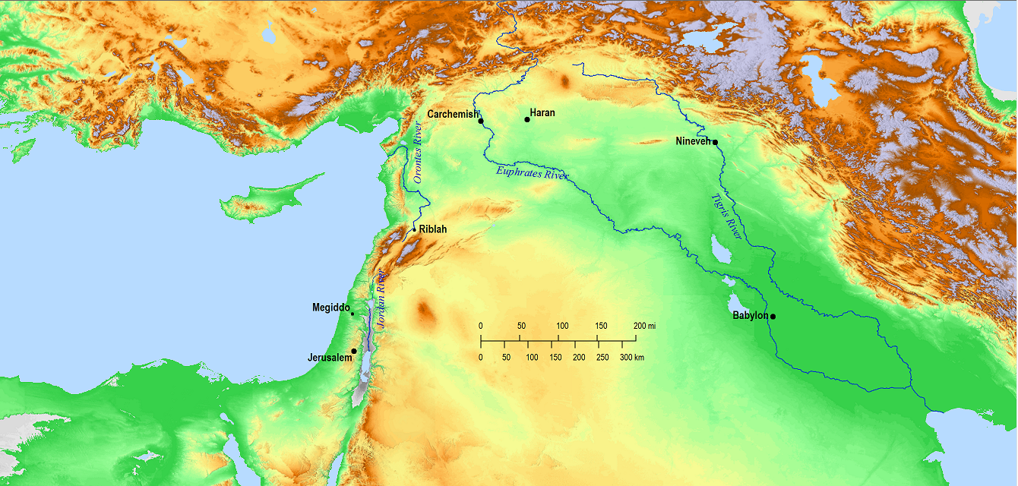
¹⁸ Then the Lord will be zealous for His land, And will have compassion for His people. ¹⁹ The Lord will answer and say to His people, “Behold, I am going to send you grain, new wine, and oil, And you will be satisfied in full with them; And I will never again make you a disgrace among the nations. ²⁰ But I will remove the northern army far from you, And I will drive it into a dry and desolate land, Its advance guard into the eastern sea, And its rear guard into the western sea. And its stench will ascend and its odor of decay will come up, Because it has done great things.”
Assyria
Babylon

Slide 47
¹⁸ Then the Lord will be zealous for His land, And will have compassion for His people. ¹⁹ The Lord will answer and say to His people, “Behold, I am going to send you grain, new wine, and oil, And you will be satisfied in full with them; And I will never again make you a disgrace among the nations. ²⁰ But I will remove the northern army far from you, And I will drive it into a dry and desolate land, Its advance guard into the eastern sea, And its rear guard into the western sea. And its stench will ascend and its odor of decay will come up, Because it has done great things.”
“Some swarms inexplicably commit suicide, flying out to sea after veering away from good feeding areas.” NG Apr. ‘53

Slide 48
²⁸ “It will come about after this That I will pour out My Spirit on all mankind; And your sons and your daughters will prophesy, Your old men will have dreams, Your young men will see visions. ²⁹ And even on the male and female servants I will pour out My Spirit in those days.
³⁰ I will display wonders in the sky and on the earth, Blood, fire, and columns of smoke. ³¹ The sun will be turned into darkness, And the moon into blood, Before the great and awesome day of the Lord comes. ³² And it will come about that everyone who calls on the name of the Lord Will be saved; For on Mount Zion and in Jerusalem There will be those who escape, Just as the Lord has said, Even among the survivors whom the Lord calls.

Slide 49
²⁸ “It will come about after this That I will pour out My Spirit on all mankind; And your sons and your daughters will prophesy, Your old men will have dreams, Your young men will see visions. ²⁹ And even on the male and female servants I will pour out My Spirit in those days.
³⁰ I will display wonders in the sky and on the earth, Blood, fire, and columns of smoke. ³¹ The sun will be turned into darkness, And the moon into blood, Before the great and awesome day of the Lord comes. ³² And it will come about that everyone who calls on the name of the Lord Will be saved;

Slide 50
²⁸ “It will come about after this That I will pour out My Spirit on all mankind; And your sons and your daughters will prophesy, Your old men will have dreams, Your young men will see visions. ²⁹ And even on the male and female servants I will pour out My Spirit in those days.
³⁰ I will display wonders in the sky and on the earth, Blood, fire, and columns of smoke. ³¹ The sun will be turned into darkness, And the moon into blood, Before the great and awesome day of the Lord comes. ³² And it will come about that everyone who calls on the name of the Lord Will be saved;

Slide 51
Acts 2 And they were all filled with the Holy Spirit and began to speak with different tongues…this is what has been spoken through the prophet Joel:
²⁸ “It will come about after this That I will pour out My Spirit on all mankind; And your sons and your daughters will prophesy, Your old men will have dreams, Your young men will see visions. ²⁹ And even on the male and female servants I will pour out My Spirit in those days.
³⁰ I will display wonders in the sky and on the earth, Blood, fire, and columns of smoke. ³¹ The sun will be turned into darkness, And the moon into blood, Before the great and awesome day of the Lord comes. ³² And it will come about that everyone who calls on the name of the Lord Will be saved;

Slide 52
Acts 2 And they were all filled with the Holy Spirit and began to speak with different tongues…this is what has been spoken through the prophet Joel:
²⁸ “It will come about after this That I will pour out My Spirit on all mankind; And your sons and your daughters will prophesy, Your old men will have dreams, Your young men will see visions. ²⁹ And even on the male and female servants I will pour out My Spirit in those days.
³⁰ I will display wonders in the sky and on the earth, Blood, fire, and columns of smoke. ³¹ The sun will be turned into darkness, And the moon into blood, Before the great and awesome day of the Lord comes. ³² And it will come about that everyone who calls on the name of the Lord Will be saved;
“Repent, and each of you be baptized in the name of Jesus Christ for the forgiveness of your sins; and you will receive the gift of the Holy Spirit.…the Lord was adding to their number day by day those who were being saved.

Slide 53
Acts 2 And they were all filled with the Holy Spirit and began to speak with different tongues…this is what has been spoken through the prophet Joel:
²⁸ “It will come about after this That I will pour out My Spirit on all mankind; And your sons and your daughters will prophesy, Your old men will have dreams, Your young men will see visions. ²⁹ And even on the male and female servants I will pour out My Spirit in those days.
³⁰ I will display wonders in the sky and on the earth, Blood, fire, and columns of smoke. ³¹ The sun will be turned into darkness, And the moon into blood, Before the great and awesome day of the Lord comes. ³² And it will come about that everyone who calls on the name of the Lord Will be saved;
“Repent, and each of you be baptized in the name of Jesus Christ for the forgiveness of your sins; and you will receive the gift of the Holy Spirit.…the Lord was adding to their number day by day those who were being saved.

Slide 54
Chapter 1
A recent Locust Invasion
Chapter 2
A future “Day of the Lord”
Coming Judgment (Day of the Lord)
Then, Restoration (Pour out my Spirit)
Chapter 3
A subsequent Day of Judgment upon the enemies of God’s people

Slide 55
CONFLICT
Ch 1
Day of the Lord
God’s Spirit
Ch 3
?
?
3 “For behold, in those days and at that time, When I restore the fortunes of Judah and Jerusalem, ² I will gather all the nations And bring them down to the Valley of Jehoshaphat. Then I will enter into judgment with them there On behalf of My people and My inheritance, Israel, Whom they have scattered among the nations; And they have divided up My land.
Ch 2
Restoration

Slide 56
CONFLICT
EZEKIEL 38
I will bring you out, and all your army…from the remote parts of the north with all its troops…
in the latter years you will come into the land that is restored from the sword…
“you will say, ‘I will go up against the land of unwalled villages. I will go against those who are at rest, who live securely, all of them living without walls’”…
“You will come from your place out of the remote parts of the north, you and many peoples with you, all of them riding horses, a large assembly and a mighty army; and you will come up against My people Israel like a cloud to cover the land.”
‘This is what the Lord God says: “Are you the one of whom I spoke in former days through My servants the prophets of Israel, who prophesied in those days for many years that I would bring you against them?
Ch 1
Day of the Lord
God’s Spirit
Ch 3
?
?
3 “For behold, in those days and at that time, When I restore the fortunes of Judah and Jerusalem, ² I will gather all the nations And bring them down to the Valley of Jehoshaphat. Then I will enter into judgment with them there On behalf of My people and My inheritance, Israel, Whom they have scattered among the nations; And they have divided up My land.
Ch 2
Restoration

Slide 57
Daniel 2
Image = 4 empires Stone=God’s kingdom Conflict
Daniel 7
4 beasts = 4 empires Son of Man receives kingdom Conflict
Enemies of God’s people gather against God’s people, but God’s judgment comes against them, and God’s people prevail
Ezekiel 36-39
Spirit on God’s kingdom, “David” over kingdom Conflict
Joel 2-3
Spirit poured out, kingdom Conflict
Acts
Good News of the kingdom Conflict
Revelation
John & Readers in the Kingdom Conflict

Slide 58
CONFLICT
Ch 1
Day of the Lord
God’s Spirit
Ch 3
?
3 “For behold, in those days and at that time, When I restore the fortunes of Judah and Jerusalem, ² I will gather all the nations And bring them down to the Valley of Jehoshaphat. Then I will enter into judgment with them there On behalf of My people and My inheritance, Israel, Whom they have scattered among the nations; And they have divided up My land.
Ch 2
Restoration

Slide 59
Day of the Lord
?

Slide 60
Isaiah
“Day of the Lord”
Fall of Babylon, 539 B.C.

Slide 61
Isaiah 13:6, 9
“Day of the Lord”
Fall of Babylon, 539 B.C.
Isaiah 13:10
“For the stars of heaven and their constellations Will not flash their light; The sun will be dark when it rises And the moon will not shed its light.”

Slide 62
Isaiah 13:6, 9
“Day of the Lord”
Fall of Babylon, 539 B.C.
Ezekiel 30:3
“Day of the Lord”
Fall of Egypt
Ezekiel 32:7-8
“And when I extinguish you, I will cover the heavens and darken their stars; I will cover the sun with a cloud And the moon will not give its light. All the shining lights in the heavens I will darken over you And will set darkness on your land,” Declares the Lord God.

Slide 63
Isaiah 13:6, 9
“Day of the Lord”
Fall of Babylon, 539 B.C.
Ezekiel 30:3
“Day of the Lord”
Fall of Egypt
Ezekiel 30:3-4
Indeed, the day of the Lord is near; It will be a day of clouds, A time of doom for the nations. A sword will come upon Egypt

Slide 64
Isaiah 13:6, 9
“Day of the Lord”
Fall of Babylon, 539 B.C.
Ezekiel 30:3
“Day of the Lord”
Fall of Egypt
Zephaniah 2:7, 14
“Day of the Lord”
Fall of Judah, 586 B.C.
Zephaniah 30:15
A day of destruction and desolation, A day of darkness and gloom, A day of clouds and thick darkness,

Slide 65
Isaiah 13:6, 9
“Day of the Lord”
Fall of Babylon, 539 B.C.
Ezekiel 30:3
“Day of the Lord”
Fall of Egypt
Zephaniah 2:7, 14
“Day of the Lord”
Fall of Judah, 586 B.C.
Amos 2:7, 14
“Day of the Lord”
Fall of Israel & Judah, 722 B.C., 586 B.C.
Amos 5:18-20
Woe to you who are longing for the day of the Lord, For what purpose will the day of the Lord be to you? It will be darkness and not light; ²⁰ Will the day of the Lord not be darkness instead of light, Even gloom with no brightness in it?

Slide 66
Isaiah 13:6, 9
“Day of the Lord”
Fall of Babylon, 539 B.C.
Ezekiel 30:3
“Day of the Lord”
Fall of Egypt
Zephaniah 2:7, 14
“Day of the Lord”
Fall of Judah, 586 B.C.
Amos 2:7, 14
“Day of the Lord”
Fall of Israel & Judah, 722 B.C., 586 B.C.
Joel 1:15, 2:1,11,15
“Day of the Lord”
Fall of “Zion”
Joel 2:2
A day of darkness and gloom, A day of clouds and thick darkness.
Joel 2:10
The sun and the moon become dark, And the stars lose their brightness.

Slide 67
Isaiah 13:6, 9
“Day of the Lord”
Fall of Babylon, 539 B.C.
Ezekiel 30:3
“Day of the Lord”
Fall of Egypt
Zephaniah 2:7, 14
“Day of the Lord”
Fall of Judah, 586 B.C.
Amos 2:7, 14
“Day of the Lord”
Fall of Israel & Judah, 722 B.C., 586 B.C.
Joel 1:15, 2:1,11,15
“Day of the Lord”
Fall of “Zion”
THE POINT:
Sun, Moon, Stars Going Dark does not necessarily mean “End of the World”

Slide 68
Isaiah 13:6, 9
“Day of the Lord”
Fall of Babylon, 539 B.C.
Ezekiel 30:3
“Day of the Lord”
Fall of Egypt
Zephaniah 2:7, 14
“Day of the Lord”
Fall of Judah, 586 B.C.
Amos 2:7, 14
“Day of the Lord”
Fall of Israel & Judah, 722 B.C., 586 B.C.
Joel 1:15, 2:1,11,15
“Day of the Lord”
Fall of “Zion”
2 Peter 3:10
“Day of the Lord”
The End of Time

Slide 69
Daniel 2
Image = 4 empires Stone=God’s kingdom Conflict
Daniel 7
4 beasts = 4 empires Son of Man receives kingdom Conflict
Enemies of God’s people gather against God’s people, but God’s judgment comes against them, and God’s people prevail
Ezekiel 36-39
Spirit on God’s kingdom, “David” over kingdom Conflict
Joel 2-3
Spirit poured out, kingdom Conflict
Acts
Good News of the kingdom Conflict
Revelation
John & Readers in the Kingdom Conflict

Slide 70
CONFLICT
Ch 3
3 “For behold, in those days and at that time, When I restore the fortunes of Judah and Jerusalem, ² I will gather all the nations And bring them down to the Valley of Jehoshaphat. Then I will enter into judgment with them there On behalf of My people and My inheritance, Israel, Whom they have scattered among the nations; And they have divided up My land.

Slide 71
CONFLICT
Ch 3
Joel 3:14-15
For the day of the Lord is near
in the valley of decision. The sun and moon have become dark, And the stars have lost their brightness.

Slide 72
CONFLICT
The Enemies of God’s People:
Joel 3:10
Beat your plowshares into swords, And your pruning hooks into spears;
Ch 3
God’s People:
Isaiah 2:4
And they will beat their swords into plowshares, and their spears into pruning knives.
Micah 4:3
Then they will beat their swords into plowshares, And their spears into pruning hooks

Slide 73
Two different aspects of God
God of Peace God of War
God’s Eyes God’s Face
1 Peter 3:12 (Psalm 34:15-16)
For the eyes of the Lord are toward the righteous, And His ears attend to their prayer, But the face of the Lord is against evildoers.
It depends on who you are…
The Righteous Evildoers
Joel 3:2 Then I will enter into judgment with them there On behalf of My people and My inheritance, Israel,
His inheritance Enemy of his inheritance
Those who sit in the heavens Those who dwell on the earth

