Slide 1
Hosea
“Faithful Love”

Slide 2
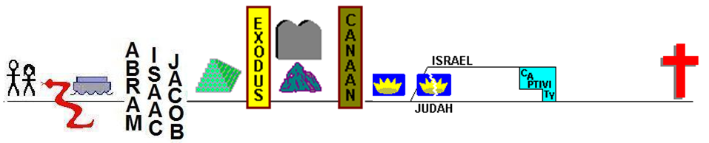

Genesis 22:17
indeed I will greatly bless you, and I will greatly multiply your seed as the stars of the heavens and as the sand, which is on the seashore
John 3:16 “For God so loved the world, that He gave His only Son, so that everyone who believes in Him will not perish, but have eternal life.
Galatians 3:29 And if ye are Christ’s, then are ye Abraham’s seed, heirs according to promise.

Slide 3
Hosea
Genesis 22:17
indeed I will greatly bless you, and I will greatly multiply your seed as the stars of the heavens and as the sand, which is on the seashore
Hosea 1:10
Yet the number of the sons of Israel
Will be like the sand of the sea,
Which cannot be measured or counted;
And in the place
Where it is said to them,
“You are not My people,”
It will be said to them,
“You are the sons of the living God.”

Slide 4
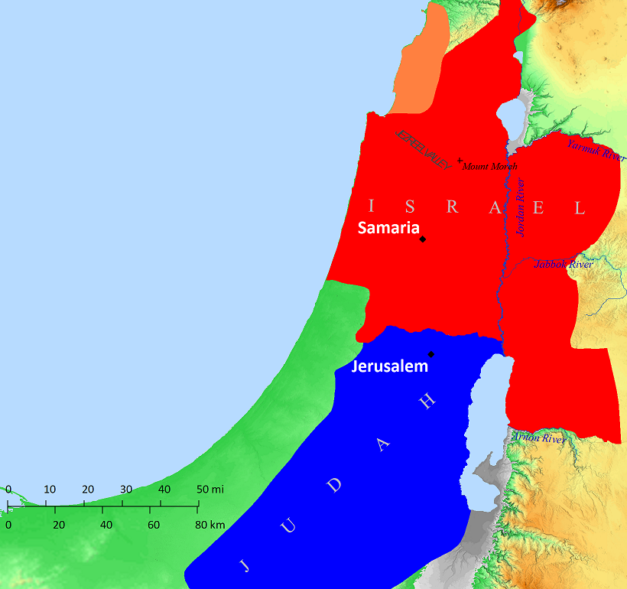
Hosea

Slide 5

Hosea

Slide 6
Uzziah
Ahaz
Jotham
Hezekiah

Slide 7
Jereboam
Uzziah
Ahaz
Jotham
Hezekiah

Slide 8
Jereboam
Uzziah
Ahaz
Jotham
Hezekiah

Slide 9
CHAPTER 1
Hosea takes a wife
She is unfaithful
She bears three children
Their names have symbolic meaning
CHAPTER 3
Hosea buys a woman
But is not intimate with her “for many days”
QUESTIONS:
  Was the Marriage Literal or merely a Literary Device?
  Was the woman a harlot before Hosea married her?
  Are the children Hosea’s?
  Is Chapter 3 a retelling of Hosea’s taking her in marriage, or is it the story of Hosea taking her back after her infidelity, or a different woman?
THIS MUCH IS CLEAR…
  Pictures Israel’s unfaithfulness to God, and God’s response

Slide 10
CHAPTER 1
Hosea takes a wife
She is unfaithful
She bears three children
Their names have symbolic meaning
CHAPTER 3
Hosea buys a woman
But is not intimate with her “for many days”
CHAPTER 1
CHAPTER 2
3:1-3
3:4-5
Hosea & Wife
HOPE
Hosea’s Family
God’s Family
God & Wife
HOPE
HOPE
THIS MUCH IS CLEAR…
  Pictures Israel’s unfaithfulness to God, and God’s response

Slide 11
Hosea 1² When the Lord first spoke through Hosea, the Lord said to Hosea, “Go, take to yourself a wife of whoredom and have children of whoredom, for the land commits great whoredom by forsaking the Lord.” ³ So he went and took Gomer, the daughter of Diblaim, and she conceived and bore him a son….
⁴ And the Lord said to him, “Call his name Jezreel, for in just a little while I will punish the house of Jehu for the blood of Jezreel, and I will put an end to the kingdom of the house of Israel.

Slide 12
Hosea 1² When the Lord first spoke through Hosea, the Lord said to Hosea, “Go, take to yourself a wife of whoredom and have children of whoredom, for the land commits great whoredom by forsaking the Lord.” ³ So he went and took Gomer, the daughter of Diblaim, and she conceived and bore him a son….
⁴ And the Lord said to him, “Call his name Jezreel, for in just a little while I will punish the house of Jehu for the blood of Jezreel, and I will put an end to the kingdom of the house of Israel.
QUESTIONS:
  Was the Marriage Literal or merely a Literary Device?
  Was the woman a harlot before Hosea married her?
  Are the children Hosea’s?
  Is Chapter 3 a retelling of Hosea’s taking her in marriage, or is it the story of Hosea taking her back after her infidelity?

Slide 13
Hosea 1² When the Lord first spoke through Hosea, the Lord said to Hosea, “Go, take to yourself a wife of whoredom and have children of whoredom, for the land commits great whoredom by forsaking the Lord.” ³ So he went and took Gomer, the daughter of Diblaim, and she conceived and bore him a son….
⁴ And the Lord said to him, “Call his name Jezreel, for in just a little while I will punish the house of Jehu for the blood of Jezreel, and I will put an end to the kingdom of the house of Israel.
QUESTIONS:
  Was the Marriage Literal or merely a Literary Device?
  Was the woman a harlot before Hosea married her?
  Are the children Hosea’s?
  Is Chapter 3 a retelling of Hosea’s taking her in marriage, or is it the story of Hosea taking her back after her infidelity?

Slide 14
Hosea 1² When the Lord first spoke through Hosea, the Lord said to Hosea, “Go, take to yourself a wife of whoredom and have children of whoredom, for the land commits great whoredom by forsaking the Lord.” ³ So he went and took Gomer, the daughter of Diblaim, and she conceived and bore him a son….
⁴ And the Lord said to him, “Call his name Jezreel, for in just a little while I will punish the house of Jehu for the blood of Jezreel, and I will put an end to the kingdom of the house of Israel.
QUESTIONS:
  Was the Marriage Literal or merely a Literary Device?
  Was the woman a harlot before Hosea married her?
  Are the children Hosea’s?
  Is Chapter 3 a retelling of Hosea’s taking her in marriage, or is it the story of Hosea taking her back after her infidelity, or a different woman?

Slide 15
Hosea 1² When the Lord first spoke through Hosea, the Lord said to Hosea, “Go, take to yourself a wife of whoredom and have children of whoredom, for the land commits great whoredom by forsaking the Lord.” ³ So he went and took Gomer, the daughter of Diblaim, and she conceived and bore him a son….
⁴ And the Lord said to him, “Call his name Jezreel, for in just a little while I will punish the house of Jehu for the blood of Jezreel, and I will put an end to the kingdom of the house of Israel.
QUESTIONS:
  Was the Marriage Literal or merely a Literary Device?
  Was the woman a harlot before Hosea married her?
  Are the children Hosea’s?
  Is Chapter 3 a retelling of Hosea’s taking her in marriage, or is it the story of Hosea taking her back after her infidelity, or a different woman?

Slide 16
Hosea 1² When the Lord first spoke through Hosea, the Lord said to Hosea, “Go, take to yourself a wife of whoredom and have children of whoredom, for the land commits great whoredom by forsaking the Lord.” ³ So he went and took Gomer, the daughter of Diblaim, and she conceived and bore him a son….
⁴ And the Lord said to him, “Call his name Jezreel, for in just a little while I will punish the house of Jehu for the blood of Jezreel, and I will put an end to the kingdom of the house of Israel.
QUESTIONS:
  Was the Marriage Literal or merely a Literary Device?
  Was the woman a harlot before Hosea married her?
  Are the children Hosea’s?
  Is Chapter 3 a retelling of Hosea’s taking her in marriage, or is it the story of Hosea taking her back after her infidelity, or a different woman?

Slide 17
Hosea 1² When the Lord first spoke through Hosea, the Lord said to Hosea, “Go, take to yourself a wife of whoredom and have children of whoredom, for the land commits great whoredom by forsaking the Lord.” ³ So he went and took Gomer, the daughter of Diblaim, and she conceived and bore him a son….
⁴ And the Lord said to him, “Call his name Jezreel, for in just a little while I will punish the house of Jehu for the blood of Jezreel, and I will put an end to the kingdom of the house of Israel.
QUESTIONS:
  Was the Marriage Literal or merely a Literary Device?
  Was the woman a harlot before Hosea married her?
  Are the children Hosea’s?
  Is Chapter 3 a retelling of Hosea’s taking her in marriage, or is it the story of Hosea taking her back after her infidelity, or a different woman?

Slide 18
Hosea 1² When the Lord first spoke through Hosea, the Lord said to Hosea, “Go, take to yourself a wife of whoredom and have children of whoredom, for the land commits great whoredom by forsaking the Lord.” ³ So he went and took Gomer, the daughter of Diblaim, and she conceived and bore him a son….
⁴ And the Lord said to him, “Call his name Jezreel, for in just a little while I will punish the house of Jehu for the blood of Jezreel, and I will put an end to the kingdom of the house of Israel.
QUESTIONS:
  Was the Marriage Literal or merely a Literary Device?
  Was the woman a harlot before Hosea married her?
  Are the children Hosea’s?
  Is Chapter 3 a retelling of Hosea’s taking her in marriage, or is it the story of Hosea taking her back after her infidelity, or a different woman?

Slide 19
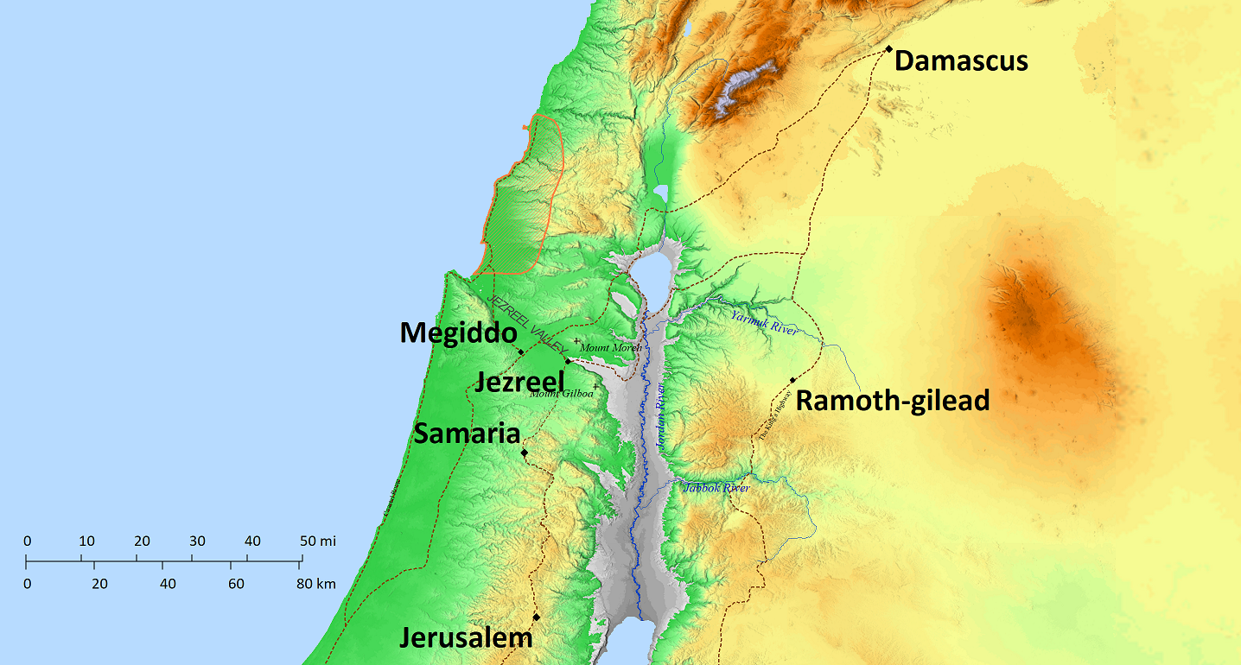
Hosea 1² When the Lord first spoke through Hosea, the Lord said to Hosea, “Go, take to yourself a wife of whoredom and have children of whoredom, for the land commits great whoredom by forsaking the Lord.” ³ So he went and took Gomer, the daughter of Diblaim, and she conceived and bore him a son….
⁴ And the Lord said to him, “Call his name Jezreel, for in just a little while I will punish the house of Jehu for the blood of Jezreel, and I will put an end to the kingdom of the house of Israel.
Naboth’s
Vineyard

Slide 20
Syrians
Joram

Slide 21
Joram
Ahaziah

Slide 22
Jehu
Jehoahaz
Jehoash
Jeroboam
Zechariah

Slide 23
Hosea 1² When the Lord first spoke through Hosea, the Lord said to Hosea, “Go, take to yourself a wife of whoredom and have children of whoredom, for the land commits great whoredom by forsaking the Lord.” ³ So he went and took Gomer, the daughter of Diblaim, and she conceived and bore him a son….
⁴ And the Lord said to him, “Call his name Jezreel, for in just a little while I will punish the house of Jehu for the blood of Jezreel, and I will put an end to the kingdom of the house of Israel.
Jehu
Jehoahaz
Jehoash
Jeroboam
Zechariah

Slide 24
Hosea 1⁶ She conceived again and bore a daughter. And the Lord said to him, “Call her name No Mercy, for I will no more have mercy on the house of Israel, to forgive them at all….
⁸ When she had weaned No Mercy, she conceived and bore a son. ⁹ And the Lord said, “Call his name Not My People, for you are not my people, and I am not your God.”

Slide 25
Hosea 1⁶ She conceived again and bore a daughter. And the Lord said to him, “Call her name No Mercy, for I will no more have mercy on the house of Israel, to forgive them at all….
⁸ When she had weaned No Mercy, she conceived and bore a son. ⁹ And the Lord said, “Call his name Not My People, for you are not my people, and I am not your God.”
Lo-ruhamah
Lo-ammi
Hosea Gomer
Jezreel Lo-ruhamah
(son) (daughter)
“bore him a son”
“conceived again and gave birth”

Slide 26
Hosea 1⁶ She conceived again and bore a daughter. And the Lord said to him, “Call her name No Mercy, for I will no more have mercy on the house of Israel, to forgive them at all….
⁸ When she had weaned No Mercy, she conceived and bore a son. ⁹ And the Lord said, “Call his name Not My People, for you are not my people, and I am not your God.”
Lo-ammi
Hosea Gomer
Jezreel Lo-ruhamah Lo-ammi
(son) (daughter) (son)
“bore him a son”
“conceived again and gave birth”
“conceived again and gave birth”

Slide 27
CHAPTER 1
“Wife of Harlotry”
Hosea Gomer
Jezreel No Mercy Not My People
(son) (daughter) (son)

Slide 28
CHAPTER 2
“Their mother has played the harlot”
God Israel
“I will have no compassion on her children,
Because they are children of harlotry”

Slide 29
CHAPTER 2
Israel
“I will go after my lovers, Who give me my bread…”
God

Slide 30
CHAPTER 2
Israel
“And she will seek them, but will not find them.”
God

Slide 31
CHAPTER 2
Israel
Then she will say, “I will go back to my first husband”
God

Slide 32
CHAPTER 2
Israel
“…I am going to persuade her,
Bring her into the wilderness,
And speak kindly to her.”
God

Slide 33
CHAPTER 2
“…I am going to persuade her,
Bring her into the wilderness,
And speak kindly to her.”
God Israel

Slide 34
CHAPTER 1
Hosea takes a wife
She is unfaithful
She bears three children
Their names have symbolic meaning
CHAPTER 3
Hosea buys a woman
But is not intimate with her “for many days”
CHAPTER 1
CHAPTER 2
3:1-3
3:4-5
Hosea & Wife
HOPE
Hosea’s Family
God’s Family
God & Wife
HOPE
HOPE
THIS MUCH IS CLEAR…
  Pictures Israel’s unfaithfulness to God, and God’s response

Slide 35
1:10-2:1
2:14-23
CHAPTER 1
CHAPTER 2
Hosea’s Family
God’s Family
HOPE
HOPE

Slide 36
¹ Then the Lord said to me, “Go again, love a woman who is loved by her husband, yet is committing adultery…” ² So I purchased her for myself for fifteen shekels of silver, and a homer and a lethech of barley. ³ Then I said to her, “You shall live with me for many days. You shall not play the prostitute, nor shall you have another man; so I will also be toward you.”
CHAPTER 3:1-3
Hosea’s persistent love
bought back
Hosea Gomer?

Slide 37
¹ Then the Lord said to me, “Go again, love a woman who is loved by her husband, yet is committing adultery as the Lord loves the sons of Israel, though they turn to other gods and love raisin cakes.”
CHAPTER 3:1-3
Hosea’s persistent love
God Israel

Slide 38
⁴ For the sons of Israel will live for many days without a king or leader, without sacrifice or memorial stone, and without ephod or household idols.
Israel in captivity
CHAPTER 3:4-5
God’s persistent love
God Israel

Slide 39
⁴ For the sons of Israel will live for many days without a king or leader, without sacrifice or memorial stone, and without ephod or household idols. ⁵ Afterward the sons of Israel will return and seek the Lord their God and David their king; and they will come trembling to the Lord and to His goodness in the last days.
CHAPTER 3:4-5
God’s persistent love
God Israel

Slide 40
Take Aways…
God’s Faithful Love (Hosea 11:1-11)
God is Grieved by our sin (Hosea 2:10-13, 5:14-15)
Whom the Lord loveth, He chasteneth (Heb 12:6, Prov 3:12)

Slide 41

1078 - Faithful Love - Title

Slide 42
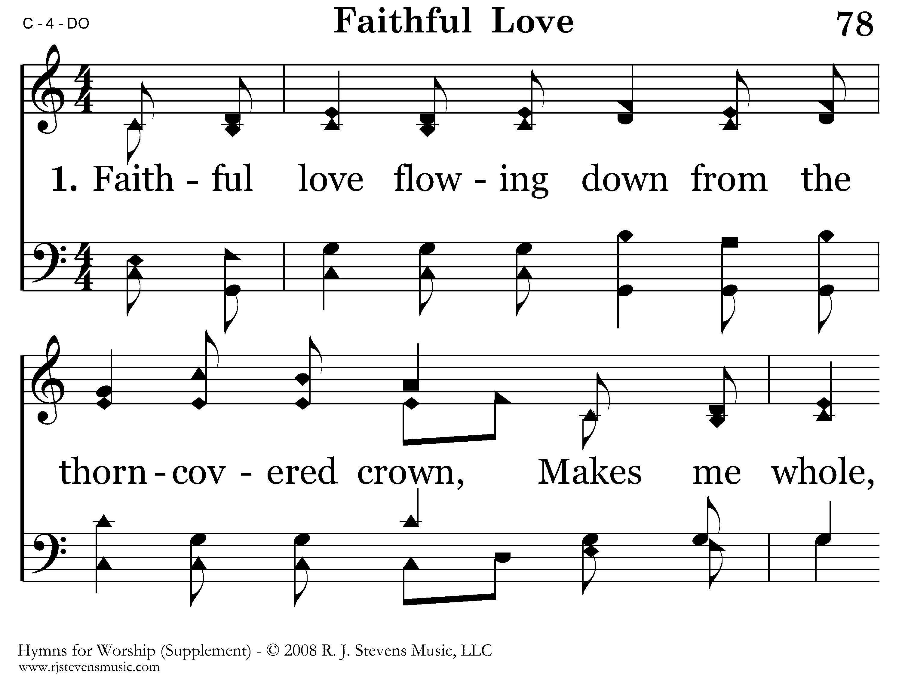
1078 - Faithful Love - 1.1

Slide 43
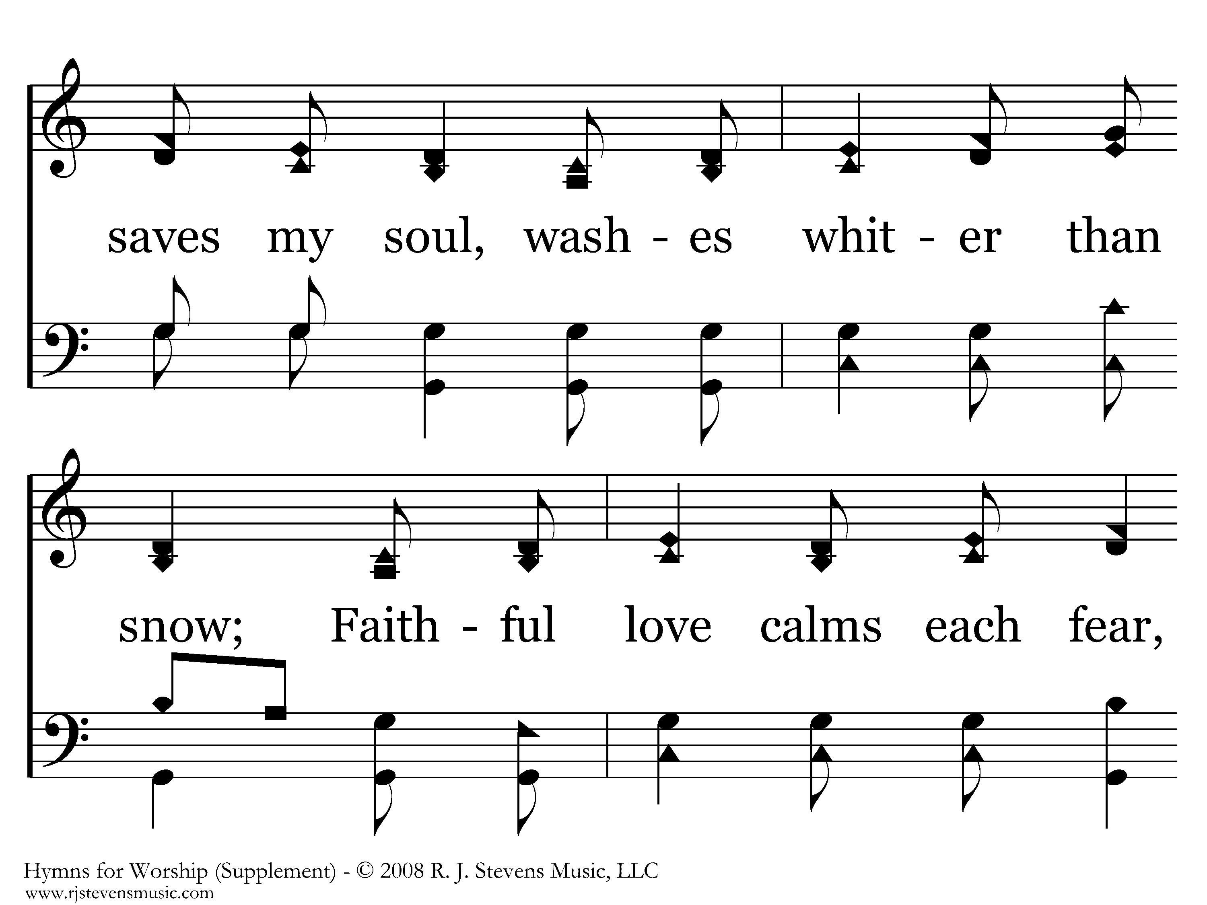
1078 - Faithful Love - 1.2

Slide 44
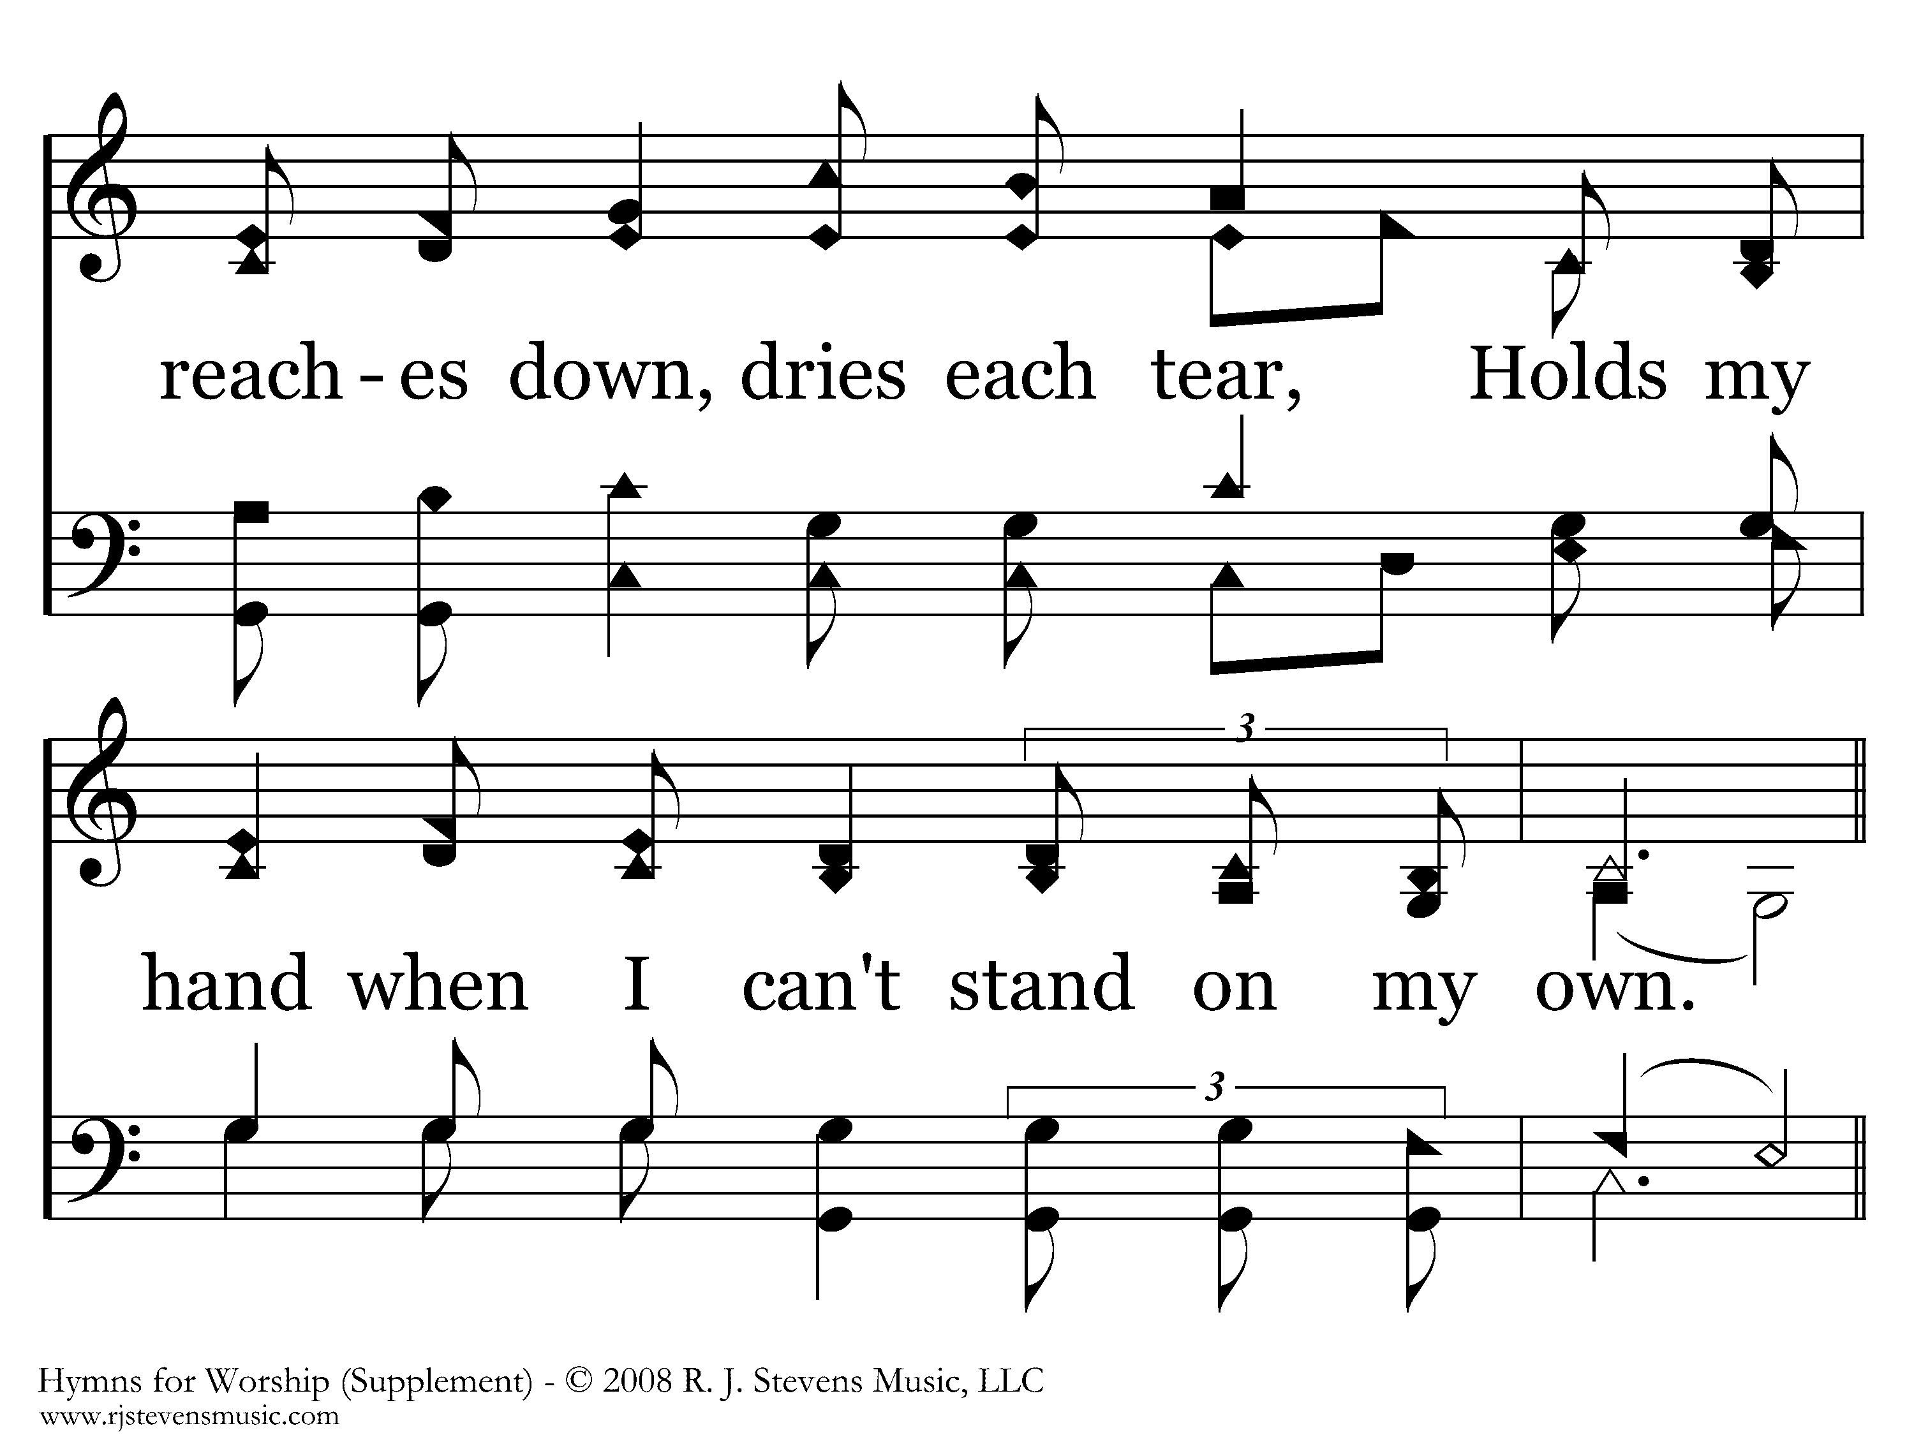
1078 - Faithful Love - 1.3

Slide 45
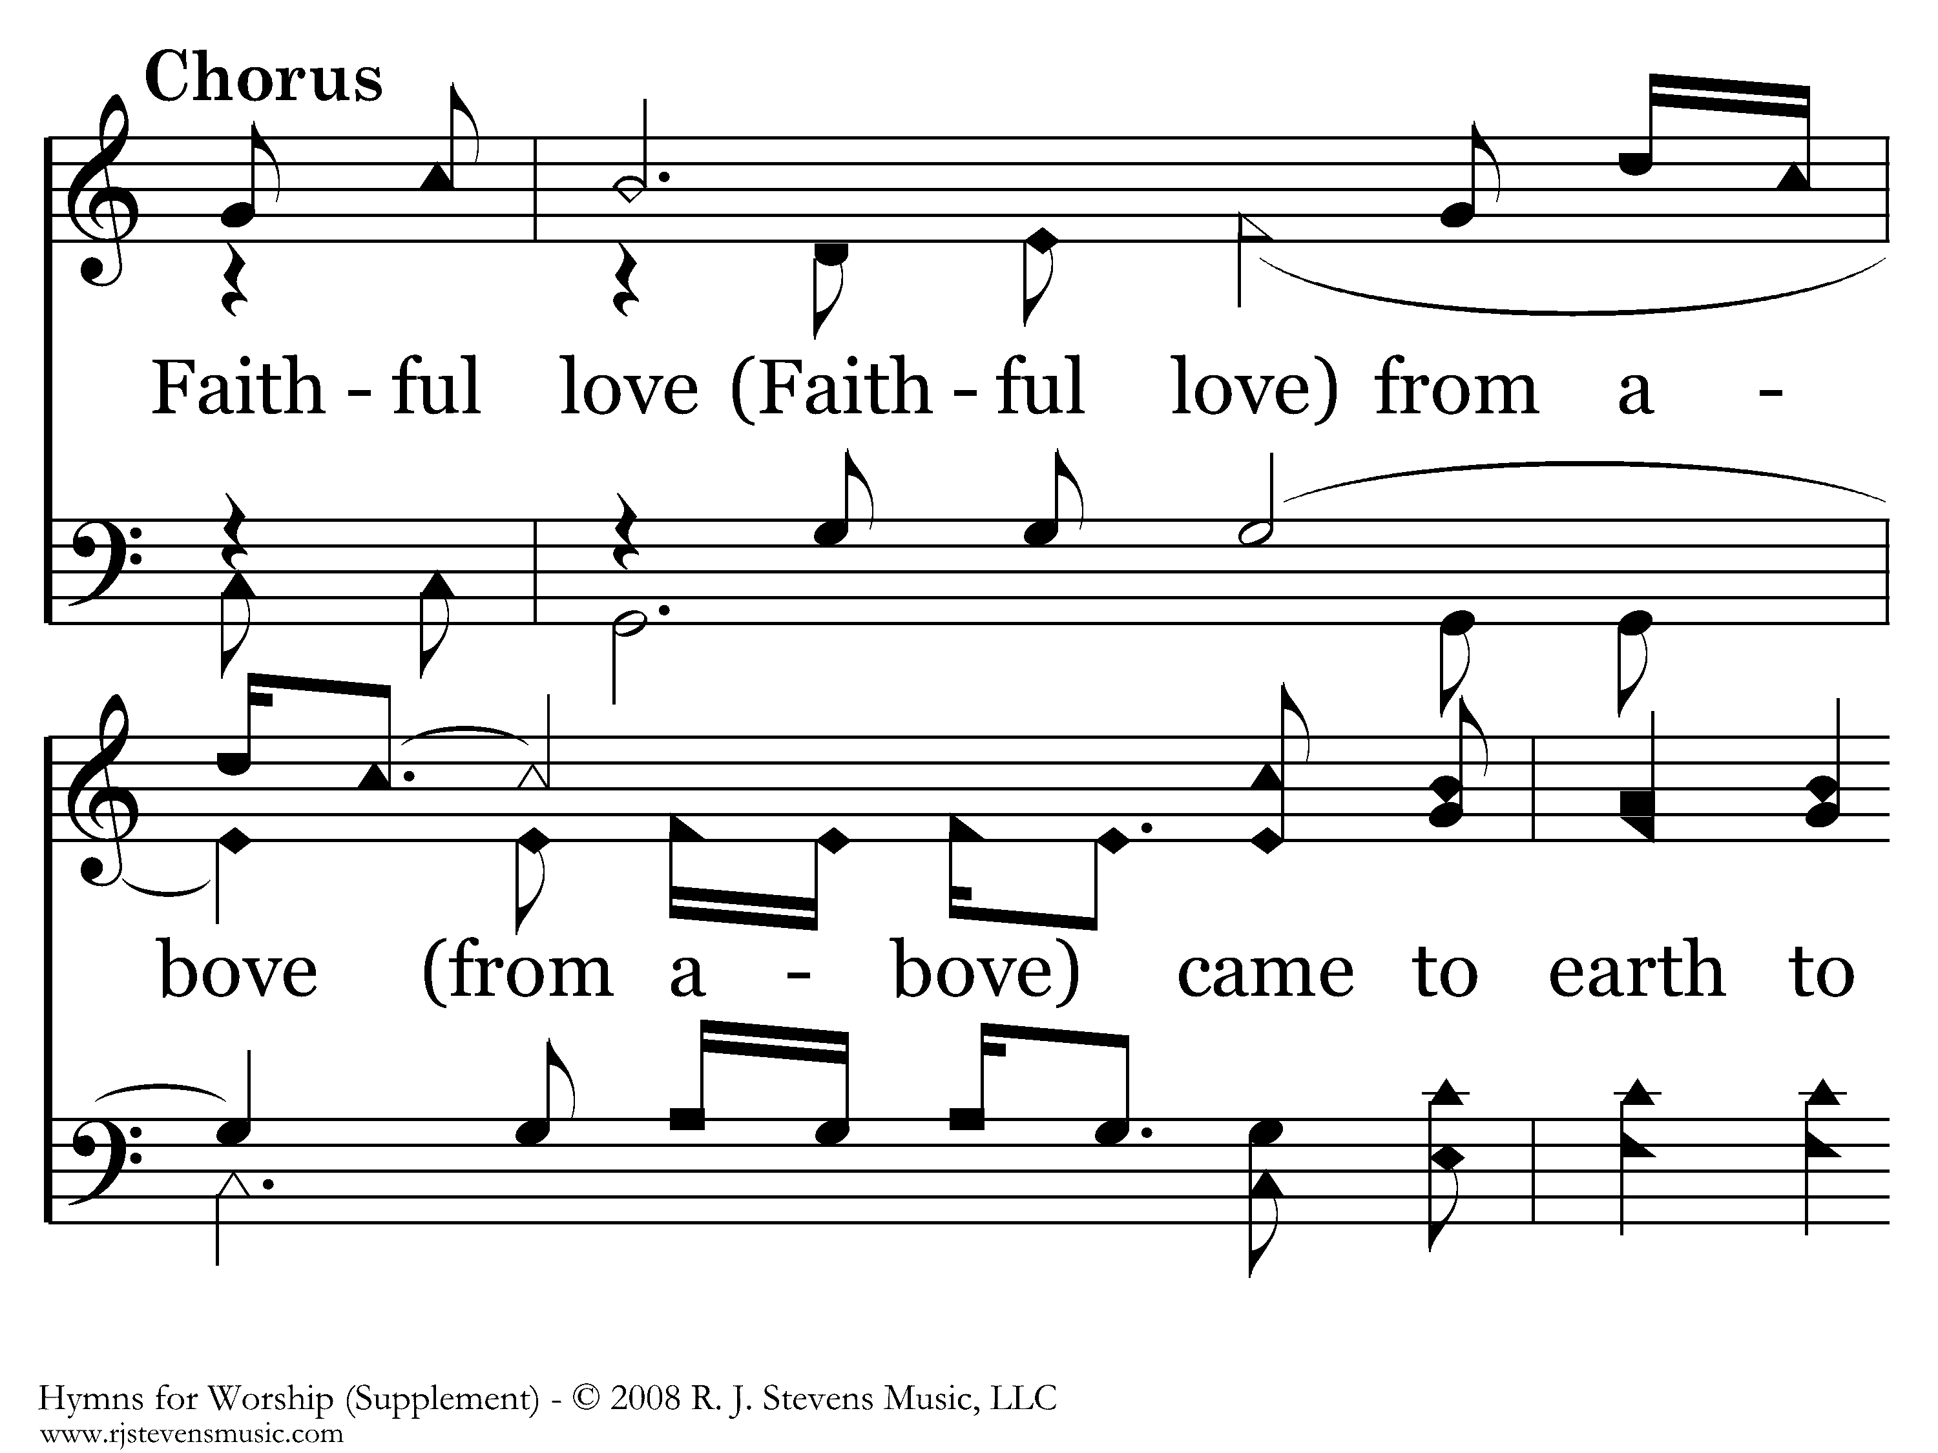
1078 - Faithful Love - 1.4

Slide 46
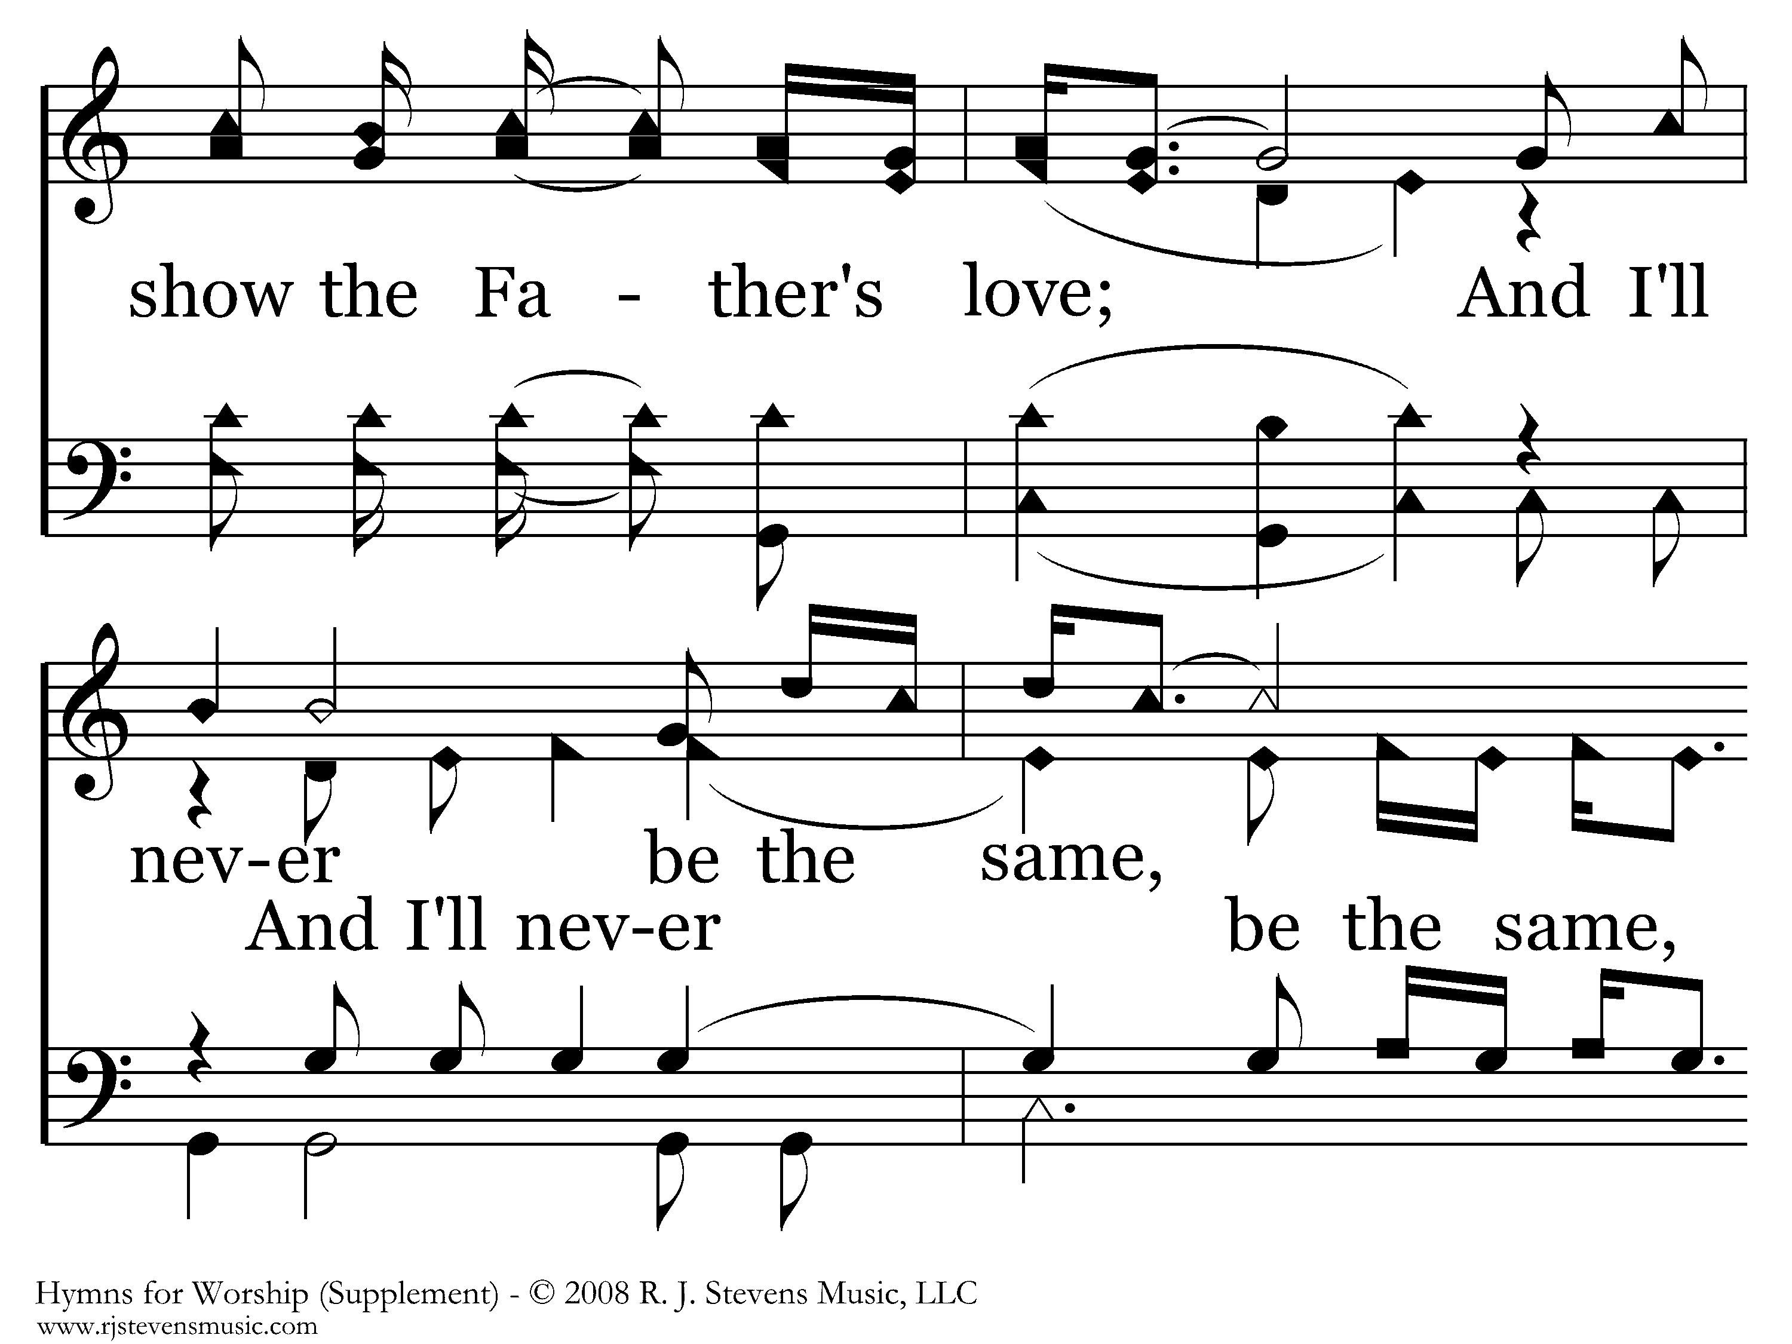
1078 - Faithful Love - 1.5

Slide 47
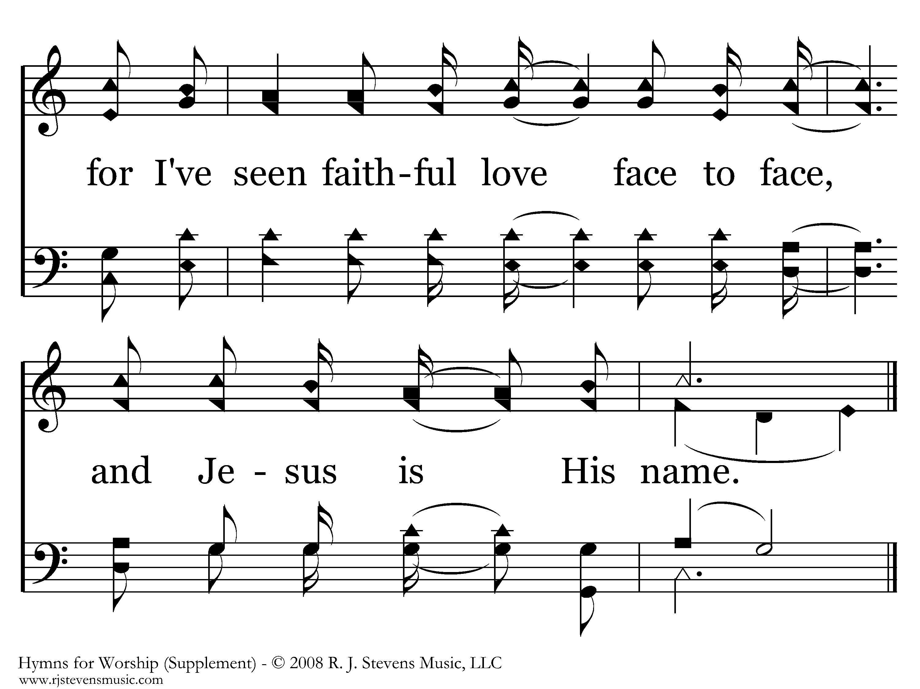
1078 - Faithful Love - 1.6
End of Verse 1

Slide 48
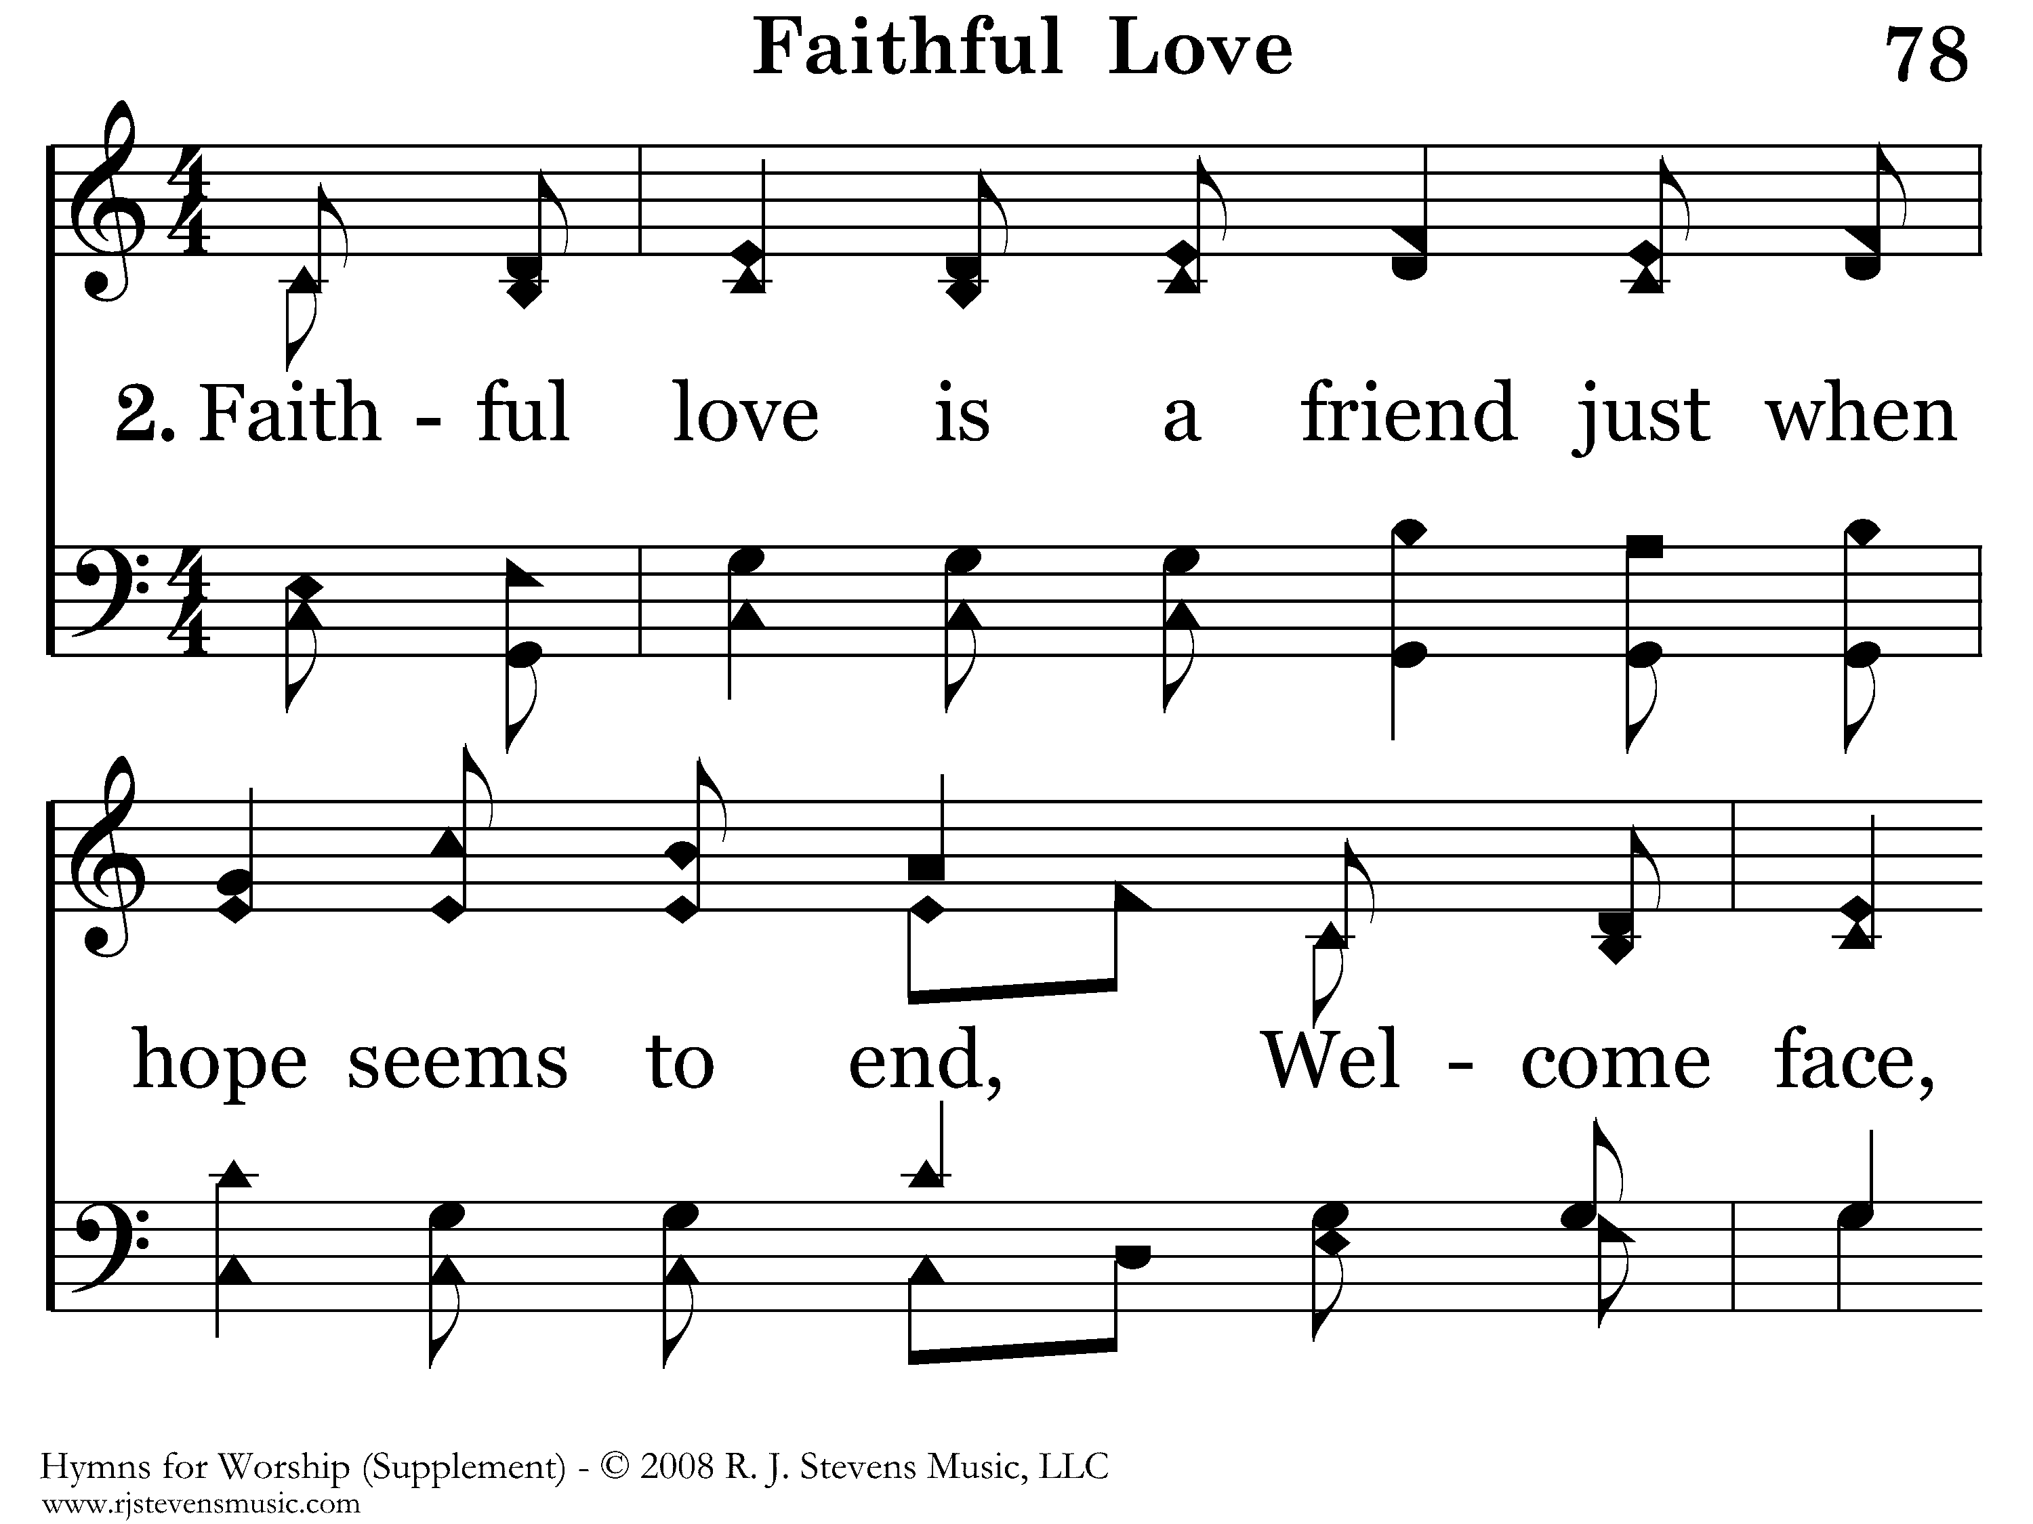
1078 - Faithful Love - 2.1

Slide 49
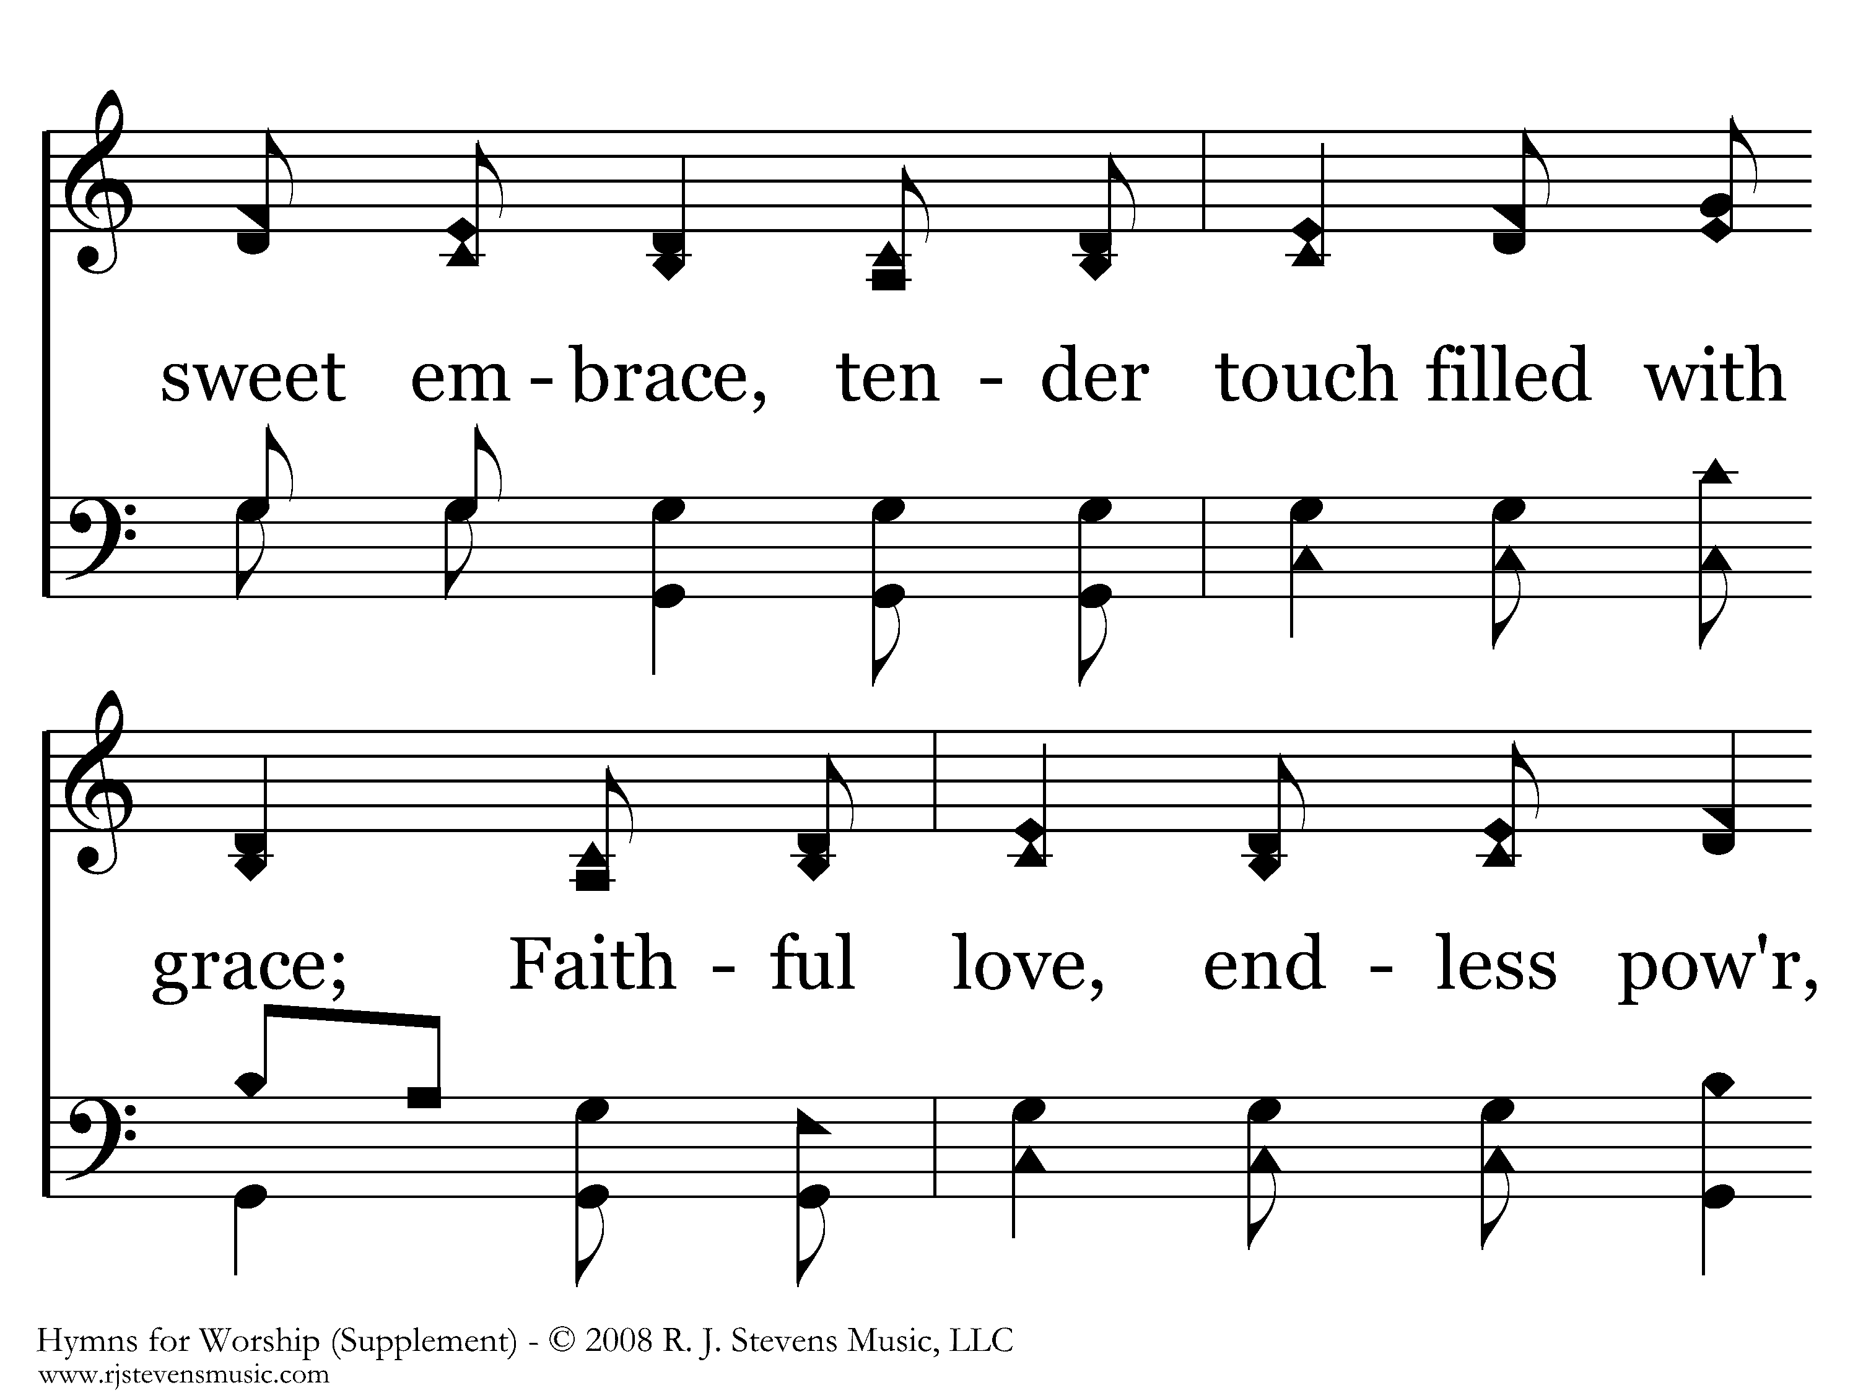
1078 - Faithful Love - 2.2

Slide 50
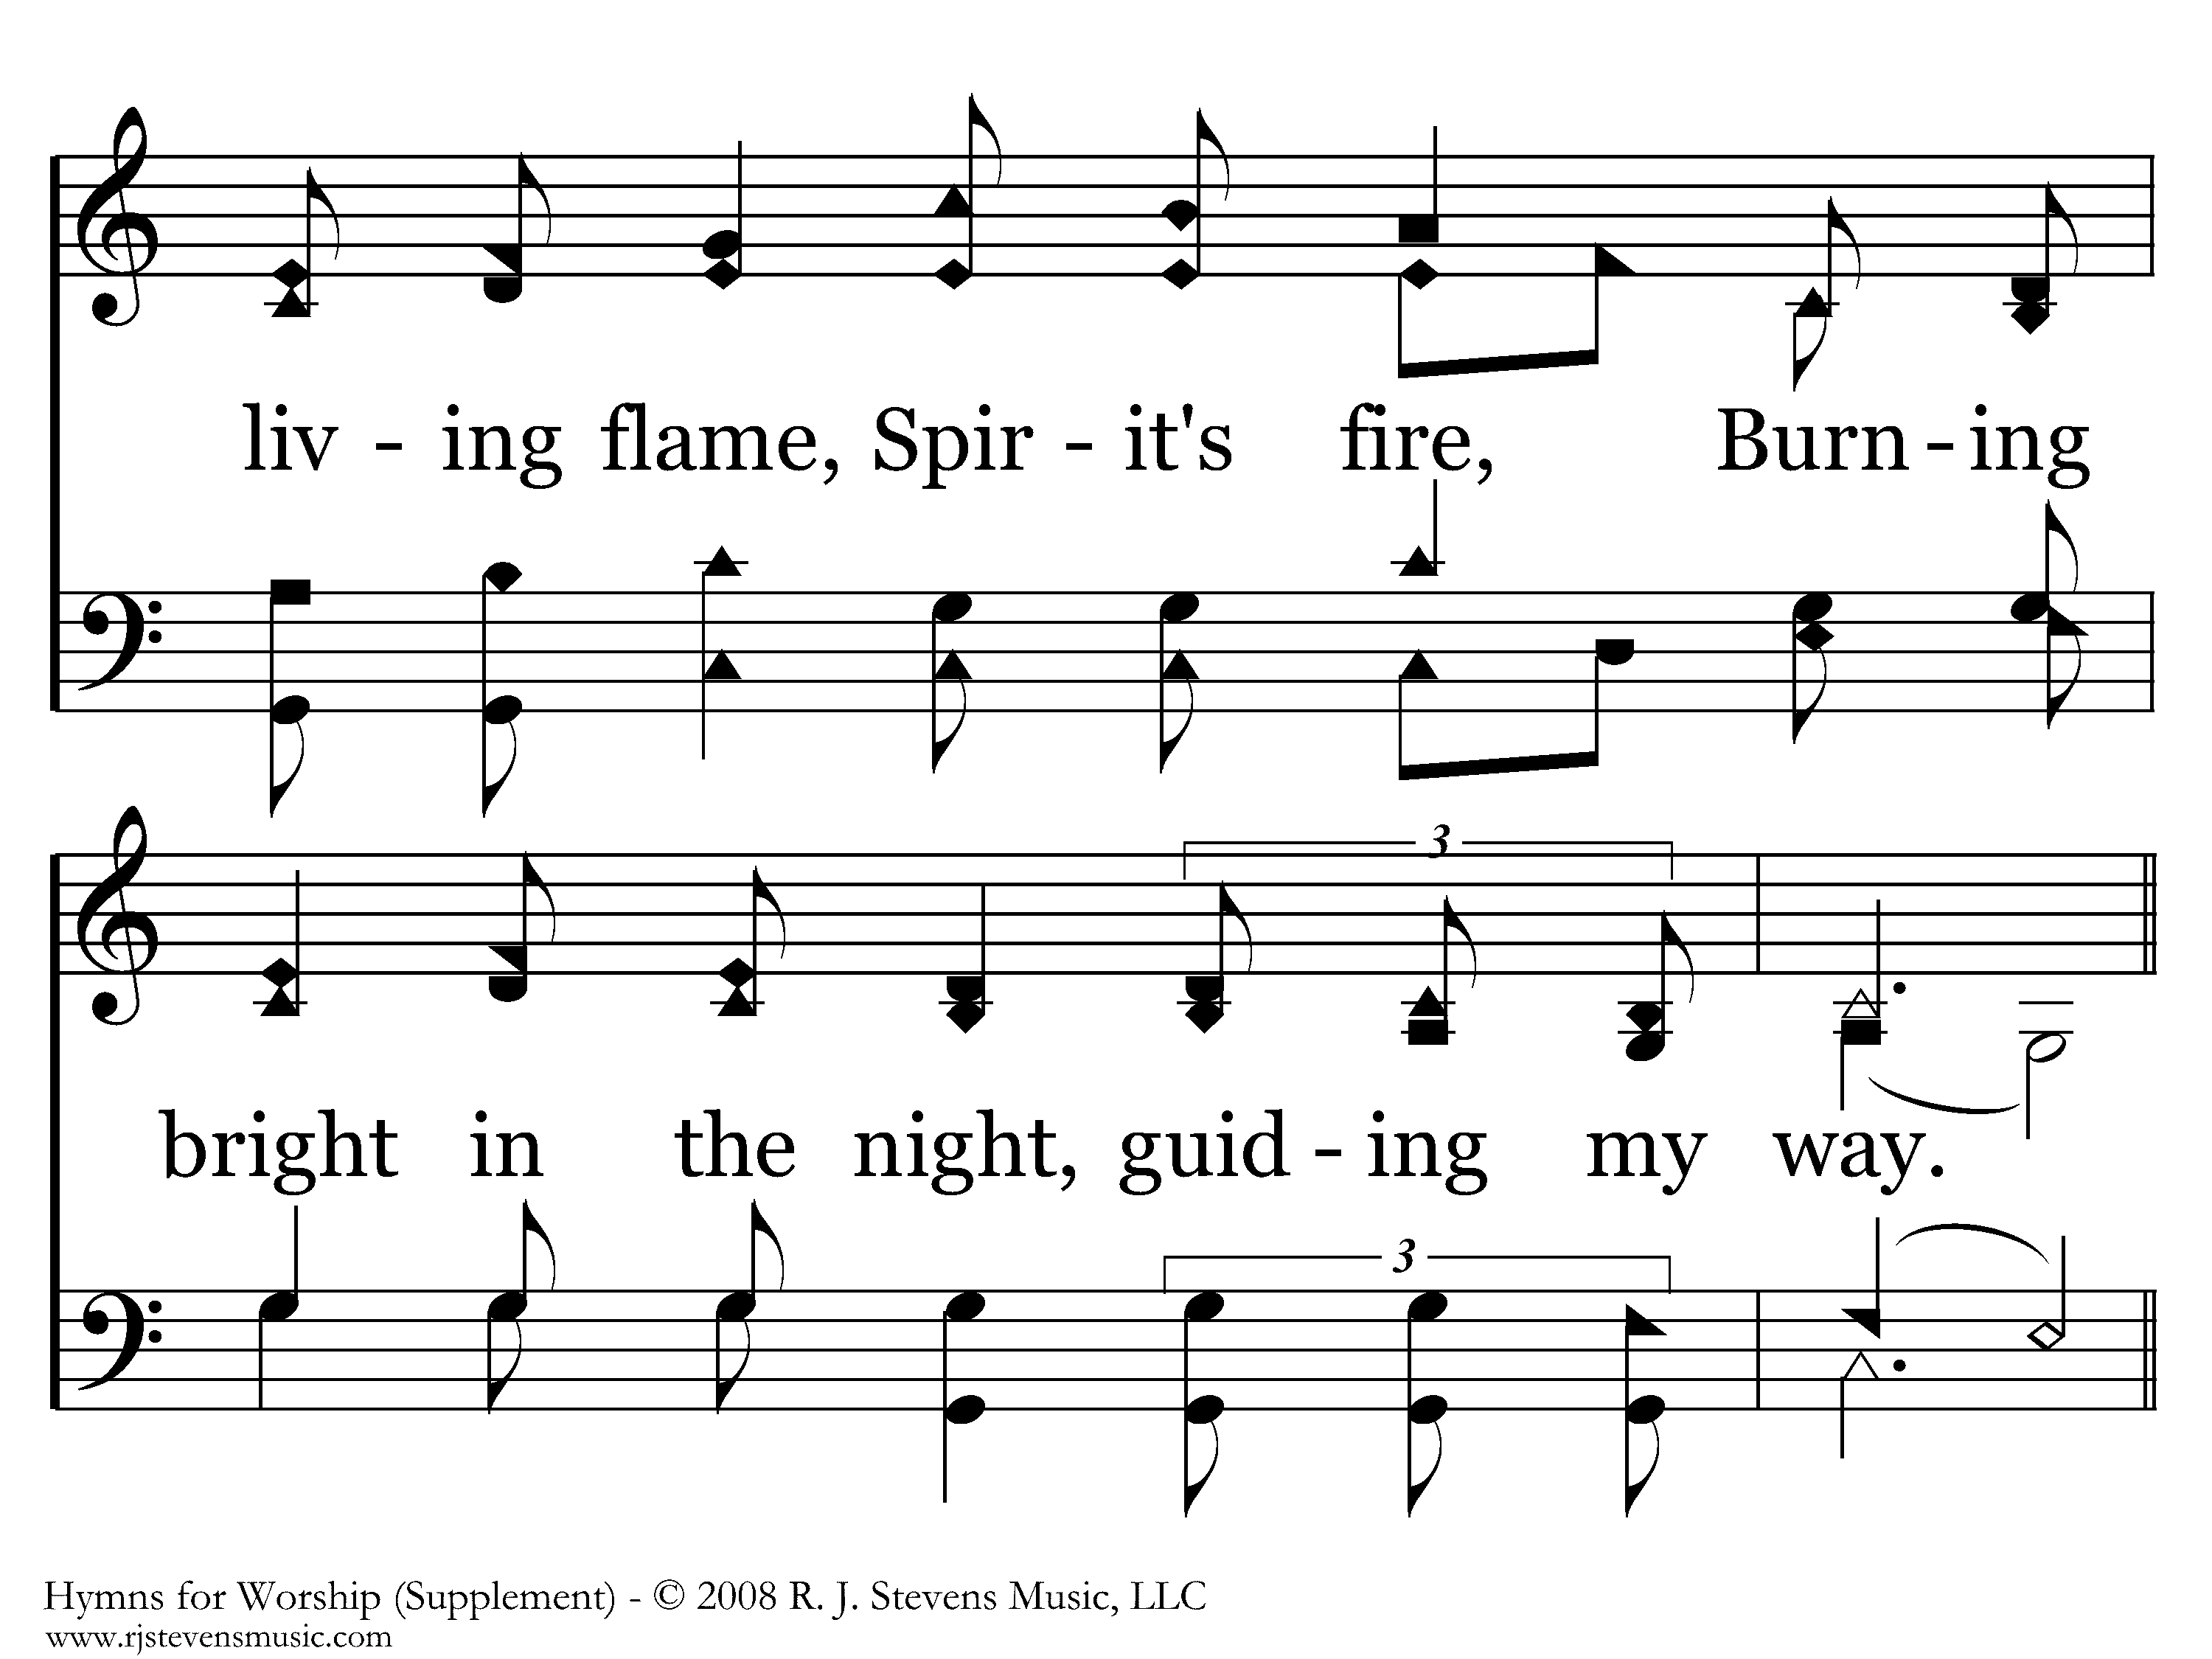
1078 - Faithful Love - 2.3

Slide 51

1078 - Faithful Love - 2.4

Slide 52

1078 - Faithful Love - 2.5

Slide 53
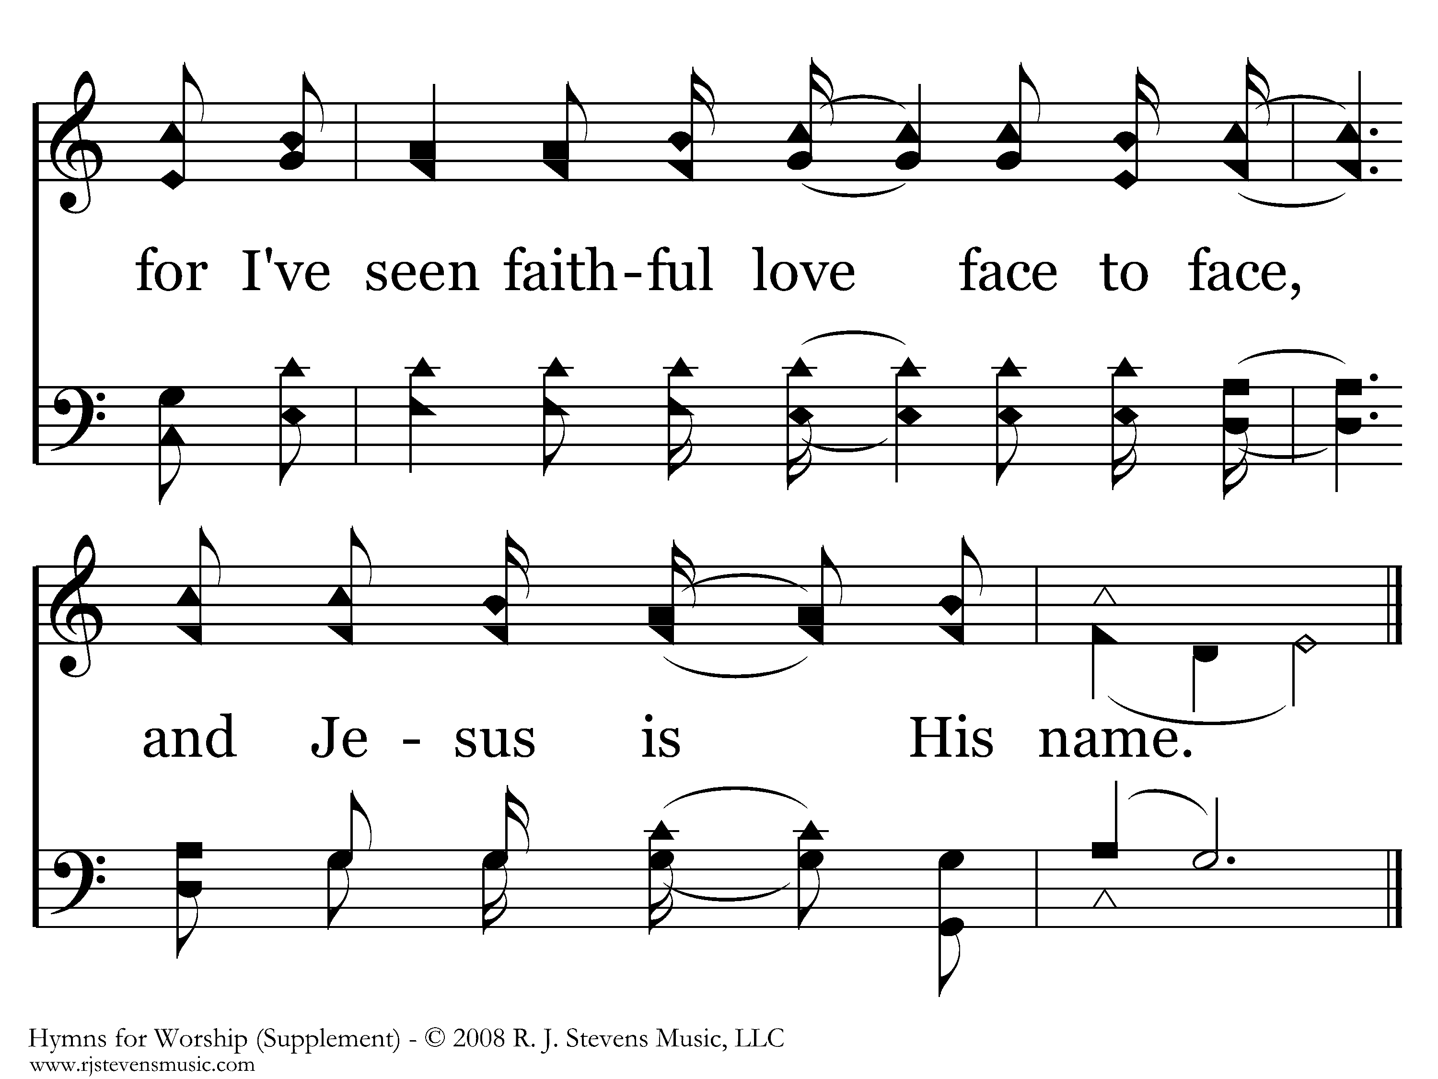
1078 - Faithful Love - 2.6
End of Song

Slide 54
Take Aways…
God’s Faithful Love (Hosea 11:1-11)
God is Grieved by our sin (Hosea 1:10-13, 5:14-15)
Whom the Lord loveth, He chasteneth (Heb 12:6, Prov 3:12)
God’s Judgment WILL come; Admah & Zeboiim (Hosea 11:8,
                Amos 6-12)

