Slide 1
Amos

Slide 2
1:1 The words of Amos, who was among the sheepherders from Tekoa, which he saw in visions concerning Israel in the days of Uzziah king of Judah, and in the days of Jeroboam son of Joash, king of Israel, two years before the earthquake.

Slide 3
Jereboam
Uzziah
1:1 The words of Amos, who was among the sheepherders from Tekoa, which he saw in visions concerning Israel in the days of Uzziah king of Judah, and in the days of Jeroboam son of Joash, king of Israel, two years before the earthquake.

Slide 4
Jereboam
Zechariah 14:5
…you will flee just as you fled from the earthquake in the days of Uzziah king of Judah
Uzziah
Zechariah
1:1 The words of Amos, who was among the sheepherders from Tekoa, which he saw in visions concerning Israel in the days of Uzziah king of Judah, and in the days of Jeroboam son of Joash, king of Israel, two years before the earthquake.

Slide 5
International Geology Review
"Amos's Earthquake:
An Extraordinary Middle East Seismic Event
of 750 B.C."
1:1 The words of Amos, who was among the sheepherders from Tekoa, which he saw in visions concerning Israel in the days of Uzziah king of Judah, and in the days of Jeroboam son of Joash, king of Israel, two years before the earthquake.

Slide 6
International Geology Review
"Amos's Earthquake:
An Extraordinary Middle East Seismic Event
of 750 B.C."
From the Abstract:
“Widely separated archaeological excavations in Israel and Jordan contain late Iron Age…architecture bearing evidence of a great earthquake. Masonry walls best display the earthquake…Debris at six sites…is tightly confined stratigraphically to the middle of the 8th-century B.C. ... The earthquake was at least magnitude 7.8, but likely was 8.2... This severe geologic disaster has been linked historically to a speech delivered at the city of Bethel by a shepherd-farmer named Amos of Tekoa."
Steven A. Austin, Gordon W. Franz, and Eric G. Frost, "Amos's Earthquake: An Extraordinary Middle East Seismic Event of 750 B.C." International Geology Review 42 (2000) 657–671.

Slide 7
1:1 The words of Amos, who was among the sheepherders from Tekoa, which he saw in visions concerning Israel in the days of Uzziah king of Judah, and in the days of Jeroboam son of Joash, king of Israel, two years before the earthquake.

Slide 8
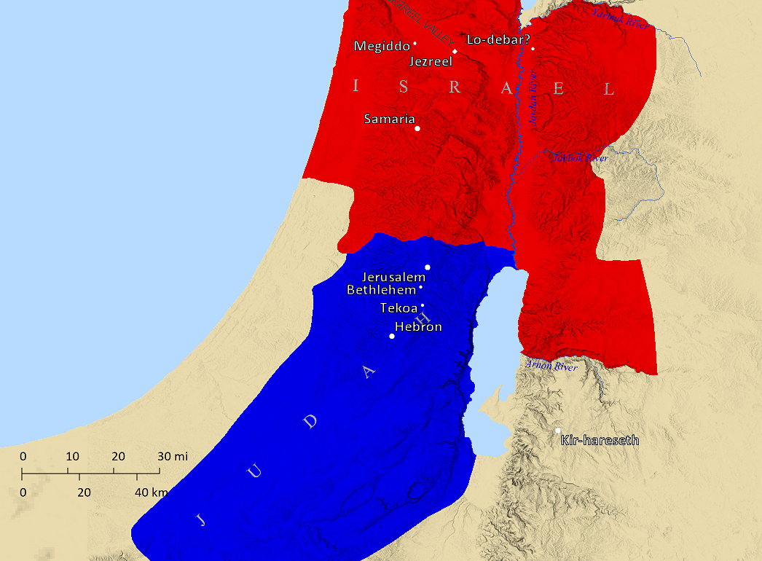

Slide 9
7:14 Then Amos replied to Amaziah, “I am not a prophet, nor am I the son of a prophet; for I am a herdsman and a grower of sycamore figs.
1:1 The words of Amos, who was among the sheepherders from Tekoa, which he saw in visions concerning Israel in the days of Uzziah king of Judah, and in the days of Jeroboam son of Joash, king of Israel, two years before the earthquake.

Slide 10
7:14 Then Amos replied to Amaziah, “I am not a prophet, nor am I the son of a prophet; for I am a herdsman and a grower of sycamore figs.
3:12
“as the shepherd snatches from the lion’s mouth a couple of legs or a piece of an ear”
1:1 The words of Amos, who was among the sheepherders from Tekoa, which he saw in visions concerning Israel in the days of Uzziah king of Judah, and in the days of Jeroboam son of Joash, king of Israel, two years before the earthquake.

Slide 11
7:14 Then Amos replied to Amaziah, “I am not a prophet, nor am I the son of a prophet; for I am a herdsman and a grower of sycamore figs.
5:8
“He who made the Pleiades and Orion, And changes deep darkness into morning”
1:1 The words of Amos, who was among the sheepherders from Tekoa, which he saw in visions concerning Israel in the days of Uzziah king of Judah, and in the days of Jeroboam son of Joash, king of Israel, two years before the earthquake.

Slide 12
7:14 Then Amos replied to Amaziah, “I am not a prophet, nor am I the son of a prophet; for I am a herdsman and a grower of sycamore figs.
he had a way with words…
3:2-8
5:18-20
9:2-4
1:1 The words of Amos, who was among the sheepherders from Tekoa, which he saw in visions concerning Israel in the days of Uzziah king of Judah, and in the days of Jeroboam son of Joash, king of Israel, two years before the earthquake.

Slide 13
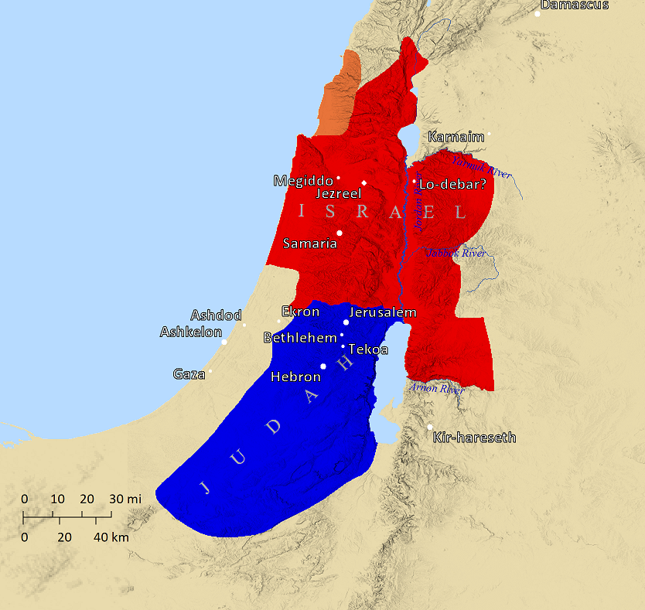

Slide 14
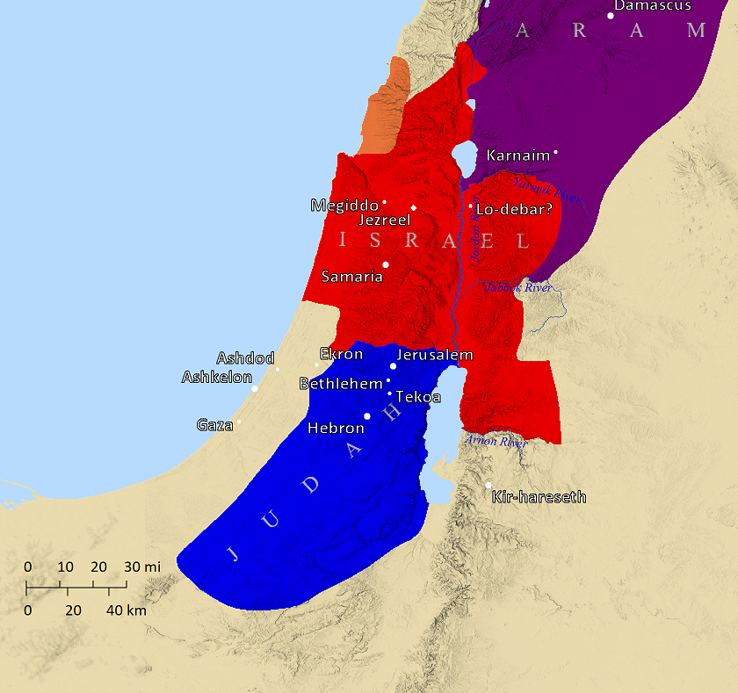
1³ This is what the Lord says: “For three offenses of Damascus, and for four, I will not revoke its punishment,
Because they threshed Gilead with iron sledges.
Gilead

Slide 15
1⁶ This is what the Lord says: “For three offenses of Gaza, and for four, I will not revoke its punishment, Because they led into exile an entire population To turn them over to Edom.

Slide 16
1⁹ This is what the Lord says: “For three offenses of Tyre, and for four, I will not revoke its punishment, Because they turned an entire population over to Edom

Slide 17
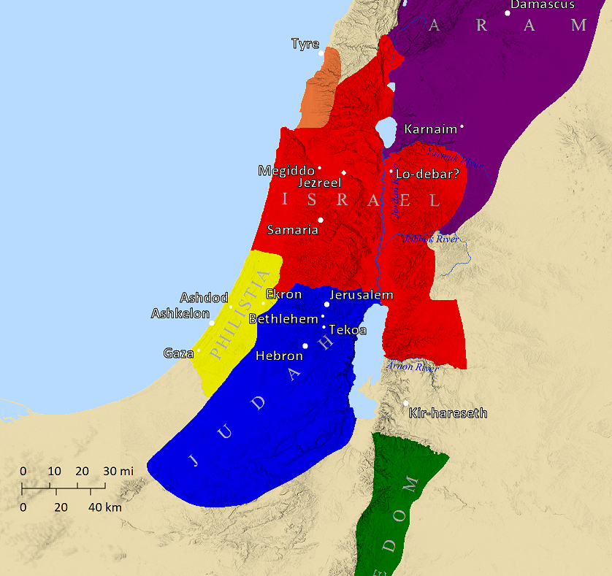
1¹¹ This is what the Lord says: “For three offenses of Edom, and for four, I will not revoke its punishment, Because he pursued his brother with the sword

Slide 18
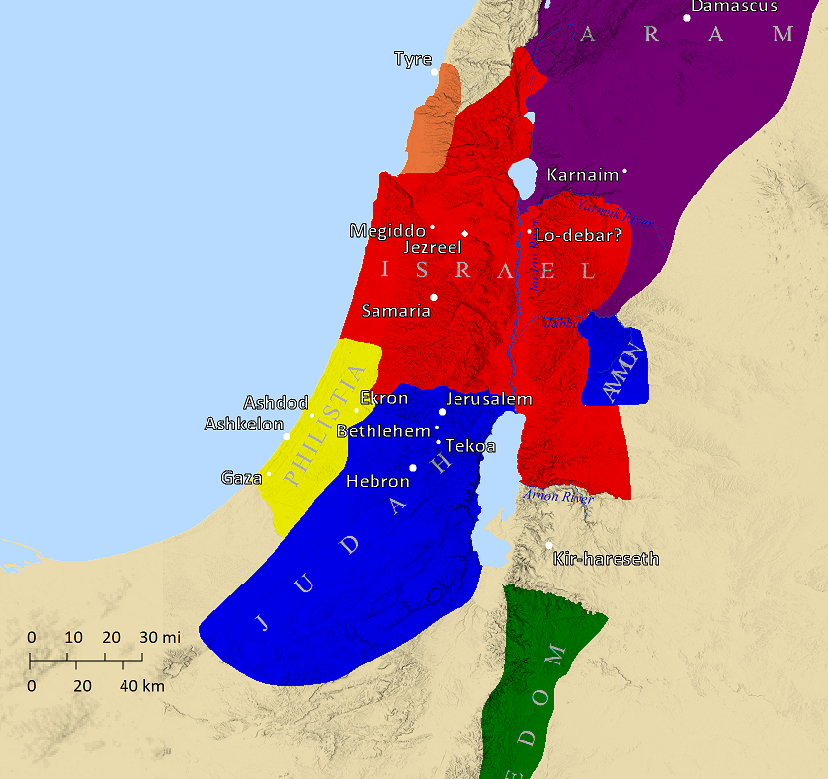
Gilead
1¹³ This is what the Lord says: “For three offenses of the sons of Ammon, and for four, I will not revoke its punishment, Because they ripped open the pregnant women of Gilead In order to enlarge their borders.

Slide 19
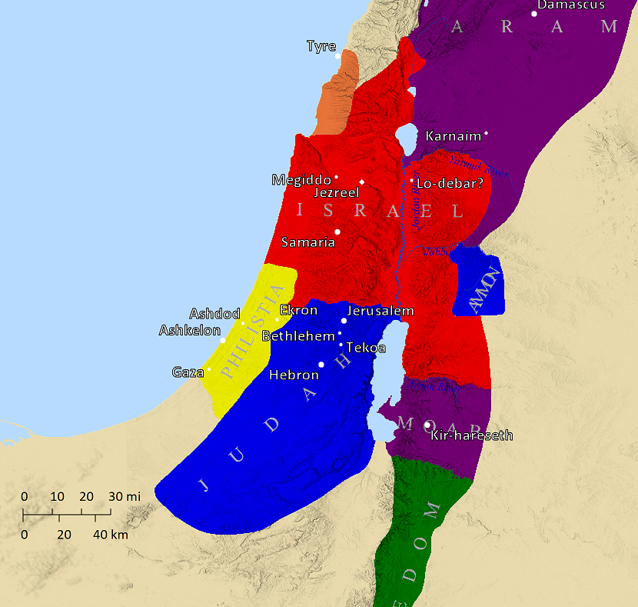
2¹ This is what the Lord says:
“For three offenses of Moab, and for four, I will not revoke its punishment, Because he burned the bones of the king of Edom to lime.

Slide 20
Judah
2:4-5

Slide 21
Israel
7 ⁹ “…Then I will rise up against the house of Jeroboam with the sword.”
¹⁰ Then Amaziah, the priest of Bethel, sent word to Jeroboam king of Israel, saying, “Amos has conspired against you… ¹¹ For this is what Amos says: ‘Jeroboam will die by the sword, and Israel will certainly go from its land into exile.’”

Slide 22
Israel
7 ¹² Then Amaziah said to Amos, “Go, you seer, flee to the land of Judah; and eat bread there and do your prophesying there! ¹³ But do not prophesy at Bethel any longer, for it is a sanctuary of the king and a royal residence.”
Bethel

Slide 23
I
II
Jereboam
Jereboam
Bethel
Golden Calf - set up by Jeroboam I
Baal Worship - Ahab & Jezebel
And yet…
“Woe to those who are carefree in Zion, And to those who feel secure on the mountain of Samaria”
“Woe to them that are at ease in Zion,
And to them that are secure in the mountain of Samaria”

Slide 24
Economic and Military Success
in Judah under Uzziah
in Israel under Jeroboam II
Amos’ Picture of a Materialistic and Corrupt Society

Slide 25
Economic and Military Success
in Judah under Uzziah
in Israel under Jeroboam II
Amos’ Picture of a Materialistic and Corrupt Society
2:6-7
…I will not revoke its punishment, Because they sell the righteous for money, And the needy for a pair of sandals. …And a man and his father resort to the same girl So as to profane My holy name.
Materialism
Inhumanity
Sexual Perversion

Slide 26
Economic and Military Success
in Judah under Uzziah
in Israel under Jeroboam II
Amos’ Picture of a Materialistic and Corrupt Society
3:15
“I will also strike the winter house together with the summer house; The houses of ivory will also perish, And the great houses will come to an end,” Declares the Lord.

Slide 27
Economic and Military Success
in Judah under Uzziah
in Israel under Jeroboam II
Amos’ Picture of a Materialistic and Corrupt Society
4:1
Hear this word, you cows of Bashan who are on the mountain of Samaria, Who exploit the poor, who oppress the needy, And say to their husbands, “Bring now, that we may drink!”

Slide 28
Economic and Military Success
in Judah under Uzziah
in Israel under Jeroboam II
Amos’ Picture of a Materialistic and Corrupt Society
6:1-7
Woe to those who are carefree in Zion, And to those who feel secure on the mountain of Samaria…
⁴ Those who lie on beds of ivory, And lounge around on their couches, And eat lambs from the flock, And calves from the midst of the fattened cattle, ⁵ Who improvise to the sound of the harp, And like David have composed songs for themselves, ⁶ Who drink wine from sacred bowls While they anoint themselves with the finest of oils— Yet they have not grieved over the collapse of Joseph. ⁷ Therefore, they will now go into exile at the head of the exiles, And the revelry of those who lounge around will come to an end.

Slide 29
6:1-7
Woe to those who are carefree in Zion, And to those who feel secure on the mountain of Samaria…
⁴ Those who lie on beds of ivory, And lounge around on their couches, And eat lambs from the flock, And calves from the midst of the fattened cattle, ⁵ Who improvise to the sound of the harp, And like David have composed songs for themselves, ⁶ Who drink wine from sacred bowls While they anoint themselves with the finest of oils— Yet they have not grieved over the collapse of Joseph. ⁷ Therefore, they will now go into exile at the head of the exiles, And the revelry of those who lounge around will come to an end.
5:15 Hate evil, love good

Slide 30
6:1-7
Woe to those who are carefree in Zion, And to those who feel secure on the mountain of Samaria…
⁴ Those who lie on beds of ivory, And lounge around on their couches, And eat lambs from the flock, And calves from the midst of the fattened cattle, ⁵ Who improvise to the sound of the harp, And like David have composed songs for themselves, ⁶ Who drink wine from sacred bowls While they anoint themselves with the finest of oils— Yet they have not grieved over the collapse of Joseph. ⁷ Therefore, they will now go into exile at the head of the exiles, And the revelry of those who lounge around will come to an end.
Woe to them that are at ease in Zion
5:15 Hate evil, love good

Slide 31
Woe to them that are at ease in Zion
5:15 Hate evil, love good
Laodicea
Revelation 3¹⁵ ‘I know your deeds, that you are neither cold nor hot; I wish that you were cold or hot. ¹⁶ So because you are lukewarm, and neither hot nor cold, I will vomit you out of My mouth. ¹⁷ Because you say, “I am rich, and have become wealthy, and have no need of anything,” and you do not know that you are wretched, miserable, poor, blind, and naked

Slide 32
Woe to them that are at ease in Zion
5:15 Hate evil, love good
What should keep us from being “at ease”?
Hatred of Sin
The sin around us
Our own sin
Ezekiel 9 ⁴ And the Lord said to him, “Go through the midst of the city, through the midst of Jerusalem, and make a mark on the foreheads of the people who groan and sigh over all the abominations which are being committed in its midst.”

Slide 33
Woe to them that are at ease in Zion
5:15 Hate evil, love good
What should keep us from being “at ease”?
Hatred of Sin
The sin around us
Our own sin
Ezekiel 6 ¹¹ “This is what the Lord God says: ‘Clap your hands, stamp your foot and say, “Woe, because of all the evil abominations of the house of Israel,

Slide 34
Woe to them that are at ease in Zion
5:15 Hate evil, love good
What should keep us from being “at ease”?
Hatred of Sin
The sin around us
Our own sin
Psalm 119:53
Burning indignation has seized me because of the wicked, Who abandon Your Law.

Slide 35
Woe to them that are at ease in Zion
5:15 Hate evil, love good
What should keep us from being “at ease”?
Hatred of Sin
The sin around us
Our own sin
Psalm 119:136
My eyes shed streams of water, Because they do not keep Your Law.

Slide 36
If we get comfortable with sin
And focused on material gain…
Amos 8:5-6
⁴ Hear this, you who trample the needy, to put an end to the humble of the land, ⁵ saying,
“When will the new moon be over, So that we may sell grain; And the Sabbath, so that we may open the wheat market, To make the ephah smaller and the shekel bigger, And to cheat with dishonest scales, ⁶ So as to buy the helpless for money, And the needy for a pair of sandals, And that we may sell the refuse of the wheat?”

