Slide 1
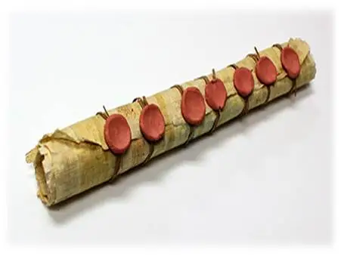
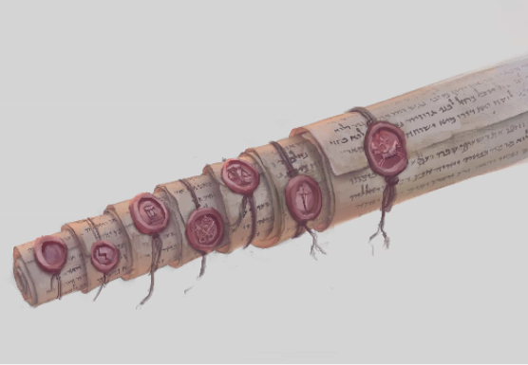
Chapter 5
In whose hand was the scroll?
What prevented the scroll from being opened?
Draw a picture of a sealed scroll. Make sure your scroll has seven seals!
Gaius 2.147 (died c. 180)
“However, wills which in the beginning were not legally executed, or if they were legally executed afterwards became void, or were revoked, are still not absolutely inoperative; for if they have been sealed with the signets of seven witnesses, the appointed heir can demand possession of the estate in accordance with the provisions of the will, provided the deceased testator was a Roman citizen and his own master at the time of his death; but if the will became inoperative, for example, because the testator lost his citizenship or his freedom, or gave himself in adoption, and he dies under the control of his adoptive father, he cannot demand possession of the estate in accordance with the provisions of the will.”

Slide 2
Jesus is the one who is worthy to open the scroll. In chapters 6-11, we will see the seven seals removed one by one, and as they are removed, coming judgments will be revealed. These are judgments on “those who dwell on the earth” (6:10, 8:13).
In the message to which of the seven churches was there mention of “the hour of trial” that was about to come upon those who “dwell upon the earth”?
Some form of the phrase “those who dwell upon the earth” is found eleven times in the book of Revelation. Check each of the following contexts and see if you can discern the significance of this phrase: 3:10, 6:10, 8:13, 11:10 (2x), 13:8, 13:12, 13:14 (2x), 17:12, 17:8. (NOTE: The NASB has “those who live on the earth,” and the NIV has “the inhabitants of the earth.”) It refers to what people?

Slide 3
Lesson 3 QUESTIONS
Match the seals on the left with the words on the right
____ 1st seal a. death
____ 2nd seal b. conquering
____ 3rd seal c. peace is destroyed
____ 4th seal d. scarcity
Is there anything that requires us to view these judgments taking place sequentially in history? In other words, could they be describing conditions that overlapped one another chronologically?
What phrases do you see in Revelation 6:1-8 that suggest this is a description of judgments to come but not final, universal judgment?
b
c
d
a

Slide 4
Mention again the evidences of persecution that we saw in the first two chapters of Revelation.
What did the Lord exhort the saints at Smyrna to do in Revelation 2:10?
For what are saints who have already been killed crying out?

Slide 5
How many verses were devoted to what was seen when…
…the 1st seal was opened?
…the 2nd seal was opened?
…the 3rd seal was opened?
…the 4th seal was opened?
…the 5th seal was opened?
…the 6th seal was opened?
In the description of these judgments, do you see a sense of increasing severity? Do you see a sense of building to a climax?

Slide 6
Chapter 7
We have seen six seals opened. There is only one more. But before that last seal is opened, there is a pause.
What is about to be unleashed upon the earth?
Four angels are doing what until the servants of God are sealed?
Read Ezekiel 9 where the prophet Ezekiel sees a vision in anticipation of the then coming judgment of God upon Jerusalem. What similarity do you see between that passage and Revelation 7?
Can you think of another time in history when God brought a series of judgments upon some nation, but before the final judgment in the series, God did something to protect his people?

