Slide 1
Complacency

Slide 2
Confidence
but not Complacency
1 Corinthians 1 ⁶ even as the testimony of Christ was confirmed in you, ⁷ so that you come short in no gift, eagerly waiting for the revelation of our Lord Jesus Christ, ⁸ who will also confirm you to the end, that you may be blameless in the day of our Lord Jesus Christ. ⁹ God is faithful, by whom you were called into the fellowship of His Son, Jesus Christ our Lord.
1 Corinthians 10 ¹² Therefore let him who thinks he stands take heed lest he fall.

Slide 3
not Complacency
but Confidence
Hebrews 3 ¹² Beware, brethren, lest there be in any of you an evil heart of unbelief in departing from the living God
Hebrews 10 ³⁹ But we are not among those who shrink back to destruction, but of those who have faith for the safekeeping of the soul.

Slide 4
Complacency
2 Samuel 7:1 Now it came about, when the king lived in his house, and the Lord had given him rest on every side from all his enemies…
2 Samuel 8:1 Now it happened afterward that David defeated the Philistines and subdued them…
2 Samuel 9:1 Then David said, “Is there anyone still left of the house of Saul, so that I could show him kindness for Jonathan’s sake?”
2 Samuel 10:2 Then David said, “I will show kindness to Hanun the son of Nahash, just as his father showed kindness to me.”
2 Samuel 10:19 When all the kings, servants of Hadadezer, saw that they had been defeated by Israel, they made peace with Israel and served them.
2 Samuel 11:1 Then it happened in the spring, at the time when kings go out to battle, that David sent Joab and his servants with him and all Israel, and they brought destruction on the sons of Ammon and besieged Rabbah. But David stayed in Jerusalem.
David’s Darkest Hour

Slide 5
Complacency
SMYRNA
I know your tribulation and your poverty
LAODICEA
…So because you are lukewarm, and neither hot nor cold, I will vomit you out of My mouth.
…you say, “I am rich, and have become wealthy, and have no need of anything”
be zealous and repent
Things are Going Well For Us

Slide 6
Complacency
SARDIS
“I know your works, that you have a name that you are alive, but you are dead. ² Be watchful, and strengthen the things which remain, that are ready to die, for I have not found your works perfect before God. ³ Remember therefore how you have received and heard; hold fast and repent. Therefore if you will not watch, I will come upon you as a thief, and you will not know what hour I will come upon you.”

Slide 7
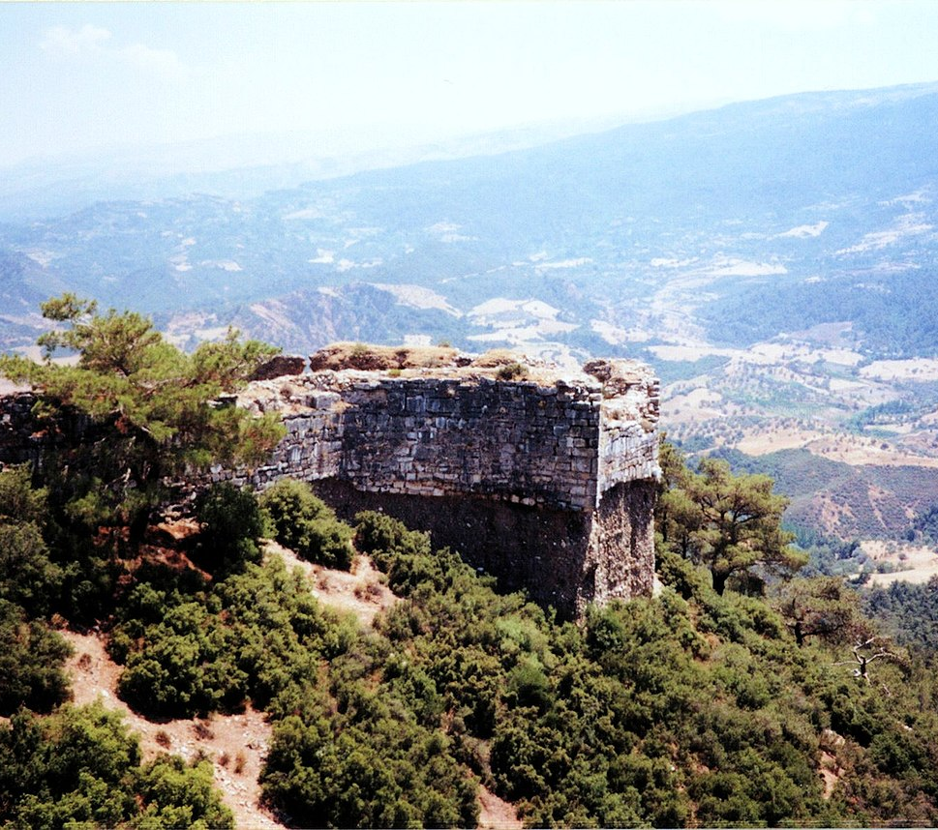
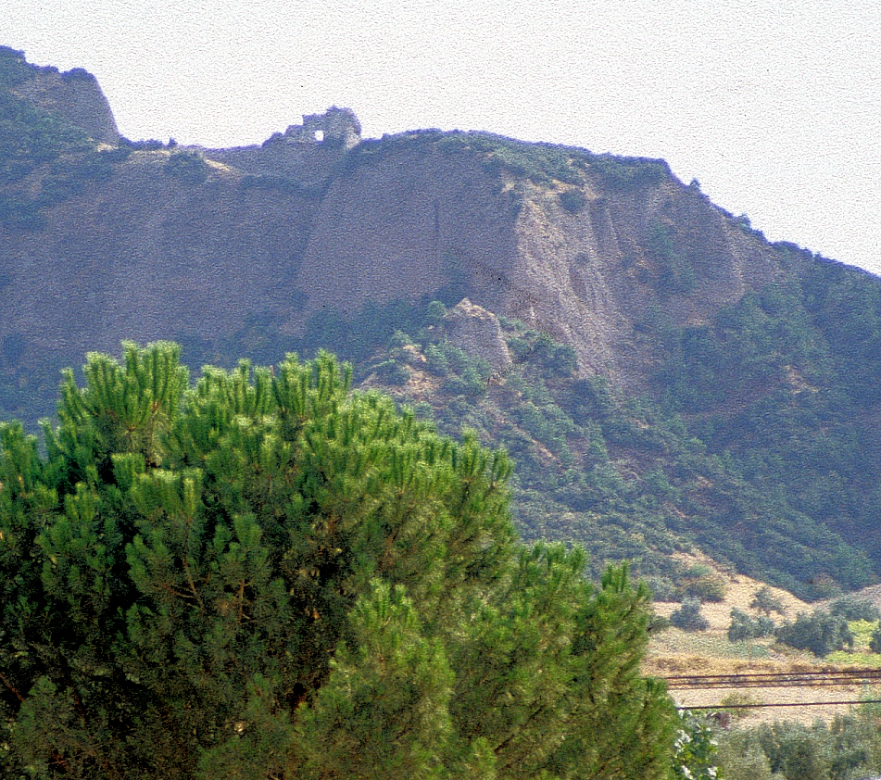
Complacency
SARDIS
“I know your works, that you have a name that you are alive, but you are dead. ² Be watchful, and strengthen the things which remain, that are ready to die, for I have not found your works perfect before God. ³ Remember therefore how you have received and heard; hold fast and repent. Therefore if you will not watch, I will come upon you as a thief, and you will not know what hour I will come upon you.”
…a part of the citadel where no guard had been set; for here the height on which the citadel stood was sheer and hardly to be assaulted, and none feared that it could be taken by an attack made here.
Herodotus 1.84
By Ken Mayer - Flickr, CC BY 2.0, https://commons.wikimedia.org/w/index.php?curid=75230152

Slide 8
Complacency
SARDIS
“I know your works, that you have a name that you are alive, but you are dead. ² Be watchful, and strengthen the things which remain, that are ready to die, for I have not found your works perfect before God. ³ Remember therefore how you have received and heard; hold fast and repent. Therefore if you will not watch, I will come upon you as a thief, and you will not know what hour I will come upon you.”
Having observed therefore that a portion of the wall was unguarded… He had discovered the carelessness of the men guarding this wall…The place was extremely precipitous….
Polybius 7.15

Slide 9
Signs of Complacency
Not seeing the wickedness around us
2 Corinthians 4:4
the god of this world has blinded the minds of the unbelieving

Slide 10
Signs of Complacency
Not seeing the wickedness around us
John 15:18
it [the world] has hated Me before it hated you.
John 15:19
because you are not of the world, but I chose you out of the world, because of this the world hates you.
John 17:14
the world has hated them because they are not of the world

Slide 11
Signs of Complacency
Not seeing the wickedness around us
Ephesians 2:2
the course of this world, according to the prince of the power of the air, of the spirit that is now working in the sons of disobedience.

Slide 12
Signs of Complacency
Not seeing the wickedness around us
Not embracing “being different”
Leviticus 11 ⁴⁴ For I am the Lord your God. Consecrate yourselves therefore, and be holy, because I am holy. And you shall not make yourselves unclean with any of the swarming things that swarm on the earth
1 Peter 1, 2

Slide 13
Signs of Complacency
Not seeing the wickedness around us
Not embracing “being different”
1 Peter 4 ⁴ In all this, they are surprised that you do not run with them in the same excesses of debauchery, and they slander you; ⁵ but they will give an account to Him who is ready to judge the living and the dead.

Slide 14
Signs of Complacency
Not seeing the wickedness around us
Not embracing “being different”
Being Different is Counterintuitive
“Peer Pressure” is natural

Slide 15
Signs of Complacency
Not seeing the wickedness around us
Not embracing “being different”
Not actively questioning everything!
Rahab
Cornelius
Dionysius the Aeropagite
Some sisters in Christ

