Slide 1
Perseverance
Jeff Smelser

Slide 2
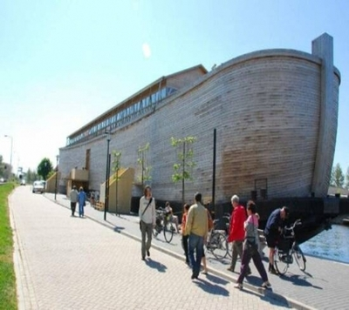
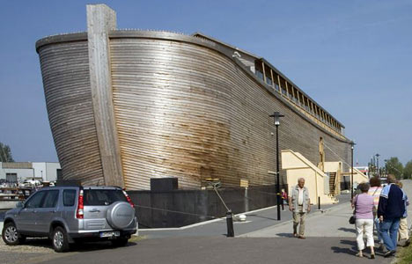
225 ft. long
30 ft. wide
Noah’s:
450 ft. long
75 ft. wide

Slide 3
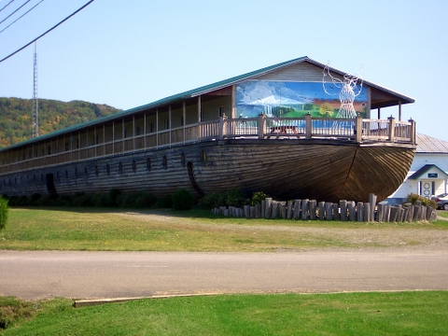
300 ft. long
36 ft. wide
Noah’s
450 ft. long
75 ft. wide

Slide 4
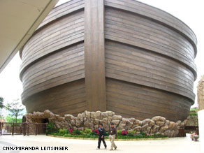

Slide 5
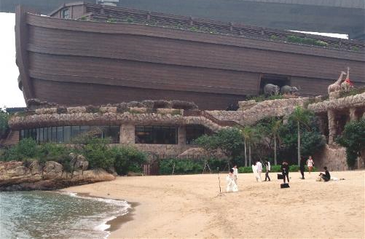

Slide 7
510 feet
1 cubit = 20.4”
51 feet
84 feet

Slide 8
Perseverance
What Noah didn’t have…
power tools
Lowe’s
What Noah had to have…
Trees (Gopher Wood)
The ability to move the trees/lumber
Time
Perseverance
Through sickness?
Through lumber shortages?
Did he make mistakes, have to tear something out and start over?
Endurance
Steadfastness
KJV, ASV: “Patience”
Genesis 6:3
So the Lord said, “My spirit will not remain in humankind indefinitely, since they are mortal. They will remain for 120 more years.”

Slide 9
Perseverance
Especially in Difficulty
(it’s not perseverance if there’s no difficulty)
Luke 21:19
Romans 12:12 “…persevering in tribulation…”
2 Corinthians 1:6 “in patient enduring of the same sufferings”
2 Thess. 1:4
James 5:11 “You heard about the perseverance of Job”
Illustrated by Athletic Perseverance
Heb. 12:1
Hebrews 12 ¹ Therefore, since we also have such a great cloud of witnesses surrounding us, let’s rid ourselves of every obstacle and the sin which so easily entangles us, and let’s run with endurance the race that is set before us…
¹⁶ But ye shall be delivered up even by parents, and brethren, and kinsfolk, and friends; and some of you shall they cause to be put to death. ¹⁷ And ye shall be hated of all men for my name's sake. ¹⁸ And not a hair of your head shall perish.
¹⁹ In your patience ye shall win your souls.
(NAS) therefore, we ourselves speak proudly of you among the churches of God for your perseverance and faith in the midst of all your persecutions and afflictions which you endure.
perseverance

Slide 10
Perseverance
Especially in Difficulty
(it’s not perseverance if there’s no difficulty)
Luke 21:19
Romans 12:12 “…persevering in tribulation…”
2 Corinthians 1:6 “in patient enduring of the same sufferings”
2 Thess. 1:4
James 5:11 “You heard about the perseverance of Job”
Illustrated by Athletic Perseverance
Heb. 12:1
Hebrews 12 ¹ Therefore, since we also have such a great cloud of witnesses surrounding us, let’s rid ourselves of every obstacle and the sin which so easily entangles us, and let’s run with endurance the race that is set before us, ² looking only at Jesus, the originator and perfecter of the faith, who for the joy set before Him endured the cross, despising the shame, and has sat down at the right hand of the throne of God.
perseverance

Slide 11
Perseverance
Especially in Difficulty
(it’s not perseverance if there’s no difficulty)
Luke 21:19
Romans 12:12 “…persevering in tribulation…”
2 Corinthians 1:6 “in patient enduring of the same sufferings”
2 Thess. 1:4
James 5:11 “You heard about the perseverance of Job”
Illustrated by Athletic Perseverance
Heb. 12:1
Hebrews 12 ¹ Therefore, since we also have such a great cloud of witnesses surrounding us, let’s rid ourselves of every obstacle and the sin which so easily entangles us, and let’s run with endurance the race that is set before us, ² looking only at Jesus, the originator and perfecter of the faith, who for the joy set before Him endured the cross, despising the shame, and has sat down at the right hand of the throne of God. ³ For consider Him who has endured such hostility by sinners against Himself, so that you will not grow weary and lose heart.
perseverance

Slide 12
Perseverance
Especially in Difficulty
(it’s not perseverance if there’s no difficulty)
Luke 21:19
Romans 12:12 “…persevering in tribulation…”
2 Corinthians 1:6 “in patient enduring of the same sufferings”
2 Thess. 1:4
James 5:11 “You heard about the perseverance of Job”
Illustrated by Athletic Perseverance
Heb. 12:1
Bring forth fruit with perseverance
Luke 8:15
Hebrews 12 ¹ Therefore, since we also have such a great cloud of witnesses surrounding us, let’s rid ourselves of every obstacle and the sin which so easily entangles us, and let’s run with endurance the race that is set before us, ² looking only at Jesus, the originator and perfecter of the faith, who for the joy set before Him endured the cross, despising the shame, and has sat down at the right hand of the throne of God. ³ For consider Him who has endured such hostility by sinners against Himself, so that you will not grow weary and lose heart.
When did Israel backslide?
Ex. 14:10ff Pharaoh’s army approached
Ex. 15:24 3 days later, no water
Ex. 16:3 Lacking food
When do people backslide?
Family Problems
Marriage problems
Work problems
No Perseverance!

Slide 13
Perseverance
Hope is associated with perseverance
Romans 8:25
Romans 15:4
Salvation requires Perseverance
Matthew 10:22, Matthew 24:13
2 Timothy 2:11-12
What Builds Perseverance
Romans 5:3
James 1:2-4
120 years!

