Slide 1
The Hardening of Pharaoh’s Heart

Slide 2
The Power of Ancient Empires
Siege
Hardening of Pharaoh’s heart

Slide 3
The Power of Ancient Empires
Siege
Hardening of Pharaoh’s heart

Slide 4
Daniel

Slide 5
Daniel 2, 7
Daniel

Slide 6
Daniel 2, 7
Medo Persia
Roman
Babylon
Greece
Daniel

Slide 7
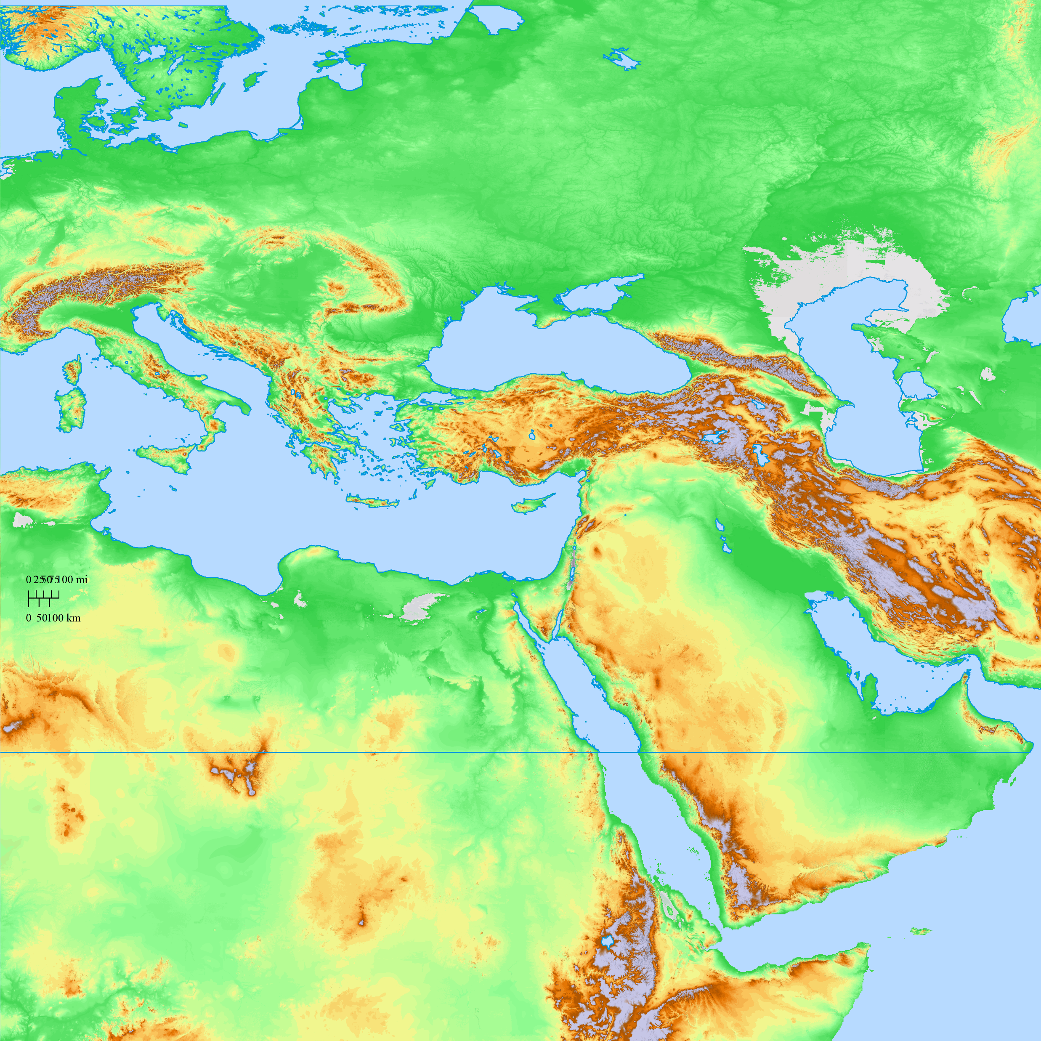
UKRAINE

Slide 8
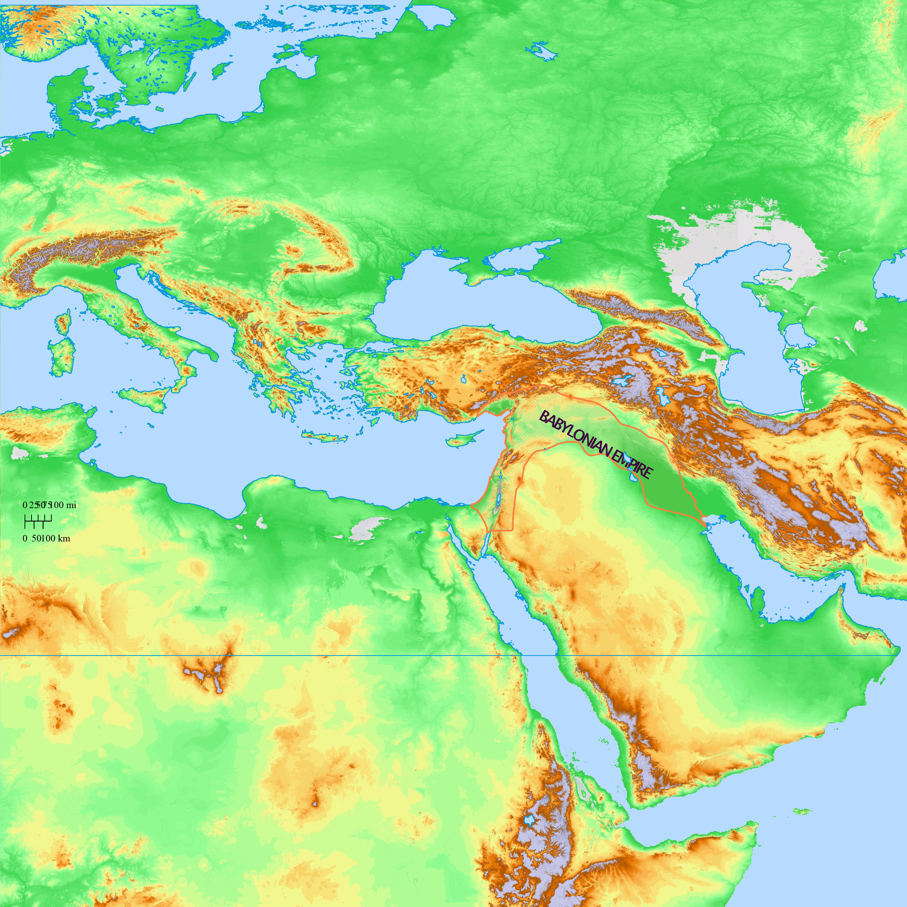
UKRAINE

Slide 9
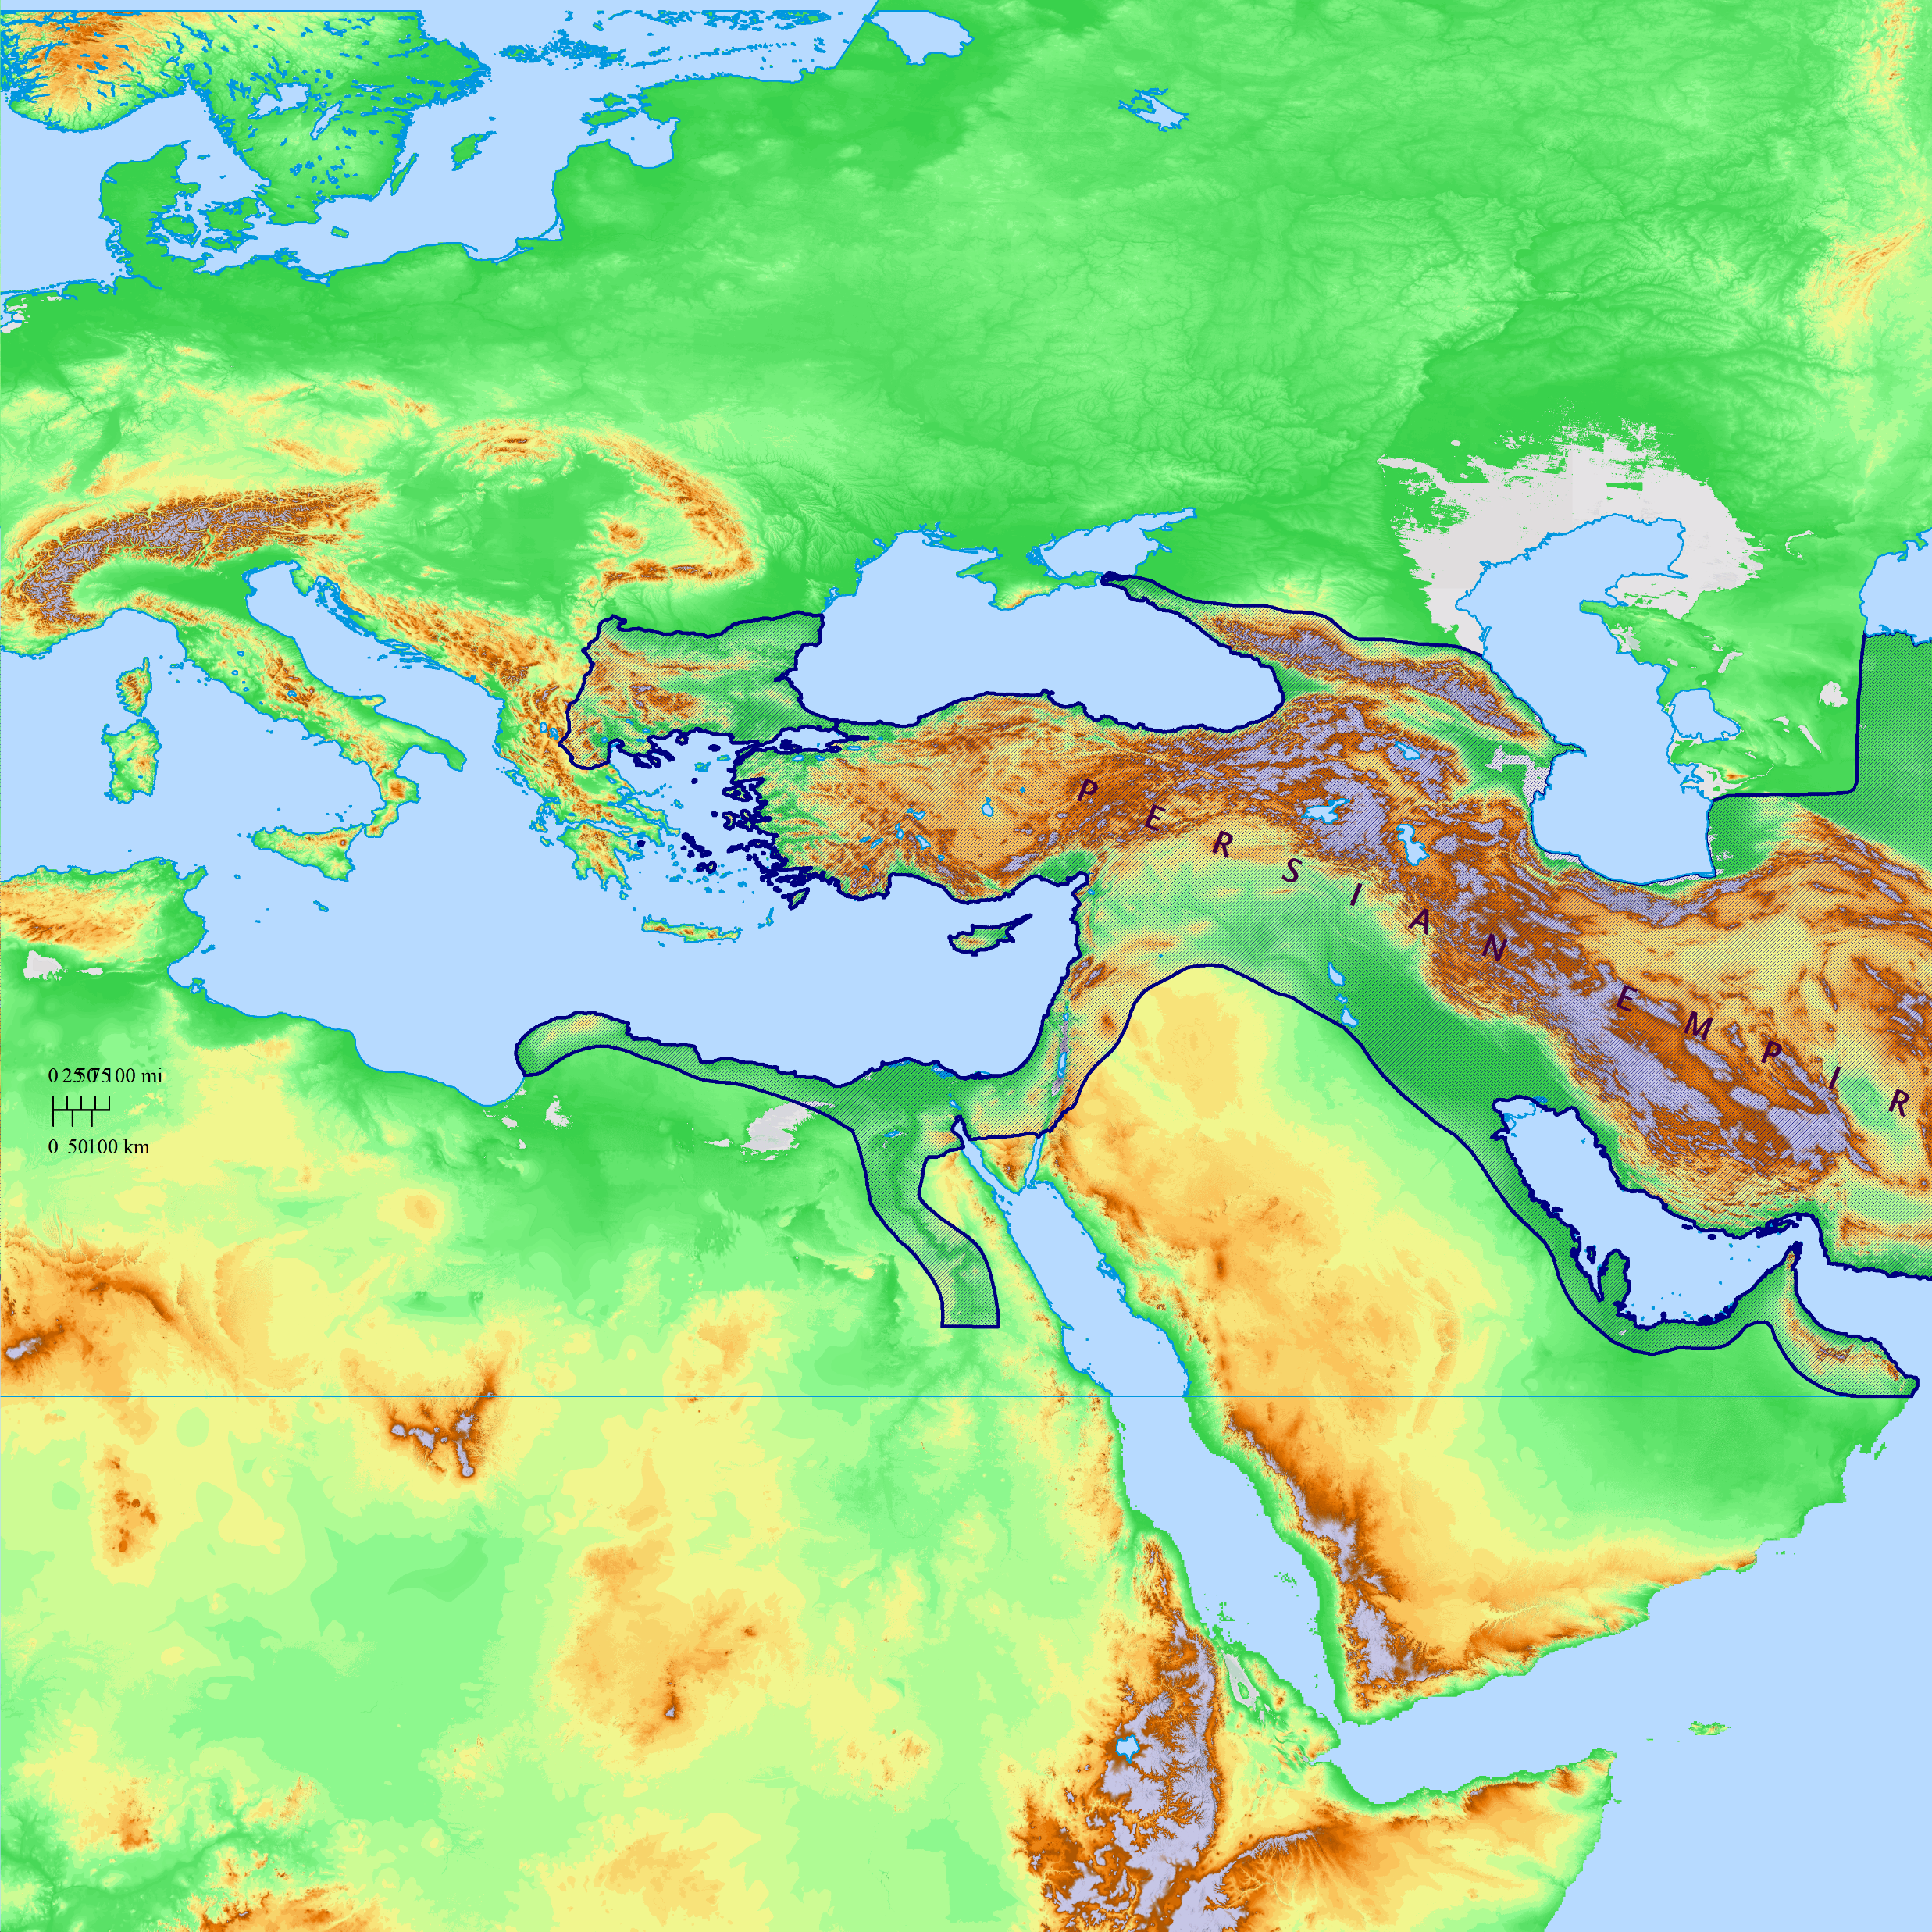
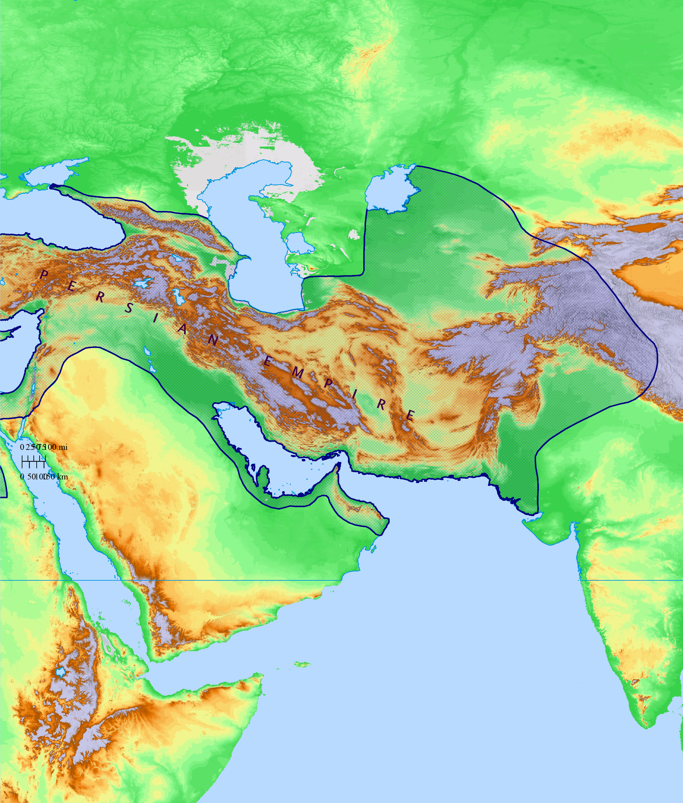
UKRAINE

Slide 10
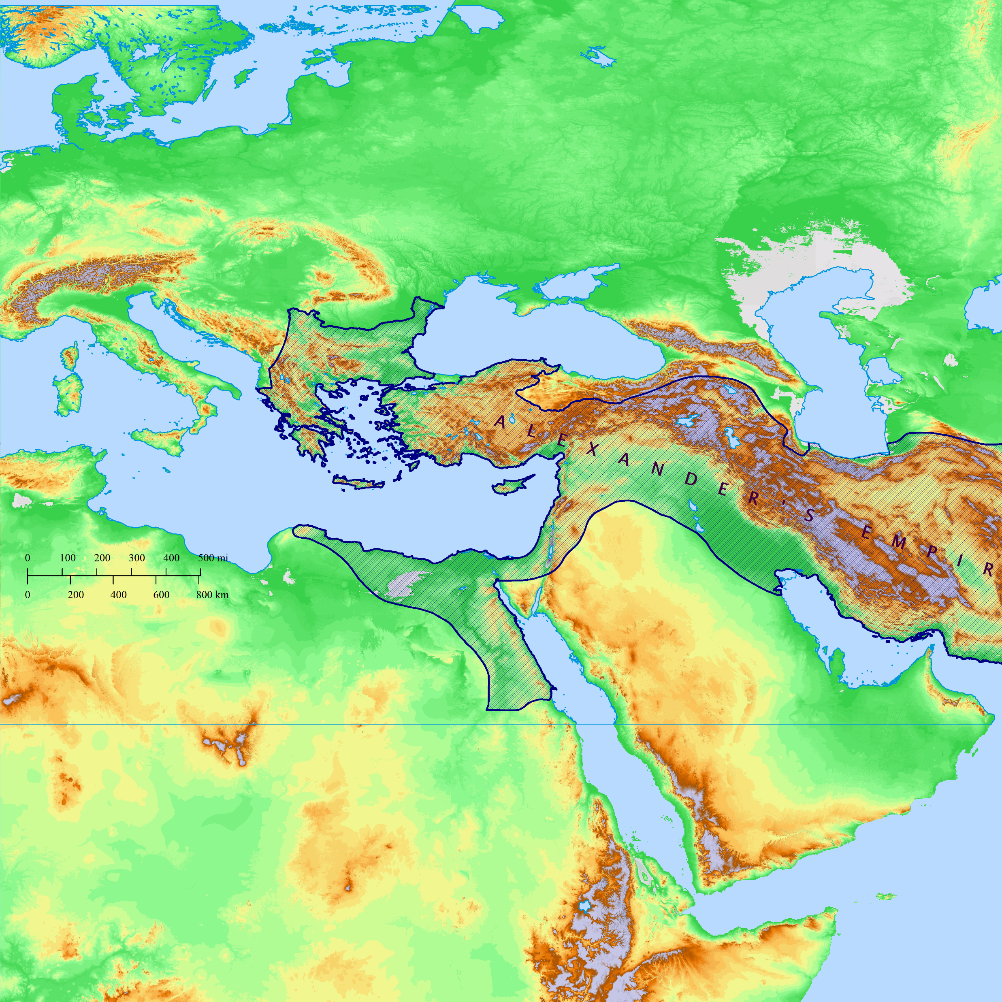
UKRAINE

Slide 11
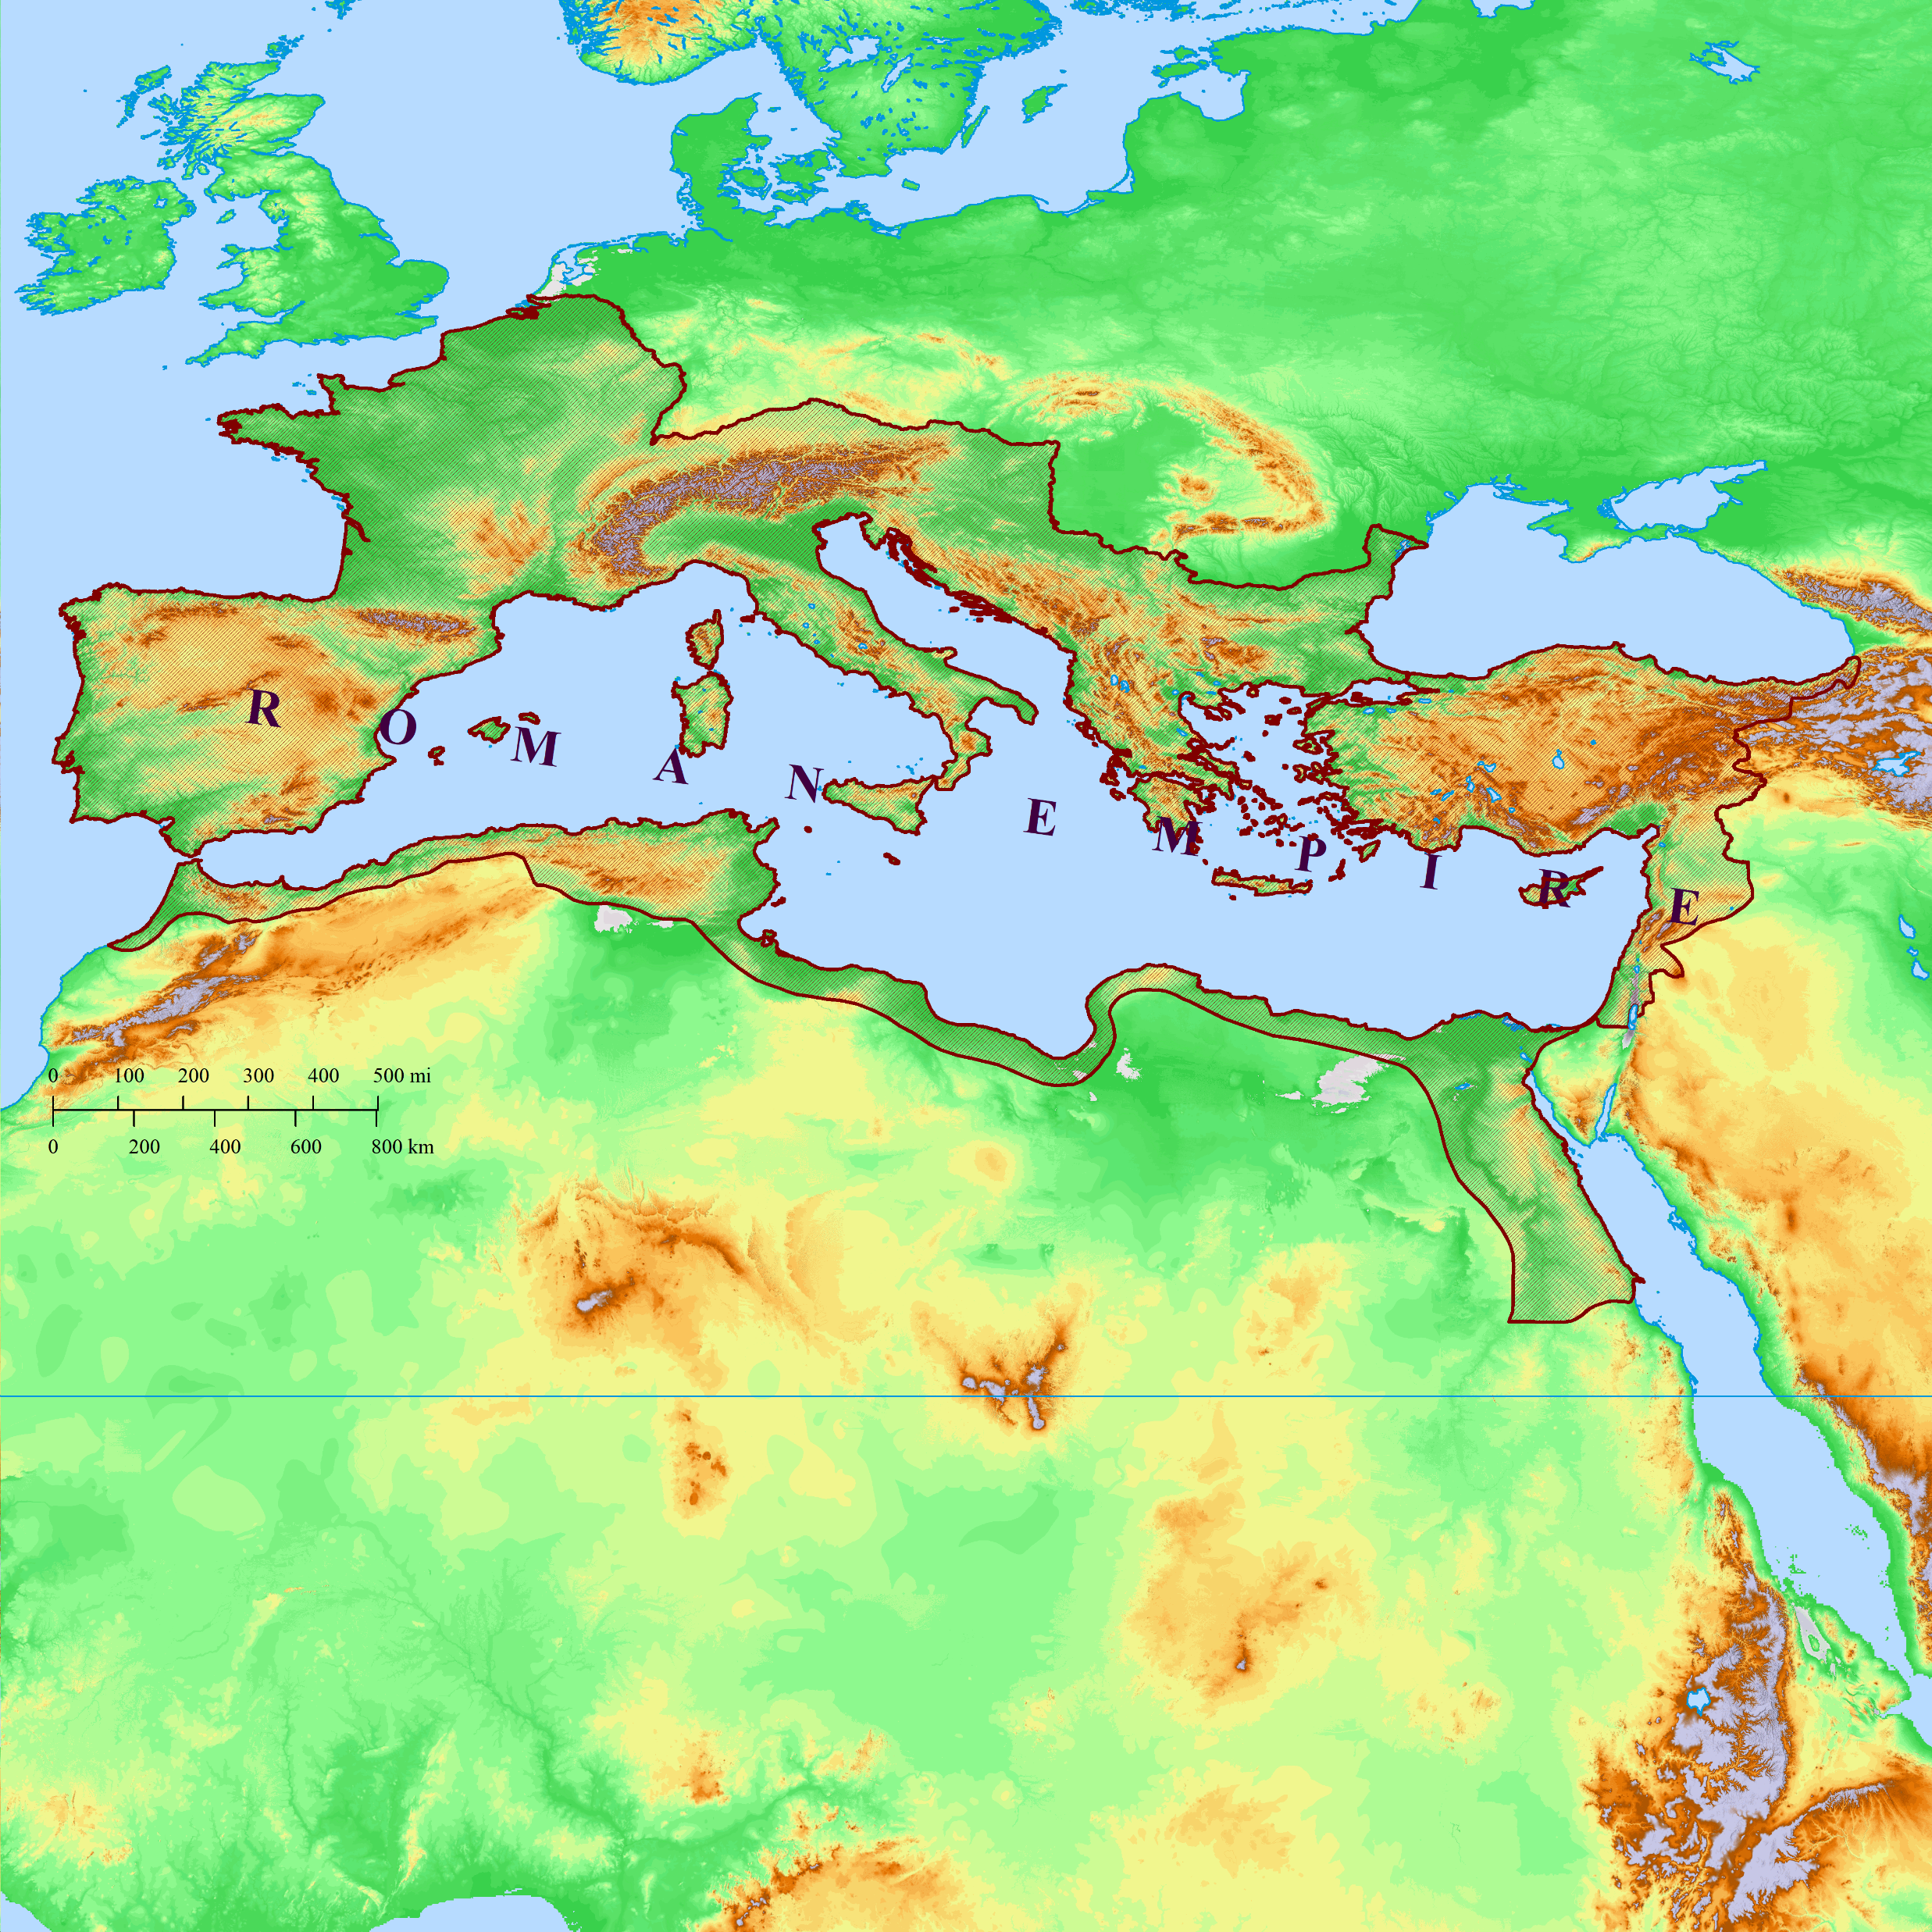
UKRAINE

Slide 12
The Power of Ancient Empires
Siege
Hardening of Pharaoh’s heart

Slide 13
The Power of Ancient Empires
Siege
Hardening of Pharaoh’s heart

Slide 14
Exodus 7 ¹ Then the Lord said to Moses, “See, I have made you as God to Pharaoh, and your brother Aaron shall be your prophet. ² As for you, you shall speak all that I command you, and your brother Aaron shall speak to Pharaoh that he let the sons of Israel go out of his land. ³ But I will harden Pharaoh’s heart, so that I may multiply My signs and My wonders in the land of Egypt. ⁴ When Pharaoh does not listen to you, I will lay My hand on Egypt and bring out My armies, My people the sons of Israel, from the land of Egypt by great judgments. ⁵ Then the Egyptians shall know that I am the Lord, when I extend My hand over Egypt and bring out the sons of Israel from their midst.”

Slide 15
?
Exodus 7 ¹ Then the Lord said to Moses, “See, I have made you as God to Pharaoh, and your brother Aaron shall be your prophet. ² As for you, you shall speak all that I command you, and your brother Aaron shall speak to Pharaoh that he let the sons of Israel go out of his land. ³ But I will harden Pharaoh’s heart, so that I may multiply My signs and My wonders in the land of Egypt. ⁴ When Pharaoh does not listen to you, I will lay My hand on Egypt and bring out My armies, My people the sons of Israel, from the land of Egypt by great judgments. ⁵ Then the Egyptians shall know that I am the Lord, when I extend My hand over Egypt and bring out the sons of Israel from their midst.”

Slide 16
Exodus 7 ¹ Then the Lord said to Moses, “See, I have made you as God to Pharaoh, and your brother Aaron shall be your prophet. ² As for you, you shall speak all that I command you, and your brother Aaron shall speak to Pharaoh that he let the sons of Israel go out of his land. ³ But I will harden Pharaoh’s heart, so that I may multiply My signs and My wonders in the land of Egypt. ⁴ When Pharaoh does not listen to you, I will lay My hand on Egypt and bring out My armies, My people the sons of Israel, from the land of Egypt by great judgments. ⁵ Then the Egyptians shall know that I am the Lord, when I extend My hand over Egypt and bring out the sons of Israel from their midst.”
Consider the sanctions on Russia…

Slide 17
Exodus 7 ¹ Then the Lord said to Moses, “See, I have made you as God to Pharaoh, and your brother Aaron shall be your prophet. ² As for you, you shall speak all that I command you, and your brother Aaron shall speak to Pharaoh that he let the sons of Israel go out of his land. ³ But I will harden Pharaoh’s heart, so that I may multiply My signs and My wonders in the land of Egypt. ⁴ When Pharaoh does not listen to you, I will lay My hand on Egypt and bring out My armies, My people the sons of Israel, from the land of Egypt by great judgments. ⁵ Then the Egyptians shall know that I am the Lord, when I extend My hand over Egypt and bring out the sons of Israel from their midst.”
Consider the sanctions on Russia…
Did anyone take away Putin’s free will?

Slide 18
Exodus 7 ¹⁰ So Moses and Aaron came to Pharaoh, and so they did, just as the Lord had commanded; and Aaron threw his staff down before Pharaoh and his servants, and it turned into a serpent.
¹¹ Then Pharaoh also called for the wise men and the sorcerers, and they too, the soothsayer priests of Egypt, did the same with their secret arts. ¹² For each one threw down his staff, and they turned into serpents. But Aaron’s staff swallowed their staffs. ¹³ Yet Pharaoh’s heart was hardened, and he did not listen to them, just as the Lord had said.

Slide 19
Exodus 7 ¹⁰ So Moses and Aaron came to Pharaoh, and so they did, just as the Lord had commanded; and Aaron threw his staff down before Pharaoh and his servants, and it turned into a serpent.
¹¹ Then Pharaoh also called for the wise men and the sorcerers, and they too, the soothsayer priests of Egypt, did the same with their secret arts. ¹² For each one threw down his staff, and they turned into serpents. But Aaron’s staff swallowed their staffs. ¹³ Yet Pharaoh’s heart was hardened, and he did not listen to them, just as the Lord had said.

Slide 20
Exodus 7 ¹⁰ So Moses and Aaron came to Pharaoh, and so they did, just as the Lord had commanded; and Aaron threw his staff down before Pharaoh and his servants, and it turned into a serpent.
¹¹ Then Pharaoh also called for the wise men and the sorcerers, and they too, the soothsayer priests of Egypt, did the same with their secret arts. ¹² For each one threw down his staff, and they turned into serpents. But Aaron’s staff swallowed their staffs. ¹³ Yet Pharaoh’s heart was hardened, and he did not listen to them, just as the Lord had said.

Slide 21
Exodus 7 ²² But the soothsayer priests of Egypt did the same with their secret arts; and Pharaoh’s heart was hardened, and he did not listen to them, just as the Lord had said.
8 ⁷ However, the soothsayer priests did the same with their secret arts, making frogs come up on the land of Egypt.
Consider the magicians’ ability to imitate these signs…
Did anyone take away Pharaoh’s free will?

Slide 22
Exodus 9 ³⁴ But when Pharaoh saw that the rain and the hail and the thunder had stopped, he sinned again and hardened his heart, he and his servants. ³⁵ So Pharaoh’s heart was hardened, and he did not let the sons of Israel go, just as the Lord had spoken through Moses. 10 ¹ Then the Lord said to Moses, “Go to Pharaoh, for I have hardened his heart and the heart of his servants…”

Slide 23
Exodus 9 ³⁴ But when Pharaoh saw that the rain and the hail and the thunder had stopped, he sinned again and hardened his heart, he and his servants. ³⁵ So Pharaoh’s heart was hardened, and he did not let the sons of Israel go, just as the Lord had spoken through Moses. 10 ¹ Then the Lord said to Moses, “Go to Pharaoh, for I have hardened his heart and the heart of his servants…”

Slide 24
Exodus 9 ³⁴ But when Pharaoh saw that the rain and the hail and the thunder had stopped, he sinned again and hardened his heart, he and his servants. ³⁵ So Pharaoh’s heart was hardened, and he did not let the sons of Israel go, just as the Lord had spoken through Moses. 10 ¹ Then the Lord said to Moses, “Go to Pharaoh, for I have hardened his heart and the heart of his servants…”
All talking about the same thing!

Slide 25
Exodus 9 ³⁴ But when Pharaoh saw that the rain and the hail and the thunder had stopped, he sinned again and hardened his heart, he and his servants. ³⁵ So Pharaoh’s heart was hardened, and he did not let the sons of Israel go, just as the Lord had spoken through Moses. 10 ¹ Then the Lord said to Moses, “Go to Pharaoh, for I have hardened his heart and the heart of his servants…”
But why not hit him with everything right at the beginning?

Slide 26
Exodus 9 ³⁴ But when Pharaoh saw that the rain and the hail and the thunder had stopped, he sinned again and hardened his heart, he and his servants. ³⁵ So Pharaoh’s heart was hardened, and he did not let the sons of Israel go, just as the Lord had spoken through Moses. 10 ¹ Then the Lord said to Moses, “Go to Pharaoh, for I have hardened his heart and the heart of his servants, so that I may perform these signs of Mine among them, ² and that you may tell in the presence of your son, and of your grandson, how I made a mockery of the Egyptians and how I performed My signs among them, so that you may know that I am the Lord.”

Slide 27
Lessons for us
When we escape consequences of sin, we can become hardened
(Ephesians 4:17-19)
Lesson for parents
(Proverbs 29:15)
Therefore, view suffering for sin as a blessing
(Hebrews 12:4-11)
Answers the question: “Why is there suffering in the world?
(Romans 8:20-21)

