Slide 1
Keeping Things in Perspective

Slide 2
Quirinius’ census near the time of Jesus’ birth
Judas of Galilee
Tribute to Caesar
Destruction of Jerusalem

Slide 3
Luke 2 ¹ Now in those days a decree went out from Caesar Augustus, that a census be taken of all the inhabited earth. ² This was the first census taken while Quirinius was governor of Syria. ³ And all the people were on their way to register for the census, each to his own city. ⁴ Now Joseph also went up from Galilee, from the city of Nazareth, to Judea, to the city of David which is called Bethlehem, because he was of the house and family of David, ⁵ in order to register along with Mary, who was betrothed to him, and was pregnant.
Quirinius’ census near the time of Jesus’ birth

Slide 4
Luke 2 ¹ Now in those days a decree went out from Caesar Augustus, that a census be taken of all the inhabited earth. ² This was the first census taken while Quirinius was governor of Syria. ³ And all the people were on their way to register for the census, each to his own city. ⁴ Now Joseph also went up from Galilee, from the city of Nazareth, to Judea, to the city of David which is called Bethlehem, because he was of the house and family of David, ⁵ in order to register along with Mary, who was betrothed to him, and was pregnant.
Quirinius’ census near the time of Jesus’ birth

Slide 5
Luke 2 ¹ Now in those days a decree went out from Caesar Augustus, that a census be taken of all the inhabited earth. ² This was the first census taken while Quirinius was governor of Syria. ³ And all the people were on their way to register for the census, each to his own city. ⁴ Now Joseph also went up from Galilee, from the city of Nazareth, to Judea, to the city of David which is called Bethlehem, because he was of the house and family of David, ⁵ in order to register along with Mary, who was betrothed to him, and was pregnant.
Quirinius’ census near the time of Jesus’ birth

Slide 6
Luke 2 ¹ Now in those days a decree went out from Caesar Augustus, that a census be taken of all the inhabited earth. ² This was the first census taken while Quirinius was governor of Syria. ³ And all the people were on their way to register for the census, each to his own city. ⁴ Now Joseph also went up from Galilee, from the city of Nazareth, to Judea, to the city of David which is called Bethlehem, because he was of the house and family of David, ⁵ in order to register along with Mary, who was betrothed to him, and was pregnant.
Quirinius’ census near the time of Jesus’ birth
“Although the Jews were at first shocked to hear of the registration of property, they gradually condescended, yielding to the arguments of the high priest…to go no further in opposition.”
Ant. xiii.3

Slide 7
Luke 2 ¹ Now in those days a decree went out from Caesar Augustus, that a census be taken of all the inhabited earth. ² This was the first census taken while Quirinius was governor of Syria. ³ And all the people were on their way to register for the census, each to his own city. ⁴ Now Joseph also went up from Galilee, from the city of Nazareth, to Judea, to the city of David which is called Bethlehem, because he was of the house and family of David, ⁵ in order to register along with Mary, who was betrothed to him, and was pregnant.
Judas of Galilee
“Although the Jews were at first shocked to hear of the registration of property, they gradually condescended, yielding to the arguments of the high priest…to go no further in opposition.”
Ant. xiii.3

Slide 8
Acts 5 ³⁷ …Judas of Galilee appeared in the days of the census and drew away some people after him; he also perished, and all those who followed him were scattered.
Judas of Galilee
“Although the Jews were at first shocked to hear of the registration of property, they gradually condescended, yielding to the arguments of the high priest…to go no further in opposition.”
Ant. xiii.3

Slide 9
Acts 5 ³⁷ …Judas of Galilee appeared in the days of the census and drew away some people after him; he also perished, and all those who followed him were scattered.
Judas of Galilee
“…a Galilaean, named Judas, incited his countrymen to revolt, upbraiding them as cowards for consenting to pay tribute to the Romans and tolerating mortal masters, after having God for their lord.”
BJ. ii.118

Slide 10
Acts 5 ³⁷ …Judas of Galilee appeared in the days of the census and drew away some people after him; he also perished, and all those who followed him were scattered.
Judas of Galilee
“…they have a passion for liberty that is almost unconquerable, since they are convinced that God alone is their leader and master.”
Ant. xviii.23
Religious and Patriotic

Slide 11
Matthew 22 ¹⁵ Then the Pharisees went and plotted together how they might trap Him in what He said. ¹⁶ And they sent their disciples to Him, along with the Herodians, saying, “Teacher, we know that You are truthful and teach the way of God in truth, and do not care what anyone thinks; for You are not partial to anyone. ¹⁷ Tell us then, what do You think? Is it permissible to pay a poll-tax to Caesar, or not?”
Luke 20 ²⁰ And so they watched Him closely, and sent spies who pretended to be righteous, in order that they might catch Him in some statement, so that they could hand Him over to the jurisdiction and authority of the governor.
Tribute to Caesar
The zealots, heirs of the spirit of Judas’ rebellion, continued to resent and resist Roman rule.
“YES” - Offend Jewish Patriots
“NO” - Guilty of Insurrection
“upbraiding them as cowards for consenting to pay tribute to the Romans.”

Slide 12
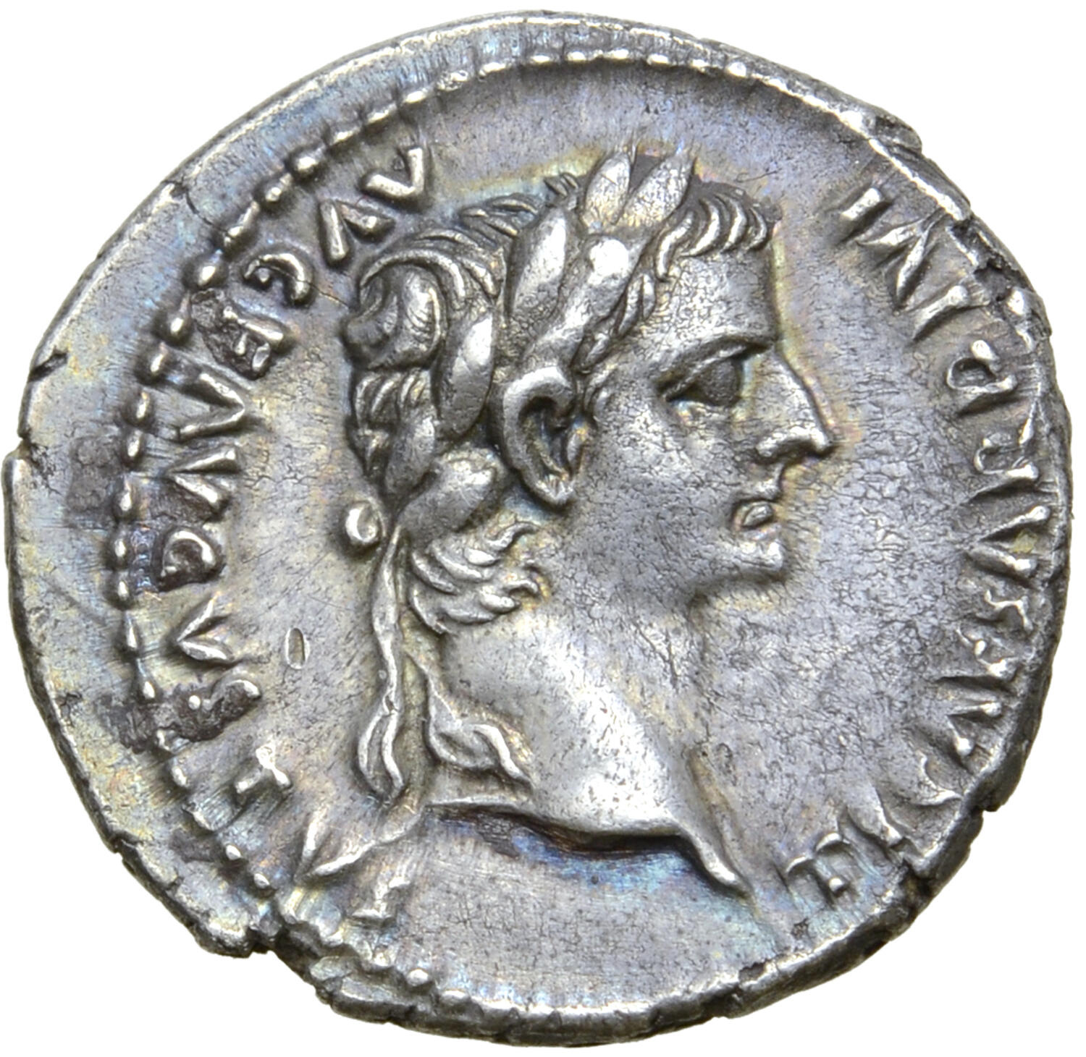
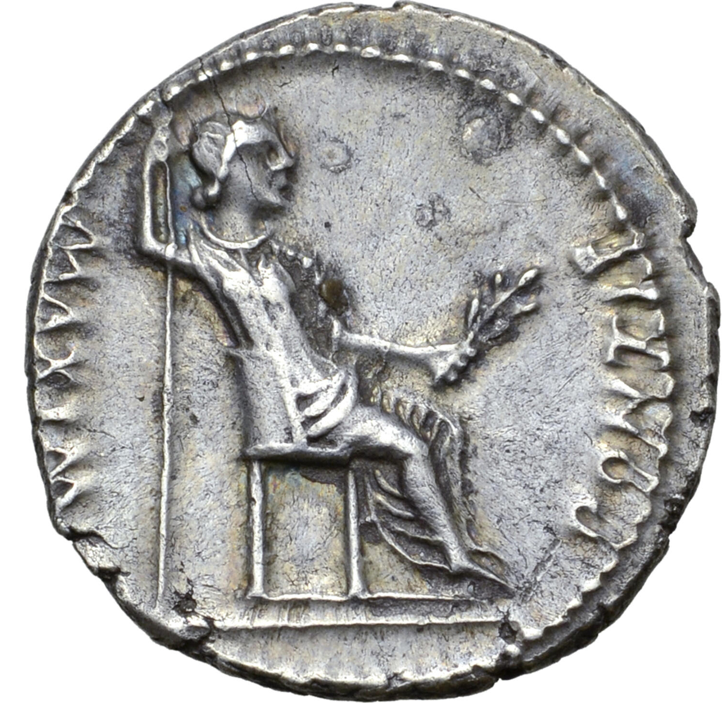
Tribute to Caesar
Matthew 22 ¹⁸ But Jesus perceived their malice, and said, “Why are you testing Me, you hypocrites?
TI CAESAR DIVI AVG F AVGVSTVS
Tiberius Caesar son of Divine Augustus, Emperor
PONTIF MAXIM
High Priest

Slide 13
Tribute to Caesar
Matthew 22 ¹⁸ But Jesus perceived their malice, and said, “Why are you testing Me, you hypocrites? ¹⁹ Show Me the coin used for the poll-tax.” And they brought Him a denarius. ²⁰ And He said to them, “Whose image and inscription is this?” ²¹ They said to Him, “Caesar’s.” Then He said to them, “Then pay to Caesar the things that are Caesar’s; and to God the things that are God’s.”

Slide 14
Destruction of Jerusalem
Jewish Rebellion, A.D. 66
Fall of Jerusalem, A.D. 70

Slide 15
Luke 6 ¹³ And when day came, He called His disciples to Him and chose twelve of them, whom He also named as apostles: ¹⁴ Simon, whom He also named Peter, and his brother Andrew; and James and John; and Philip and Bartholomew; ¹⁵ and Matthew and Thomas; James the son of Alphaeus, and Simon who was called the Zealot; ¹⁶ Judas the son of James, and Judas Iscariot, who became a traitor.

Slide 16
Luke 6 ¹³ And when day came, He called His disciples to Him and chose twelve of them, whom He also named as apostles: ¹⁴ Simon, whom He also named Peter, and his brother Andrew; and James and John; and Philip and Bartholomew; ¹⁵ and Matthew and Thomas; James the son of Alphaeus, and Simon who was called the Zealot; ¹⁶ Judas the son of James, and Judas Iscariot, who became a traitor.

Slide 17
Luke 6 ¹³ And when day came, He called His disciples to Him and chose twelve of them, whom He also named as apostles: ¹⁴ Simon, whom He also named Peter, and his brother Andrew; and James and John; and Philip and Bartholomew; ¹⁵ and Matthew and Thomas; James the son of Alphaeus, and Simon who was called the Zealot; ¹⁶ Judas the son of James, and Judas Iscariot, who became a traitor.

Slide 18
God is in Control, His Kingdom will Endure
I Don’t Know What He has in Mind
We are United in Something Greater
Keep Political Passions and Opinions in Perspective

Slide 19
God is in Control, His Kingdom will Endure
Daniel 2
²⁰ Daniel said,
“May the name of God be blessed forever and ever, For wisdom and power belong to Him. ²¹ It is He who changes the times and the periods; He removes kings and appoints kings”
Four Kingdoms
All Will Fall
God’s Kingdom Established Forever

Slide 20
God is in Control, His Kingdom will Endure
Daniel 3
¹⁵ “…what god is there who can rescue you from my hands?”
²⁸ “Blessed be the God of Shadrach, Meshach, and Abed-nego, who has sent His angel and rescued His servants who put their trust in Him, violating the king’s command, and surrendered their bodies rather than serve or worship any god except their own God. ²⁹ …there is no other god who is able to save in this way.”

Slide 21
God is in Control, His Kingdom will Endure
Daniel 4
²⁶ “…your kingdom will remain as yours after you recognize that it is Heaven that rules.”
^{34 “}…For His dominion is an everlasting dominion, And His kingdom endures from generation to generation. ³⁵ All the inhabitants of the earth are of no account, But He does according to His will among the army of heaven And among the inhabitants of earth…”

Slide 22
God is in Control, His Kingdom will Endure
Daniel 5
²⁶ “This is the interpretation of the message: ‘Menē’—God has numbered your kingdom and put an end to it. ²⁷ ‘Tekēl’—you have been weighed on the scales and found deficient. ²⁸ ‘Perēs’—your kingdom has been divided and given to the Medes and Persians.”

Slide 23
God is in Control, His Kingdom will Endure
Daniel 6
²⁶ “…in all the realm of my kingdom people are to tremble and fear before the God of Daniel;
For He is the living God and enduring forever, And His kingdom is one which will not be destroyed…”

Slide 24
God is in Control, His Kingdom will Endure
Daniel 7 (Remember the Four Kingdoms?)
^{12 “}…their dominion was taken away”
^{13 “}… One like a son of man was coming, And He came up to the Ancient of Days And was presented before Him. ¹⁴ And to Him was given dominion, Honor, and a kingdom, So that all the peoples, nations, and populations of all languages Might serve Him. His dominion is an everlasting dominion Which will not pass away; And His kingdom is one Which will not be destroyed.

Slide 25
God is in Control
I Don’t Know What He has in Mind
We are United in Something Greater
Keep Political Passions and Opinions in Perspective

