Slide 1
Daniel, Lesson III
A God who changes times and seasons (epochs),
removes and sets up kings Dan. 2:21
The Dream of Nebuchadnezzar and Fulfillment Dan. 2:40, 44

Slide 2
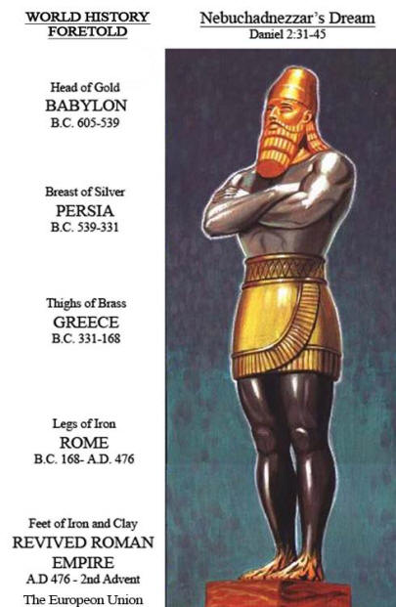

Slide 3
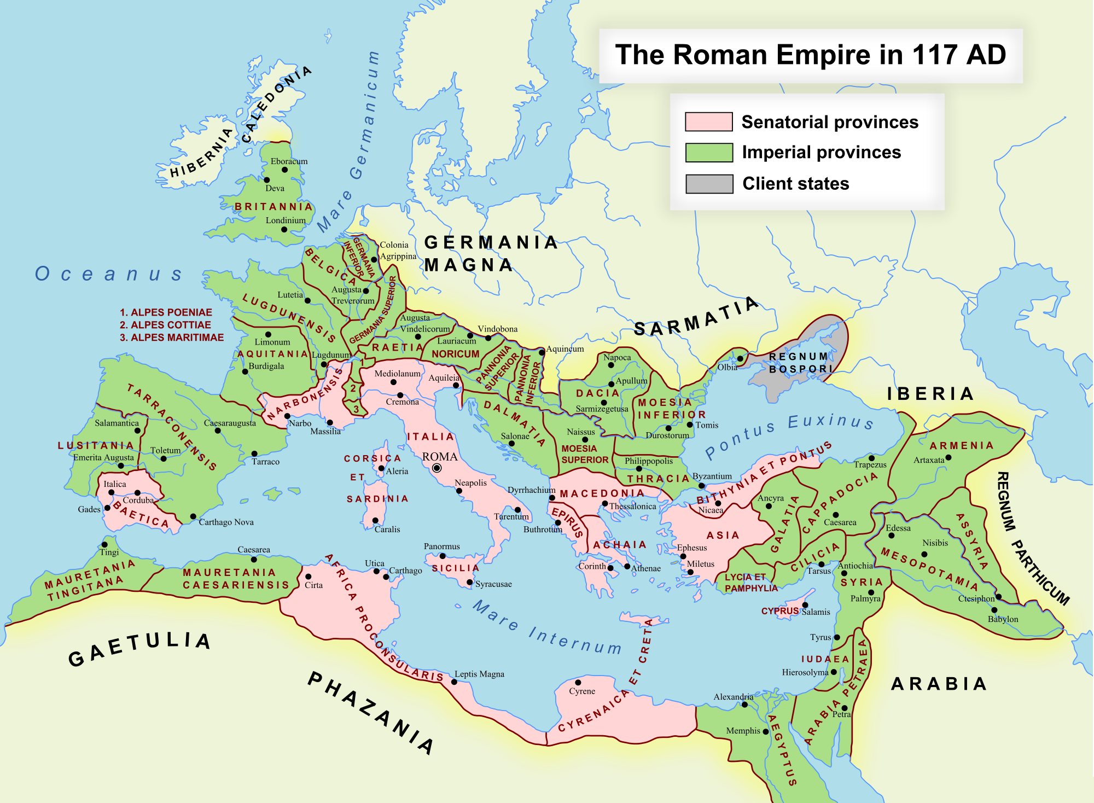

Slide 4
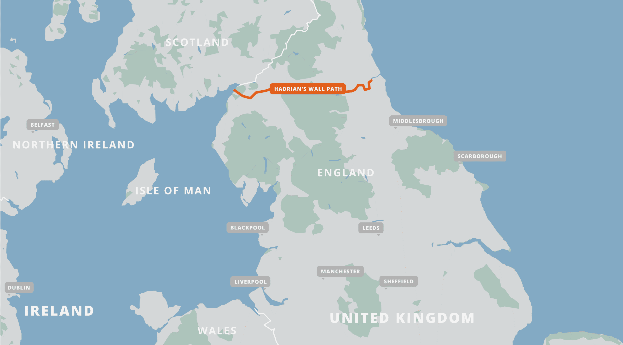

Slide 5
Dan. 2:21, a God that changes times and seasons
In days of 4th kingdom-Dan. 2:40. Set up a an eternal; indestructible Kingdom,
Dan. 2:44. Start as a stone cut out of mountain w/o hand,
break in pieces these kingdoms, Dan.2:44-45
Great Britain (up to Hardrian’s Wall), Belgium, Germany, France,Spain, Portugal, Czech Republic, Slovakia, Austria , Hungary, Romania, Switzerland, Italy, Slovenia, Croatia, Yugoslavia, Albania, Bulgaria, Moldova, Macedonia, Greece, Ukraine, Turkey, Syria , Jordan, Iraq, Iran, Afghanistan
Dan. 2:35- A Great Mountain that filled the earth. Compare Isa. 2: 2-4

