Slide 1
For Some, “Science” is a Stumblingblock
What is Science?
“know”
based on our experience, observation, testing, experimentation
“Science” changes
We can’t function without relying on Science
Science can’t tell us everything

Slide 2
Faith and the Age of the Earth
Faith and the Age of the Earth

Slide 3
Not so much about
what one thinks
as about
why one thinks it
THE PROBLEM IS NOT THE CONCLUSION.
THE PROBLEM IS THE ASSUMPTIONS.
Faith and the Age of the Earth
Faith and the Age of the Earth

Slide 4
Seeming Indications that the Universe & the Earth are OLD
Geological Formations
Radiometric Dating Techniques
Fossil Fuels
Star Light

Slide 5
WHERE DOES THE TIME GO?
Creation
Week
Flood
Abram

Slide 6
WHERE DOES THE TIME GO?
Creation
Week
GAP THEORY
Flood
Abram
1:1
1:2
Formless & Void
“GAP”
1:3ff

Slide 7
WHERE DOES THE TIME GO?
Creation
Week
GAP THEORY
Pre-Adamism
Flood
Abram
SCOFIELD REFERENCE BIBLE on Isaiah 45:18
“Only the earth, not the universe, is said to have been ‘without form and void.’”
“The face of the earth bears the marks of a catastrophe.”
“The word ‘was’ may also be translated ‘became,’…’became without form and void.’”
tohu wabohu “is used to describe a condition produced by divine judgment” [Dt. 33:10, Jer. 4:23, Is. 24:10, 34:11]
“Such a prehistoric divine judgment would throw some light on Satan’s fall…”
“This interpretation leaves room for an undetermined period of time between the original creation and divine judgment.”
1:2
“Became”
Formless & Void
summary
1:2
Formless & Void
1:1
1:3ff
full account

Slide 8
WHERE DOES THE TIME GO?
Creation
Week
Flood
Abram

Slide 9
WHERE DOES THE TIME GO?
DAY-AGE THEORY
Creation Week
Flood
Abram

Slide 10
WHERE DOES THE TIME GO?
Creation
Week
SKIPPED
GENERATIONS
Flood
Abram

Slide 11
⁹Enosh lived ninety years, and became the father of Kenan.
¹⁰Then Enosh lived eight hundred and fifteen years after he became the father of Kenan, and he had other sons and daughters.
¹¹So all the days of Enosh were nine hundred and five years, and he died.
¹²Kenan lived seventy years, and became the father of Mahalalel.
¹³Then Kenan lived eight hundred and forty years after he became the father of Mahalalel, and he had other sons and daughters.
¹⁴So all the days of Kenan were nine hundred and ten years, and he died.
¹⁵Mahalalel lived sixty-five years, and became the father of Jared.
¹⁶Then Mahalalel lived eight hundred and thirty years after he became the father of Jared, and he had other sons and daughters.
¹⁷So all the days of Mahalalel were eight hundred and ninety-five years, and he died.
⁹Enosh lived ninety years, and became the father of Kenan.
¹⁰Then Enosh lived eight hundred and fifteen years after he became the father of Kenan, and he had other sons and daughters.
¹¹So all the days of Enosh were nine hundred and five years, and he died.
¹²Kenan lived seventy years, and became the father of Mahalalel.
¹³Then Kenan lived eight hundred and forty years after he became the father of Mahalalel, and he had other sons and daughters.
¹⁴So all the days of Kenan were nine hundred and ten years, and he died.
¹⁵Mahalalel lived sixty-five years, and became the father of Jared.
¹⁶Then Mahalalel lived eight hundred and thirty years after he became the father of Jared, and he had other sons and daughters.
¹⁷So all the days of Mahalalel were eight hundred and ninety-five years, and he died.
⁹Enosh lived ninety years, and became the father of Kenan.
¹⁰Then Enosh lived eight hundred and fifteen years after he became the father of Kenan, and he had other sons and daughters.
¹¹So all the days of Enosh were nine hundred and five years, and he died.
¹²Kenan lived seventy years, and became the father of Mahalalel.
¹³Then Kenan lived eight hundred and forty years after he became the father of Mahalalel, and he had other sons and daughters.
¹⁴So all the days of Kenan were nine hundred and ten years, and he died.
¹⁵Mahalalel lived sixty-five years, and became the father of Jared.
¹⁶Then Mahalalel lived eight hundred and thirty years after he became the father of Jared, and he had other sons and daughters.
¹⁷So all the days of Mahalalel were eight hundred and ninety-five years, and he died.
⁹Enosh lived ninety years, and became the father of Kenan.
¹⁰Then Enosh lived eight hundred and fifteen years after he became the father of Kenan, and he had other sons and daughters.
¹¹So all the days of Enosh were nine hundred and five years, and he died.
¹²Kenan lived seventy years, and became the father of Mahalalel.
¹³Then Kenan lived eight hundred and forty years after he became the father of Mahalalel, and he had other sons and daughters.
¹⁴So all the days of Kenan were nine hundred and ten years, and he died.
¹⁵Mahalalel lived sixty-five years, and became the father of Jared.
¹⁶Then Mahalalel lived eight hundred and thirty years after he became the father of Jared, and he had other sons and daughters.
¹⁷So all the days of Mahalalel were eight hundred and ninety-five years, and he died.
WHERE DOES THE TIME GO?
Creation
Week
SKIPPED
GENERATIONS
Flood
Abram
c. 2000 B.C.

Slide 12
WHERE DOES THE TIME GO?
LXX has Cainan in Genesis 11
¹²And Arphaxad lived 135 years and begat Kainan. ¹³And after begetting Kainan, Arphaxad lived 430 years and begat sons and daughters and he died.
¹⁴And Kainan lived 130 years and begat Shela. And after begetting Shela, Kainan lived 330 years and begat sons and daughters and he died.
And Shela lived 130 years and begat Eber. ¹⁵And after begetting Eber, Shela lived 330 years and begat sons and daughters and he died.
¹⁶And Eber lived 134 years, and begat Peleg.
¹²Arpachshad lived thirty-five years, and became the father of Shelah;
¹³and Arpachshad lived four hundred and three years after he became the father of Shelah, and he had other sons and daughters.
¹⁴Shelah lived thirty years, and became the father of Eber;
¹⁵and Shelah lived four hundred and three years after he became the father of Eber, and he had other sons and daughters.
¹⁶Eber lived thirty-four years, and became the father of Peleg;
Creation
Week
¹²Arpachshad lived thirty-five years, and became the father of Shelah;
¹³and Arpachshad lived four hundred and three years after he became the father of Shelah, and he had other sons and daughters.
¹⁴Shelah lived thirty years, and became the father of Eber;
¹⁵and Shelah lived four hundred and three years after he became the father of Eber, and he had other sons and daughters.
¹⁶Eber lived thirty-four years, and became the father of Peleg;
Lk. 3:36 Cainan
SKIPPED
GENERATIONS
Flood
Abram
c. 2000 B.C.

Slide 13
WHERE DOES THE TIME GO?
LXX has Cainan in Genesis 5
Creation
Week
Codex Alexandrinus and most minuscules also have Cainan in 1 Chronicles 1
SKIPPED
GENERATIONS
Flood
Abram
EITHER CAINAN BELONGS BETWEEN
ARPHAXAD AND SHELA, OR HE DOESN’T
If Cainan belongs, then the LXX (and Luke) is correct and there is no missing generation.
If Cainan does not belong, then there is no missing generation!
c. 2000 B.C.

Slide 14
WHERE DOES THE TIME GO?
Creation
Week
6,000 to 7,000 yrs

Slide 15
ASSUMPTIONS
BEGAN "FROM SCRATCH": igneous rocks had to come from lava, petroleum had to come from decaying organic matter, etc.
CONSTANT RATE: natural processes have always progressed as we see them progressing today

Slide 16
CONSTANT RATE: natural processes have always progressed as we see them progressing today

Slide 17
CONSTANT RATE

Slide 18
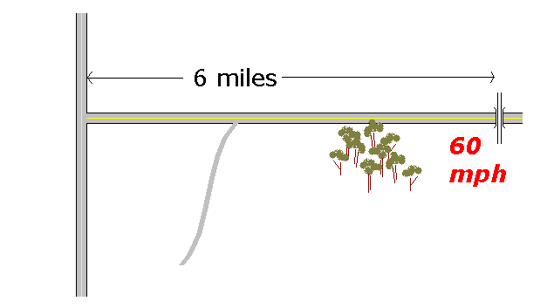
CONSTANT RATE???
(Have all things continued as they were from the beginning of creation?)
at intersection
6 minutes ago

Slide 19
CONSTANT RATE???
(Have all things continued as they were from the beginning of creation?)
“at intersection
6 minutes ago”

Slide 20
CONSTANT RATE???
(Have all things continued as they were from the beginning of creation?)
Sudden geological change
Man becomes carnivorous
Animals come to fear man
Atmospheric change?
Sudden change in life span

Slide 21
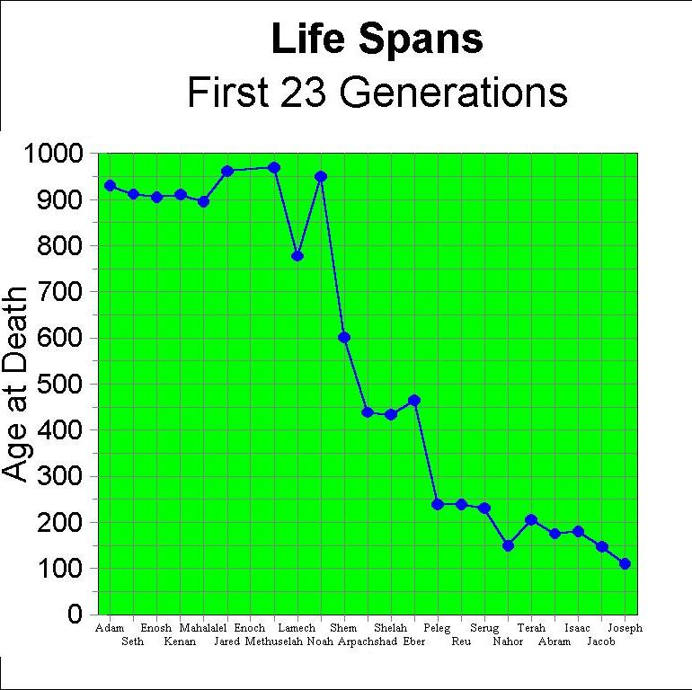
FLOOD

Slide 22
2 Pt. 3:5-7a
“For this they wilfully forget, that there were heavens from of old, and an earth compacted out of water and amidst water, by the word of God; by which means the world that then was, being overflowed with water, perished: but the heavens that now are, and the earth, by the same word have been stored up for fire…”

Slide 23
2 Pt. 3:5-7a
“For this they wilfully forget, that there were heavens from of old, and an earth compacted out of water and amidst water, by the word of God; by which means the world that then was, being overflowed with water, perished: but the heavens that now are, and the earth, by the same word have been stored up for fire…”

Slide 24
2 Pt. 3:5-7a
“For this they wilfully forget, that there were heavens from of old, and an earth compacted out of water and amidst water, by the word of God; by which means the world that then was, being overflowed with water, perished: but the heavens that now are, and the earth, by the same word have been stored up for fire…”
Can’t assume “constant rate”
The world has changed; we live in a different world!

Slide 25
ASSUMPTIONS
BEGAN "FROM SCRATCH": igneous rocks had to come from lava, petroleum had to come from decaying organic matter, etc.

Slide 26
BEGAN “FROM SCRATCH”???

Slide 27
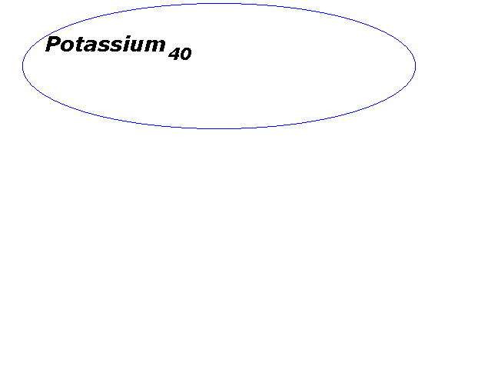

Slide 28
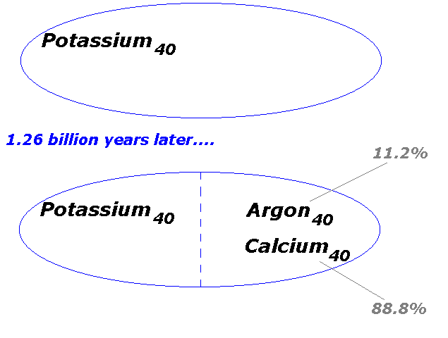

Slide 29
Age (t) of a rock using the potassium-argon radiometric dating method where t_{1/2} is the half life of potassium₄₀
t = t_{1/2} ln [1 + (argon₄₀)/(0.112)(potassium₄₀)]/ [ ln (2)]

Slide 30
DAY 1—Light
DAY 2—Expanse, separating waters above from waters below
DAY 3—Land & Plants
DAY 4—Sun, Moon, Stars
DAY 5—Birds of the air, fishes of the seas ________________
DAY 6—Land animals, Man

Slide 31
DAY 1—Light
DAY 2—Expanse, separating waters above from waters below
DAY 3—Land & Plants
DAY 4—Sun, Moon, Stars
DAY 5—Birds of the air, fishes of the seas spacefillerspacefiller
DAY 6—Land animals, Man

Slide 32
Mature Rocks? (did all igneous rocks have to start out as lava?)
Did all “fossil” fuels have to start out as decaying organic matter?
Did starlight have to start out at the stars?

Slide 33
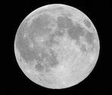
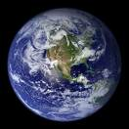
approx. 250,000 miles
< 1.5 seconds

Slide 34
93 million miles to the Sun
At the speed of light (186,000 miles/second)...
…Time to sun is 8 minutes, 14 seconds

Slide 35
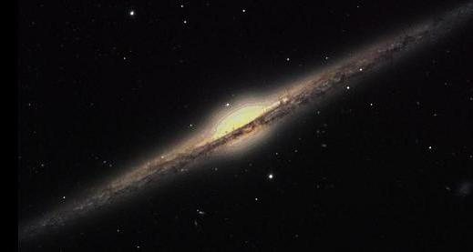
100,000 years

Slide 36
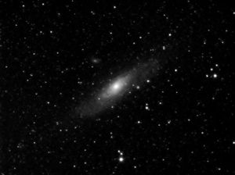
Andromeda Galaxy
2.5 million light years

Slide 37
1st Day
LIGHT
2nd Day
SKY, WATERS
3rd Day
LAND, PLANTS
4th Day
SUN, MOON, STARS
5th Day
BIRDS, FISHES
6th Day
ANIMALS, MAN

Slide 38
1st Day
LIGHT
2nd Day
SKY, WATERS
3rd Day
LAND, PLANTS
4th Day
SUN, MOON, STARS
5th Day
BIRDS, FISHES
6th Day
ANIMALS, MAN

Slide 39
Dr. Roger C. Wiens
Division of Geological & Planetary Sciences
California Institute of Technology
“It would not be inconsistent with the scientific evidence to conclude that God made everything relatively recently, but with the appearance of great age, just as Genesis 1 and 2 tell of God making Adam as a fully grown man (which implies the appearance of age).
“It would not be inconsistent with the scientific evidence to conclude that God made everything relatively recently, but with the appearance of great age, just as Genesis 1 and 2 tell of God making Adam as a fully grown man (which implies the appearance of age). That is a philosophical and theological matter which we won't go into here…”

Slide 40
The Bible: creation occurred approximately 6000 or 7000 years ago.
Science says the universe, including the earth, is billions of years old.
Discrepancy: this is a philosophical question, not a scientific question.
Scientists assume there must be a naturalistic explanation
necessarily arrive at a false conclusion in any instance where the explanation is not naturalistic.
However, their discipline limits them to discovering explanations that are naturalistic.
We have philosophical (not empirical) reasons for believing in Divine Creation
But if it was an act of God, science will not be able to discover its means.
Empirical science cannot explain what is not empirical
Attempting to explain creation in terms of observed processes necessarily precludes a singular act of God
Being outside of anything we have experienced or can observe, the story of creation can only be told by one who was there.
Science may to point to the absence of any viable naturalistic explanation.
Empirical science cannot explain when God did what empirical science cannot prove God did.
Concerning the origin of all things, rather than starting with science and letting that define for us the limitations of scripture or the nature of the creation narrative, we ought to start with an understanding of the limitations of science and then let scripture speak for itself.

