Slide 1
Background to Captivity, Daniel
1. Josiah, Reformer defeated by Pharaoh Necho.
2. Jehoahaz, son of Josiah, rules 3 months, defeated by Egyptians
3. Jehoiakim king 609: Nebuchadnezzar subjugates (605 ): Daniel, seed royal, taken: Nebuchadnezzar finishes off Jehoiakim, 598,
4. Jehoiachin his son appointed, Nebuchadnezzar removes him after 3 months, takes to him to Babylon, 597 (Ezekiel)
5. Zedekiah, son of Josiah appointed, rebels, Jer. falls, temple destroyed, captives to Babylon, 586
6. Gedaliah made governor, killed, people flee to Egypt taking Jeremiah.

Slide 2
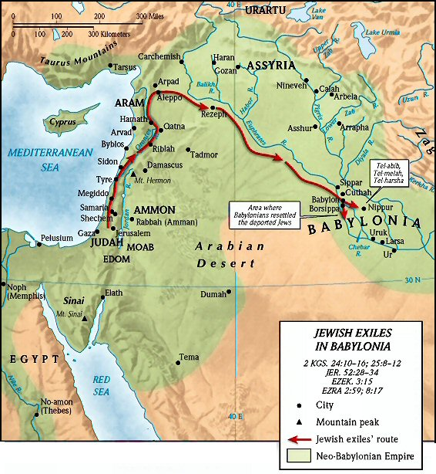

Slide 3
Impasse: Declaration of Wise Men
There is not a man upon the earth that can show the king’s matter, forasmuch as no king, lord or ruler has asked such a thing of any magician, enchanter or Chaldean…and there is no other that can show it before the king, except the gods, whose dwelling is not with flesh. Dan. 2:10-12
What will be obvious with Daniel’s revelation of dream, interpretation?
Whose God is?

Slide 4
Evaluating the Information
But where all these gods come from: Rom. 1:21-22:
Counterfeits of the Original
Gen. 1:1; Acts 17:24ff; John 1:1-3; Col. 1:15-17; consist; cohere, hold together….
Isa; 43:10; 44:6; 45:21-22:
Now suppose all this not true. Close Bible. Tell anything about God.

