Slide 1
“What is Christianity”
Jeff Smelser

Slide 2
Acts 2
The Center of it All

Slide 3
What is Christianity?

Slide 4
NATION
LAND
ALL FAMILIES BLESSED

Slide 9
1 Corinthians 15:1-4

Slide 10
The Lord’s Supper

Slide 11
1 Peter 4:3 Blessed be the God and Father of our Lord Jesus Christ, who according to His great mercy has caused us to be born again to a living hope through the resurrection of Jesus Christ from the dead
“until he comes”

Slide 12
³⁶ Therefore let all the house of Israel know for certain that God has made Him both Lord and Christ—this Jesus whom you crucified.”
Acts 2

Slide 13
³⁸ Peter said to them, “Repent, and each of you be baptized in the name of Jesus Christ for the forgiveness of your sins; and you will receive the gift of the Holy Spirit.”
Acts 2

Slide 14
⁴⁰ And with many other words he solemnly testified and kept on urging them, saying, “Be saved from this perverse generation!”
Acts 2

Slide 15
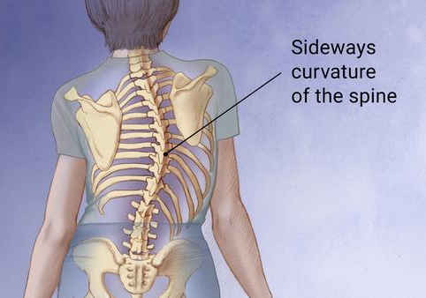
⁴⁰ And with many other words he solemnly testified and kept on urging them, saying, “Be saved from this perverse generation!”
“perverse”
think of scoliosis
Acts 2

Slide 16
⁴⁰ And with many other words he solemnly testified and kept on urging them, saying, “Be saved from this perverse generation!”
“messed up”
Acts 2

Slide 17
⁴⁰ And with many other words he solemnly testified and kept on urging them, saying, “Be saved from this perverse generation!”
Any worse than ours?
They were religious
Jews
Gentiles
Acts 2

Slide 18
A Recognition of a Problem
Acts 2:40
“this perverse generation”
Acts 2

Slide 19
A Recognition of a Problem
1 John 3:16-17
“the world passes away”
Acts 2

Slide 20
I’m Part of the Problem
1 John 3:16-17
“the world passes away”
Romans 3:9
“Are we better than they?”
1 Corinthians 6:11
“such were some of you”
Acts 2

Slide 21
An Initiation
⁴¹ So then, those who had received his word were baptized; and that day there were added about three thousand souls.
Acts 2

Slide 22
A Commitment
⁴¹ So then, those who had received his word were baptized; and that day there were added about three thousand souls.
Acts 2

Slide 23
A Community
⁴⁴ And all the believers were together and had all things in common; ⁴⁵ and they would sell their property and possessions and share them with all, to the extent that anyone had need.
Acts 2

