Slide 1
“Sensuality or Modesty”
Jeff Smelser

Slide 2
Dressing modestly is not about a list of rules
It’s a mindset
Part of the problem: we often don’t realize the degree that we have inherited a mindset from the world

Slide 3
The World is characterized by sensuality
We have been influenced by the world
This affects what we judge to be appropriate

Slide 4
Sensuality
Definition: “the enjoyment, expression, or pursuit of physical, especially sexual, pleasure.”
God is the creator of physical pleasure
The Issue: Does pleasure control you?
Romans 6:12-13
Therefore sin is not to reign in your mortal body so that you obey its lusts
Genesis 3:6 the tree was…
good for food
a delight to the eyes
was desirable to make one wise
1 John 2:16
the lust of the flesh
and the lust of the eyes
and the boastful pride of life
She obeyed her lusts/desires

Slide 5
Sensuality
Definition: “the enjoyment, expression, or pursuit of physical, especially sexual, pleasure.”
God is the creator of physical pleasure
The Issue: Does pleasure control you?
Romans 6:12-13
Therefore sin is not to reign in your mortal body so that you obey its lusts… but present yourselves to God as those who are alive from the dead, and your body’s parts as instruments of righteousness for God.
She obeyed her lusts/desires

Slide 6
Sensuality
Definition: “The quality or state of being sensual; devotedness to the gratification of the bodily appetites; free indulgence in carnal or sensual pleasures; luxuriousness; voluptuousness; lewdness”
sensuality is a word for being controlled by fleshly appetites

Slide 7
Sensuality
the works of the flesh in Galatians 5, including, “emulations, wrath, strife, seditions, heresies, envyings”
James 3¹⁴ But if ye have bitter envying and strife in your hearts, glory not, and lie not against the truth. ¹⁵ This wisdom descendeth not from above, but is earthly, sensual, devilish. ¹⁶ For where envying and strife is, there is confusion and every evil work.
sensuality is a word for being controlled by fleshly appetites

Slide 8
Sensuality
the works of the flesh in Galatians 5, including, “emulations, wrath, strife, seditions, heresies, envyings”
Jude ¹⁷ But, beloved, remember ye the words which were spoken before of the apostles of our Lord Jesus Christ; ¹⁸ How that they told you there should be mockers in the last time, who should walk after their own ungodly lusts. ¹⁹ These be they who separate themselves, sensual, having not the Spirit.
sensuality is a word for being controlled by fleshly appetites
You can train a dog with food
because the dog is controlled by food.

Slide 9
Sensuality
Sexuality is like all other physical pleasures created by God:
A blessing to be enjoyed within the constraints of God’s instructions
sensuality is a word for being controlled by fleshly appetites
Sensuality ignores the constraints of God’s instructions

Slide 10
Sensuality & the World
Sensuality Used to Sell Everything from Cars to Soda
Business Blog…
Sex and Sensuality in Advertising: Why it is effective and how to refine it
“They’re not quite selling a product but rather an expression of desire – a lifestyle that can be envisioned with the product or service.”
“Sex is a primitive instinct which qualifies it as an attention-grabbing technique in the media domain”

Slide 11
Sensuality & Attire
“Sex is a primitive instinct which qualifies it as an attention-grabbing technique”

Slide 12
Sensuality & Attire
May not be aiming at Sensuality
But if we determine what is acceptable attire by the world’s standard, we may dress in a sensual way,
because the world is sensual
What is wrong seems normal to the world

Slide 13
Sensuality & the World
¹⁷ So I say this, and affirm in the Lord, that you are to no longer walk just as the Gentiles also walk, in the futility of their minds, ¹⁸ being darkened in their understanding, excluded from the life of God because of the ignorance that is in them, because of the hardness of their heart; ¹⁹ and they, having become callous, have given themselves up to indecent behavior for the practice of every kind of impurity with greediness. ²⁰ But you did not learn Christ in this way, ²¹ if indeed you have heard Him and have been taught in Him, just as truth is in Jesus, ²² that, in reference to your former way of life, you are to rid yourselves of the old self, which is being corrupted in accordance with the lusts of deceit, ²³ and that you are to be renewed in the spirit of your minds, ²⁴ and to put on the new self, which in the likeness of God has been created in righteousness and holiness of the truth.
What is wrong seems normal to the world

Slide 14
Sensuality & the World
What is wrong seems normal to the world
¹⁷ So I say this, and affirm in the Lord, that you are to no longer walk just as the Gentiles also walk
Expect to be Changed!

Slide 15
Sensuality & the World
What is wrong seems normal to the world
¹⁷ So I say this, and affirm in the Lord, that you are to no longer walk just as the Gentiles also walk , in the futility of their minds, ¹⁸ being darkened in their understanding, excluded from the life of God because of the ignorance that is in them, because of the hardness of their heart;
Recognize that the World
Doesn’t Recognize
What is Right vs. What is Wrong!

Slide 16
Sensuality & the World
What is wrong seems normal to the world
¹⁷ So I say this, and affirm in the Lord, that you are to no longer walk just as the Gentiles also walk , in the futility of their minds, ¹⁸ being darkened in their understanding, excluded from the life of God because of the ignorance that is in them, because of the hardness of their heart; ¹⁹ and they, having become callous, have given themselves up to indecent behavior for the practice of every kind of impurity with greediness.
The World Doesn’t See Indecency as Indecency

Slide 17
Sensuality & the World
What is wrong seems normal to the world
¹⁷ So I say this, and affirm in the Lord, that you are to no longer walk just as the Gentiles also walk , in the futility of their minds, ¹⁸ being darkened in their understanding, excluded from the life of God because of the ignorance that is in them, because of the hardness of their heart; ¹⁹ and they, having become callous, have given themselves up to indecent behavior for the practice of every kind of impurity with greediness. ²⁰ But you did not learn Christ in this way, ²¹ if indeed you have heard Him and have been taught in Him, just as truth is in Jesus, ²² that, in reference to your former way of life, you are to rid yourselves of the old self

Slide 18
Sensuality & the World
What is wrong seems normal to the world
¹⁷ So I say this, and affirm in the Lord, that you are to no longer walk just as the Gentiles also walk , in the futility of their minds, ¹⁸ being darkened in their understanding, excluded from the life of God because of the ignorance that is in them, because of the hardness of their heart; ¹⁹ and they, having become callous, have given themselves up to indecent behavior for the practice of every kind of impurity with greediness. ²⁰ But you did not learn Christ in this way, ²¹ if indeed you have heard Him and have been taught in Him, just as truth is in Jesus, ²² that, in reference to your former way of life, you are to rid yourselves of the old self, which is being corrupted in accordance with the lusts of deceit, ²³ and that you are to be renewed in the spirit of your minds
Getting Rid of the Old Self Means Getting a New Mind

Slide 19
Sensuality & the World
What is wrong seems normal to the world
¹⁷ So I say this, and affirm in the Lord, that you are to no longer walk just as the Gentiles also walk , in the futility of their minds, ¹⁸ being darkened in their understanding, excluded from the life of God because of the ignorance that is in them, because of the hardness of their heart; ¹⁹ and they, having become callous, have given themselves up to indecent behavior for the practice of every kind of impurity with greediness. ²⁰ But you did not learn Christ in this way, ²¹ if indeed you have heard Him and have been taught in Him, just as truth is in Jesus, ²² that, in reference to your former way of life, you are to rid yourselves of the old self, which is being corrupted in accordance with the lusts of deceit, ²³ and that you are to be renewed in the spirit of your minds, ²⁴ and to put on the new self, which in the likeness of God has been created in righteousness and holiness of the truth.

Slide 20
Sensuality & the World
What is wrong seems normal to the world
Sleeping Together without Marriage
Pornography
White Lies
Foul Language
Revenge
How to Decide What to Wear?
“what is appropriate” won’t work if I have the world’s view of what is appropriate.
No more so than
In boyfriend/girlfriend relationship
when to tell the truth
in my vocabulary
I can’t start with what is acceptable to the world

Slide 21
Sensuality & Attire
What is wrong seems normal to the world
Sensuality is normal in our world.
Showing a lot of skin appeals to the sensual appetites of a man.
Showing a lot of skin is normal in our world.
But there’s a double standard

Slide 22
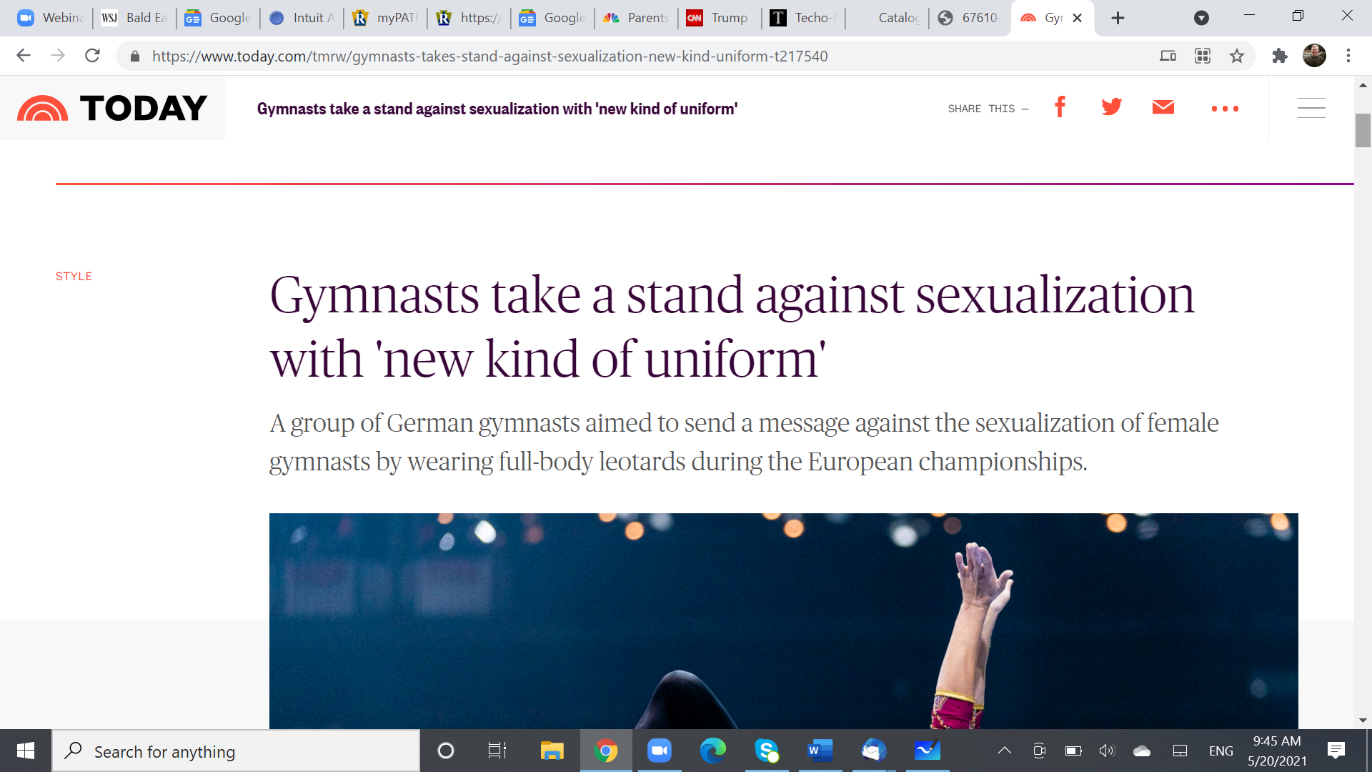
Sensuality & Attire

Slide 23
Sensuality & Attire
What is wrong seems normal to the world
The “Appropriate” argument from 1 Timothy 2:9
“modest” means “appropriate”
Whatever is appropriate to the occasion is “modest”
But this just makes the world’s standard of propriety our standard
Look at the text:
⁹ In like manner, that women adorn themselves in modest apparel, with shamefastness and sobriety; not with braided hair, and gold or pearls or costly raiment; ¹⁰ but (which becometh women professing godliness) through good works.

Slide 24
Sensuality & Attire
What is wrong seems normal to the world
The “Appropriate” argument from 1 Timothy 2:9
“modest” means “appropriate”
Whatever is appropriate to the occasion is “modest”
But this just makes the world’s standard of propriety our standard
Look at the text:
⁹ Likewise, I want women to adorn themselves with proper clothing, modestly and discreetly, not with braided hair and gold or pearls or expensive apparel, ¹⁰ but rather by means of good works, as is proper for women making a claim to godliness.

Slide 25
Sensuality & Attire
What is wrong seems normal to the world
The “Appropriate” argument from 1 Timothy 2:9
“modest” means “appropriate”
Whatever is appropriate to the occasion is “modest”
But this just makes the world’s standard of propriety our standard
Look at the text:
⁹ Likewise, I want women to adorn themselves with proper clothing, modestly and discreetly, not with braided hair and gold or pearls or expensive apparel, ¹⁰ but rather by means of good works, as is proper for women making a claim to godliness.

Slide 26
Sensuality & Attire
What is wrong seems normal to the world
Many Areas of Application
Sports
Beach wear
“Dressing Up”
For some in the world, “elegant” has come to be confused with “Sensual” (Wedding, High School Graduation Photo)

Slide 27
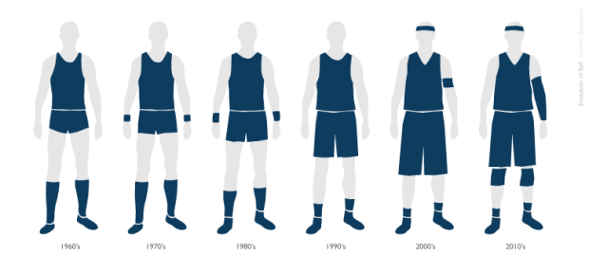

Slide 28
“That would be inappropriate”
True, but only because of societal expectations?
After all, at a wedding, a woman dressed in a very short skirt and very low neckline is thought to be acceptable

Slide 29
Ephesians 4
¹⁷ So I say this, and affirm in the Lord, that you are to no longer walk just as the Gentiles also walk , in the futility of their minds, ¹⁸ being darkened in their understanding, excluded from the life of God because of the ignorance that is in them, because of the hardness of their heart; ¹⁹ and they, having become callous, have given themselves up to indecent behavior for the practice of every kind of impurity with greediness. ²⁰ But you did not learn Christ in this way, ²¹ if indeed you have heard Him and have been taught in Him, just as truth is in Jesus, ²² that, in reference to your former way of life, you are to rid yourselves of the old self, which is being corrupted in accordance with the lusts of deceit, ²³ and that you are to be renewed in the spirit of your minds, ²⁴ and to put on the new self, which in the likeness of God has been created in righteousness and holiness of the truth.

