Slide 1
“Why Do You Delay”
Jeff Smelser

Slide 2
Acts 21:40-22:16

Slide 3
^{3 “}God has said, ‘You shall not eat from it or touch it, or you will die.’”
⁴ The serpent said to the woman, “You certainly will not die! ⁵ For God knows that on the day you eat from it your eyes will be opened, and you will become like God…”
GENESIS 3

Slide 4
^{3 “}God has said, ‘You shall not eat from it or touch it, or you will die.’”
⁴ The serpent said to the woman, “You certainly will not die! ⁵ For God knows that on the day you eat from it your eyes will be opened, and you will become like God…”
GENESIS 3

Slide 5
^{3 “}God has said, ‘You shall not eat from it or touch it, or you will die.’”
⁴ The serpent said to the woman, “You certainly will not die! ⁵ For God knows that on the day you eat from it your eyes will be opened, and you will become like God…”
GENESIS 3

Slide 6
^{3 “}God has said, ‘You shall not eat from it or touch it, or you will die.’”
⁴ The serpent said to the woman, “You certainly will not die! ⁵ For God knows that on the day you eat from it your eyes will be opened, and you will become like God…”
GENESIS 3

Slide 7
^{3 “}God has said, ‘You shall not eat from it or touch it, or you will die.’”
⁴ The serpent said to the woman, “You certainly will not die! ⁵ For God knows that on the day you eat from it your eyes will be opened, and you will become like God…”
GENESIS 3

Slide 8
“God has said,
‘you will die.’”
The serpent said
“You certainly will not die!
…you will become like God”
GENESIS 3

Slide 9
⁶ When the woman saw that the tree was good for food, and that it was a delight to the eyes, and that the tree was desirable to make one wise, she took some of its fruit and ate.”
GENESIS 3

Slide 10
Isaiah 59
¹ Behold, the Lord’s hand is not so short That it cannot save; Nor is His ear so dull That it cannot hear. ² But your wrongdoings have caused a separation between you and your God, And your sins have hidden His face from you so that He does not hear.

Slide 11
James 4
⁴ …do you not know that friendship with the world is hostility toward God? Therefore whoever wants to be a friend of the world makes himself an enemy of God.

Slide 12
Isaiah 9 ⁶ For a Child will be born to us, a Son will be given to us; And the government will rest on His shoulders; And His name will be called Wonderful Counselor, Mighty God, Eternal Father, Prince of Peace.

Slide 13
“Bethlehem”
Micah
“This One will be our peace.”

Slide 14
“Bethlehem”
Acts 10
³⁶ The word which He sent to the sons of Israel, preaching peace through Jesus Christ

Slide 15
John 11 ⁴⁷ Therefore the chief priests and the Pharisees convened a council meeting, and they were saying, “What are we doing in regard to the fact that this man is performing many signs? ⁴⁸ If we let Him go on like this, all the people will believe in Him, and the Romans will come and take over both our place and our nation.”
They wanted to be in charge!
Why did many of the Jews reject Jesus?
Acts 10
³⁶ The word which He sent to the sons of Israel, preaching peace through Jesus Christ

Slide 16
Saul was different
Acts 26⁹ “So I thought to myself that I had to act in strong opposition to the name of Jesus of Nazareth.”
WHY?

Slide 17
Saul was different
Apostle
Paul
Seems clear:
He didn’t believe Jesus was the Messiah (the Christ)
He didn’t believe Jesus had been raised from the dead
Jesus’ Resurrection was the proof
In Romans 1:4 Paul speaks of Christ Jesus saying he
“was declared the Son of God with power according to the Spirit of holiness by the resurrection from the dead, Jesus Christ our Lord.”

Slide 18
Saul was different
Seems clear:
He didn’t believe Jesus was the Messiah
He didn’t believe Jesus had been raised from the dead
Jesus’ Resurrection was the key
1 Corinthians 15 ¹⁴ and if Christ has not been raised, then our preaching is in vain, your faith also is in vain… ¹⁷ and if Christ has not been raised, your faith is worthless; you are still in your sins….
¹⁹ If we have hoped in Christ only in this life, we are of all people most to be pitied.

Slide 19
Saul was different
Seems clear:
He didn’t believe Jesus was the Messiah
He didn’t believe Jesus had been raised from the dead
Jesus’ Resurrection was the key
Acts 26 ⁸ Why is it considered incredible among you people if God raises the dead?
⁹ “So I thought to myself that I had to act in strong opposition to the name of Jesus of Nazareth.

Slide 20
Saul was different
Seems clear:
He didn’t believe Jesus was the Messiah
He didn’t believe Jesus had been raised from the dead
Jesus’ Resurrection was the key
Acts 26 ⁸ Why is it considered incredible among you people if God raises the dead?
⁹ “So I thought to myself that I had to act in strong opposition to the name of Jesus of Nazareth.

Slide 21
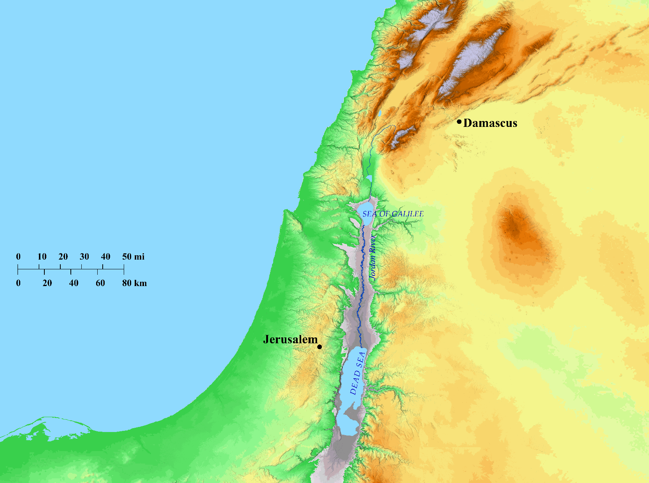
130 miles

Slide 22
Acts 22¹⁶ “Now why do you delay? Get up and be baptized, and wash away your sins by calling on His name.”
Possible Reasons for Delay…
If he wasn’t convinced that Jesus had been raised from the dead

Slide 23
Acts 22¹⁶ “Now why do you delay? Get up and be baptized, and wash away your sins by calling on His name.”
Possible Reasons for Delay…
If he wasn’t convinced that Jesus had been raised from the dead
But he was convinced!
Acts 26 ¹⁶ But get up and stand on your feet; for this purpose I have appeared to you…you have seen Me
Acts 22 ¹⁴ ‘The God of our fathers has appointed you to know His will and to see the Righteous One and to hear a message from His mouth.
Acts 9 ²⁷ But Barnabas took hold of him and brought him to the apostles and described to them how he had seen the Lord on the road
1 Cor. 9 ¹ Have I not seen Jesus our Lord?
1 Cor. 15 ⁸ Last of all, as to one untimely born, He appeared to me also.

Slide 24
Acts 22¹⁶ “Now why do you delay? Get up and be baptized, and wash away your sins by calling on His name.”
Possible Reasons for Delay…
If he wasn’t yet convinced that Jesus was the Messiah

Slide 25
Acts 22¹⁶ “Now why do you delay? Get up and be baptized, and wash away your sins by calling on His name.”
Possible Reasons for Delay…
If he wasn’t yet convinced that Jesus was the Messiah
But he was convinced!
Acts 26 ¹⁶ “’But get up and stand on your feet; for this purpose I have appeared to you, to appoint you as a servant and a witness not only to the things in which you have seen Me, but also to the things in which I will appear to you, ¹⁷ rescuing you from the Jewish people and from the Gentiles, to whom I am sending you, ¹⁸ to open their eyes so that they may turn from darkness to light, and from the power of Satan to God, that they may receive forgiveness of sins and an inheritance among those who have been sanctified by faith in Me.’
¹⁹ “For that reason, King Agrippa, I did not prove disobedient to the heavenly vision, ²⁰ but continually proclaimed to those in Damascus first, and in Jerusalem, and then all the region of Judea, and even to the Gentiles, that they are to repent and turn to God, performing deeds consistent with repentance.”

Slide 26
Acts 22¹⁶ “Now why do you delay? Get up and be baptized, and wash away your sins by calling on His name.”
Possible Reasons for Delay…
If he didn’t believe he had done anything wrong
Baptism is for the remission of sins
Baptism is putting your faith in Jesus’ death to atone for your sins
One thing I ask young children who want to be baptized…

Slide 27
Acts 22¹⁶ “Now why do you delay? Get up and be baptized, and wash away your sins by calling on His name.”
Possible Reasons for Delay…
If he didn’t believe he had done anything wrong
But he did

Slide 28
Acts 22¹⁶ “Now why do you delay? Get up and be baptized, and wash away your sins by calling on His name.”
Possible Reasons for Delay…
If he wasn’t sorry for what he had done wrong
Godly sorrow leads to repentance (2 Corinthians 7:10)

Slide 29
Acts 22¹⁶ “Now why do you delay? Get up and be baptized, and wash away your sins by calling on His name.”
Possible Reasons for Delay…
If he wasn’t sorry for what he had done wrong
Sorrow is needful so I’ll appreciate Jesus’ sacrifice
Hebrews 6
Hebrews 10
Sorrow is needful so I will be motivated to leave wrong living behind
Romans 6:23
1 Peter 1:13
Psalm 51
Matthew 5:3-4
James 4:9

Slide 30
Acts 22¹⁶ “Now why do you delay? Get up and be baptized, and wash away your sins by calling on His name.”
Possible Reasons for Delay…
If he wasn’t sorry for what he had done wrong
But he was!
Acts 9 ⁹ And for three days he was without sight, and neither ate nor drank.

Slide 31
Acts 22¹⁶ “Now why do you delay? Get up and be baptized, and wash away your sins by calling on His name.”
Possible Reasons for Delay…
If he wasn’t sorry for what he had done wrong
But he was!
1 Corinthians 15 ⁹ For I am the least of the apostles, and not fit to be called an apostle, because I persecuted the church of God.
¹⁰ But by the grace of God I am what I am, and His grace toward me did not prove vain; but I labored even more than all of them, yet not I, but the grace of God with me.

Slide 32
Acts 22¹⁶ “Now why do you delay? Get up and be baptized, and wash away your sins by calling on His name.”
Possible Reasons for Delay…
If he wasn’t sorry for what he had done wrong
But he was!
1 Timothy 1:12-16

Slide 33
Acts 22¹⁶ “Now why do you delay? Get up and be baptized, and wash away your sins by calling on His name.”
Possible Reasons for Delay…
If he wasn’t ready to commit to a life of obedience to God’s will
“repentance”
A blank check
Unknown Challenges that lay ahead for Paul
Escape in a basket
More than 40 men vowed a hunger strike until they killed him
Imprisonment
2 Corinthians 11:23-32
Philippians 3:4-11

Slide 34
Acts 22¹⁶ “Now why do you delay? Get up and be baptized, and wash away your sins by calling on His name.”
Possible Reasons for Delay…
If he wasn’t ready to commit to a life of obedience to God’s will
“repentance”
A blank check
Unknown Challenges that lay ahead for people today
Family resistance
Marital entanglements (Matthew 19:12, 1 Corinthians 7:11)
The Rich Young Ruler (Matthew 19:16-22)

Slide 35
Acts 22¹⁶ “Now why do you delay? Get up and be baptized, and wash away your sins by calling on His name.”
Possible Reasons for Delay…
If he wasn’t ready to commit to a life of obedience to God’s will

Slide 36
Acts 22¹⁶ “Now why do you delay? Get up and be baptized, and wash away your sins by calling on His name.”
Possible Reasons for Delay…
If he wasn’t ready to commit to a life of obedience to God’s will
But he was, and did so

Slide 37
Acts 22¹⁶ “Now why do you delay? Get up and be baptized, and wash away your sins by calling on His name.”
Possible Reasons for Delay…
If he wasn’t ready to commit to a life of obedience to God’s will
Acts 9 ²⁶ When he came to Jerusalem, he tried repeatedly to associate with the disciples; and yet they were all afraid of him, as they did not believe that he was a disciple. ²⁷ But Barnabas took hold of him and brought him to the apostles and described to them how he had seen the Lord on the road, and that He had talked to him, and how he had spoken out boldly in the name of Jesus at Damascus. ²⁸ And he was with them, moving about freely in Jerusalem, speaking out boldly in the name of the Lord.

Slide 38
Acts 22¹⁶ “Now why do you delay? Get up and be baptized, and wash away your sins by calling on His name.”
Why Delay?
Do you believe he was raised from the dead?
Do you believe Jesus is the Messiah (Christ)?
Do you believe you have sinned against God?
Are you sorry for your sins?
Have you repented, and are you ready to commit to a life of obedience to God’s will?

