Slide 1
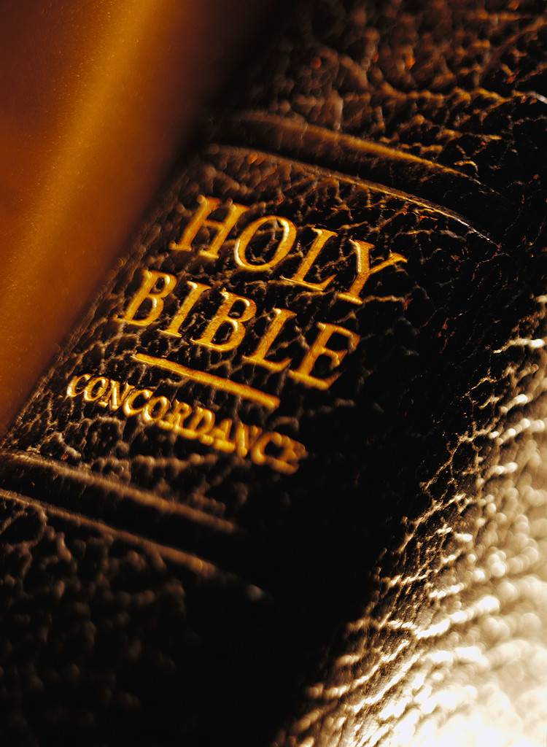
Salvation and Redemption
Notes:
2-7-21: Central Jersey Church, Zoom, Snow Day
4-25-21: Exton, PA

Slide 2
Redeem:
“To release, free, deliver by paying a ransom.”

Slide 3
Exo. 15:13
“In Thy lovingkindness Thou hast led the people who thou hast redeemed in Thy strength Thou hast guided them to Thy holy habitation.”

Slide 4
Exo. 15:13
“In Thy lovingkindness Thou hast led the people who thou hast redeemed in Thy strength Thou hast guided them to Thy holy habitation.”
Exo. 15:16
“Terror and dread fall upon them; by the greatness of Thine arm they are motionless as stone; until Thy people pass over, O Lord, until the people pass over whom thou has purchased.”

Slide 5
Exo. 15:13
“In Thy lovingkindness Thou hast led the people who thou hast redeemed in Thy strength Thou hast guided them to Thy holy habitation.”
Exo. 15:16
“Terror and dread fall upon them; by the greatness of Thine arm they are motionless as stone; until Thy people pass over, O Lord, until the people pass over whom thou has purchased.”
Deut. 7:8
“but because the LORD loves you, and because He would keep the oath which He swore to your fathers, the LORD has brought you out with a mighty hand, and redeemed you from the house of bondage, from the hand of Pharaoh king of Egypt.”

Slide 6
Salvation Means Many Different Things to Different People
Can mean attaining heaven, happiness, God or becoming divine, attaining nirvana, annihilation or nothingness, liberation/freedom or release from undesirable conditions, cessation from pain and suffering, well-being, an abundant life, a higher state of being or consciousness, or reincarnation until one attains a state of perfection.
Notes:
- As an example of the many worldviews and religious teachings.

Slide 7
“There couldn’t possibly be just one way. . . One of the mistakes that human beings make is believing that there is only one way to live. There are many paths to what you call God.” -Oprah Winfrey
“God is not a personality outside of you. What God is, is inextricably part of what you are. God is the dimension of depth within you. . . God is beyond all forms of life but also indwells every form of life as their essence.” -Eckhart Tolle
Notes:
And so, as Tolle and Oprah believe, salvation is attaining that higher state of consciousness and knowledge.
But what is Biblical salvation?

Slide 8
Rom. 3:23
“for all have sinned and fall short of the glory of God.”

Slide 9
Rom. 3:23
“for all have sinned and fall short of the glory of God.”
Rom. 6:23
“For the wages of sin is death, but the gift of God is eternal life in Christ Jesus our Lord.”

Slide 10
Rom. 3:23
“for all have sinned and fall short of the glory of God.”
Rom. 6:23
“For the wages of sin is death, but the gift of God is eternal life in Christ Jesus our Lord.”
Gal. 3:13
“Christ has redeemed us from the curse of the law, having become a curse for us (for it is written, “Cursed is everyone who hangs on a tree”).”
Notes:
- So in the Bible Redemption is the way to Salvation.

Slide 11
Redeem:
“To release, free, deliver by paying a ransom.”
EXAGORAZO =

Slide 12
Redeem:
“To release, free, deliver by paying a ransom.”
EXAGORAZO =
Agora – Market Place

Slide 13
Redeem:
“To release, free, deliver by paying a ransom.”
EXAGORAZO =
Agora – Market Place
Ex – Out of

Slide 14
Without Christ We Are in Spiritual Slavery
Jn. 8:34- Jesus says we are servants/slaves to sin.

Slide 15
Without Christ We Are in Spiritual Slavery
Jn. 8:34- Jesus says we are servants/slaves to sin.
Rom. 6:17- Paul says we are servants/slaves to sin.

Slide 16
Without Christ We Are in Spiritual Slavery
Jn. 8:34- Jesus says we are servants/slaves to sin.
Rom. 6:17- Paul says we are servants/slaves to sin.
Rom. 7:14- We are “sold under” sin. – From a word that means “to export for sale.” We were sold as a commodity, yet by our own doing and choice.

Slide 17
The Central Message of the
Cross is Redemption

Slide 18
B. The O.T. Is the Preparation for Redemption in the Coming Messiah

Slide 19
C. The Exodus of Israel from Egypt Foreshadows Redemption in Christ

Slide 20
D. We Have Redemption in Christ

Slide 21
Christ Redeemed us by Purchasing us with His Precious Blood Acts 20:28; I Cor. 6:20; I Cor. 7:23; Rev. 5:9

Slide 22
Who is this Christ?

Slide 23
The Anointed One Prophesied in the Old Testament

Slide 24
The Lamb of God Who “Takes Away the Sin of the World”

Slide 25
“the Lamb slain from the foundation of the World”

Slide 26
God in the Flesh
Notes:
It was lost on me as a child for some reason. I assumed Jesus was only the Son of God, not actually God/deity.
I failed to see that sonship in this sense implied equality with God.

Slide 27
Affirmed in Church History
Justin Martyr, 150 AD
"Christ is called both God and Lord of hosts." (Dialogue with Trypho, ch, 36)
"Moreover, in the diapsalm of the forty-sixth Psalm, reference is thus made to Christ: 'God went up with a shout, the Lord with the sound of a trumpet." (Dialogue with Trypho, ch 37)

Slide 28
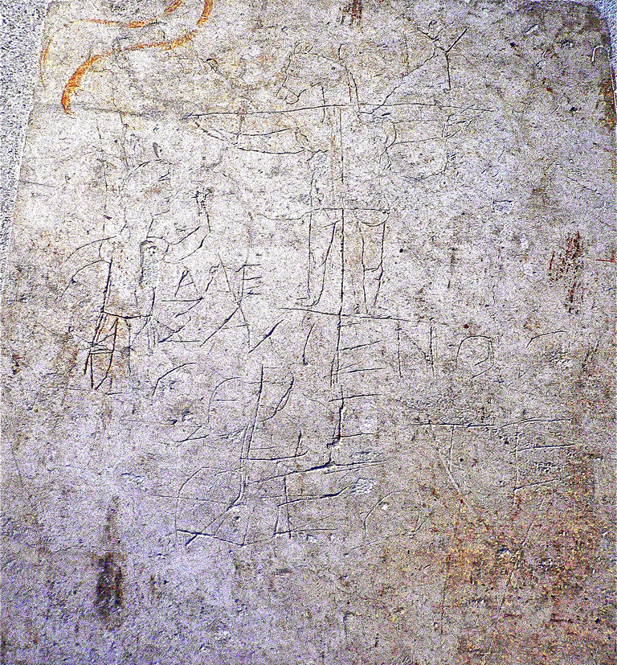
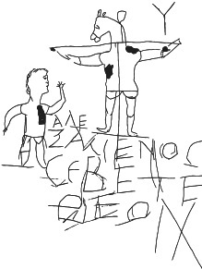
Alexamenos Graffiti, Rome, ca. 200 A.D.
Discovered in 1857 on Wall of an Imperial School for Roman Page Boys

Slide 29
Alexamenos Graffiti, Rome, ca. 200 A.D.
Discovered in 1857 on Wall of an Imperial School for Roman Page Boys
"Alexamenos worships [his] ____

Slide 30
Alexamenos Graffiti, Rome, ca. 200 A.D.
Discovered in 1857 on Wall of an Imperial School for Roman Page Boys
"Alexamenos worships [his] God".

Slide 31
But Does the Bible Teach This?
John 1:14, 1-3
Isaiah 9:6 (ca. 700 B.C.)
“For a child will be born to us, a son will be given to us; And the government will rest on His shoulders; And His name will be called Wonderful Counselor, Mighty God, Eternal Father, Prince of Peace.”
Notes:
Does it sound like Jesus is God?

Slide 32
E. Five Greek Terms for
Forgiveness in Christ

Slide 33
1. Dikaiosis = Acquittal of a Crime

Slide 34
1. Dikaiosis = Acquittal of a Crime In N.T. = “Justification”

Slide 35
2. Aphesis = Cancelling of a Debt

Slide 36
2. Aphesis = Cancelling of a Debt In N.T. = “Forgiveness” Acts 2:38- ”Remission”

Slide 37
3. Huiothesia = Adoption

Slide 38
3. Huiothesia = Adoption In N.T. = Adoption, Sonship, Children of God

Slide 39
4. Katallasso = Reconciliation

Slide 40
4. Katallasso = Reconciliation In N.T. = Reconciliation

Slide 41
5. Apolutrosis = To set free, to make free, to loose by a purchase price

Slide 42
5. Apolutrosis = To set free, to make free, to loose by a purchase price In N.T. = Redemption Rom 8:23- We still wait for the redemption of our bodies. “Not only that, but we also who have the firstfruits of the Spirit, even we ourselves groan within ourselves, eagerly waiting for the adoption, the redemption of our body.”

Slide 43
Justification Forgiveness (Remission) Adoption Reconciliation Redemption
Notes:
- Let’s think of the justification, forgiveness, adoption, reconciliation and redemption accomplished for us in the Lord’s death.

