Slide 1
Maintaining the Ancient Order
Necessity, History, and Continuing Effort

Slide 2
Present Concept of Church: An organized religious body of specific congregations sharing a head, distinct practices, in God’s service.
Or, all or any of the churches in the world of every variety.
Rather than unpack all that, Review the Ancient Order
Jesus established an “ekklesia.” (Mt. 16:18).
Definiton of “ekklesia:” Assembly, Community, Congregation
A collection of people, not particulary religious: Acts. 19:32, 39
Of all the “ekklesias” in the world, Jesus has one, which death cannot conquer.
Who? The saved, collected in Him, his body: Eph. 5:23
Baptized believers, Mt. 28:18-20; Mk. 16:15-16; Abiding in Christ, Jn. 15: 7
Over which in all things, he is head: Eph. 1:22-23

Slide 3
Even in the N.T., straying from Ancient Order: II Thess. 2:3, 7
Ephesus: Rev. 2:5; Laodicea: Rev. 3:16; Smyrna: Rev. 3:1, 4
By 606, finally a successful claim to human headship, Boniface III
Apostasy was full blown
History knows of efforts to get back to the Ancient Order.
Wycliffe-1300’s, Jan Hus-1400’s, Huldrych Zwingli, Martin Luther- 1500’s
Haldane brothers, Robert Sandeman, 1700’s in Scotland
Of supposed Restoration in U.S. by James O’Kelly, Elias Smith, Abner Jones, Barton Stone, The Campbells:
“Where the scriptures speak, we speak, where the scriptures are silent we are silent.”

Slide 4
Unknown to them, groups believing so, and calling themselves churches of Christ in Europe have been there from the beginning.
Pricillianous, 385, Irish-Scottish preachers baptizing along Rhine in 4th and 5th Centuries
Gundulf, Italian missionary, Western Germany. Converts persecuted by
Archbishop Cambrai in 1025. From this time, records in Alsatia.
Gundulf taught that disciples in original church did not believe in
Purgatory, magic sacramentalism, hereditary sin, children’s sprinkling, instrumental music, the worship of images, saints, or Mary
He taught them that small congregations of “true Christians” existed in
the German Rhineland, Alsace, and in Switzerland.
Their preachers burnt at the stake by German Emperor Goslar in 1052
This faith preached there by men from Switzerland, Italy, Macedonia

Slide 5
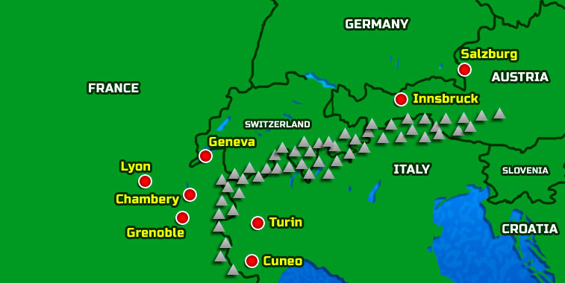
Why so obscure in History?
Unlike the “Reformers” not RC Rebels trying to change the church.
Their followers less in number, easily reduced by martyred deaths by the thousands, yet they persisted.
Much we know is by their recorded persecutions. Trace into 20th Cent.

Slide 6
Without clergy, organization, manuals, just the scriptures, their faith and practice was:
Jesus Lord, His word authority, scriptures only Guide
Nothing to be imposed or required not therein
Rejected “inner light,” guidance. D.O. of Holy Spirit. This and next distginguished from Anabaptists.
Rejected Premillennialism
Disciples called Christians (Christen)
As a geograhically dispersed body, (Christengemeine) the church (community, ekklesia) of Christ
Outwardly as a group the church, inwardly the kingdom (Lk. 17:20-21)
Congregations, Assemblies, led by own elders, served by deacons
Assembled frequently, but always on 1st day to eat Lord’s supper
Took care of their needy from giving on first day
Preachers dependent upon disciples they “ministered” to
Sang without accompaniment of instruments
Each born in God’s image, untainted by sin
Babies did not need to be “baptized”
Baptism was for penitent believers.
Baptism was for remission of sins
Rejected human organization, government, heads
Rejected human governing documents
Christ coming to complete rule, not to begin
Being saved by grace through blood of Christ, Heaven their destiny

Slide 7
A most significant fact.
Without contact, without communication, without knowledge of one another, what existed in Europe by people “speaking where the scriptures speak, being silent where they are silent,” is precisely what people here arrived at doing the same thing. Eph. 4:3-7.
The Ancient Order has been, can be, and in order to obey our God, must be maintained. II Tim. 1:13; I Pet. 4:11; Jude 3; II Tim. 3:16-17
Maintaining the Ancient Order
Is that Important to you?

