Slide 1
“God’s Plan to Save Us”
Jeff Smelser

Slide 2
God’s Plan to Save Us
ALL FAMILIES BLESSED
Notes:
Covid
Biden
Basketball player, but death is inevitable
Hebrews 2, “fear of death”

Slide 3
God’s Plan to Save Us
ALL FAMILIES BLESSED
PROBLEM
Sin
Death
SOLUTION
Jesus’ Death
Resurrection
Notes:
Covid
Biden
Basketball player, but death is inevitable
Hebrews 2, “fear of death”

Slide 4
God’s Plan to Save Us
“
Why Do We Need to be Saved?
(saved from what?)
Death
Separation
“So He drove the man out; and at the east of the Garden of Eden He stationed the cherubim and the flaming sword which turned every direction to guard the way to the tree of life.”
(Genesis 3:24)
Hebrews 2:15
… those who through fear of death were subject to slavery all their lives.
Notes:
Covid
Biden
Basketball player, but death is inevitable
Hebrews 2, “fear of death”

Slide 5
God’s Plan to Save Us
Why Do We Need to be Saved?
(saved from what?)
Death
Separation
Sin
Notes:
Covid
Biden
Basketball player, but death is inevitable
Hebrews 2, “fear of death”

Slide 6
God’s Plan to Save Us
Why is Separation a Problem?
God is a Personal Being
We Need a Relationship with Him
Notes:
Covid
Biden
Basketball player, but death is inevitable
Hebrews 2, “fear of death”

Slide 7
God’s Plan to Save Us
Not merely out of harmony with the universe
rather
Out of Harmony with the Creator of the Universe
Why is Separation a Problem?
God is a Personal Being
Romans 1²⁰
For his invisible attributes, namely, his eternal power and divine nature, have been clearly perceived, ever since the creation of the world, in the things that have been made.
Romans 1²⁵
For they exchanged the truth of God for falsehood, and worshiped and served the creature rather than the Creator, who is blessed forever.
Notes:
Covid
Biden
Basketball player, but death is inevitable
Hebrews 2, “fear of death”

Slide 8
God’s Plan to Save Us
Why is Separation a Problem?
God is a Personal Being
“
God said,
“Abraham, my friend”
(Isaiah 41:8)
Notes:
Covid
Biden
Basketball player, but death is inevitable
Hebrews 2, “fear of death”

Slide 9
God’s Plan to Save Us
Why is Separation a Problem?
God is a Personal Being
“
King Jehoshaphat said to God, “Did You not, our God, drive out the inhabitants of this land from Your people Israel, and give it to the descendants of Your friend Abraham forever?”
(2 Chronicles 20:7)
Notes:
Covid
Biden
Basketball player, but death is inevitable
Hebrews 2, “fear of death”

Slide 10
God’s Plan to Save Us
Why is Separation a Problem?
God is a Personal Being
“
¹⁷ The Lord said, “Shall I hide from Abraham what I am about to do, ¹⁸ since Abraham will certainly become a great and mighty nation, and in him all the nations of the earth will be blessed? ¹⁹For I have chosen him”
(Genesis 18:17-19)
Notes:
Covid
Biden
Basketball player, but death is inevitable
Hebrews 2, “fear of death”

Slide 11
God’s Plan to Save Us
Why is Separation a Problem?
God is a Personal Being
“
Abraham’s conversation with God…
(Genesis 18:22-33)
Notes:
Covid
Biden
Basketball player, but death is inevitable
Hebrews 2, “fear of death”

Slide 12
God’s Plan to Save Us
Why is Separation a Problem?
God is a Personal Being
Genesis 6
⁵ The Lord saw that the wickedness of man was great in the earth, and that every intention of the thoughts of his heart was only evil continually. ⁶ And the Lord regretted that he had made man on the earth, and it grieved him to his heart.
Notes:
Covid
Biden
Basketball player, but death is inevitable
Hebrews 2, “fear of death”

Slide 13
God’s Plan to Save Us
Exodus 3¹³ Then Moses said to God, “If I come to the people of Israel and say to them, ‘The God of your fathers has sent me to you,’ and they ask me, ‘What is his name?’ what shall I say to them?” ¹⁴ God said to Moses, “I am who I am.” And he said, “Say this to the people of Israel: ‘I am has sent me to you.’”
Why is Separation a Problem?
God is a Personal Being
Notes:
Covid
Biden
Basketball player, but death is inevitable
Hebrews 2, “fear of death”

Slide 14
God’s Plan to Save Us
Why is Separation a Problem?
God is a Personal Being
Leviticus 19 ¹ And the Lord spoke to Moses, saying, ² “Speak to all the congregation of the people of Israel and say to them, You shall be holy, for I the Lord your God am holy.
Notes:
Covid
Biden
Basketball player, but death is inevitable
Hebrews 2, “fear of death”

Slide 15
God’s Plan to Save Us
Why is Separation a Problem?
God is a Personal Being
Isaiah 1
² Hear, O heavens, and give ear, O earth; for the Lord has spoken: “Children have I reared and brought up, but they have rebelled against me. ³ The ox knows its owner, and the donkey its master's crib, but Israel does not know, my people do not understand.”
Notes:
Covid
Biden
Basketball player, but death is inevitable
Hebrews 2, “fear of death”

Slide 16
God’s Plan to Save Us
Why is Separation a Problem?
God is a Personal Being
Isaiah 1
“Come now, let us reason together, says the Lord: though your sins are like scarlet, they shall be as white as snow;
Notes:
Covid
Biden
Basketball player, but death is inevitable
Hebrews 2, “fear of death”

Slide 17
God’s Plan to Save Us
Genesis 2:7
then the Lord
God formed the
man of dust from
the ground and breathed into his nostrils the breath of life, and the man became a living creature.
Why is Separation a Problem?
God is a Personal Being
We Need a Relationship with Him
Notes:
Covid
Biden
Basketball player, but death is inevitable
Hebrews 2, “fear of death”

Slide 18
God’s Plan to Save Us
Why is Separation a Problem?
God is a Personal Being
We Need a Relationship with Him
Acts 17:25
he himself gives to all mankind life and breath and everything.
Notes:
Covid
Biden
Basketball player, but death is inevitable
Hebrews 2, “fear of death”

Slide 19
God’s Plan to Save Us
Why is Separation a Problem?
God is a Personal Being
We Need a Relationship with Him
Hebrews 1:3
…he upholds the universe by the word of his power.
Notes:
Covid
Biden
Basketball player, but death is inevitable
Hebrews 2, “fear of death”

Slide 20
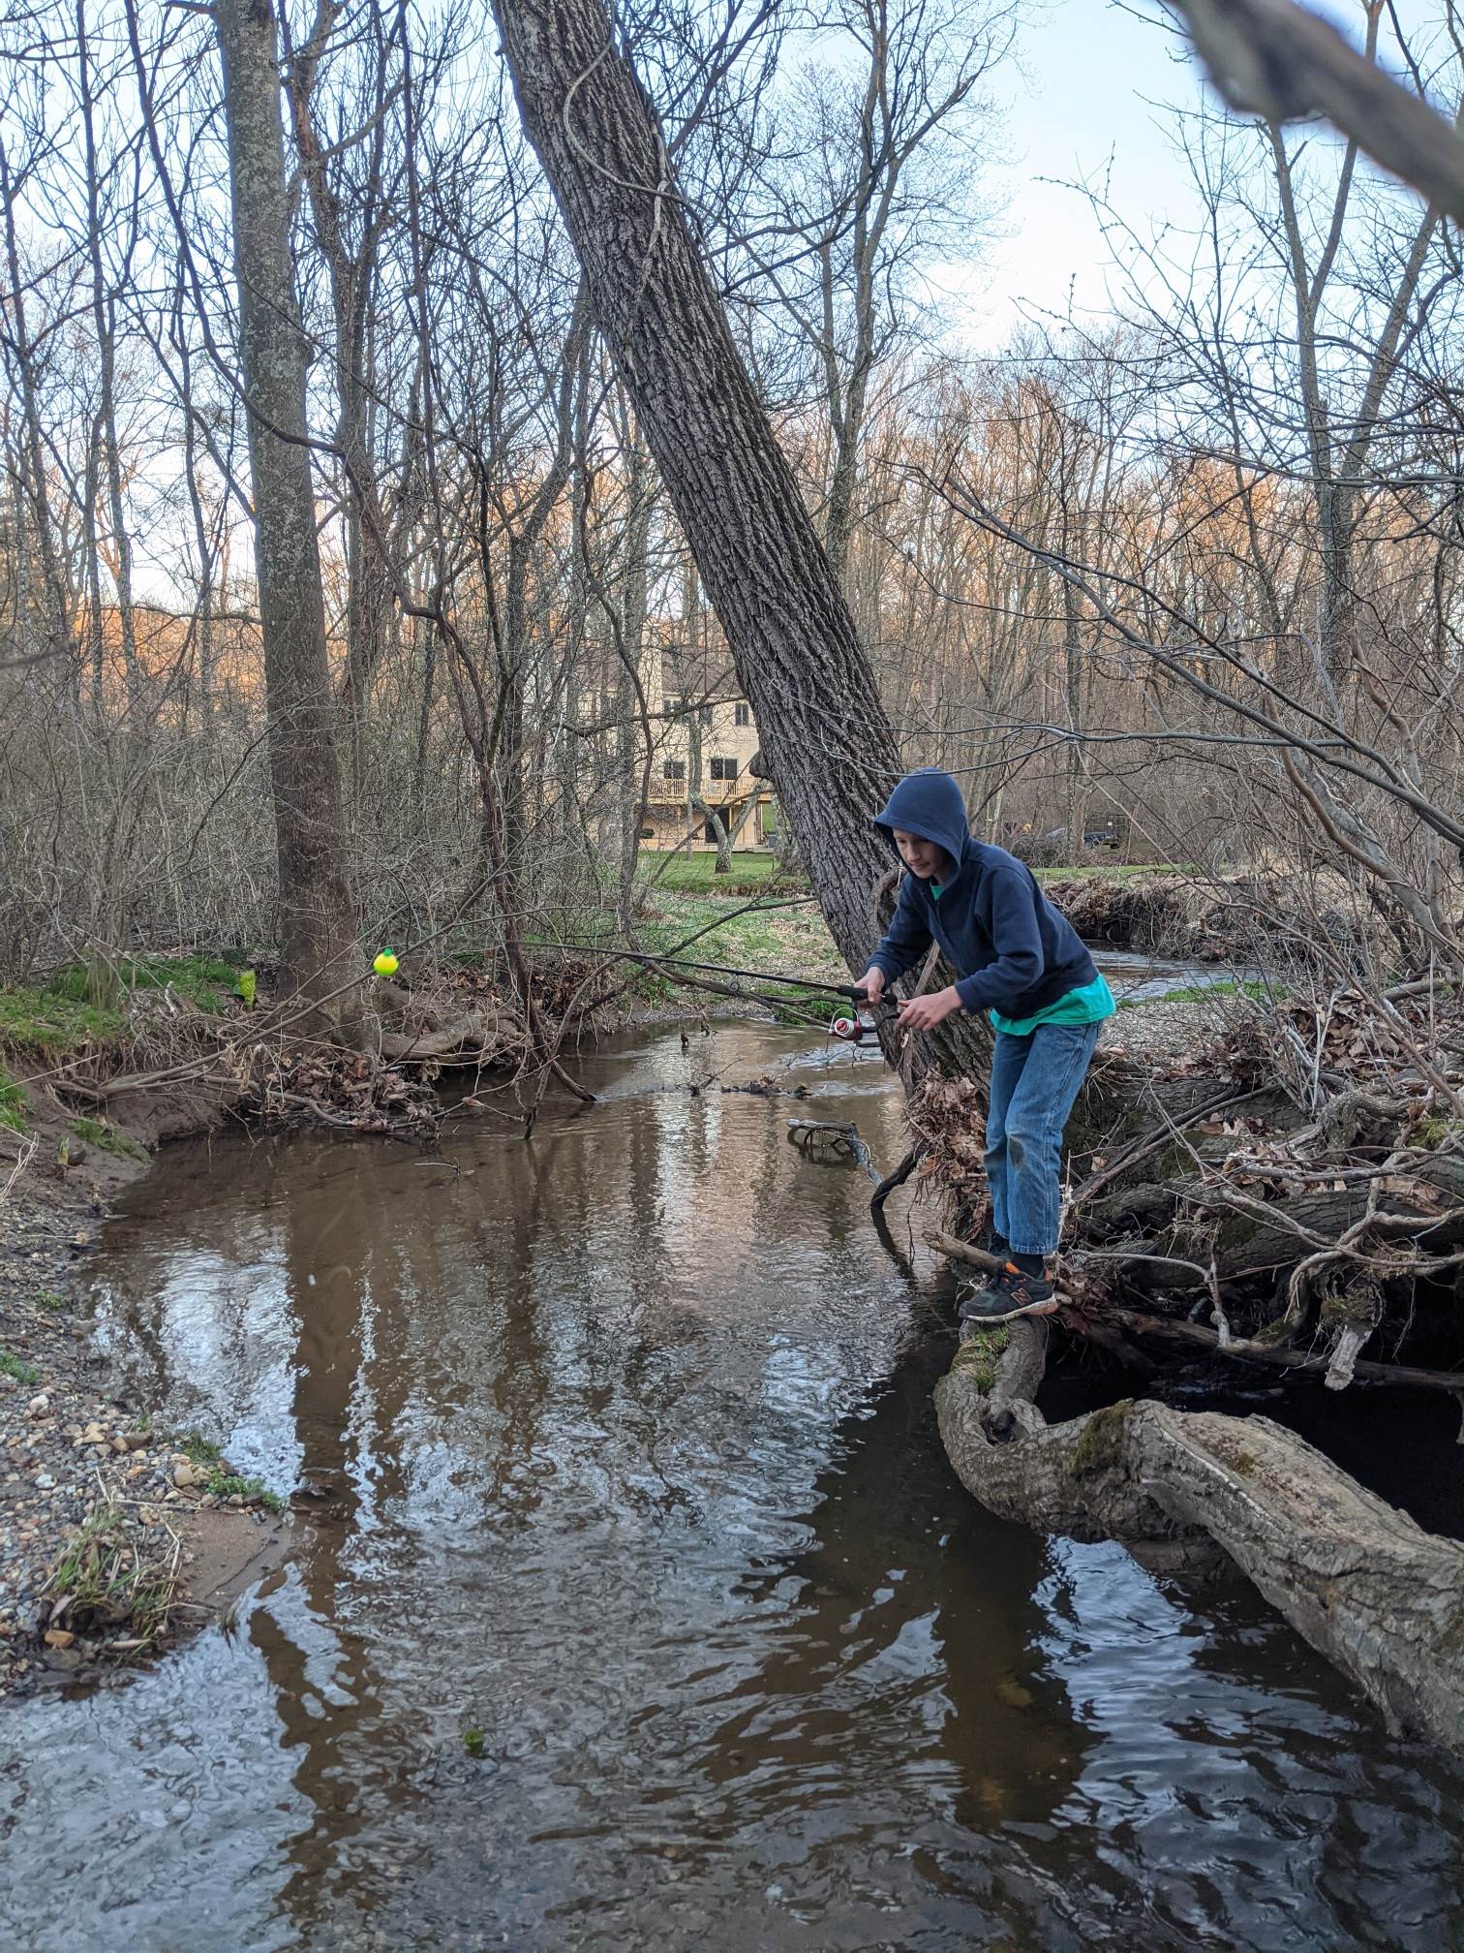
God’s Plan to Save Us
Why is Separation a Problem?
God is a Personal Being
We Need a Relationship with Him
Hebrews 1:3
…he upholds the universe by the word of his power.
Notes:
Covid
Biden
Basketball player, but death is inevitable
Hebrews 2, “fear of death”

Slide 21
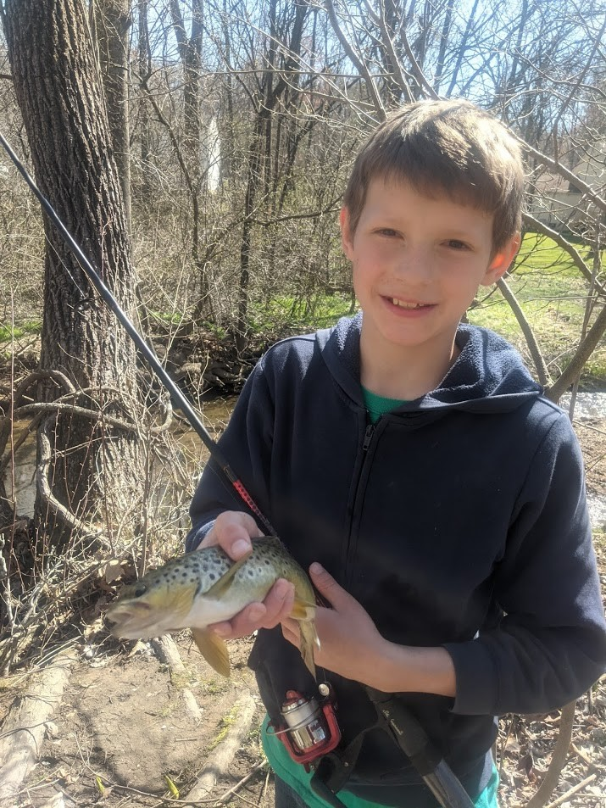
God’s Plan to Save Us
Why is Separation a Problem?
God is a Personal Being
We Need a Relationship with Him
Hebrews 1:3
…he upholds the universe by the word of his power.
Notes:
Covid
Biden
Basketball player, but death is inevitable
Hebrews 2, “fear of death”

Slide 22
God’s Plan to Save Us
Why Did Eating Fruit Separate from God?
Notes:
Covid
Biden
Basketball player, but death is inevitable
Hebrews 2, “fear of death”

