Slide 1
“Fostering Faith”
Jeff Smelser

Slide 2
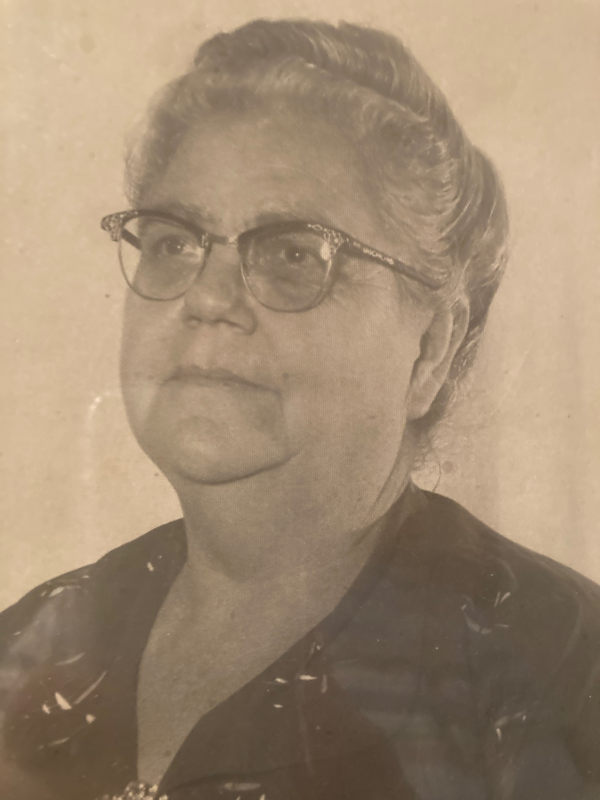
“She was strict”

Slide 3
Why be strict?
To keep kids in control
To protect kids from harm
To point kids to heaven

Slide 4
Raising Children to be God’s Children
Ephesians 6 ⁴ Fathers, do not provoke your children to anger, but bring them up in the discipline and instruction of the Lord.

Slide 5
Faith is not simply inherited
Judges 2 ⁷ The people served the Lord all the days of Joshua, and all the days of the elders who survived Joshua, who had seen all the great work of the Lord which He had done for Israel. ⁸ Then Joshua the son of Nun, the servant of the Lord, died at the age of 110.
¹⁰ All that generation also were gathered to their fathers; and another generation rose up after them who did not know the Lord, nor even the work which He had done for Israel. ¹¹ Then the sons of Israel did evil in the sight of the Lord and served the Baals, ¹² and they abandoned the Lord, the God of their fathers, who had brought them out of the land of Egypt, and they followed other gods from the gods of the peoples who were around them, and bowed down to them; so they provoked the Lord to anger.

Slide 6
Faith is not simply inherited
2 Kings 12 ² Jehoash did what was right in the sight of the Lord all his days that Jehoiada the priest instructed him.
2 Chronicles 24 ¹⁷ But after the death of Jehoiada the officials of Judah came and bowed down to the king, and the king listened to them. ¹⁸ And they abandoned the house of the Lord…
His loyalty was to his step-father, and not to God

Slide 7
They must have their own faith
How do you foster that?
It’s possible:
2 Timothy 1 ⁵ For I am mindful of the sincere faith within you, which first dwelled in your grandmother Lois and your mother Eunice, and I am sure that it is in you as well.
2 Timothy 3 ¹⁴ You, however, continue in the things you have learned and become convinced of, knowing from whom you have learned them, ¹⁵ and that from childhood you have known the sacred writings which are able to give you the wisdom that leads to salvation through faith which is in Christ Jesus.

Slide 8
They must have their own faith
How do you foster that?
It’s possible:
Joshua 24:15
“as for me and my house, we will serve the Lord.”

Slide 9
They must have their own faith
How do you foster that?
It’s possible:
1 Corinthians 16
¹⁵ …(you know the household of Stephanas, that they were the first fruits of Achaia, and that they have devoted themselves for ministry to the saints)

Slide 10
They must have their own faith
How do you foster that?
Deuteronomy 6 ⁶ These words, which I am commanding you today, shall be on your heart. ⁷ And you shall repeat them diligently to your sons and speak of them when you sit in your house, when you walk on the road, when you lie down, and when you get up.
NOT by doing nothing
Not by commanding faith

Slide 11
They must have their own faith
How do you foster that?
Deuteronomy 6 ⁶ These words, which I am commanding you today, shall be on your heart.
Proverbs 1
⁸Listen, my son, to your father’s instruction, And do not ignore your mother’s teaching;
Teach!
Be what you want them to be
Consider their thoughts
Acknowledge your Ignorance

Slide 12
They must have their own faith
How do you foster that?
Letter to a schoolboy from his mother​
​
She encourages her son to write, requesting anything he needs
She learns the boy’s teacher has “departed”
She is disappointed; she knew that teacher had been looking out for her son
She had inquired of him concerning her son’s health and studies
He had told her the slave in charge of the son was reliable
She now tells the son that he and the slave will have to seek out a new teacher
Oxyrhynchus 930 (2nd or 3rd cent. A.D.)​
Give them Room to have their Own Faith
If you were a Jew in late 1st Century B.C. …
Saul
born in Tarsus (Acts 22:3)
citizen of Tarsus (Acts 21:39)
Resided in Tarsus (Acts 9:30 – 11:25)
“from Tarsus” (Acts 9:11)
But brought up in Jerusalem at the feet of Gamaliel (Acts 22:3)

