Slide 1
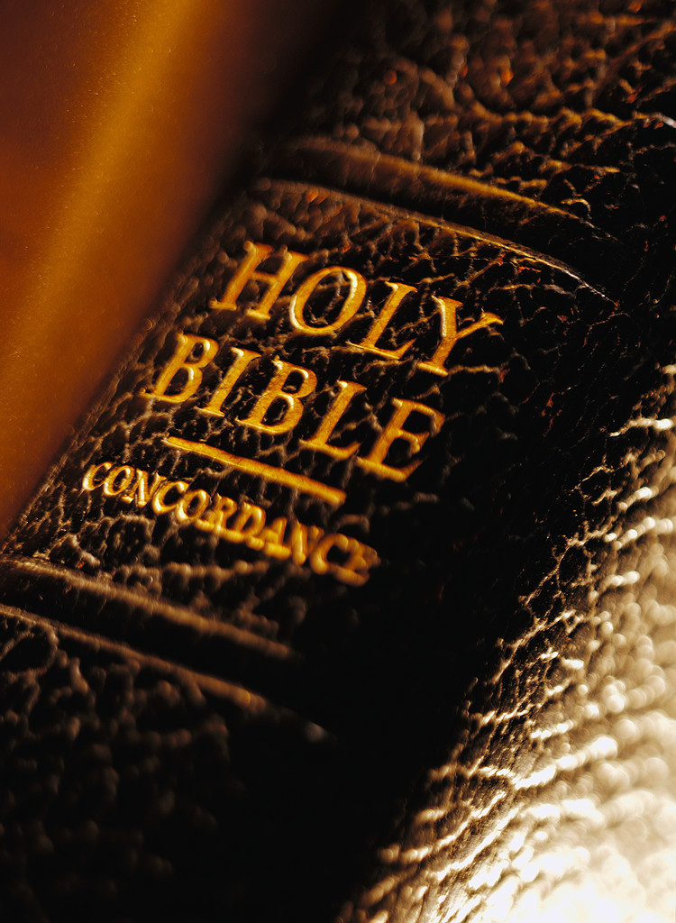
Redemption in the Cross

Slide 2
Col. 1:20
“And having made peace through the blood of his cross.”

Slide 3
Col. 1:20
“And having made peace through the blood of his cross.”
Eph. 2:16
“And he might reconcile both unto God in one body by the cross.”

Slide 4
Col. 1:20
“And having made peace through the blood of his cross.”
Eph. 2:16
“And he might reconcile both unto God in one body by the cross.”
Gal. 6:14
“But God forbid that I should glory save in the cross of our Lord Jesus Christ.”

Slide 5
Col. 1:20
“And having made peace through the blood of his cross.”
Eph. 2:16
“And he might reconcile both unto God in one body by the cross.”
Gal. 6:14
“But God forbid that I should glory save in the cross of our Lord Jesus Christ.”
I Cor. 1:18
“For the preaching of the cross is to them that perish foolishness; but unto us which are saved it is the power of God.

Slide 6
Eph. 1:7
“In Him we have redemption through His blood, the forgiveness of sins, according to the riches of His grace.”

Slide 7
Eph. 1:7
“In Him we have redemption through His blood, the forgiveness of sins, according to the riches of His grace.”

Slide 8
Isa. 53:10
“But the LORD desired To crush Him, causing Him grief; If He renders Himself as a guilt offering, He will see His offspring, He will prolong His days, And the good pleasure of the LORD will prosper in His hand.

Slide 9
Isa. 53:10
“But the LORD desired To crush Him, causing Him grief; If He renders Himself as a guilt offering, He will see His offspring, He will prolong His days, And the good pleasure of the LORD will prosper in His hand.
Eph. 5:2
“and walk in love, just as Christ also loved you and gave Himself up for us, an offering and a sacrifice to God as a fragrant aroma.”

Slide 10
Heb. 9:6-9
“Now when these things have been so prepared, the priests are continually entering the outer tabernacle, performing the divine worship, but into the second, only the high priest enters once a year, not without taking blood which he offers for himself and for the sins of the people committed in ignorance. The Holy Spirit is signifying this, that the way into the holy place has not yet been disclosed while the outer tabernacle is still standing, which is a symbol for the present time. Accordingly both gifts and sacrifices are offered which cannot make the worshiper perfect in conscience,”

Slide 11
Sin Offerings – Lev. 4:1-35 Trespass and Guilt Offerings – Lev. 5:6-6:7 Day of Atonement When Sins Were Placed on the Scapegoat – Lev. 16:21, 22
Some O.T. Sacrifices and Offerings Included:

Slide 12
Lev. 16:21, 22
“Then Aaron shall lay both of his hands on the head of the live goat, and confess over it all the wrongdoings of the sons of Israel and all their unlawful acts regarding all their sins; and he shall place them on the head of the goat and send it away into the wilderness by the hand of a man who stands ready. Then the goat shall carry on itself all their wrongdoings to an isolated territory; he shall release the goat in the wilderness.”
Psa. 103:12
“As far as the east is from the west; so far has he removed our transgressions from us.”

Slide 13
Lev. 16:21, 22
“Then Aaron shall lay both of his hands on the head of the live goat, and confess over it all the wrongdoings of the sons of Israel and all their unlawful acts regarding all their sins; and he shall place them on the head of the goat and send it away into the wilderness by the hand of a man who stands ready. Then the goat shall carry on itself all their wrongdoings to an isolated territory; he shall release the goat in the wilderness.”

Slide 14
Lev. 16:21, 22
“Then Aaron shall lay both of his hands on the head of the live goat, and confess over it all the wrongdoings of the sons of Israel and all their unlawful acts regarding all their sins; and he shall place them on the head of the goat and send it away into the wilderness by the hand of a man who stands ready. Then the goat shall carry on itself all their wrongdoings to an isolated territory; he shall release the goat in the wilderness.”
Psa. 103:12
“As far as the east is from the west; so far has he removed our transgressions from us.”

Slide 15
Lev. 16:21, 22
“Then Aaron shall lay both of his hands on the head of the live goat, and confess over it all the wrongdoings of the sons of Israel and all their unlawful acts regarding all their sins; and he shall place them on the head of the goat and send it away into the wilderness by the hand of a man who stands ready. Then the goat shall carry on itself all their wrongdoings to an isolated territory; he shall release the goat in the wilderness.”
Psa. 103:12
“As far as the east is from the west; so far has he removed our transgressions from us.”
I Pet. 2:24
“Who Himself bore our sins in His own body on the tree, that we, having died to sins, might live for righteousness—by whose stripes you were healed.”

Slide 16
The Exodus of Israel from Egypt Foreshadows Redemption in Christ

Slide 17
Exo. 15:13
“In Thy lovingkindness Thou hast led the people who thou hast redeemed in Thy strength Thou hast guided them to Thy holy habitation.”

Slide 18
Exo. 15:13
“In Thy lovingkindness Thou hast led the people who thou hast redeemed in Thy strength Thou hast guided them to Thy holy habitation.”
Exo. 15:16
“Terror and dread fall upon them; by the greatness of Thine arm they are motionless as stone; until Thy people pass over, O Lord, until the people pass over whom thou has purchased.”

Slide 19
Exo. 15:13
“In Thy lovingkindness Thou hast led the people who thou hast redeemed in Thy strength Thou hast guided them to Thy holy habitation.”
Exo. 15:16
“Terror and dread fall upon them; by the greatness of Thine arm they are motionless as stone; until Thy people pass over, O Lord, until the people pass over whom thou has purchased.”
How Did Christ Purchase Us?

Slide 20
Acts 20:28
“Be on guard for yourselves and for all the flock, among which the Holy Spirit has made you overseers, to shepherd the church of God which He purchased with His own blood.”

Slide 21
Acts 20:28
“Be on guard for yourselves and for all the flock, among which the Holy Spirit has made you overseers, to shepherd the church of God which He purchased with His own blood.”
I Cor. 6:20
“For you have been bought for a price: therefore glorify God in your body.”

Slide 22
Acts 20:28
“Be on guard for yourselves and for all the flock, among which the Holy Spirit has made you overseers, to shepherd the church of God which He purchased with His own blood.”
I Cor. 6:20
“For you have been bought for a price: therefore glorify God in your body.”
I Cor. 7:23
“You were bought with a price, do not become slaves of men.”

Slide 23
Acts 20:28
“Be on guard for yourselves and for all the flock, among which the Holy Spirit has made you overseers, to shepherd the church of God which He purchased with His own blood.”
I Cor. 6:20
“For you have been bought for a price: therefore glorify God in your body.”
I Cor. 7:23
“You were bought with a price, do not become slaves of men.”
Rev. 5:9
“And they sang a new song, saying, “Worthy are You to take the scroll and to break its seals; for You were slaughtered, and You purchased people for God with Your blood from every tribe, language, people, and nation.””

Slide 24
The Value of Any Item is Determined by its Cost What Did our Salvation Cost? The Very Lifeblood of our Lord Jesus

Slide 25
I Pet. 1:18-20
“knowing that you were not redeemed with perishable things like silver or gold from your futile way of life inherited from your forefathers, but with precious blood, as of a lamb unblemished and spotless, the blood of Christ. For He was foreknown before the foundation of the world, but has appeared in these last times for the sake of you.”

