Slide 1
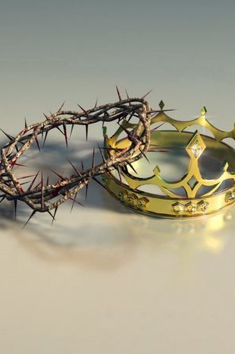
Perception of a King

Slide 2
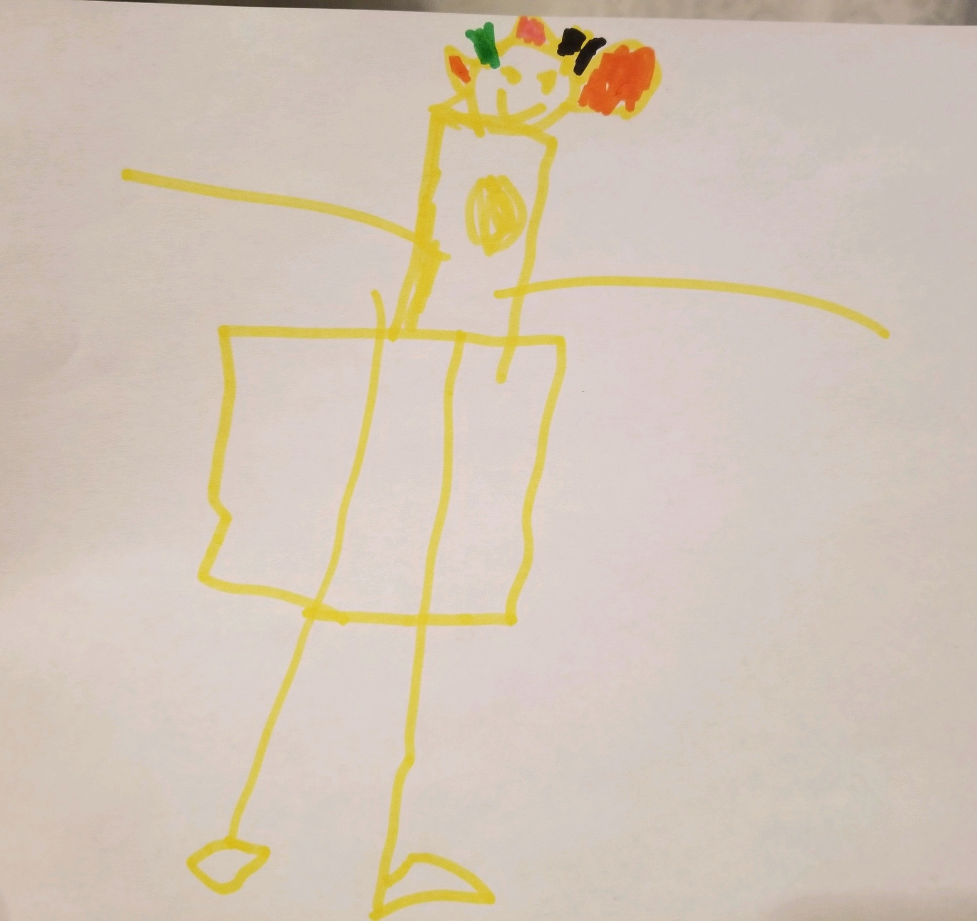
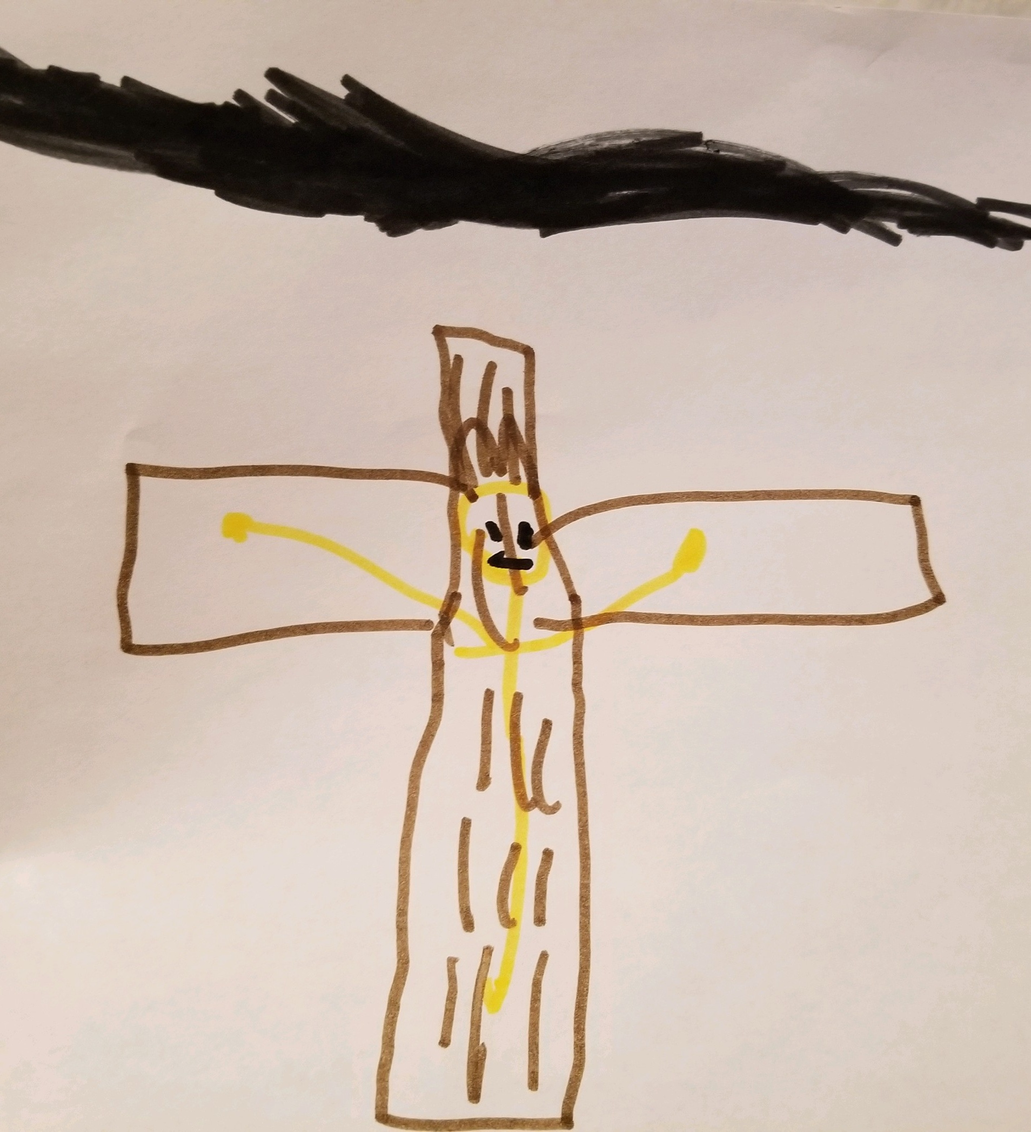
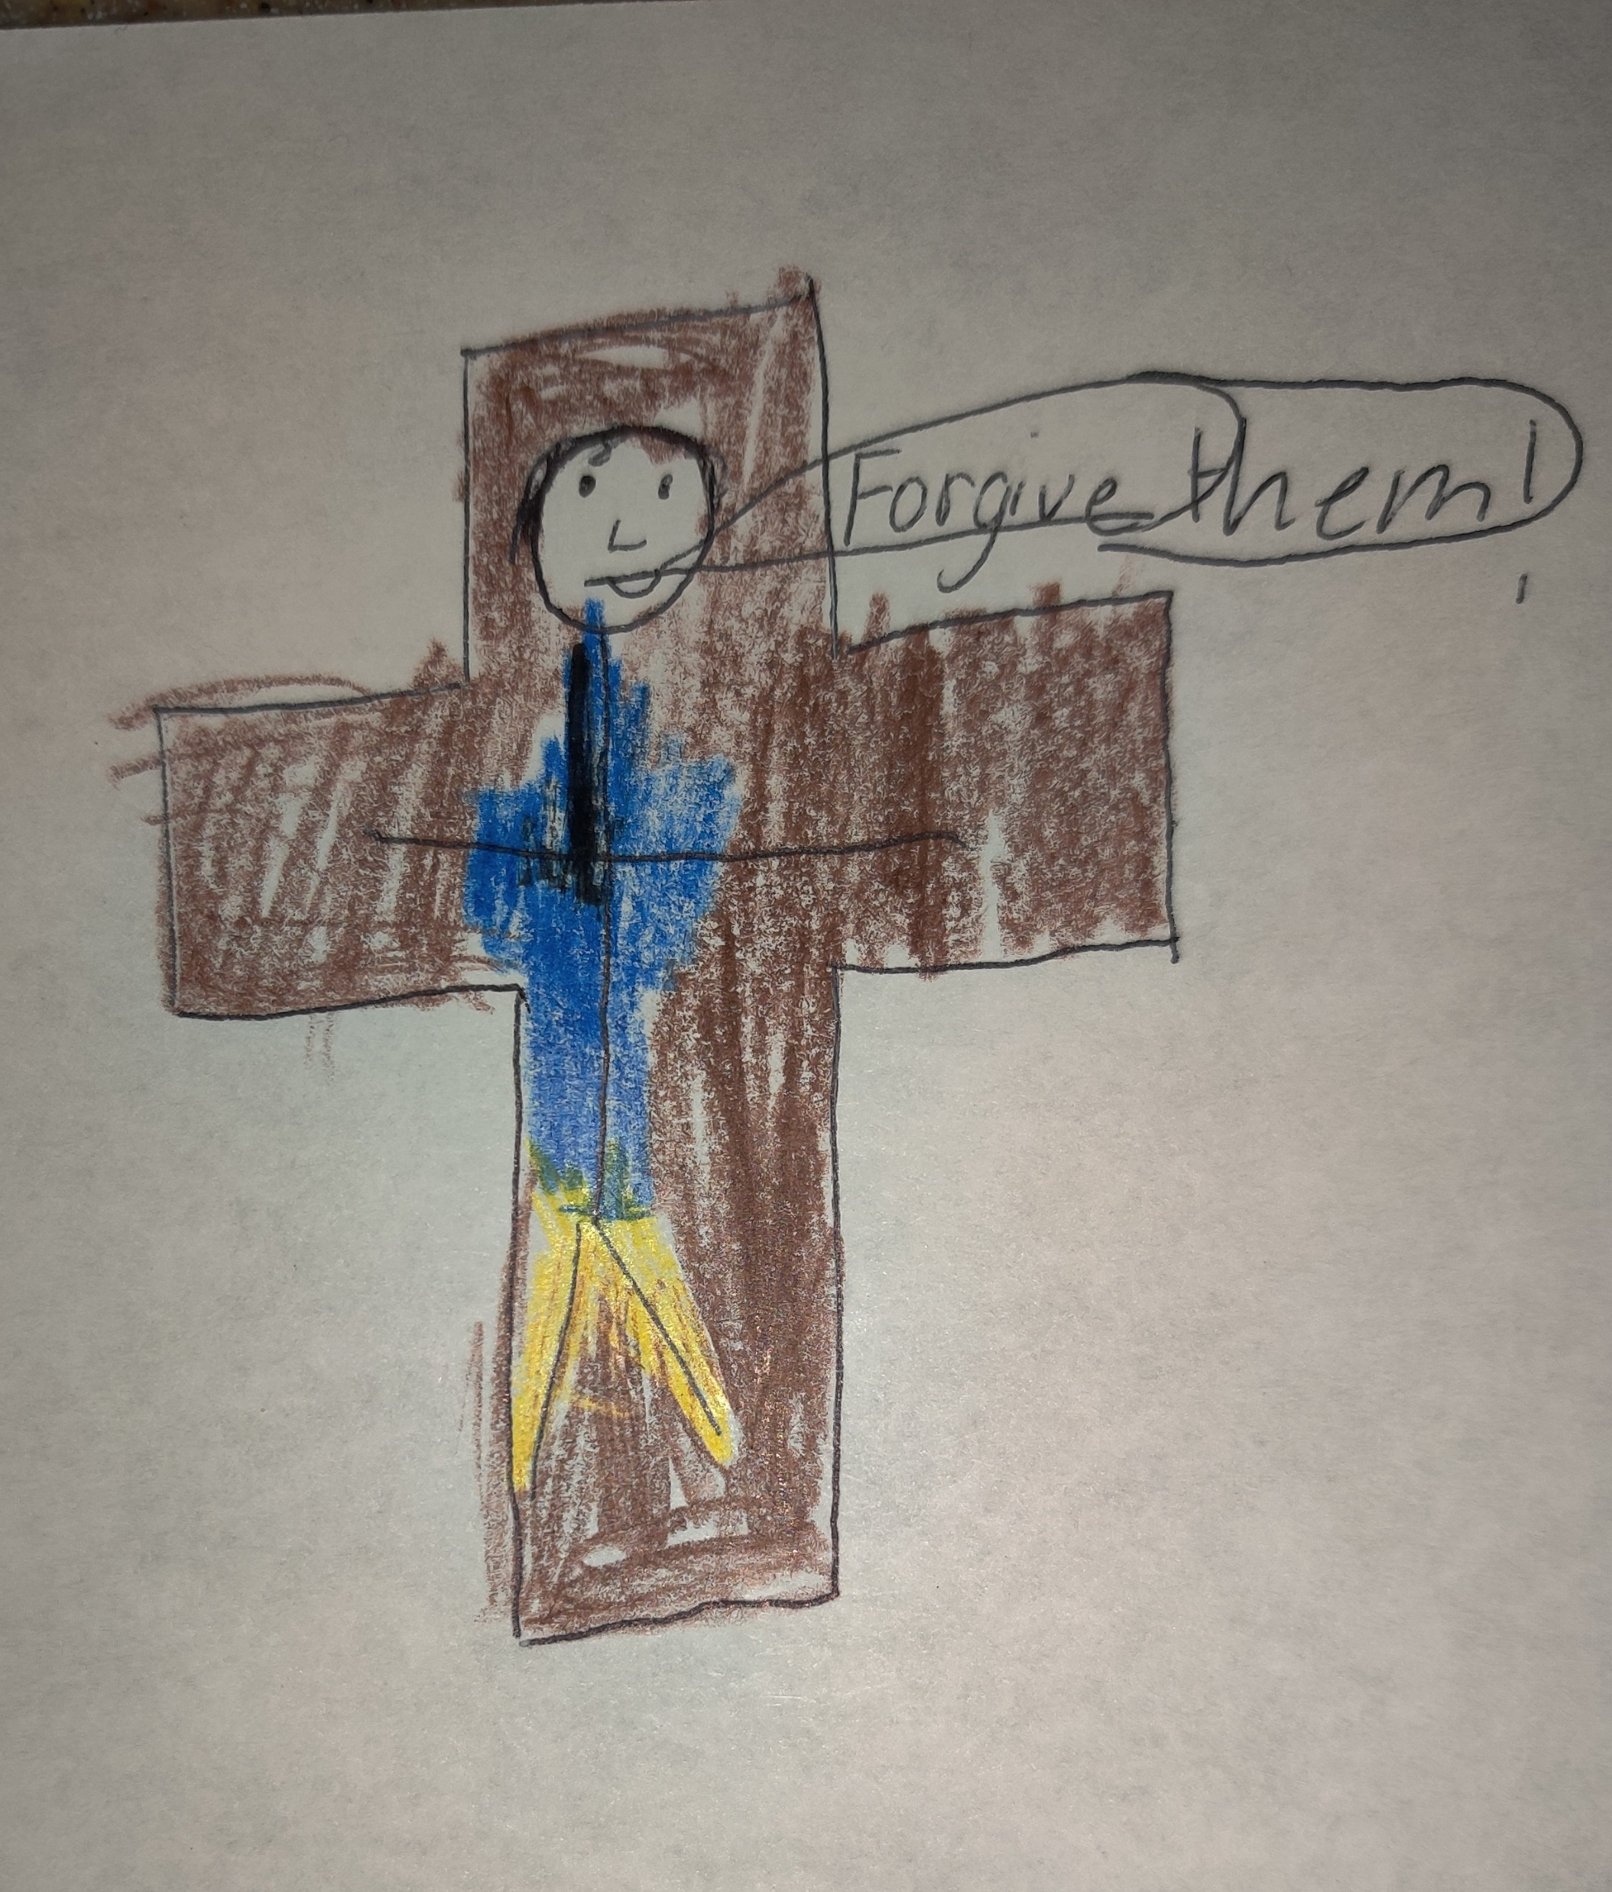
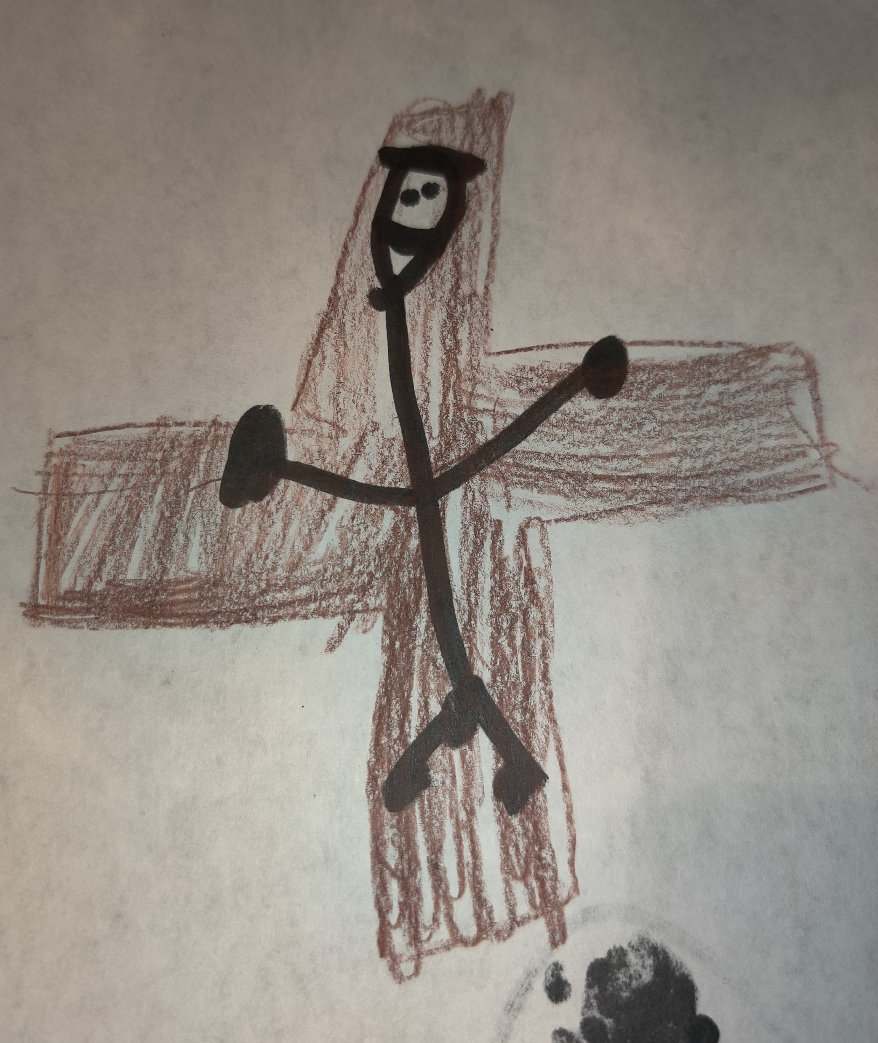
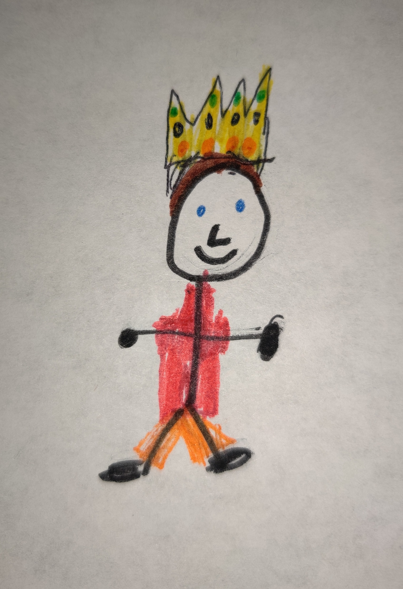
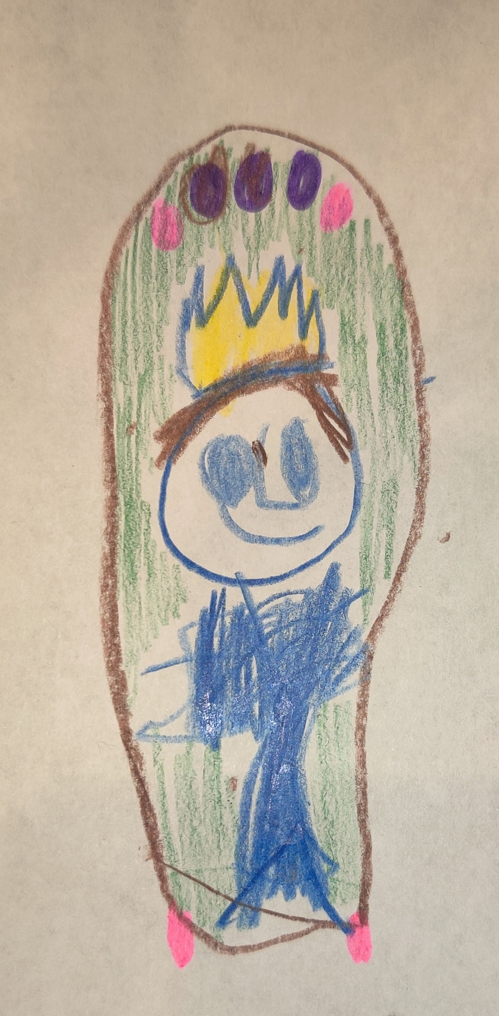

Slide 3
“…he who is the blessed and only Sovereign, the King of kings and Lord of lords, who alone has immortality, who dwells in unapproachable light, whom no one has ever seen or can see. To him be honor and eternal dominion. Amen.”
1 Timothy 6:15-16

Slide 4
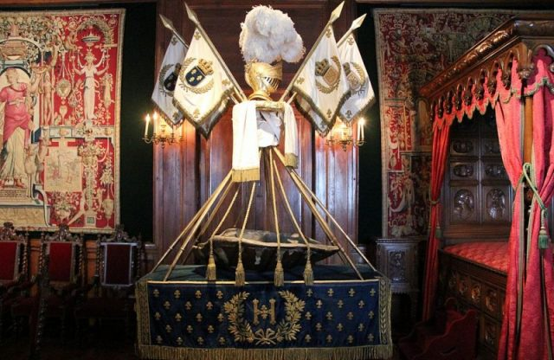
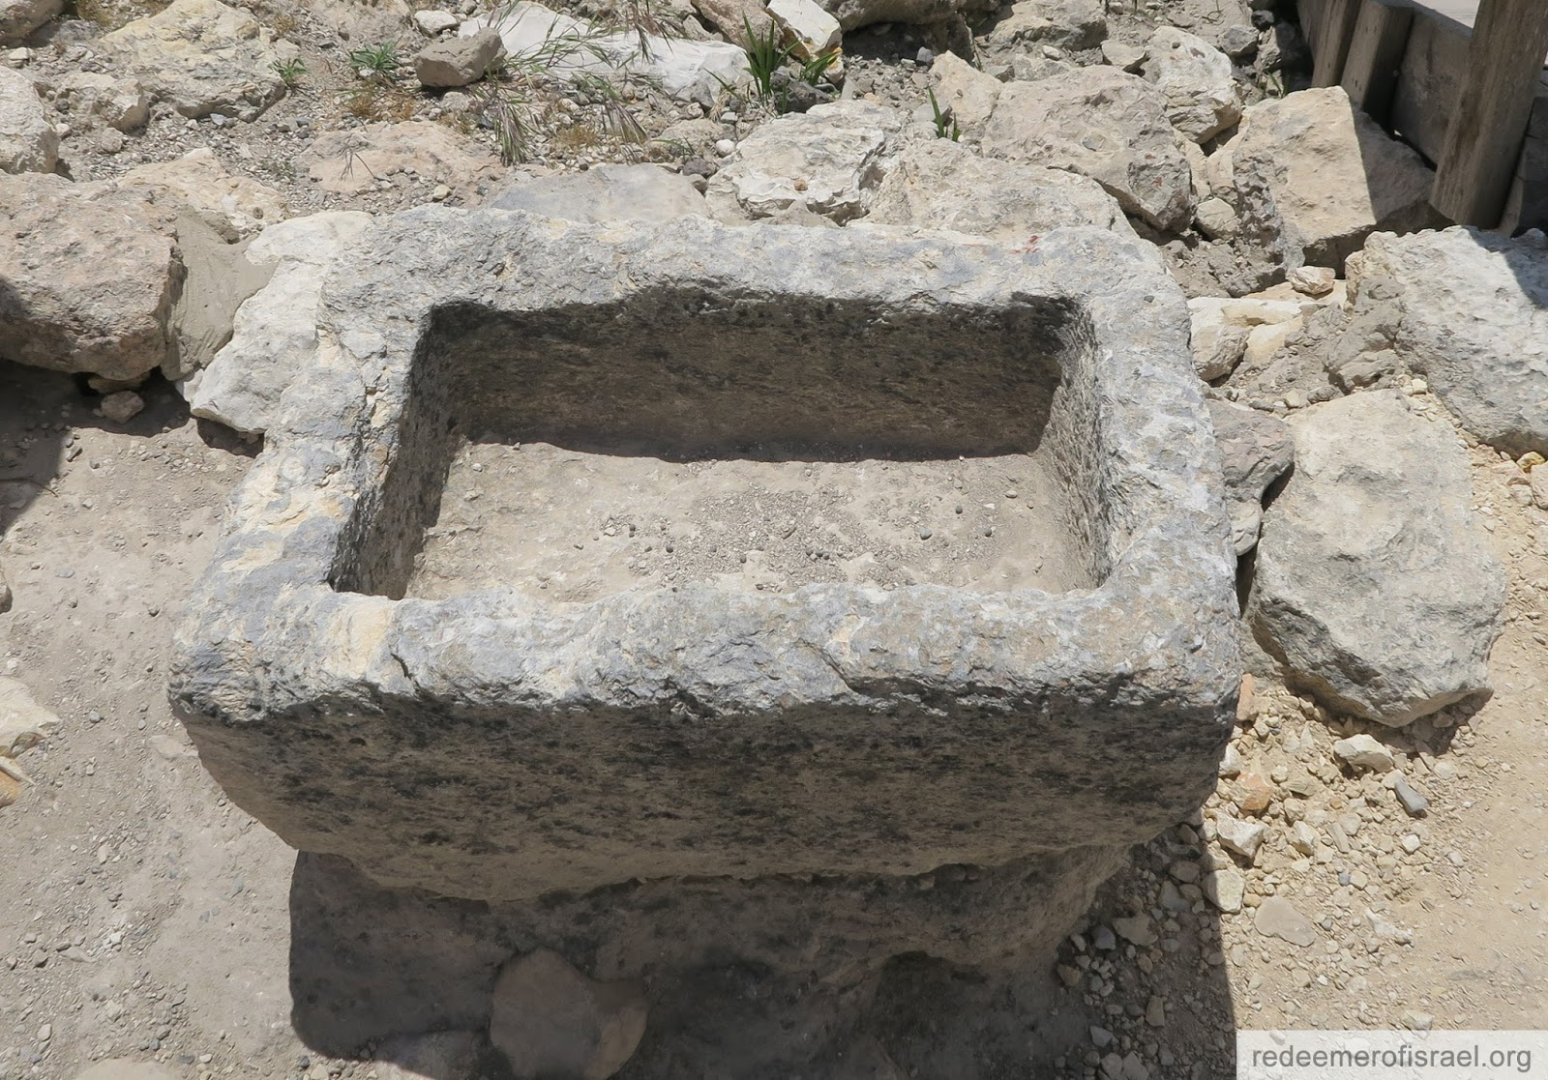

Slide 5
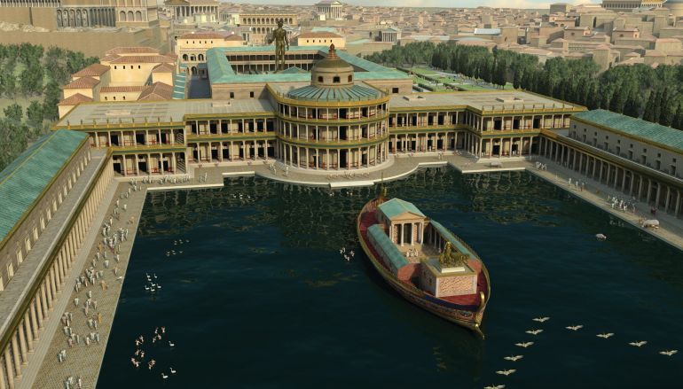
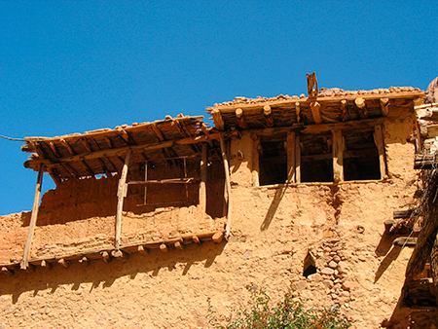

Slide 6
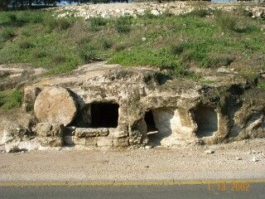
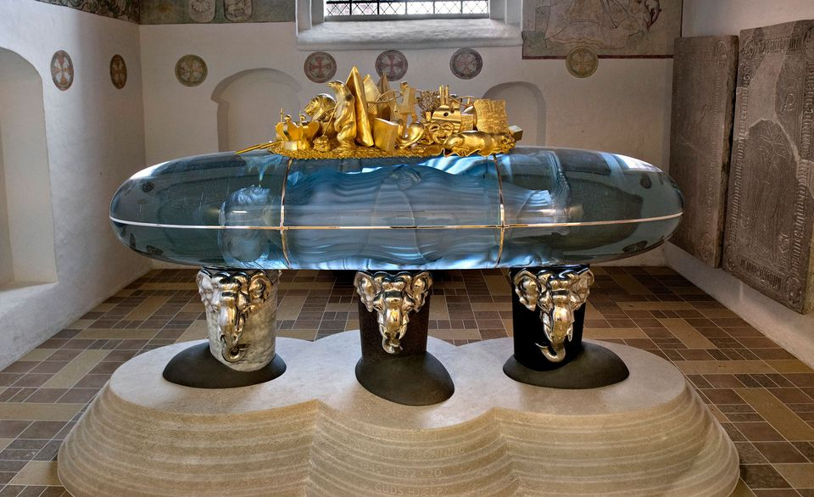

Slide 7
“…and being found in human form, he humbled himself by becoming obedient to the point of death, even death on a cross.”
Philippians 2:8

Slide 8
“…the ruler of the kings of the earth, to him who loved us and washed us from our sins in his own blood, and has made us kings and priests to his God and father, to him by glory and dominion forever and ever.”
Revelation 1:5-6

