Slide 1

This Webcast will begin at 11:45
If you’re watching by Facebook,
you will experience a delay
of approximately 15 or 20 seconds

Slide 2
Prayer

Slide 3
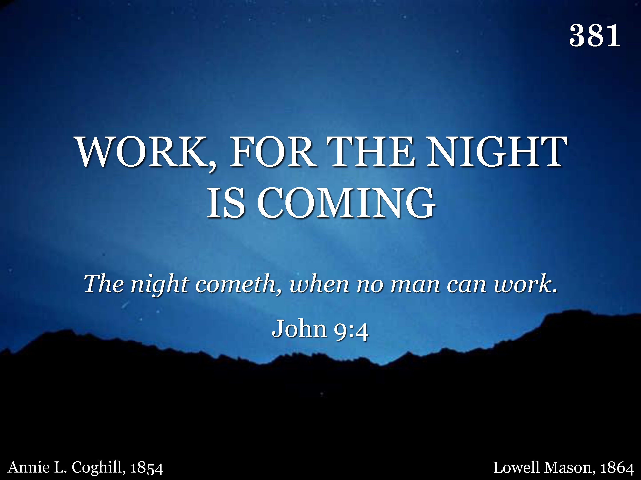
381 - Work, For The Night Is Coming - Title

Slide 4
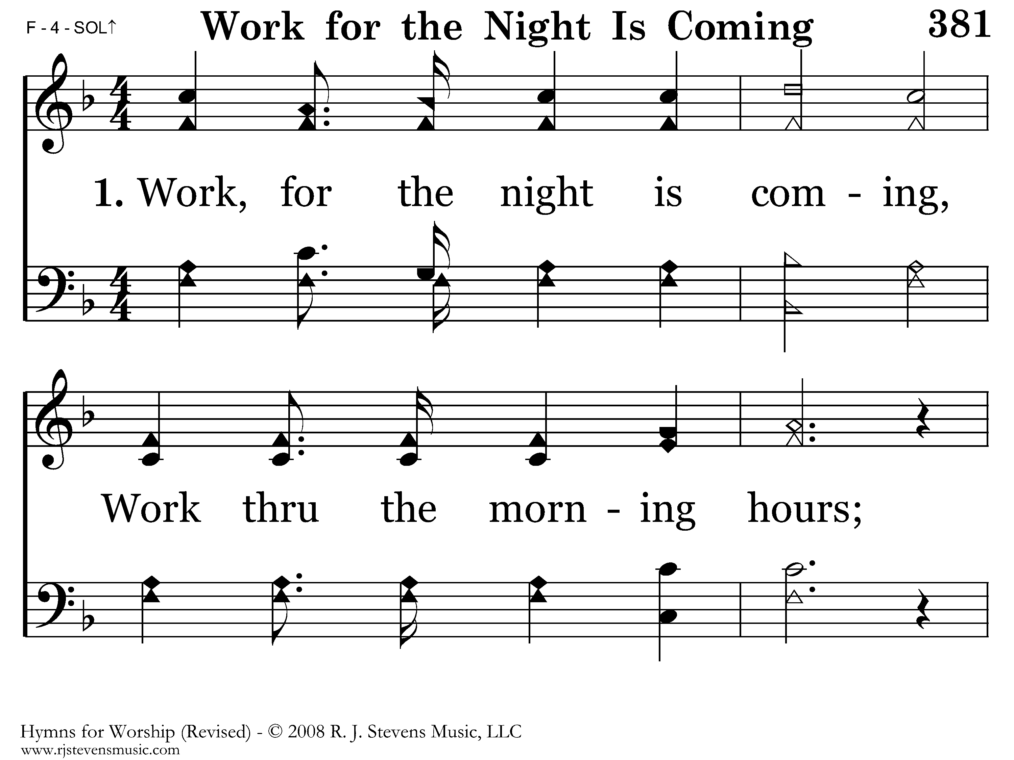
381 - Work, For The Night Is Coming - 1.1

Slide 5
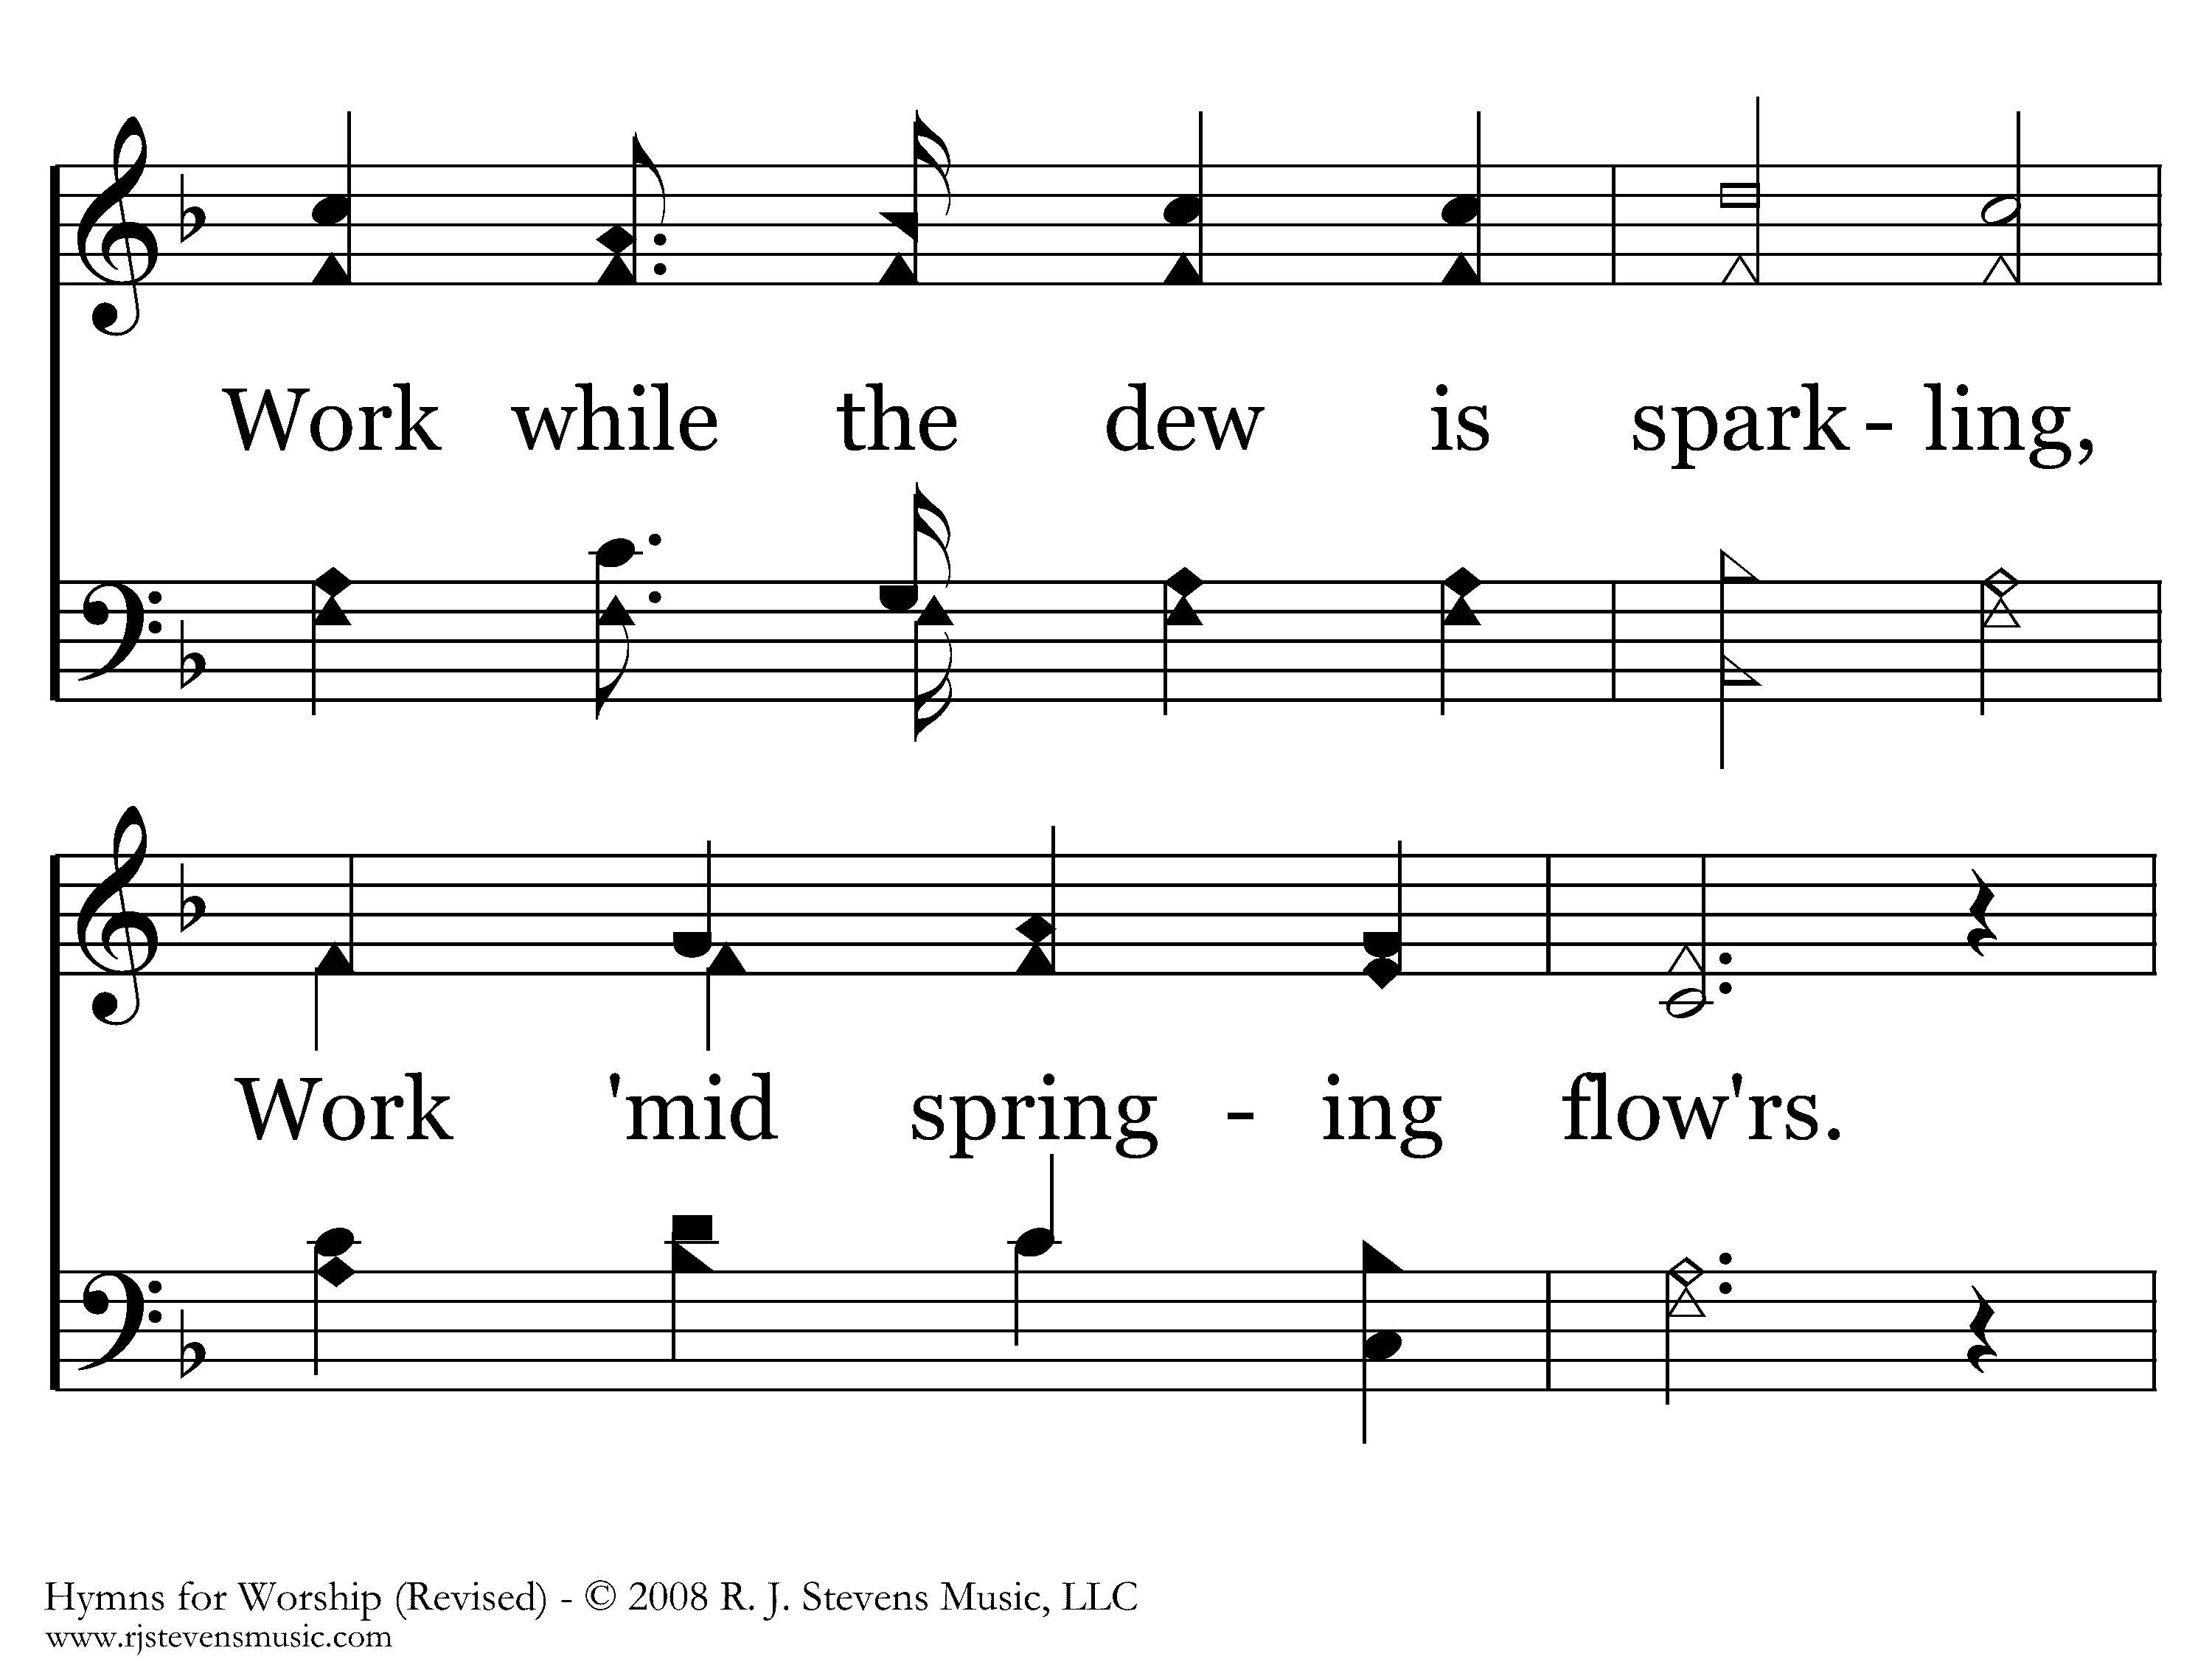
381 - Work, For The Night Is Coming - 1.2

Slide 6
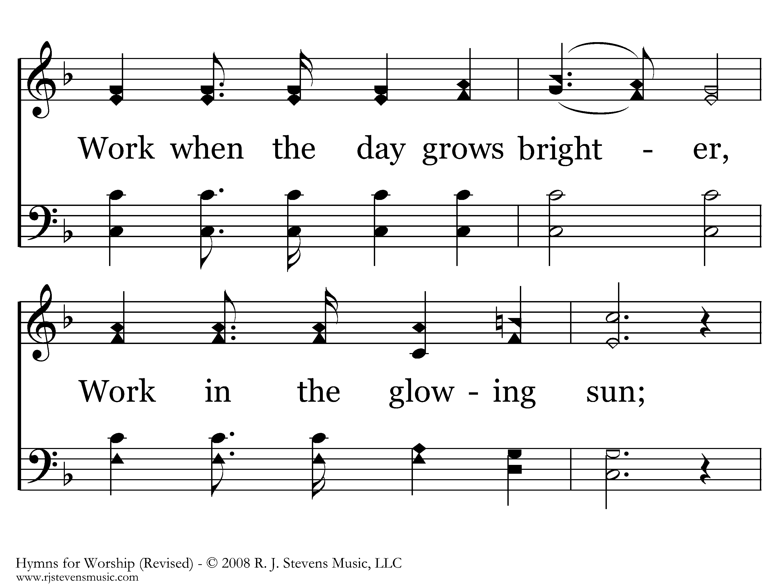
381 - Work, For The Night Is Coming - 1.3

Slide 7
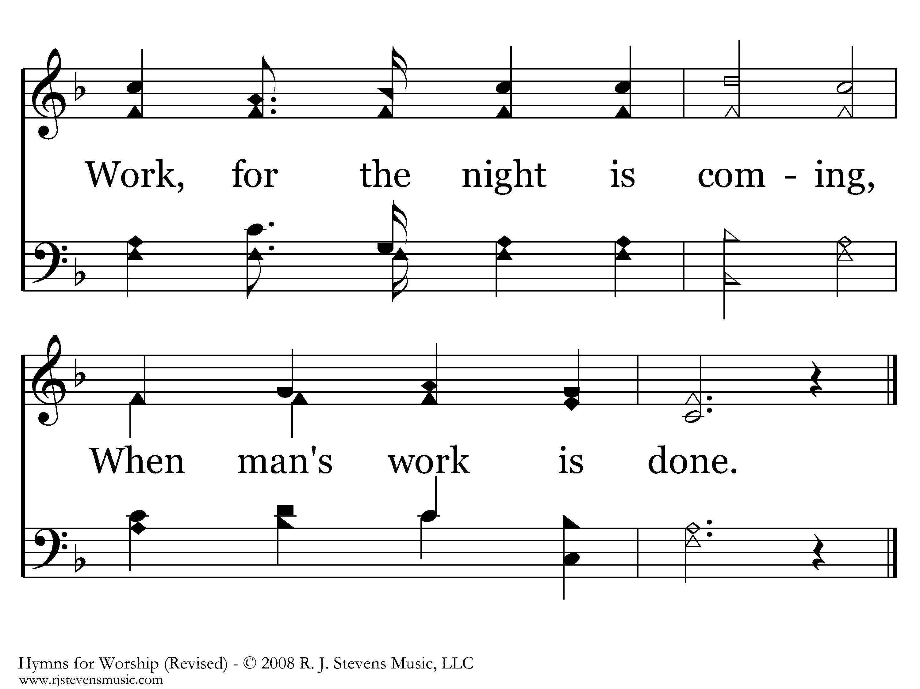
381 - Work, For The Night Is Coming - 1.4
End of Verse 1

Slide 8
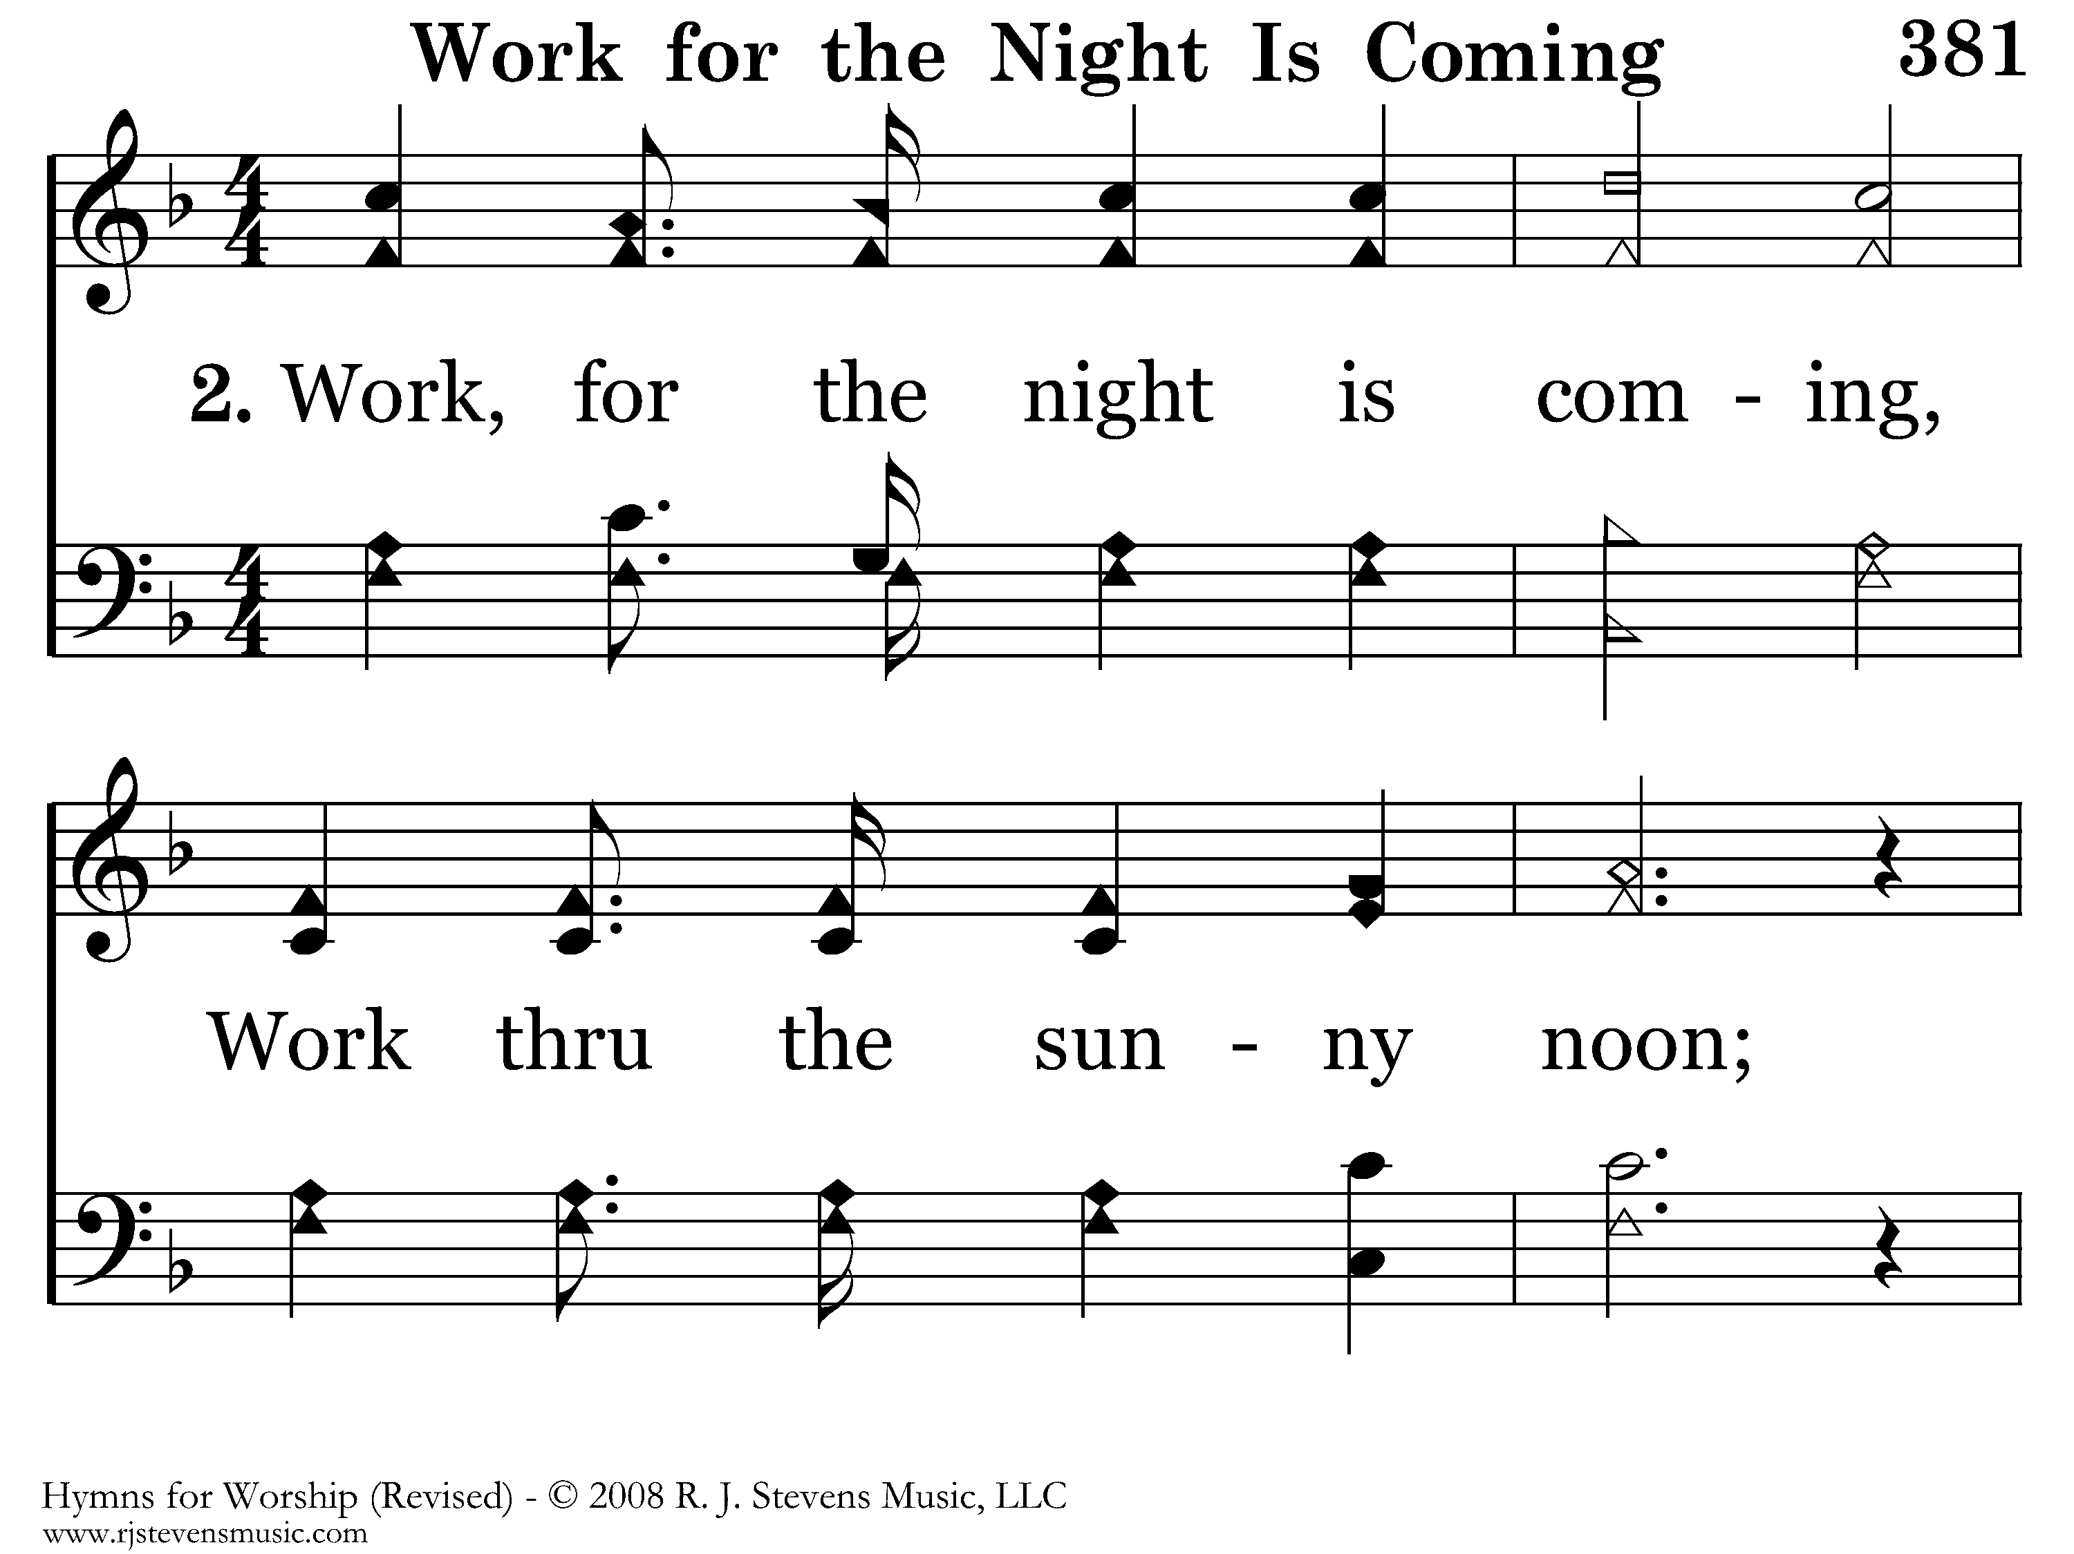
381 - Work, For The Night Is Coming - 2.1

Slide 9
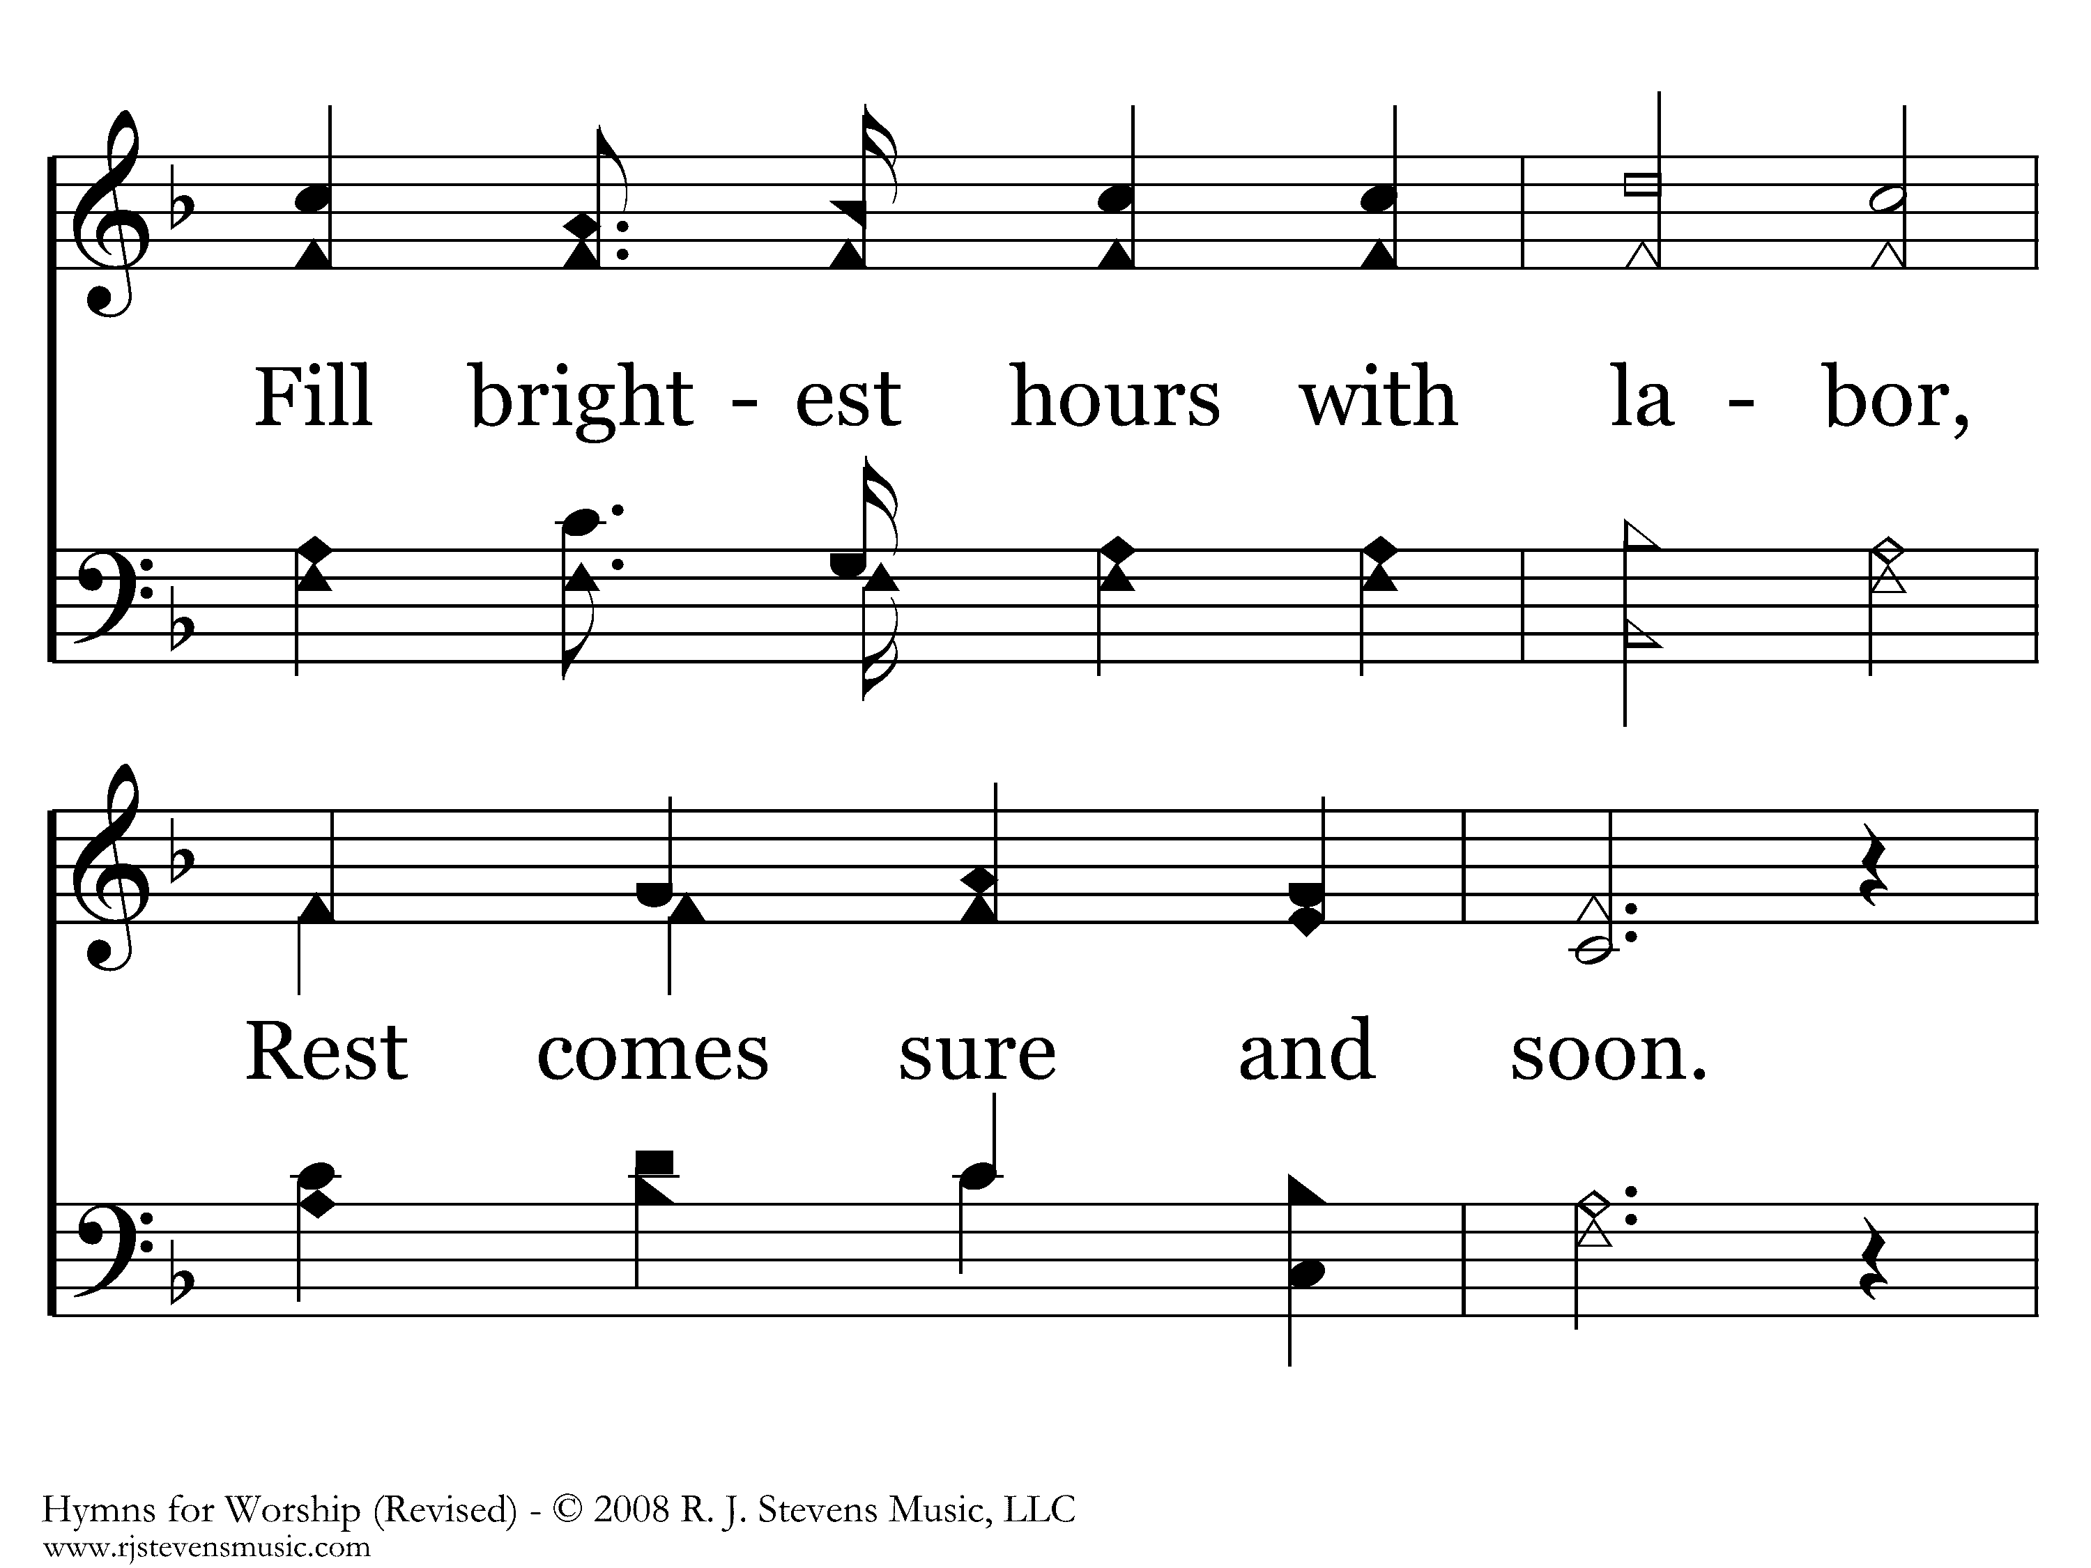
381 - Work, For The Night Is Coming - 2.2

Slide 10
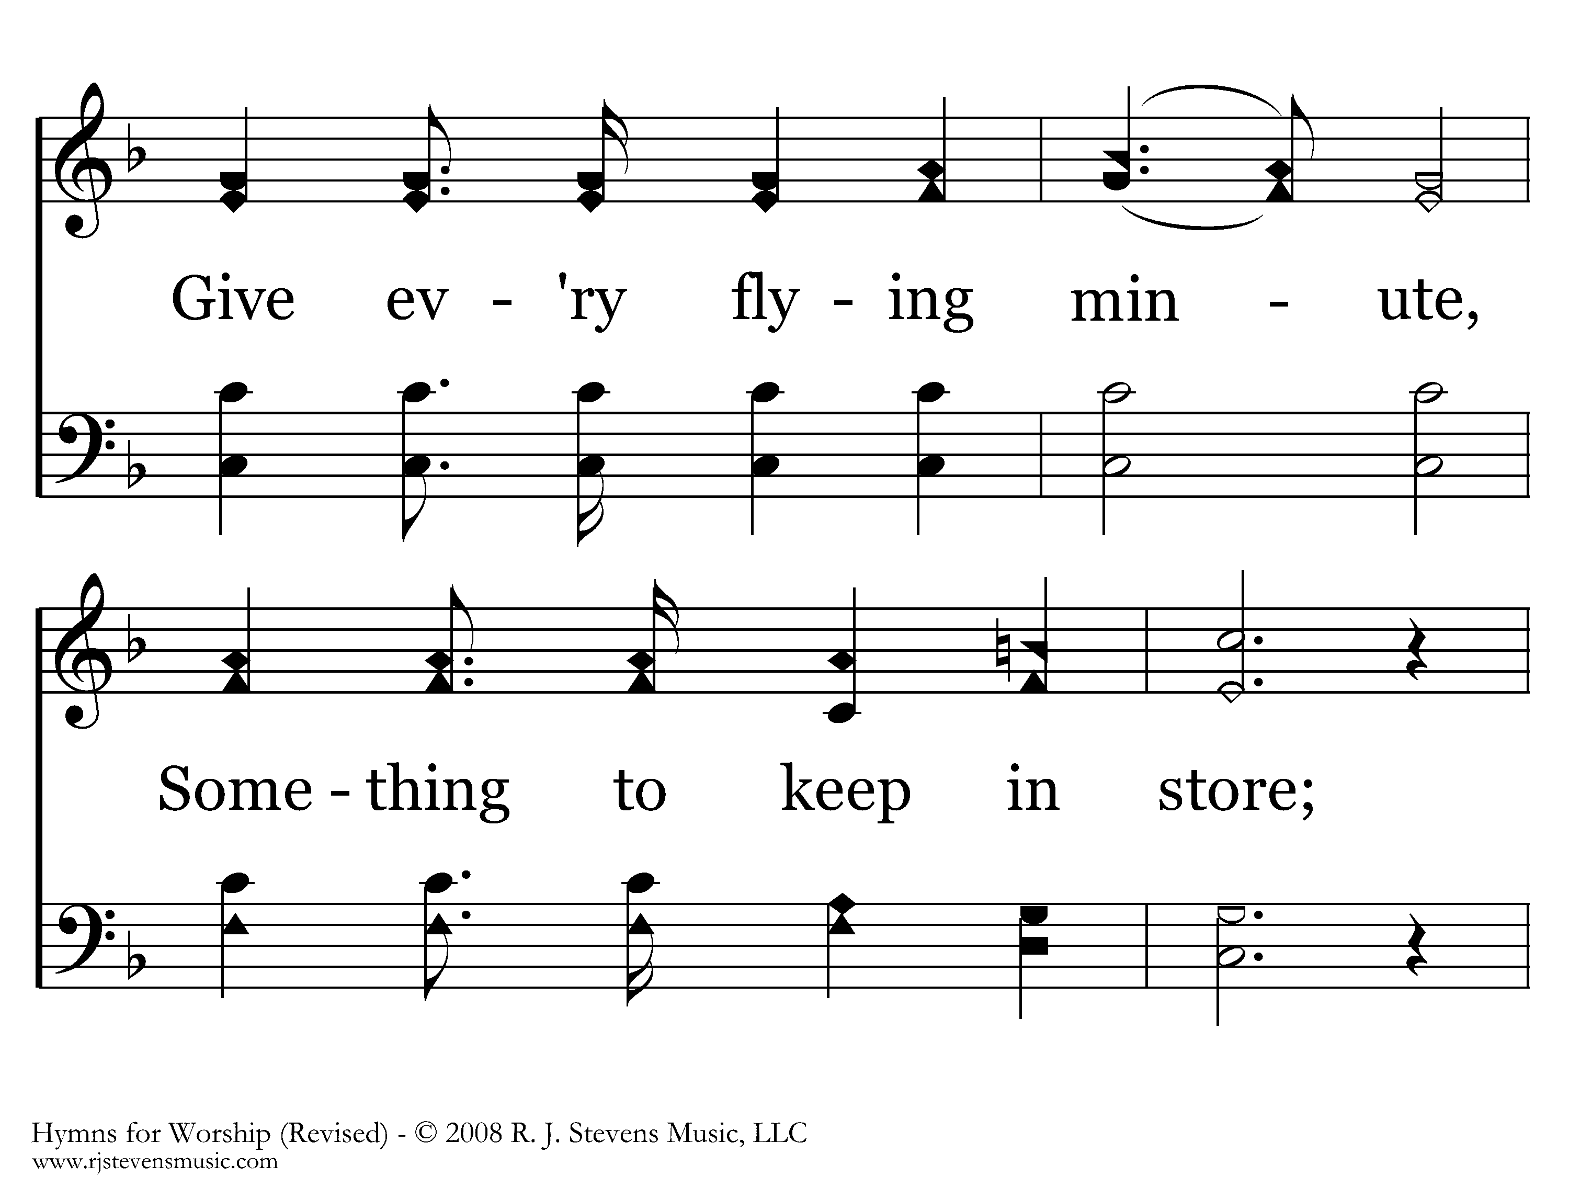
381 - Work, For The Night Is Coming - 2.3

Slide 11
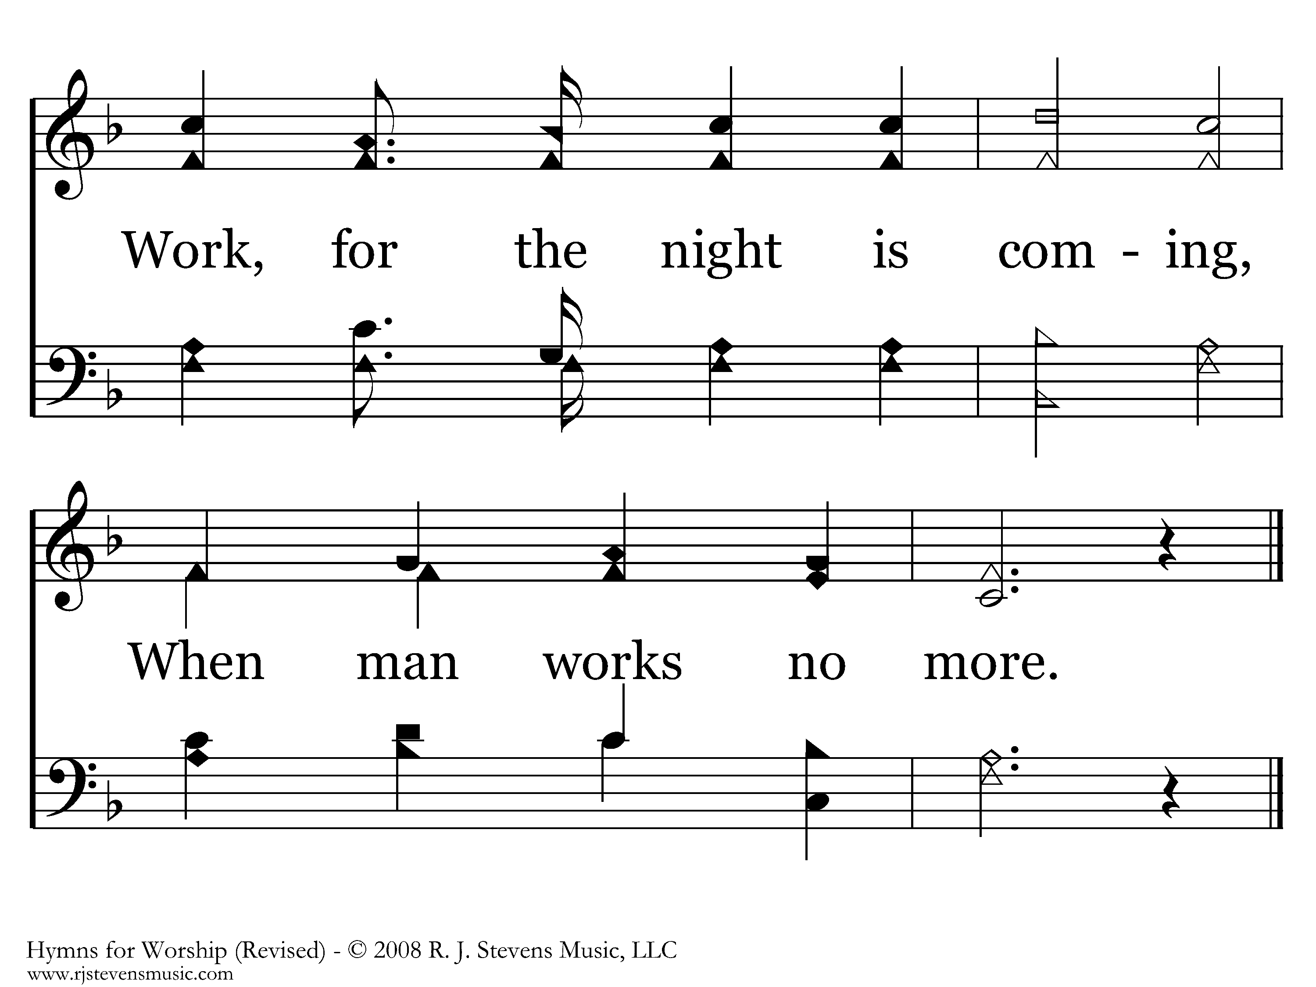
381 - Work, For The Night Is Coming - 2.4
End of Verse 2

Slide 12
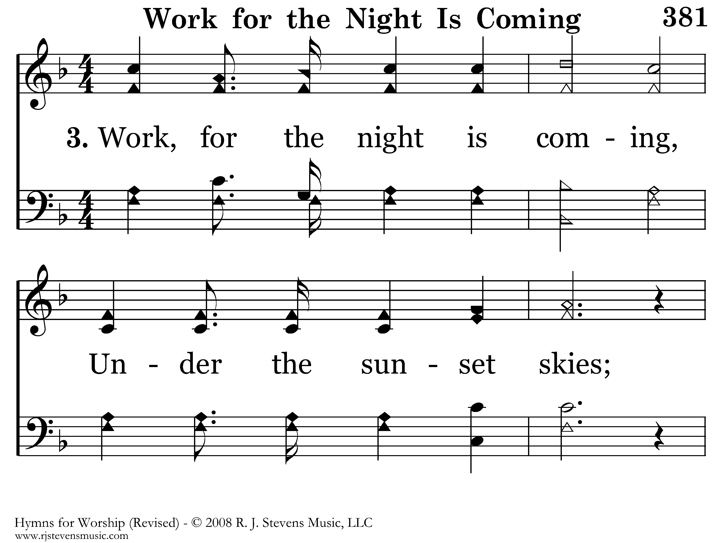
381 - Work, For The Night Is Coming - 3.1

Slide 13
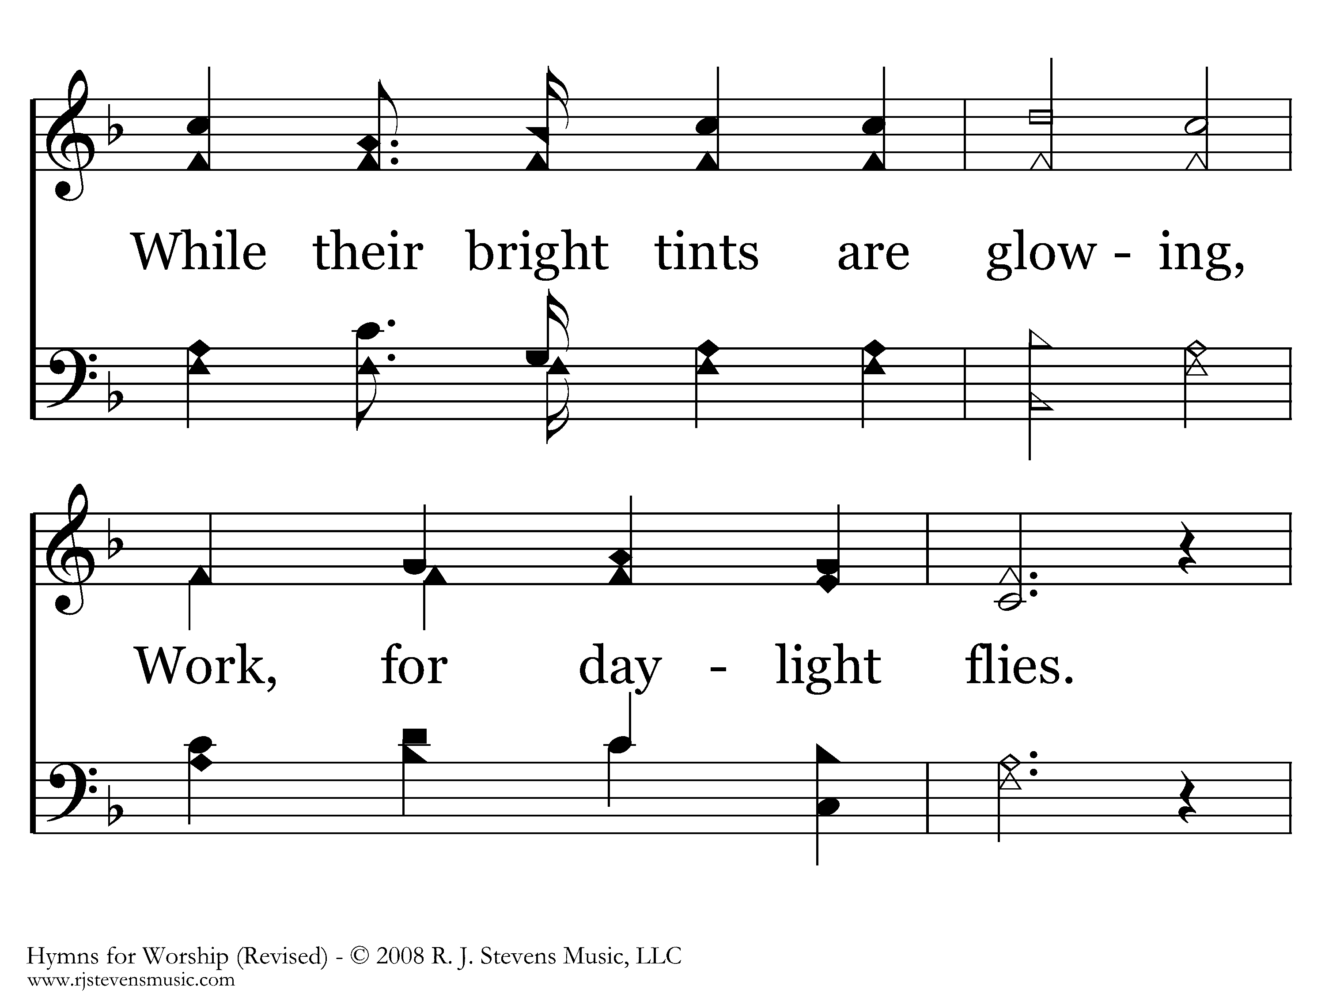
381 - Work, For The Night Is Coming - 3.2

Slide 14
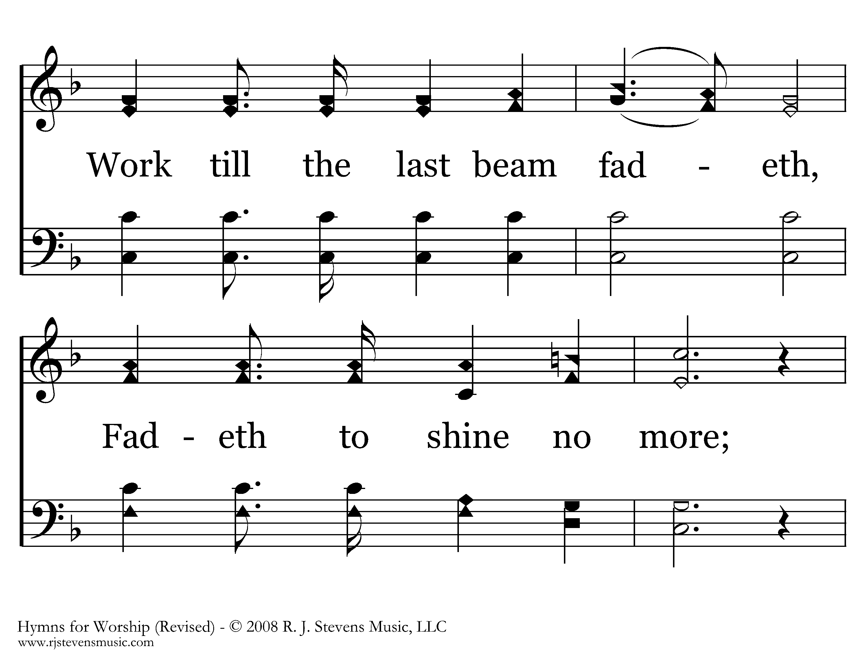
381 - Work, For The Night Is Coming - 3.3

Slide 15
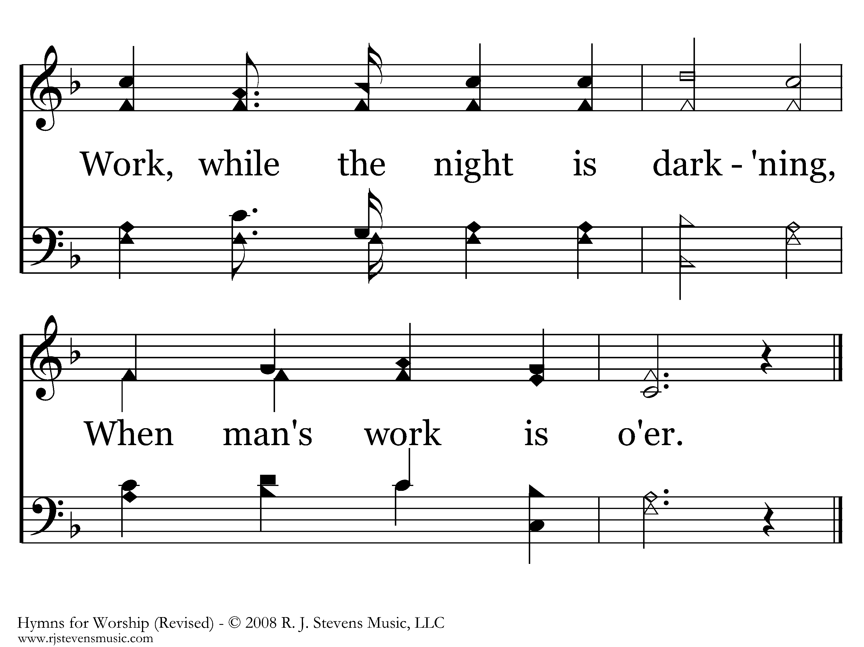
381 - Work, For The Night Is Coming - 3.4
End of Song

Slide 16

361 - In His Time - Title

Slide 17
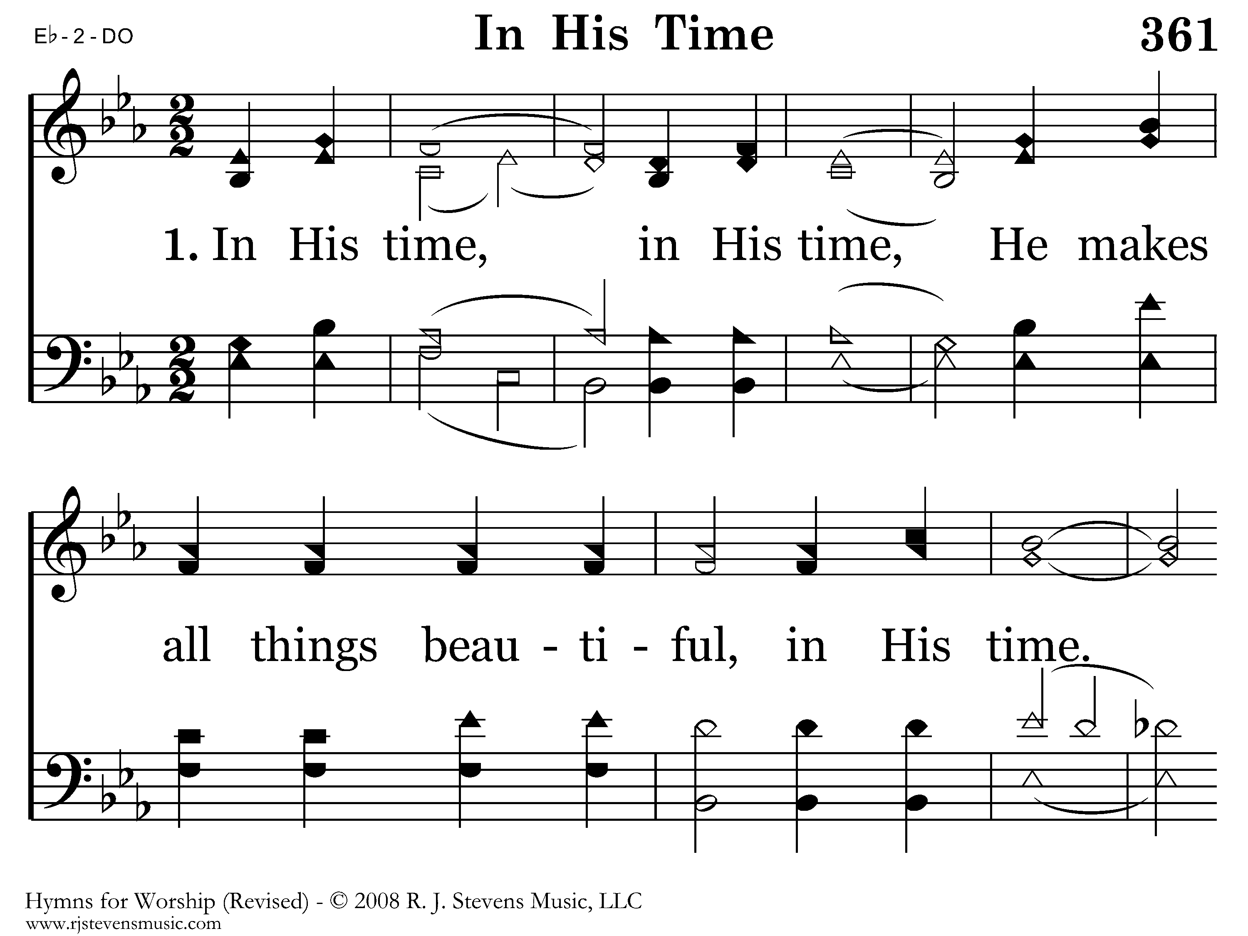
361 - In His Time - 1.1

Slide 18
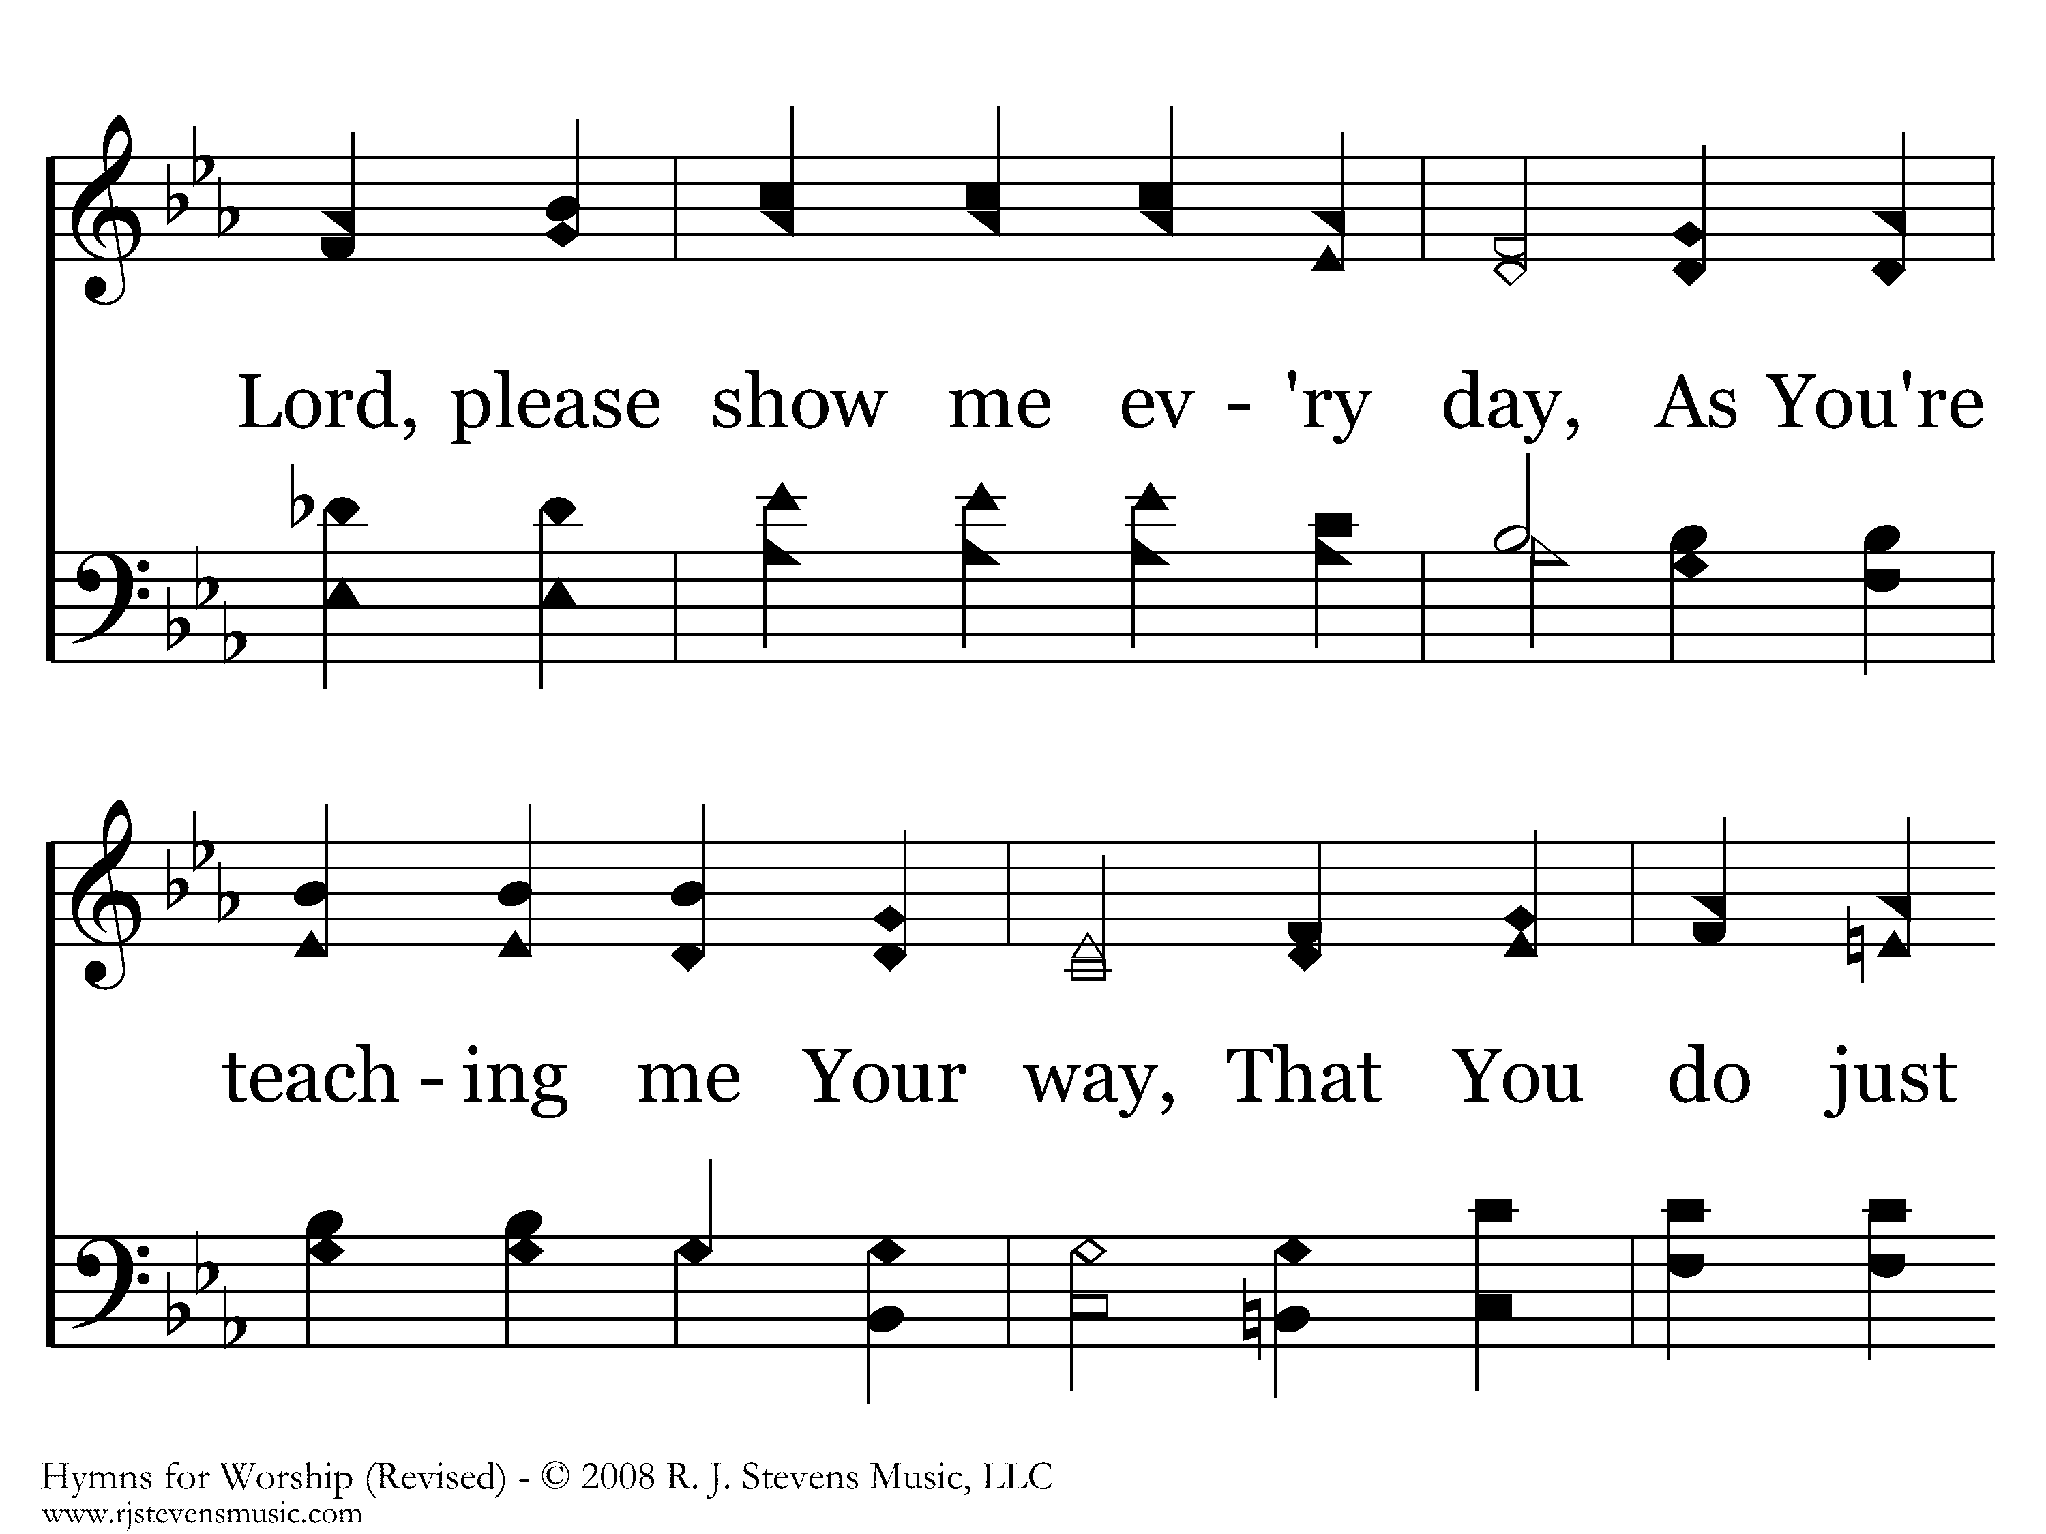
361 - In His Time - 1.2

Slide 19
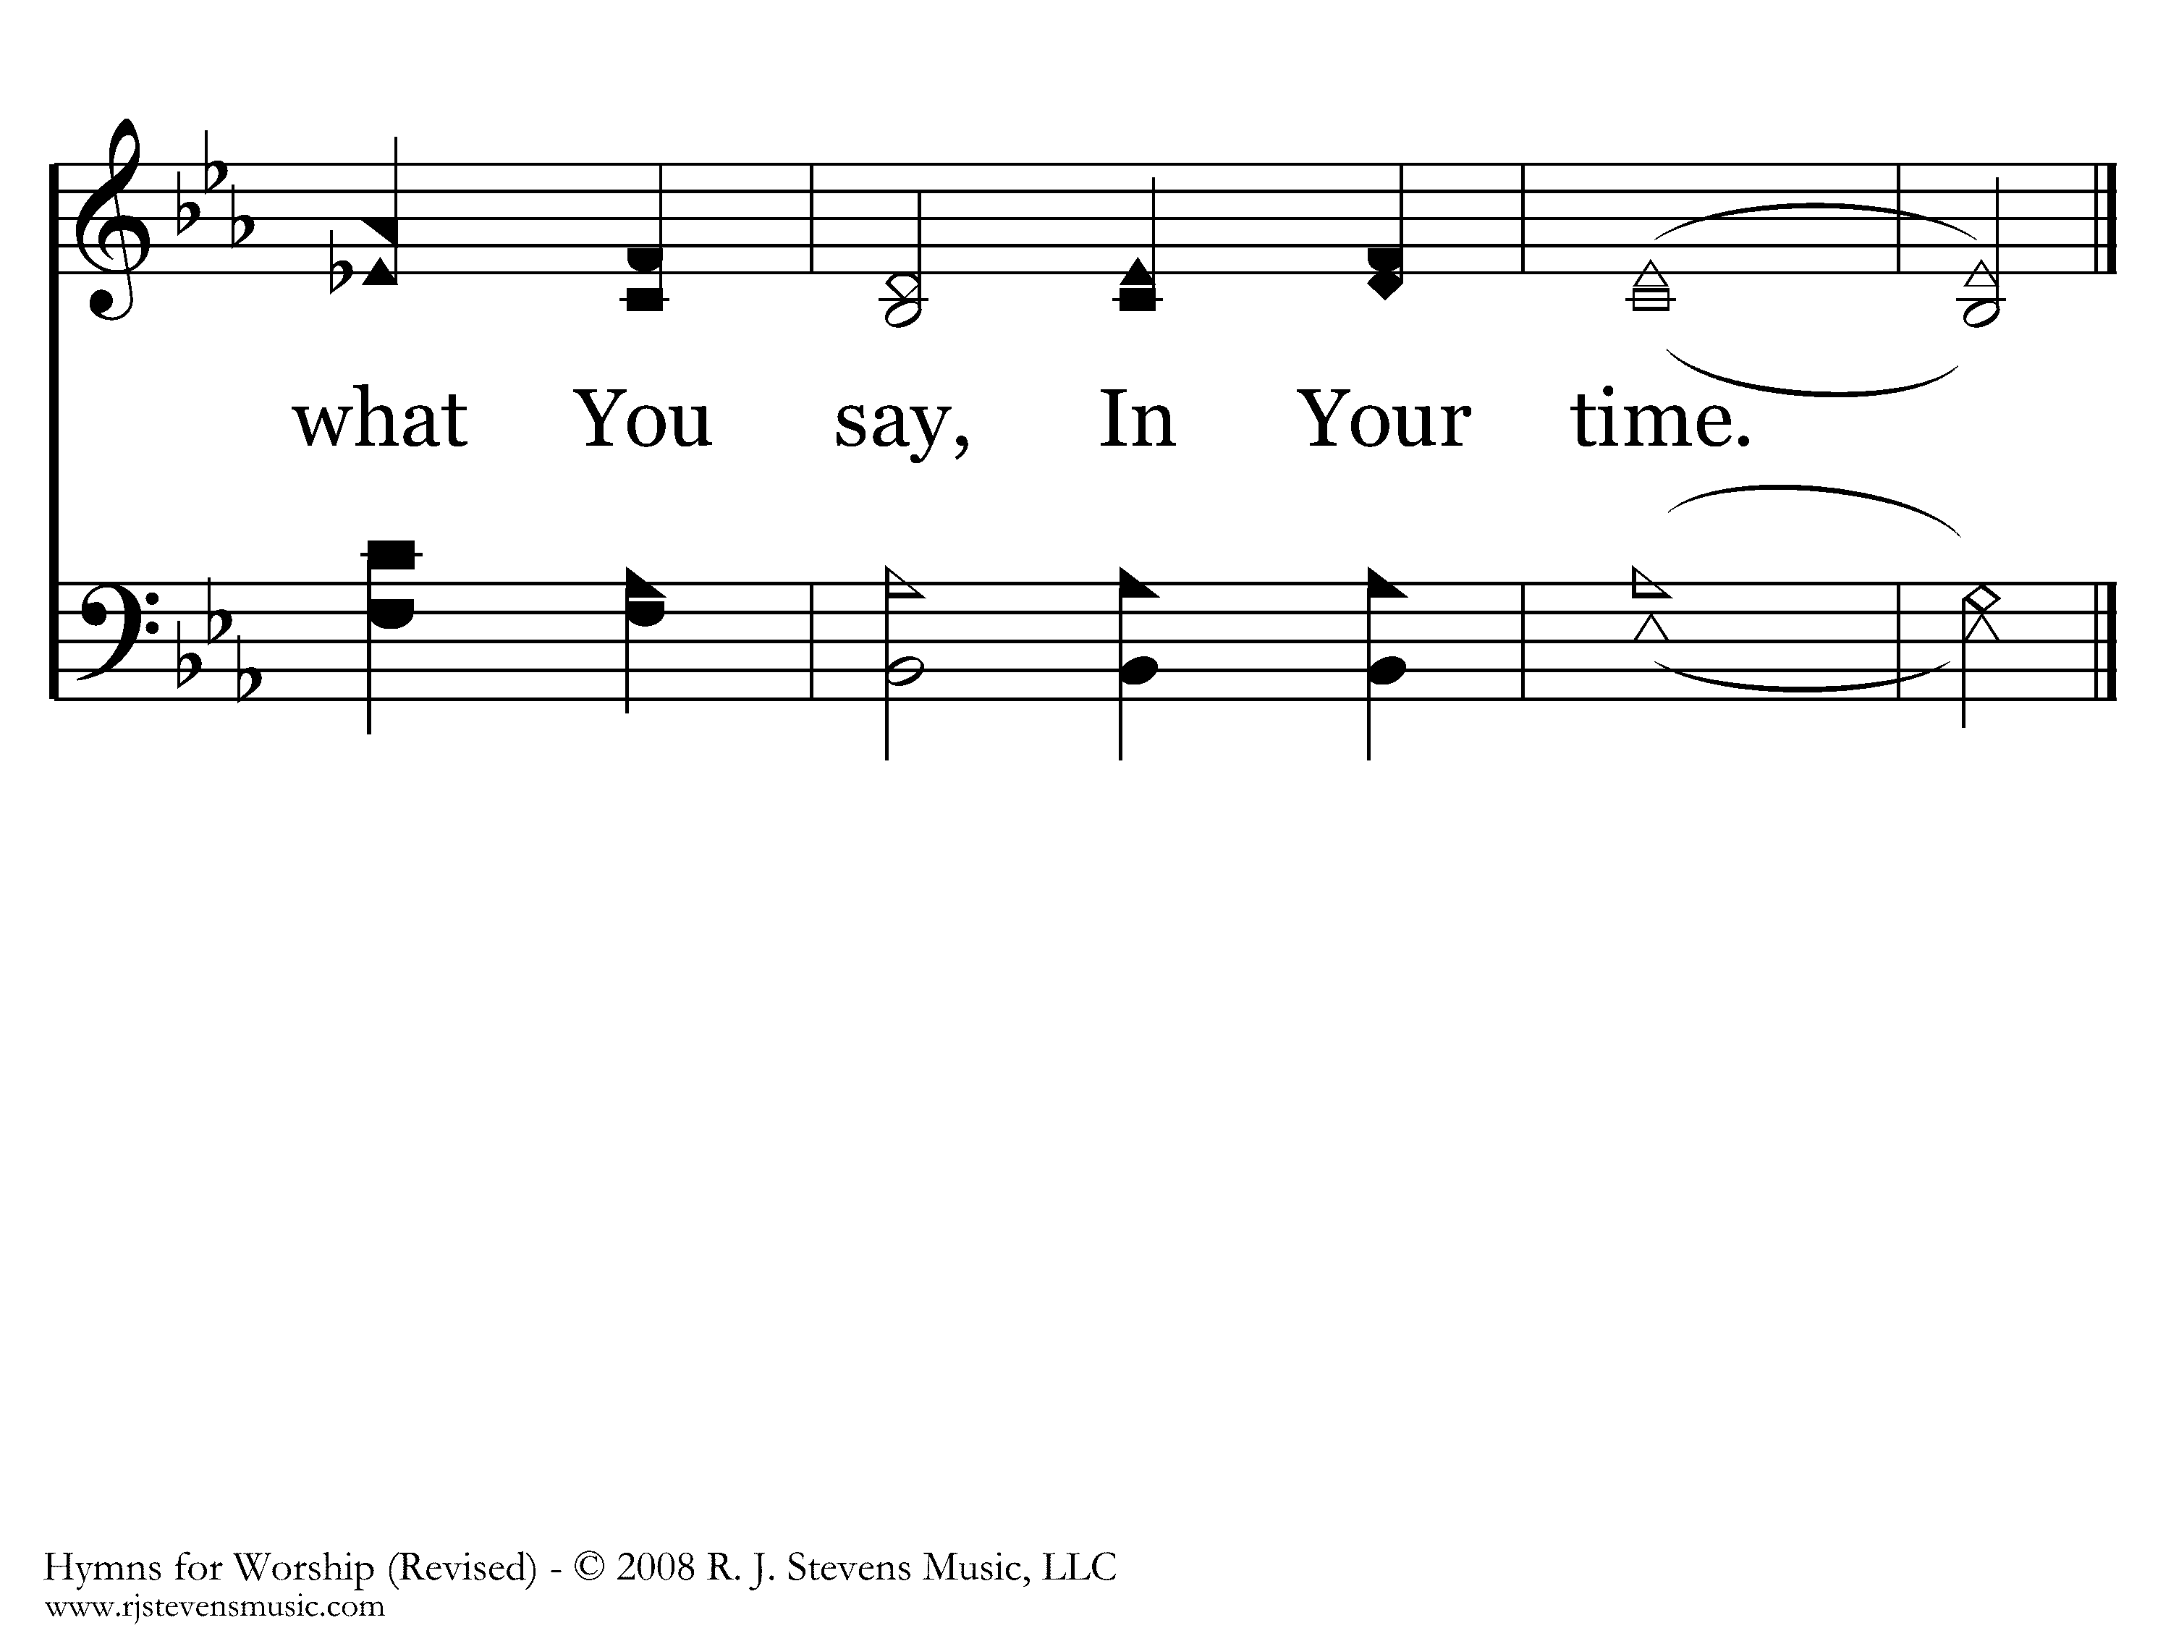
361 - In His Time - 1.3
End of Verse 1

Slide 20
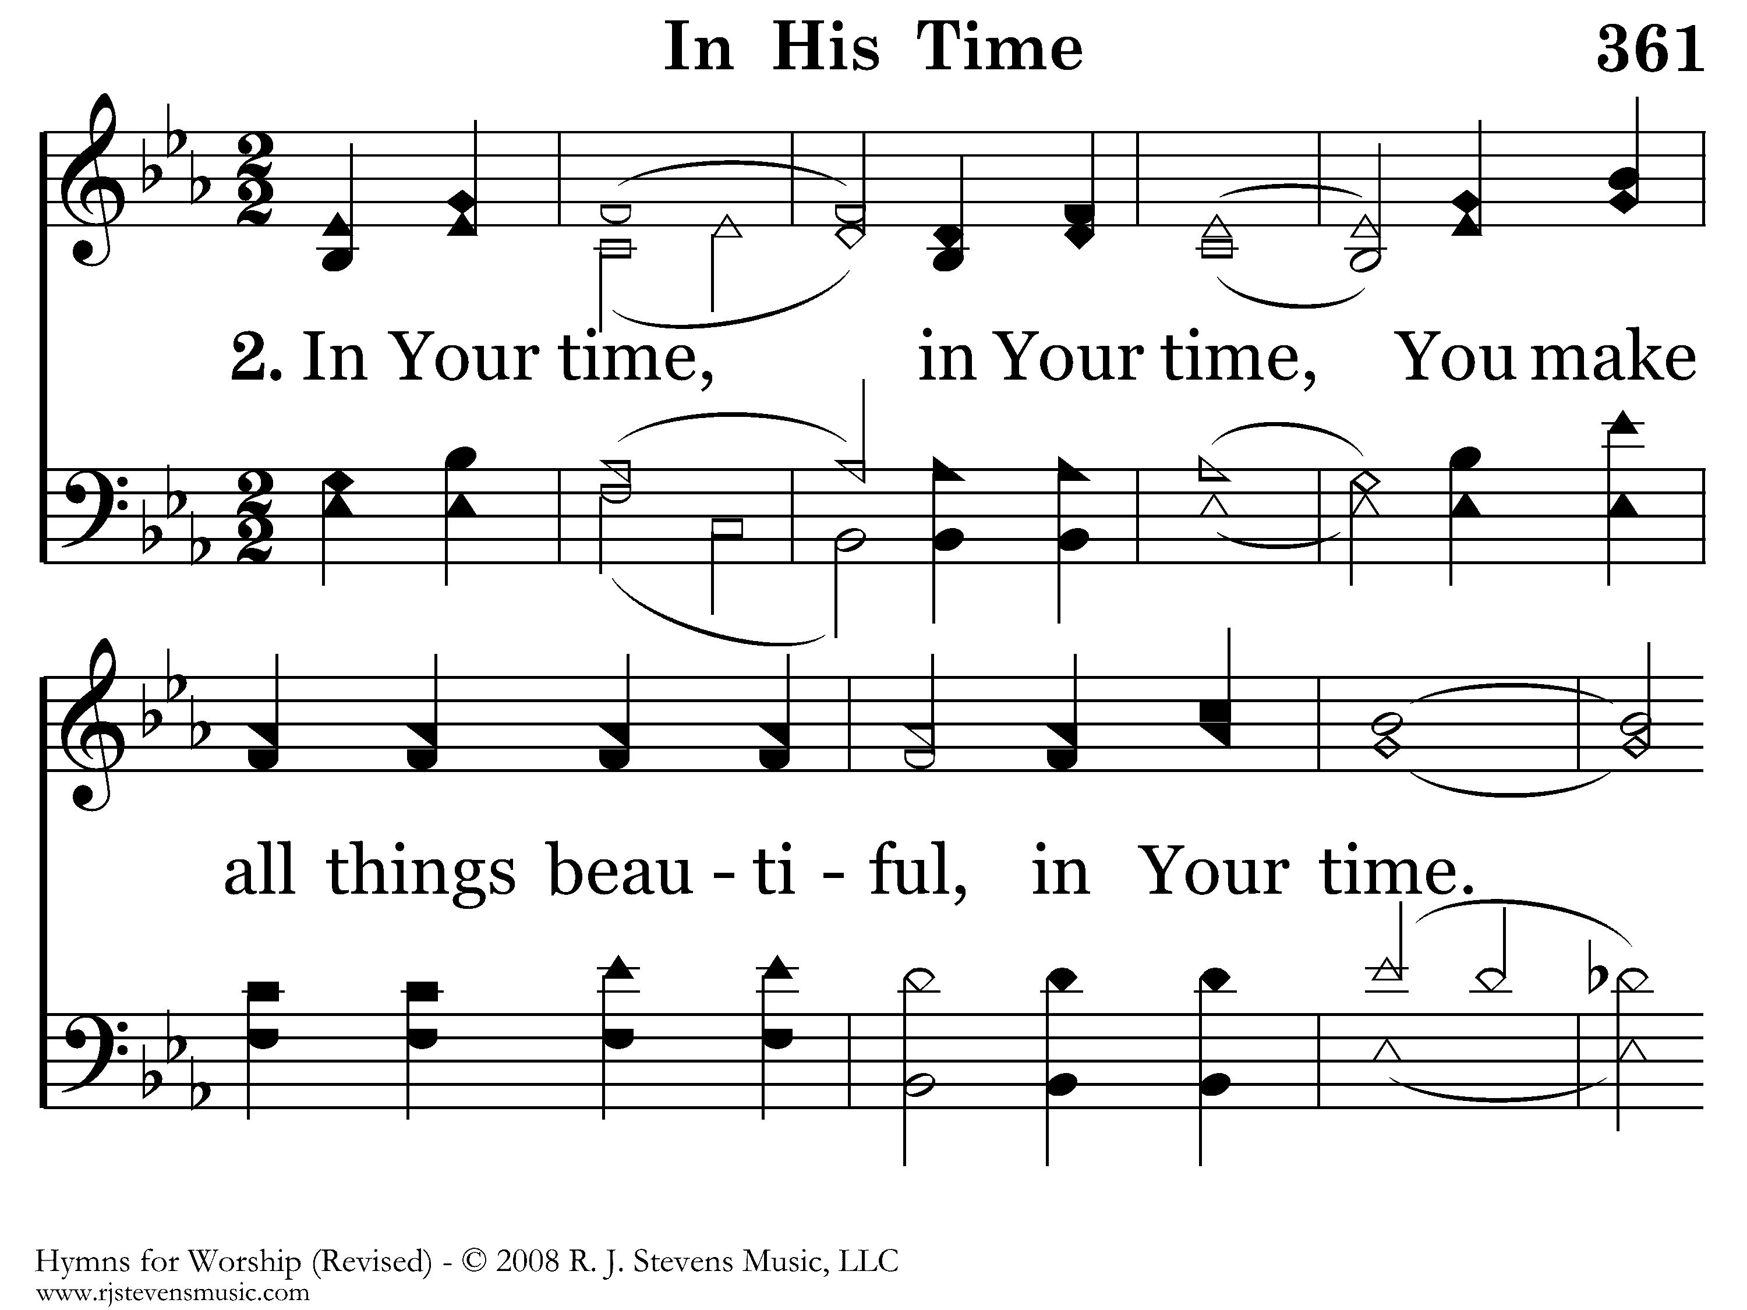
361 - In His Time - 2.1

Slide 21
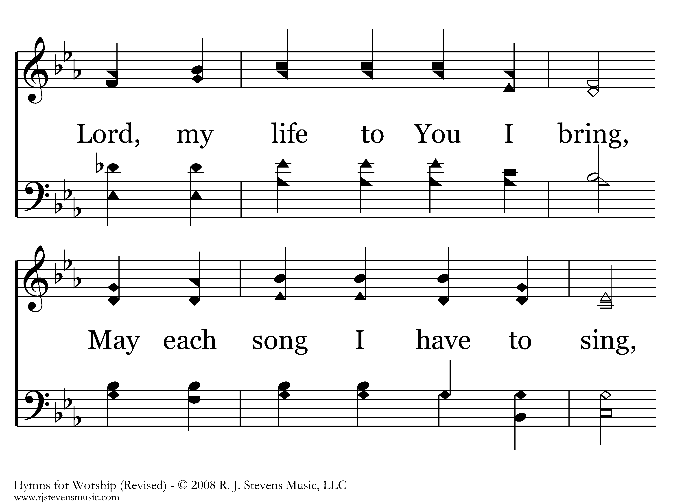
361 - In His Time - 2.2

Slide 22
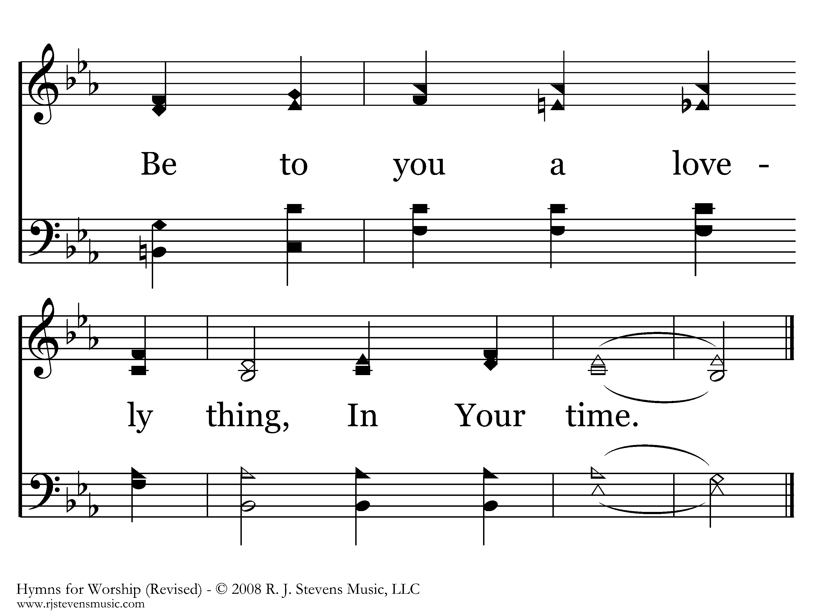
361 - In His Time - 2.3
End of Song

Slide 23
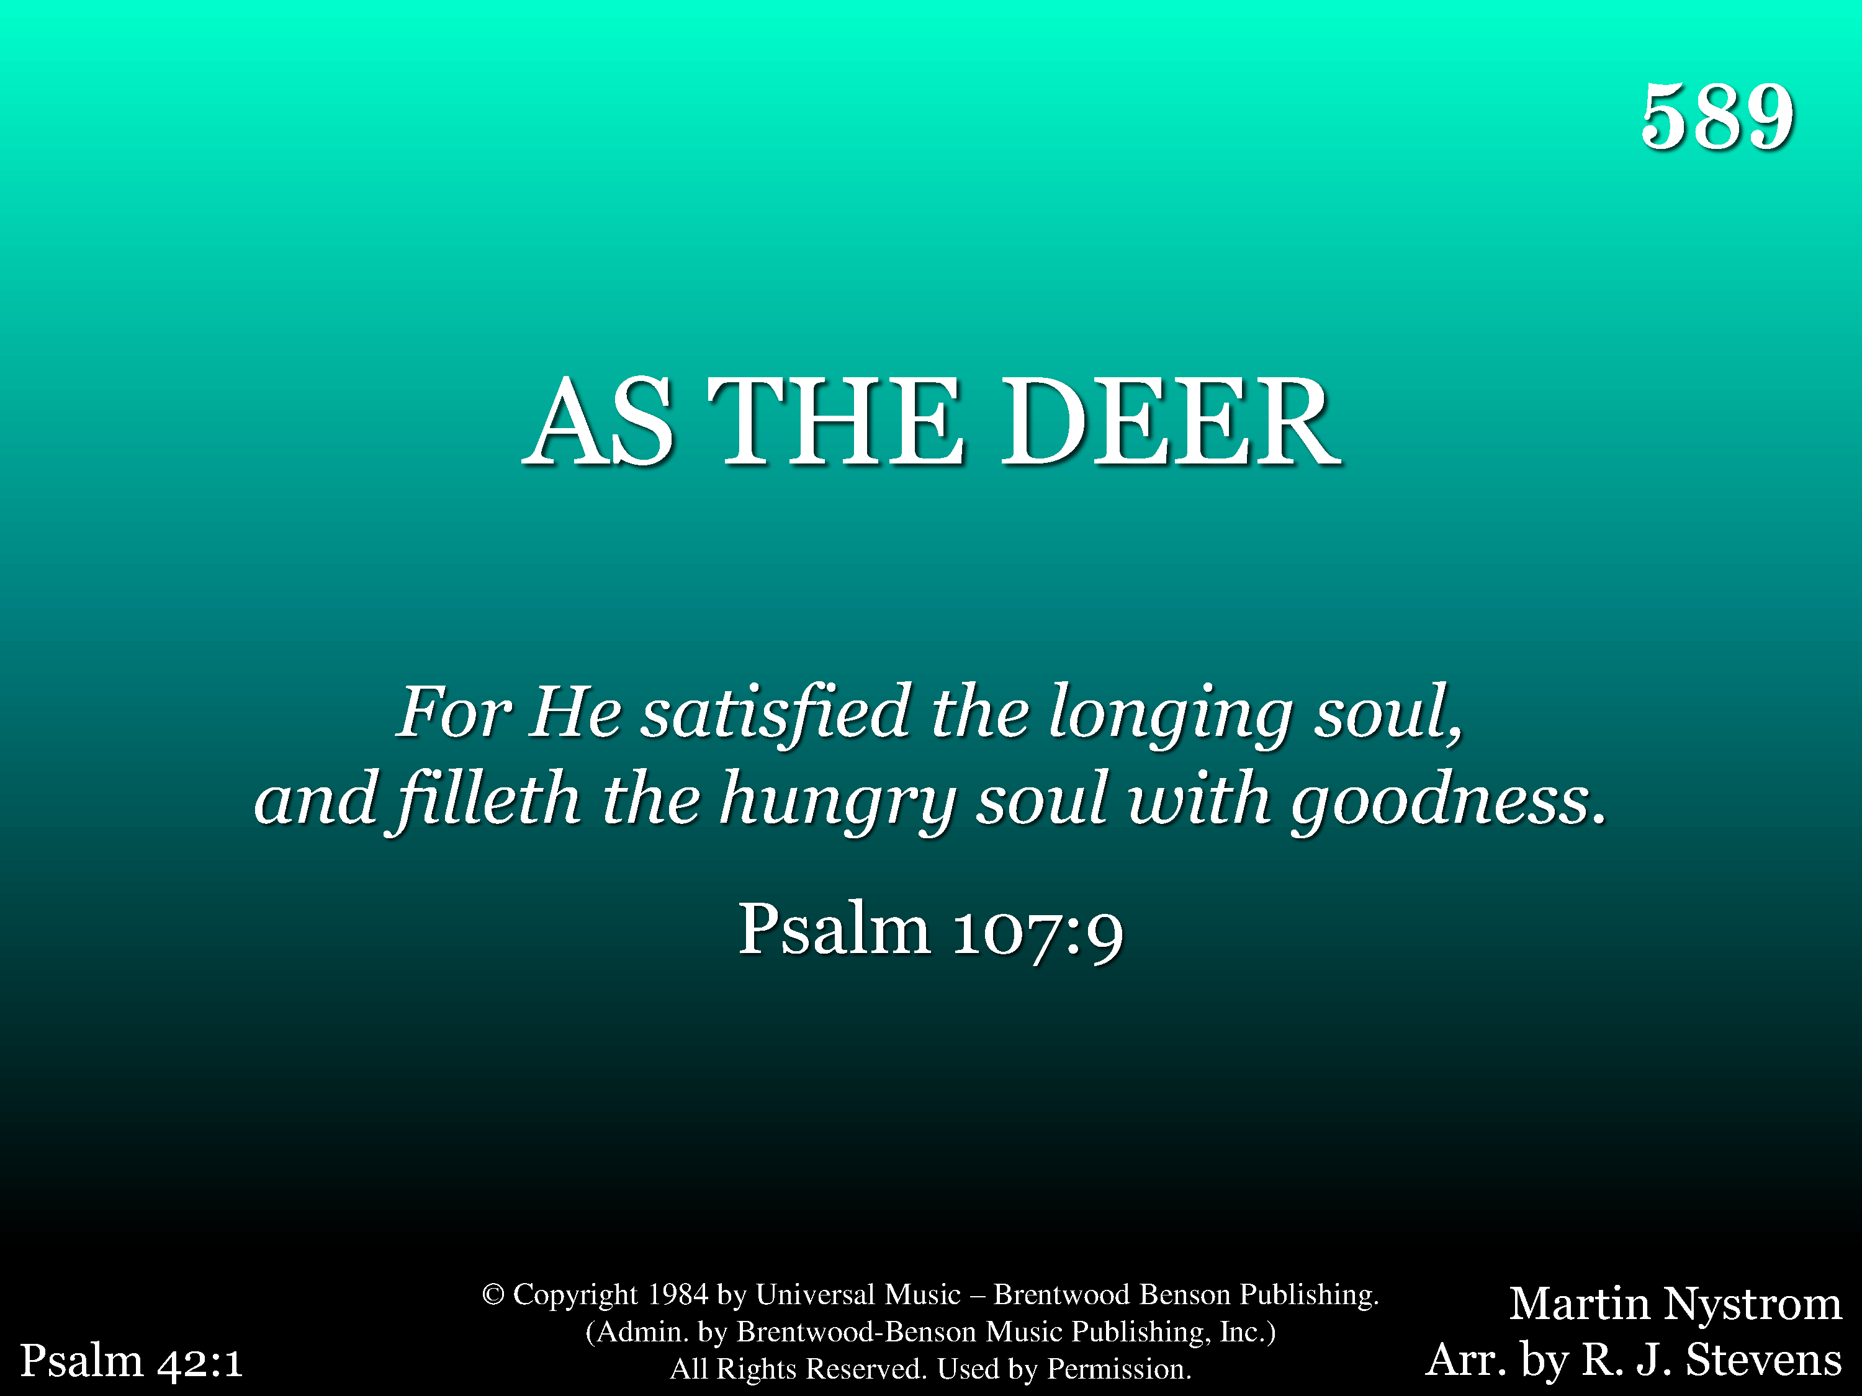
589 - As The Deer - Title

Slide 24
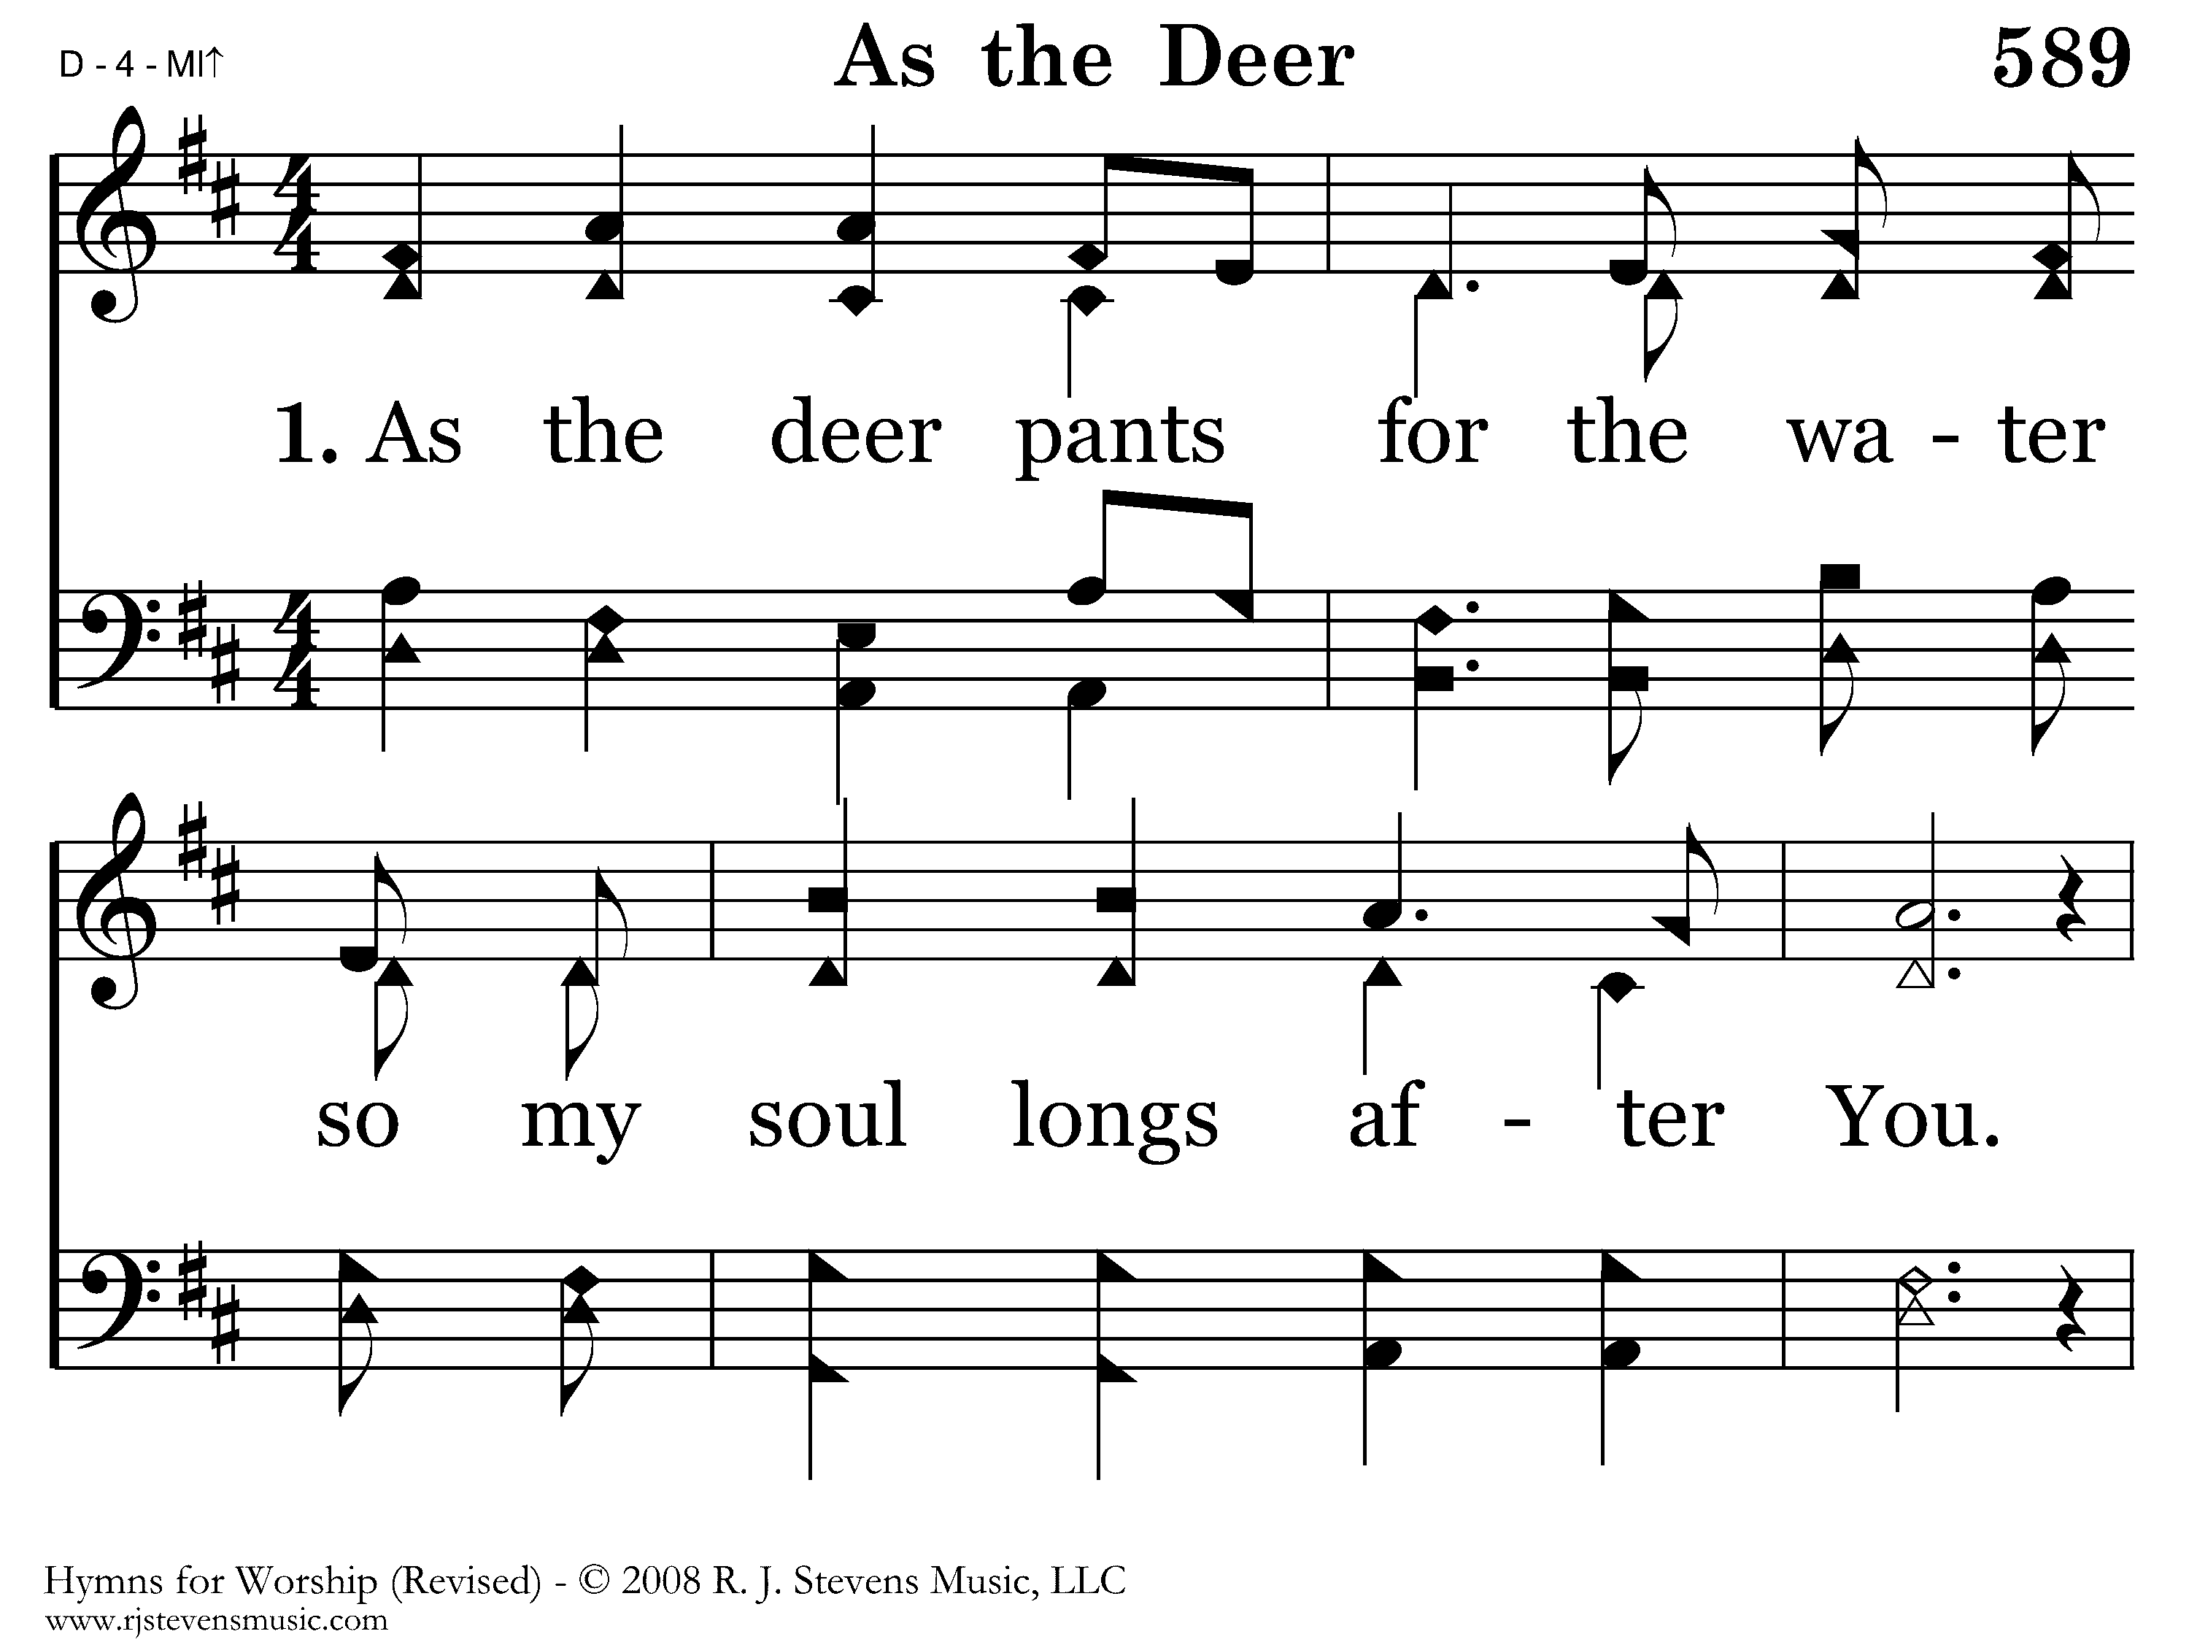
589 - As The Deer - 1.1

Slide 25
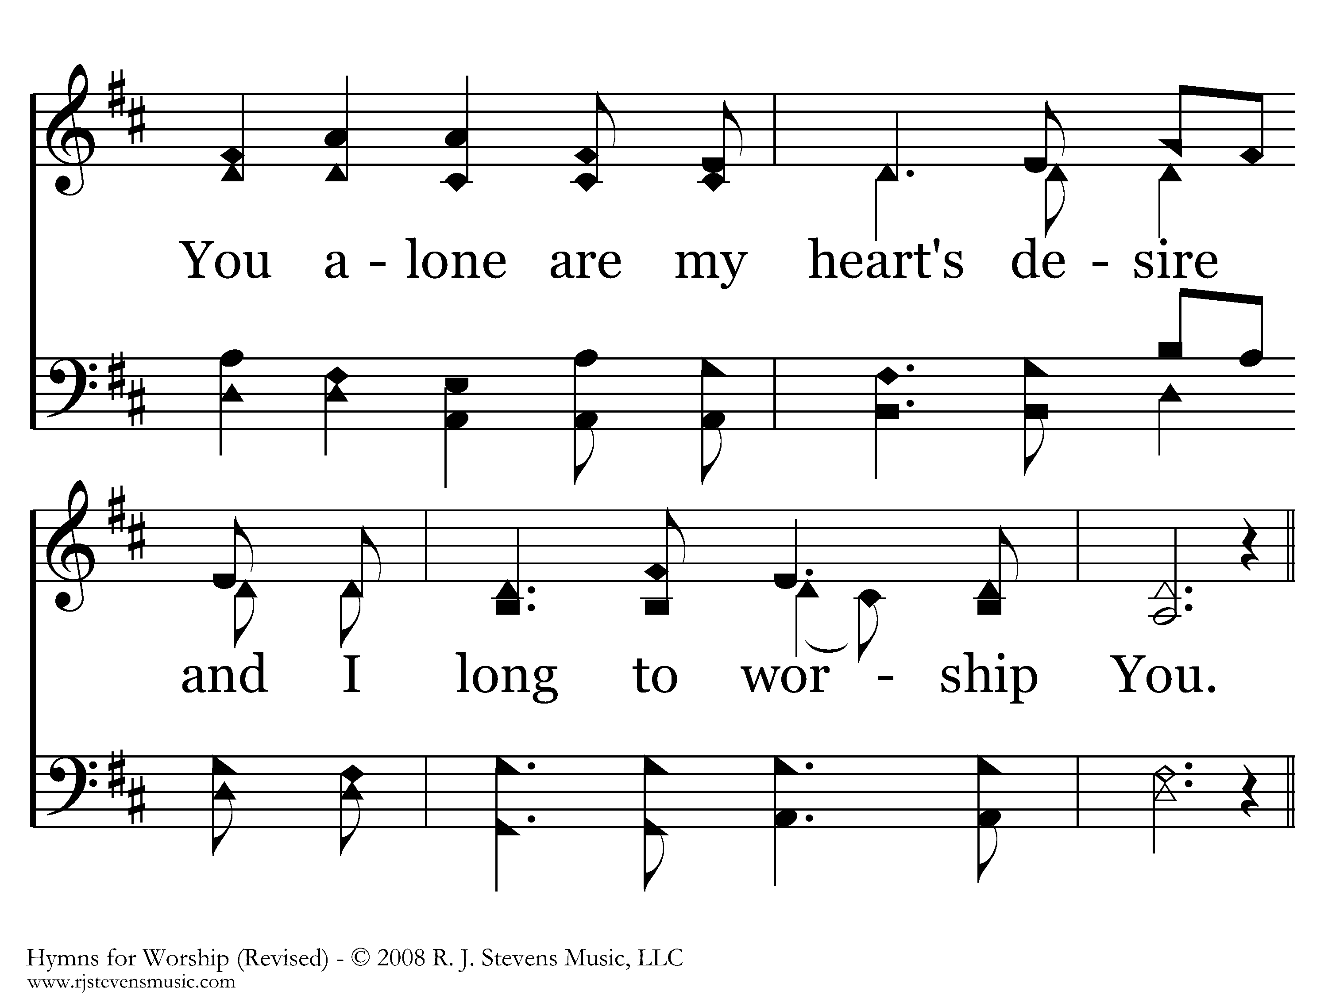
589 - As The Deer - 1.2

Slide 26
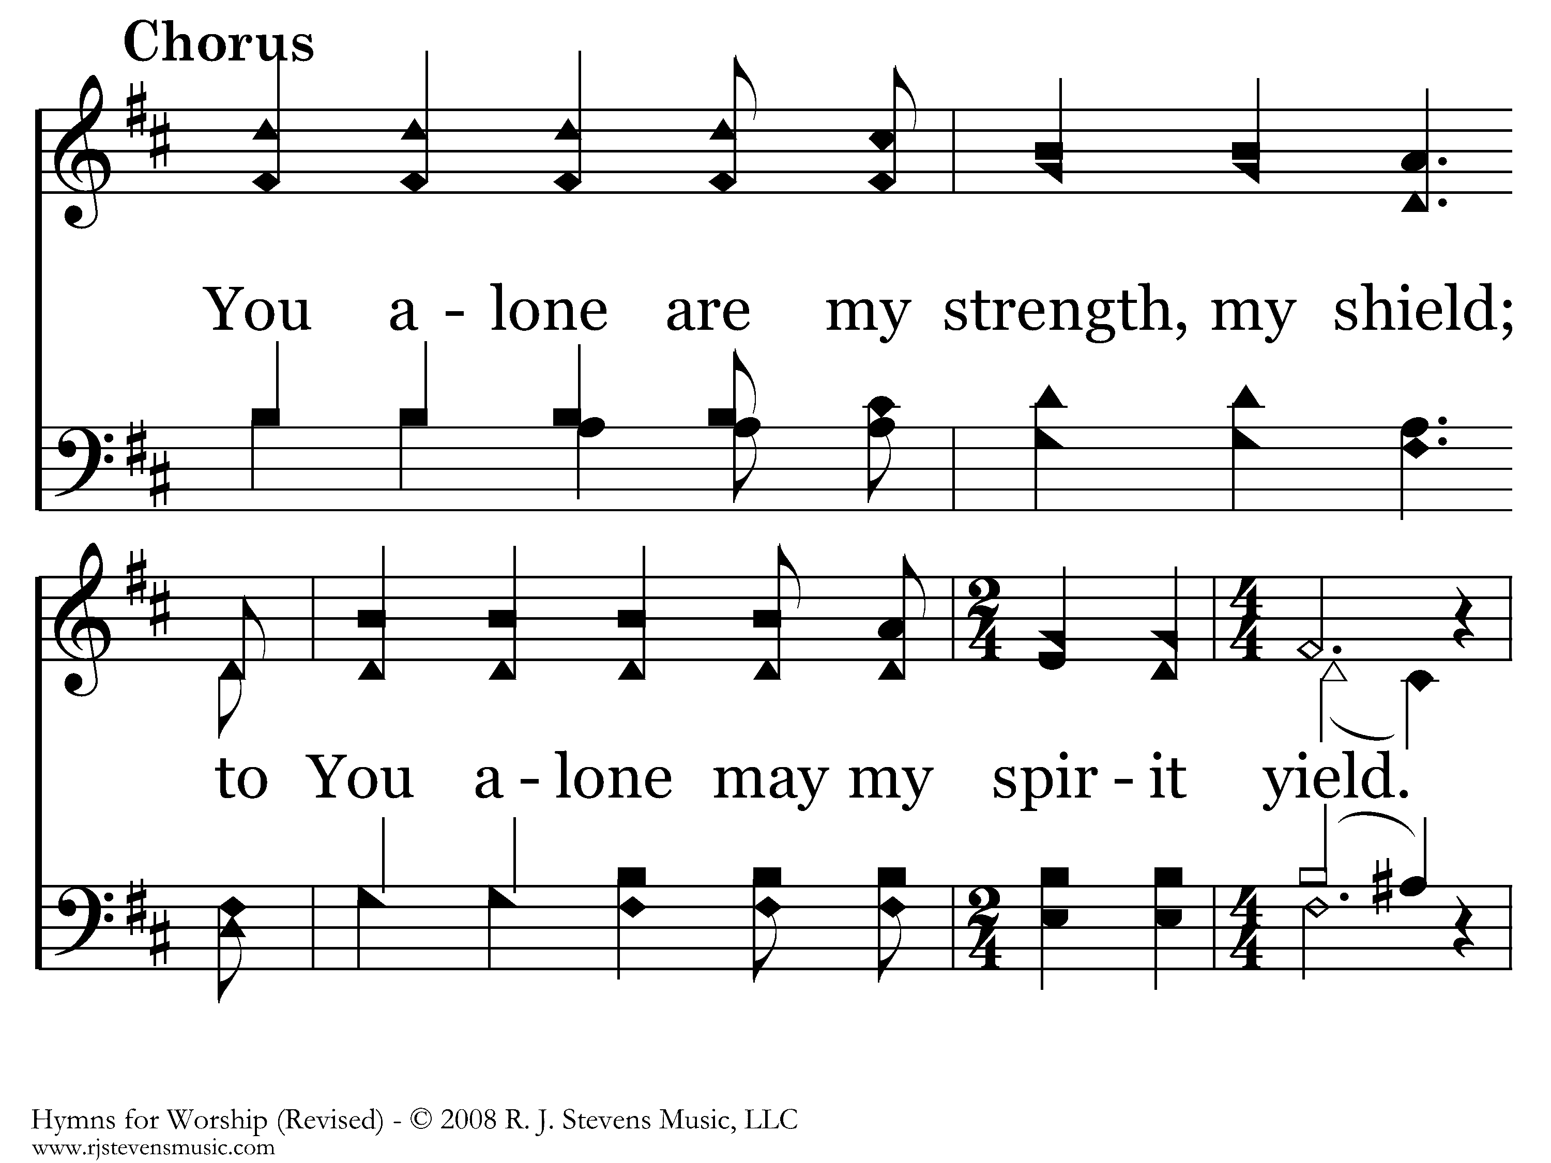
589 - As The Deer - C.1

Slide 27
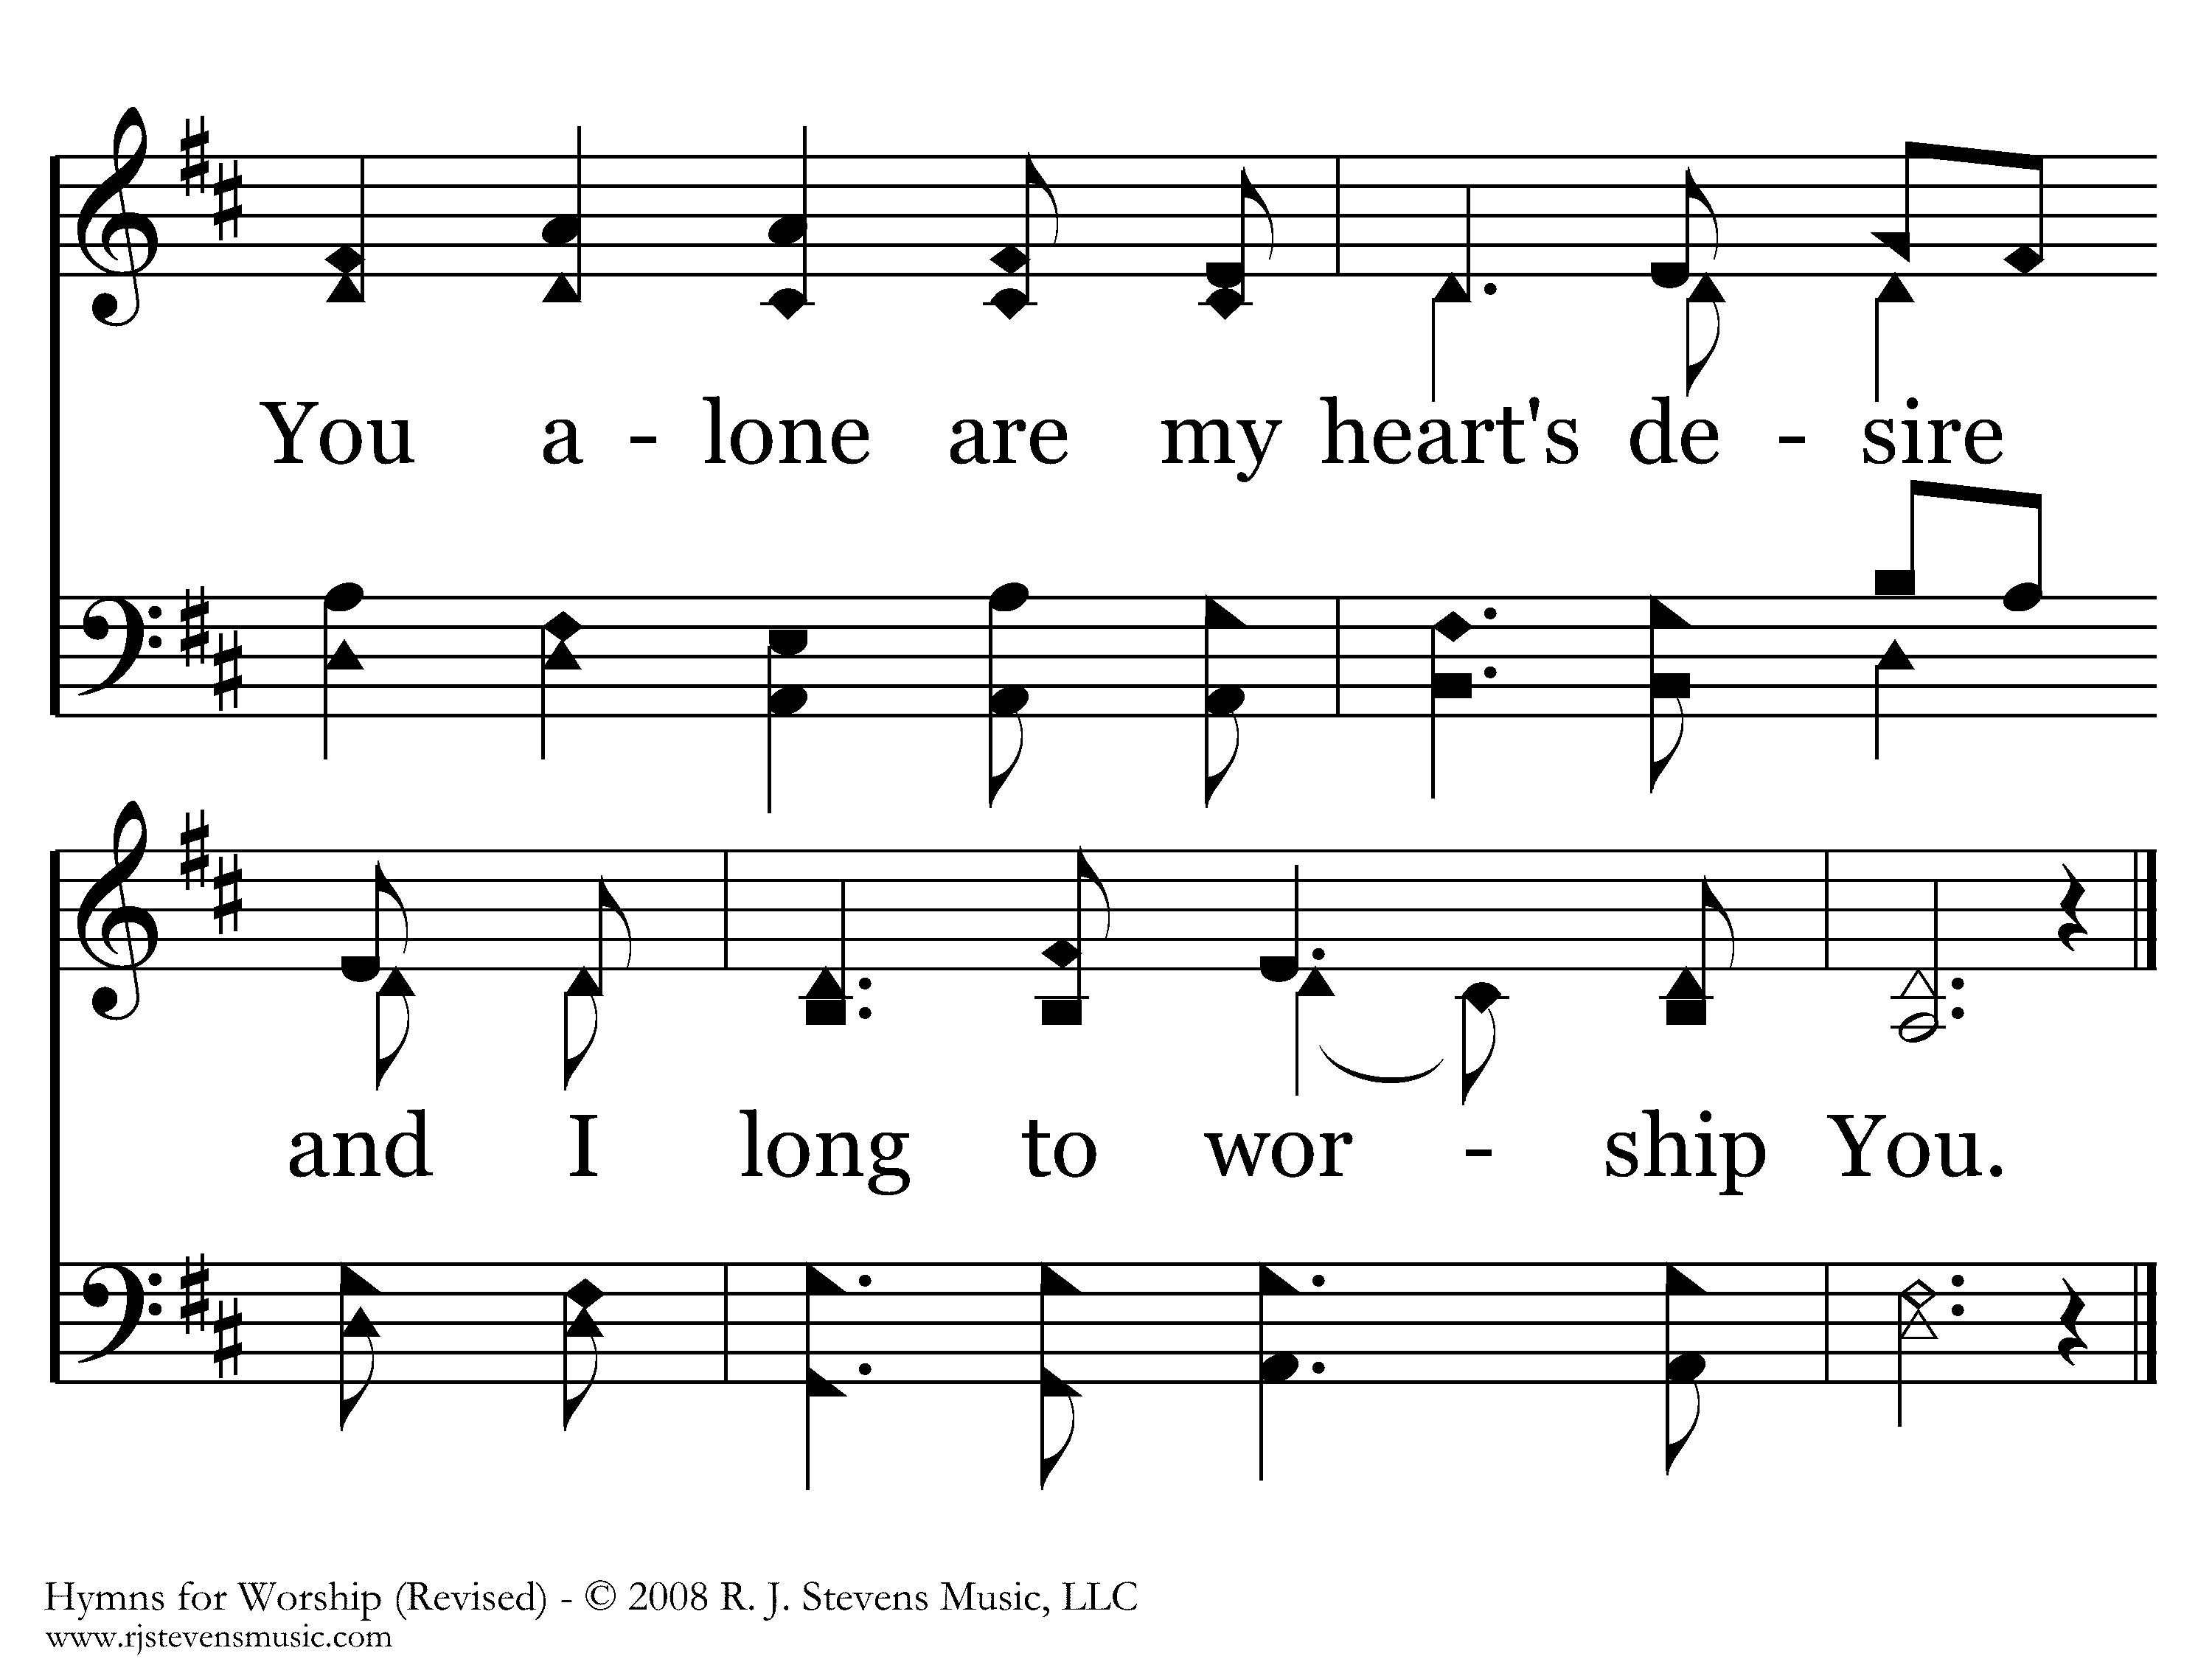
589 - As The Deer - C.2
End of Verse 1

Slide 28
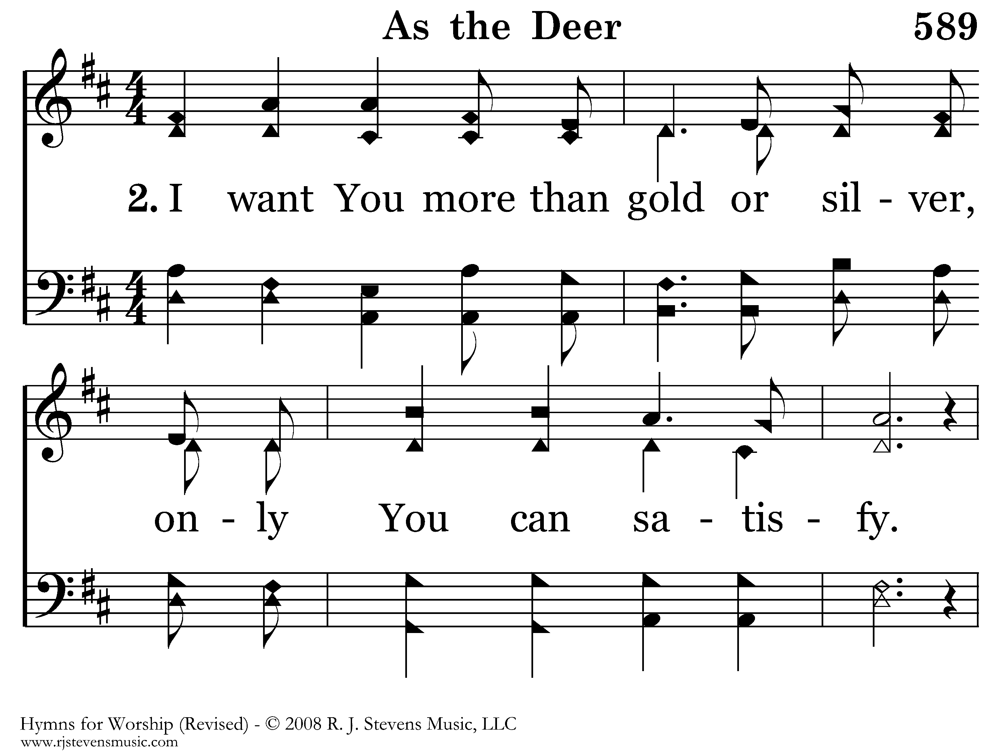
589 - As The Deer - 2.1

Slide 29
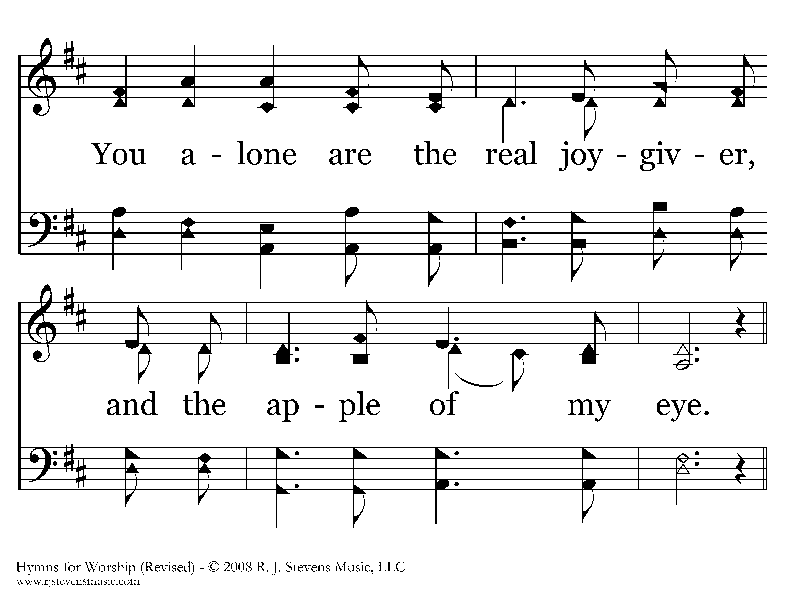
589 - As The Deer - 2.2

Slide 30
589 - As The Deer - C.1

Slide 31
589 - As The Deer - C.2
End of Song

Slide 32
Mark 10
³⁵ James and John, the two sons of Zebedee, came up to Jesus, saying, “Teacher, we want You to do for us whatever we ask of You.” ³⁶ And He said to them, “What do you want Me to do for you?” ³⁷ They said to Him, “Grant that we may sit, one on Your right and one on Your left, in Your glory.”

Slide 33
Mark 10
⁴² Calling them to Himself, Jesus said to them, “You know that those who are recognized as rulers of the Gentiles lord it over them; and their great men exercise authority over them.
⁴³ But it is not this way among you, but whoever wishes to become great among you shall be your servant; ⁴⁴ and whoever wishes to be first among you shall be slave of all.
⁴⁵ For even the Son of Man did not come to be served, but to serve, and to give His life a ransom for many.”
Julius Caesar
Cleopatra
Marc Antony and Octavian
Jesus is greater than them all
He demonstrated his power over
Weather
Disease
Physics
Space/Time
Death
Ephesians 1:19ff
…These are in accordance with the working of the strength of His might ²⁰ which He brought about in Christ, when He raised Him from the dead and seated Him at His right hand in the heavenly places, ²¹ far above all rule and authority and power and dominion, and every name that is named, not only in this age but also in the one to come.
Revelation 19:15f
¹⁵ From His mouth comes a sharp sword, so that with it He may strike down the nations, and He will rule them with a rod of iron; and He treads the wine press of the fierce wrath of God, the Almighty. ¹⁶ And on His robe and on His thigh He has a name written, “KING OF KINGS, AND LORD OF LORDS.”

Slide 34
Mark 10
⁴⁵ For even the Son of Man did not come to be served, but to serve, and to give His life a ransom for many.”

Slide 35
Mark 10
⁴⁵ For even the Son of Man did not come to be served, but to serve, and to give His life a ransom for many.”

Slide 36
Mark 10
⁴⁵ For even the Son of Man did not come to be served, but to serve, and to give His life a ransom for many.”
He demonstrated his power over
Weather
Disease
Physics
Space/Time
Death
Death
Notes:
Though greater than all the kings and emperors, he yielded his life to a governor who was pressured by a mob

Slide 37
Mark 10
⁴⁵ For even the Son of Man did not come to be served, but to serve, and to give His life a ransom in place of many.”
He demonstrated his power over
Weather
Disease
Physics
Space/Time
Death
Death
1 Peter 2:24
and He Himself bore our sins in His body on the cross, so that we might die to sin and live to righteousness; for by His wounds you were healed.

Slide 38
Mark 10
⁵ James and John, the two sons of Zebedee, came up to Jesus, saying, “Teacher, we want You to do for us whatever we ask of You.” ³⁶ And He said to them, “What do you want Me to do for you?” ³⁷ They said to Him, “Grant that we may sit, one on Your right and one on Your left, in Your glory.”
Ephesians 1:19ff
…These are in accordance with the working of the strength of His might ²⁰ which He brought about in Christ, when He raised Him from the dead and seated Him at His right hand in the heavenly places, ²¹ far above all rule and authority and power and dominion, and every name that is named, not only in this age but also in the one to come.
Ephesians 2:4ff
⁴ But God, being rich in mercy, because of His great love with which He loved us, ⁵ even when we were dead in our transgressions,
made us alive together with Christ (by grace you have been saved), ⁶ and raised us up with Him, and seated us with Him in the heavenly places in Christ Jesus,

Slide 39
Mark 10
⁵ James and John, the two sons of Zebedee, came up to Jesus, saying, “Teacher, we want You to do for us whatever we ask of You.” ³⁶ And He said to them, “What do you want Me to do for you?” ³⁷ They said to Him, “Grant that we may sit, one on Your right and one on Your left, in Your glory.”
Ephesians 1:19ff
…These are in accordance with the working of the strength of His might ²⁰ which He brought about in Christ, when He raised Him from the dead and seated Him at His right hand in the heavenly places, ²¹ far above all rule and authority and power and dominion, and every name that is named, not only in this age but also in the one to come.
Ephesians 2:4ff
⁴ But God, being rich in mercy, because of His great love with which He loved us, ⁵ even when we were dead in our transgressions,
made us alive together with Christ (by grace you have been saved), ⁶ and raised us up with Him, and seated us with Him in the heavenly places in Christ Jesus

Slide 40
2 Timothy 2:11-12
¹¹ It is a trustworthy statement:
For if we died with Him, we will also live with Him;
¹² If we endure, we will also reign with Him
Romans 8:16-17
¹⁶ The Spirit Himself testifies with our spirit that we are children of God, ¹⁷and if children, heirs also, heirs of God and fellow heirs with Christ, if indeed we suffer with Him so that we may also be glorified with Him.

Slide 41
Prayer

Slide 42
Exhortation
Marty Lewis

Slide 43
The Rock of My Heart
29
Hymn: M. W. Bassford (2000); based on Psalm 73:2, 21-28
Tune: Glenda B. Schales (2000)
© 2000 Lynn and Janet Wall

Slide 44
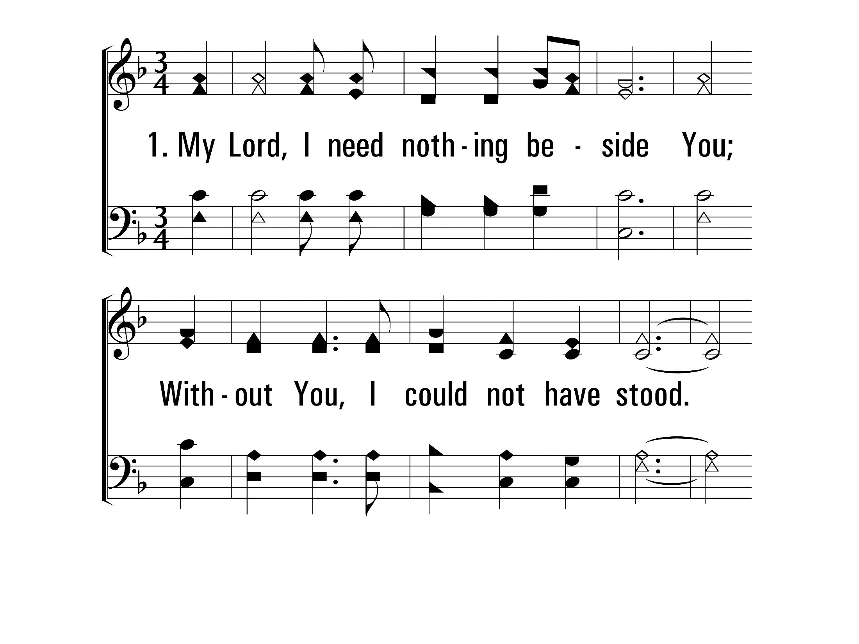
TheRockOfMyHeart_st1_a
Vs 1
© 2014 Sumphonia Productions, LLC

Slide 45
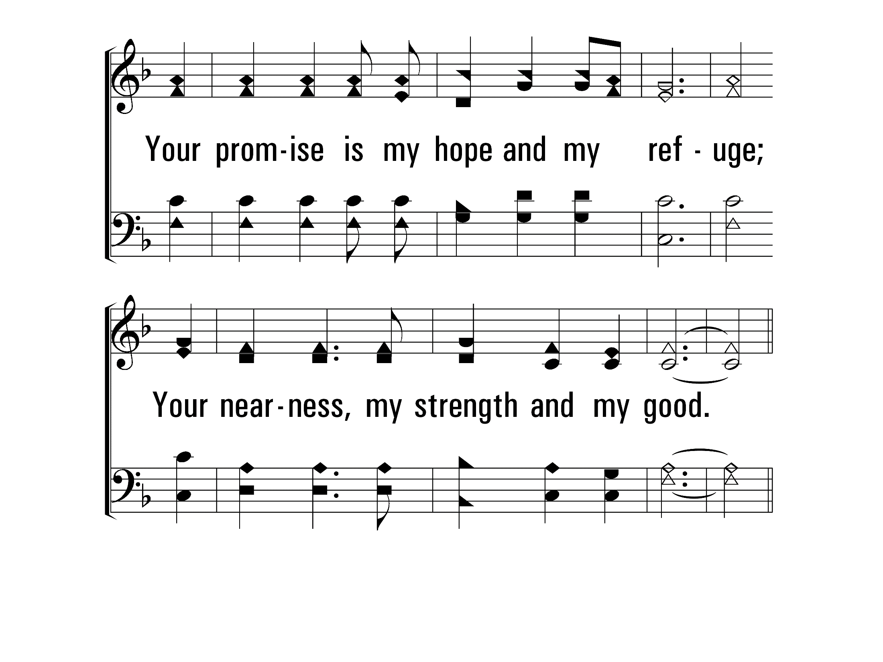
TheRockOfMyHeart_st1_b
Vs 1
© 2014 Sumphonia Productions, LLC

Slide 46
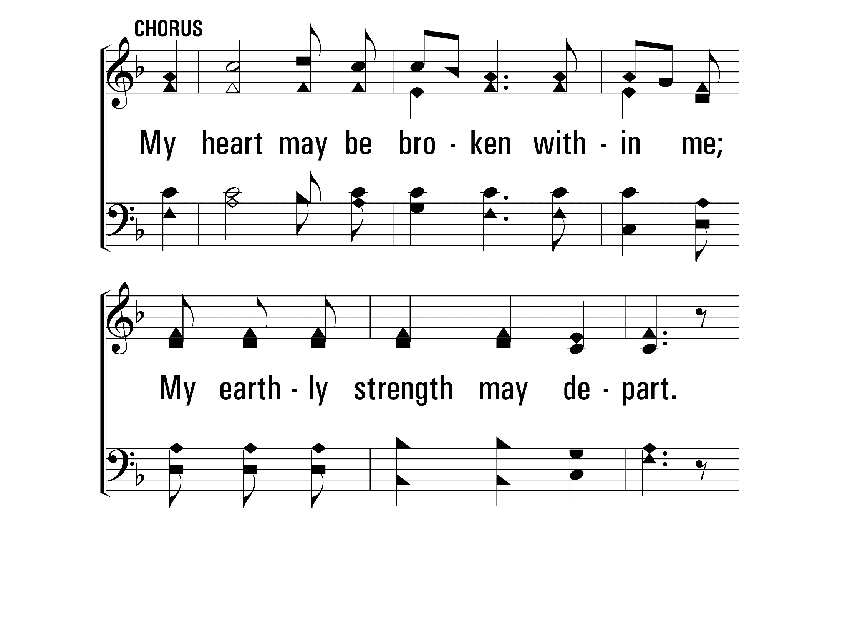
TheRockOfMyHeart_cho_a
Chorus
© 2014 Sumphonia Productions, LLC

Slide 47
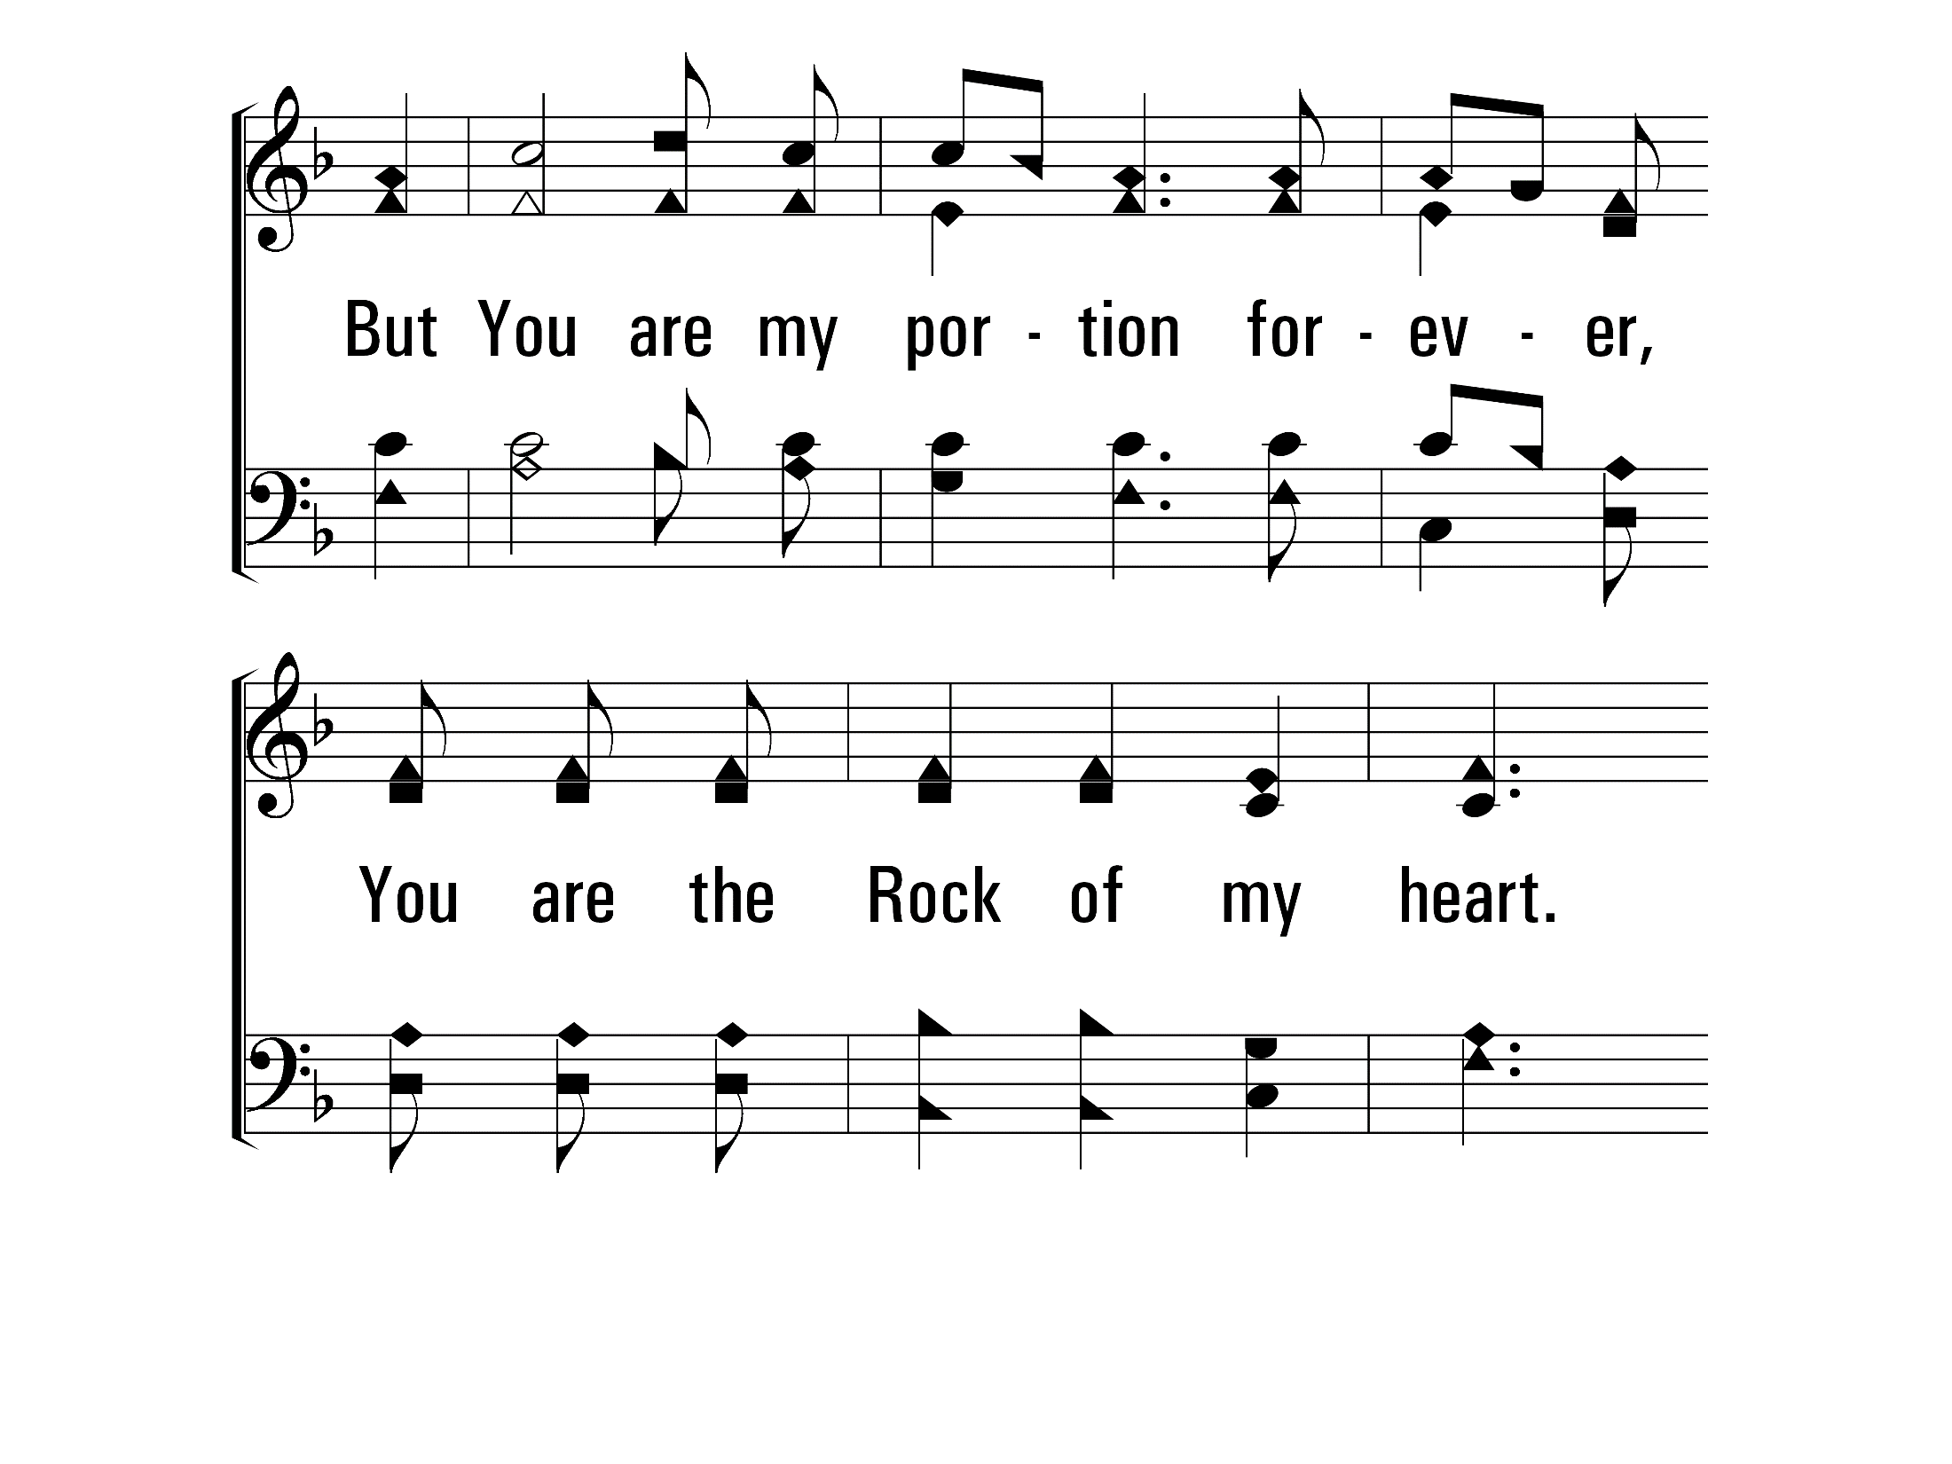
TheRockOfMyHeart_cho_b
Chorus
© 2014 Sumphonia Productions, LLC

Slide 48
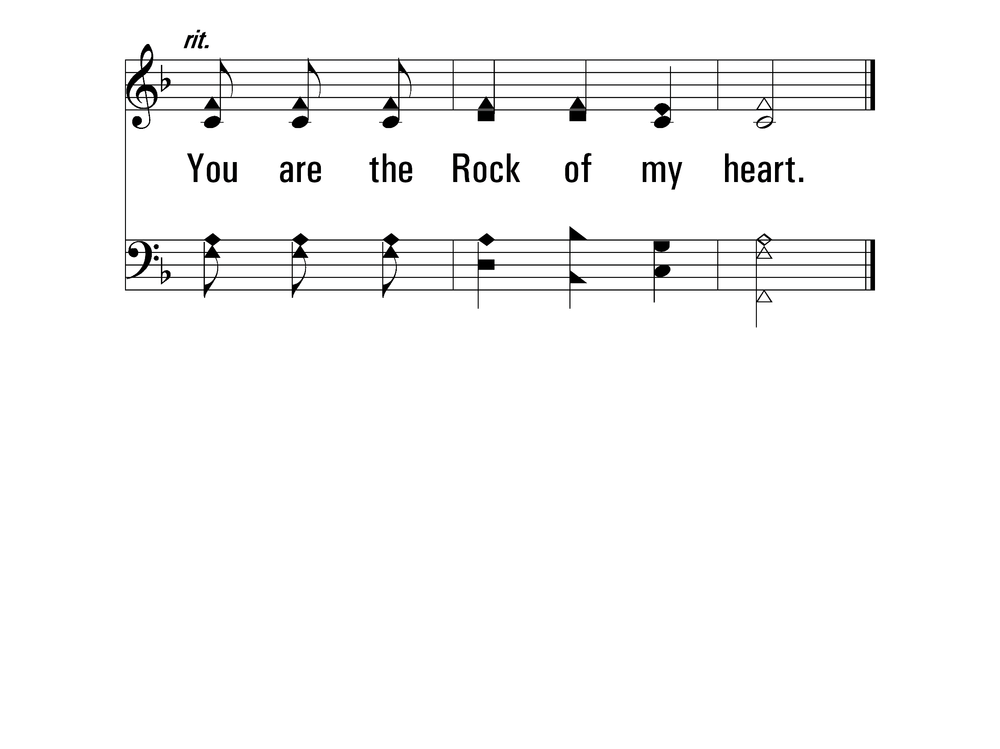
TheRockOfMyHeart_cho_c
Chorus
© 2014 Sumphonia Productions, LLC

Slide 49
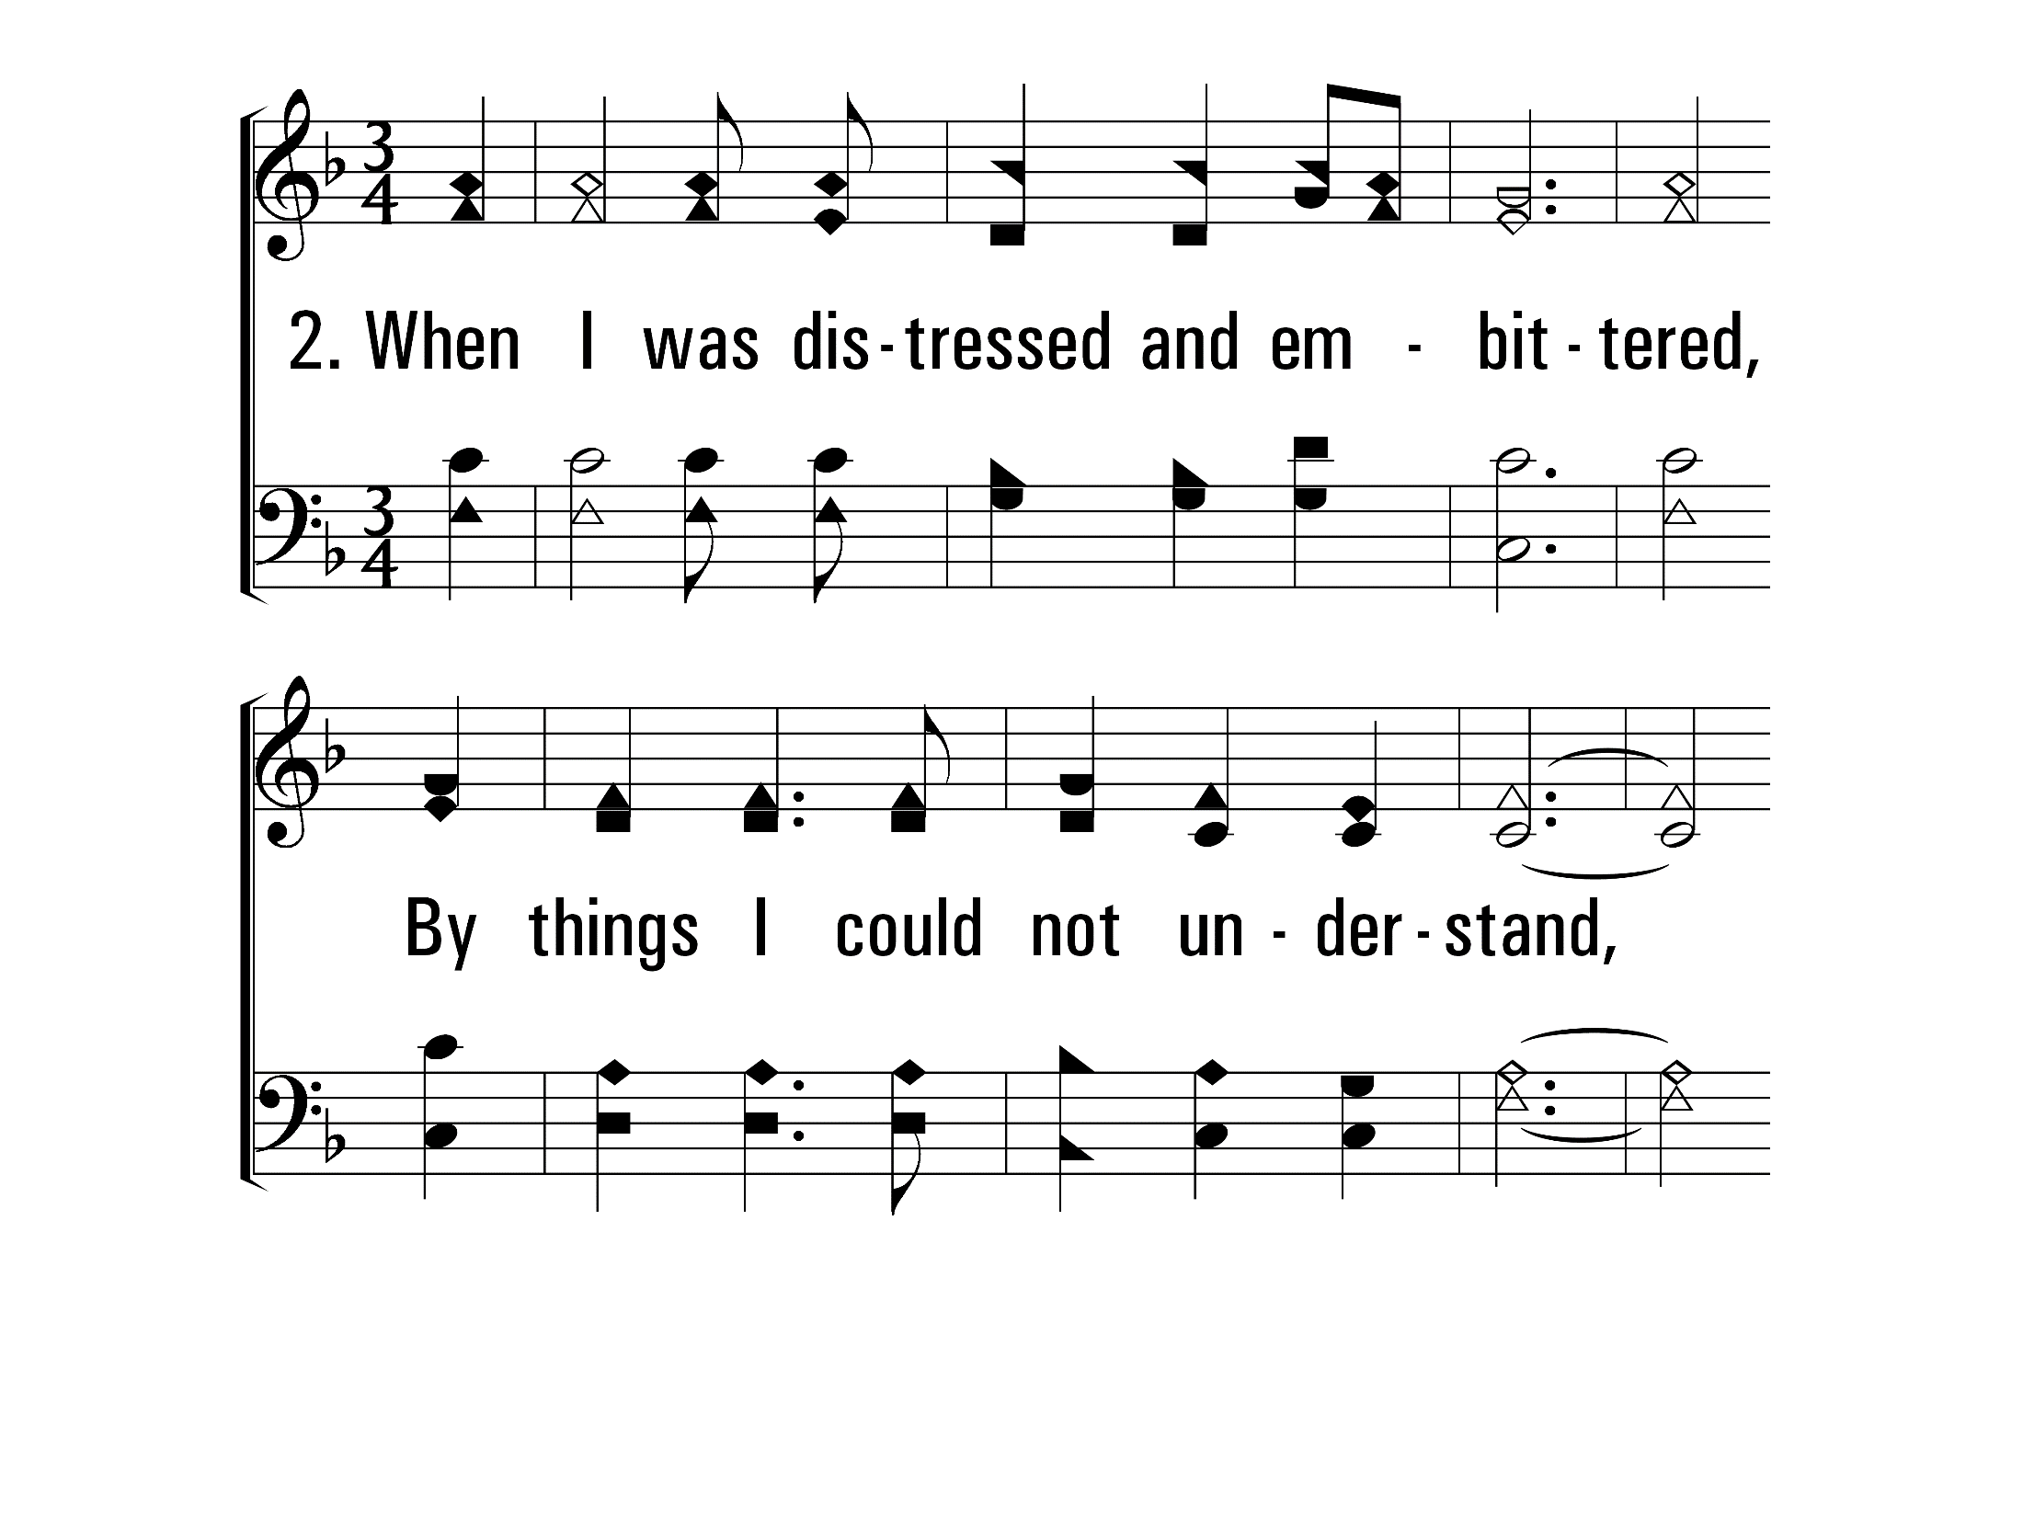
TheRockOfMyHeart_st2_a
Vs 2
© 2014 Sumphonia Productions, LLC

Slide 50
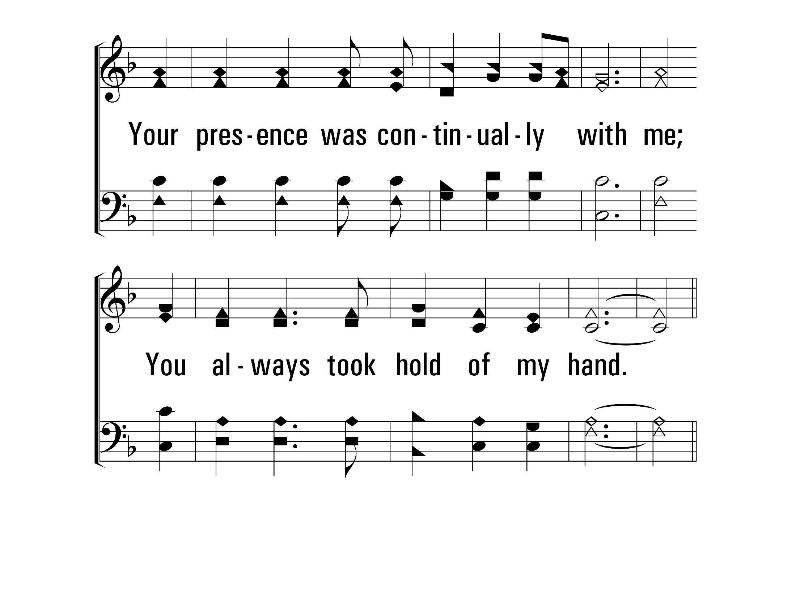
TheRockOfMyHeart_st2_b
Vs 2
© 2014 Sumphonia Productions, LLC

Slide 51
TheRockOfMyHeart_cho_a
Chorus
© 2014 Sumphonia Productions, LLC

Slide 52
TheRockOfMyHeart_cho_b
Chorus
© 2014 Sumphonia Productions, LLC

Slide 53
TheRockOfMyHeart_cho_c
Chorus
© 2014 Sumphonia Productions, LLC

Slide 54
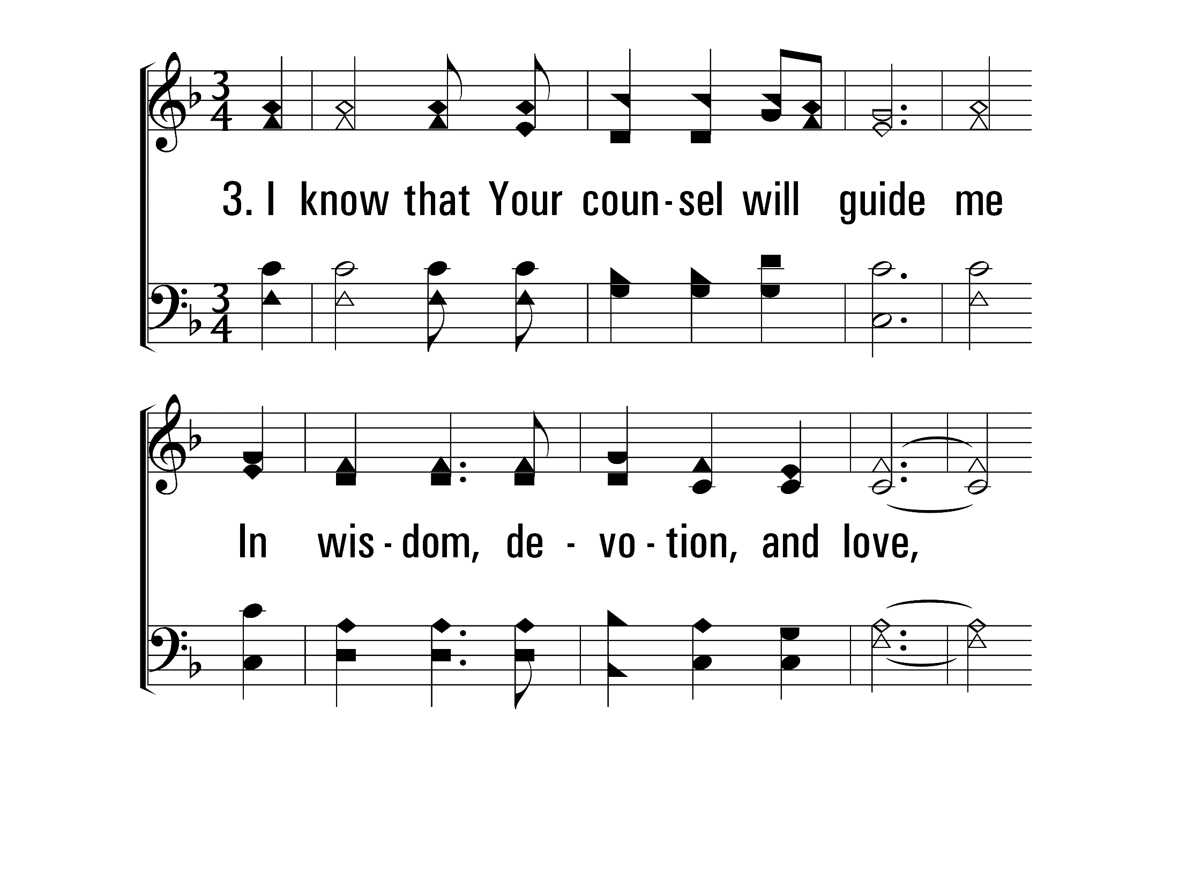
TheRockOfMyHeart_st3_a
Vs 3
© 2014 Sumphonia Productions, LLC

Slide 55
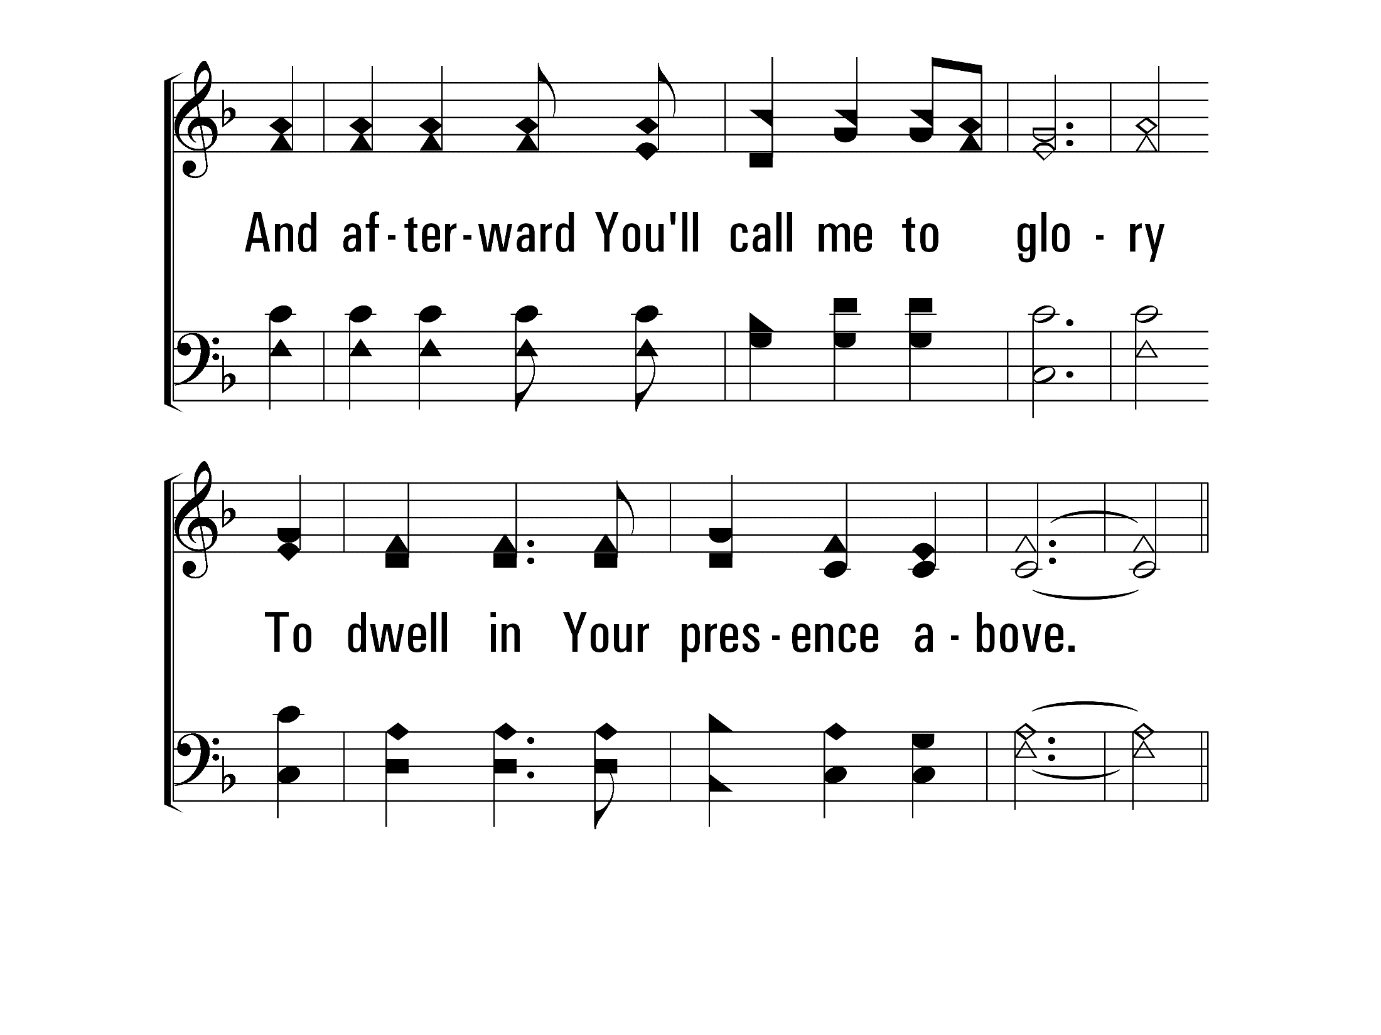
TheRockOfMyHeart_st3_b
Vs 3
© 2014 Sumphonia Productions, LLC

Slide 56
TheRockOfMyHeart_cho_a
Chorus
© 2014 Sumphonia Productions, LLC

Slide 57
TheRockOfMyHeart_cho_b
Chorus
© 2014 Sumphonia Productions, LLC

Slide 58
TheRockOfMyHeart_cho_c
Chorus
© 2014 Sumphonia Productions, LLC
End

