Slide 1
What to do about things said
in the book of Revelation

Slide 2
1 The Revelation of Jesus Christ, which God gave Him to show to His bond-servants, the things which must soon take place; and He sent and communicated it by His angel to His bond-servant John, ² who testified to the word of God and to the testimony of Jesus Christ, even to all that he saw. ³ Blessed is he who reads and those who hear the words of the prophecy, and heed the things which are written in it; for the time is near.

Slide 3
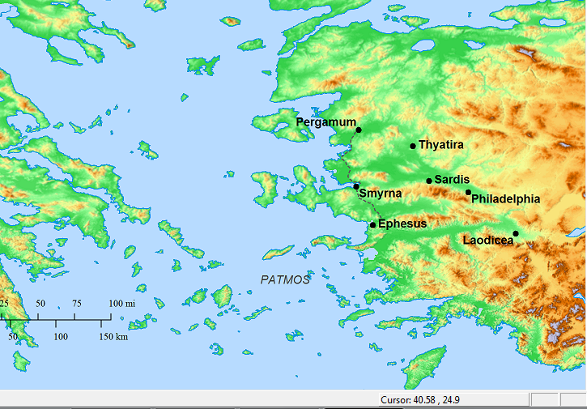
Tribulation
Not some tribulation off in the distant future, e.g., in 2020
⁹ I, John, your brother and fellow partaker in the tribulation and kingdom and perseverance which are in Jesus, was on the island called Patmos because of the word of God and the testimony of Jesus.
¹⁰ I was in the Spirit on the Lord’s day, and I heard behind me a loud voice like the sound of a trumpet, ¹¹ saying, “Write in a book what you see, and send it to the seven churches: to Ephesus and to Smyrna and to Pergamum and to Thyatira and to Sardis and to Philadelphia and to Laodicea.”

Slide 4
¹³ …you hold fast My name, and did not deny My faith even in the days of Antipas, My witness, My faithful one, who was killed among you,
¹⁰ Because you have kept the word of My perseverance, I also will keep you from the hour of testing, that hour which is about to come upon the whole world, to test those who dwell on the earth. ¹¹ I am coming quickly
⁹ ‘I know your tribulation….
¹⁰ Do not fear what you are about to suffer. Behold, the devil is about to cast some of you into prison, so that you will be tested, and you will have tribulation for ten days.
⁹ I, John, your brother and fellow partaker in the tribulation

Slide 5
¹³ …you hold fast My name, and did not deny My faith...
¹⁴ But I have a few things against you, because you have there some who hold the teaching of Balaam…
¹⁵ So you also have some who in the same way hold the teaching of the Nicolaitans. ¹⁶ Therefore repent…
²⁰ But I have this against you, that you tolerate the woman Jezebel, who calls herself a prophetess, and she teaches and leads My bond-servants astray so that they commit acts of immorality and eat things sacrificed to idols…
²⁴ But I say to you, the rest who are in Thyatira, who do not hold this teaching… ²⁵ … hold fast until I come.
³ So remember what you have received and heard; and keep it, and repent.
Be faithful until death, and I will give you the crown of life.
¹⁰ Because you have kept the word of My perseverance, I also will keep you from the hour of testing
you have perseverance and have endured for My name’s sake and have not grown weary. ⁴ But I have this against you, that you have left your first love. ⁵ Therefore remember from where you have fallen, and repent…
¹⁸ I advise you to buy from Me gold refined by fire so that you may become rich
⁹ I, John, your brother and fellow partaker in the tribulation and kingdom and perseverance which are in Jesus

Slide 6
To him who overcomes, to him I will give some of the hidden manna…
He who overcomes, and he who keeps My deeds until the end, to him I will give authority over the nations
He who overcomes will thus be clothed in white garments
He who overcomes will not be hurt by the second death.
He who overcomes, I will make him a pillar in the temple of My God
To him who overcomes, I will grant to eat of the tree of life which is in the Paradise of God.
He who overcomes, I will grant to him to sit down with Me on My throne

Slide 7
¹⁹ Therefore write the things which you have seen, and the things which are, and the things which will take place after these things.

Slide 8
¹⁹ Therefore write the things which you have seen, and the things which are, and the things which will take place after these things.

Slide 9
John sees the Lord
Messages to the 7 churches
1
¹⁹ Therefore write the things which you have seen, and the things which are, and the things which will take place after these things.
4:1 After these things I looked, and behold, a door standing open in heaven, and the first voice which I had heard, like the sound of a trumpet speaking with me, said, “Come up here, and I will show you what must take place after these things.”
2-3
the things which are
the things which will take place after these things.
4-22
“things which must soon take place“
“the time is near.”

Slide 10
John sees the Lord
Messages to the 7 churches

Slide 11
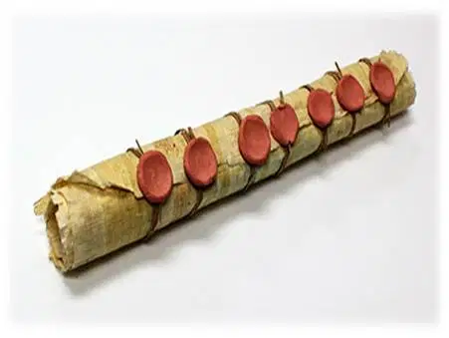
1
2-3
4-11
12-19
John sees the Lord
Messages to the 7 churches
4 God on his throne
5 The scroll, the lamb is worthy to open it
7-11
VICTORY!

Slide 12
1
2-3
4-11
12-19
John sees the Lord
Messages to the 7 churches
4 God on his throne
5 The scroll, the lamb is worthy to open it
Judgment upon the Roman Empire using imagery from Daniel 7
7-11
the souls of those who had been slain because of the word of God, and because of the testimony which they had maintained
VICTORY!

Slide 13
1
2-3
4-11
12-19
John sees the Lord
Messages to the 7 churches
4 God on his throne
5 The scroll, the lamb is worthy to open it
Judgment upon the Roman Empire using imagery from Daniel 7
7-11
and they cried out with a loud voice, saying…

Slide 14
1
2-3
4-11
12-19
John sees the Lord
Messages to the 7 churches
4 God on his throne
5 The scroll, the lamb is worthy to open it
Judgment upon the Roman Empire using imagery from Daniel 7
7-11
“How long, O Lord, holy and true, will You refrain from judging and avenging our blood on those who dwell on the earth?”

Slide 15
1
2-3
4-11
12-19
John sees the Lord
Messages to the 7 churches
4 God on his throne
5 The scroll, the lamb is worthy to open it
Judgment upon the Roman Empire using imagery from Daniel 7
7-11
there will be delay no longer

Slide 16
6:5-6 I looked, and behold, a black horse; and he who sat on it had a pair of scales in his hand. And I heard something like a voice in the center of the four living creatures saying, “A quart of wheat for a denarius, and three quarts of barley for a denarius
6:12 I looked when He broke the sixth seal, and there was a great earthquake; and the sun became black as sackcloth made of hair, and the whole moon became like blood
6:15 Then the kings of the earth and the great men and the commanders and the rich and the strong and every slave and free man hid themselves in the caves
8:8 something like a great mountain burning with fire was thrown into the sea
9:7 The appearance of the locusts was like horses prepared for battle

Slide 17
If we could identify a particular disaster as something that was predicted in the Bible, what should we do about it?
If the 7 churches could have identified a particular disaster as something mentioned in Revelation what were they to do about it?
“persevere”
“Be faithful unto death”
“overcome”
The point wasn’t to match up current events with things described Revelation
The point was, “overcome,” “persevere”!
And the point wasn’t to say to the unbelievers, “See I told you so”
So what should we do? Overcome
Overcome!

Slide 18
1 Thessalonians 5 ¹ Now as to the times and the epochs, brethren, you have no need of anything to be written to you. ² For you yourselves know full well that the day of the Lord will come just like a thief in the night. ³ While they are saying, “Peace and safety!” then destruction will come upon them suddenly like labor pains upon a woman with child, and they will not escape. ⁴ But you, brethren, are not in darkness, that the day would overtake you like a thief; ⁵ for you are all sons of light and sons of day. We are not of night nor of darkness; ⁶ so then let us not sleep as others do, but let us be alert and sober. ⁷ For those who sleep do their sleeping at night, and those who get drunk get drunk at night. ⁸ But since we are of the day, let us be sober, having put on the breastplate of faith and love, and as a helmet, the hope of salvation. ⁹ For God has not destined us for wrath, but for obtaining salvation through our Lord Jesus Christ, ¹⁰ who died for us, so that whether we are awake or asleep, we will live together with Him. ¹¹ Therefore encourage one another and build up one another, just as you also are doing.

