Slide 1
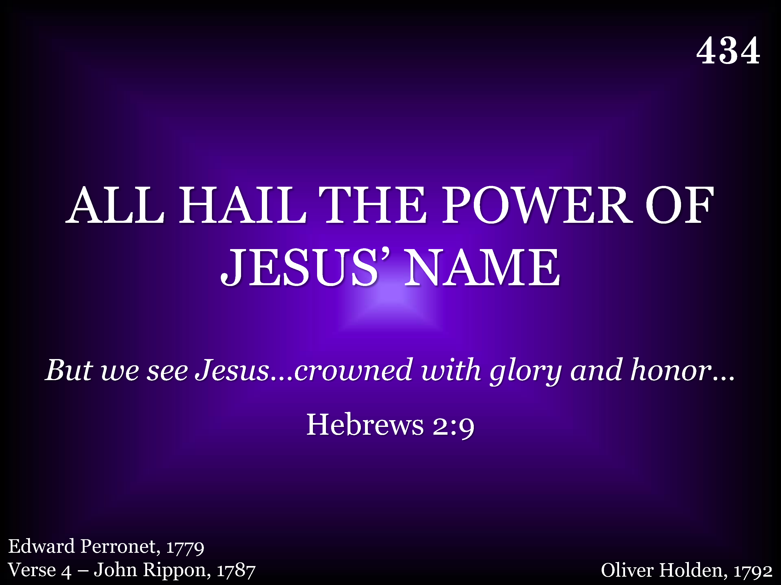
434 - All Hail The Power Of Jesus' Name - Title

Slide 2
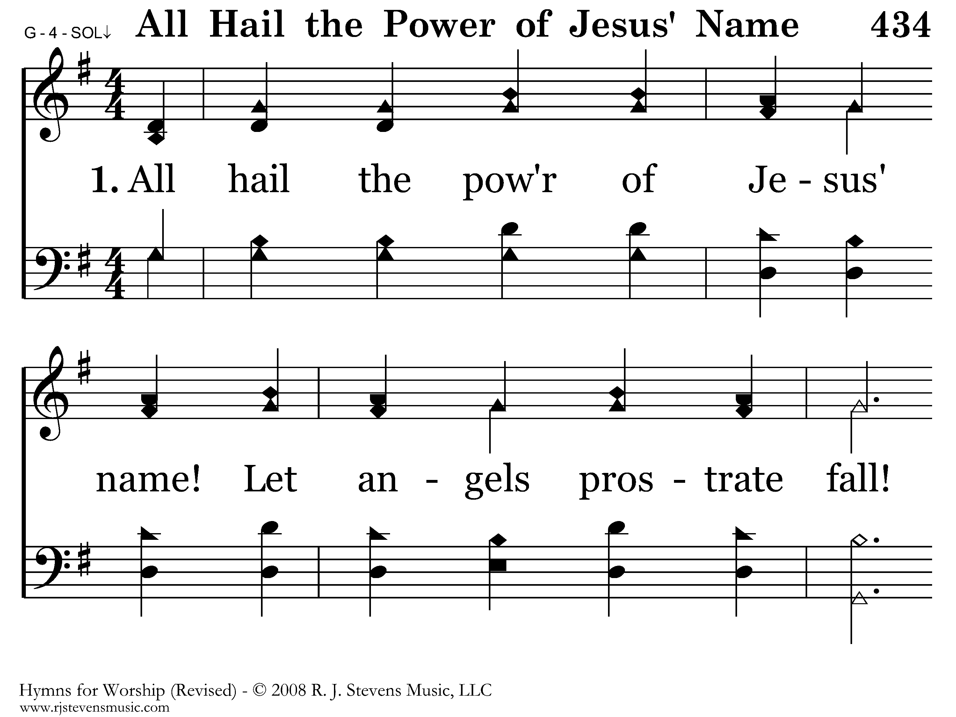
434 - All Hail The Power Of Jesus' Name - 1.1

Slide 3
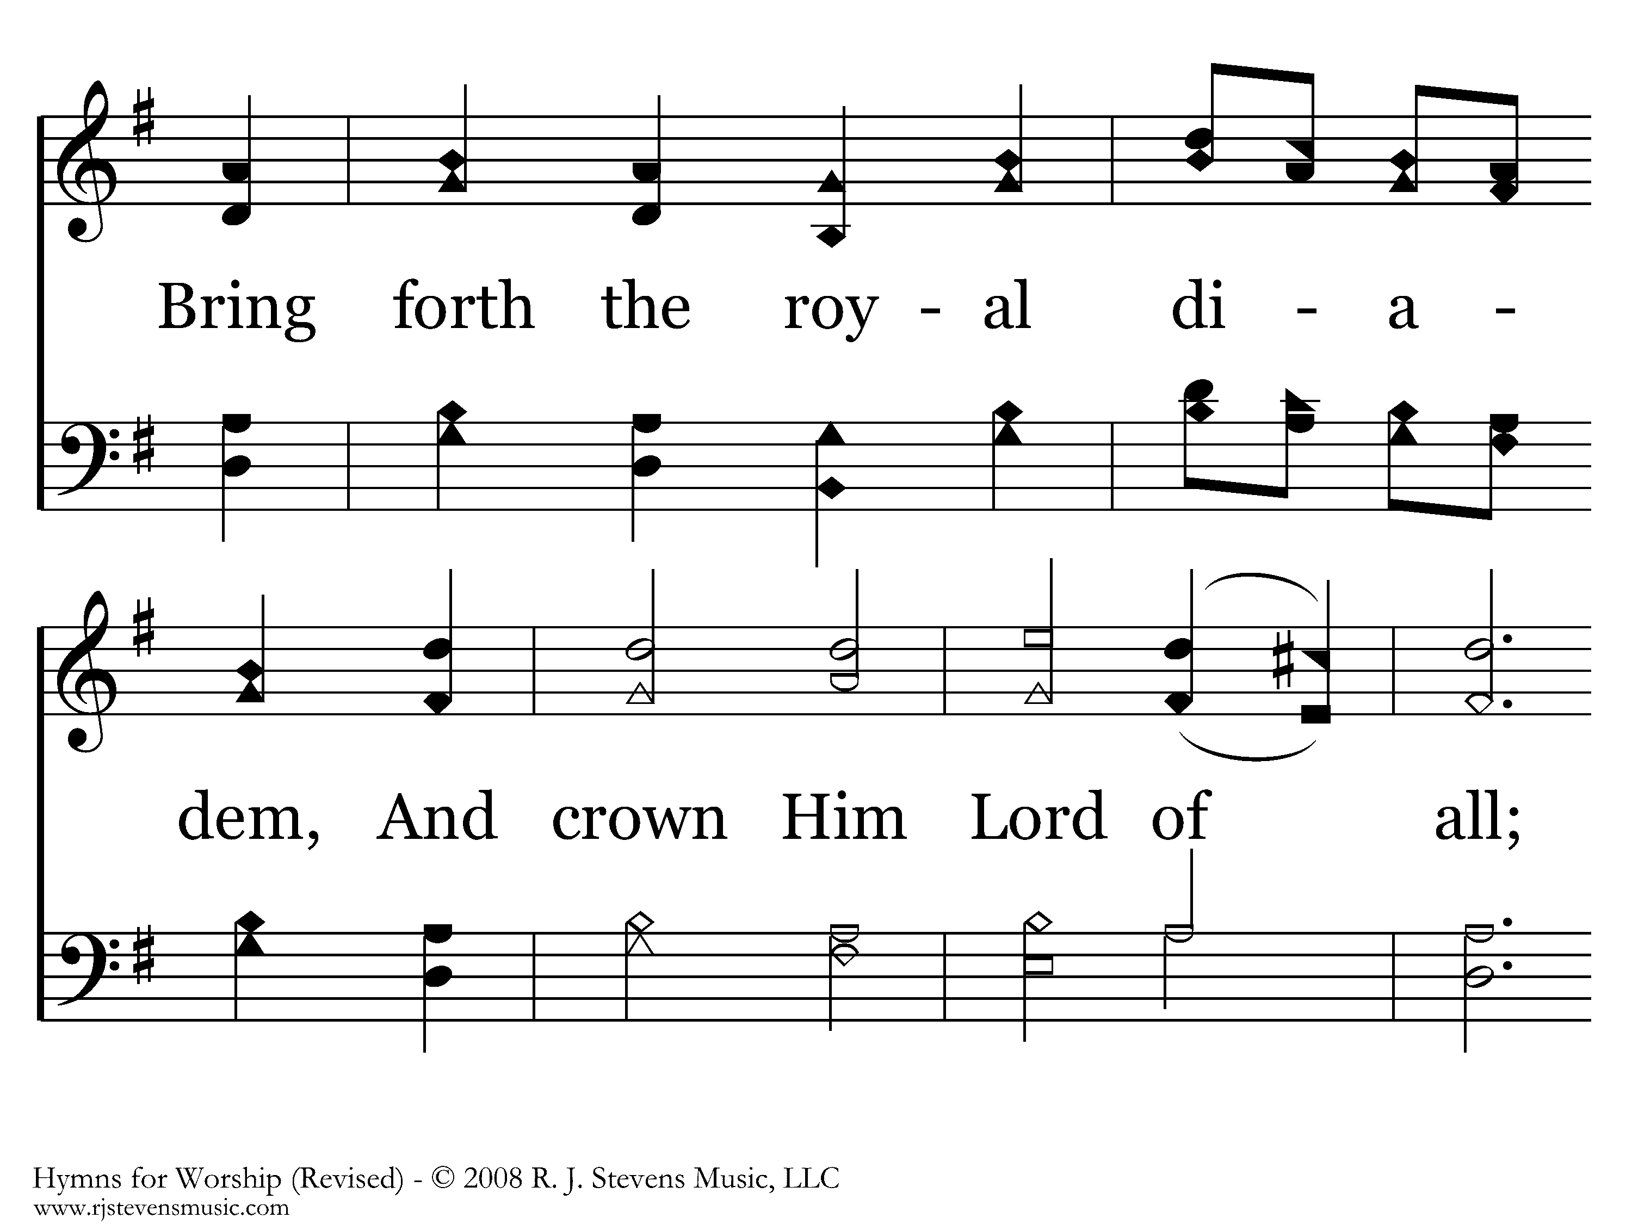
434 - All Hail The Power Of Jesus' Name - 1.2

Slide 4
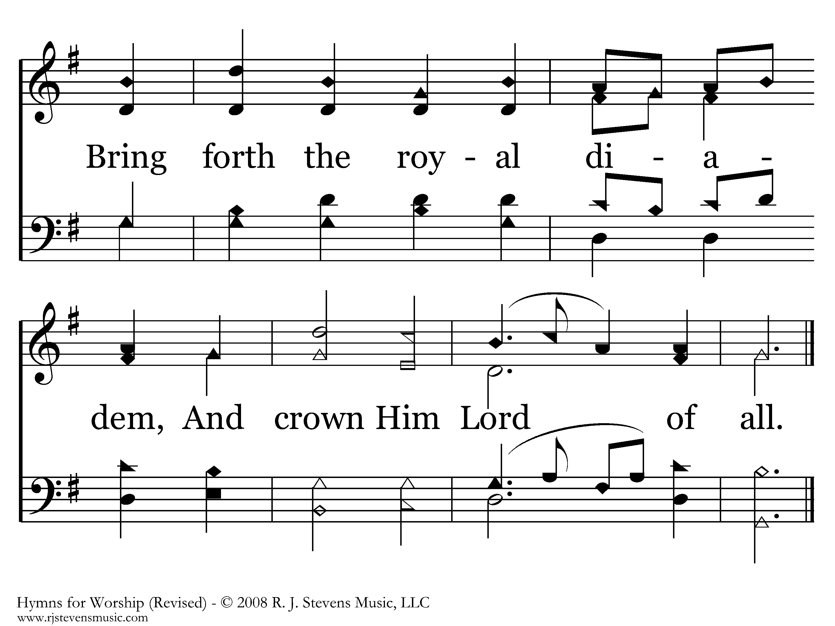
434 - All Hail The Power Of Jesus' Name - 1.3
End of Verse 1

Slide 5
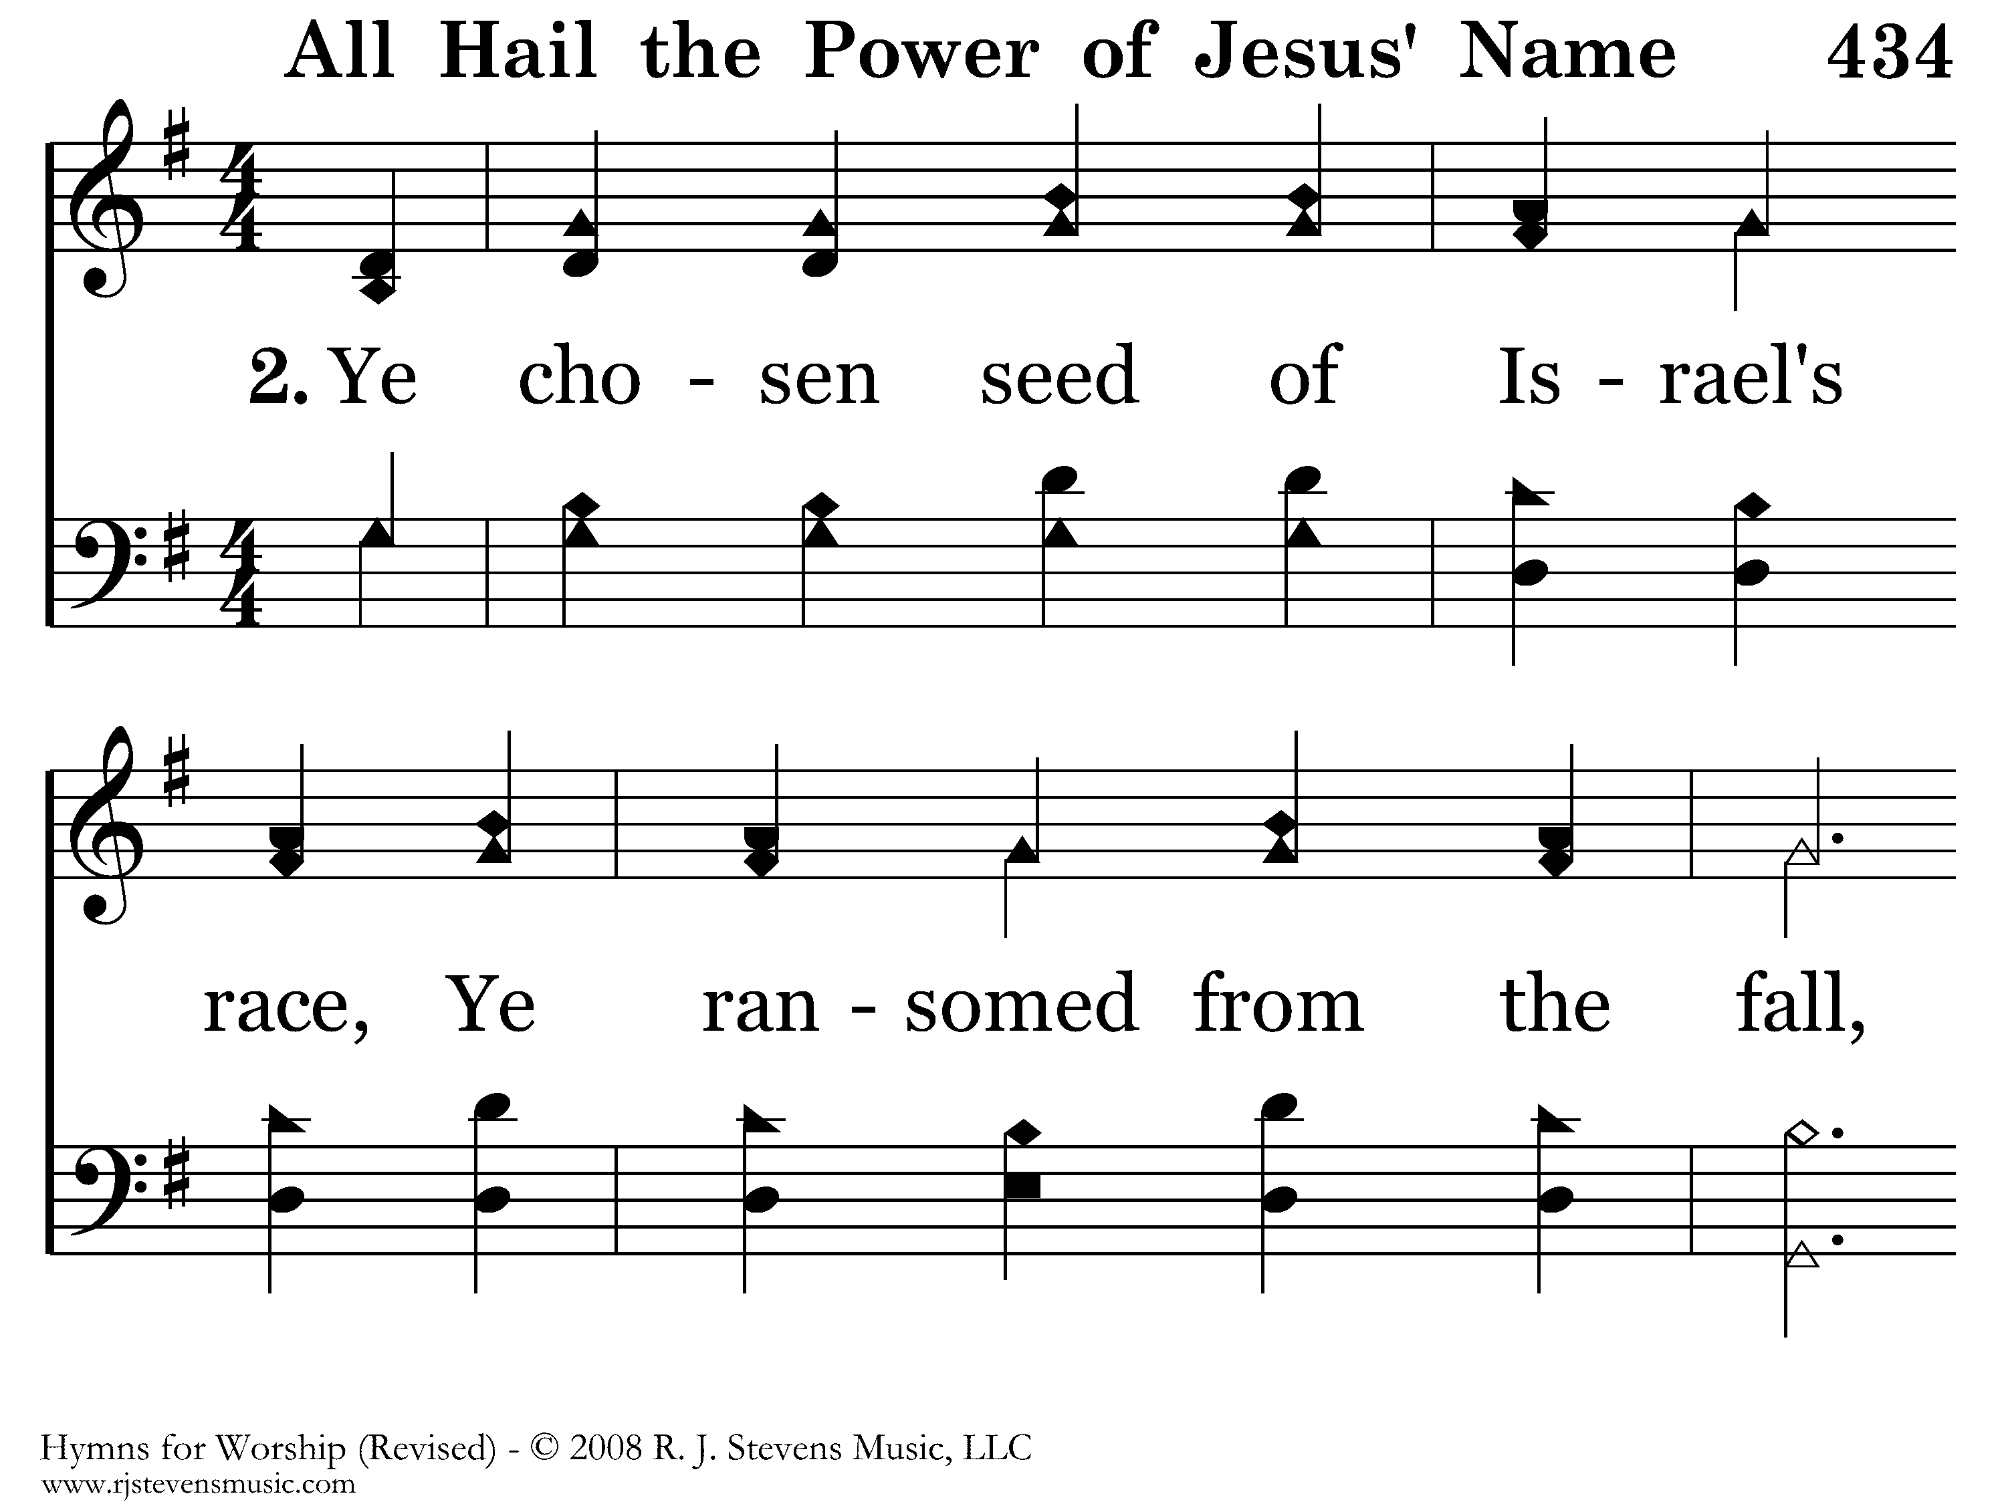
434 - All Hail The Power Of Jesus' Name - 2.1

Slide 6
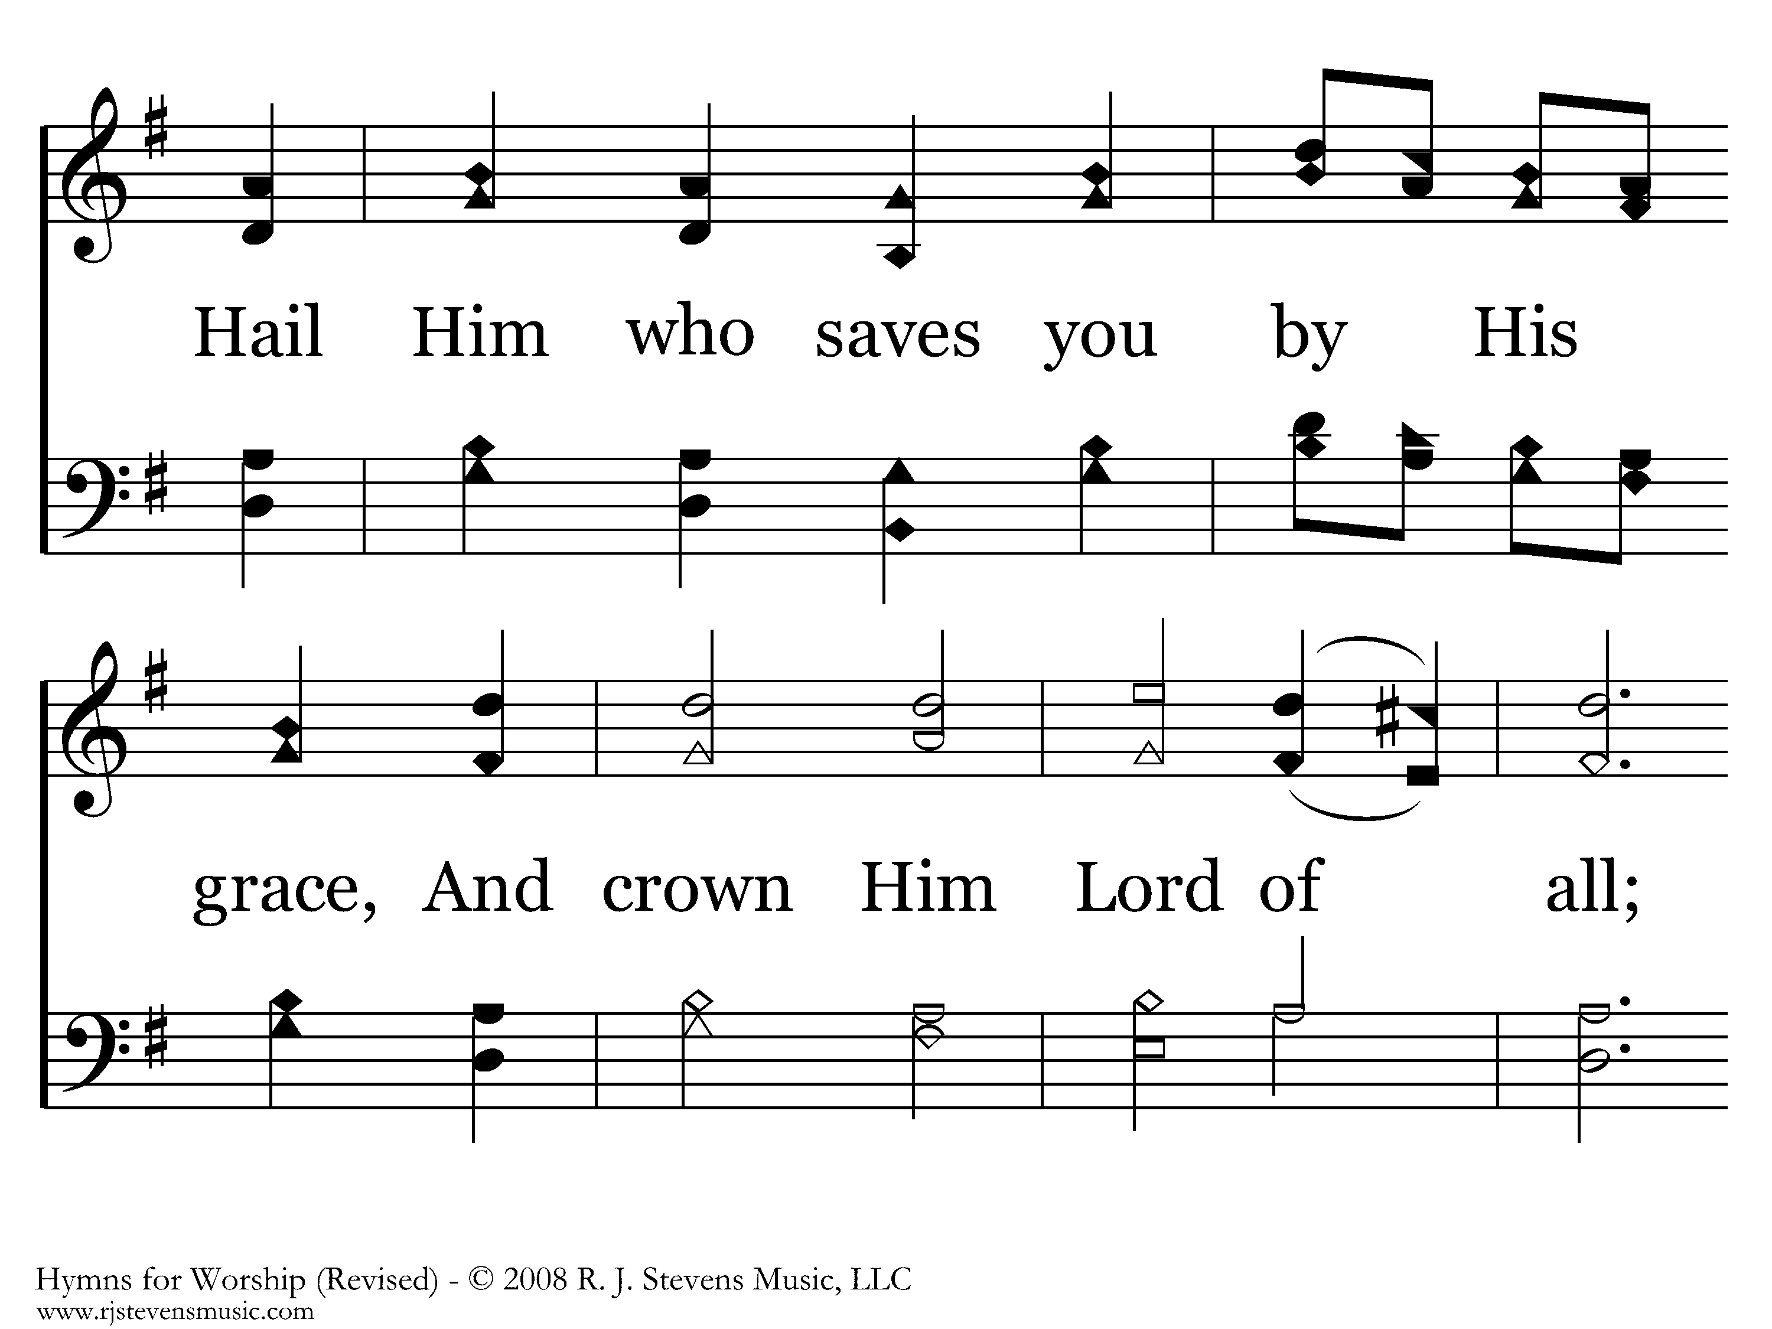
434 - All Hail The Power Of Jesus' Name - 2.2

Slide 7
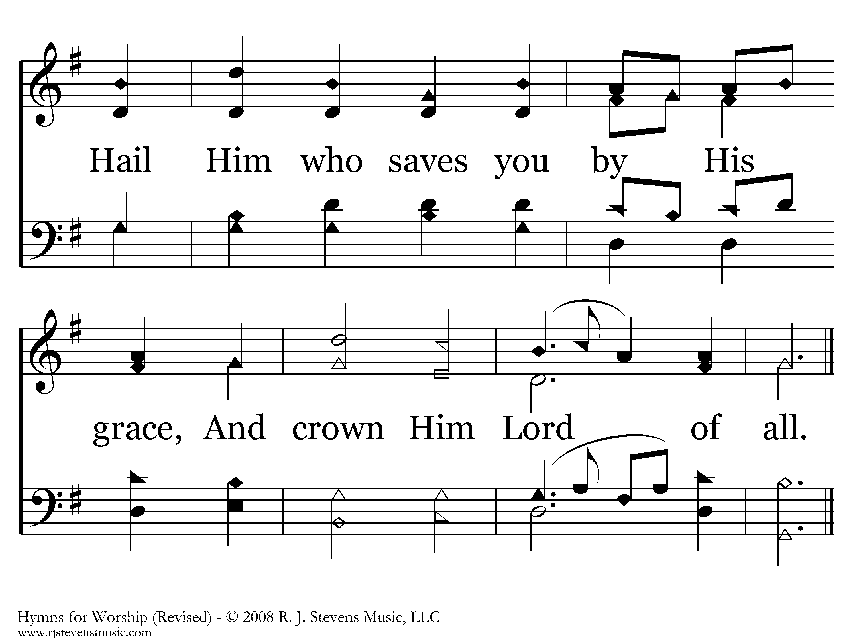
434 - All Hail The Power Of Jesus' Name - 2.3
End of Verse 2

Slide 8
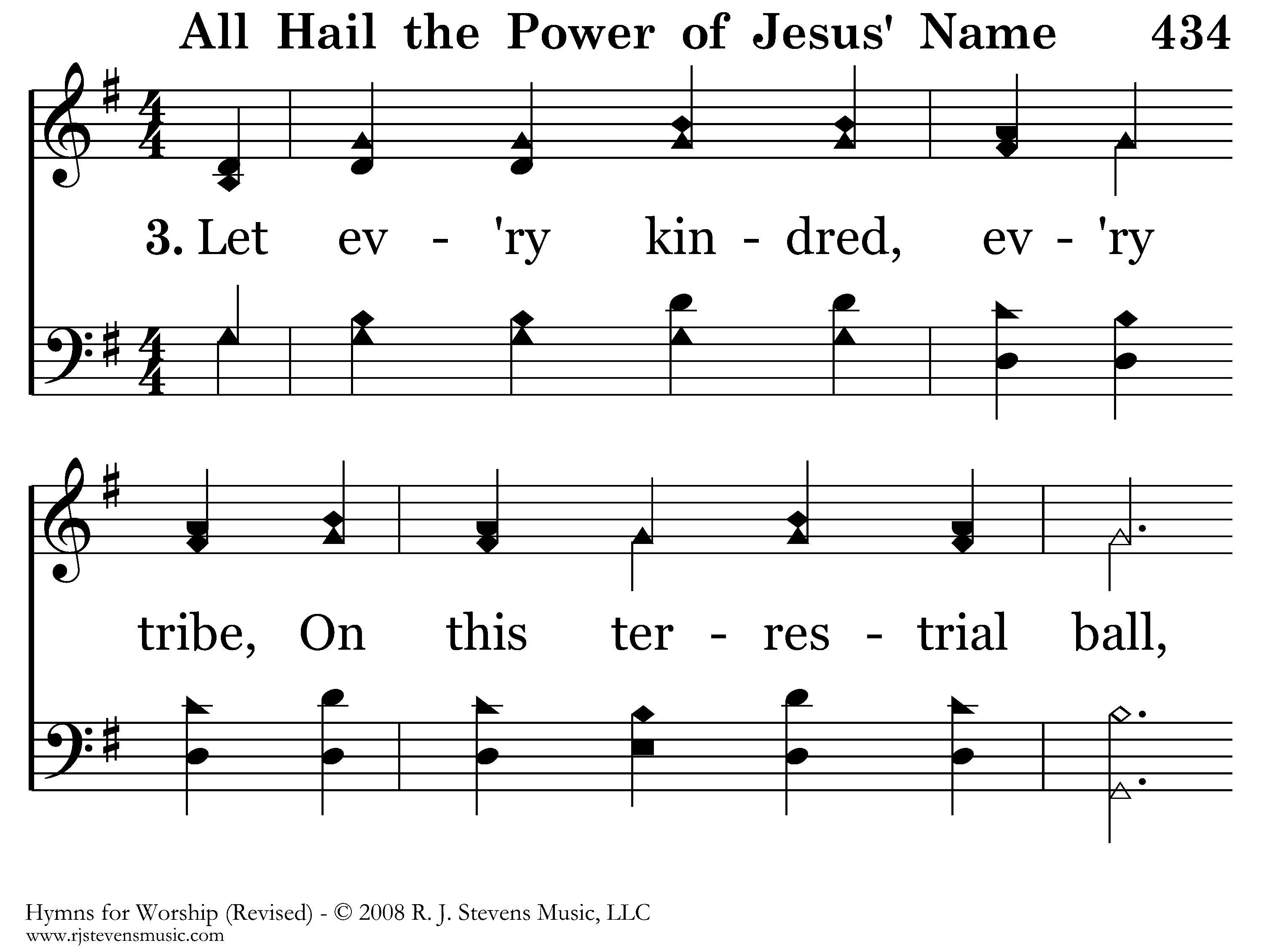
434 - All Hail The Power Of Jesus' Name - 3.1

Slide 9

434 - All Hail The Power Of Jesus' Name - 3.2

Slide 10
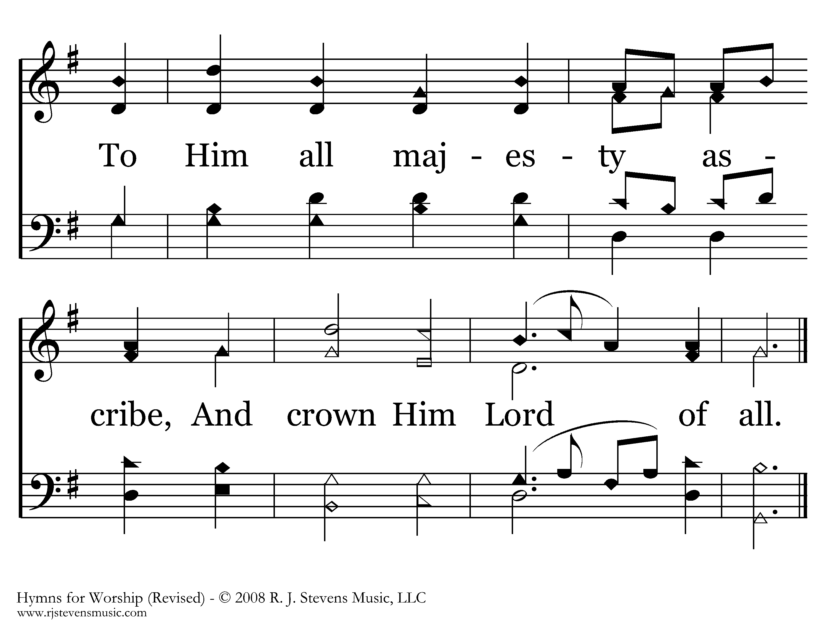
434 - All Hail The Power Of Jesus' Name - 3.3
End of Verse 3

Slide 11
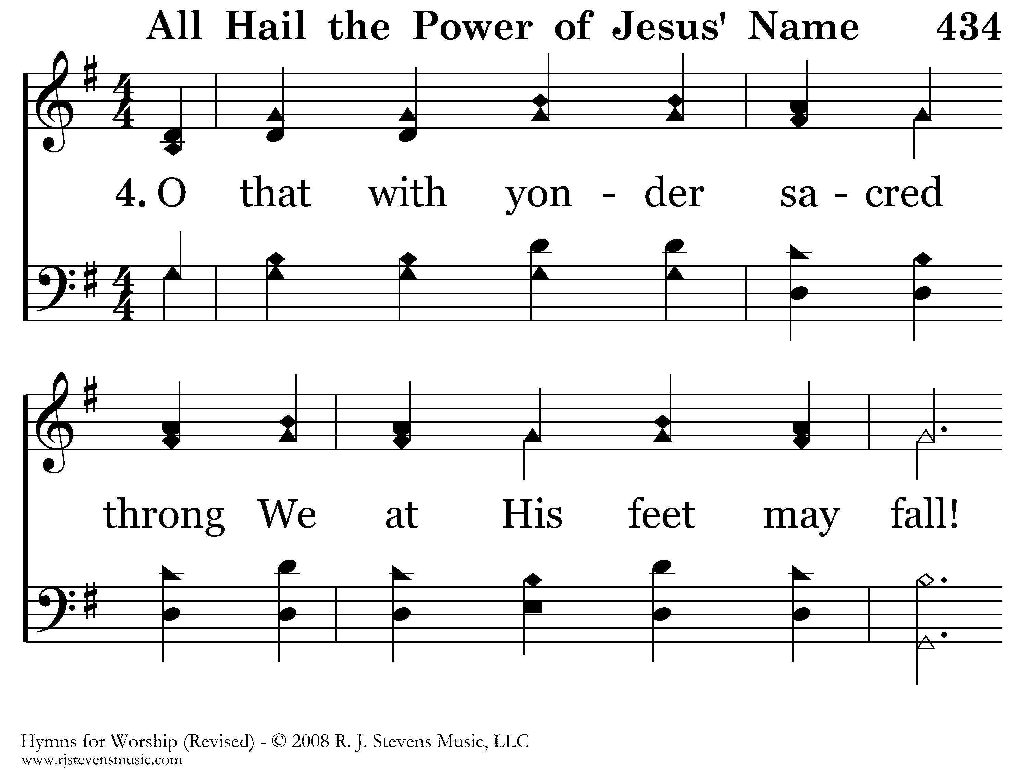
434 - All Hail The Power Of Jesus' Name - 4.1

Slide 12
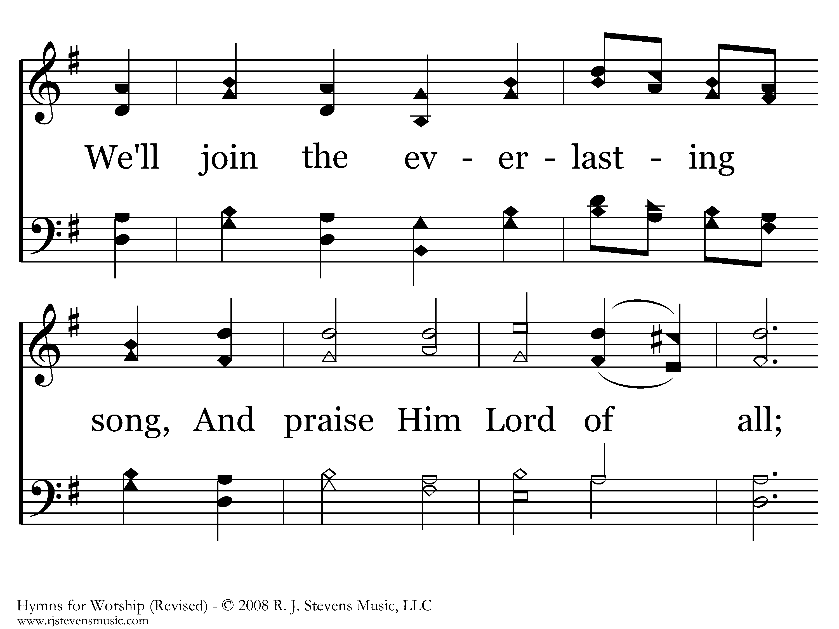
434 - All Hail The Power Of Jesus' Name - 4.2

Slide 13
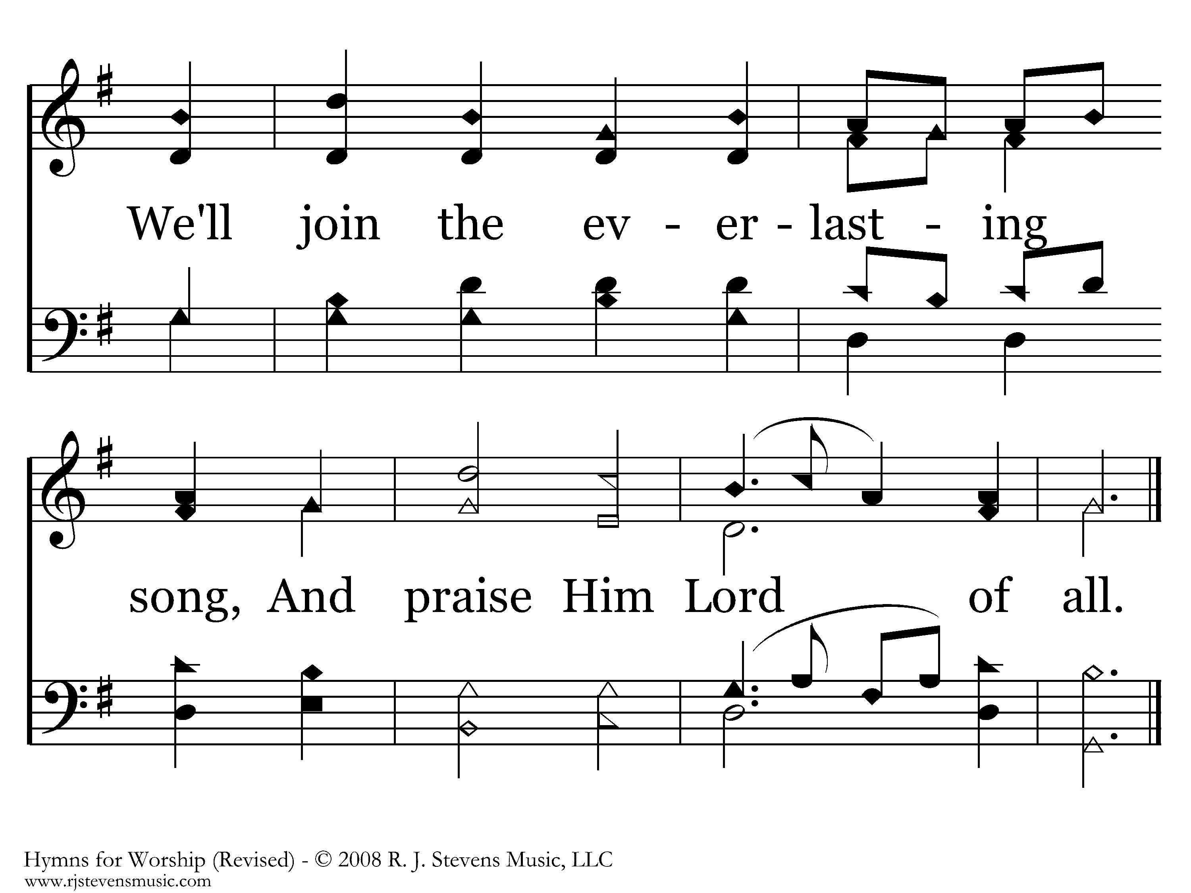
434 - All Hail The Power Of Jesus' Name - 4.3
End of Song

Slide 15
You Are My All in All
180
Hymn: Dennis Jernigan (1991)
Tune: Dennis Jernigan (1991)
© 1991 Shepherd's Heart Music (admin. by Praisecharts Publishing, Inc.)

Slide 16
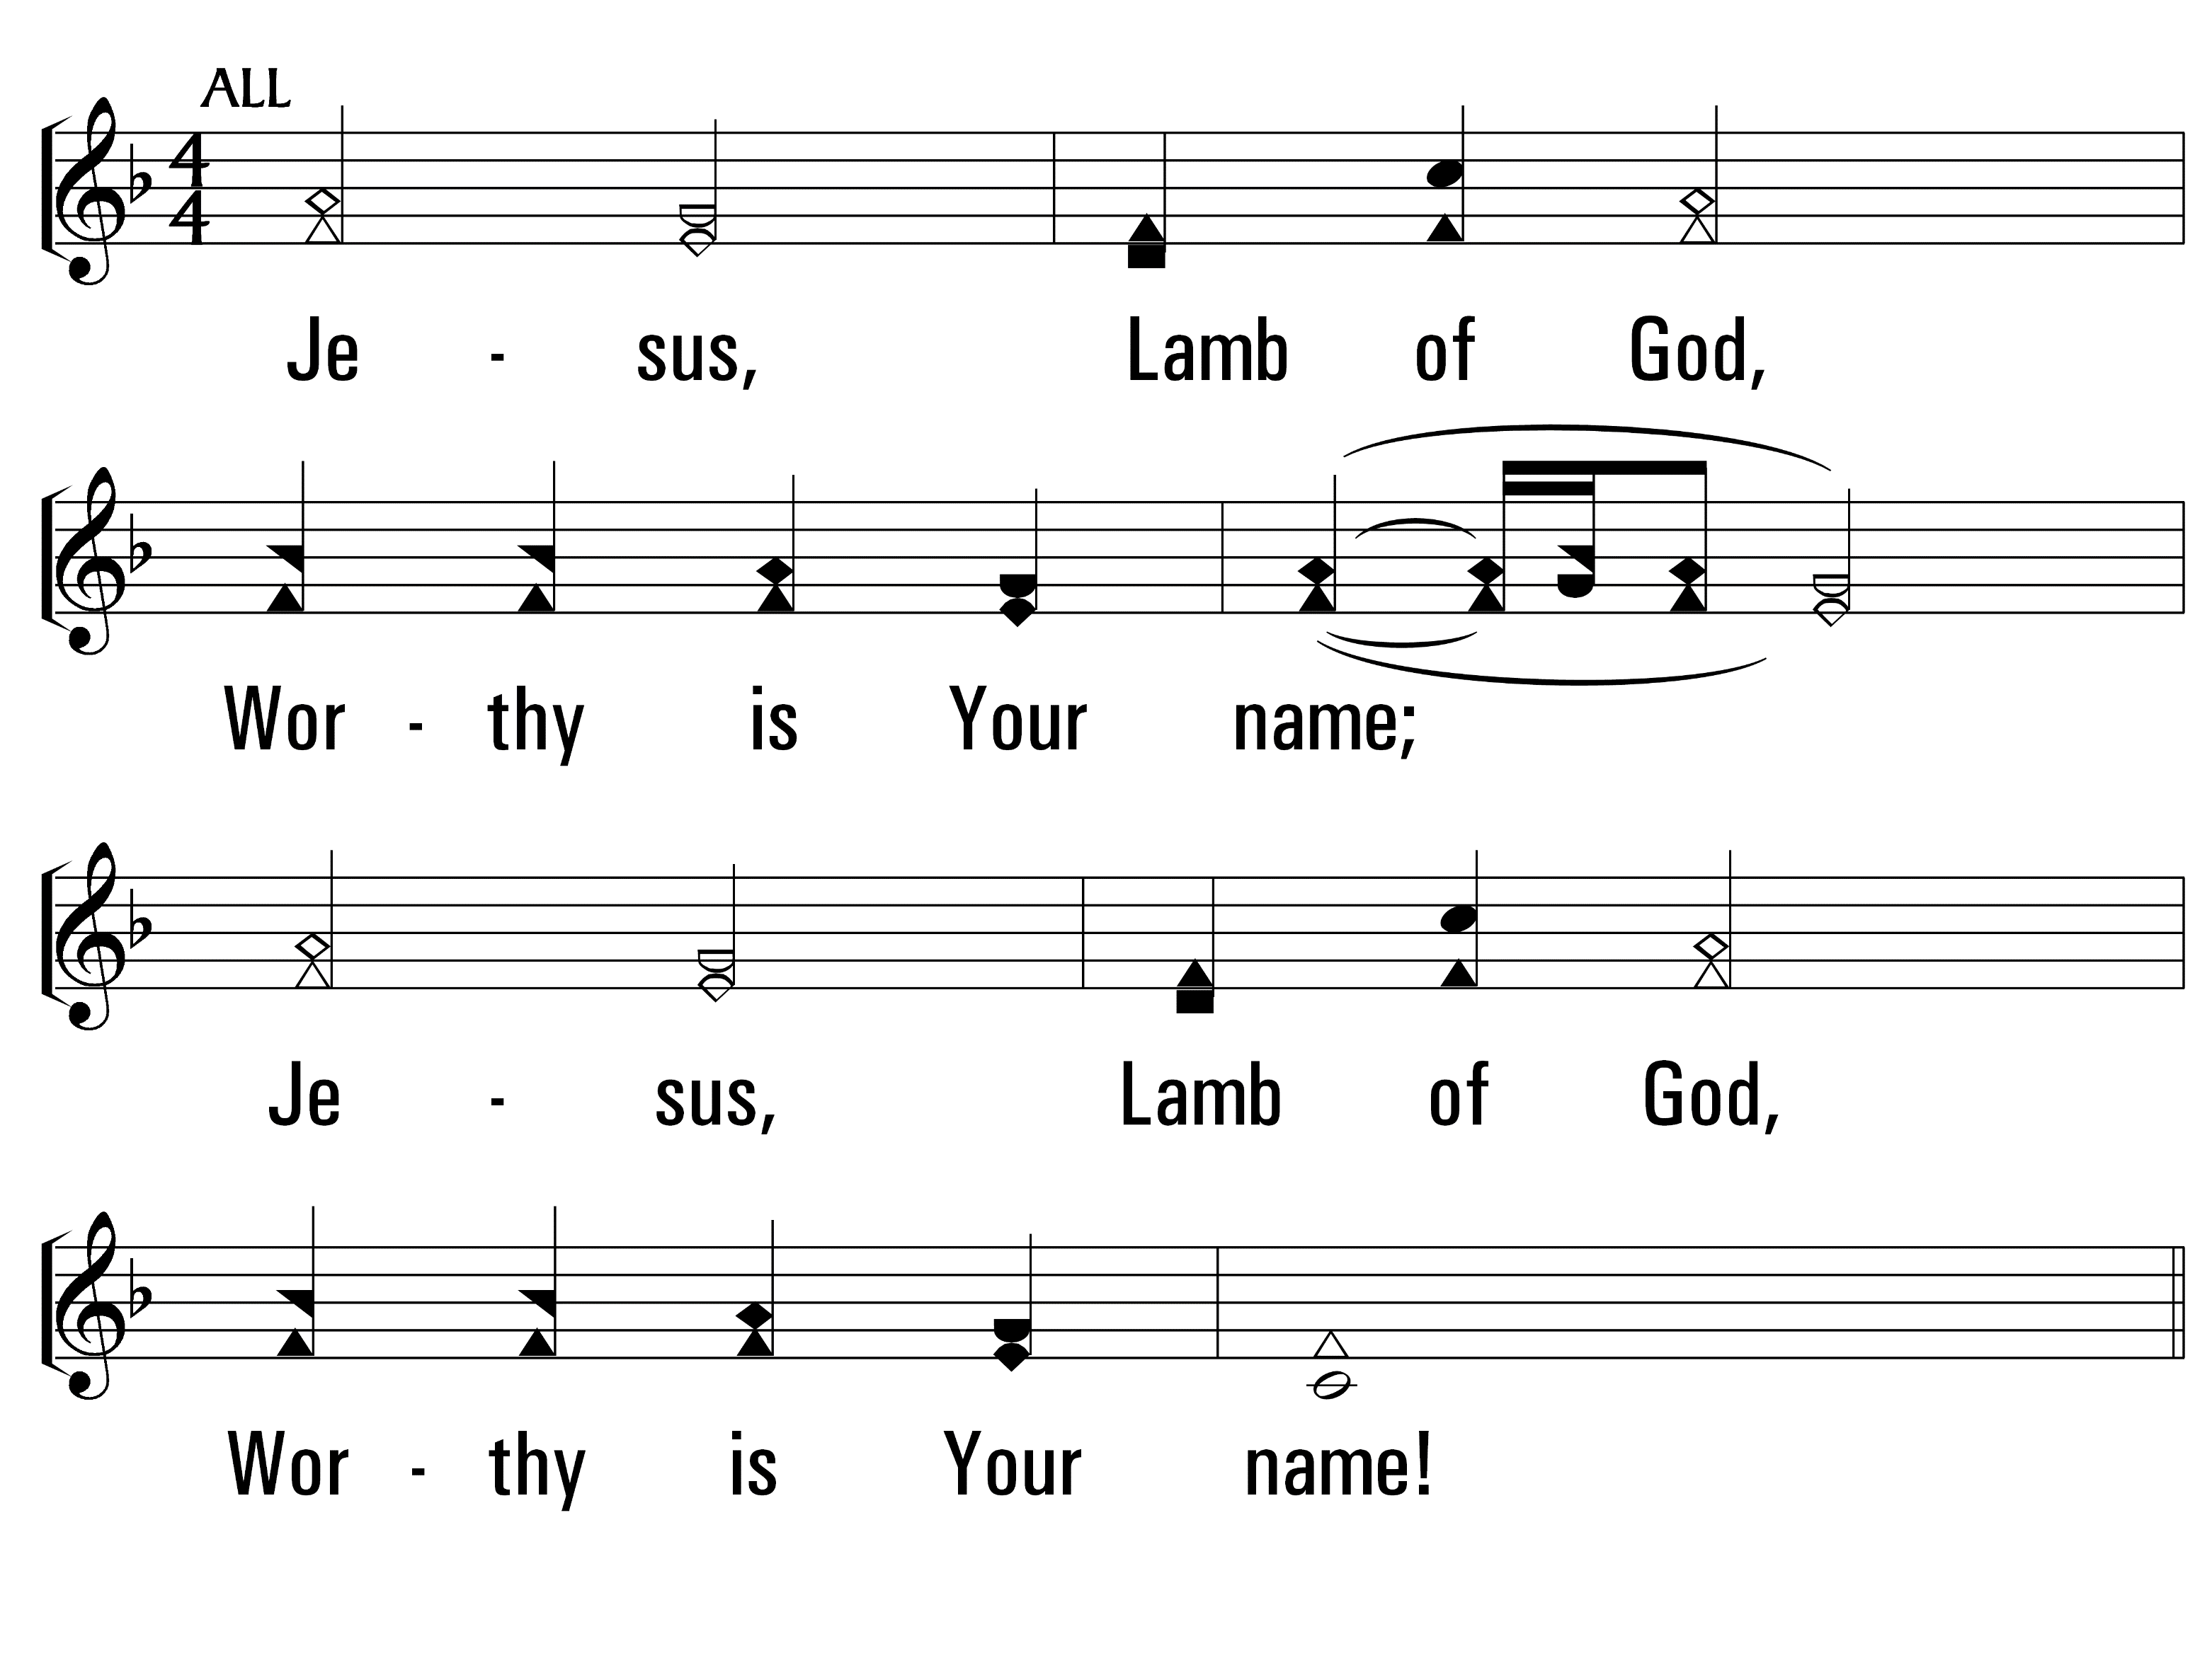
YouAreMyAllInAll_st1_a
Vs 1
© 2014 Sumphonia Productions, LLC

Slide 17
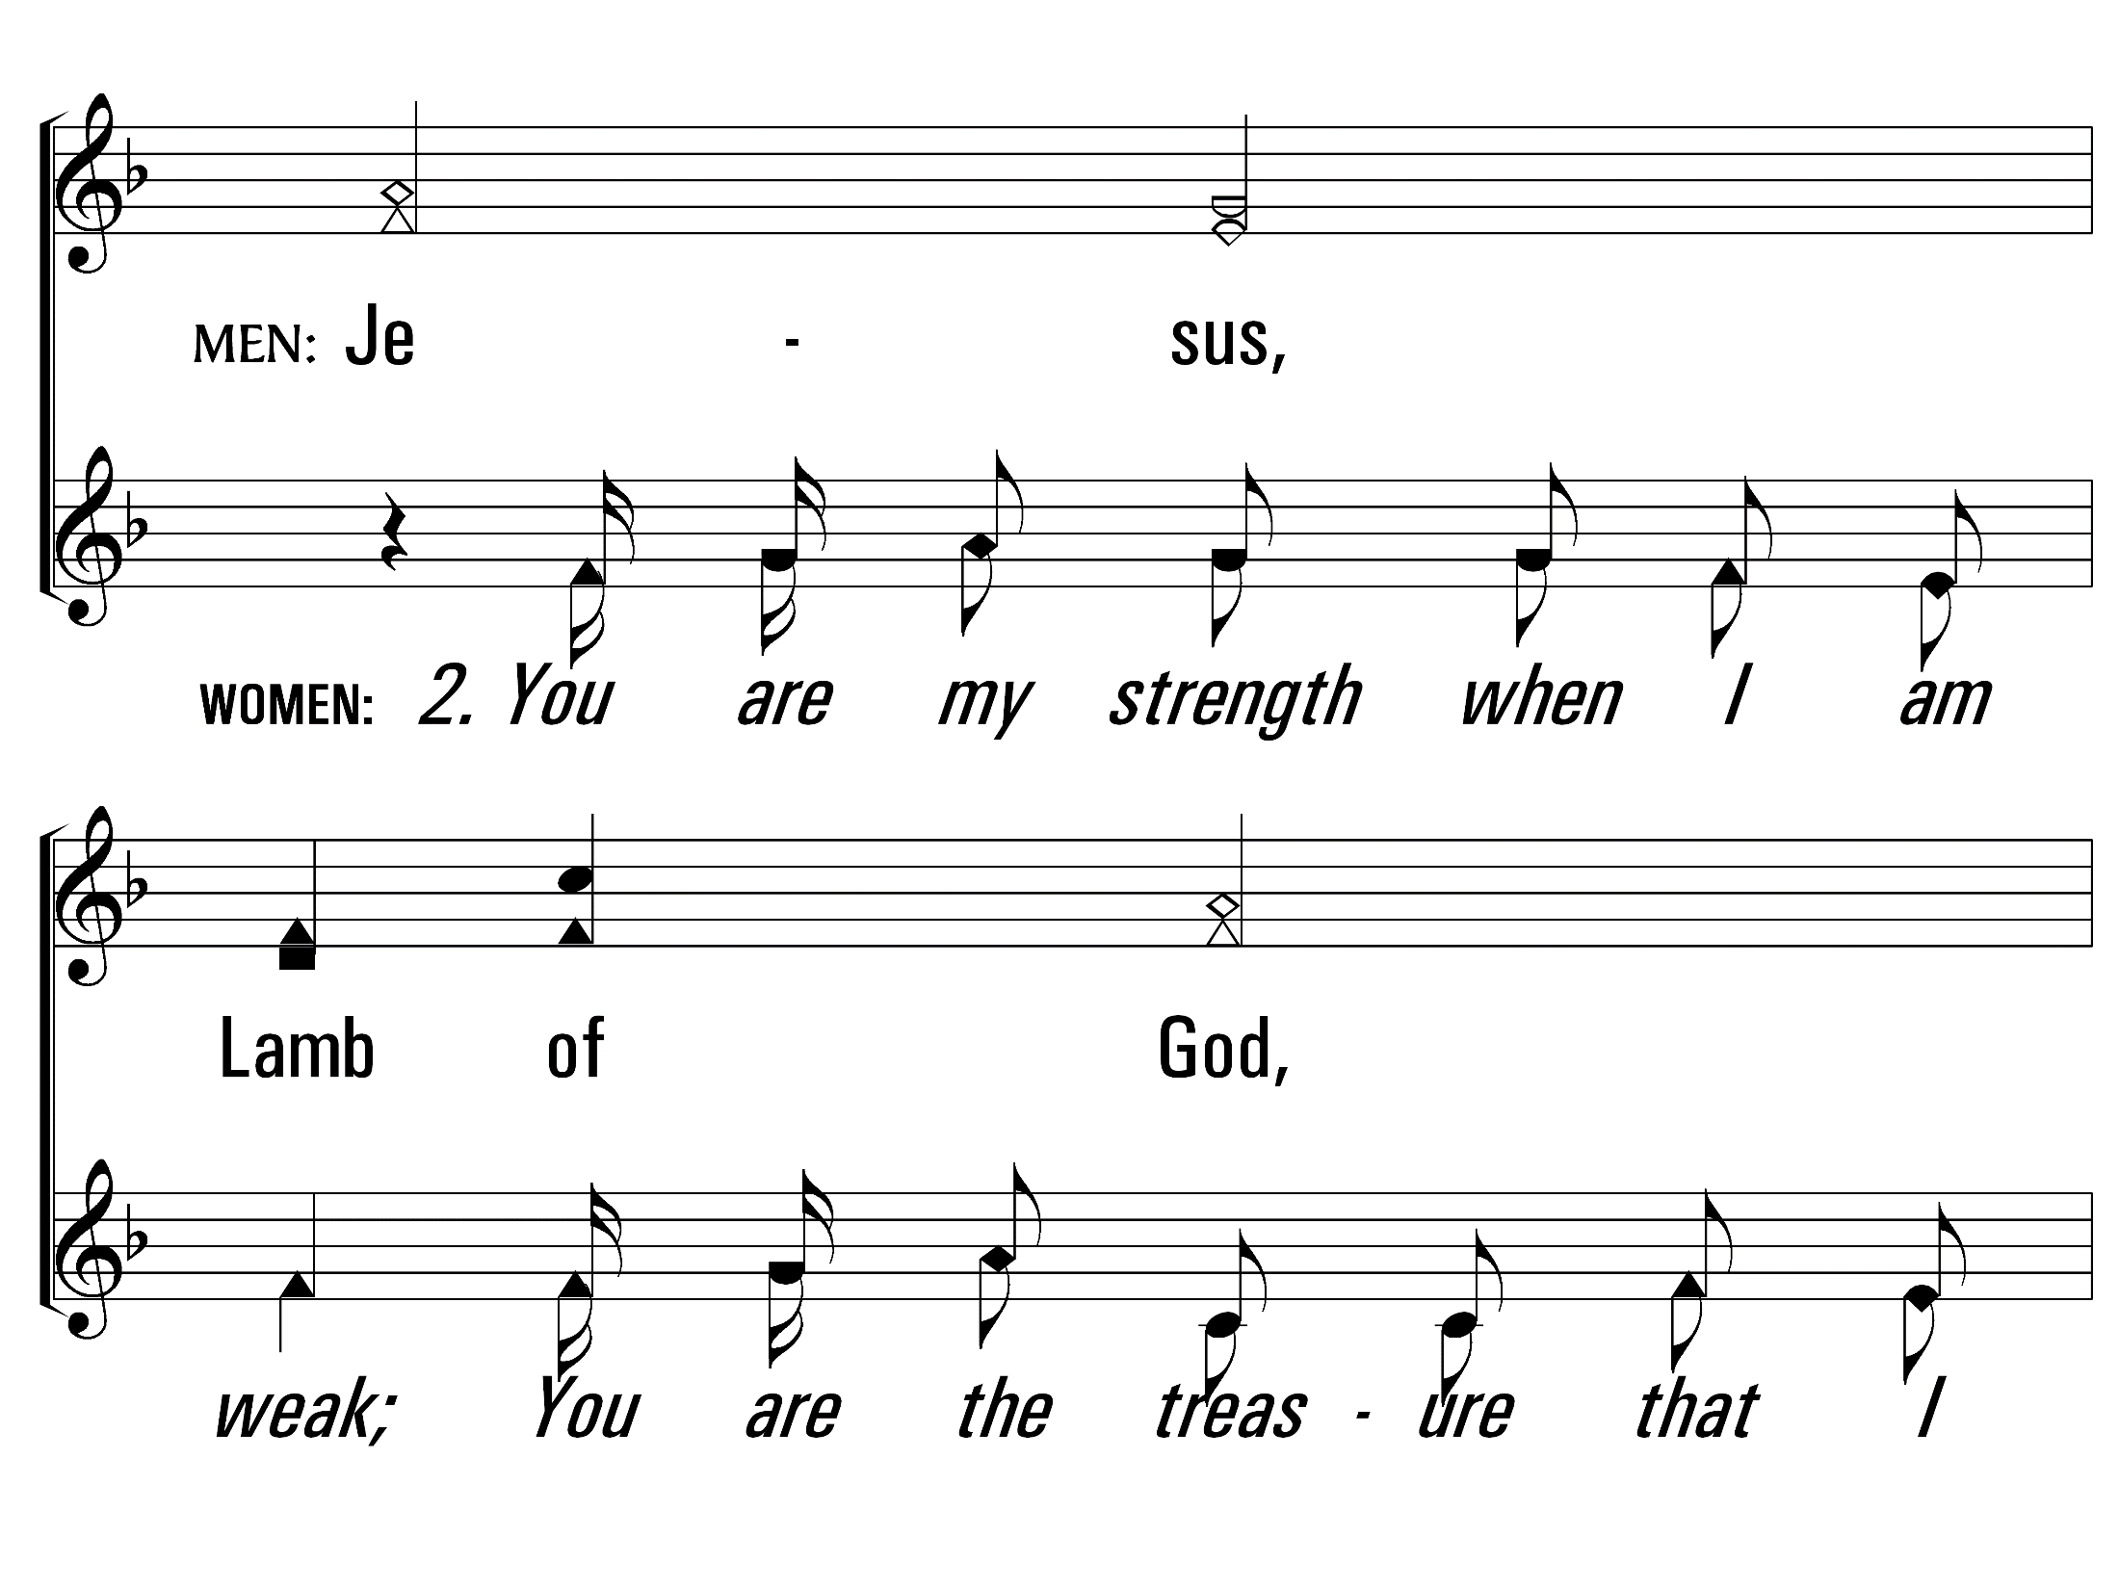
YouAreMyAllInAll_st2_a
Vs 2
© 2014 Sumphonia Productions, LLC

Slide 18
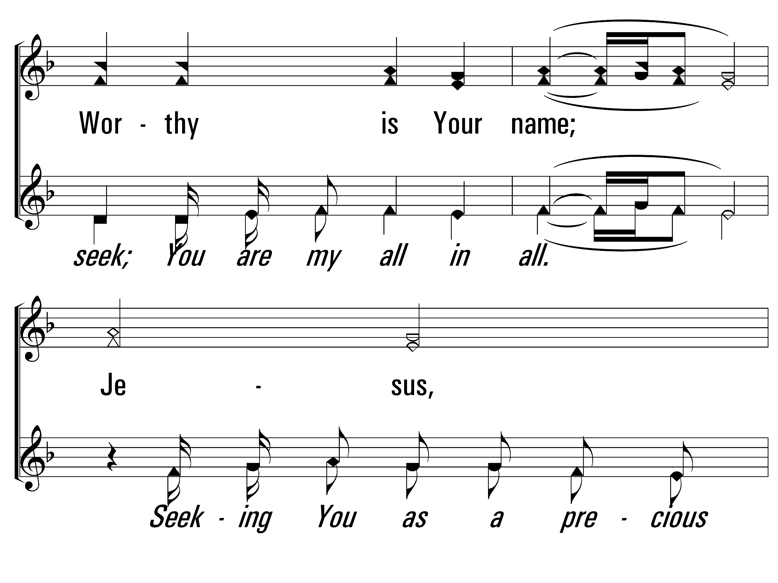
YouAreMyAllInAll_st2_b
Vs 2
© 2014 Sumphonia Productions, LLC

Slide 19
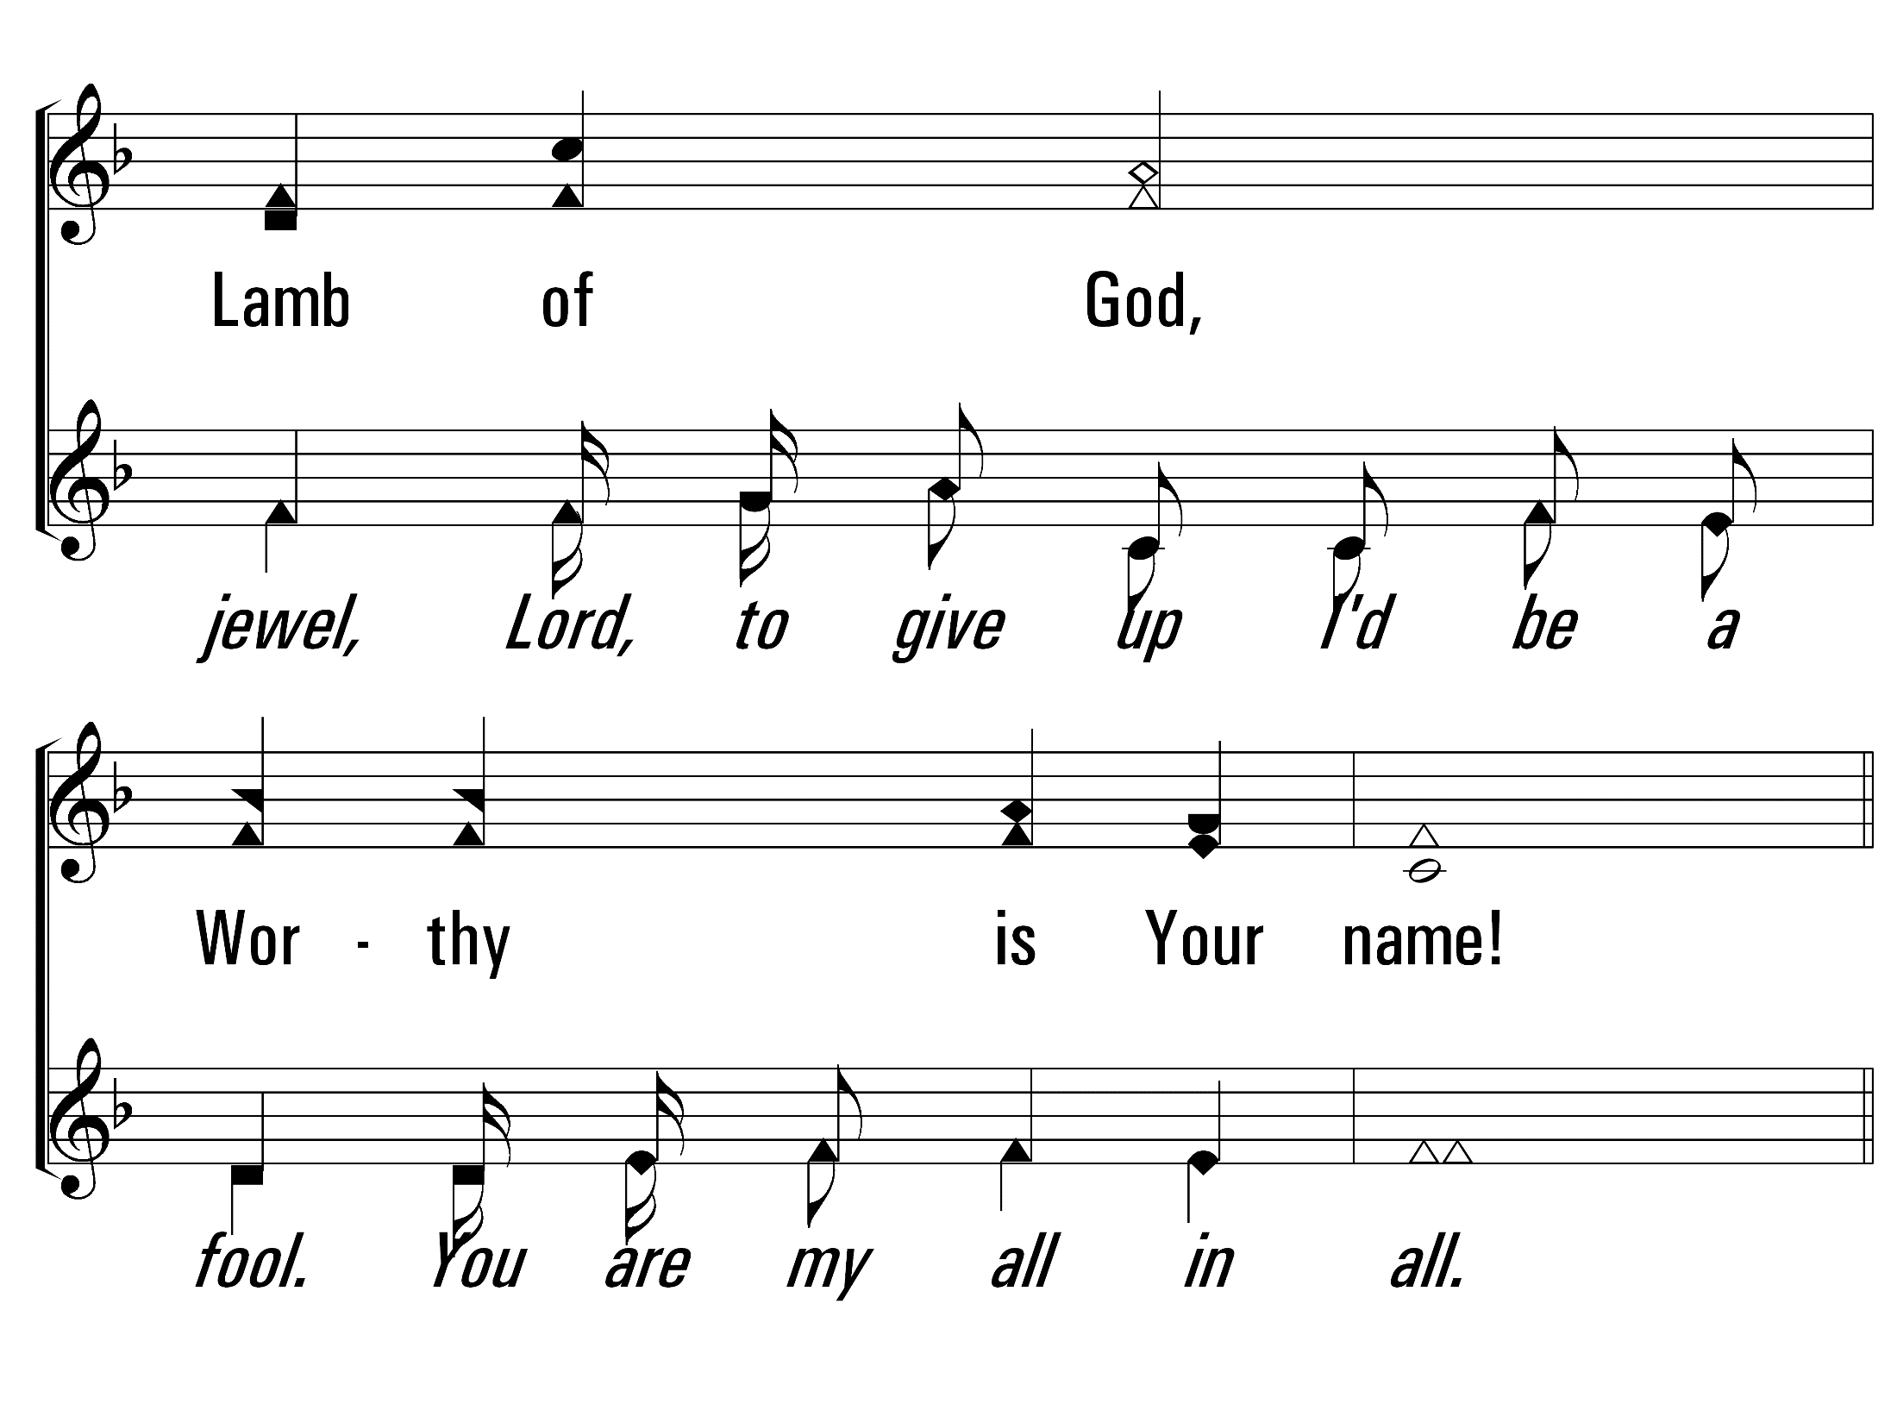
YouAreMyAllInAll_st2_c
Vs 2
© 2014 Sumphonia Productions, LLC

Slide 20
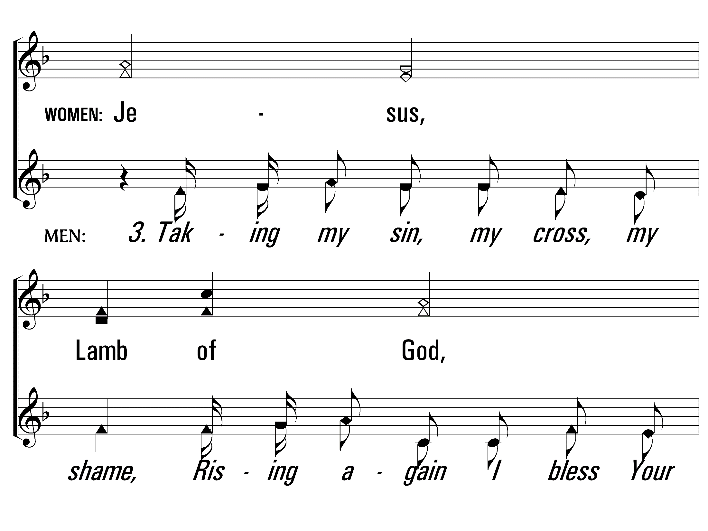
YouAreMyAllInAll_st3_a
Vs 3
© 2014 Sumphonia Productions, LLC

Slide 21
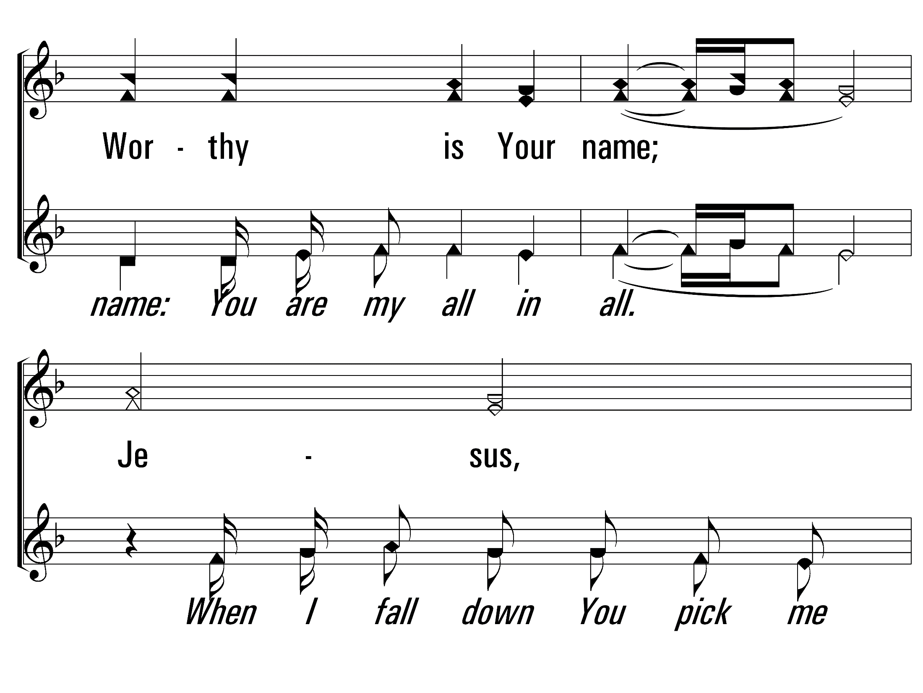
YouAreMyAllInAll_st3_b
Vs 3
© 2014 Sumphonia Productions, LLC

Slide 22
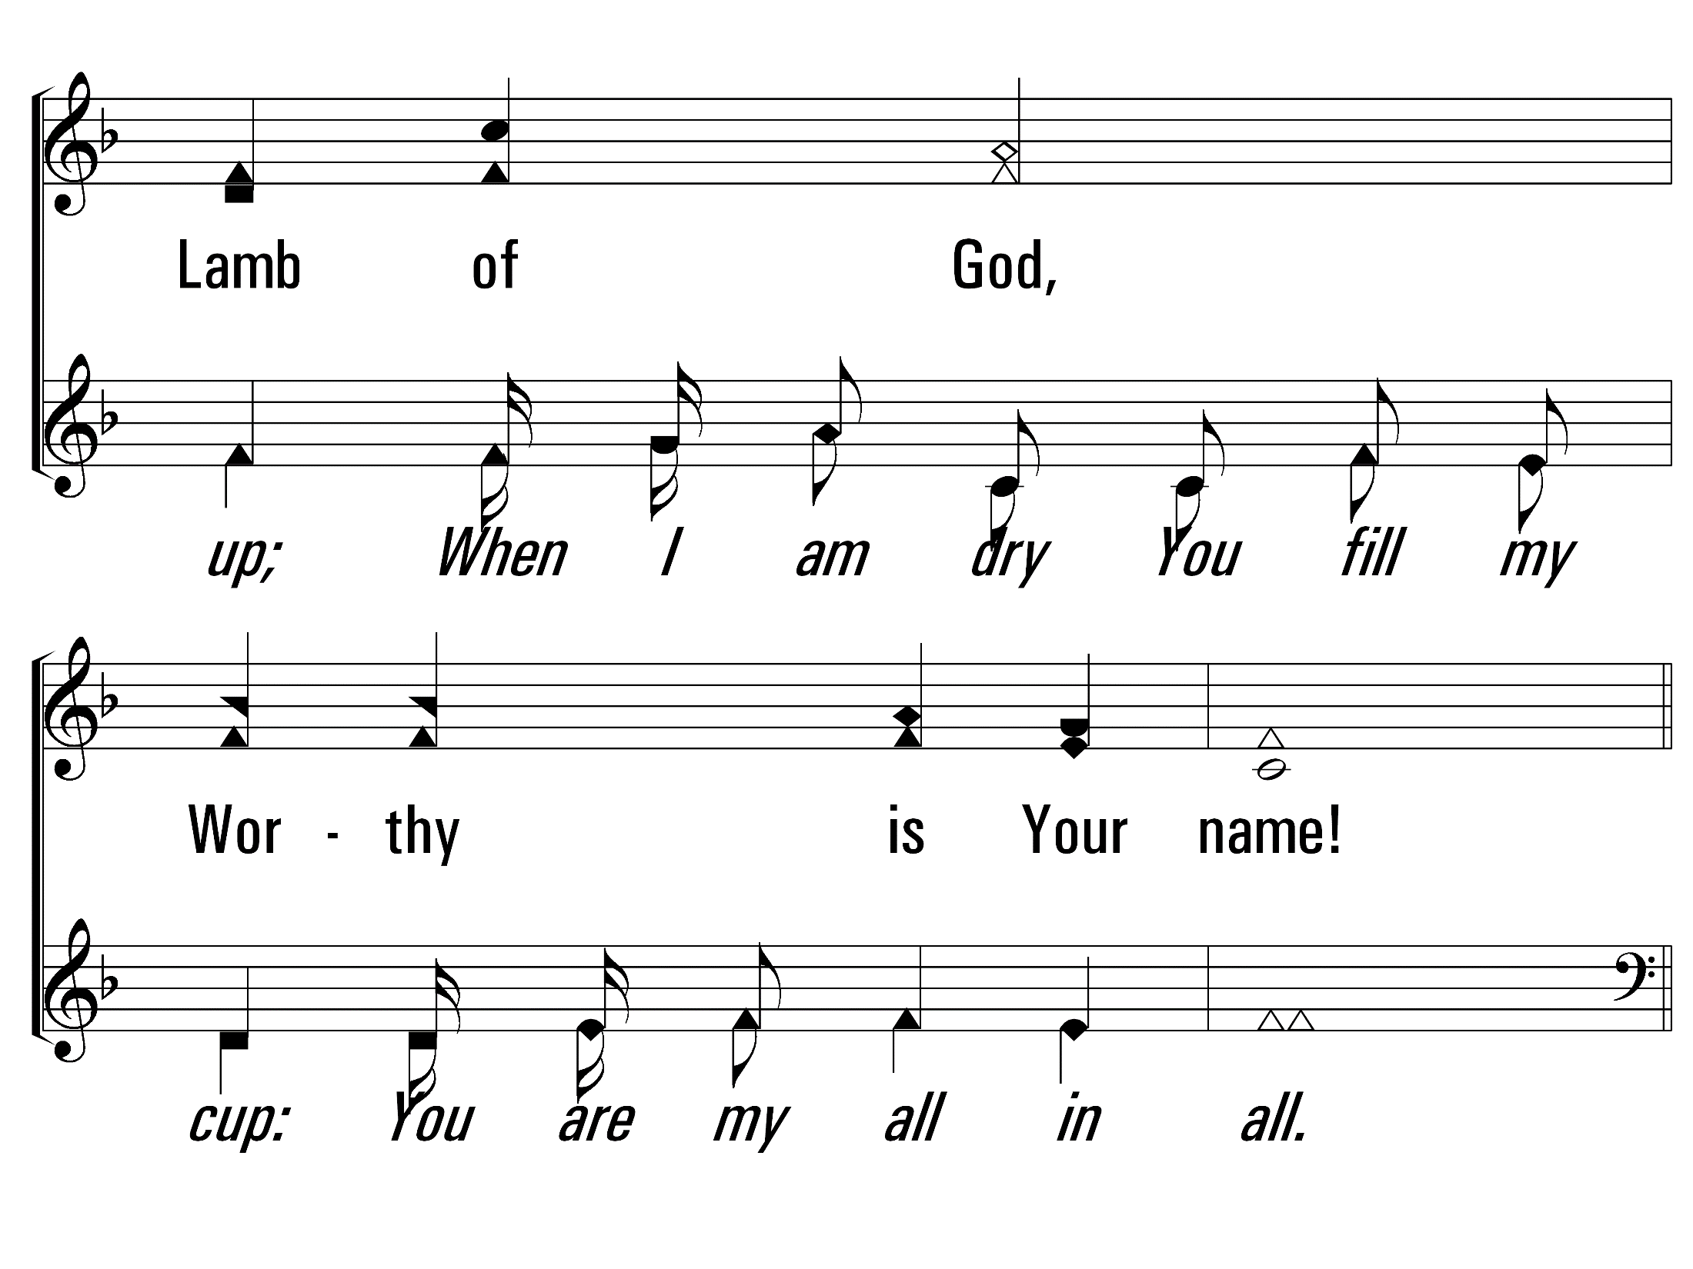
YouAreMyAllInAll_st3_c
Vs 3
© 2014 Sumphonia Productions, LLC

Slide 23
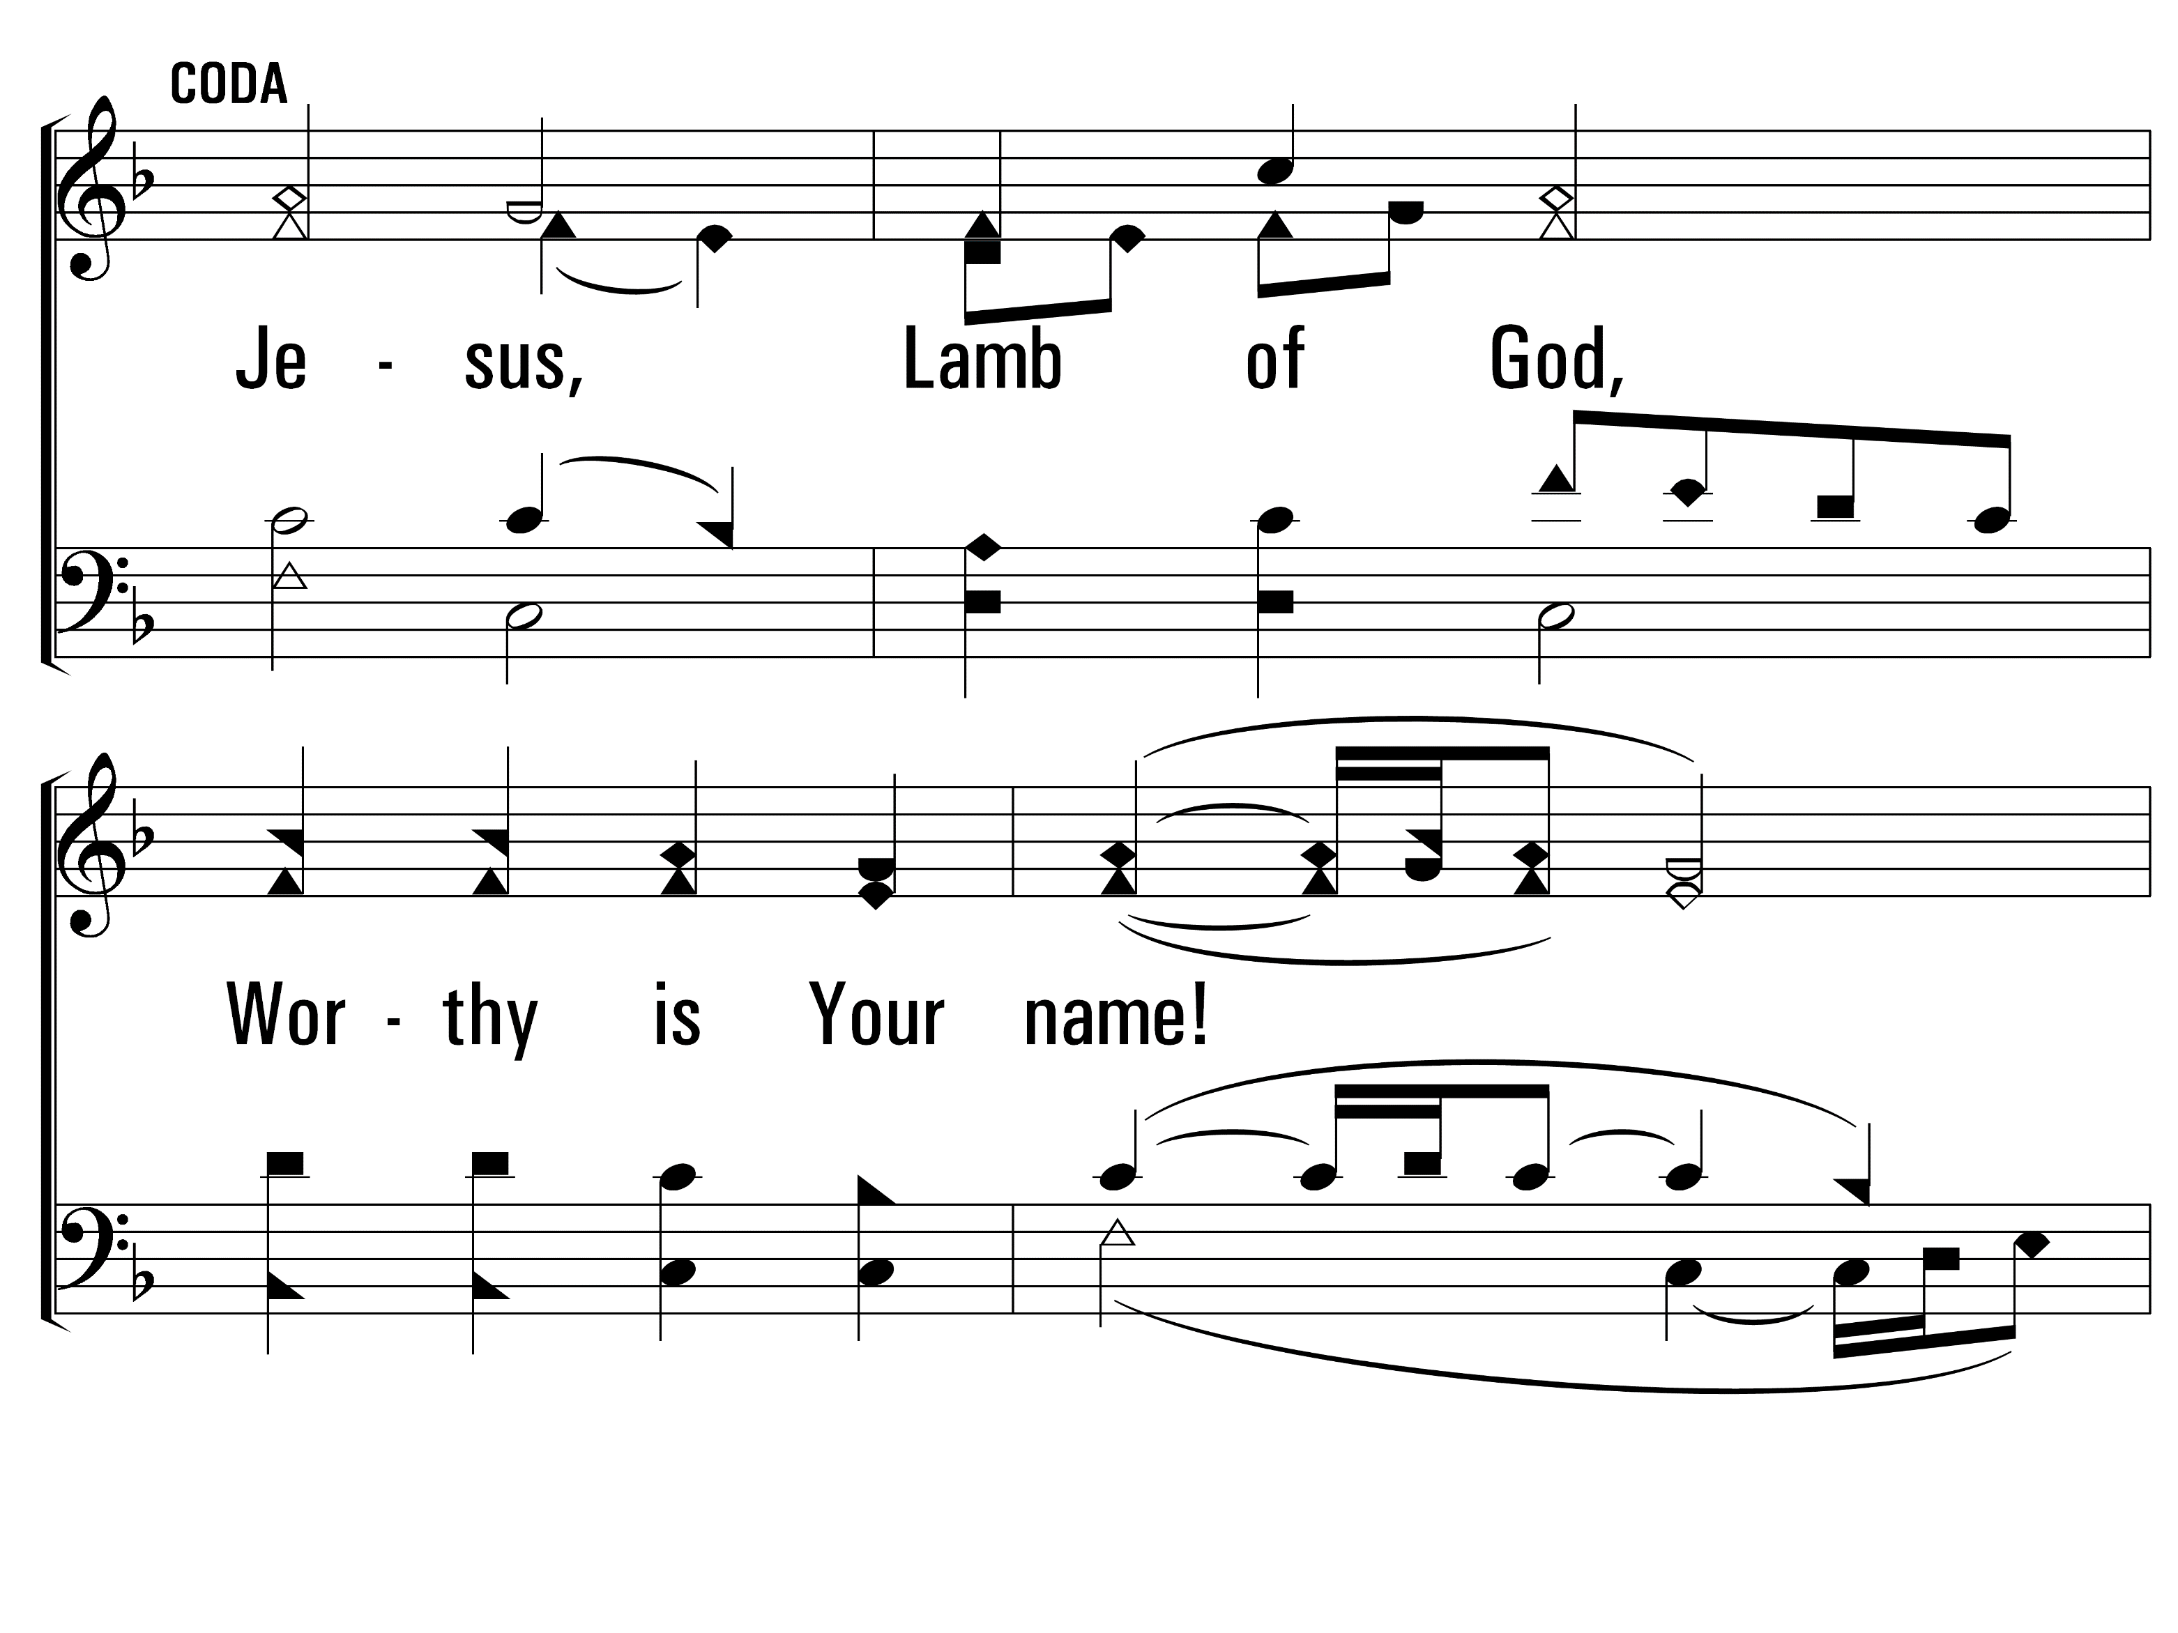
YouAreMyAllInAll_coda_a
Coda
© 2014 Sumphonia Productions, LLC

Slide 24
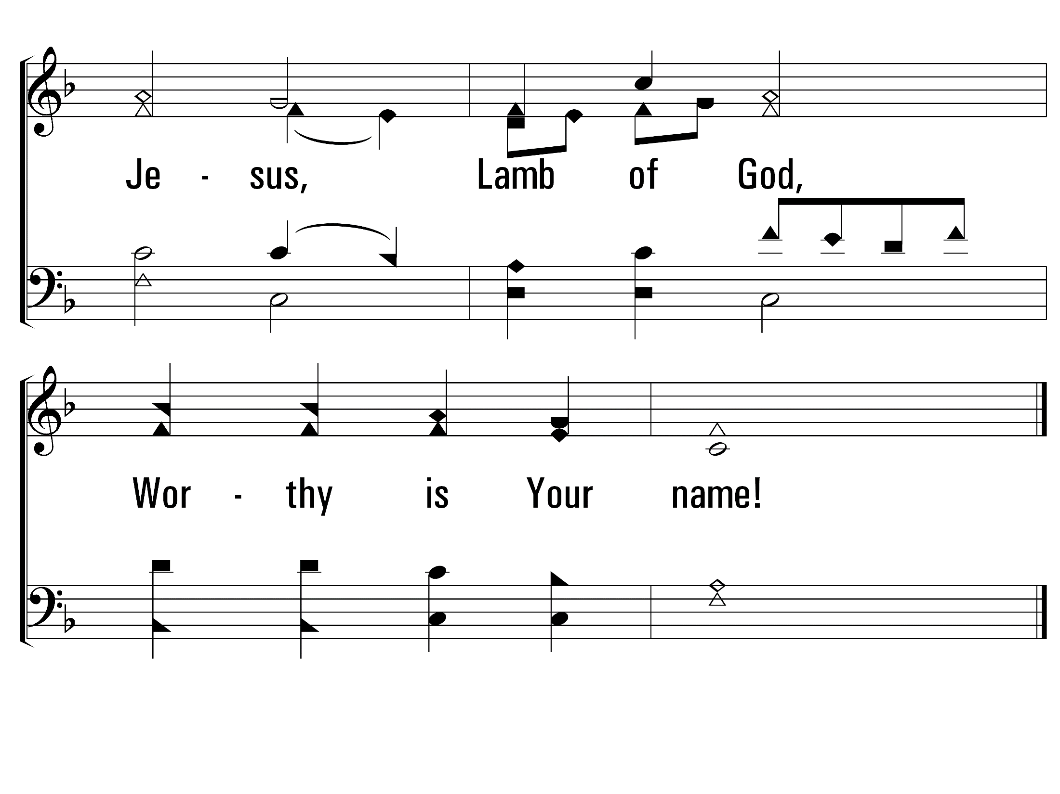
YouAreMyAllInAll_coda_b
Coda
© 2014 Sumphonia Productions, LLC
End

Slide 25
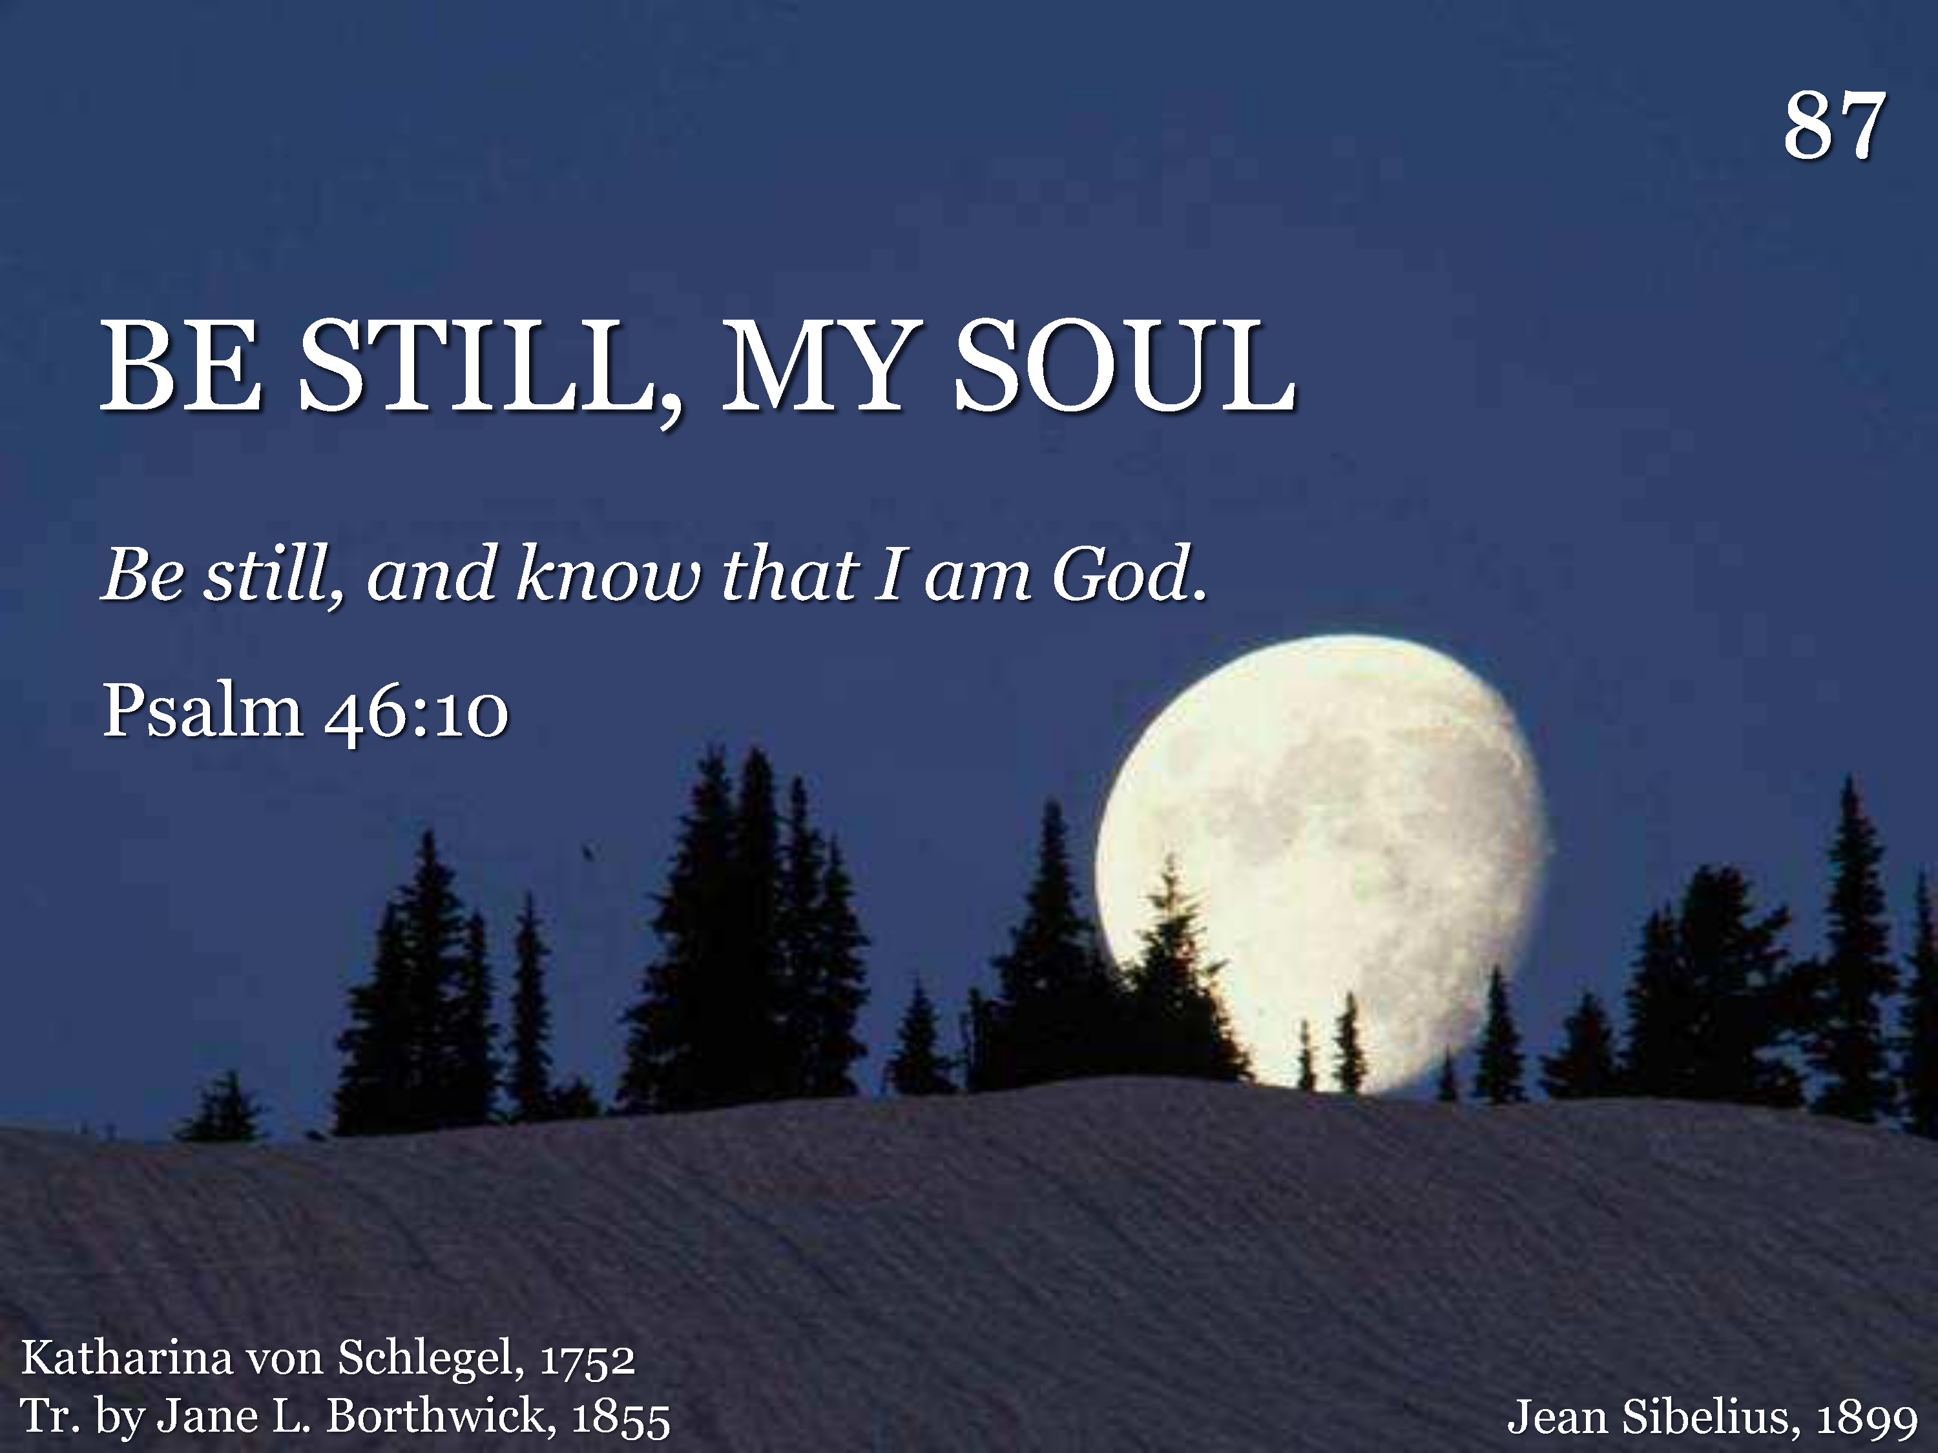
087 - Be Still My Soul - Title

Slide 26
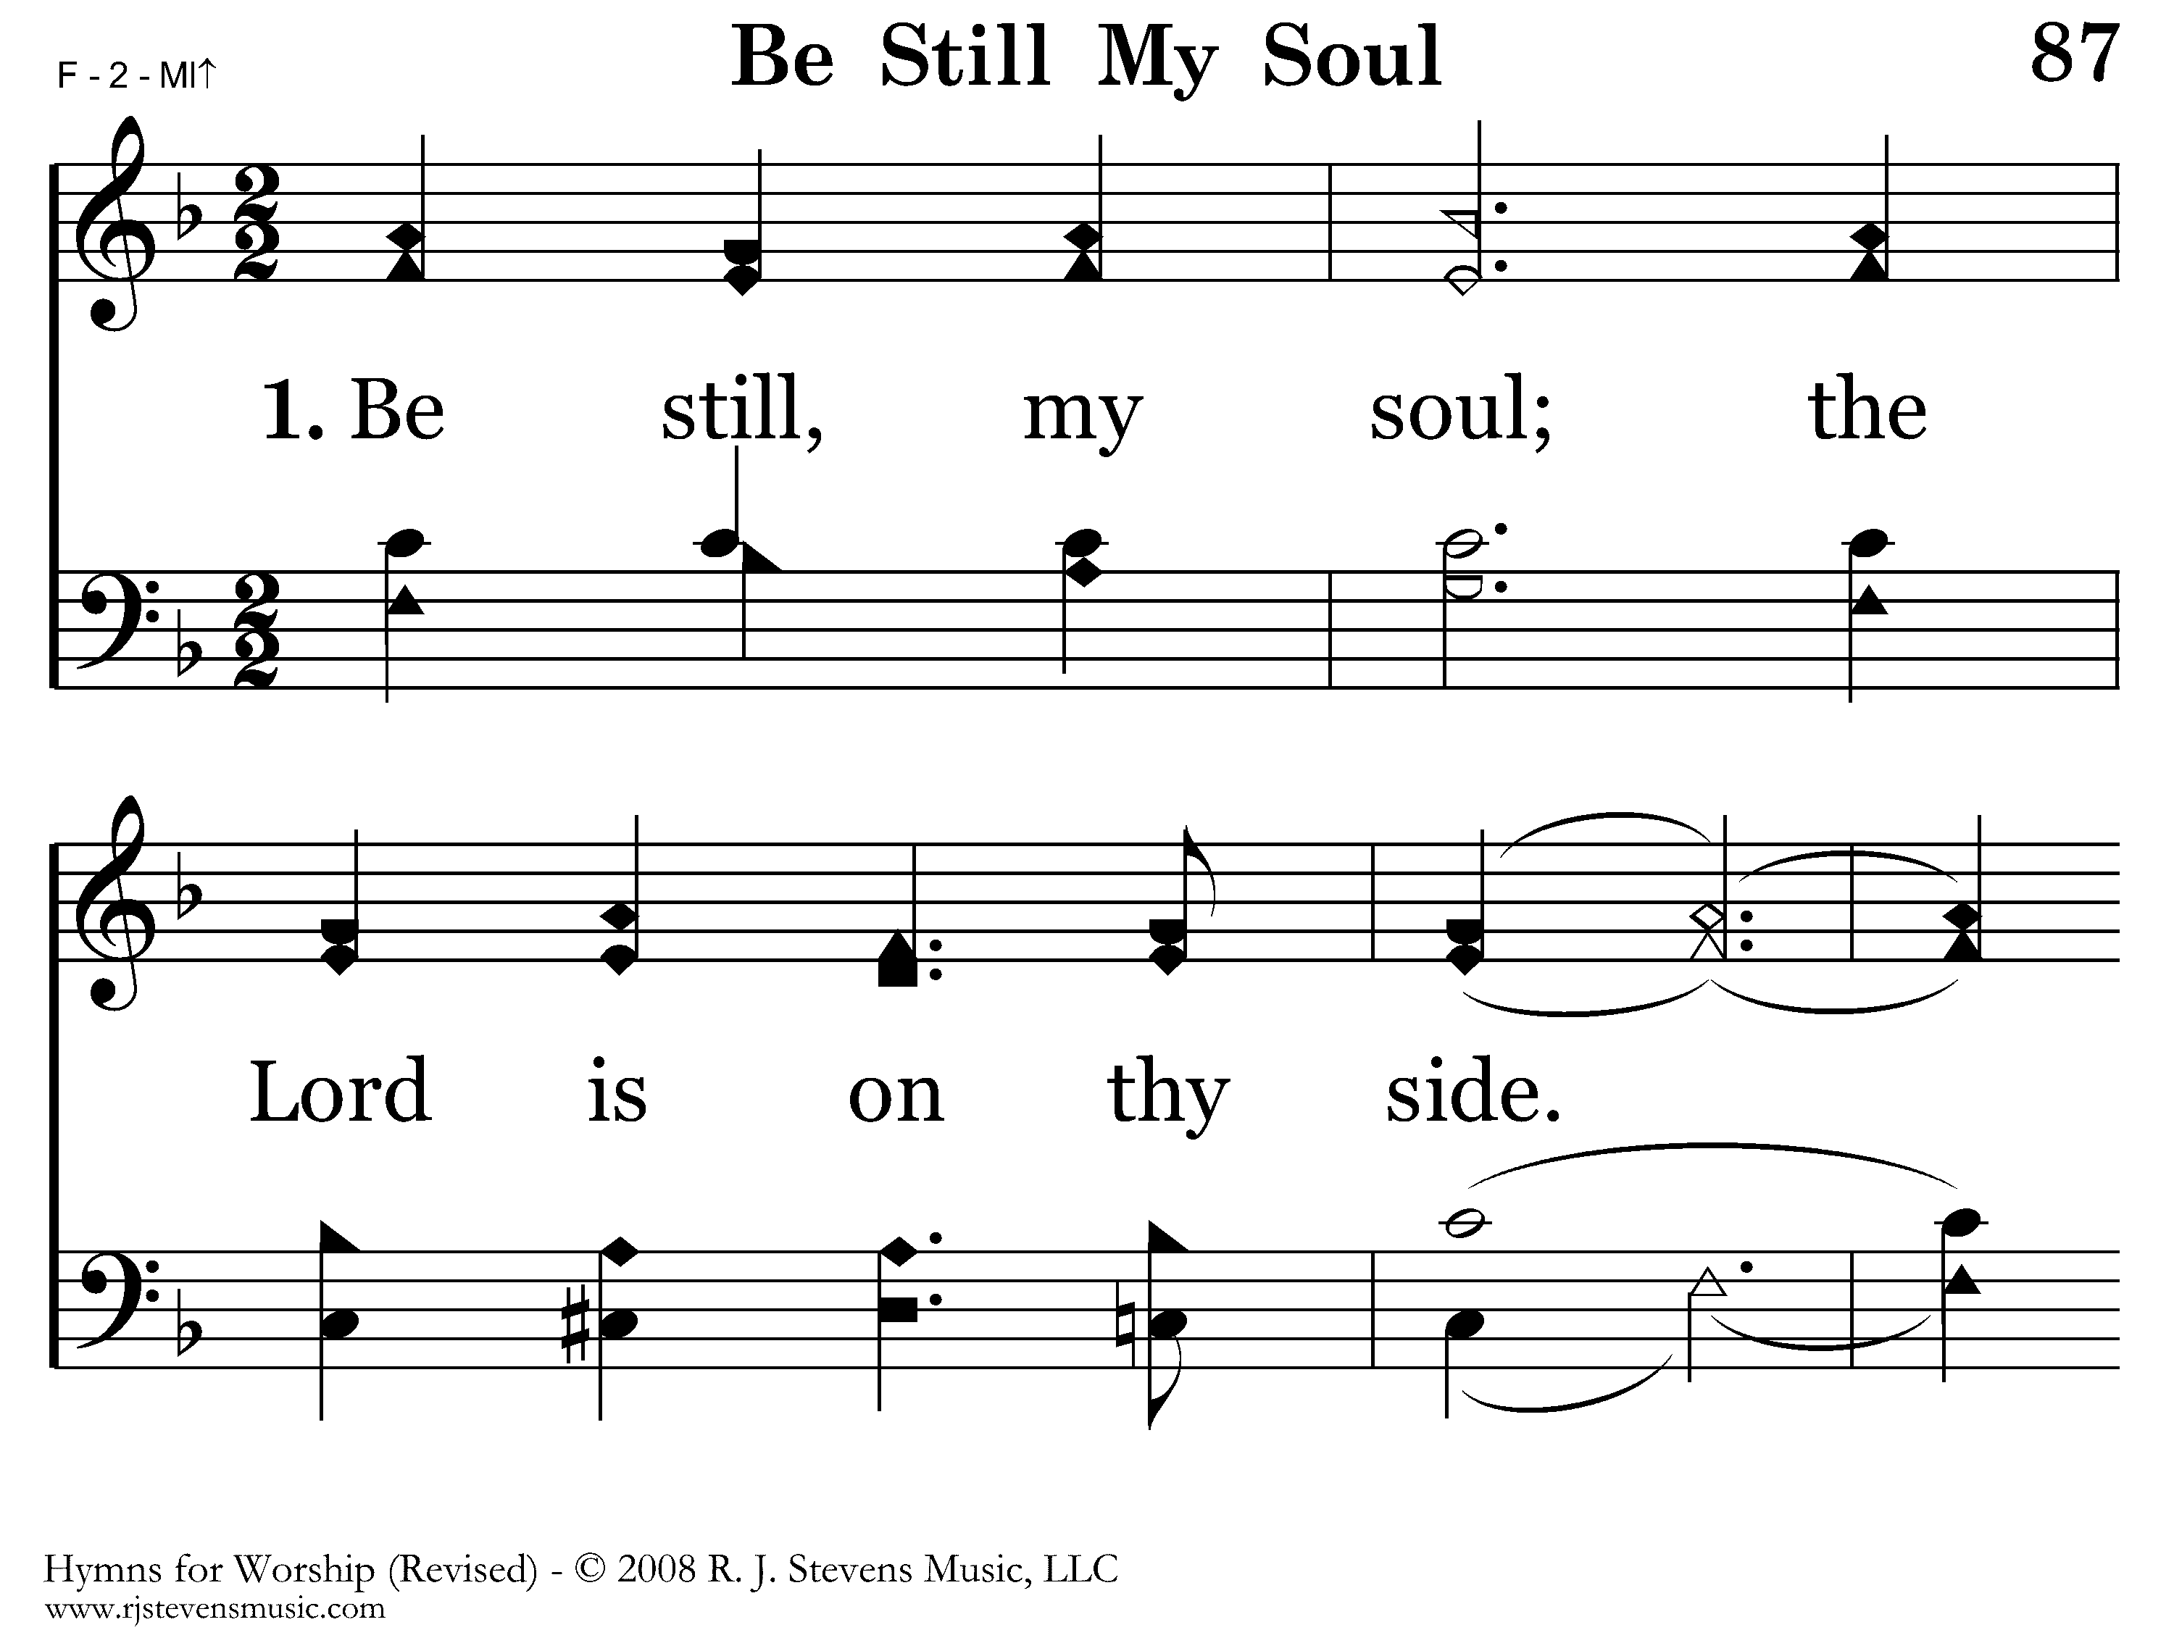
087 - Be Still My Soul - 1.1

Slide 27
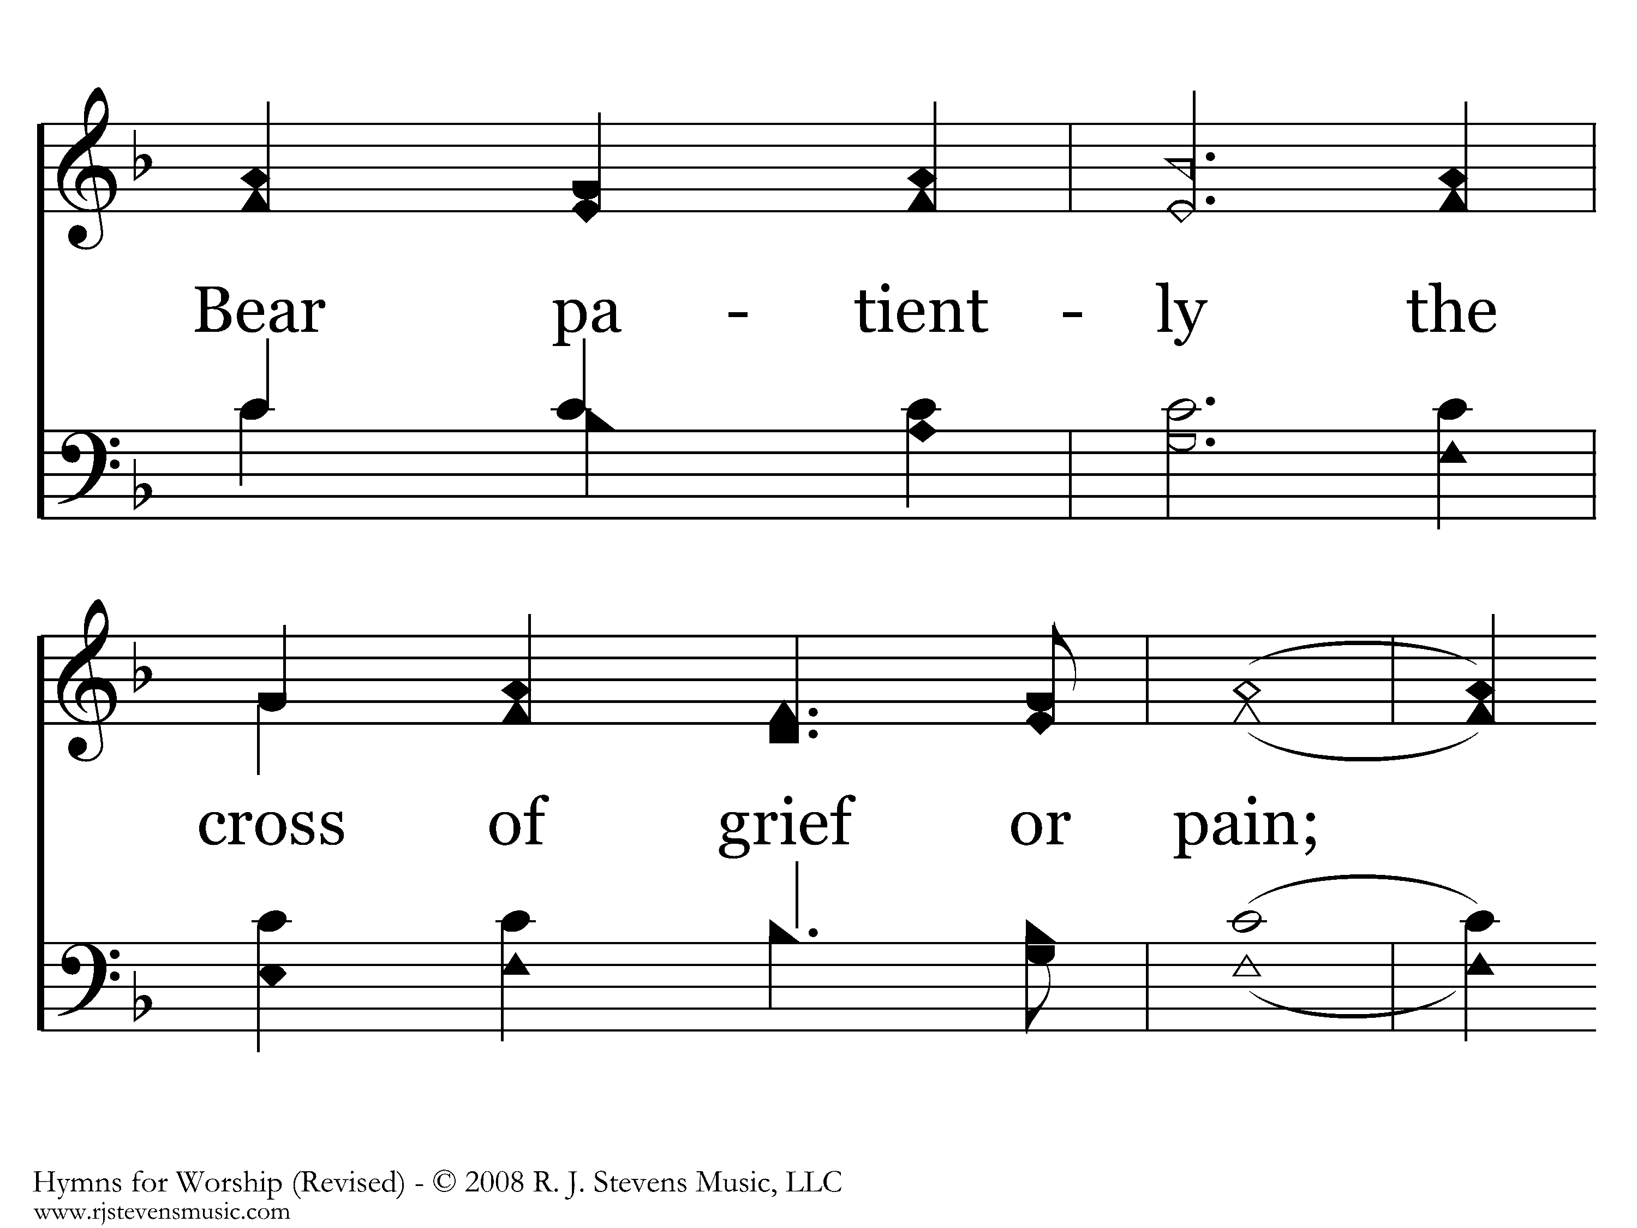
087 - Be Still My Soul - 1.2

Slide 28
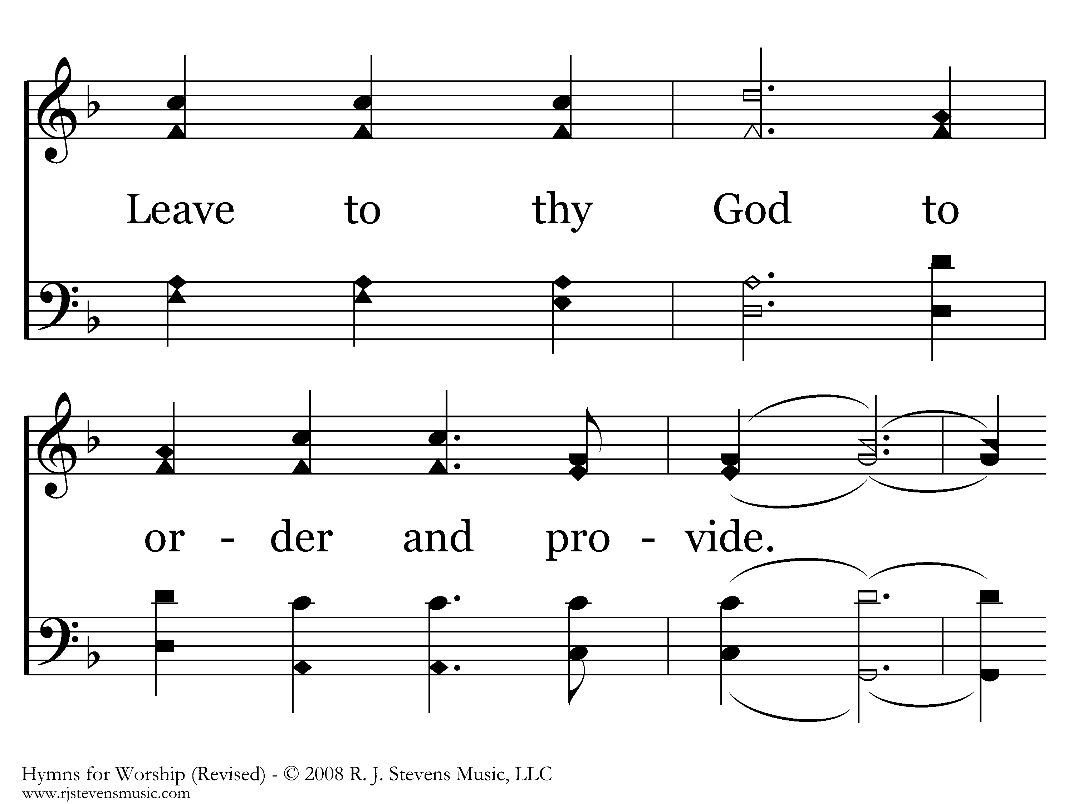
087 - Be Still My Soul - 1.3

Slide 29
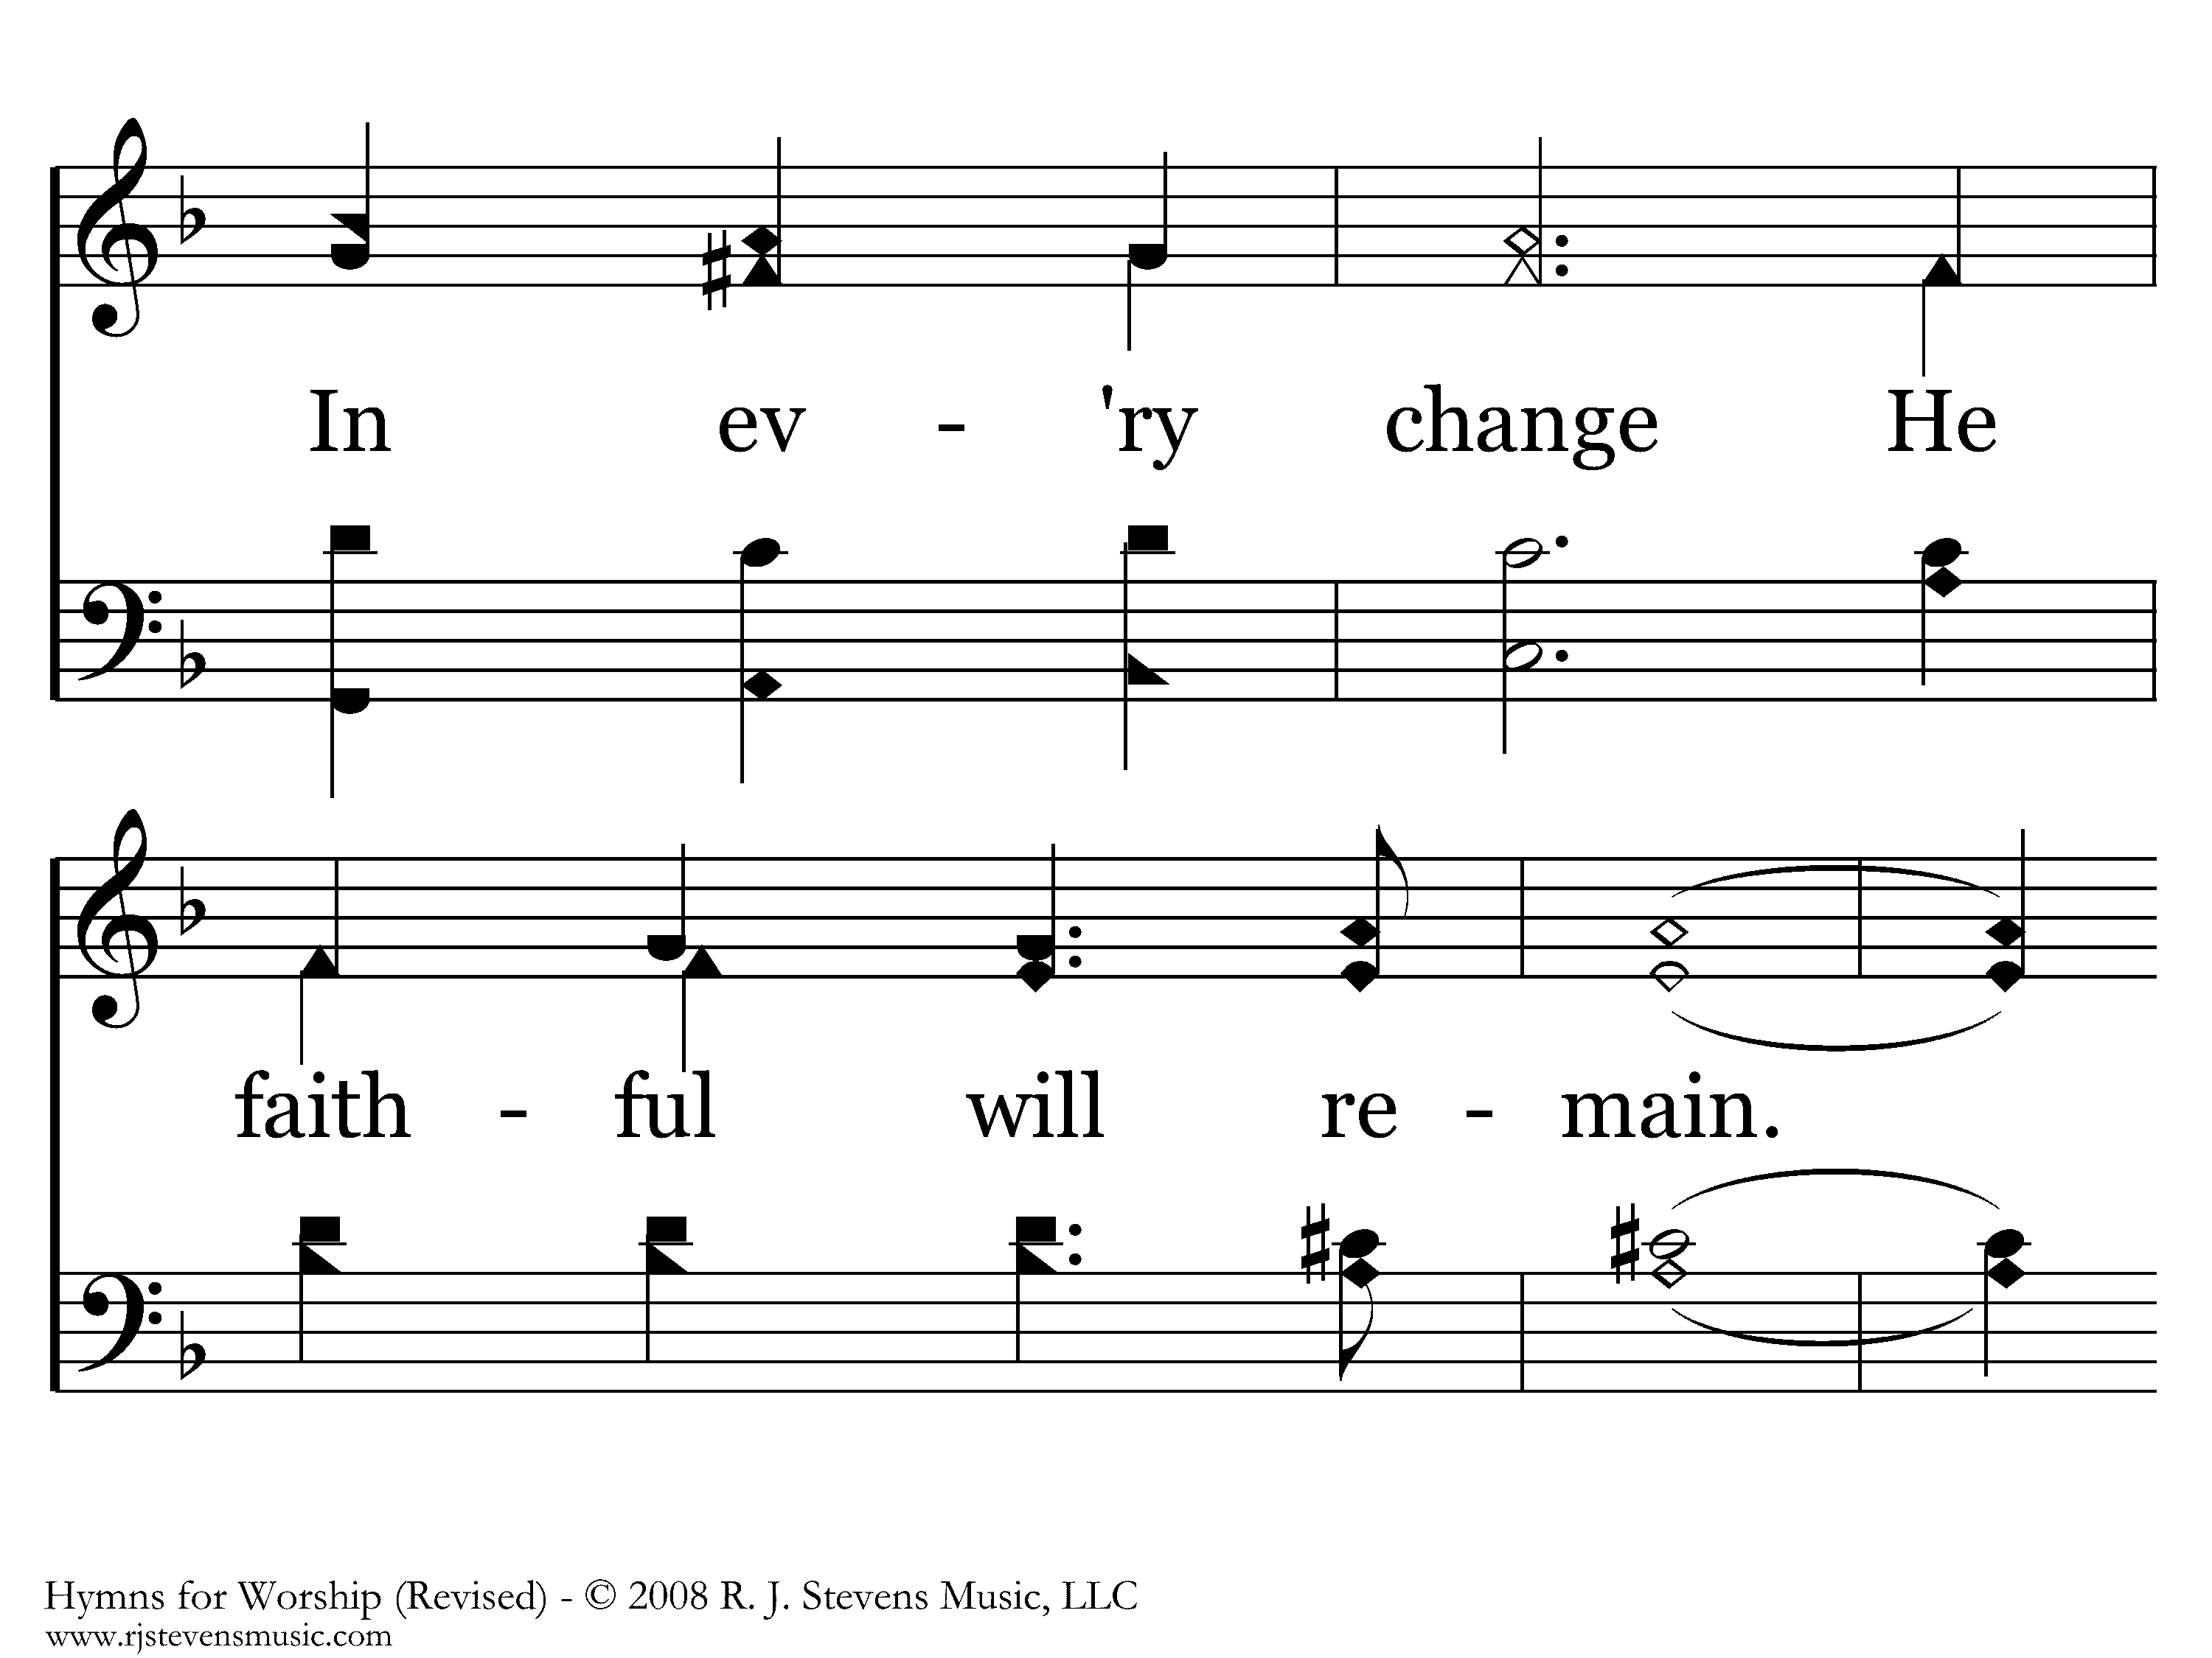
087 - Be Still My Soul - 1.4

Slide 30
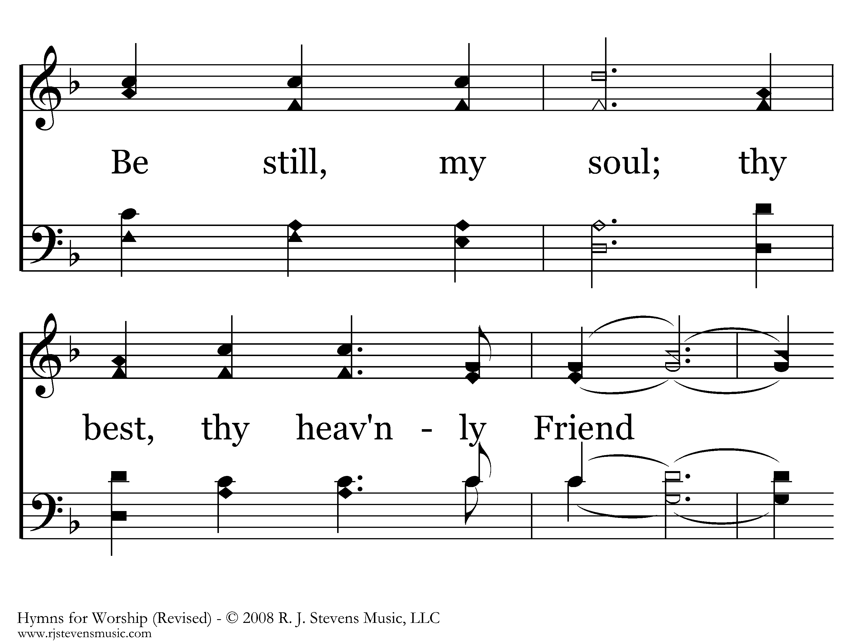
087 - Be Still My Soul - 1.5

Slide 31
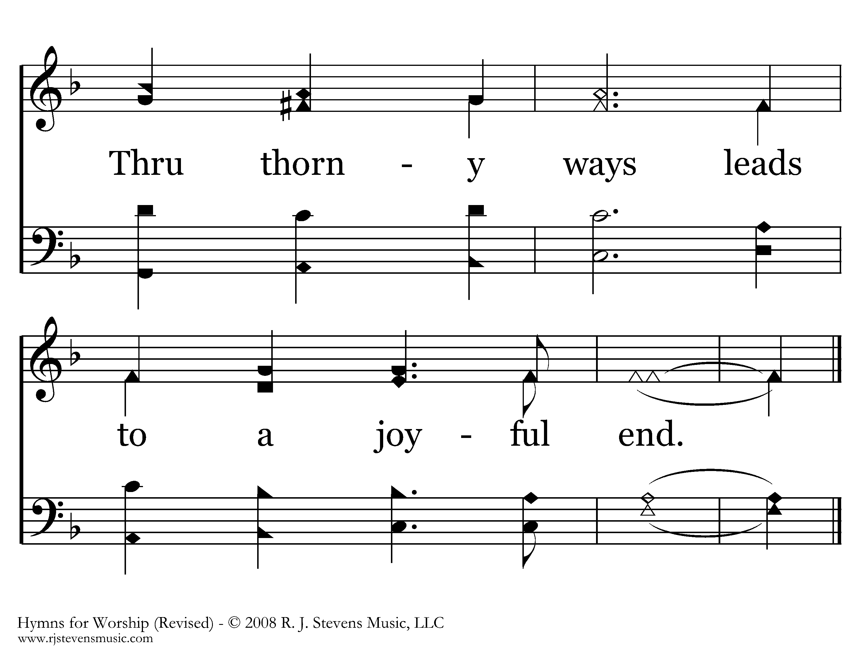
087 - Be Still My Soul - 1.6
End of Verse 1

Slide 32

087 - Be Still My Soul - 2.1

Slide 33
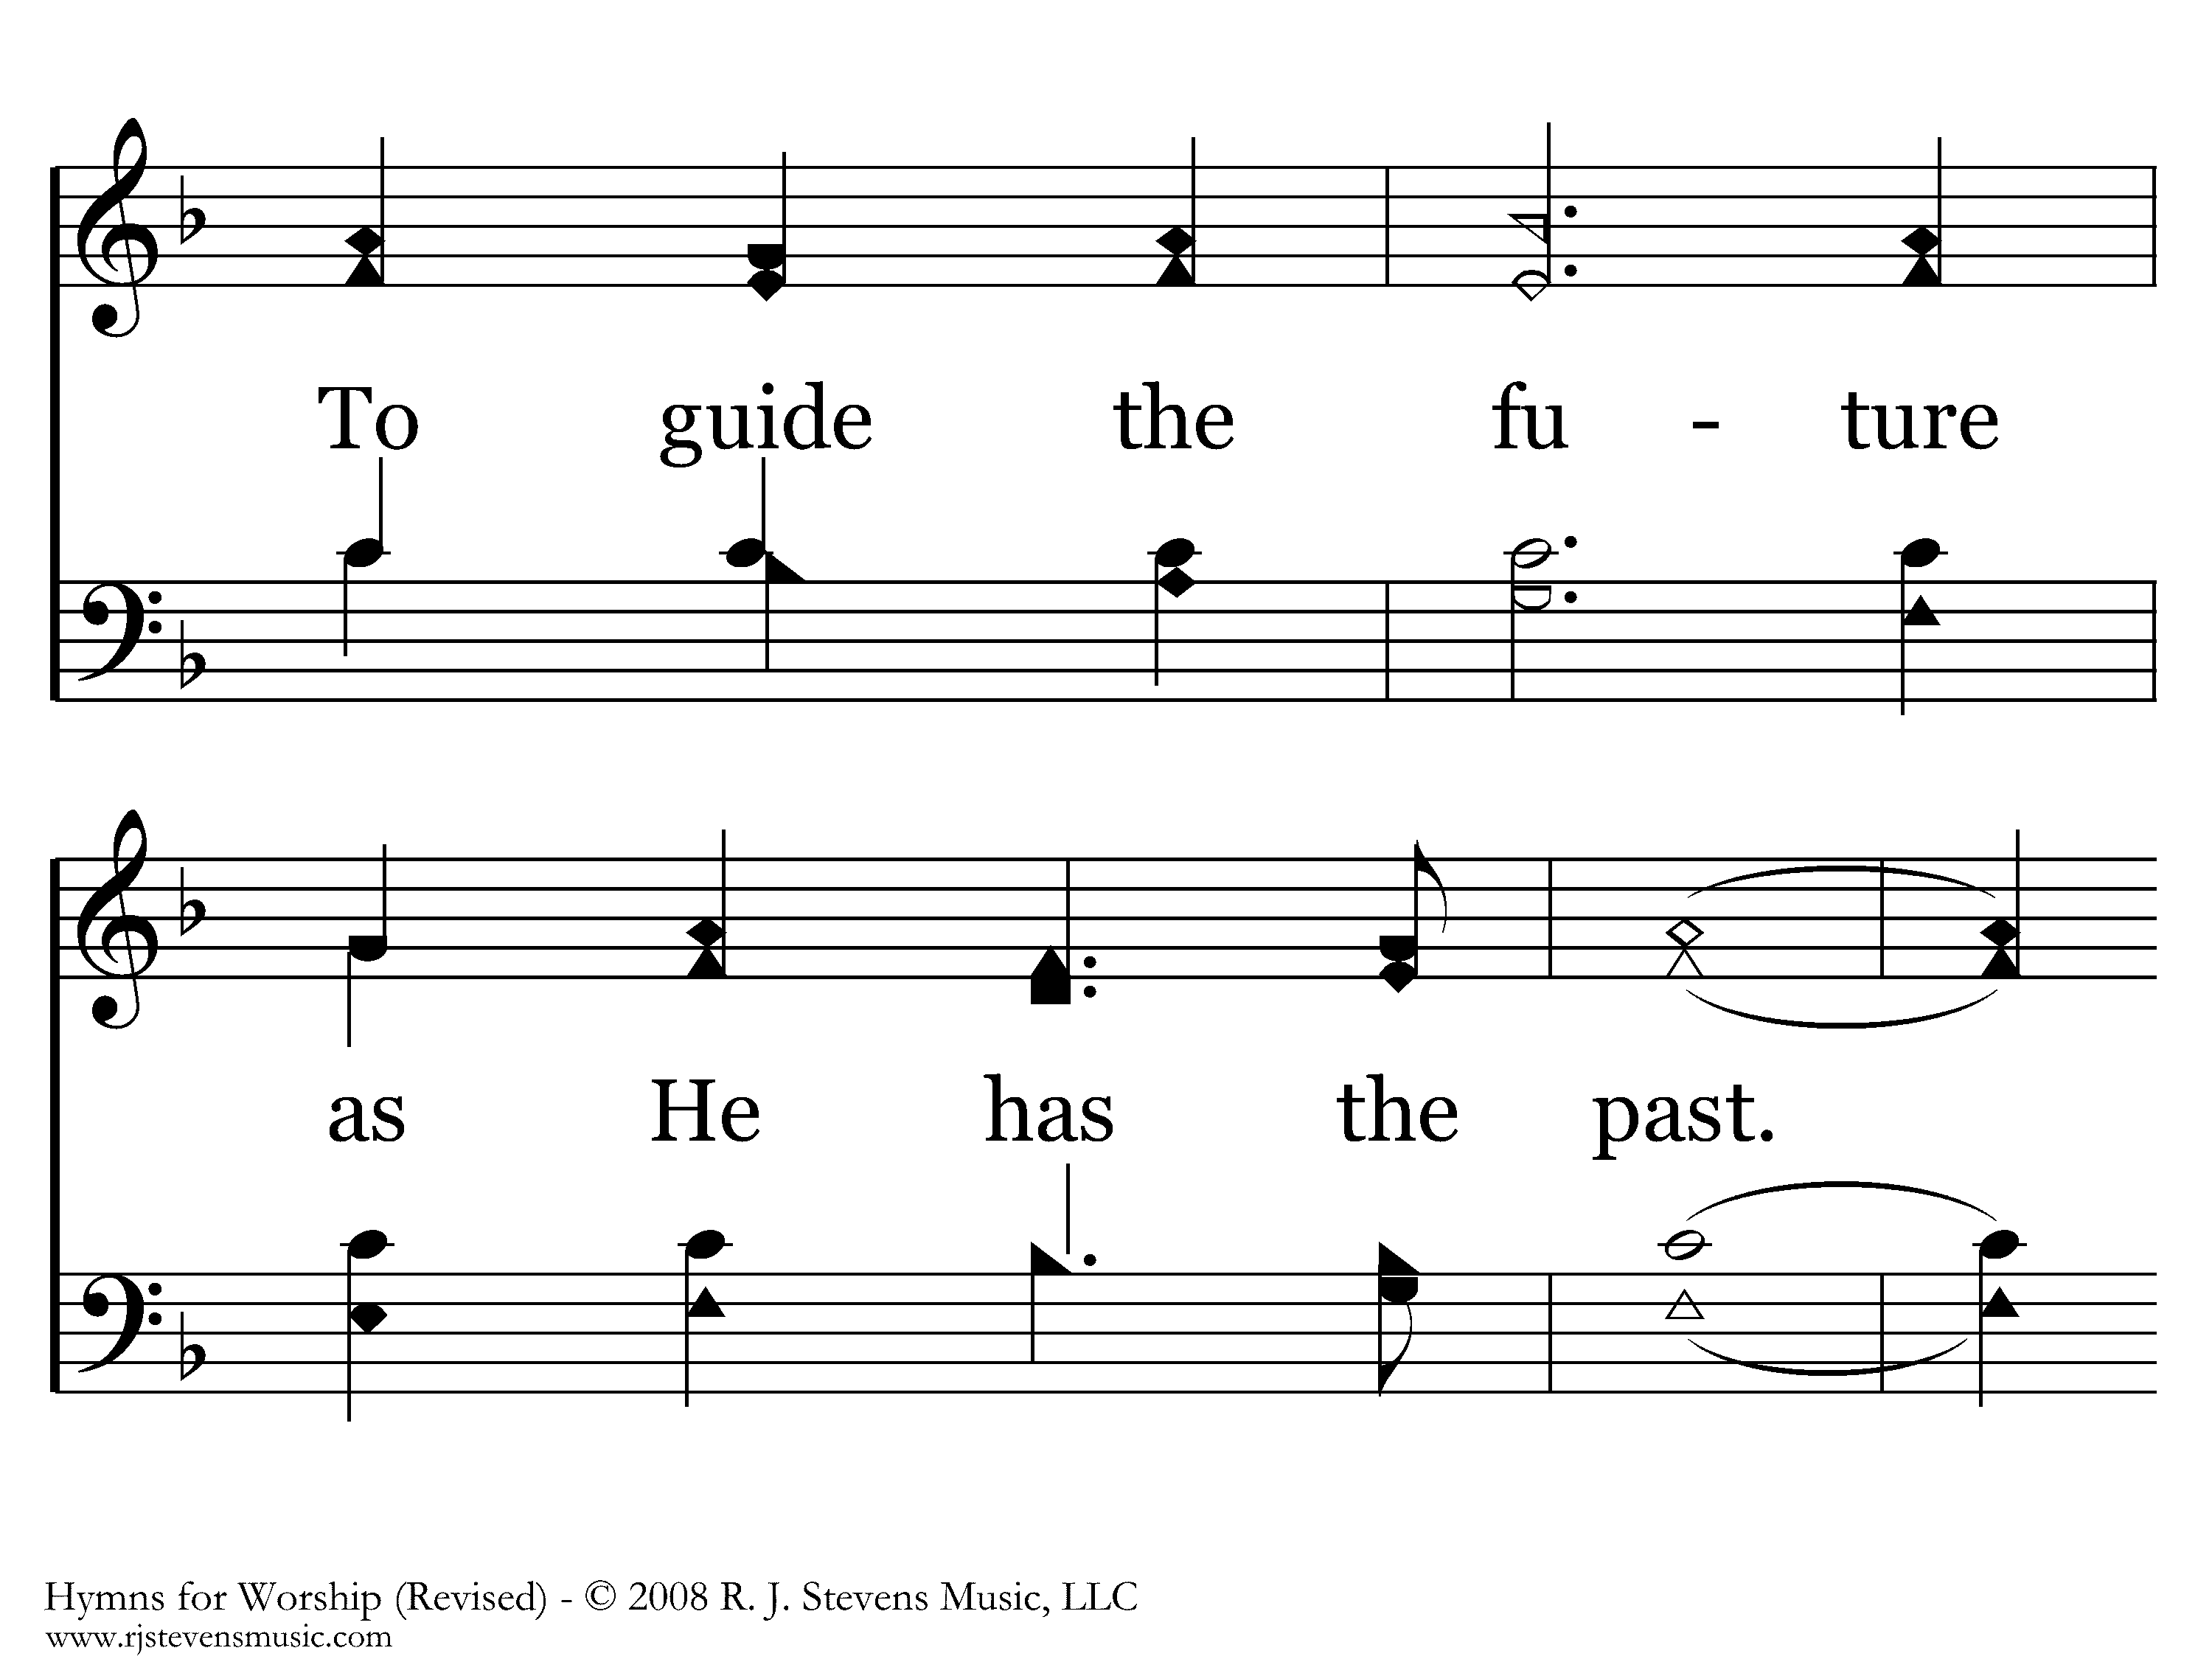
087 - Be Still My Soul - 2.2

Slide 34
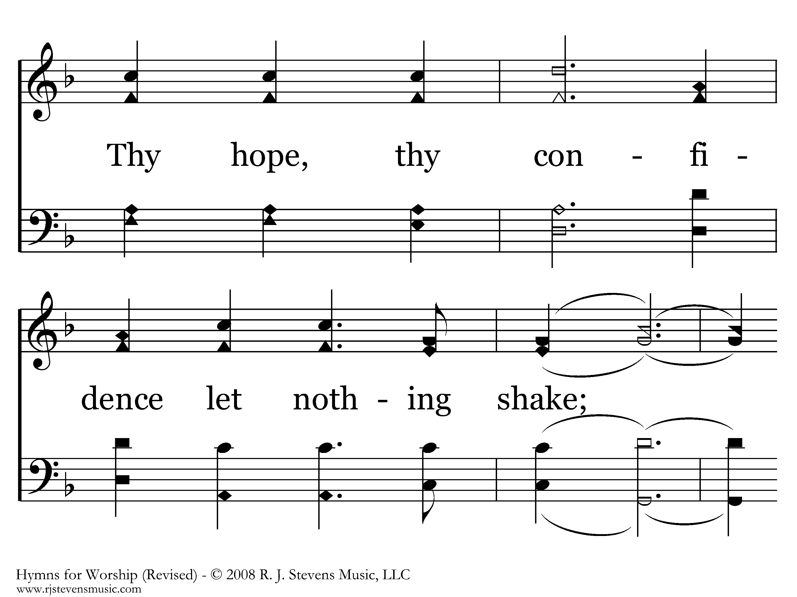
087 - Be Still My Soul - 2.3

Slide 35
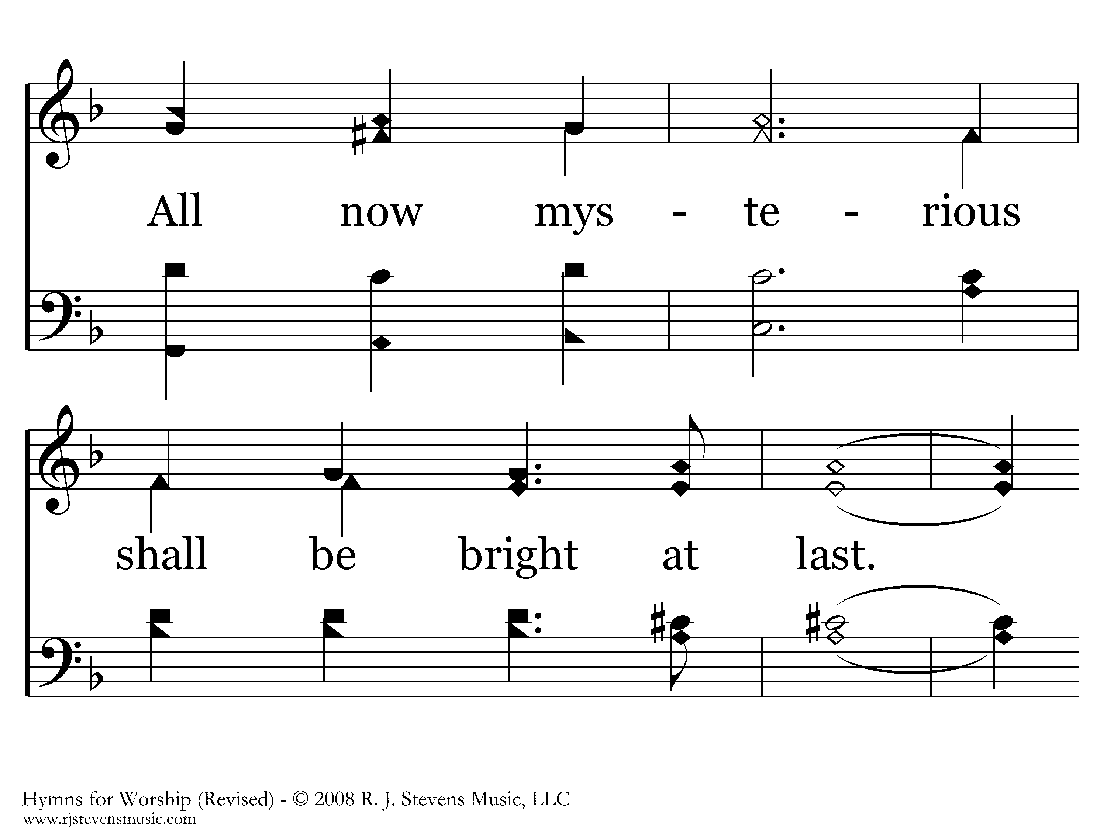
087 - Be Still My Soul - 2.4

Slide 36
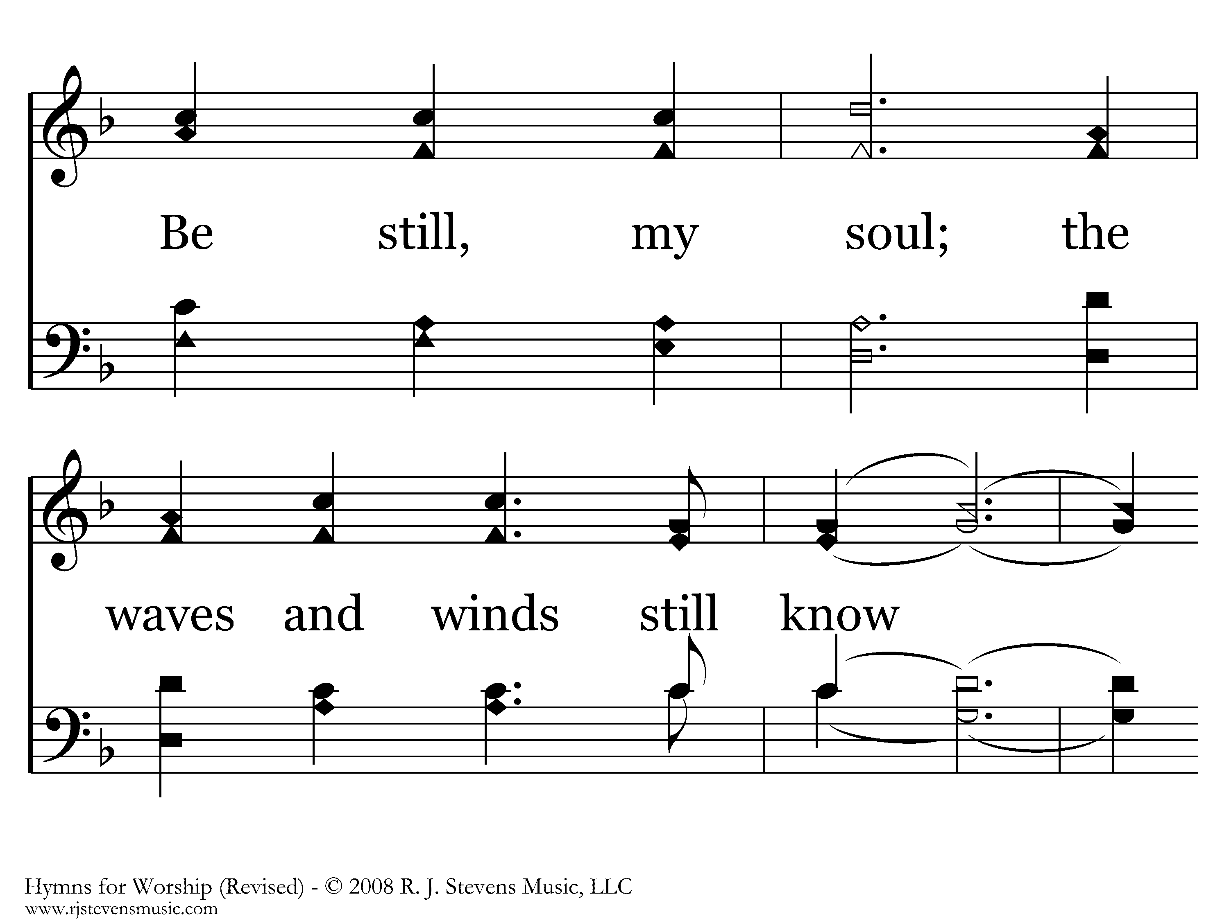
087 - Be Still My Soul - 2.5

Slide 37
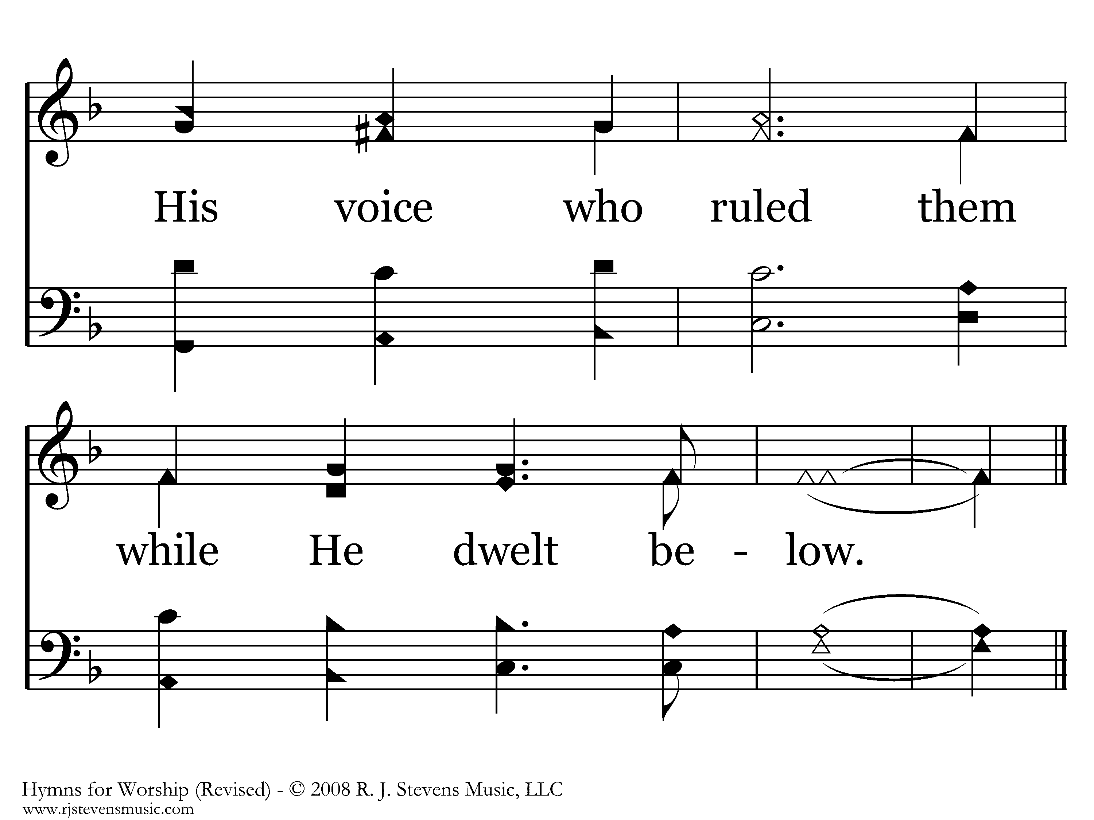
087 - Be Still My Soul - 2.6
End of Verse 2

Slide 38
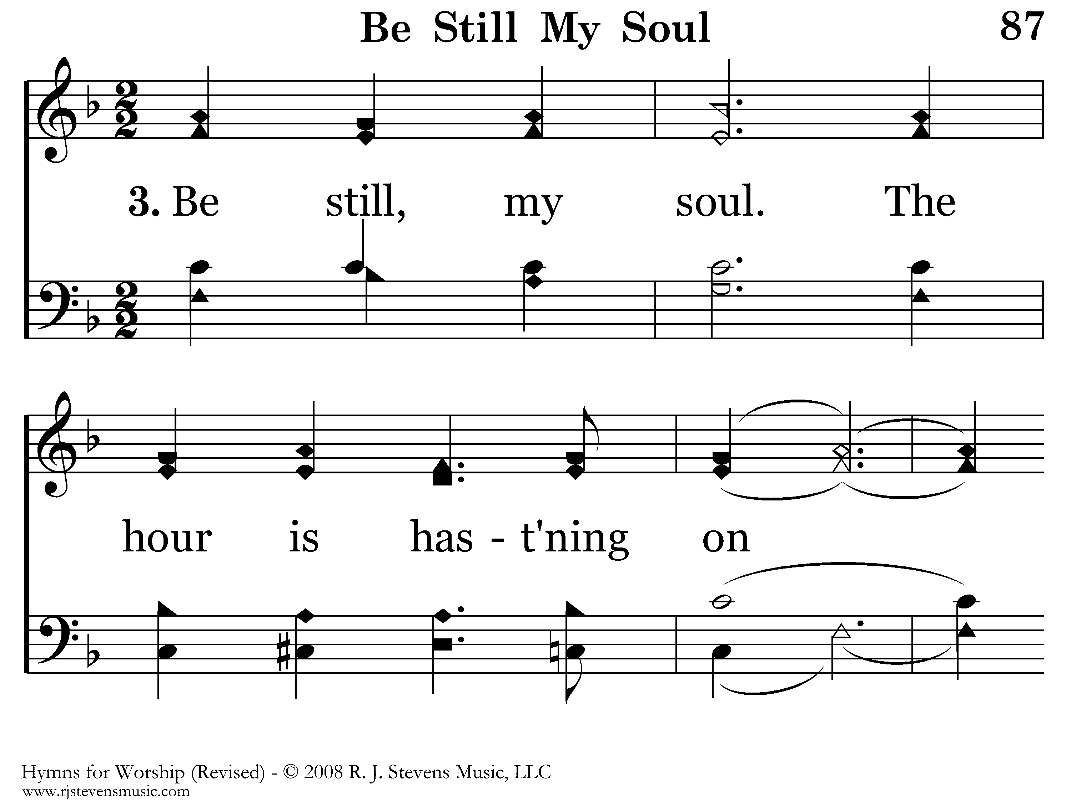
087 - Be Still My Soul - 3.1

Slide 39
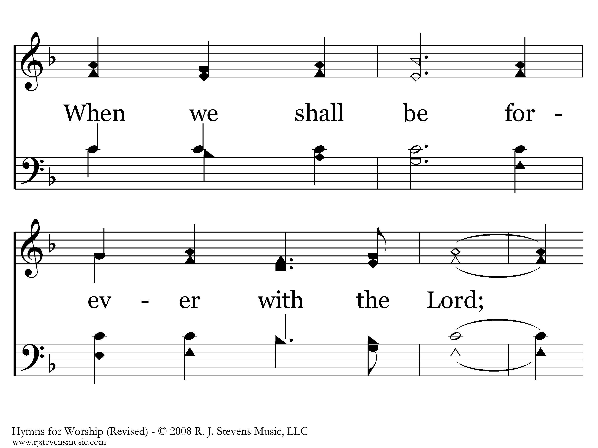
087 - Be Still My Soul - 3.2

Slide 40
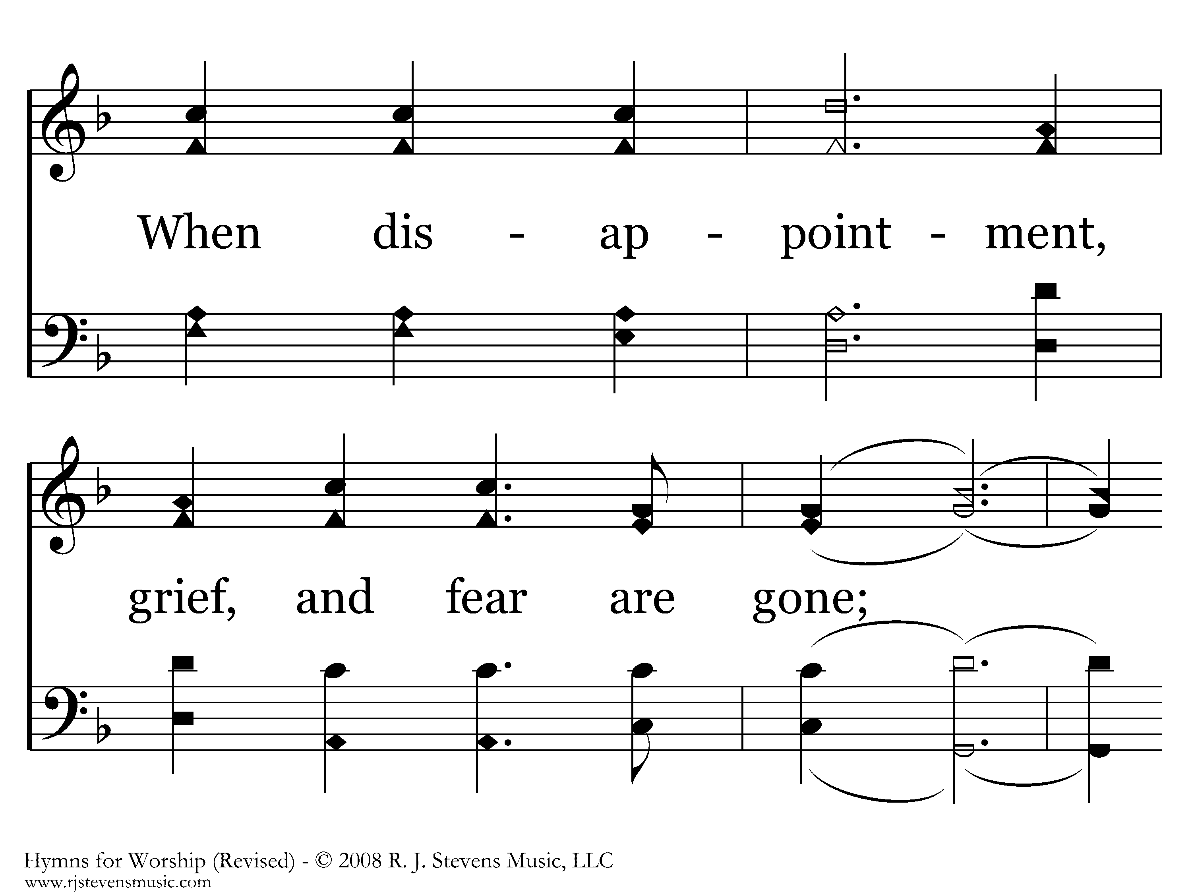
087 - Be Still My Soul - 3.3

Slide 41
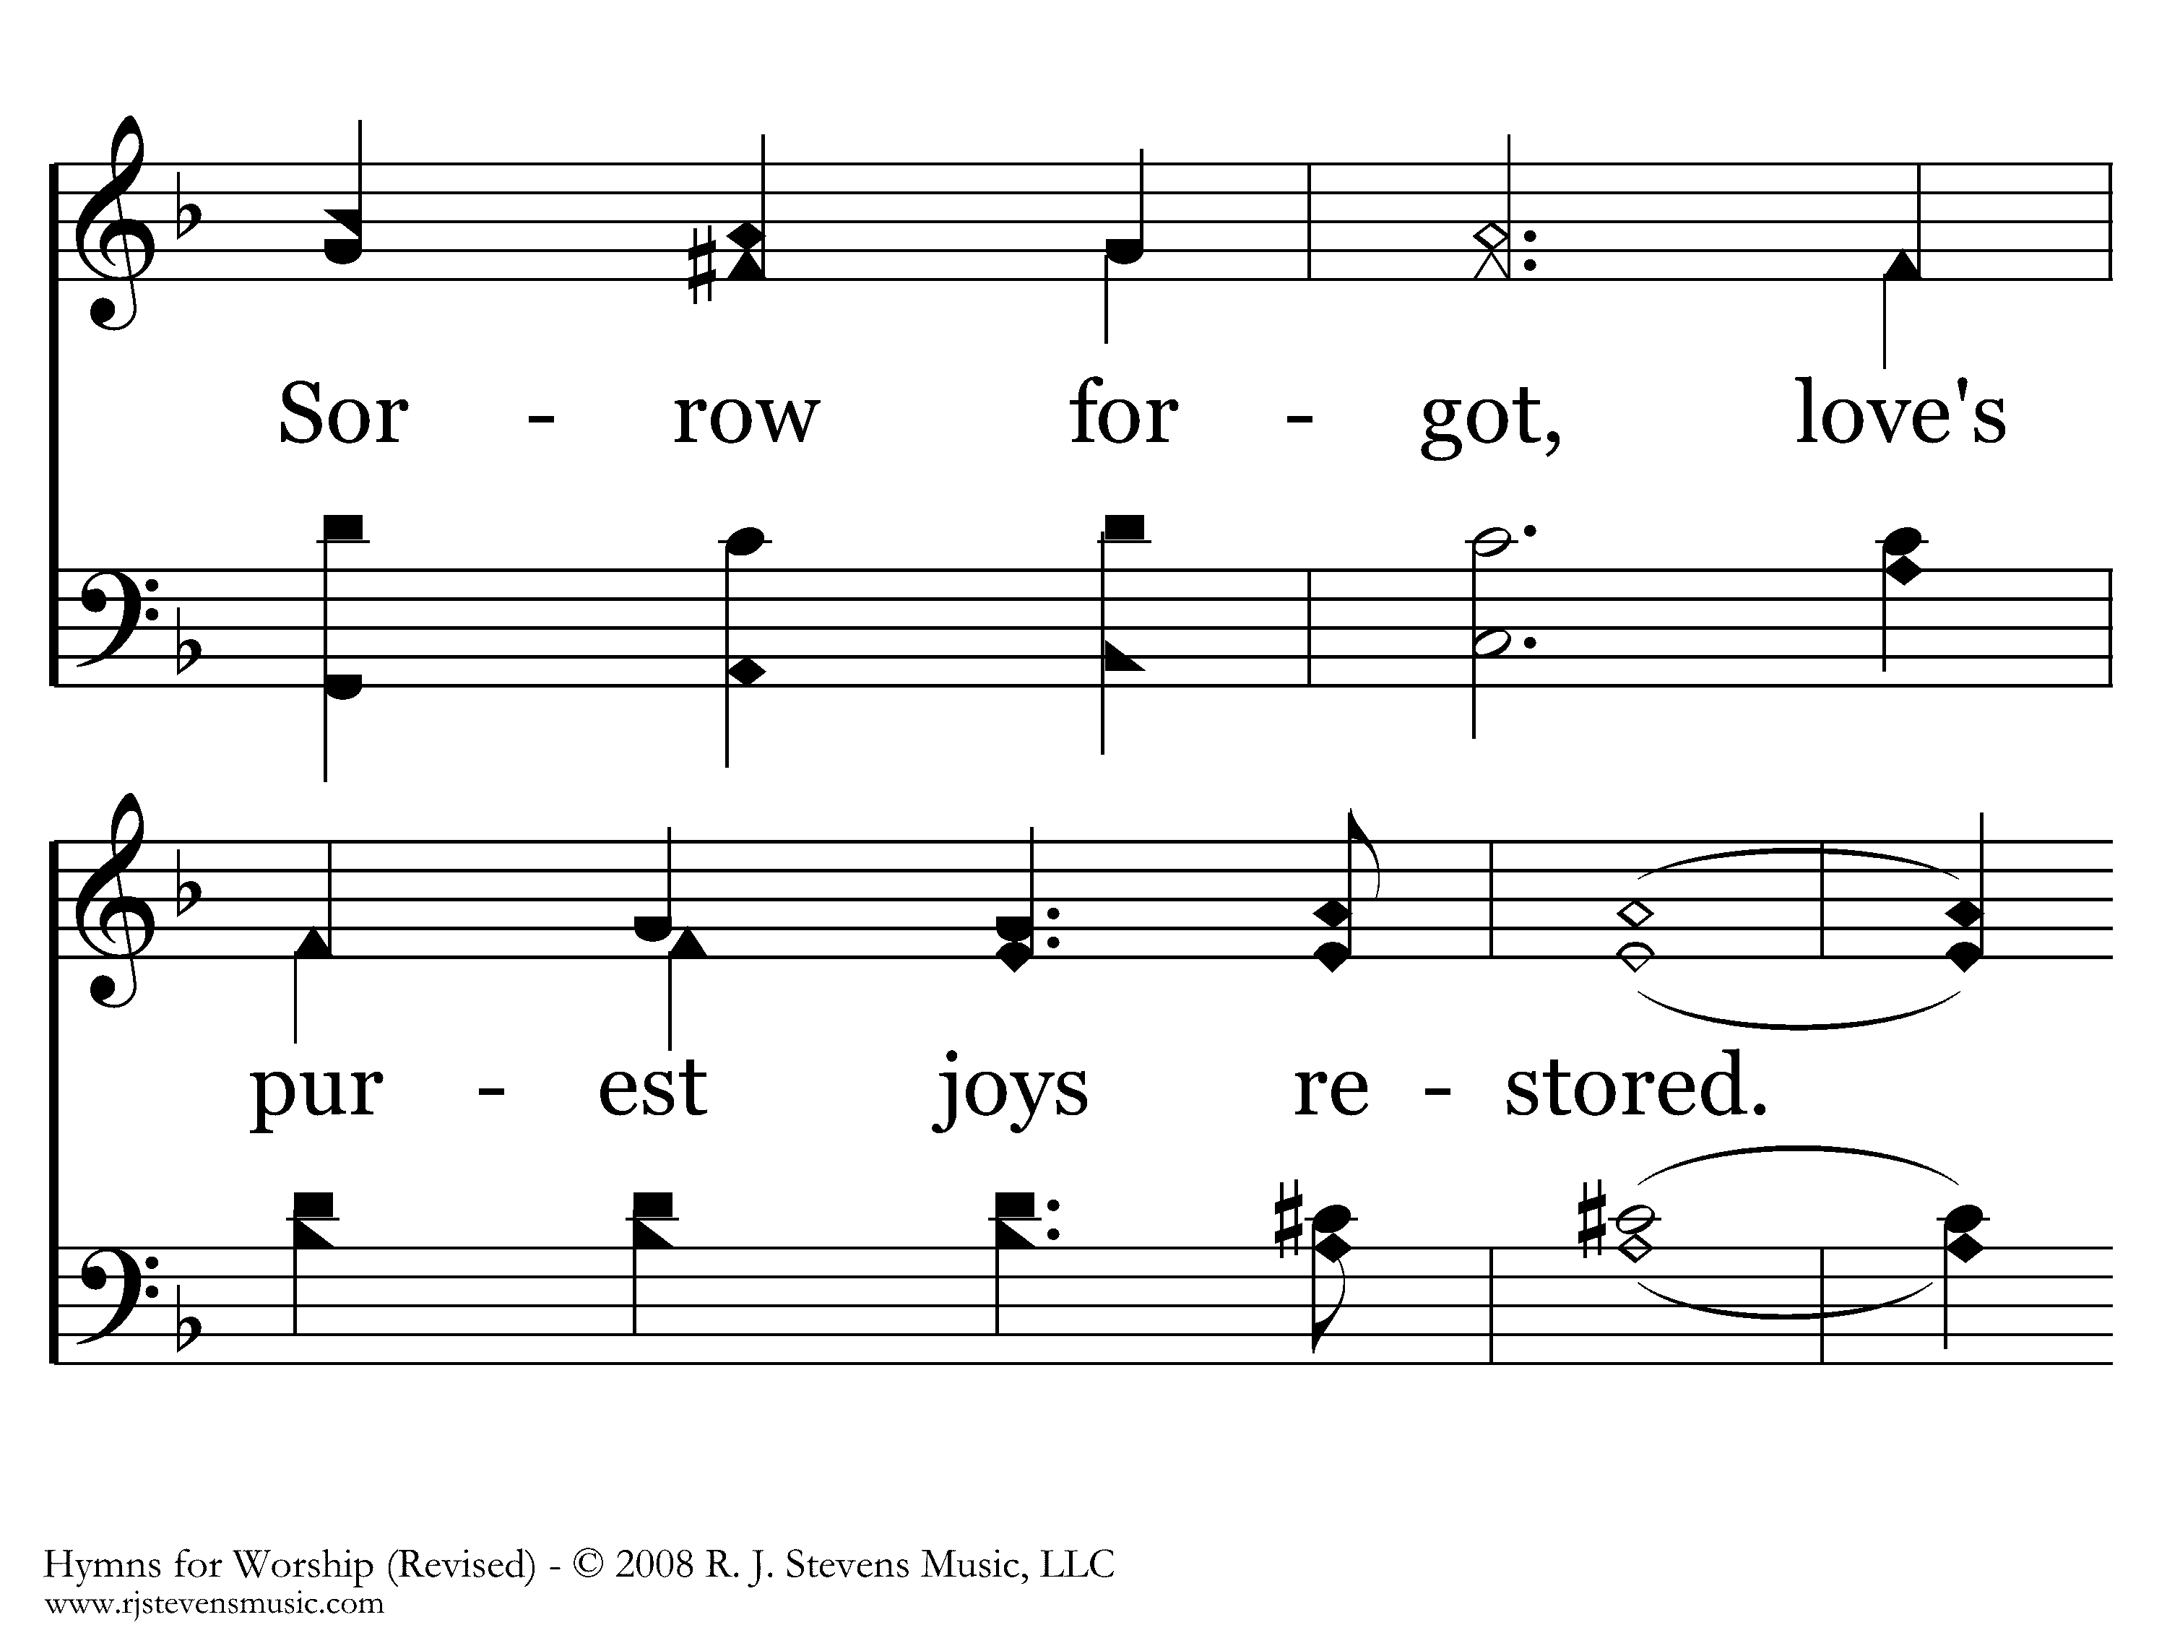
087 - Be Still My Soul - 3.4

Slide 42
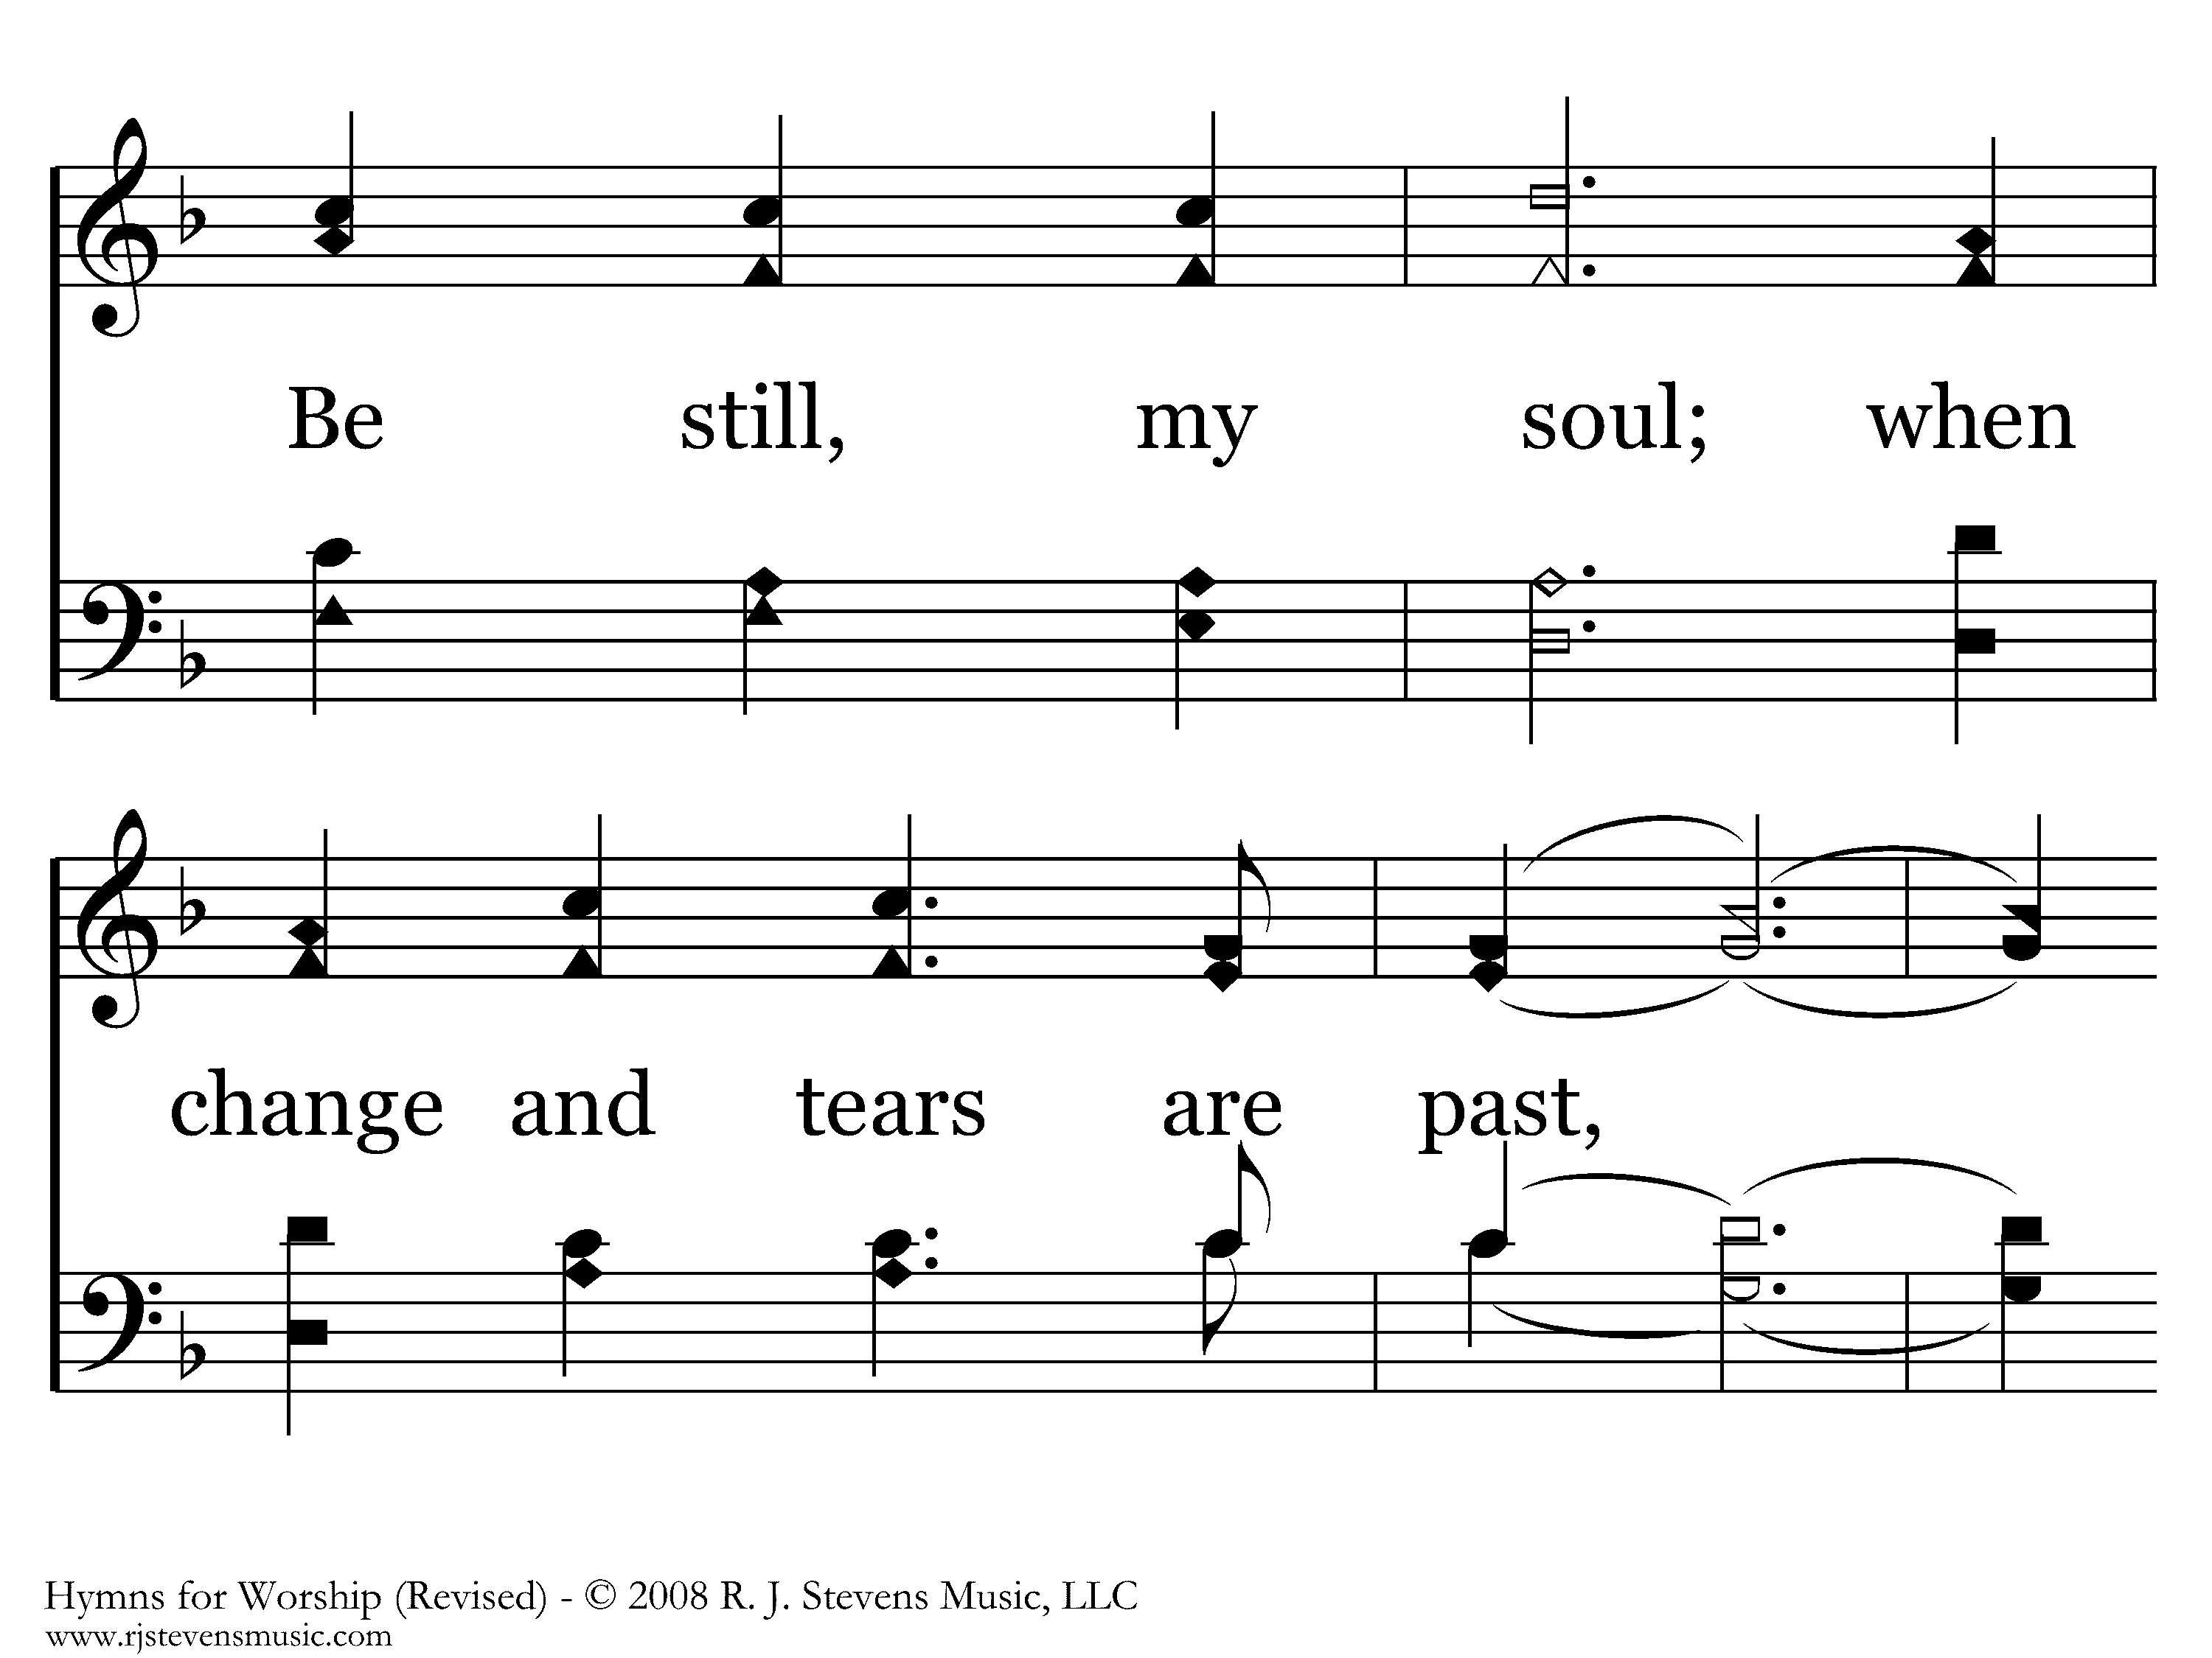
087 - Be Still My Soul - 3.5

Slide 43
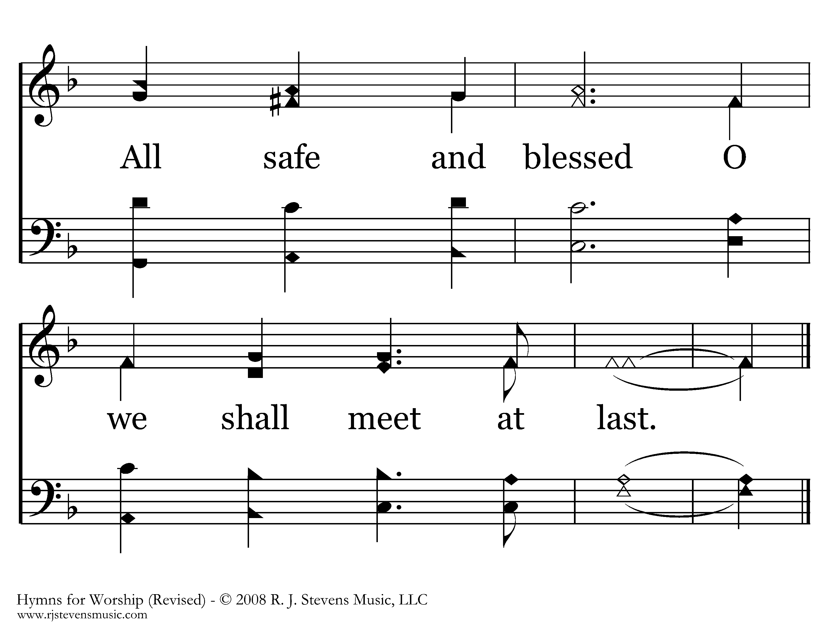
087 - Be Still My Soul - 3.6
End of Song

Slide 45
WORSHIP
WITHIN THE
VEIL
HEB 10:19
Unless otherwise indicated, all Scripture quotations are from The ESV® Bible (The Holy Bible, English Standard Version®), copyright © 2001 by Crossway, a publishing ministry of Good News Publishers. Used by permission. All rights reserved.

Slide 46
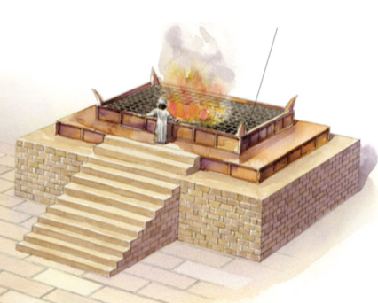
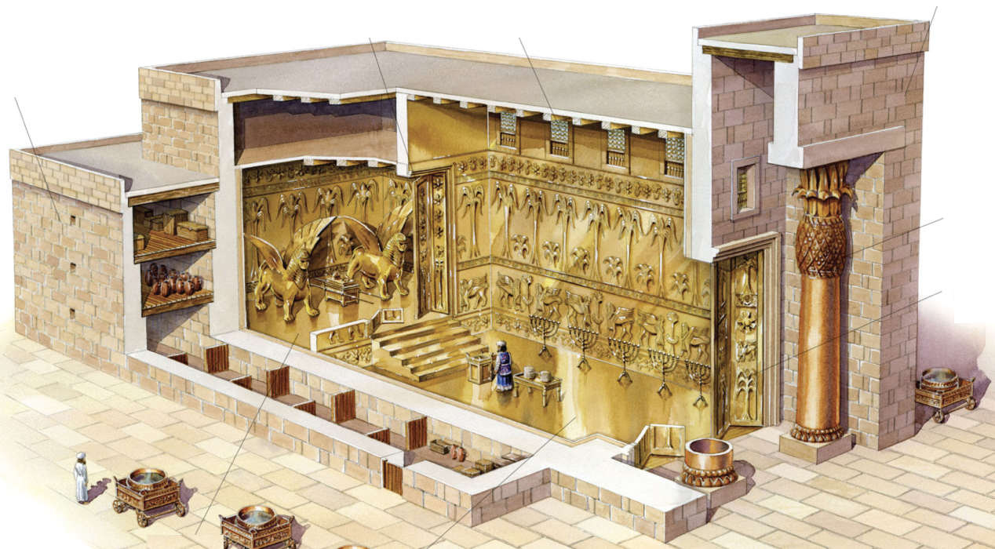
A NATION OF PRIESTS
If you are a Christian,
you are a priest of God Almighty!
The priesthood: showing what holiness looks like
Ex 19:6 - Israel: “a kingdom of priests and a holy nation”
1 Pt 2:5,9 - Christians: “a holy priesthood…
a royal priesthood”

Slide 47

A NATION OF PRIESTS
The role of priest had 2 dimensions:
Represent the people to God
(draw near, offer sacrifices, intercede, etc.)
Represent God to the people
(holy clothing, conduct, teaching about holiness [Lv 10:8ff; Dt 17:8ff])
God

Slide 48

APPROACHING GOD
God
Ex 25:8 - Lessons from the tabernacle:
I must have clean hands &
a pure heart
A death occurred to allow me to come near
I still cannot see God Himself
The tabernacle/temple said:
- God is with you
- …But keep your distance!

Slide 49
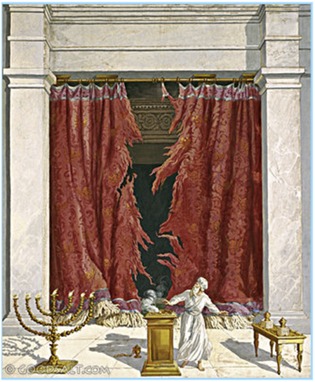
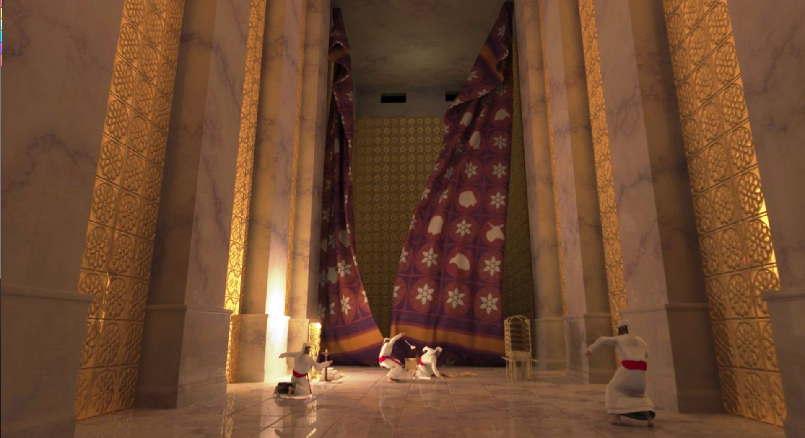
APPROACHING GOD

Slide 50
WORSHIP WITHIN THE VEIL
God
Mk 15:38 - When Jesus died, the veil was torn open.
Heb 10:19-20 - We now have an unbelievable privilege:
  By the blood of Jesus, we can enter the most holy place!
  How does this perspective transform our worship?

Slide 51
WORSHIP WITHIN THE VEIL
God
Heb 13:15-16 - How is our praise described?
    What are the qualities of a pleasing sacrifice to God?
    What are the qualities of pleasing worship to God?
    1 Chr 16:4-36 - David’s song service for the ark
    How can leaders & followers offer a better sacrifice?

Slide 52
WORSHIP WITHIN THE VEIL
God
  Preparation:
  Get your heart ready
  Perspective:
  God’s holy presence
  Participation: The more you give, the more you & others benefit
  Practice: Make hymns a habit, work at it

