Slide 1
What Unites Us
Sunday, 9:45 am
December 8, 2019
Exton

Slide 2
What Unites Us

Slide 3
Compatibility?
Considered important in choosing a mate, for maybe 50 years
Look around you – Apart from shared faith, are these we the people you’d have said, “I’d like to spend forever with that guy!”
And yet, we aspire to just that
Recent visit to a large congregation, didn’t know enough about them to say we have similar personalities or a lot of common interests, and yet...

Slide 4
“Faith!”

Slide 5
“Christ”
Eph. 2:15b
so that in Himself He might make the two into one new man, thus establishing peace
But thinking about what do we do that helps make us one…

Slide 6
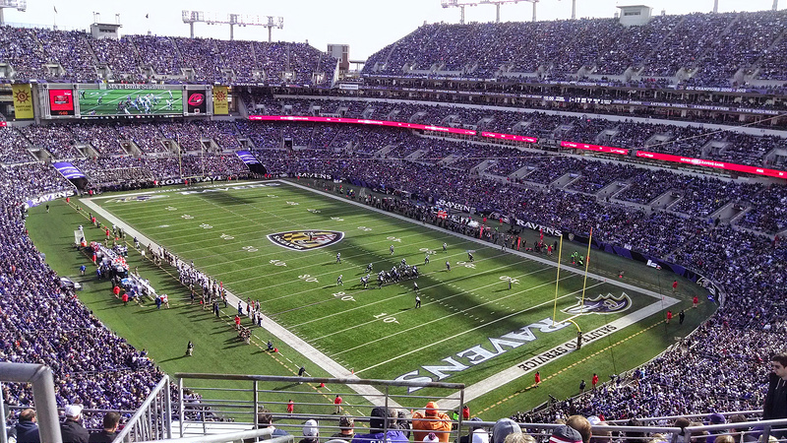
Worship
Consider a 70,000 avid fans in a football stadium….
Male & female, different occupations, races, ages, political viewpoints, some healthy, some with serious health issues, etc.
BUT, United in ONE thing they all adore OUTSIDE OF THEMSELVES

Slide 7
Worship
Consider a 70,000 avid fans in a football stadium….
Close game and exciting finish…
Are fans distracted by their disparate individual concerns?
Notes:
One who frets about not being popular and another feeling like no one has a marriage as difficult as his and another whining that her parents are too strict, and another complaining she’s just so tired? NO, they’re all focused on the team on the field!

Slide 8
Worship
Consider a 70,000 avid fans in a football stadium….
The object of our praise becomes the focus of our attention

Slide 9
Worship
The object of our praise becomes the focus of our attention

Slide 10
Praising God unites Diverse People
We are focused on and aspiring to the same thing
Simon Peter, Jewish fisherman from Galilee
& Luke, Gentile physician
Simon the Zealot (Luke 6:15)
& Matthew the tax collector (Mt 10:3)
Notes:
When focused on and aspiring to the same thing, we become united

Slide 11
Praising God Lifts Us out of Our Troubles
Psalm 22
“A Cry of Anguish and a Song of Praise”

Slide 12
Singing Praises Unites Us
United in message
– we’re saying the same thing
United in experience
– same pitch, rhythm; or if different, harmonizing and blending
United in result
– what we say when we sing reinforces our common conviction and aspiration.
Acts 4 ²⁴ And when they heard this, they lifted their voices to God with one accord and said, “O Lord, it is You who made the heaven and the earth and the sea, and all that is in them”

Slide 13
Worship Unites Us with All of God’s Creation
“This is My Father’s World” (#127, 2nd Stanza)
Psalm 19:1
Psalm 148
This is my Father's world The birds their carols raise The morning light, the lily white Declare their maker's praise
The heavens are telling of the glory of God; And their expanse is declaring the work of His hands.
Notes:
“ When we raise our voice in praise to our God, we join with all of creation in a Great Song that has been sung from the dawn of time and will ring out through all eternity.”

Slide 14
We Identify with the Object of Our Worship
football fans:
"we lost” / “we won” “we aren’t tackling very well”
wear the colors
won’t wear the rivals colors!

Slide 15
We Identify with the Object of Our Worship
“We Become What We Worship: A Biblical Theology of Idolatry”
to those who “Call on Him as Father”...
“You shall be holy, for I am holy” (1 Peter 1:16)
Ephesians 4:11-16
Ephesians 4-6
Romans 8:29 For those whom He foreknew, He also predestined to become conformed to the image of His Son, so that He would be the firstborn among many brethren

Slide 16
Worshiping God (outside of ourselves)
vs.
Worshiping ourselves
God

