Slide 1
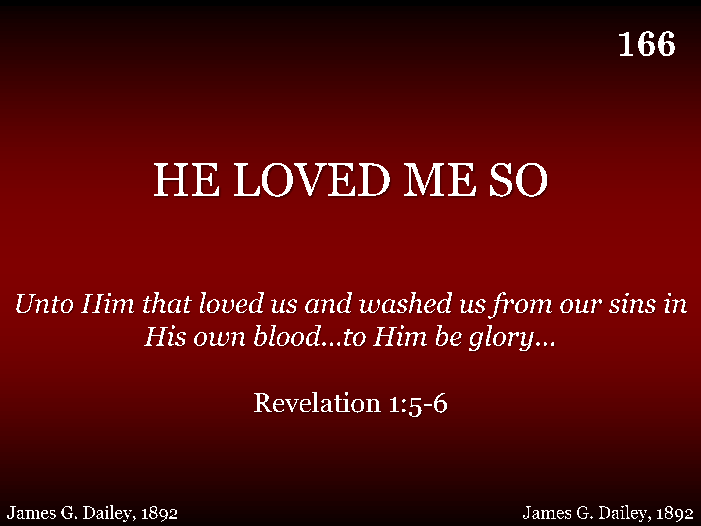
166 - He Loved Me So - Title

Slide 2
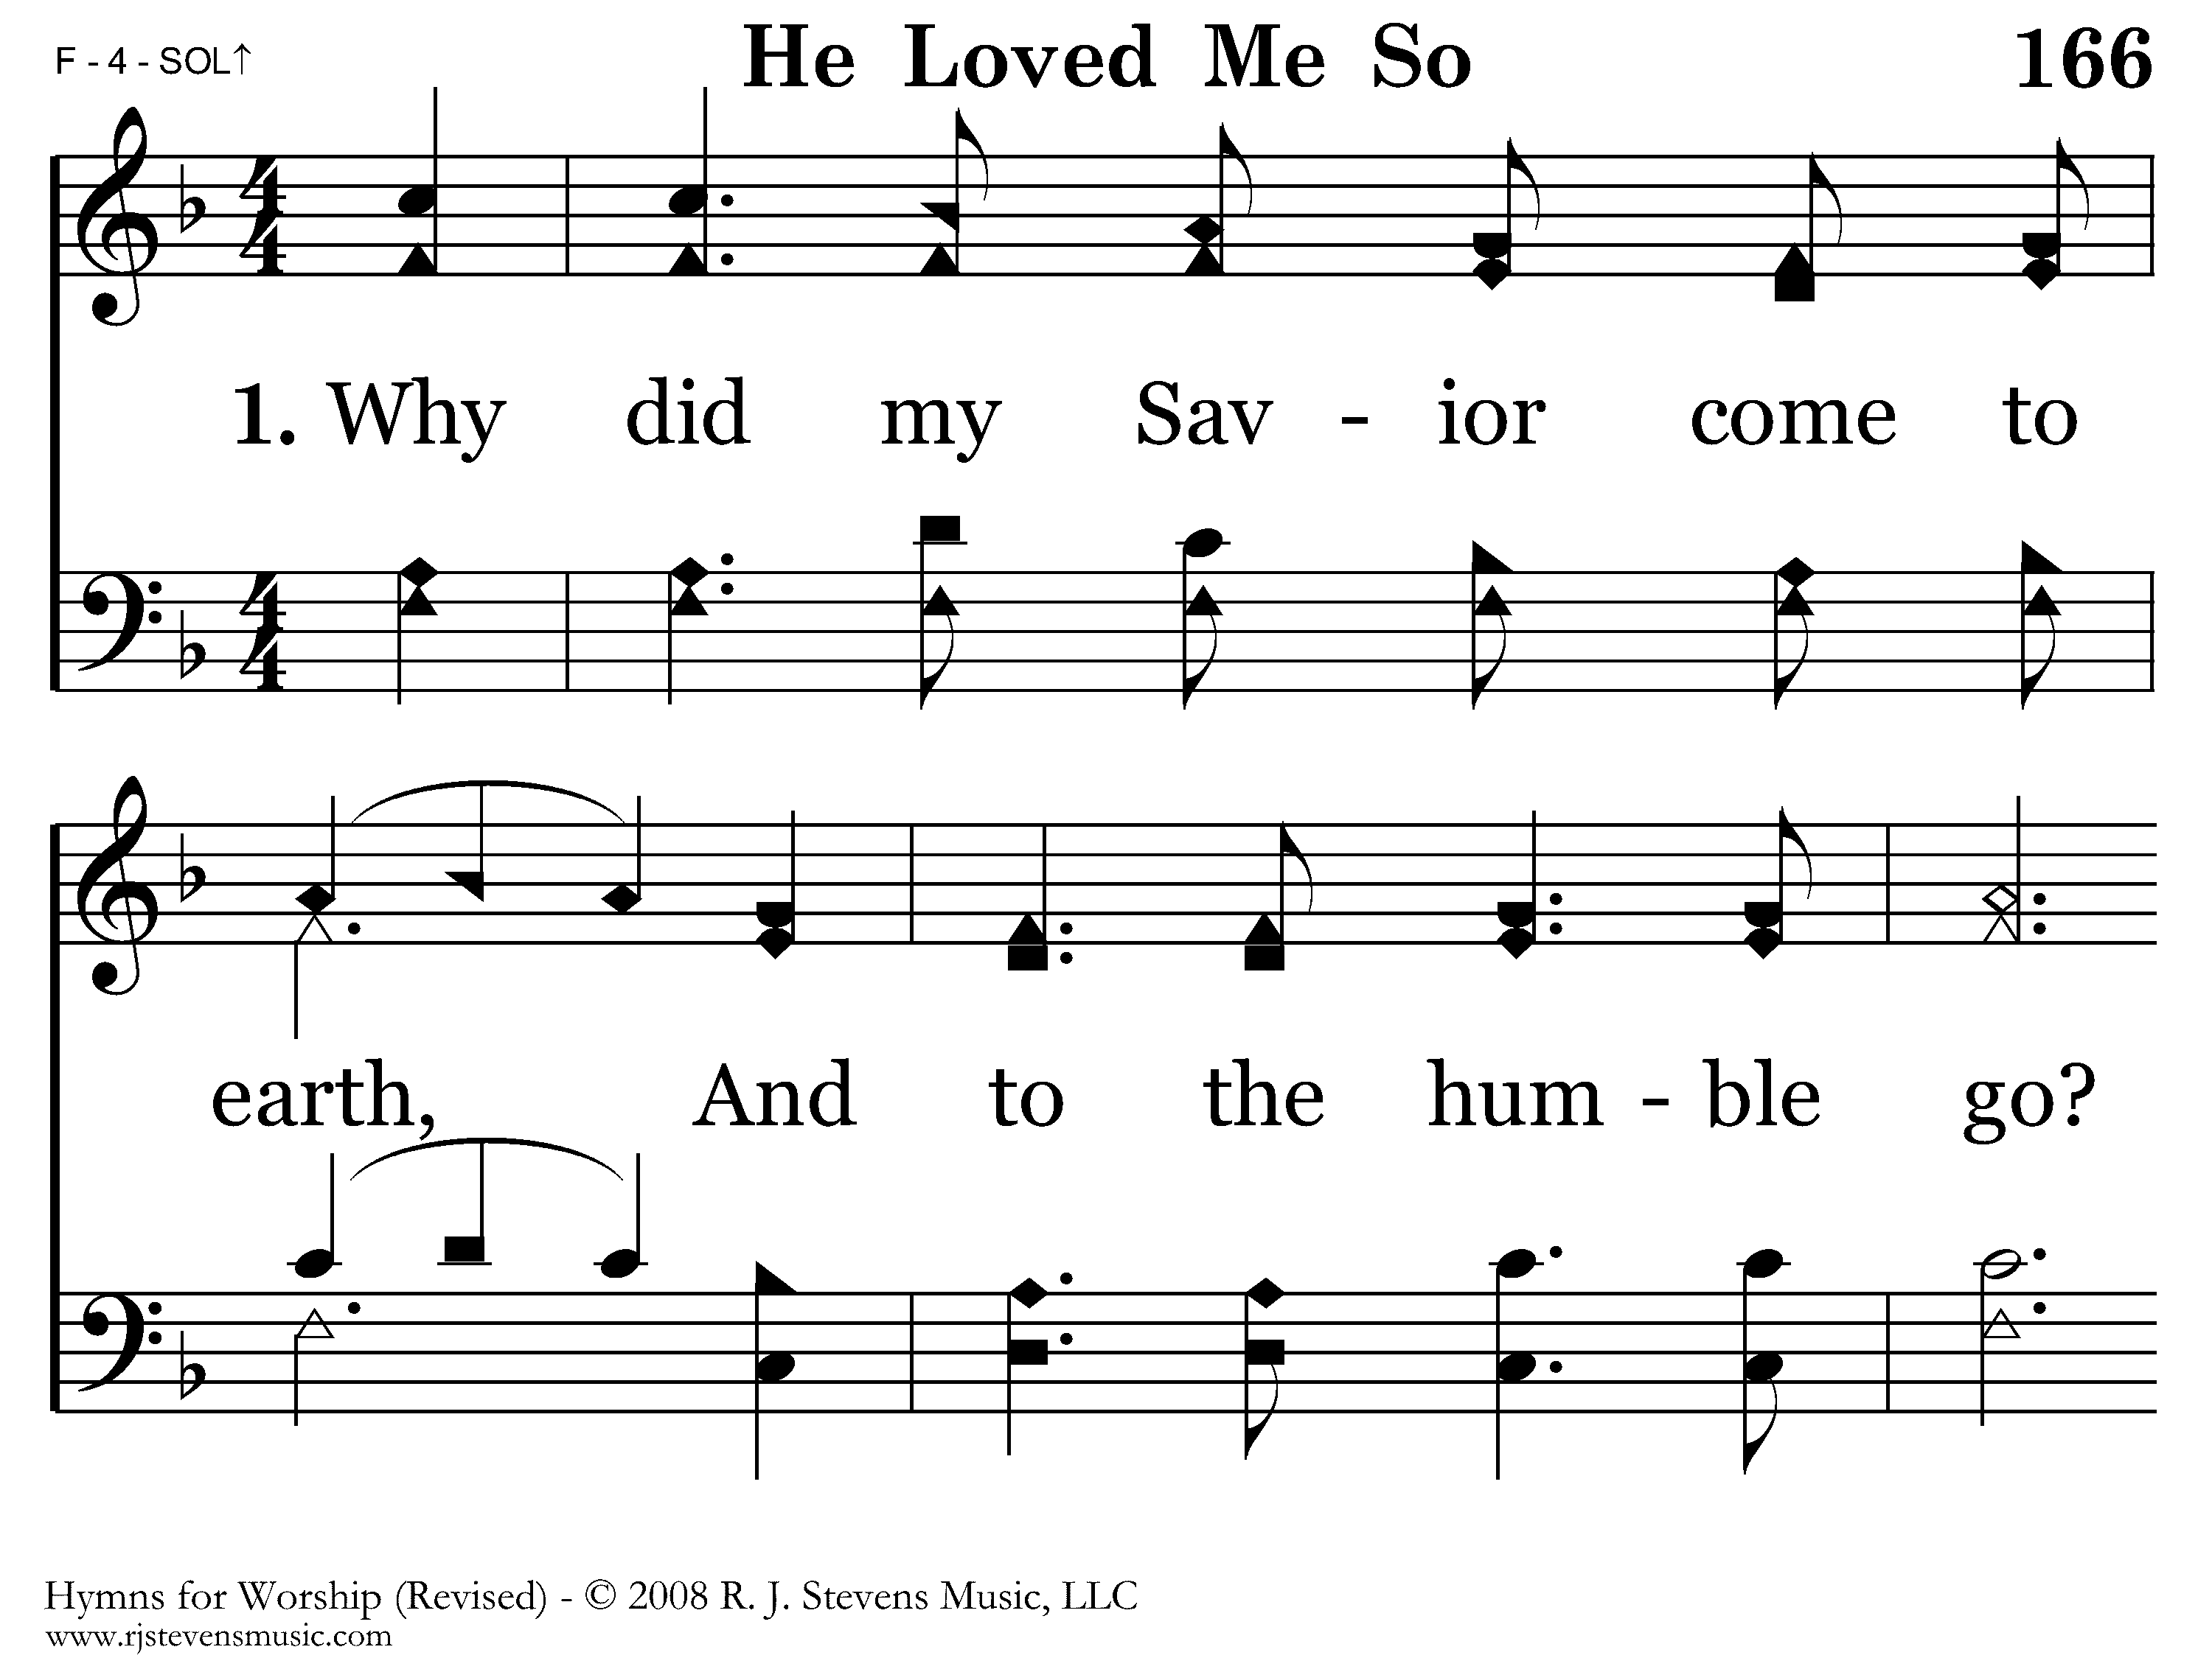
166 - He Loved Me So - 1.1

Slide 3
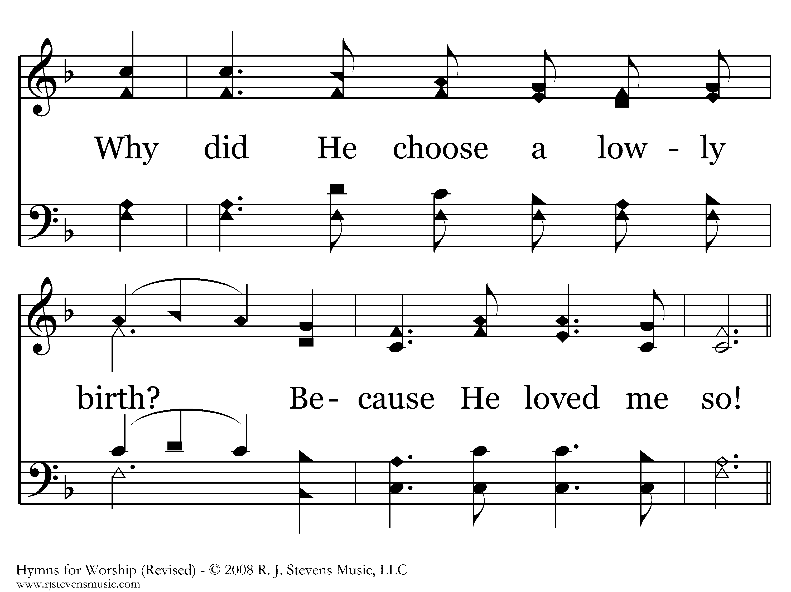
166 - He Loved Me So - 1.2
End of Verse 1

Slide 4
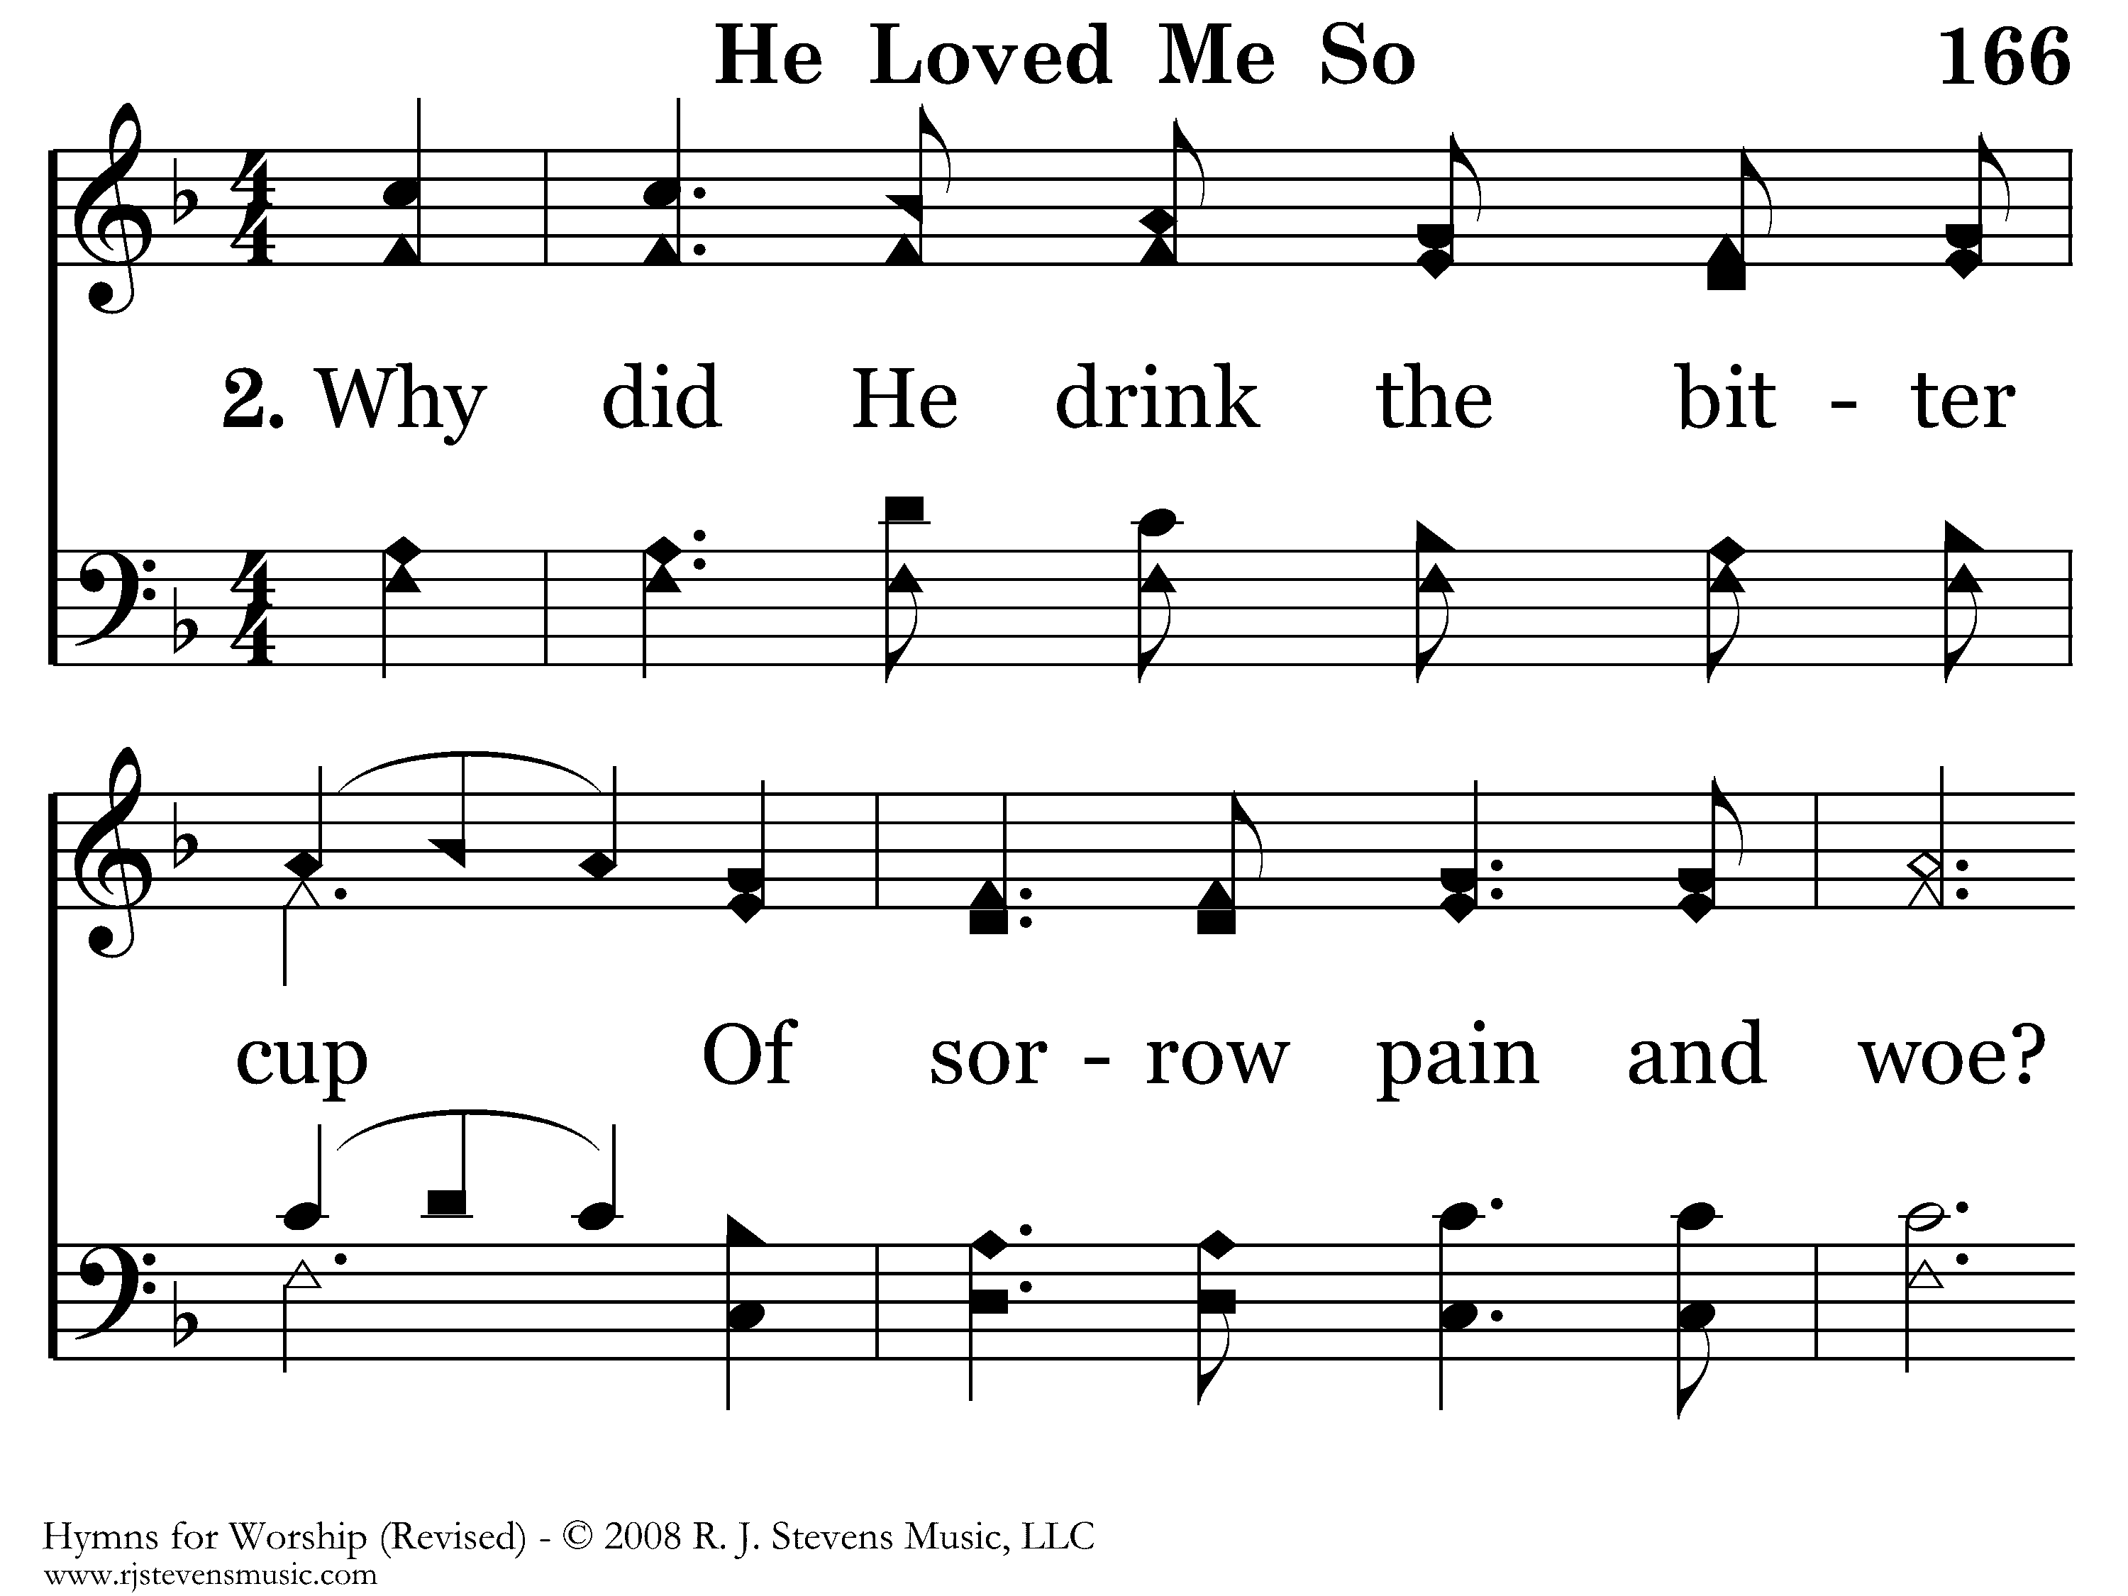
166 - He Loved Me So - 2.1

Slide 5
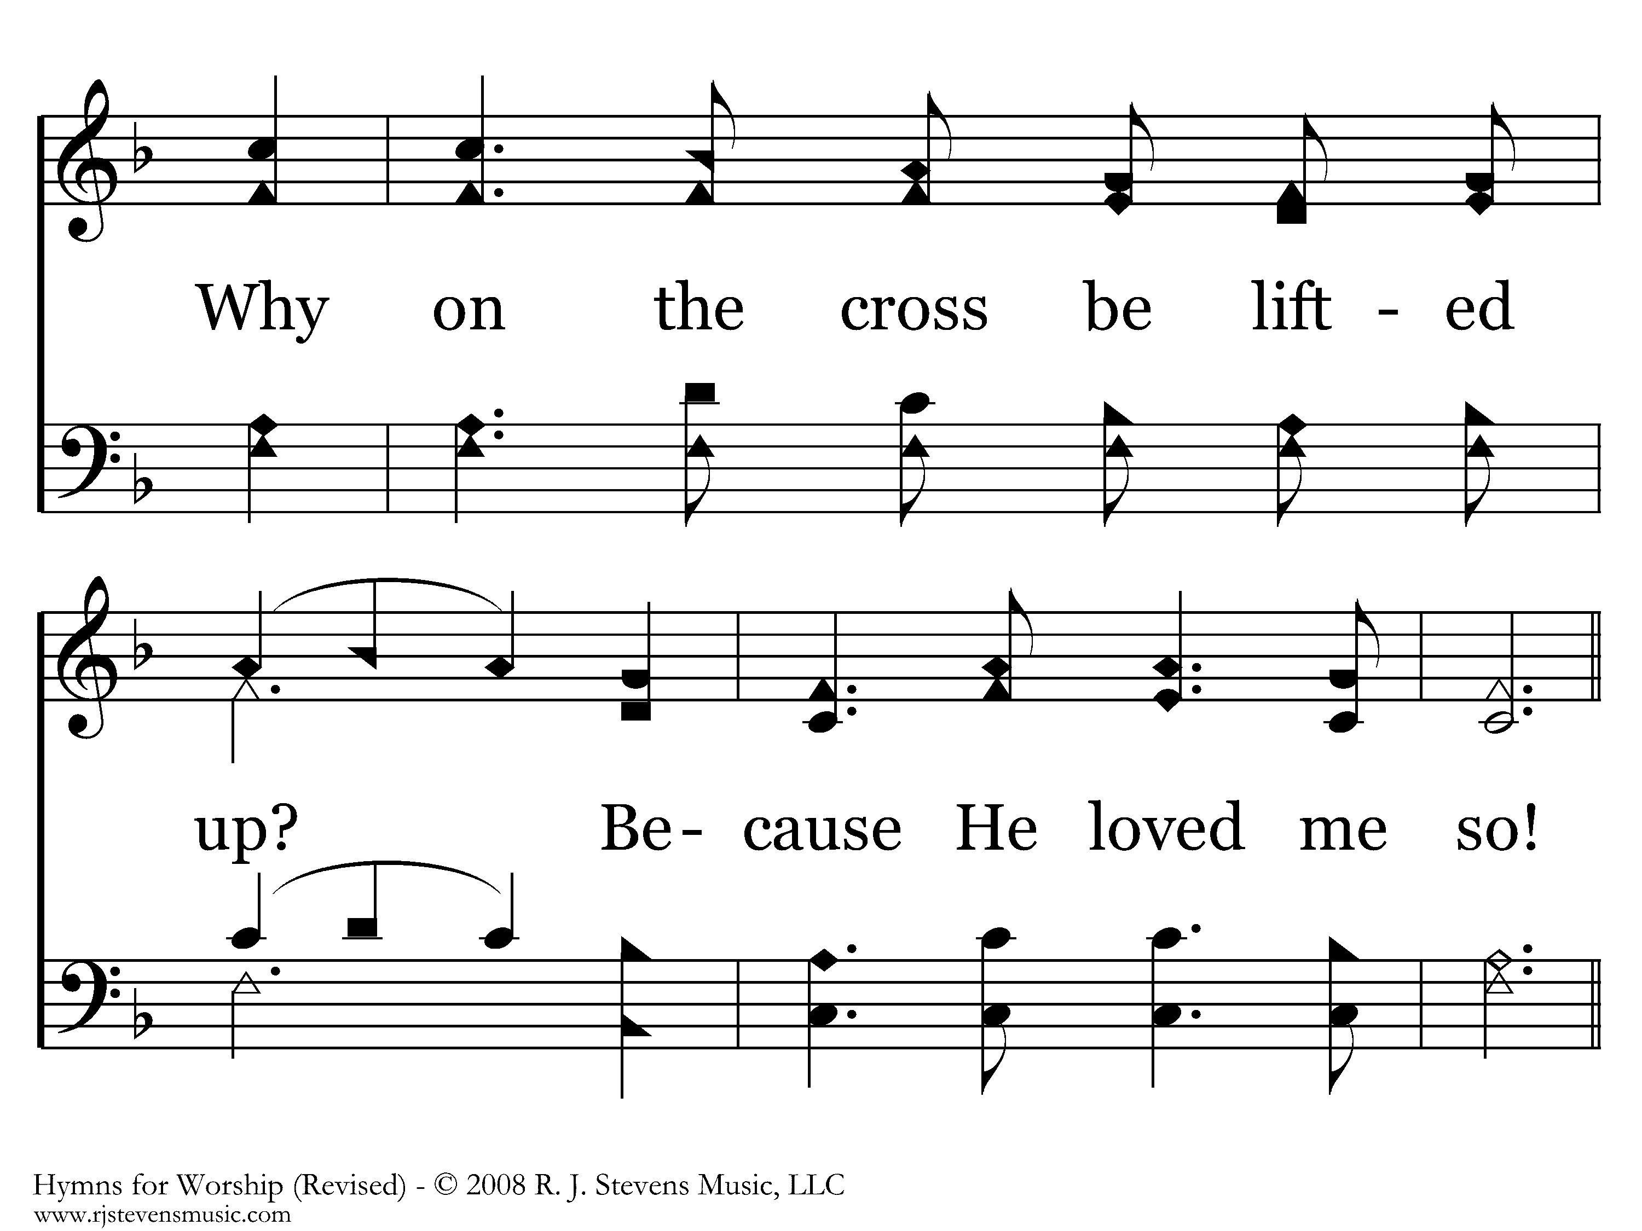
166 - He Loved Me So - 2.2
End of Verse 2

Slide 6
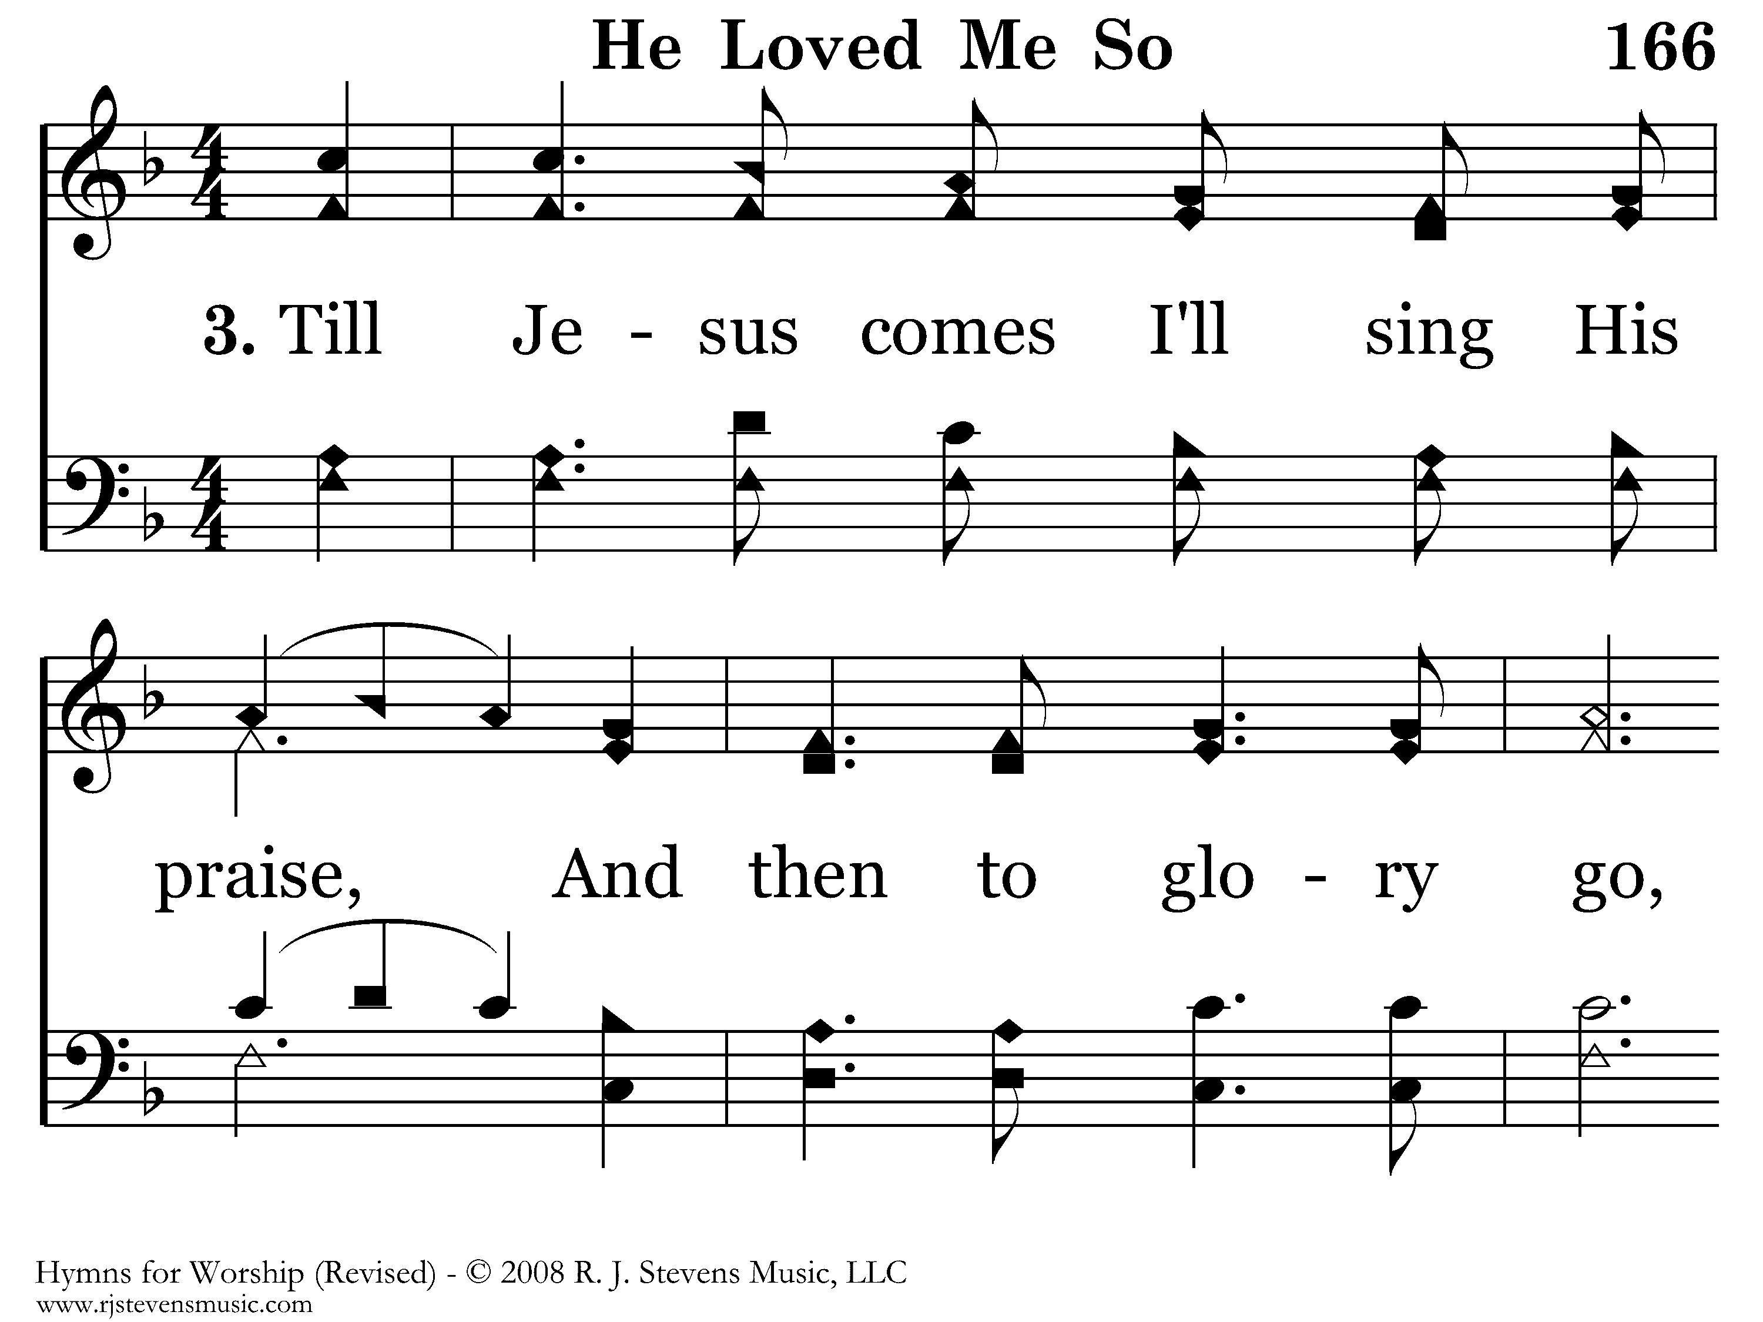
166 - He Loved Me So - 3.1

Slide 7
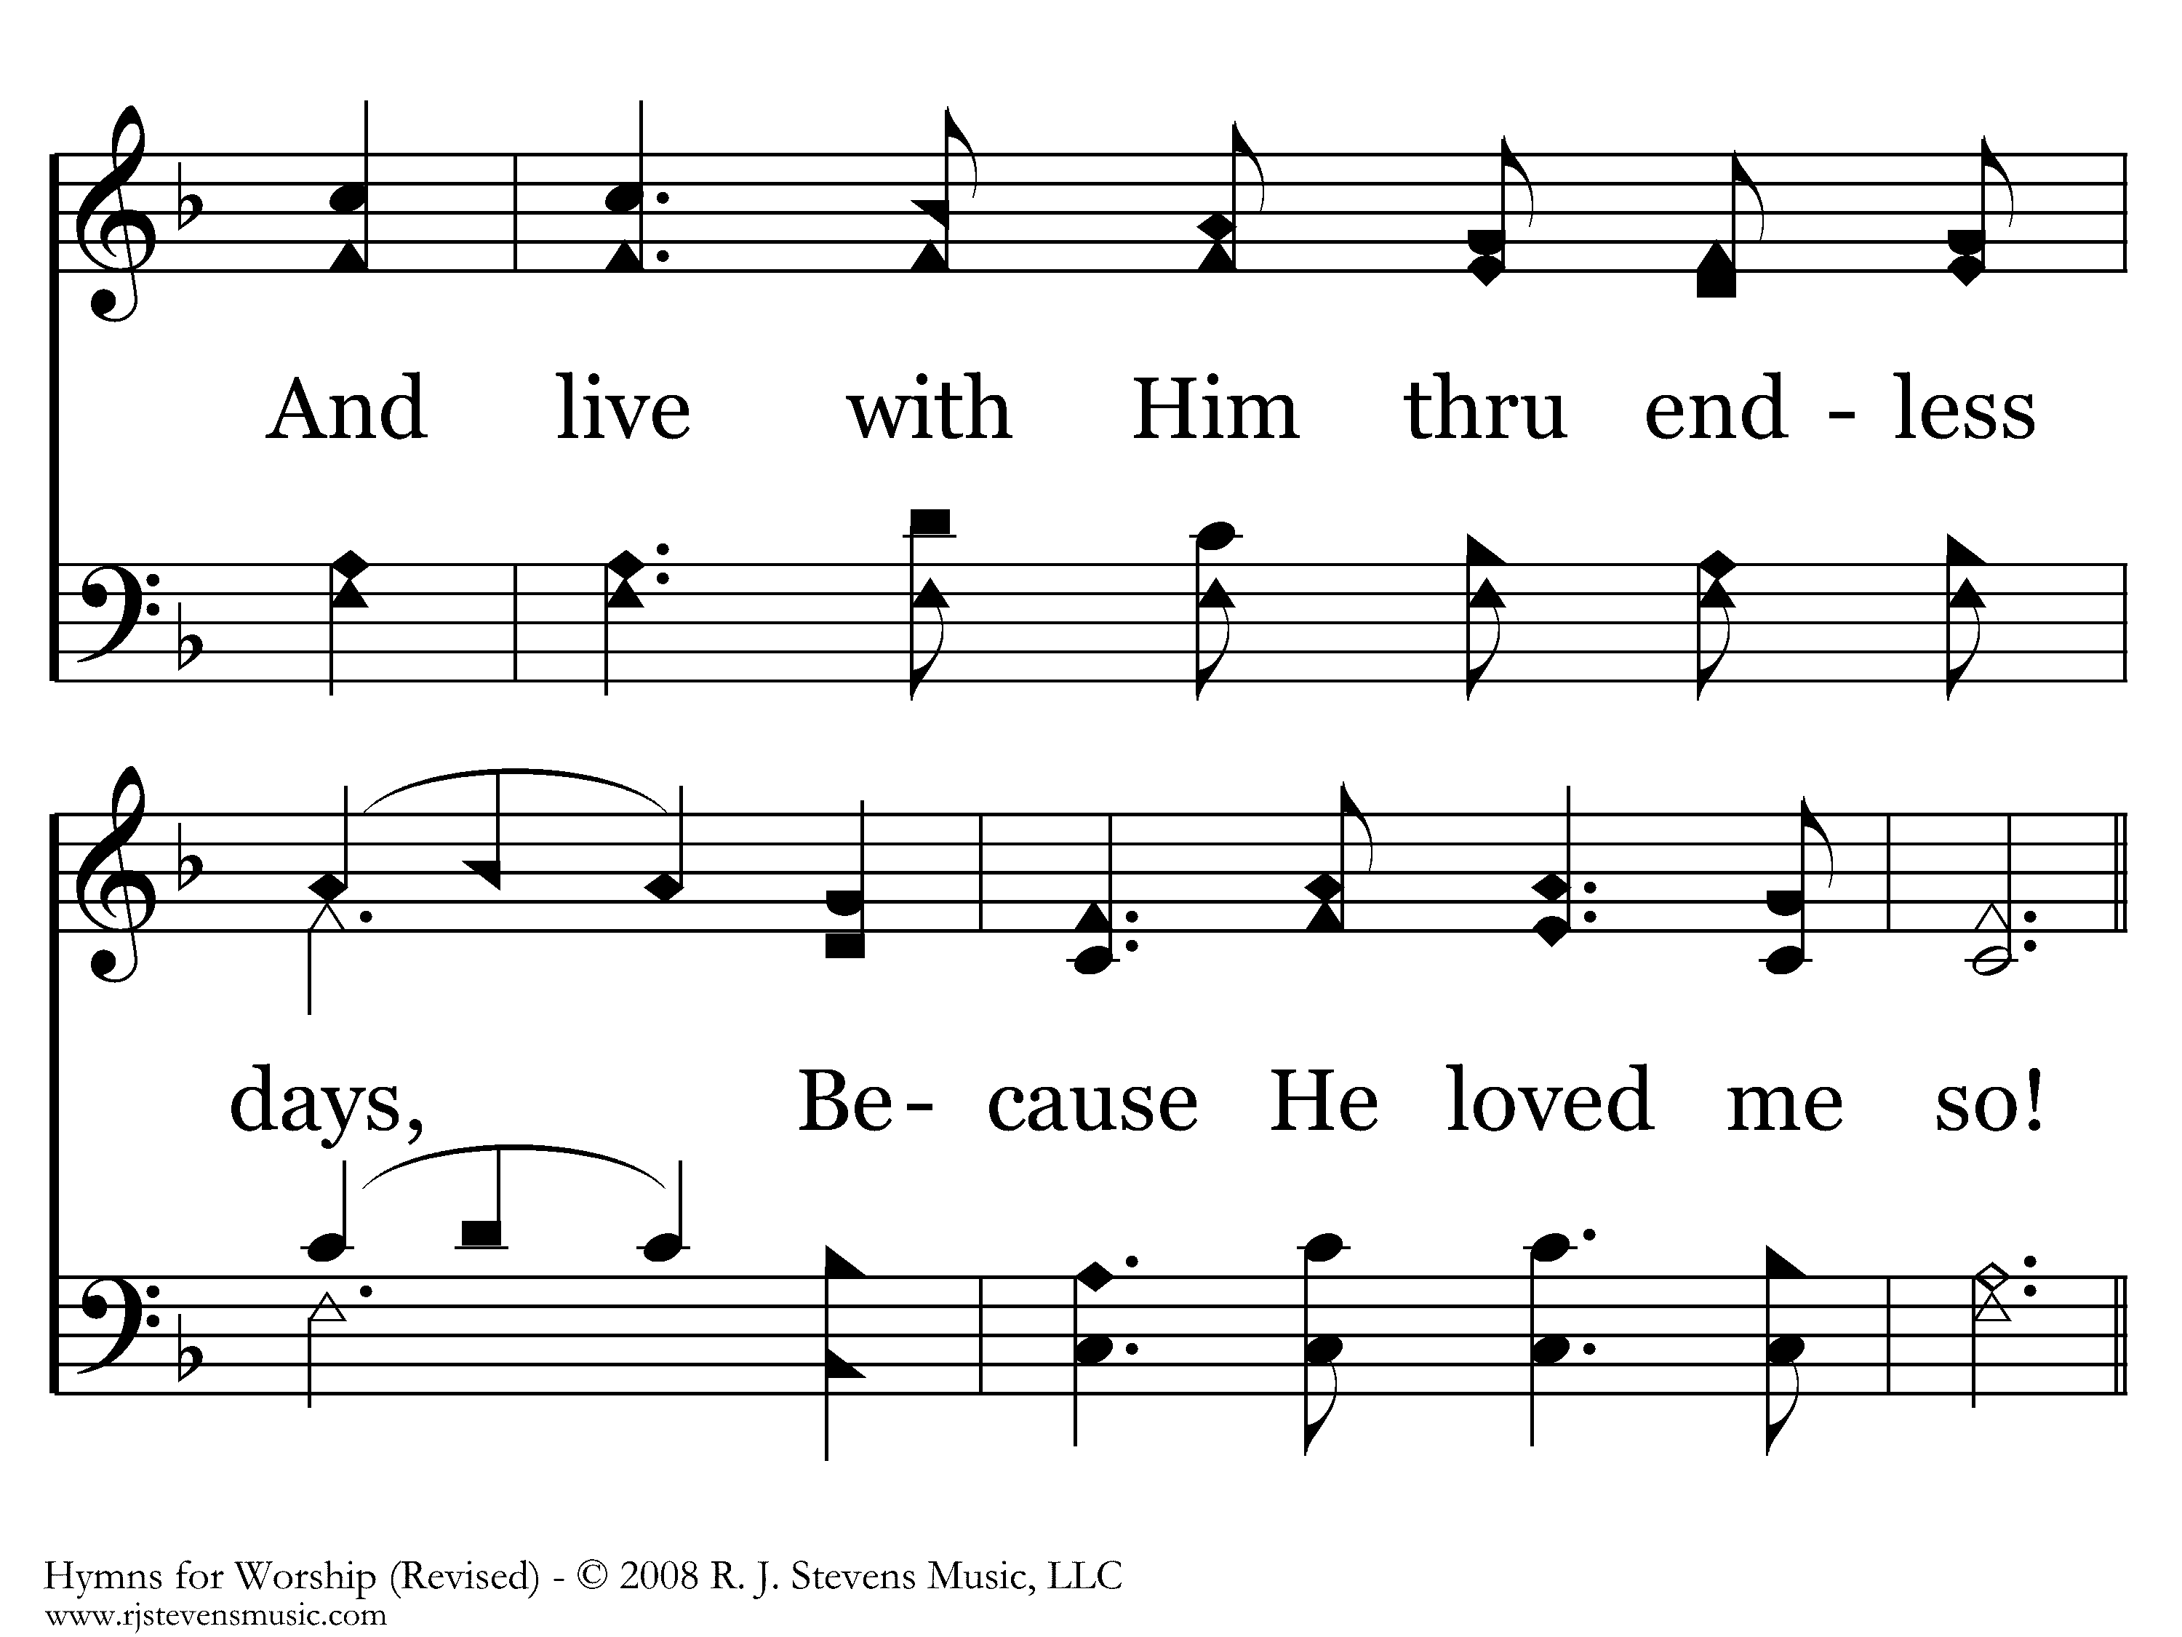
166 - He Loved Me So - 3.2

Slide 8
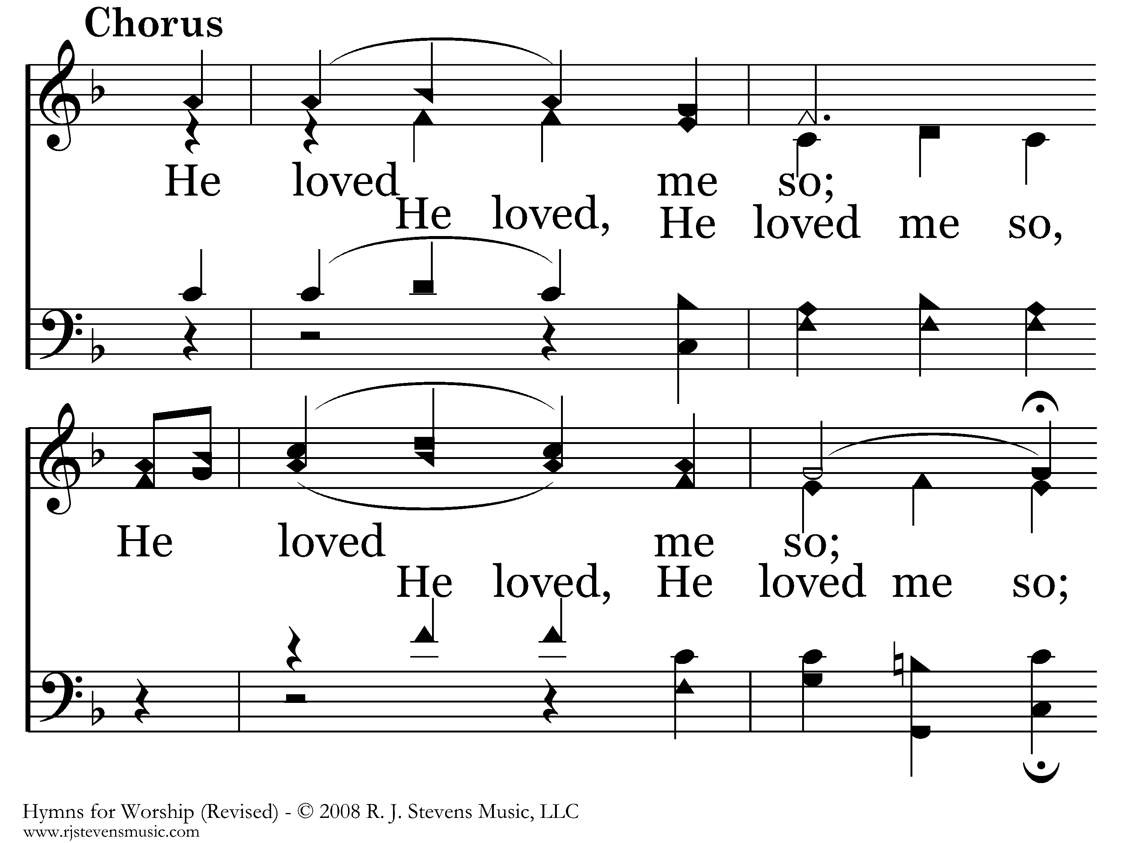
166 - He Loved Me So - C.1

Slide 9
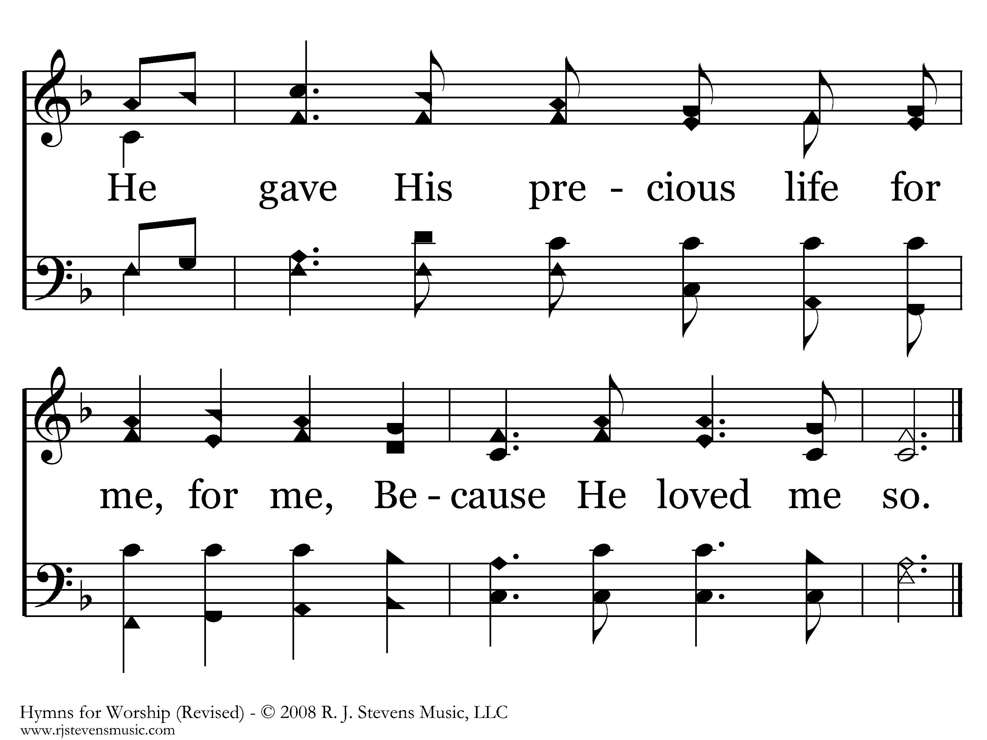
166 - He Loved Me So - C.2
End of Song

Slide 10
Jesus’ Birth, Death, and the Cosmic Conflict of Revelation
Sunday,
December 15, 2019
11:45 am
Exton
El nacimiento de Jesús, la muerte y el conflicto cósmico de la revelación

Slide 11
1 Why are the nations in an uproar
And the peoples devising a vain thing?
2 The kings of the earth take their stand
And the rulers take counsel together
Against the Lord and against His Anointed, saying,
3 “Let us tear their fetters apart
And cast away their cords from us!”
⁴ He who sits in the heavens laughs,
The Lord scoffs at them.
⁵ Then He will speak to them in His anger
And terrify them in His fury, saying,
⁶ “But as for Me, I have installed My King
Upon Zion, My holy mountain.”
Psalm 2
¿Por qué se amotinan las gentes
y los pueblos piensan cosas vanas?
2 Se levantarán los reyes de la tierra,
y príncipes conspirarán
contra Jehová y contra su ungido, diciendo:
3 «Rompamos sus ligaduras
y echemos de nosotros sus cuerdas.»
⁴ El que mora en los cielos se reirá;
el Señor se burlará de ellos.
⁵ Luego les hablará en su furor,
y los turbará con su ira:
⁶ «Yo he puesto mi rey
sobre Sión, mi santo monte.»
Salmos 2

Slide 12
1 Why are the nations in an uproar
And the peoples devising a vain thing?
2 The kings of the earth take their stand
And the rulers take counsel together
Against the Lord and against His Anointed, saying,
3 “Let us tear their fetters apart
And cast away their cords from us!”
Acts 4
Peter & John have been released
They give an Account to the Disciples
The Disciples Rejoice, Quoting Psalm 2
Psalm 2
¿Por qué se amotinan las gentes
y los pueblos piensan cosas vanas?
2 Se levantarán los reyes de la tierra,
y príncipes conspirarán
contra Jehová y contra su ungido, diciendo:
3 «Rompamos sus ligaduras
y echemos de nosotros sus cuerdas.»
Hechos 4
Peter y John han sido liberados
Dan una cuenta a los discípulos
Los discípulos se regocijan, citando el Salmo 2
Salmos 2

Slide 13
1 Why are the nations in an uproar
And the peoples devising a vain thing?
2 The kings of the earth take their stand
And the rulers take counsel together
Against the Lord and against His Anointed, saying,
3 “Let us tear their fetters apart
And cast away their cords from us!”
Acts 4 ²⁵ “…‘Why did the Gentiles rage,
And the peoples devise futile things?
²⁶ ‘The kings of the earth took their stand,
And the rulers were gathered together
Against the Lord and against His Christ.’
²⁷ For truly in this city there were gathered together against Your holy servant Jesus, whom You anointed, both Herod and Pontius Pilate, along with the Gentiles and the peoples of Israel”
Psalm 2
¿Por qué se amotinan las gentes
y los pueblos piensan cosas vanas?
2 Se levantarán los reyes de la tierra,
y príncipes conspirarán
contra Jehová y contra su ungido, diciendo:
3 «Rompamos sus ligaduras
y echemos de nosotros sus cuerdas.»
Hechos 4²⁵ “¿Por qué se amotinan las gentes
y los pueblos piensan cosas vanas?
²⁶ Se reunieron los reyes de la tierra
y los príncipes se juntaron en uno
contra el Señor y contra su Cristo.”
²⁷ »Y verdaderamente se unieron en esta ciudad Herodes y Poncio Pilato, con los gentiles y el pueblo de Israel, contra tu santo Hijo Jesús, a quien ungiste”
Salmos 2

Slide 14
1 Why are the nations in an uproar
And the peoples devising a vain thing?
2 The kings of the earth take their stand
And the rulers take counsel together
Against the Lord and against His Anointed, saying,
3 “Let us tear their fetters apart
And cast away their cords from us!”
Acts 4 ²⁵ “…‘Why did the Gentiles rage,
And the peoples devise futile things?
²⁶ ‘The kings of the earth took their stand,
And the rulers were gathered together
Against the Lord and against His Christ.’
²⁷ For truly in this city there were gathered together against Your holy servant Jesus, whom You anointed, both Herod and Pontius Pilate, along with the Gentiles and the peoples of Israel”
Psalm 2
¿Por qué se amotinan las gentes
y los pueblos piensan cosas vanas?
2 Se levantarán los reyes de la tierra,
y príncipes conspirarán
contra Jehová y contra su ungido, diciendo:
3 «Rompamos sus ligaduras
y echemos de nosotros sus cuerdas.»
Hechos 4²⁵ “¿Por qué se amotinan las gentes
y los pueblos piensan cosas vanas?
²⁶ Se reunieron los reyes de la tierra
y los príncipes se juntaron en uno
contra el Señor y contra su Cristo.”
²⁷ »Y verdaderamente se unieron en esta ciudad Herodes y Poncio Pilato, con los gentiles y el pueblo de Israel, contra tu santo Hijo Jesús, a quien ungiste”
Salmos 2

Slide 15
1 Why are the nations in an uproar
And the peoples devising a vain thing?
2 The kings of the earth take their stand
And the rulers take counsel together
Against the Lord and against His Anointed, saying,
3 “Let us tear their fetters apart
And cast away their cords from us!”
Acts 4 ²⁵ “…‘Why did the Gentiles rage,
And the peoples devise futile things?
²⁶ ‘The kings of the earth took their stand,
And the rulers were gathered together
Against the Lord and against His Christ.’
²⁷ For truly in this city there were gathered together against Your holy servant Jesus, whom You anointed, both Herod and Pontius Pilate, along with the Gentiles and the peoples of Israel”
Psalm 2
¿Por qué se amotinan las gentes
y los pueblos piensan cosas vanas?
2 Se levantarán los reyes de la tierra,
y príncipes conspirarán
contra Jehová y contra su ungido, diciendo:
3 «Rompamos sus ligaduras
y echemos de nosotros sus cuerdas.»
Hechos 4²⁵ “¿Por qué se amotinan las gentes
y los pueblos piensan cosas vanas?
²⁶ Se reunieron los reyes de la tierra
y los príncipes se juntaron en uno
contra el Señor y contra su Cristo.”
²⁷ »Y verdaderamente se unieron en esta ciudad Herodes y Poncio Pilato, con los gentiles y el pueblo de Israel, contra tu santo Hijo Jesús, a quien ungiste”
Salmos 2

Slide 16
1 Why are the nations in an uproar
And the peoples devising a vain thing?
2 The kings of the earth take their stand
And the rulers take counsel together
Against the Lord and against His Anointed, saying,
3 “Let us tear their fetters apart
And cast away their cords from us!”
Acts 4 ²⁵ “…‘Why did the Gentiles rage,
And the peoples devise futile things?
²⁶ ‘The kings of the earth took their stand,
And the rulers were gathered together
Against the Lord and against His Christ.’
²⁷ For truly in this city there were gathered together against Your holy servant Jesus, whom You anointed, both Herod and Pontius Pilate, along with the Gentiles and the peoples of Israel”
Psalm 2
¿Por qué se amotinan las gentes
y los pueblos piensan cosas vanas?
2 Se levantarán los reyes de la tierra,
y príncipes conspirarán
contra Jehová y contra su ungido, diciendo:
3 «Rompamos sus ligaduras
y echemos de nosotros sus cuerdas.»
Hechos 4²⁵ “¿Por qué se amotinan las gentes
y los pueblos piensan cosas vanas?
²⁶ Se reunieron los reyes de la tierra
y los príncipes se juntaron en uno
contra el Señor y contra su Cristo.”
²⁷ »Y verdaderamente se unieron en esta ciudad Herodes y Poncio Pilato, con los gentiles y el pueblo de Israel, contra tu santo Hijo Jesús, a quien ungiste”
Salmos 2

Slide 17
1 Why are the nations in an uproar
And the peoples devising a vain thing?
2 The kings of the earth take their stand
And the rulers take counsel together
Against the Lord and against His Anointed, saying,
3 “Let us tear their fetters apart
And cast away their cords from us!”
Acts 4 ²⁵ “…‘Why did the Gentiles rage,
And the peoples devise futile things?
²⁶ ‘The kings of the earth took their stand,
And the rulers were gathered together
Against the Lord and against His Christ.’
²⁷ For truly in this city there were gathered together against Your holy servant Jesus, whom You anointed, both Herod and Pontius Pilate, along with the Gentiles and the peoples of Israel”
Psalm 2
¿Por qué se amotinan las gentes
y los pueblos piensan cosas vanas?
2 Se levantarán los reyes de la tierra,
y príncipes conspirarán
contra Jehová y contra su ungido, diciendo:
3 «Rompamos sus ligaduras
y echemos de nosotros sus cuerdas.»
Hechos 4²⁵ “¿Por qué se amotinan las gentes
y los pueblos piensan cosas vanas?
²⁶ Se reunieron los reyes de la tierra
y los príncipes se juntaron en uno
contra el Señor y contra su Cristo.”
²⁷ »Y verdaderamente se unieron en esta ciudad Herodes y Poncio Pilato, con los gentiles y el pueblo de Israel, contra tu santo Hijo Jesús, a quien ungiste”
Salmos 2

Slide 18
Luke 23
6 When Pilate heard it, he asked whether the man was a Galilean. 7 And when he learned that He belonged to Herod’s jurisdiction, he sent Him to Herod…
Acts 4 ²⁵ “…‘Why did the Gentiles rage,
And the peoples devise futile things?
²⁶ ‘The kings of the earth took their stand,
And the rulers were gathered together
Against the Lord and against His Christ.’
²⁷ For truly in this city there were gathered together against Your holy servant Jesus, whom You anointed, both Herod and Pontius Pilate, along with the Gentiles and the peoples of Israel”
Lucas 23
6 Entonces Pilato, cuando oyó decir «Galilea», preguntó si el hombre era galileo. 7 Y al saber que era de la jurisdicción de Herodes, lo remitió a Herodes…
Hechos 4²⁵ “¿Por qué se amotinan las gentes
y los pueblos piensan cosas vanas?
²⁶ Se reunieron los reyes de la tierra
y los príncipes se juntaron en uno
contra el Señor y contra su Cristo.”
²⁷ »Y verdaderamente se unieron en esta ciudad Herodes y Poncio Pilato, con los gentiles y el pueblo de Israel, contra tu santo Hijo Jesús, a quien ungiste”

Slide 19
Luke 23
11 And Herod with his soldiers, after treating Him with contempt and mocking Him, dressed Him in a gorgeous robe and sent Him back to Pilate. 12 Now Herod and Pilate became friends with one another that very day; for before they had been enemies with each other.
Acts 4 ²⁵ “…‘Why did the Gentiles rage,
And the peoples devise futile things?
²⁶ ‘The kings of the earth took their stand,
And the rulers were gathered together
Against the Lord and against His Christ.’
²⁷ For truly in this city there were gathered together against Your holy servant Jesus, whom You anointed, both Herod and Pontius Pilate, along with the Gentiles and the peoples of Israel”
Lucas 23
11 Entonces Herodes con sus soldados lo menospreció y se burló de él, vistiéndolo con una ropa espléndida; y volvió a enviarlo a Pilato. 12 Y aquel día, Pilato y Herodes, que estaban enemistados, se hicieron amigos.
Hechos 4²⁵ “¿Por qué se amotinan las gentes
y los pueblos piensan cosas vanas?
²⁶ Se reunieron los reyes de la tierra
y los príncipes se juntaron en uno
contra el Señor y contra su Cristo.”
²⁷ »Y verdaderamente se unieron en esta ciudad Herodes y Poncio Pilato, con los gentiles y el pueblo de Israel, contra tu santo Hijo Jesús, a quien ungiste”

Slide 20
Luke 23
11 And Herod with his soldiers, after treating Him with contempt and mocking Him, dressed Him in a gorgeous robe and sent Him back to Pilate. 12 Now Herod and Pilate became friends with one another that very day; for before they had been enemies with each other.
Acts 4 ²⁵ “…‘Why did the Gentiles rage,
And the peoples devise futile things?
²⁶ ‘The kings of the earth took their stand,
And the rulers were gathered together
Against the Lord and against His Christ.’
²⁷ For truly in this city there were gathered together against Your holy servant Jesus, whom You anointed, both Herod and Pontius Pilate, along with the Gentiles and the peoples of Israel”
Lucas 23
11 Entonces Herodes con sus soldados lo menospreció y se burló de él, vistiéndolo con una ropa espléndida; y volvió a enviarlo a Pilato. 12 Y aquel día, Pilato y Herodes, que estaban enemistados, se hicieron amigos.
Hechos 4²⁵ “¿Por qué se amotinan las gentes
y los pueblos piensan cosas vanas?
²⁶ Se reunieron los reyes de la tierra
y los príncipes se juntaron en uno
contra el Señor y contra su Cristo.”
²⁷ »Y verdaderamente se unieron en esta ciudad Herodes y Poncio Pilato, con los gentiles y el pueblo de Israel, contra tu santo Hijo Jesús, a quien ungiste”

Slide 21
Another Herod also opposed the Lord’s Christ
Acts 4 ²⁵ “…‘Why did the Gentiles rage,
And the peoples devise futile things?
²⁶ ‘The kings of the earth took their stand,
And the rulers were gathered together
Against the Lord and against His Christ.’
²⁷ For truly in this city there were gathered together against Your holy servant Jesus, whom You anointed, both Herod and Pontius Pilate, along with the Gentiles and the peoples of Israel”
Otro Herodes también se opuso al Cristo del Señor.
Hechos 4²⁵ “¿Por qué se amotinan las gentes
y los pueblos piensan cosas vanas?
²⁶ Se reunieron los reyes de la tierra
y los príncipes se juntaron en uno
contra el Señor y contra su Cristo.”
²⁷ »Y verdaderamente se unieron en esta ciudad Herodes y Poncio Pilato, con los gentiles y el pueblo de Israel, contra tu santo Hijo Jesús, a quien ungiste”

Slide 22
Another Herod
Acts 4 ²⁵ “…‘Why did the Gentiles rage,
And the peoples devise futile things?
²⁶ ‘The kings of the earth took their stand,
And the rulers were gathered together
Against the Lord and against His Christ.’
²⁷ For truly in this city there were gathered together against Your holy servant Jesus, whom You anointed, both Herod and Pontius Pilate, along with the Gentiles and the peoples of Israel”
⁷ Then Herod secretly called the magi and determined from them the exact time the star appeared. ⁸ And he sent them to Bethlehem and said, “Go and search carefully for the Child; and when you have found Him, report to me, so that I too may come and worship Him.”
Otro Herodes
Hechos 4²⁵ “¿Por qué se amotinan las gentes
y los pueblos piensan cosas vanas?
²⁶ Se reunieron los reyes de la tierra
y los príncipes se juntaron en uno
contra el Señor y contra su Cristo.”
²⁷ »Y verdaderamente se unieron en esta ciudad Herodes y Poncio Pilato, con los gentiles y el pueblo de Israel, contra tu santo Hijo Jesús, a quien ungiste”
⁷ Entonces Herodes llamó en secreto a los sabios y se cercioró del tiempo exacto en que había aparecido la estrella. ⁸ Y enviándolos a Belén, dijo:
—Id allá y averiguad con diligencia acerca del niño y, cuando lo halléis, hacédmelo saber, para que yo también vaya a adorarlo.

Slide 23
Another Herod
Acts 4 ²⁵ “…‘Why did the Gentiles rage,
And the peoples devise futile things?
²⁶ ‘The kings of the earth took their stand,
And the rulers were gathered together
Against the Lord and against His Christ.’
²⁷ For truly in this city there were gathered together against Your holy servant Jesus, whom You anointed, both Herod and Pontius Pilate, along with the Gentiles and the peoples of Israel”
¹² And having been warned by God in a dream not to return to Herod, the magi left for their own country by another way.
Otro Herodes
Hechos 4²⁵ “¿Por qué se amotinan las gentes
y los pueblos piensan cosas vanas?
²⁶ Se reunieron los reyes de la tierra
y los príncipes se juntaron en uno
contra el Señor y contra su Cristo.”
²⁷ »Y verdaderamente se unieron en esta ciudad Herodes y Poncio Pilato, con los gentiles y el pueblo de Israel, contra tu santo Hijo Jesús, a quien ungiste”
¹² Pero siendo avisados por revelación en sueños que no volvieran a Herodes, regresaron a su tierra por otro camino.

Slide 24
Another Herod
Acts 4 ²⁵ “…‘Why did the Gentiles rage,
And the peoples devise futile things?
²⁶ ‘The kings of the earth took their stand,
And the rulers were gathered together
Against the Lord and against His Christ.’
²⁷ For truly in this city there were gathered together against Your holy servant Jesus, whom You anointed, both Herod and Pontius Pilate, along with the Gentiles and the peoples of Israel”
¹³ Now when they had gone, behold, an angel of the Lord appeared to Joseph in a dream and said, “Get up! Take the Child and His mother and flee to Egypt, and remain there until I tell you; for Herod is going to search for the Child to destroy Him.”
Otro Herodes
Hechos 4²⁵ “¿Por qué se amotinan las gentes
y los pueblos piensan cosas vanas?
²⁶ Se reunieron los reyes de la tierra
y los príncipes se juntaron en uno
contra el Señor y contra su Cristo.”
²⁷ »Y verdaderamente se unieron en esta ciudad Herodes y Poncio Pilato, con los gentiles y el pueblo de Israel, contra tu santo Hijo Jesús, a quien ungiste”
¹³ Después que partieron ellos, un ángel del Señor apareció en sueños a José y le dijo: «Levántate, toma al niño y a su madre, y huye a Egipto. Permanece allá hasta que yo te diga, porque acontecerá que Herodes buscará al niño para matarlo.»

Slide 25
Another Herod
Acts 4 ²⁵ “…‘Why did the Gentiles rage,
And the peoples devise futile things?
²⁶ ‘The kings of the earth took their stand,
And the rulers were gathered together
Against the Lord and against His Christ.’
²⁷ For truly in this city there were gathered together against Your holy servant Jesus, whom You anointed, both Herod and Pontius Pilate, along with the Gentiles and the peoples of Israel”
¹⁴ So Joseph got up and took the Child and His mother while it was still night, and left for Egypt. ¹⁵ He remained there until the death of Herod…
Otro Herodes
Hechos 4²⁵ “¿Por qué se amotinan las gentes
y los pueblos piensan cosas vanas?
²⁶ Se reunieron los reyes de la tierra
y los príncipes se juntaron en uno
contra el Señor y contra su Cristo.”
²⁷ »Y verdaderamente se unieron en esta ciudad Herodes y Poncio Pilato, con los gentiles y el pueblo de Israel, contra tu santo Hijo Jesús, a quien ungiste”
¹⁴ Entonces él, despertando, tomó de noche al niño y a su madre, y se fue a Egipto. ¹⁵ Estuvo allí hasta la muerte de Herodes

Slide 26
Another Herod
Acts 4 ²⁵ “…‘Why did the Gentiles rage,
And the peoples devise futile things?
²⁶ ‘The kings of the earth took their stand,
And the rulers were gathered together
Against the Lord and against His Christ.’
²⁷ For truly in this city there were gathered together against Your holy servant Jesus, whom You anointed, both Herod and Pontius Pilate, along with the Gentiles and the peoples of Israel”
¹⁶ Then when Herod saw that he had been tricked by the magi, he became very enraged, and sent and slew all the male children who were in Bethlehem and all its vicinity, from two years old and under, according to the time which he had determined from the magi.
Otro Herodes
Hechos 4²⁵ “¿Por qué se amotinan las gentes
y los pueblos piensan cosas vanas?
²⁶ Se reunieron los reyes de la tierra
y los príncipes se juntaron en uno
contra el Señor y contra su Cristo.”
²⁷ »Y verdaderamente se unieron en esta ciudad Herodes y Poncio Pilato, con los gentiles y el pueblo de Israel, contra tu santo Hijo Jesús, a quien ungiste”
¹⁶ Herodes entonces, cuando se vio burlado por los sabios, se enojó mucho y mandó matar a todos los niños menores de dos años que había en Belén y en todos sus alrededores, conforme al tiempo indicado por los sabios.

Slide 27
Self-important men seeking to protect their own power
Acts 4 ²⁵ “…‘Why did the Gentiles rage,
And the peoples devise futile things?
²⁶ ‘The kings of the earth took their stand,
And the rulers were gathered together
Against the Lord and against His Christ.’
²⁷ For truly in this city there were gathered together against Your holy servant Jesus, whom You anointed, both Herod and Pontius Pilate, along with the Gentiles and the peoples of Israel”
Hombres importantes que buscan proteger su propio poder
Hechos 4²⁵ “¿Por qué se amotinan las gentes
y los pueblos piensan cosas vanas?
²⁶ Se reunieron los reyes de la tierra
y los príncipes se juntaron en uno
contra el Señor y contra su Cristo.”
²⁷ »Y verdaderamente se unieron en esta ciudad Herodes y Poncio Pilato, con los gentiles y el pueblo de Israel, contra tu santo Hijo Jesús, a quien ungiste”

Slide 28
The Original: Satan
“Against the Lord and against His Anointed”
Revelation 12
⁴ …the dragon stood before the woman who was about to give birth, so that when she gave birth he might devour her child.
El original: Satanás
“contra el Señor y contra su Cristo.”
Apocalipses 12
⁴ …Y el dragón se paró frente a la mujer que estaba para dar a luz, a fin de devorar a su hijo tan pronto como naciera.

Slide 29

“Writhe and labor to give birth,
Daughter of Zion,
Like a woman in childbirth;
For now you will go out of the city,
Dwell in the field,
And go to Babylon.
There you will be rescued;
There the Lord will redeem you
From the hand of your enemies.
Micah 4:10
“But as for you, Bethlehem Ephrathah,
Too little to be among the clans of Judah,
From you One will go forth for Me to be ruler in Israel.
His goings forth are from long ago,
From the days of eternity.”
Revelation 12:1-6
² and she was with child; and she cried out, being in labor and in pain to give birth.

Slide 30
Revelation 12:1-6
DRAGON
Wilderness
CHILD
1,260 days

Slide 31
Revelation 12:7-14
DRAGON
Michael & his Angels
& angels
“Now the salvation, and the power, and the kingdom of our God and the authority of His Christ have come, for the accuser of our brethren has been thrown down, he who accuses them before our God day and night.
“And they overcame him because of the blood of the Lamb and because of the word of their testimony, and they did not love their life even when faced with death.”
Wilderness
Time, times & half a time

Slide 32
DRAGON
Michael & his Angels
Hebrews 2¹⁴ Therefore, since the children share in flesh and blood, He Himself likewise also partook of the same,
that through death He might render powerless him who had the power of death, that is, the devil
& angels
Wilderness
CHILD
Time, times & half a time
= 1,260 days

Slide 33
In the Lord’s Supper, we proclaim which side we have chosen in this cosmic conflict.
We proclaim that we have chosen the side of the Lord and His Anointed
En la Cena del Señor, proclamamos qué lado hemos elegido en este conflicto cósmico.
Proclamamos que hemos elegido el lado del Señor y Su Ungido.

Slide 34
In Christ Alone
306
Hymn: Keith Getty (2001); Stuart Townend (2001)
Tune: Keith Getty (2001); Stuart Townend (2001); arr. D. J. Bulls
© 2001 Thankyou Music (admin. by EMI Christian Music Publishing)

Slide 35
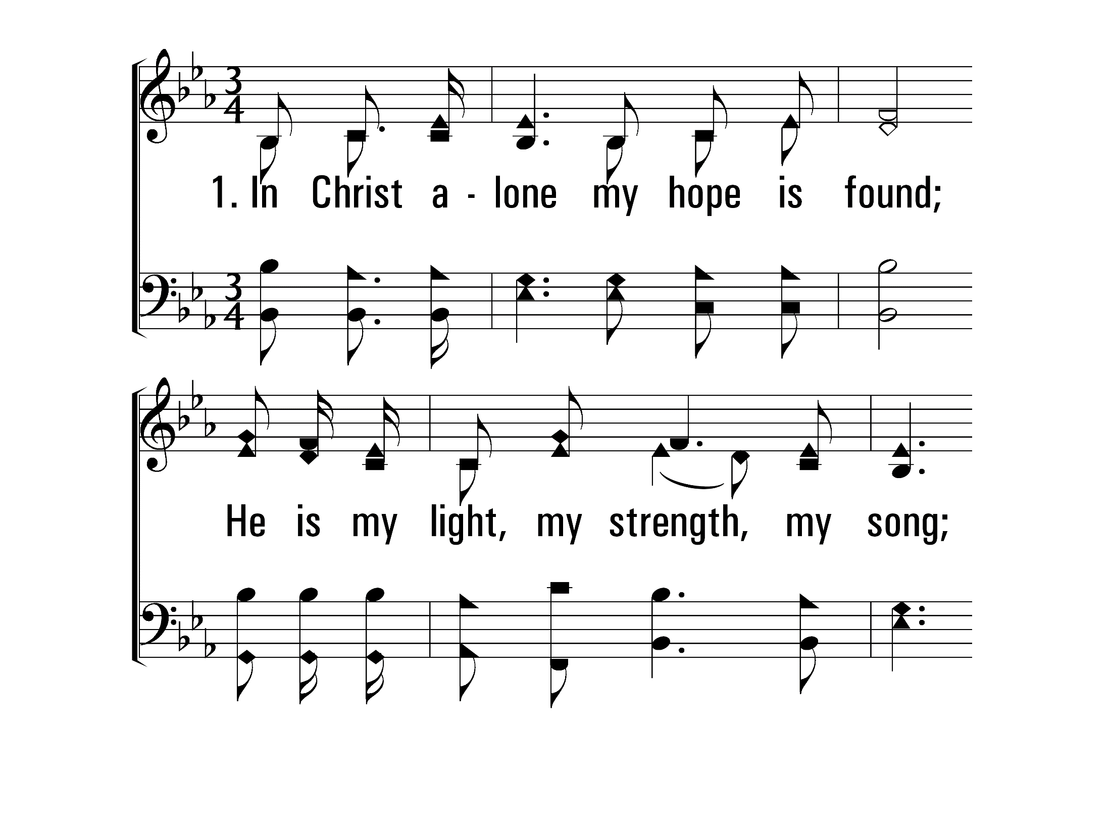
InChristAlone_st1_a
Vs 1
© 2014 Sumphonia Productions, LLC

Slide 36
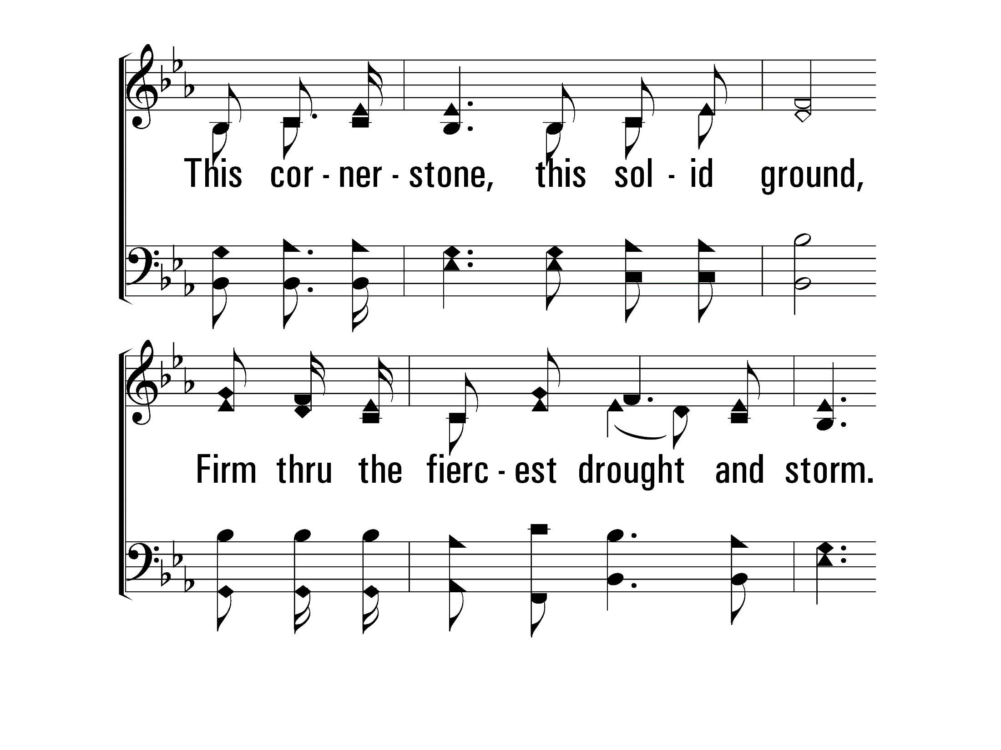
InChristAlone_st1_b
Vs 1
© 2014 Sumphonia Productions, LLC

Slide 37
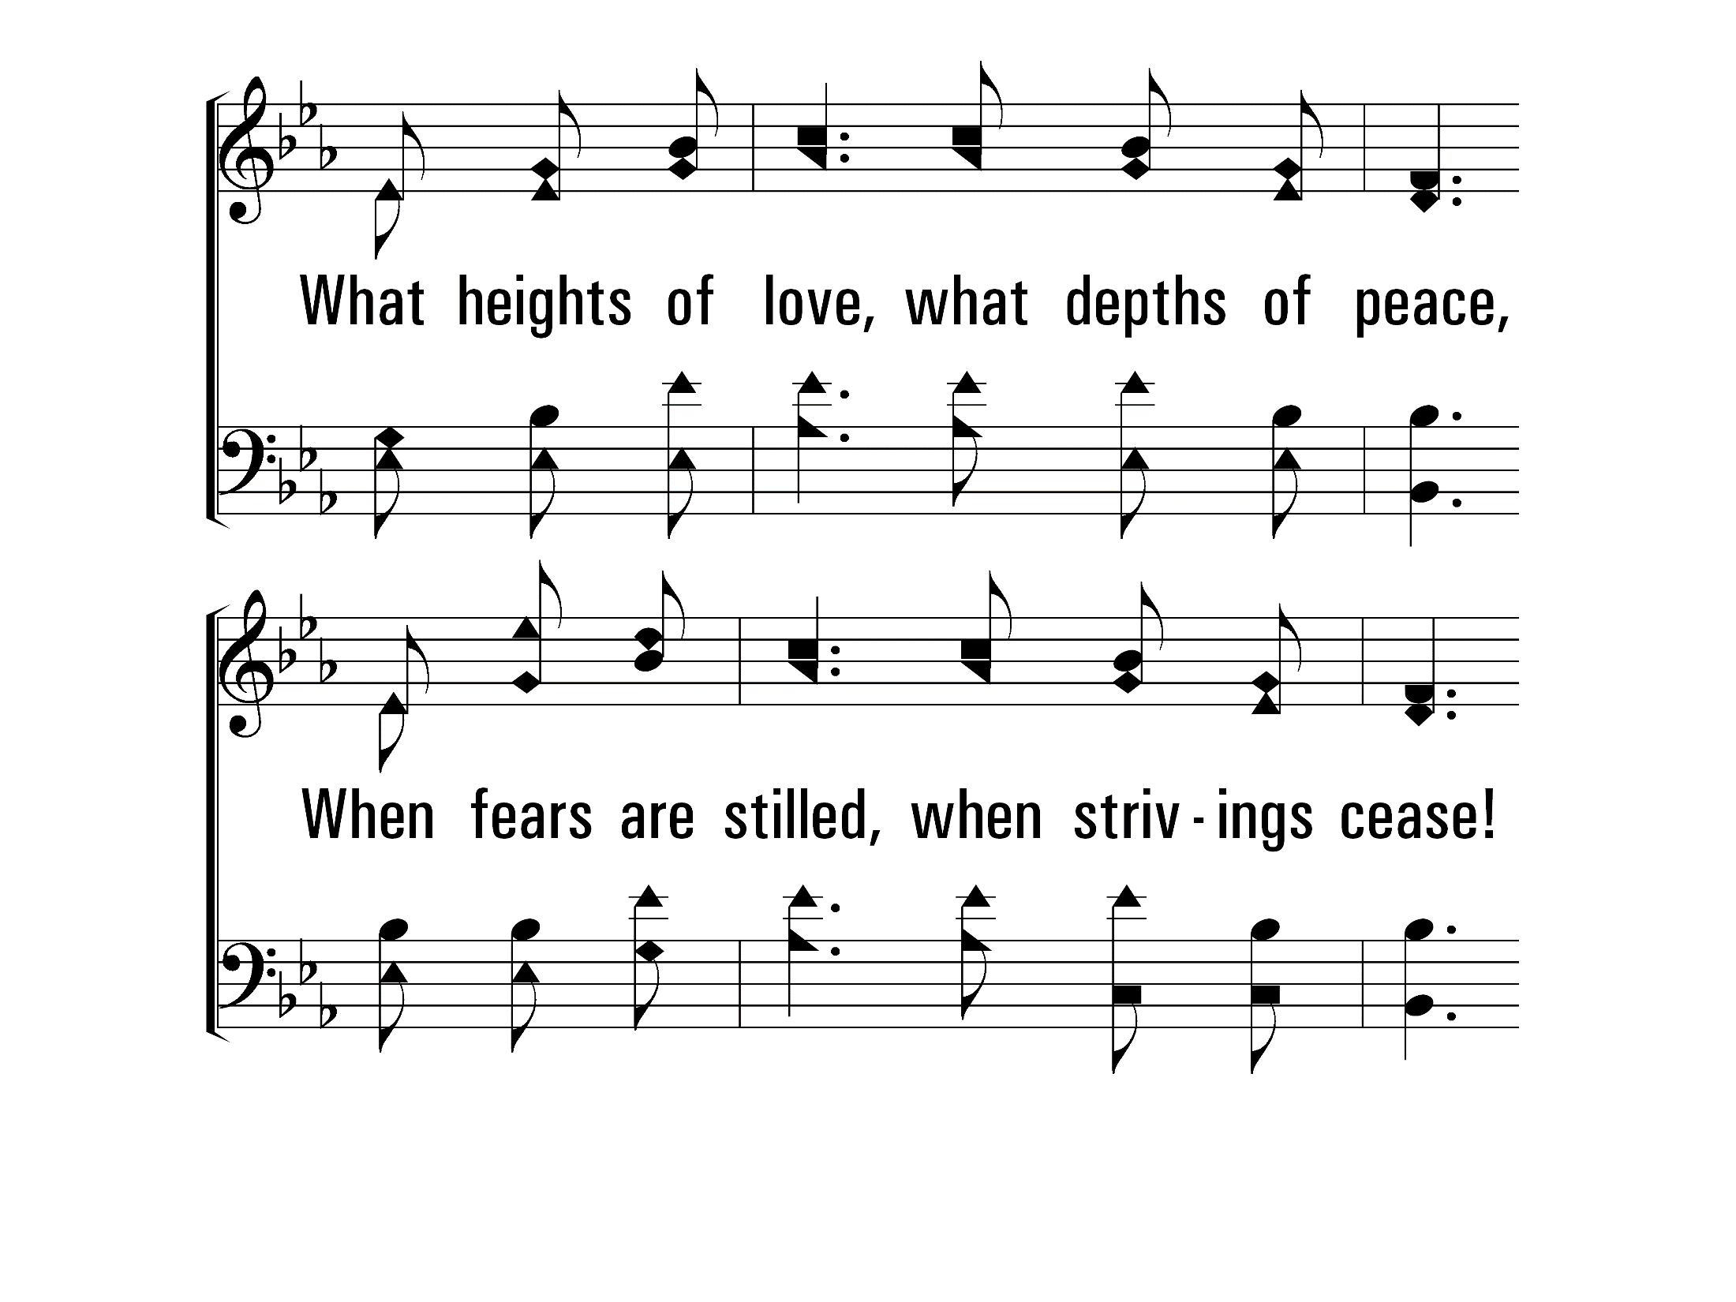
InChristAlone_st1_c
Vs 1
© 2014 Sumphonia Productions, LLC

Slide 38
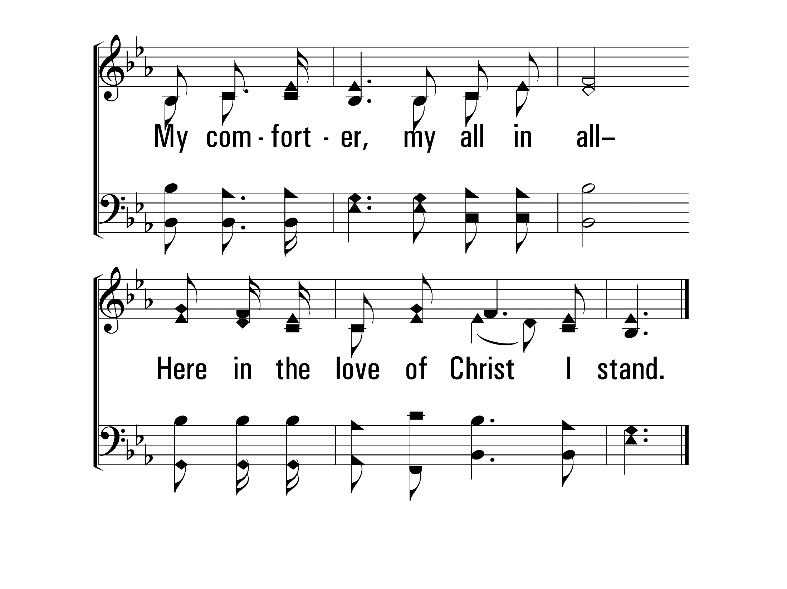
InChristAlone_st1_d
Vs 1
© 2014 Sumphonia Productions, LLC

Slide 39
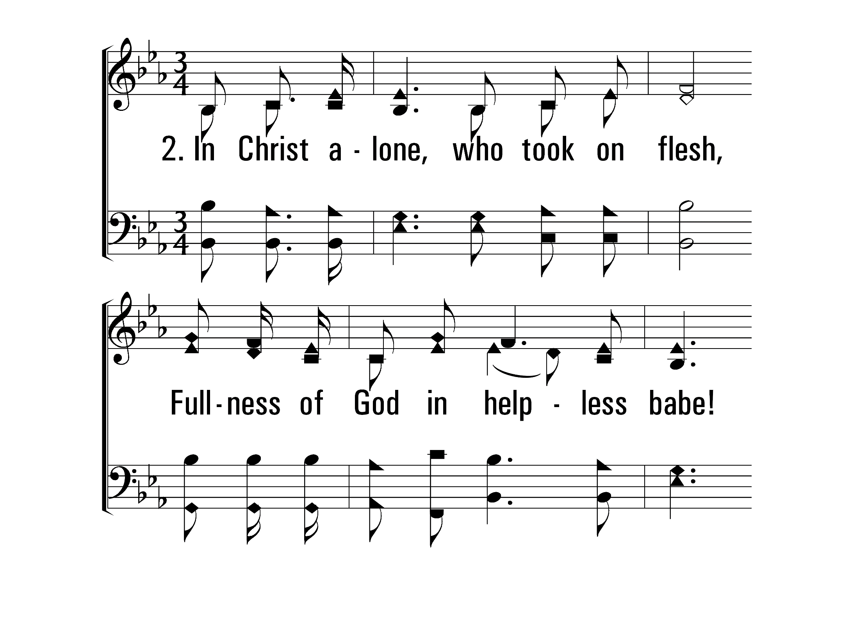
InChristAlone_st2_a
Vs 2
© 2014 Sumphonia Productions, LLC

Slide 40
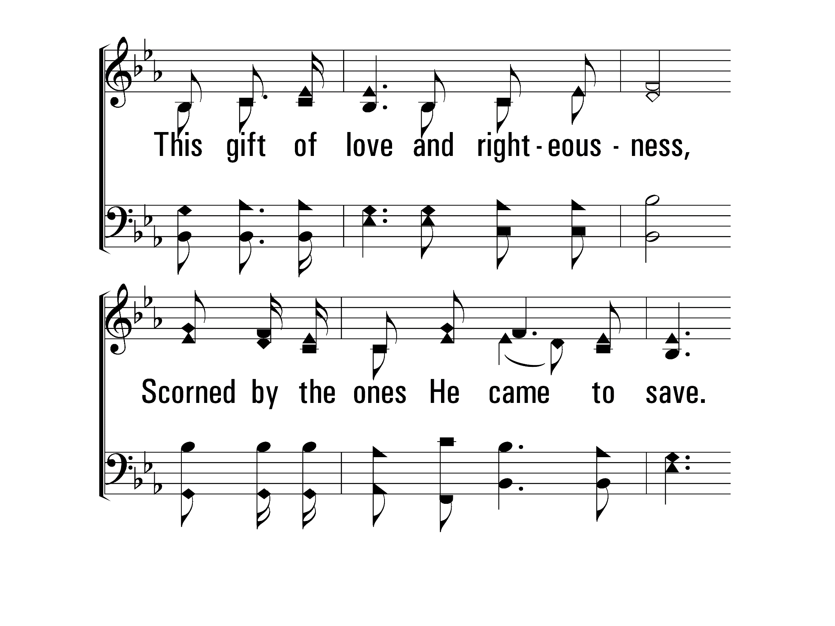
InChristAlone_st2_b
Vs 2
© 2014 Sumphonia Productions, LLC

Slide 41
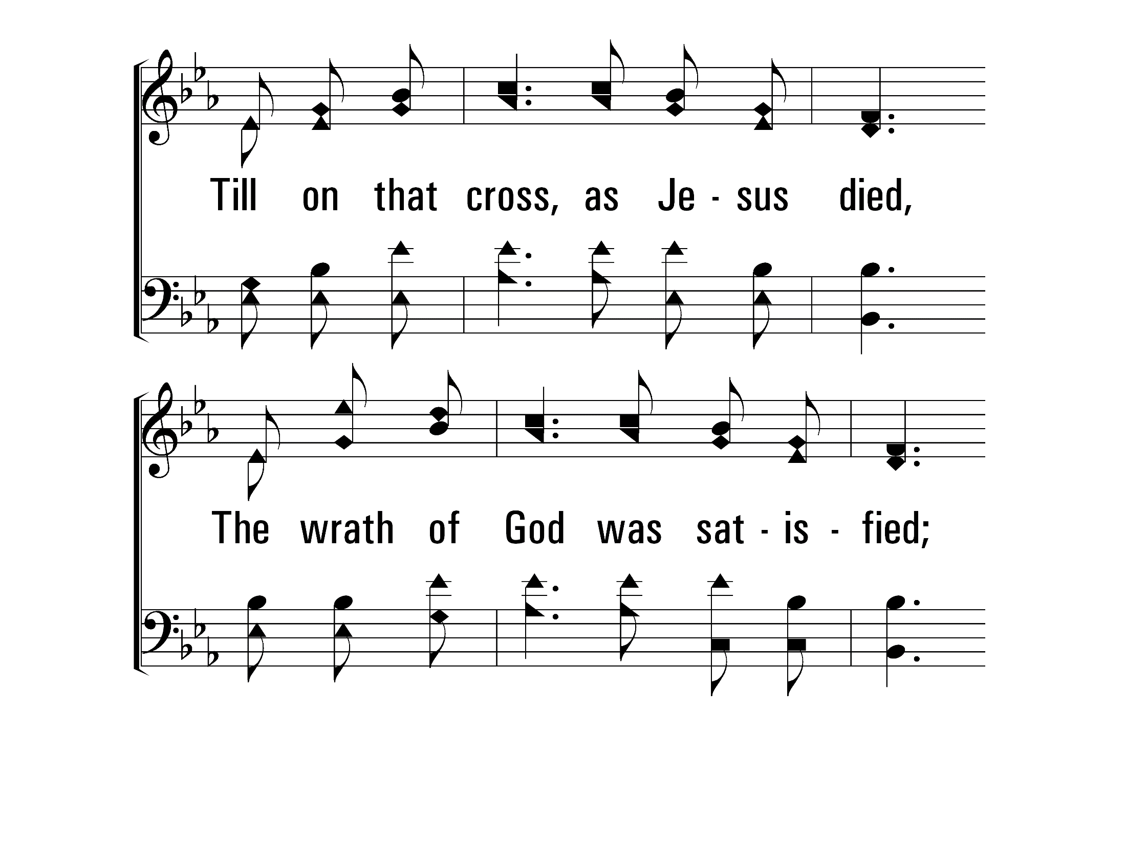
InChristAlone_st2_c
Vs 2
© 2014 Sumphonia Productions, LLC

Slide 42
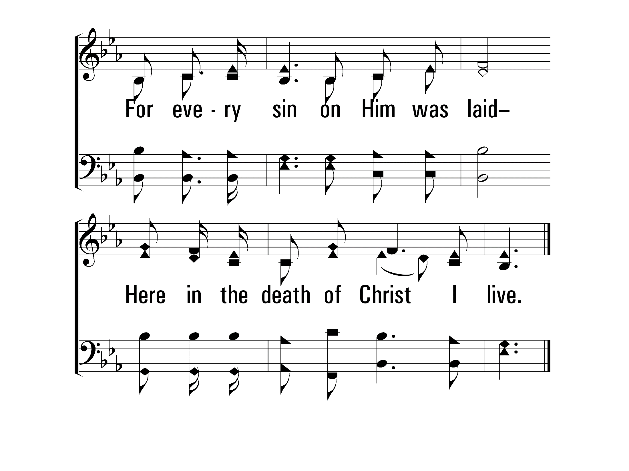
InChristAlone_st2_d
Vs 2
© 2014 Sumphonia Productions, LLC

Slide 43
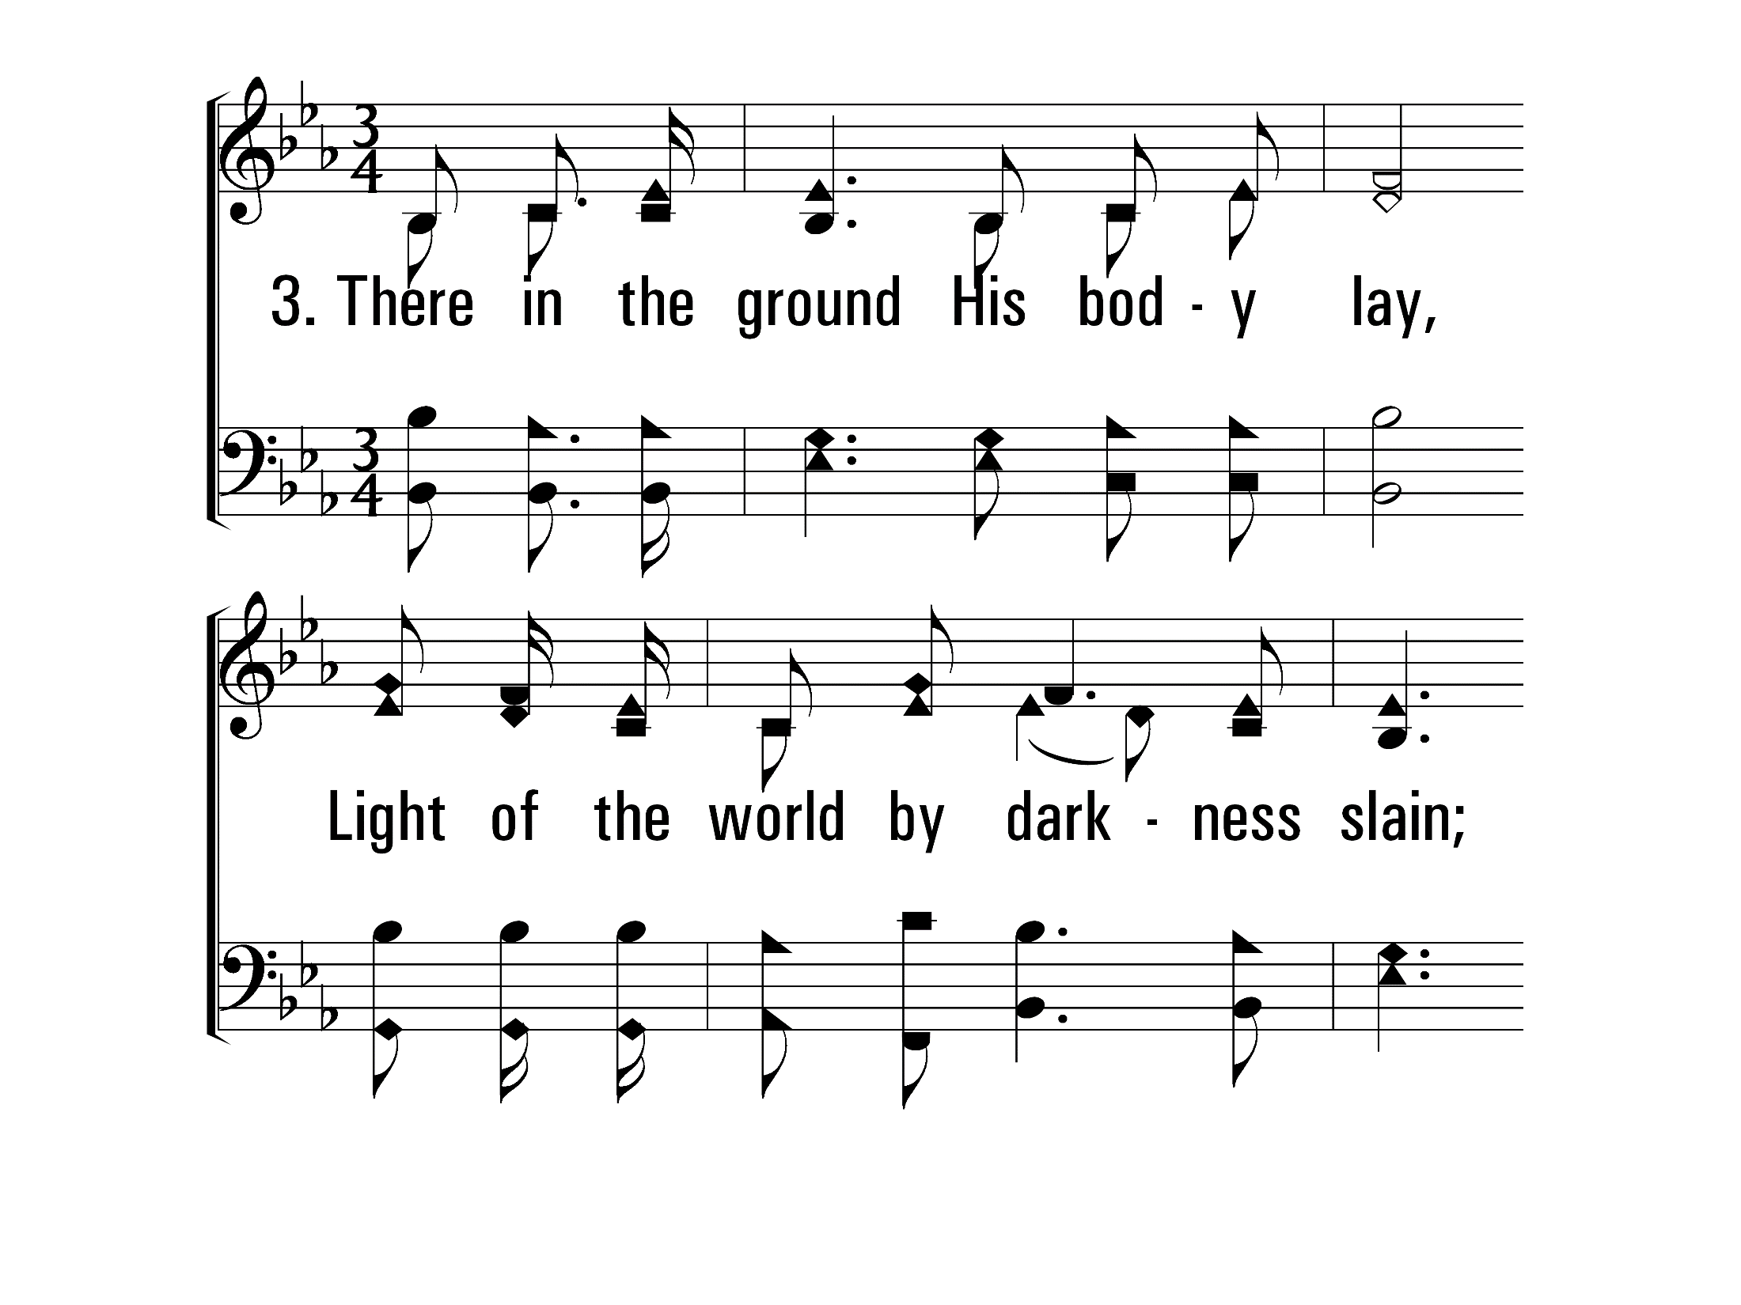
InChristAlone_st3_a
Vs 3
© 2014 Sumphonia Productions, LLC

Slide 44
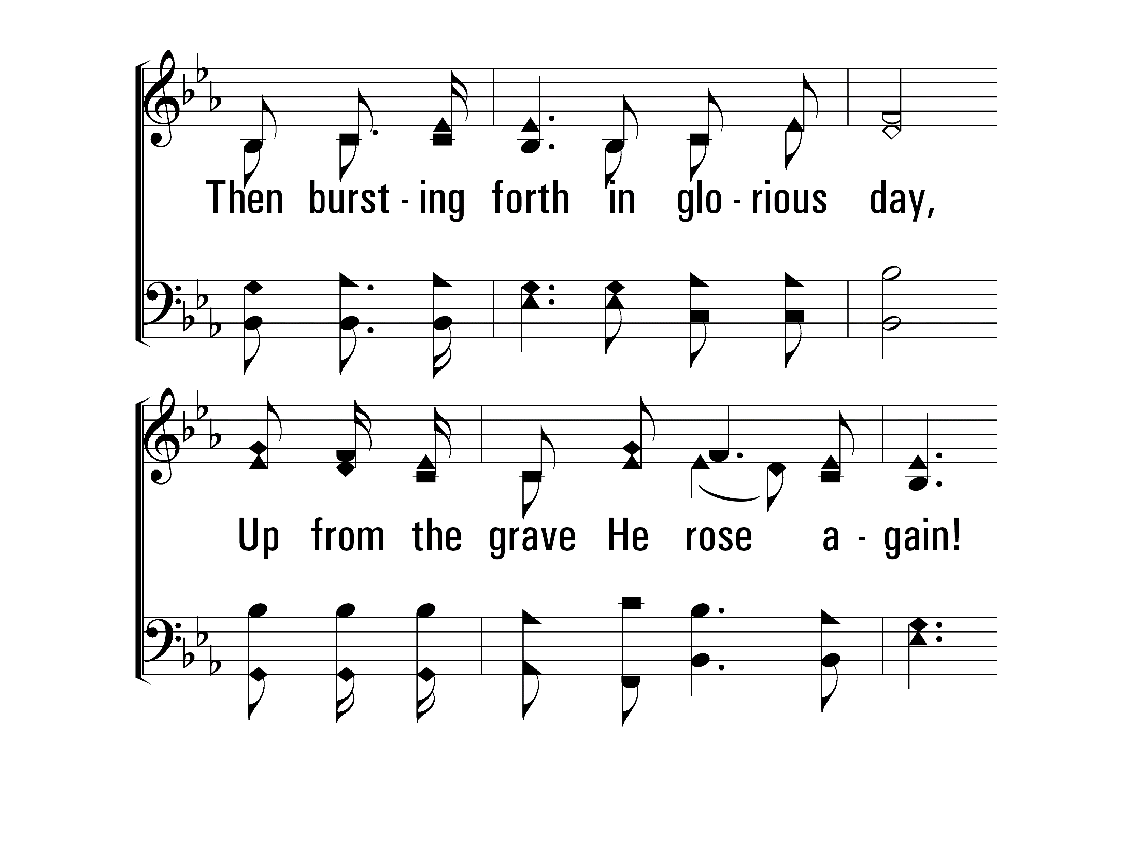
InChristAlone_st3_b
Vs 3
© 2014 Sumphonia Productions, LLC

Slide 45
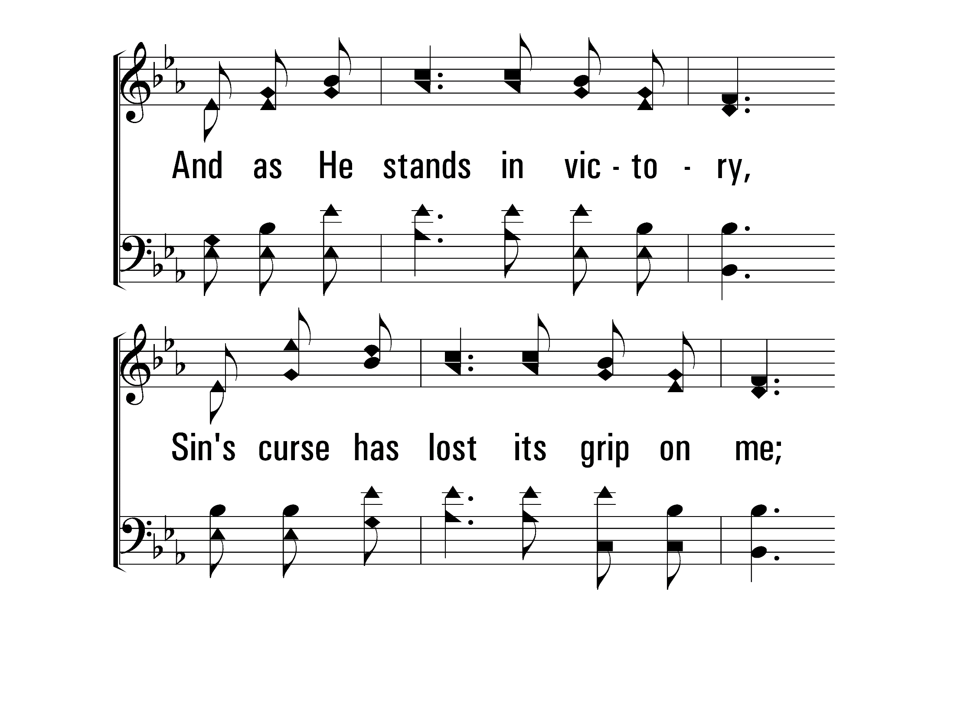
InChristAlone_st3_c
Vs 3
© 2014 Sumphonia Productions, LLC

Slide 46
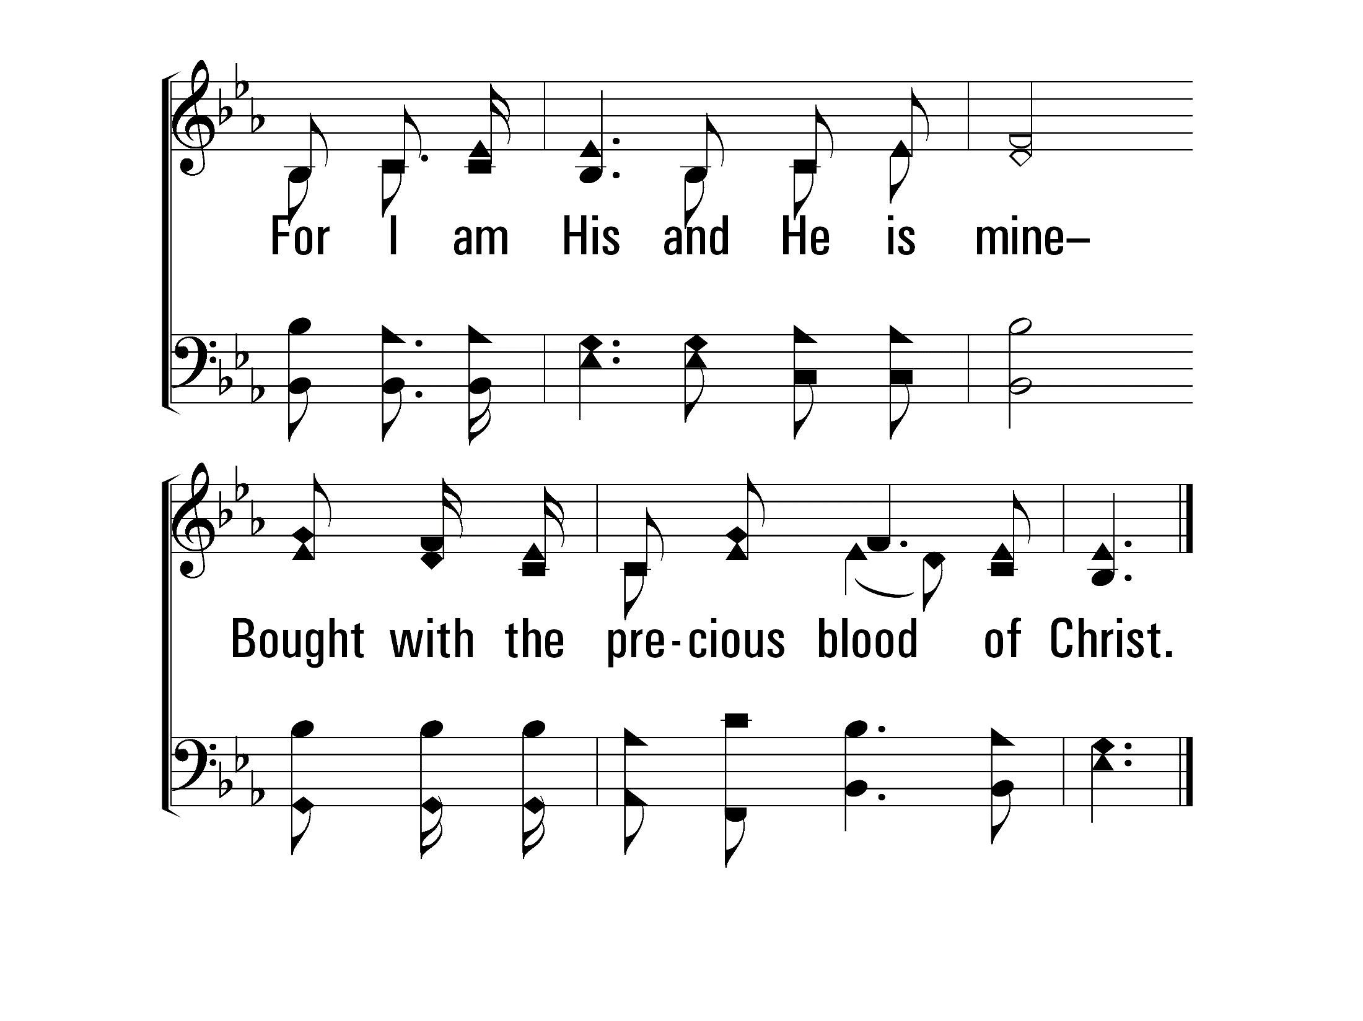
InChristAlone_st3_d
Vs 3
© 2014 Sumphonia Productions, LLC

Slide 47

InChristAlone_st4_a
Vs 4
© 2014 Sumphonia Productions, LLC

Slide 48
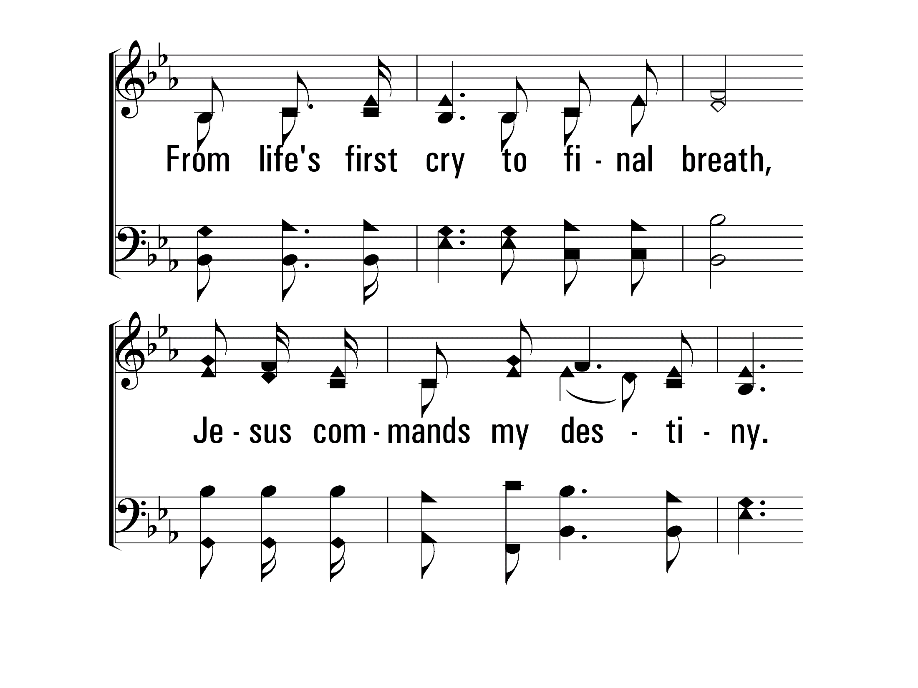
InChristAlone_st4_b
Vs 4
© 2014 Sumphonia Productions, LLC

Slide 49
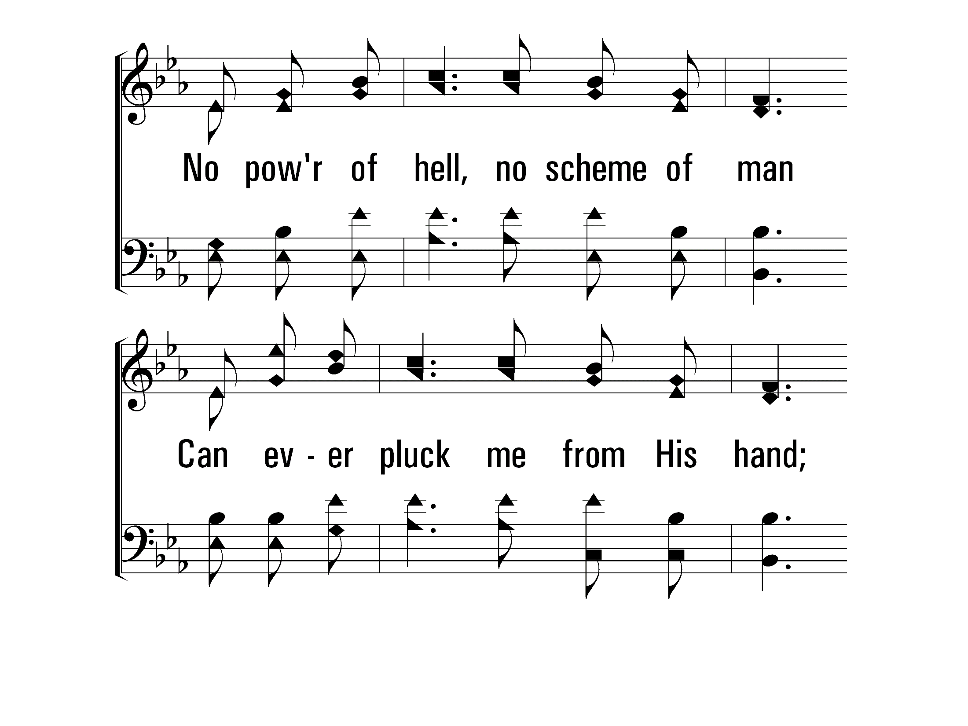
InChristAlone_st4_c
Vs 4
© 2014 Sumphonia Productions, LLC

Slide 50
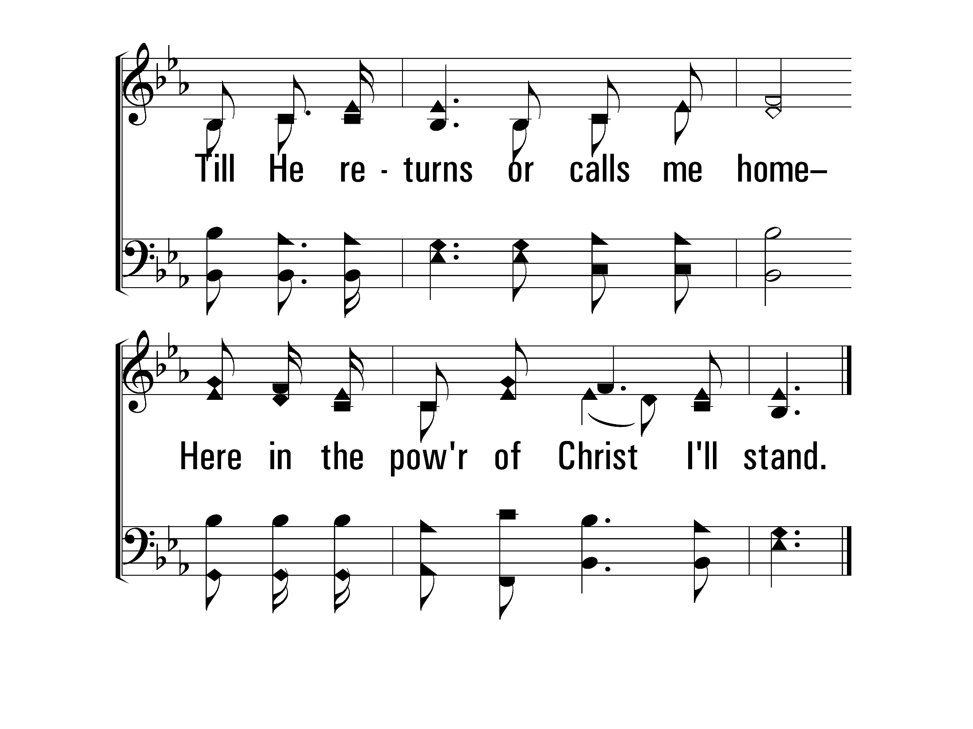
InChristAlone_st4_d
Vs 4
© 2014 Sumphonia Productions, LLC
End

Slide 51

1143 - More Precious Than Silver - Title

Slide 52
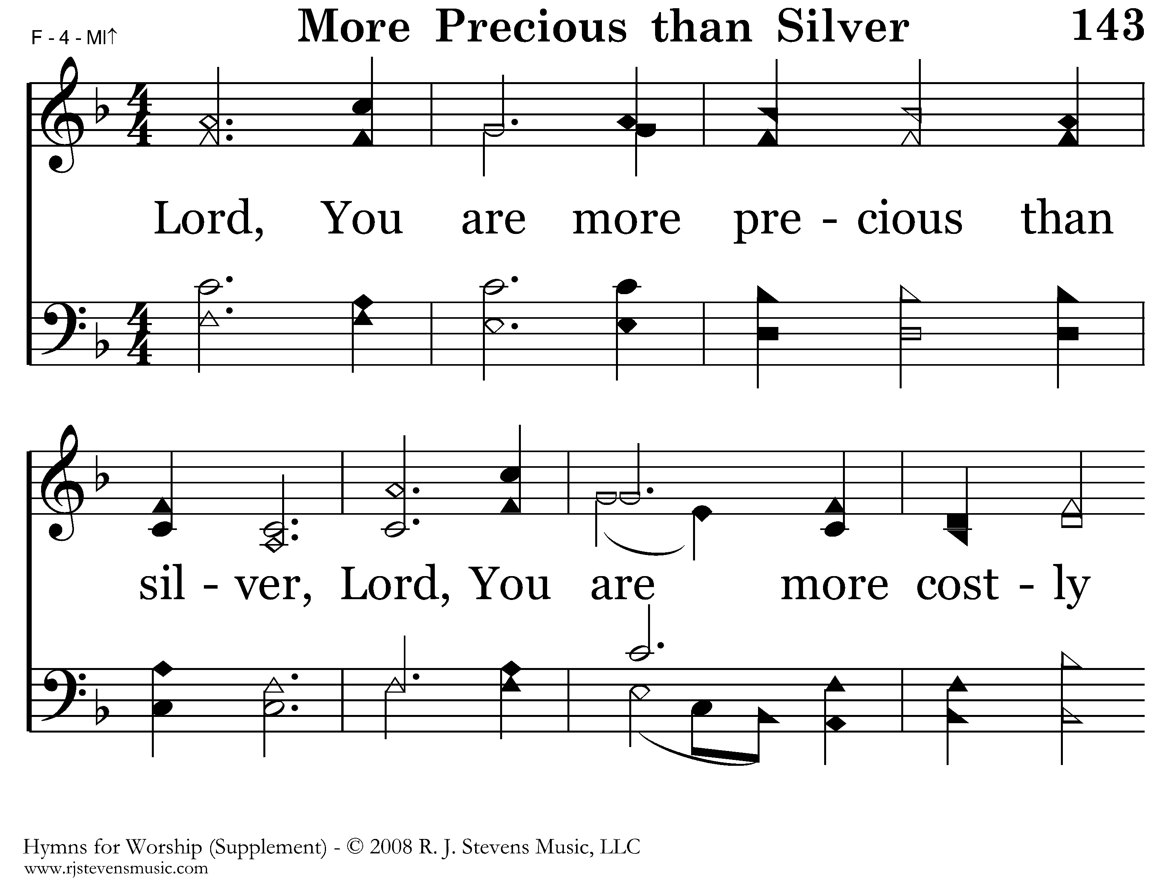
1143 - More Precious Than Silver - 1.1

Slide 53
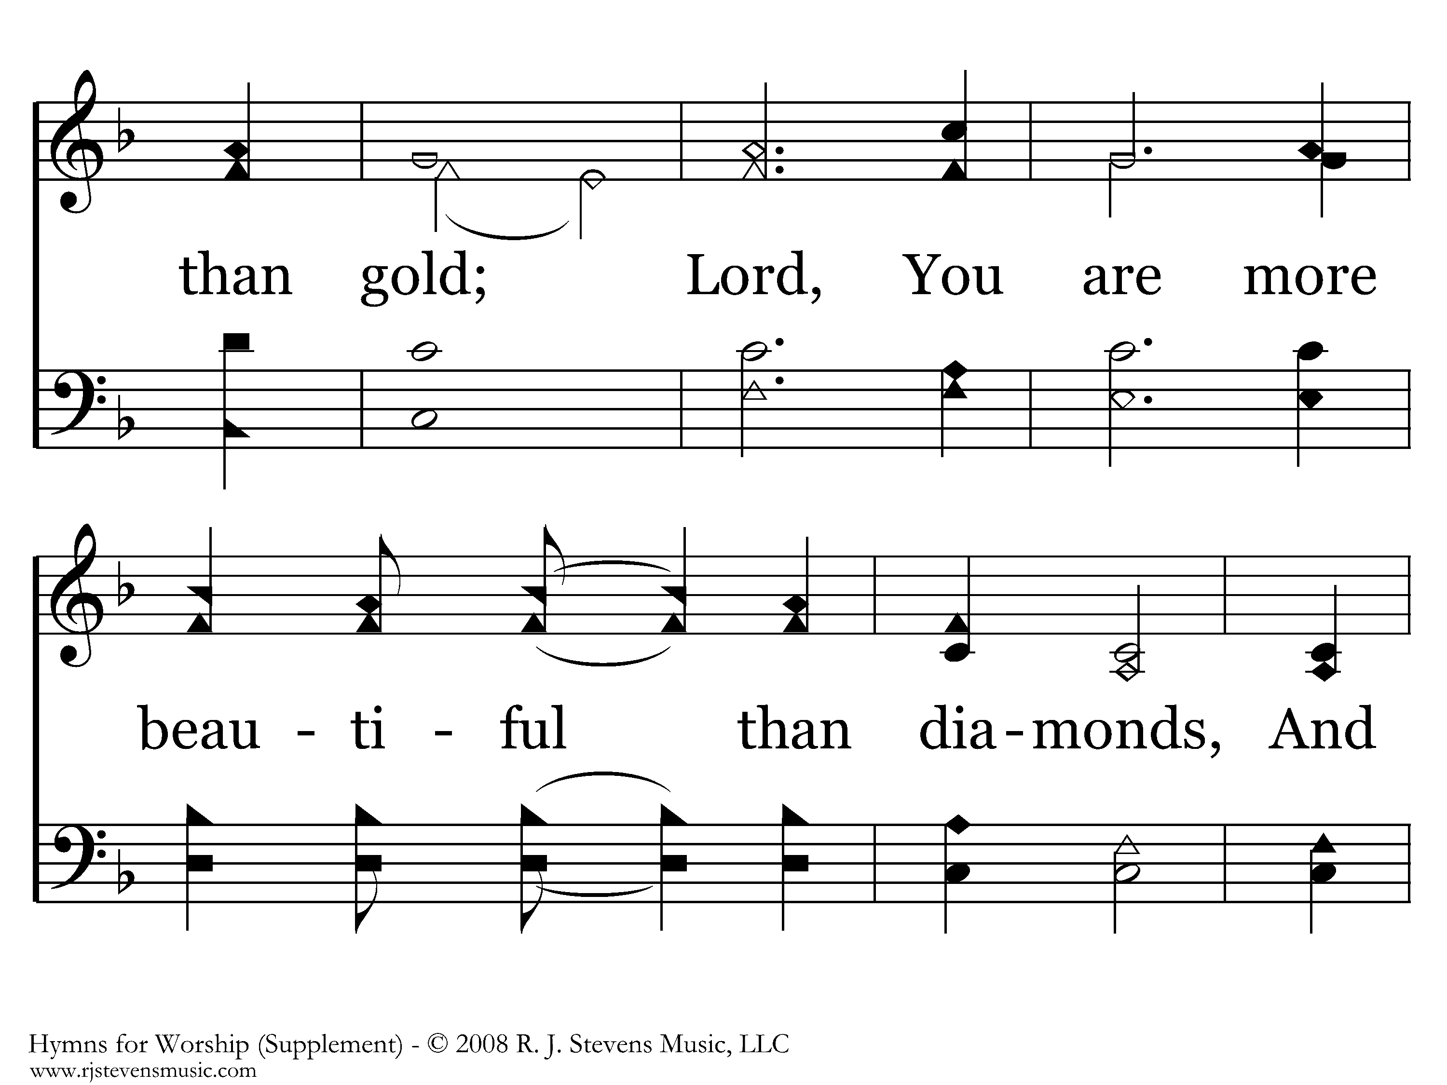
1143 - More Precious Than Silver - 1.2

Slide 54
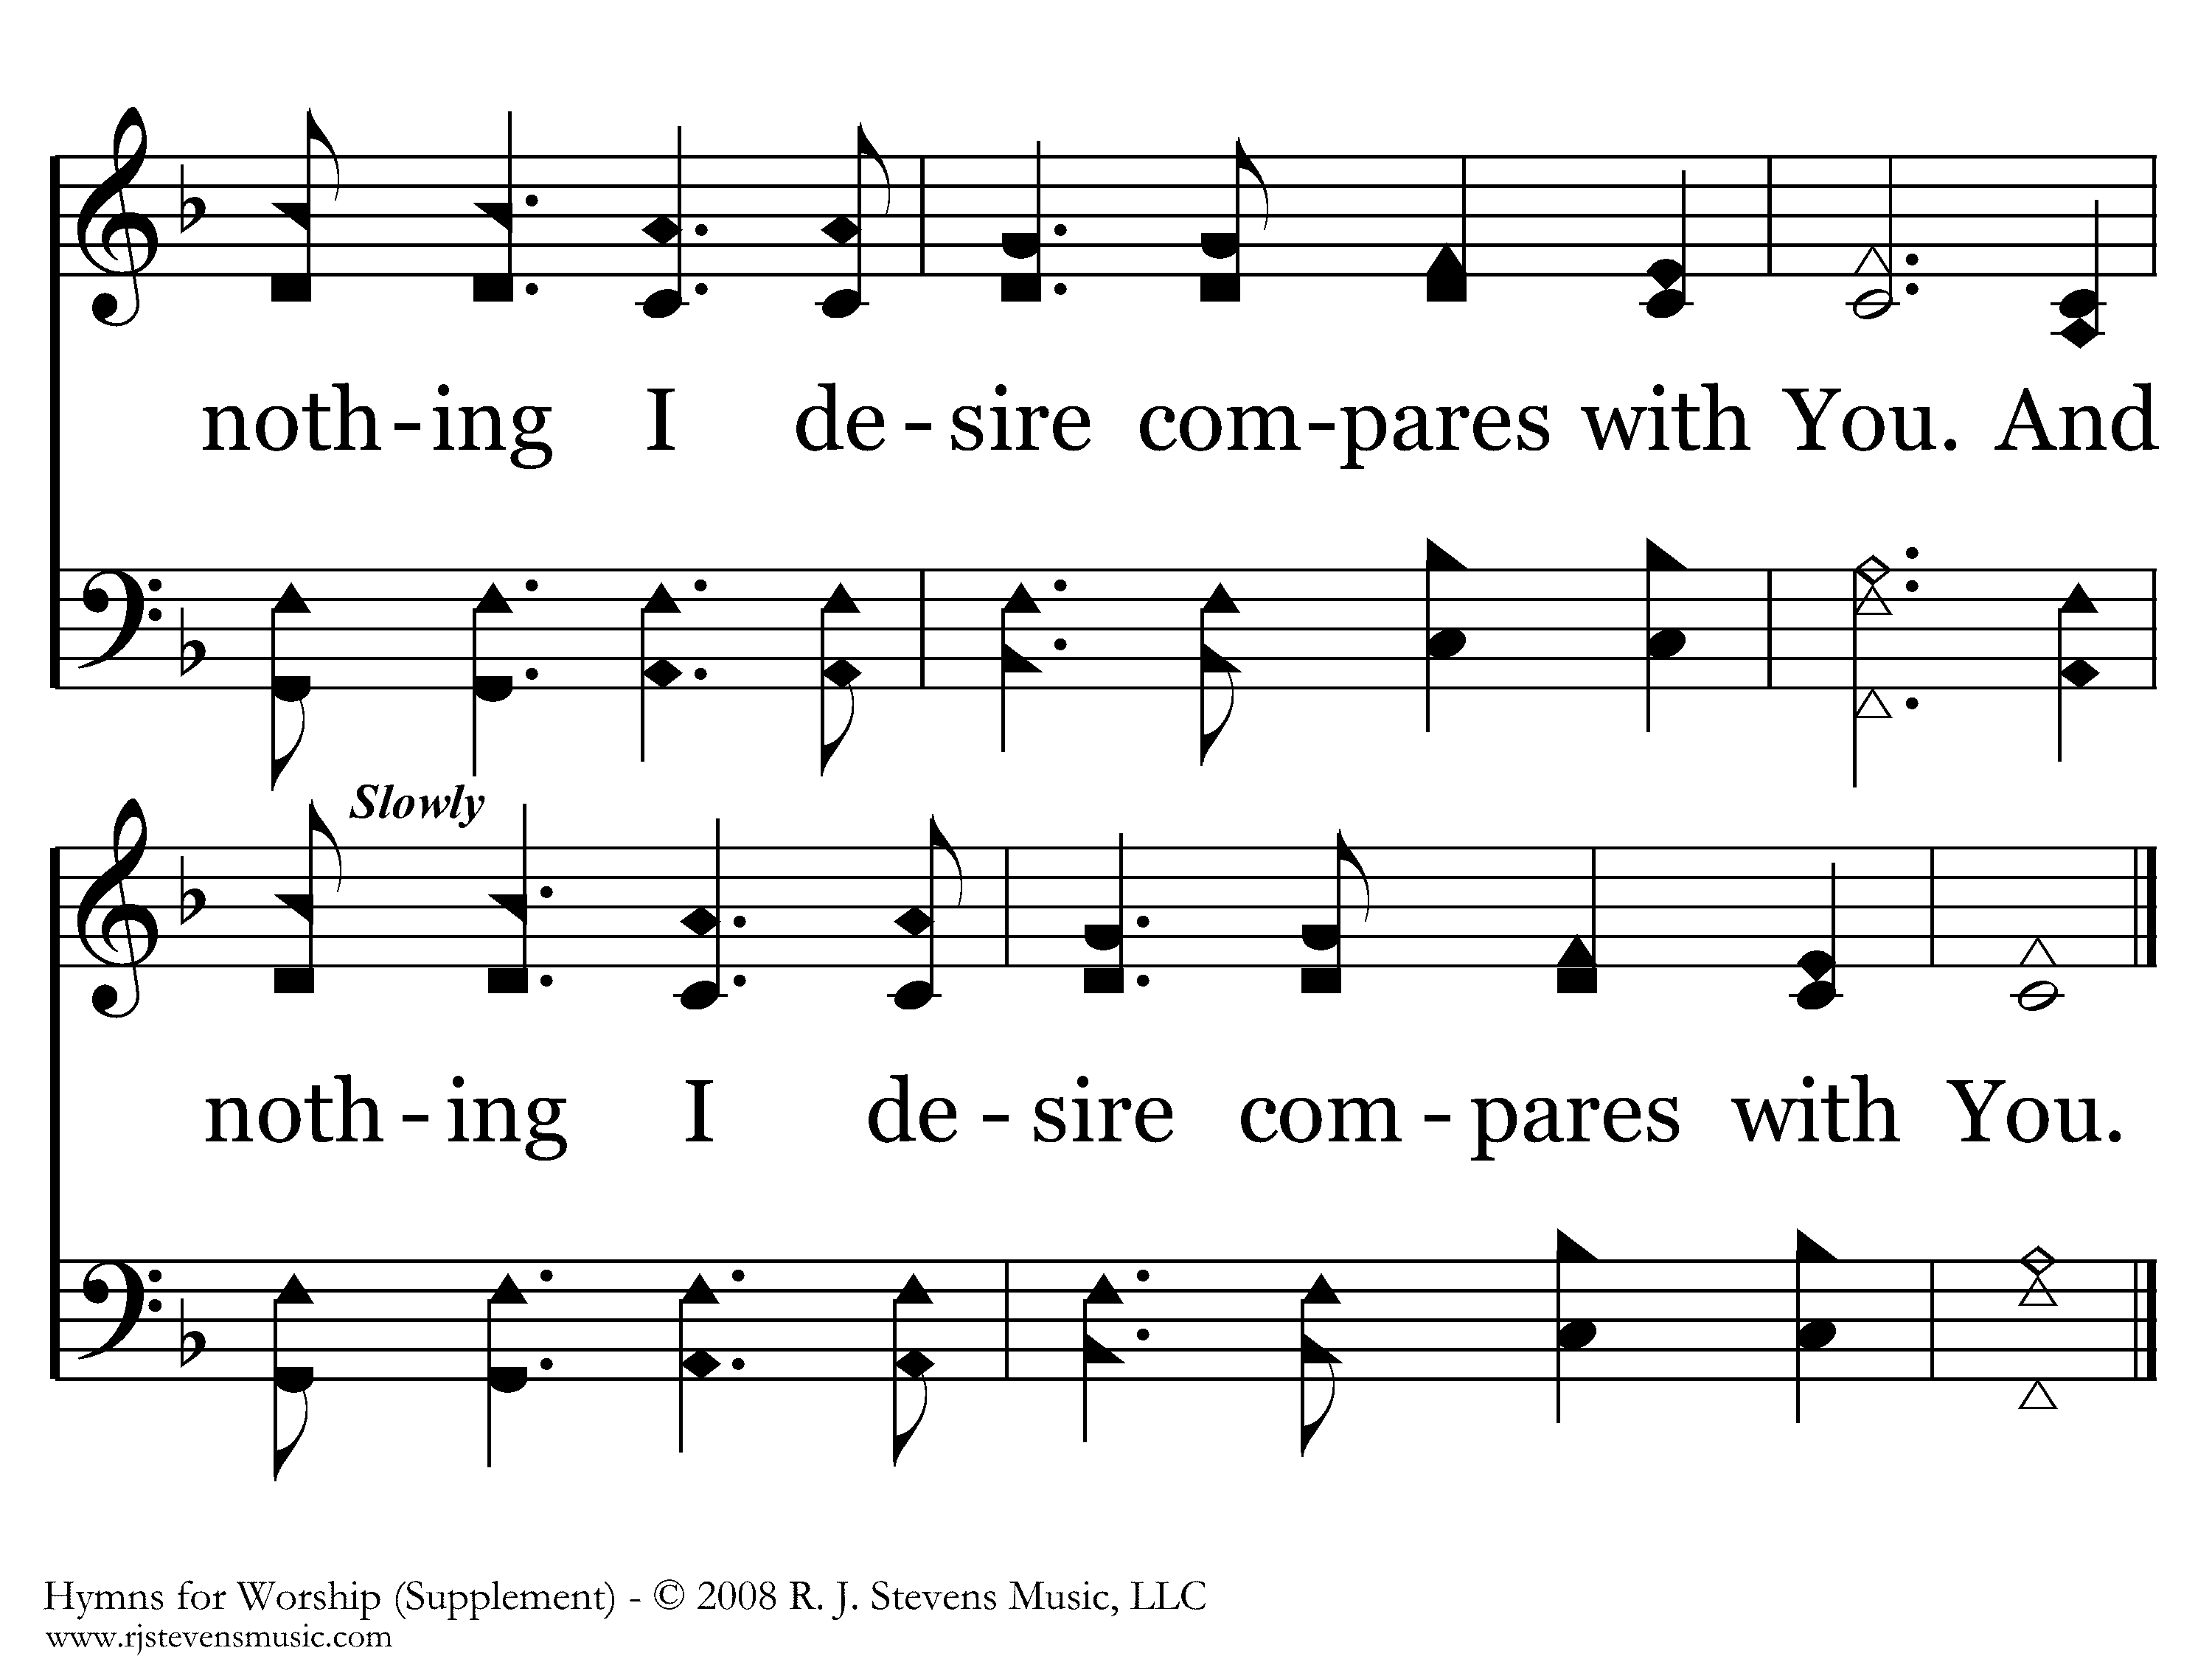
1143 - More Precious Than Silver - 1.3
End of Song

Slide 55
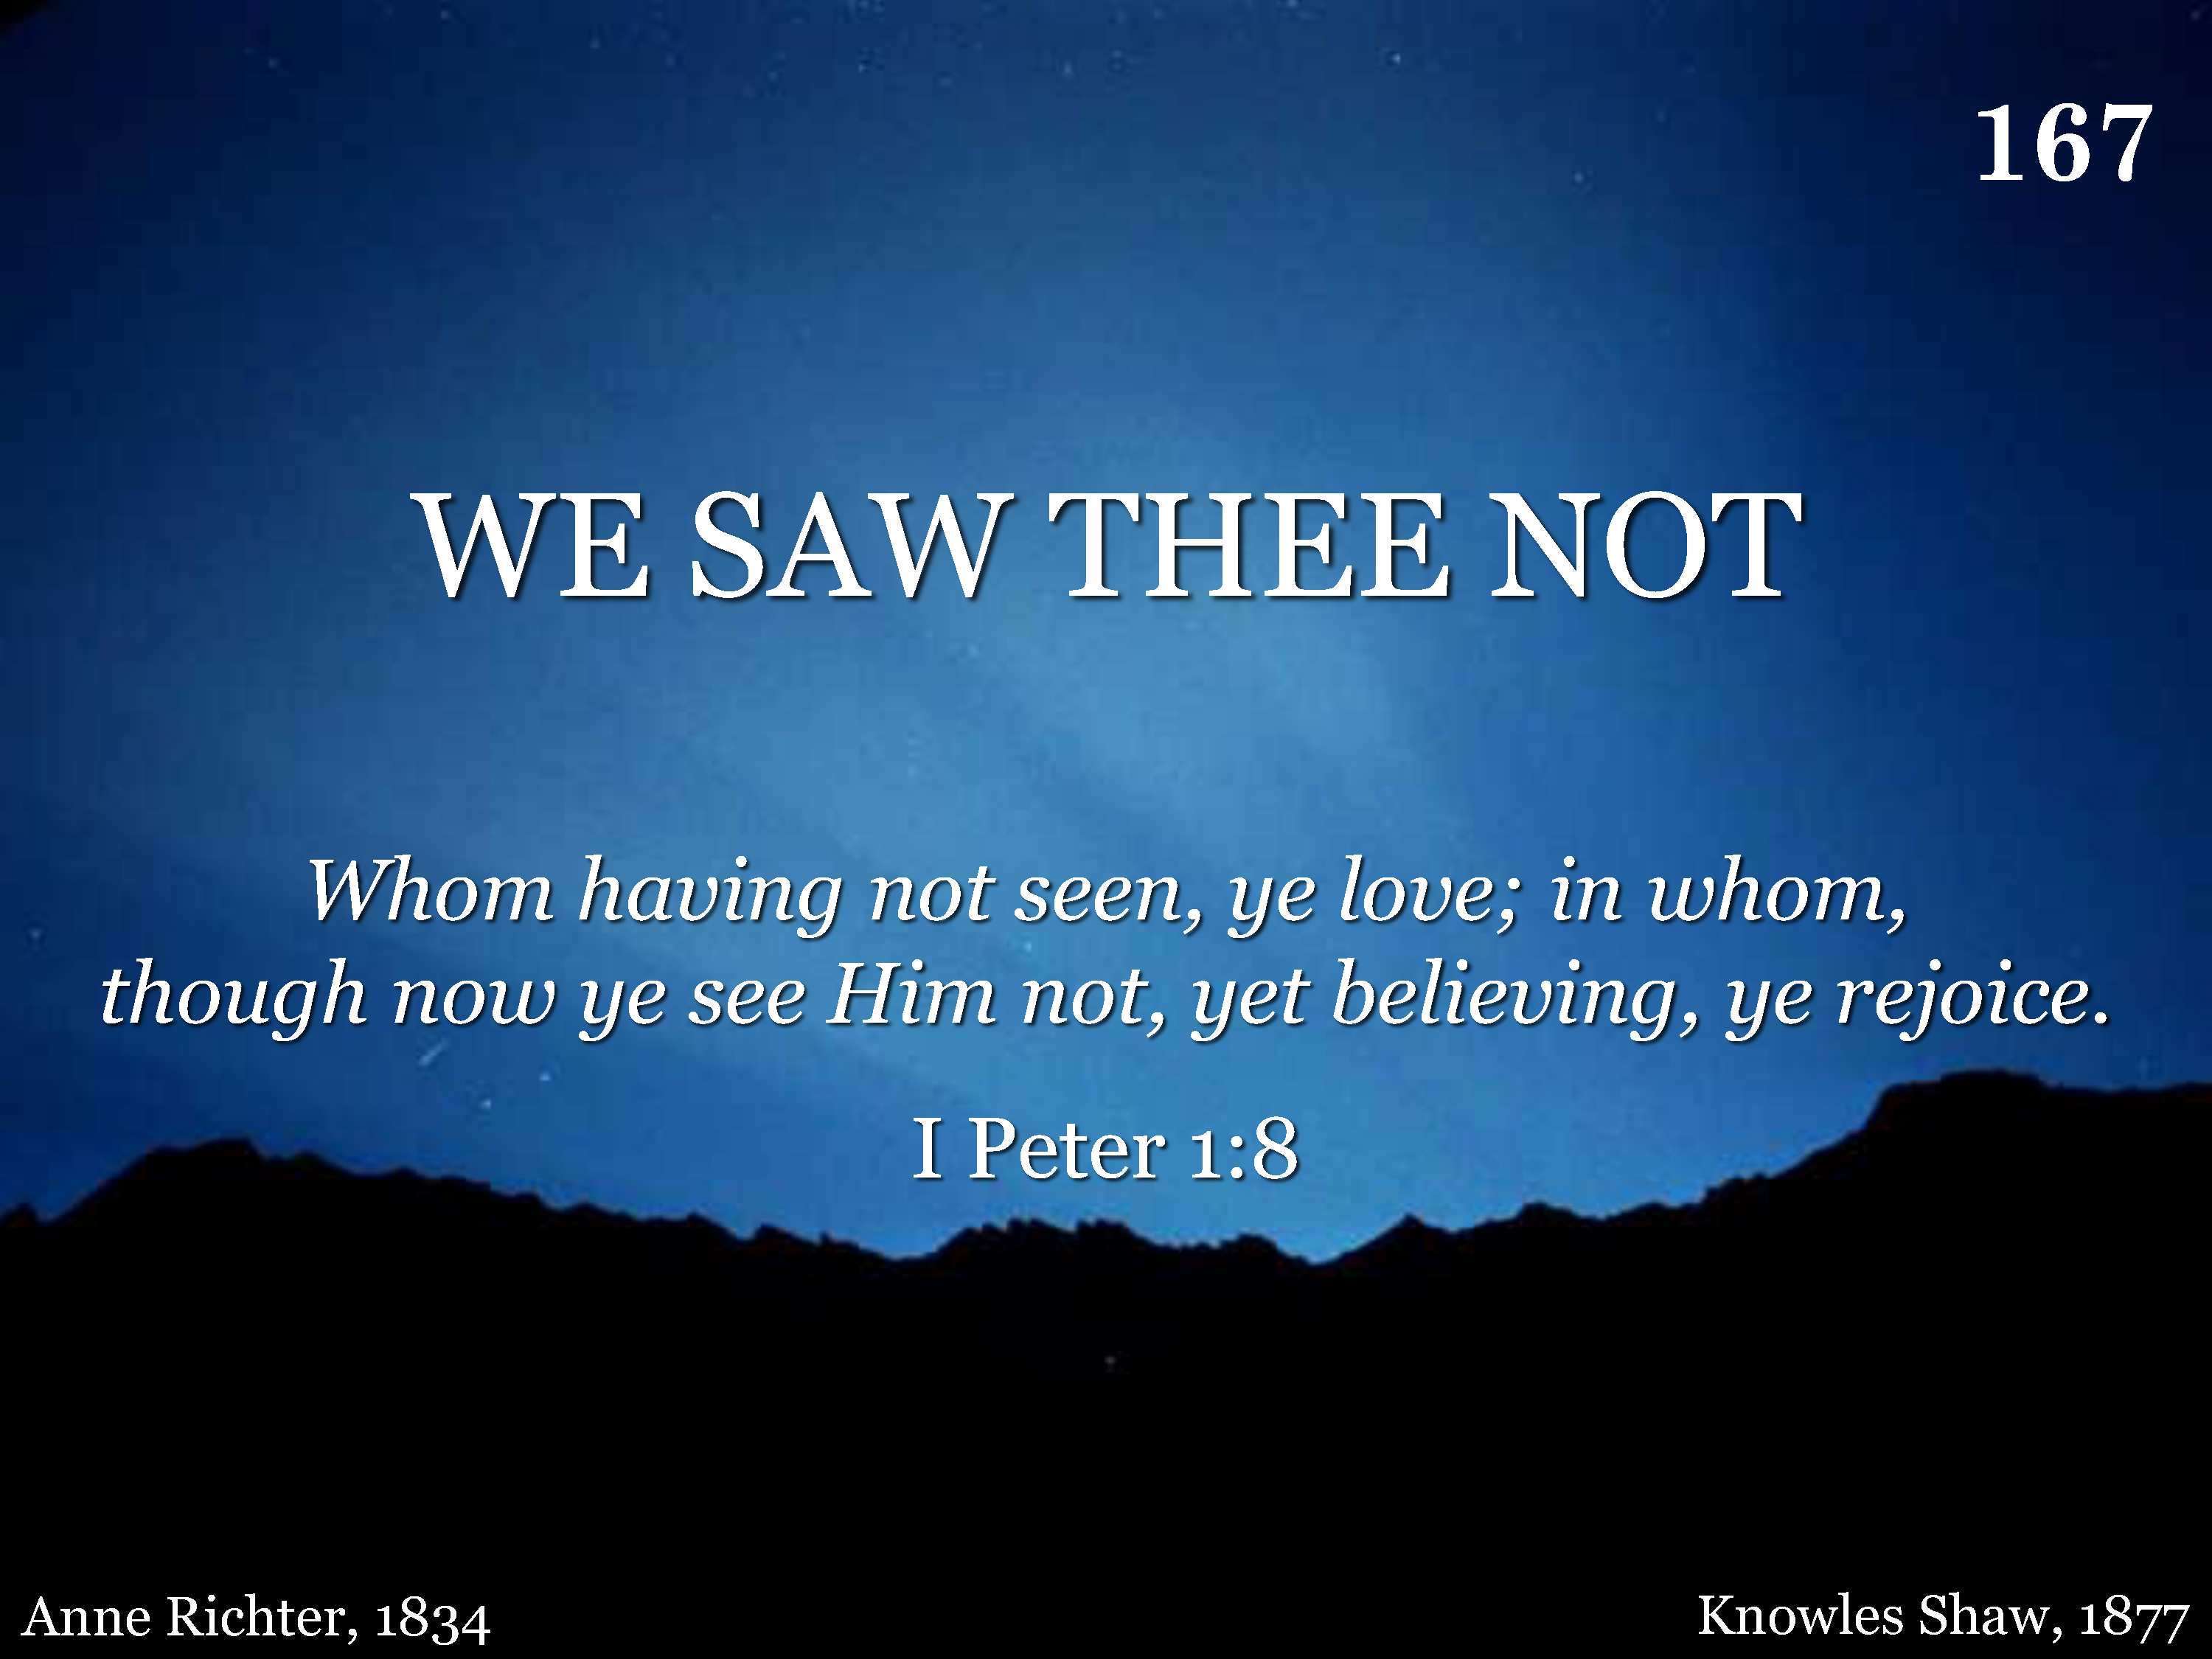
167 - We Saw Thee Not - Title

Slide 56
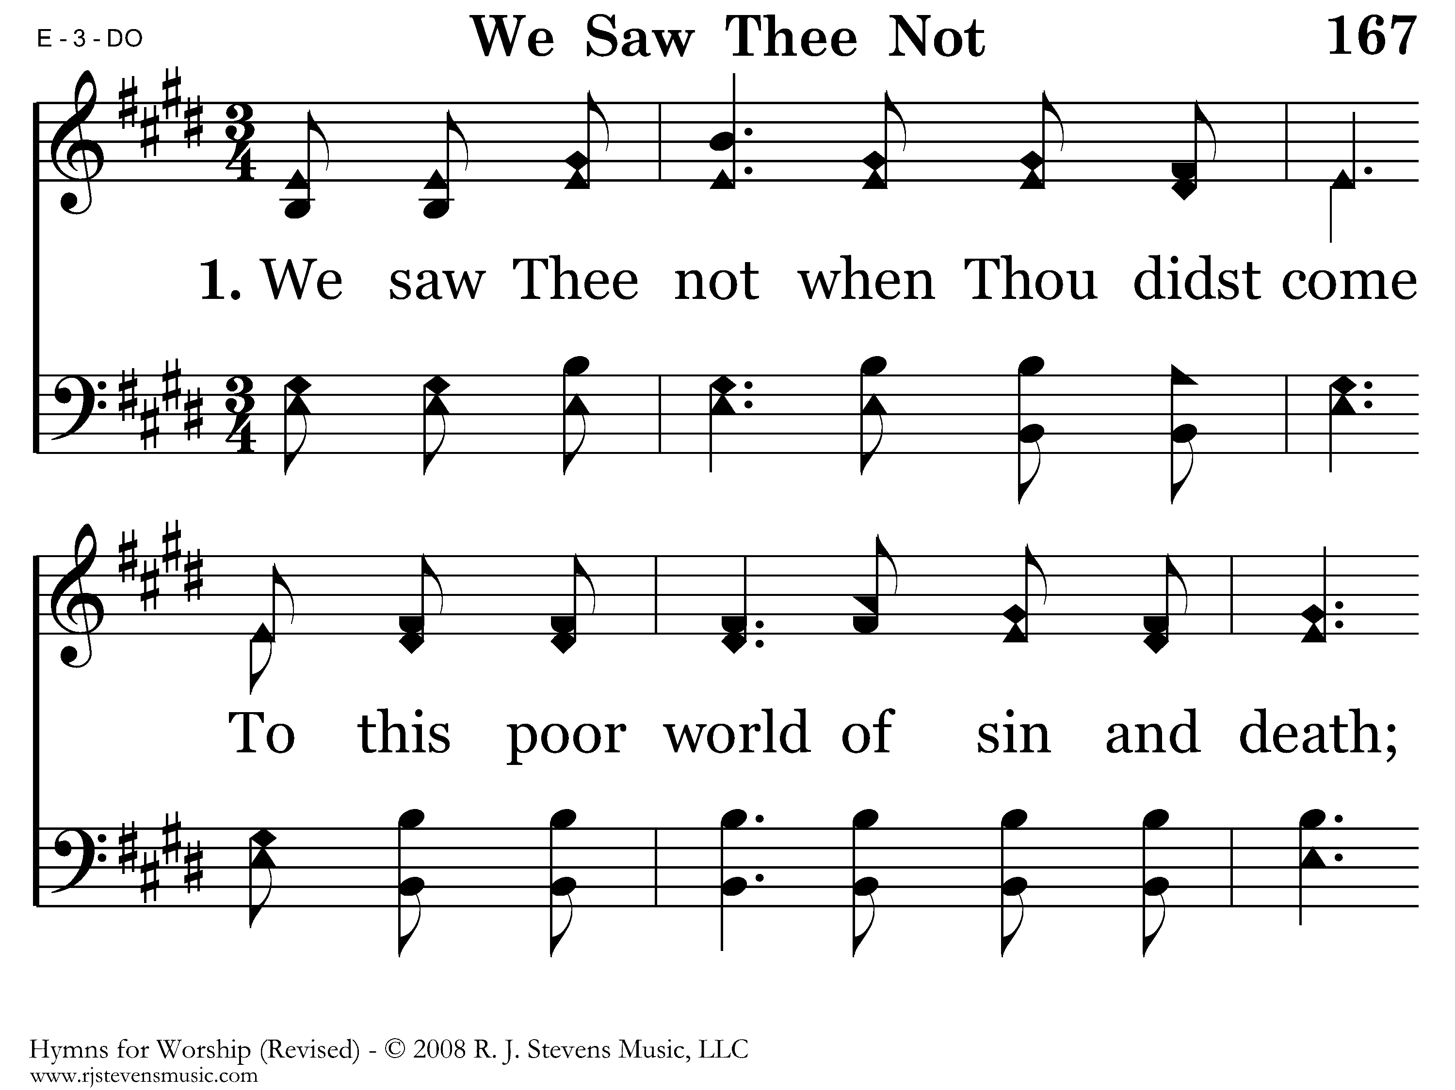
167 - We Saw Thee Not - 1.1

Slide 57
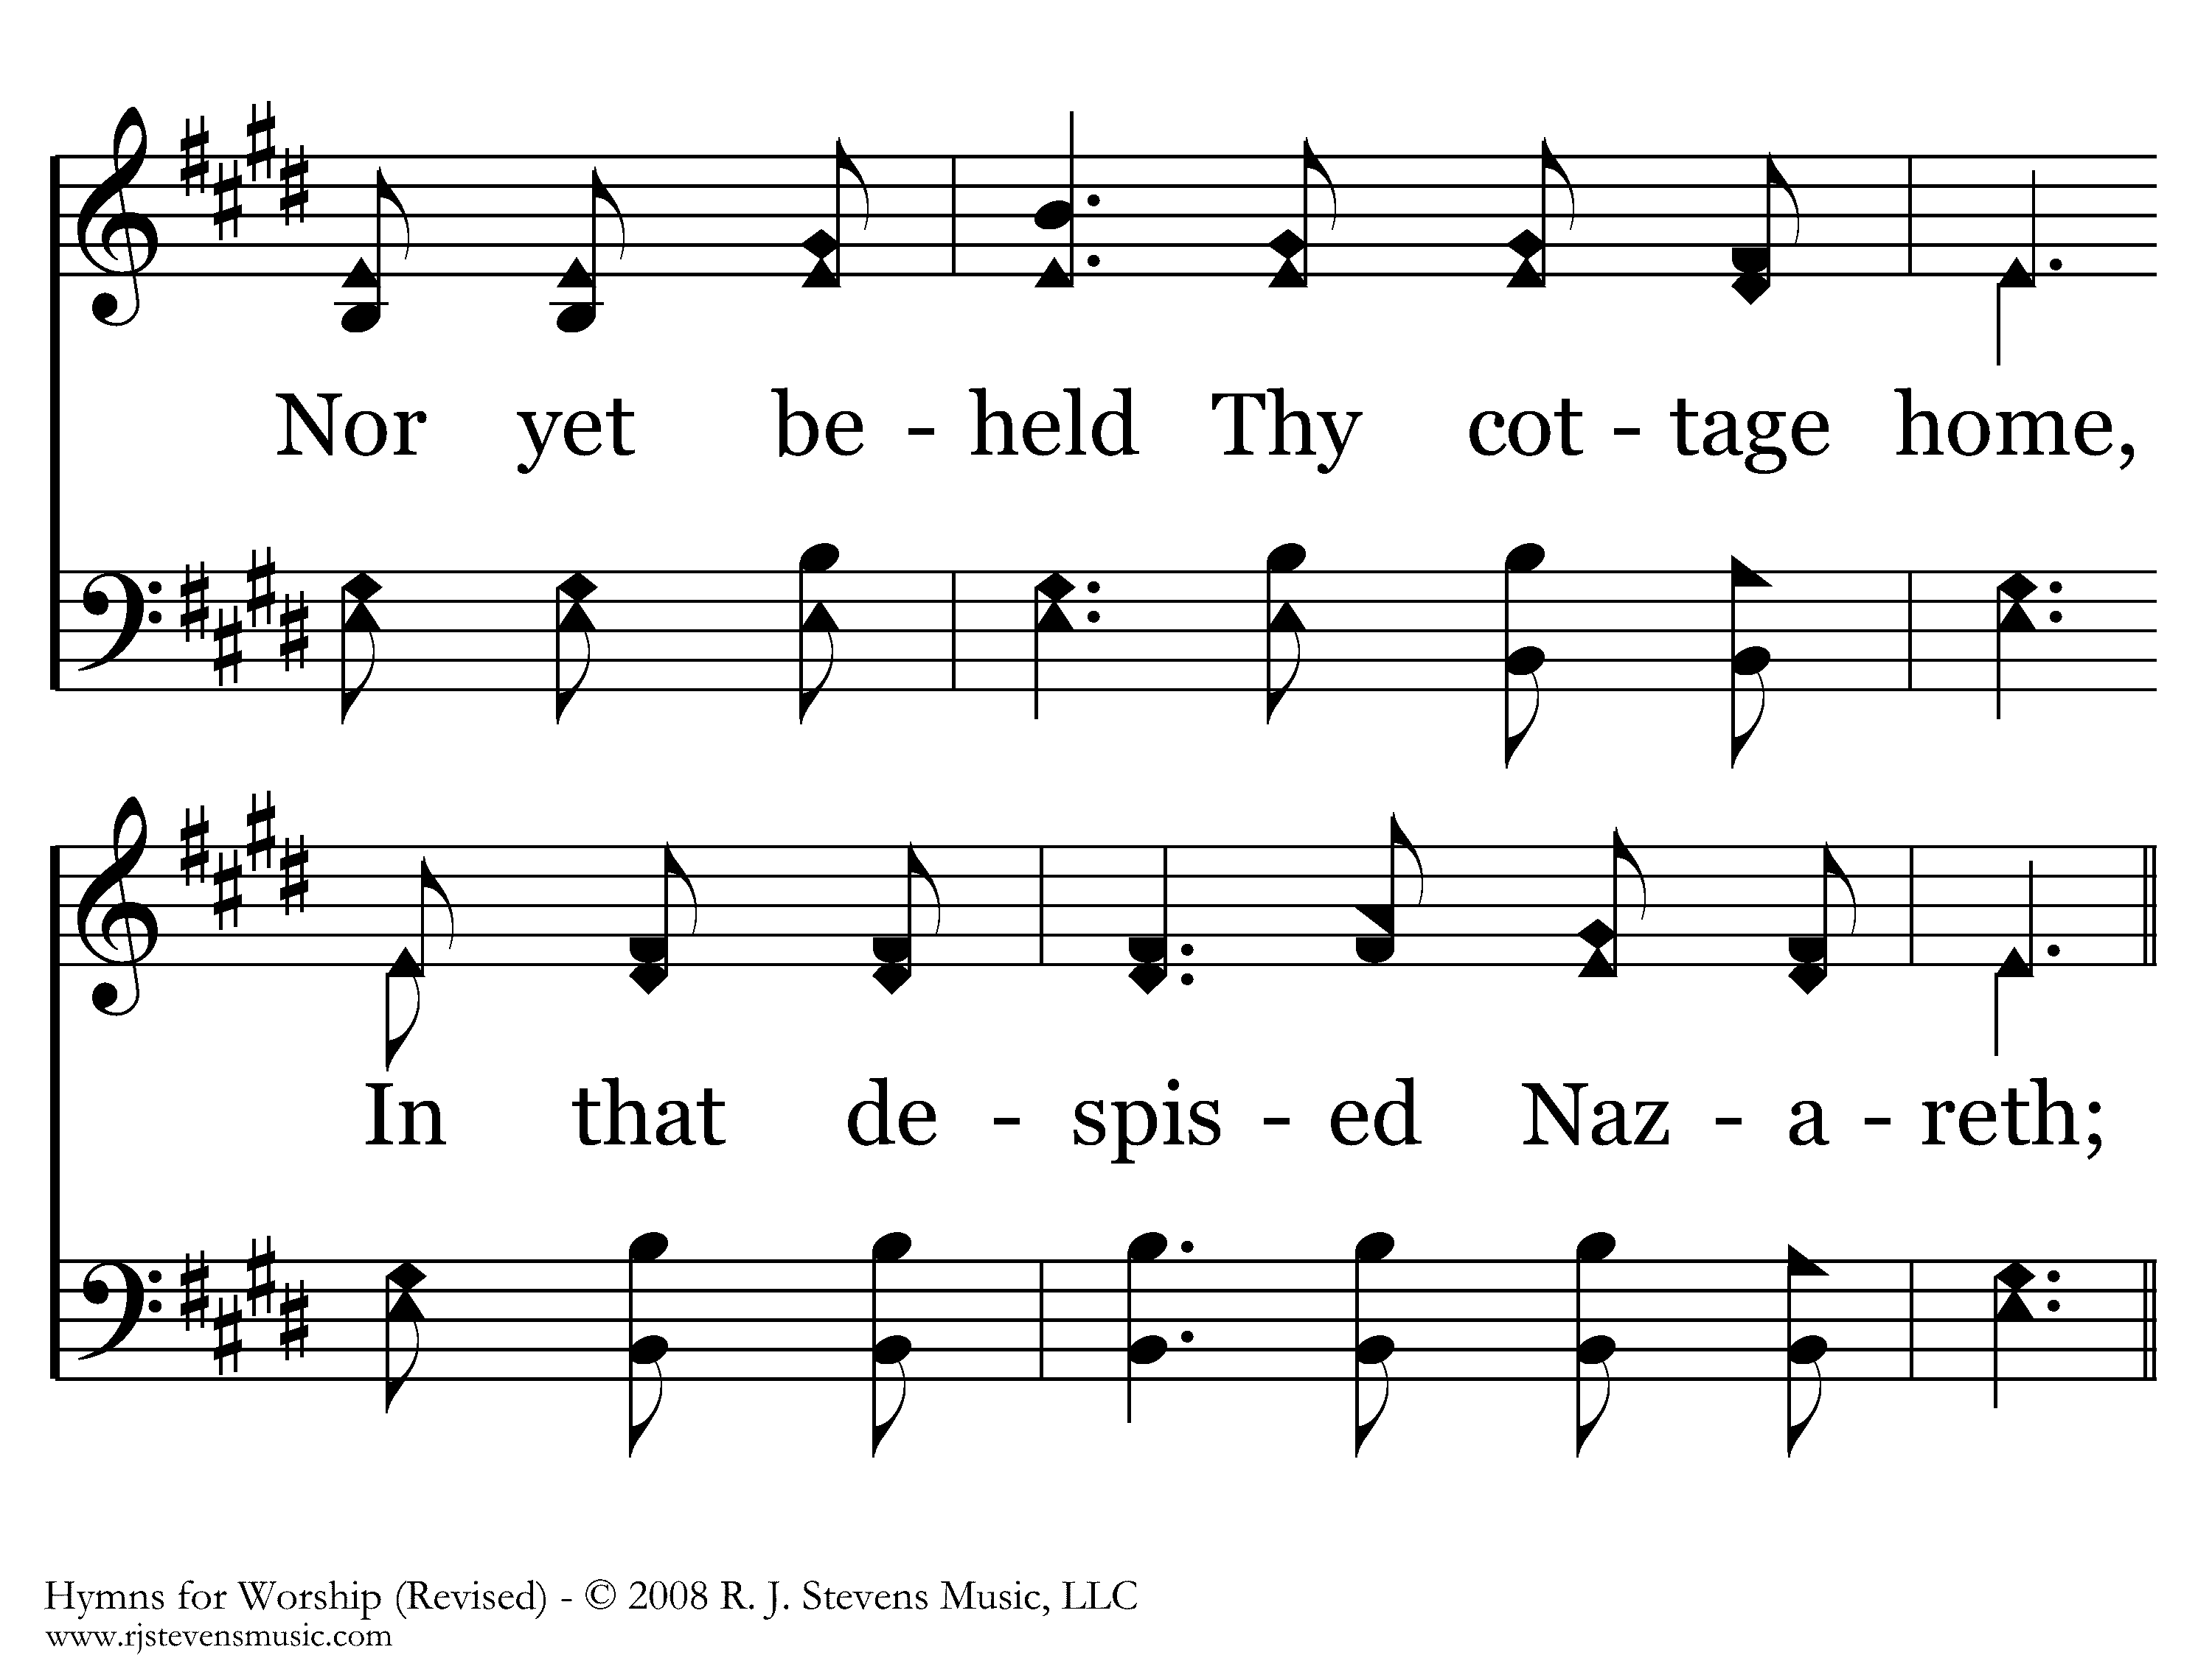
167 - We Saw Thee Not - 1.2

Slide 58
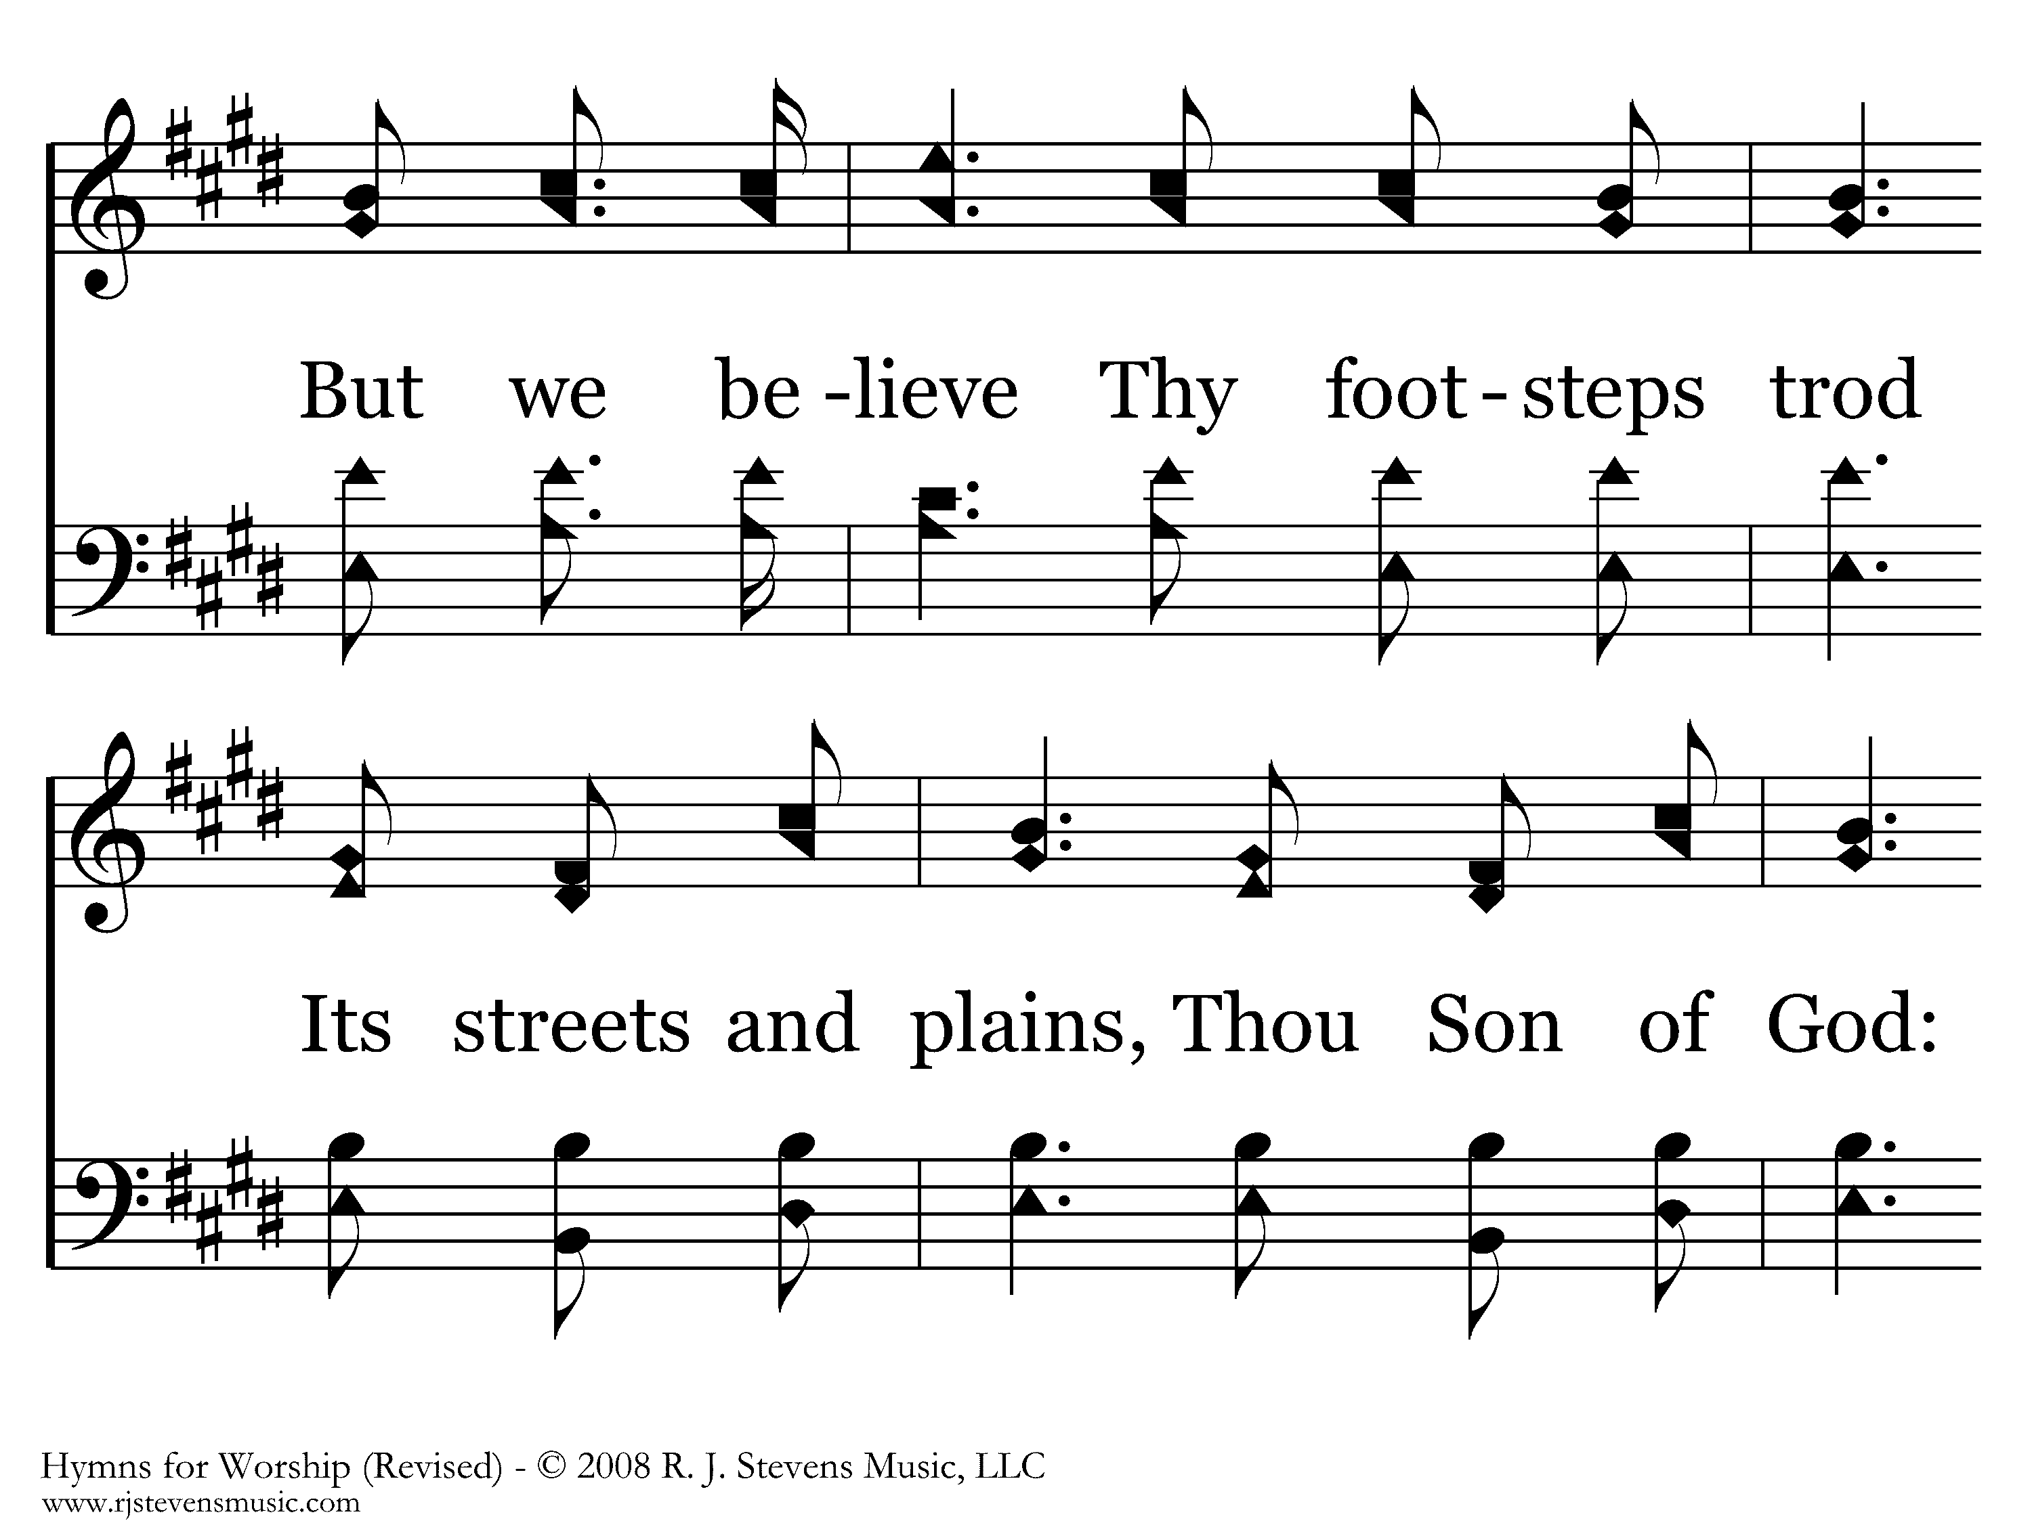
167 - We Saw Thee Not - 1.3

Slide 59
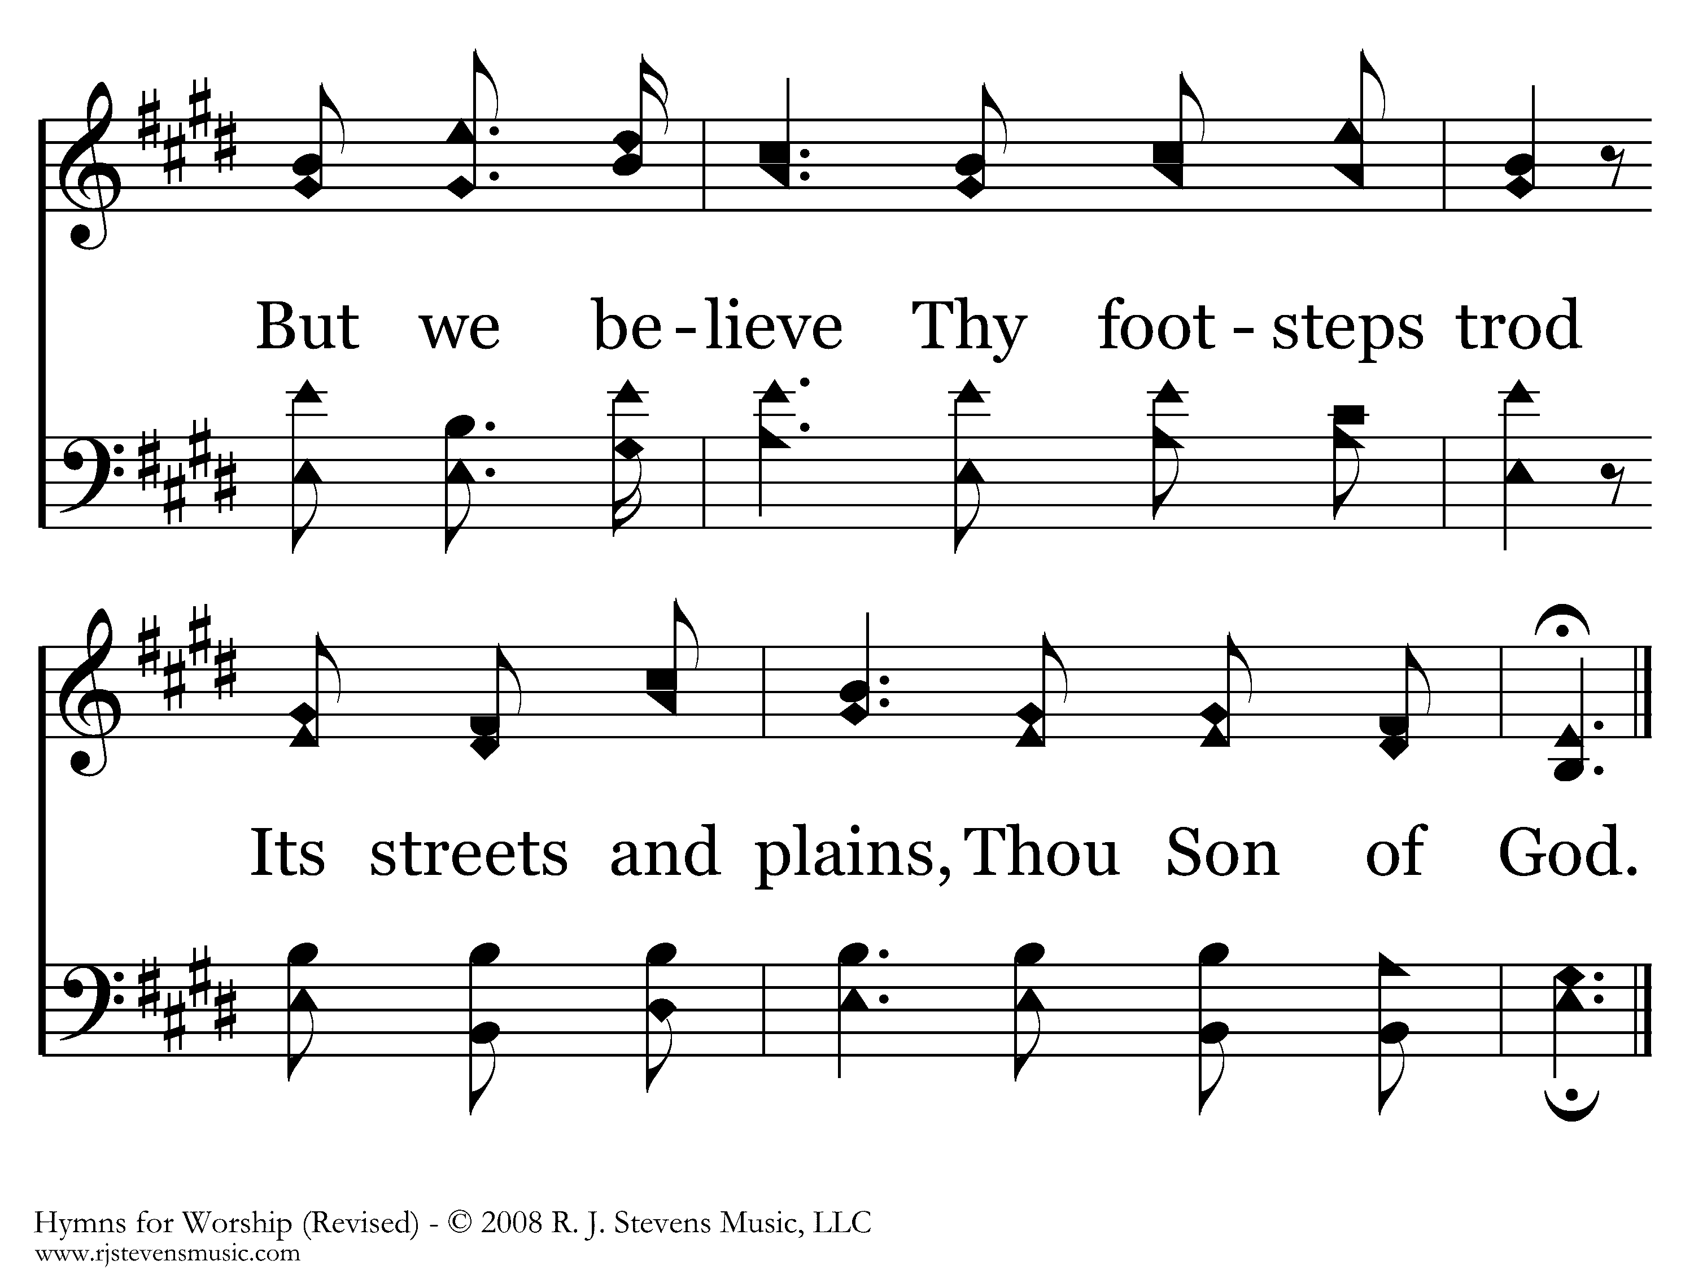
167 - We Saw Thee Not - 1.4
End of Verse 1

Slide 60

167 - We Saw Thee Not - 2.1

Slide 61
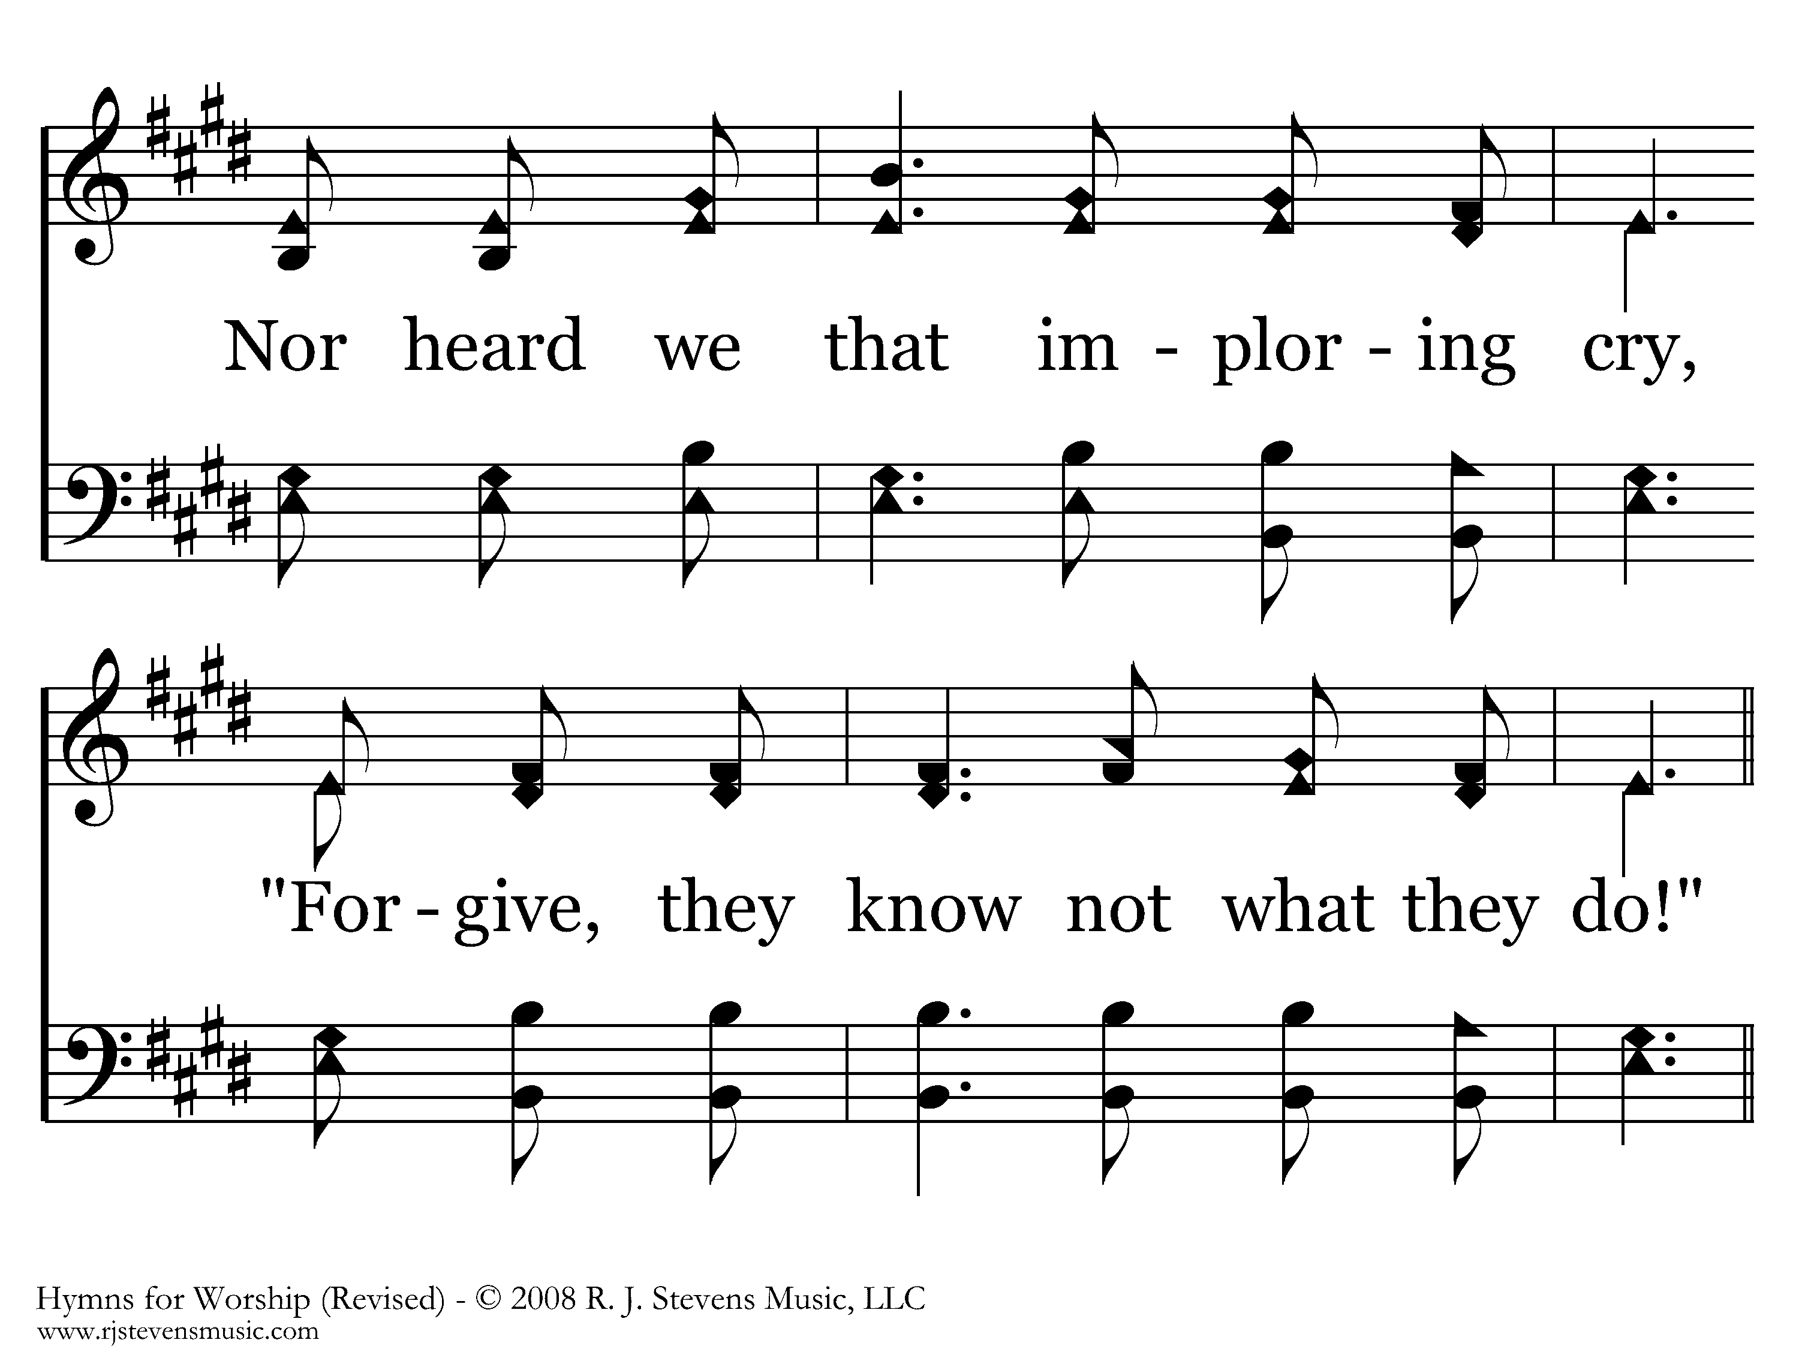
167 - We Saw Thee Not - 2.2

Slide 62
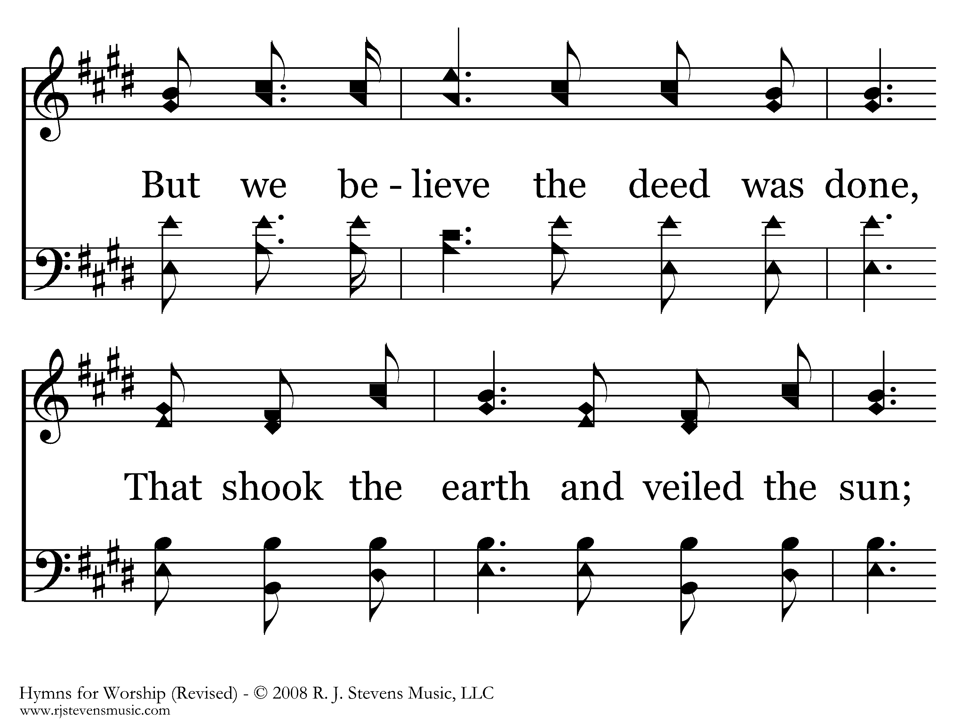
167 - We Saw Thee Not - 2.3

Slide 63
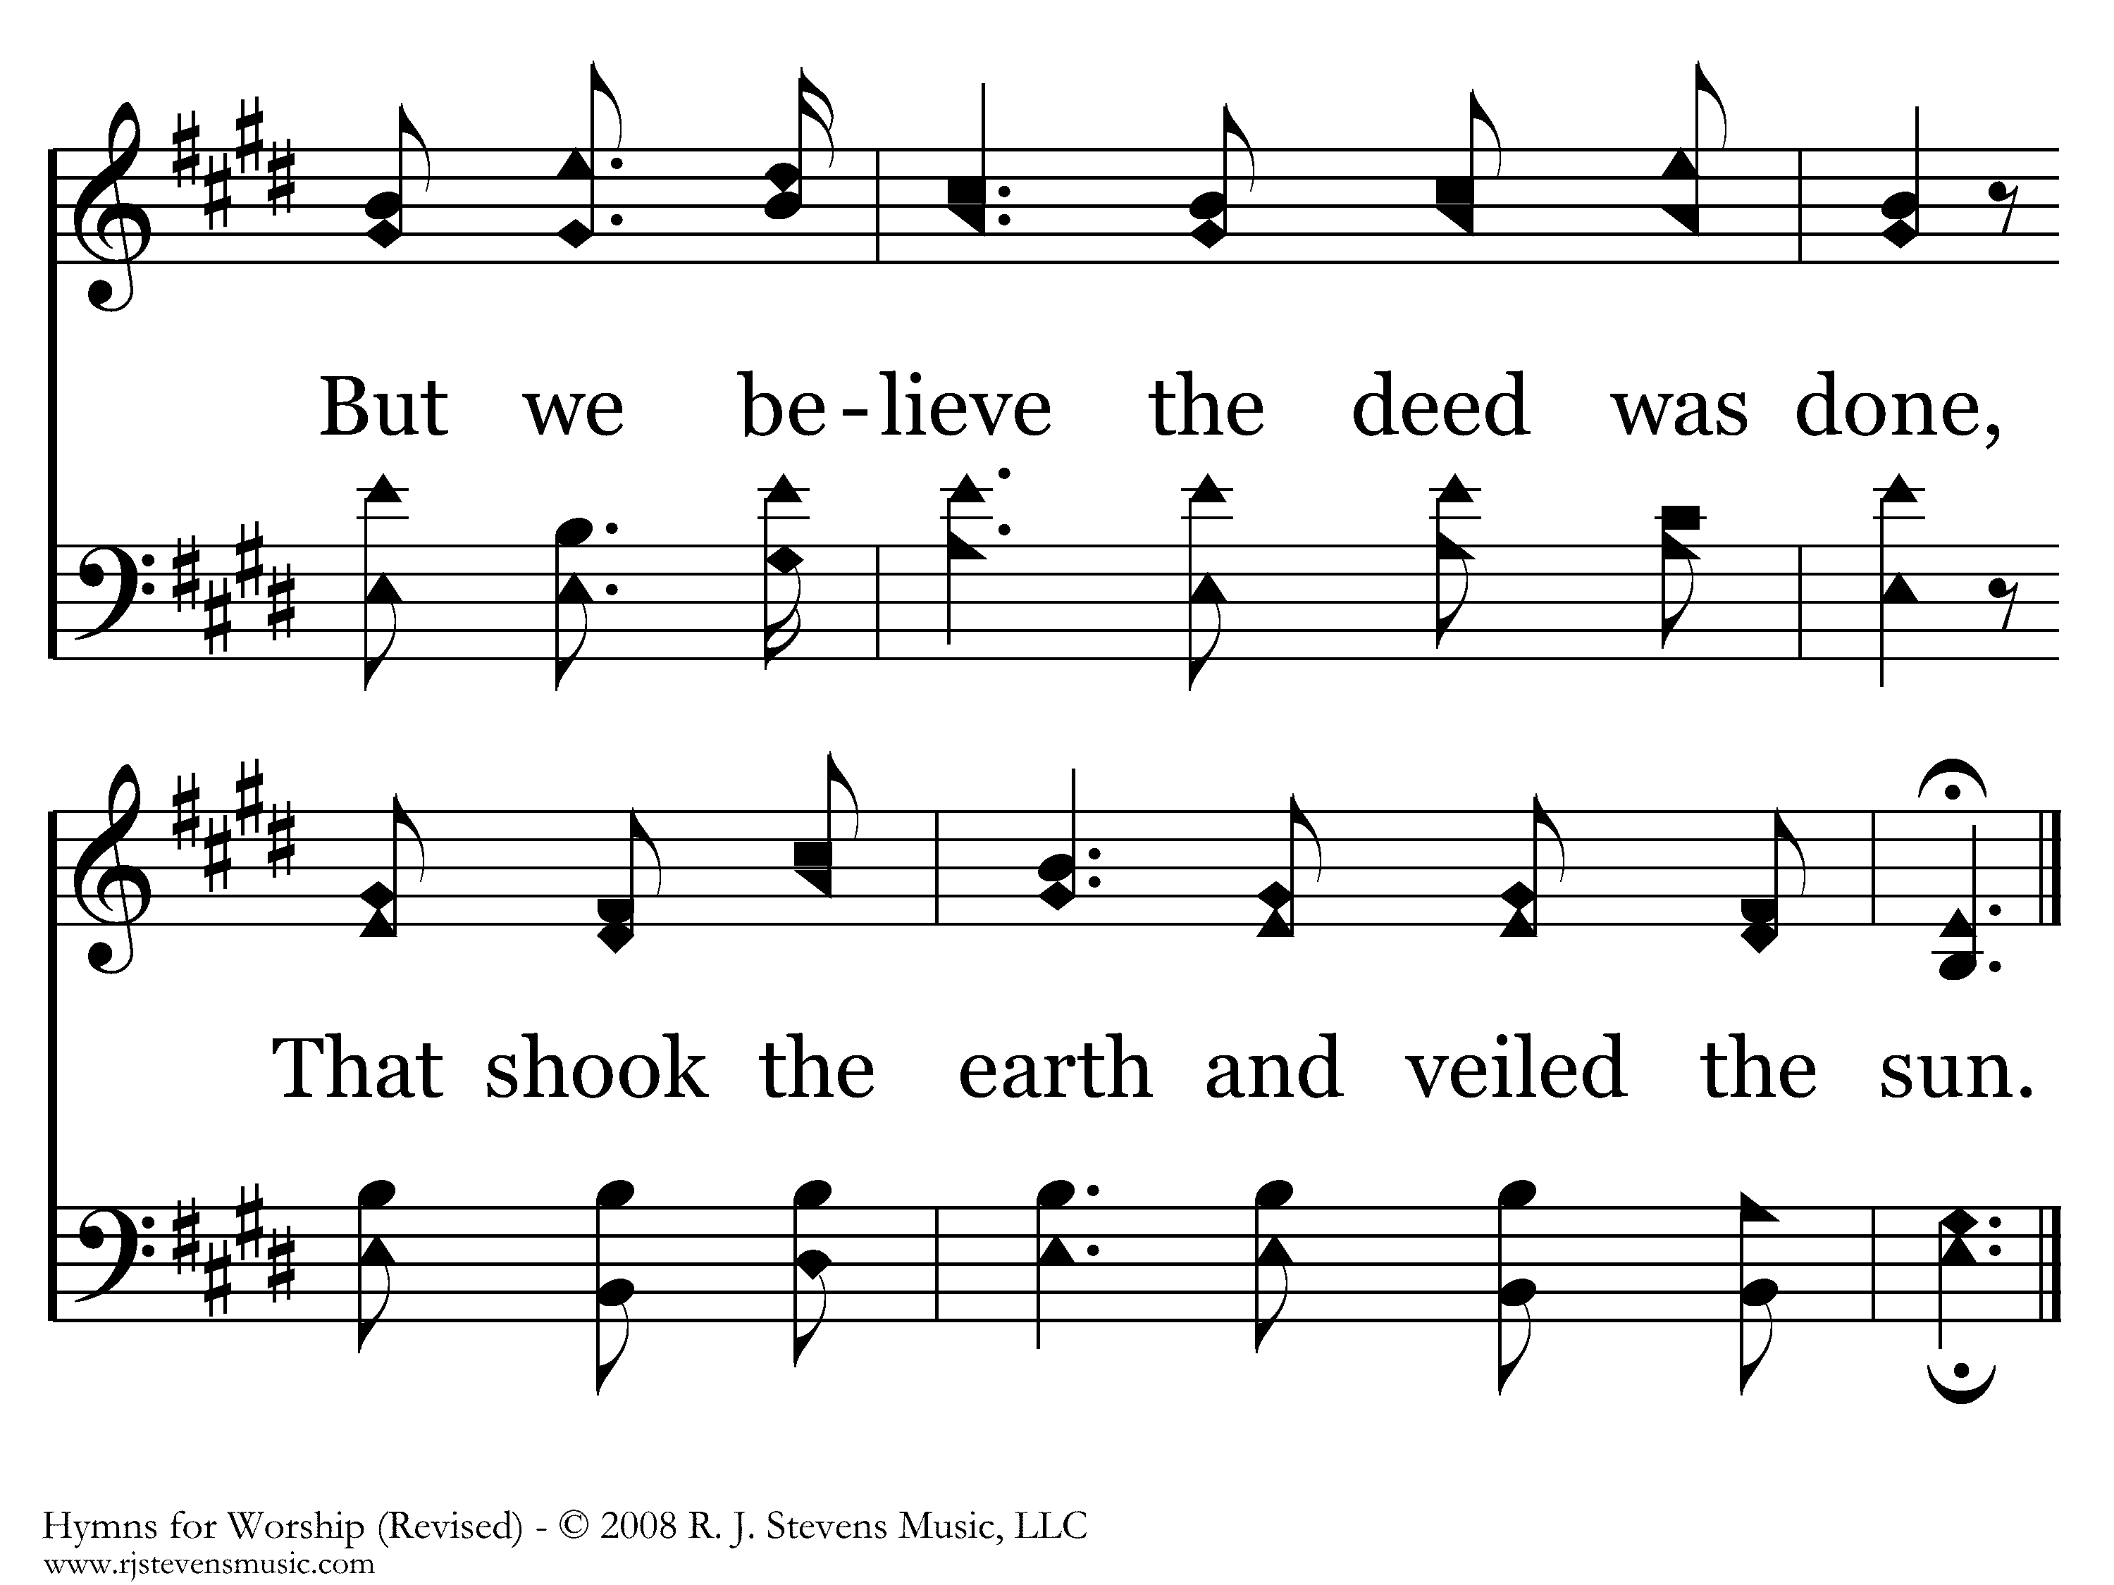
167 - We Saw Thee Not - 2.4
End of Verse 2

Slide 64
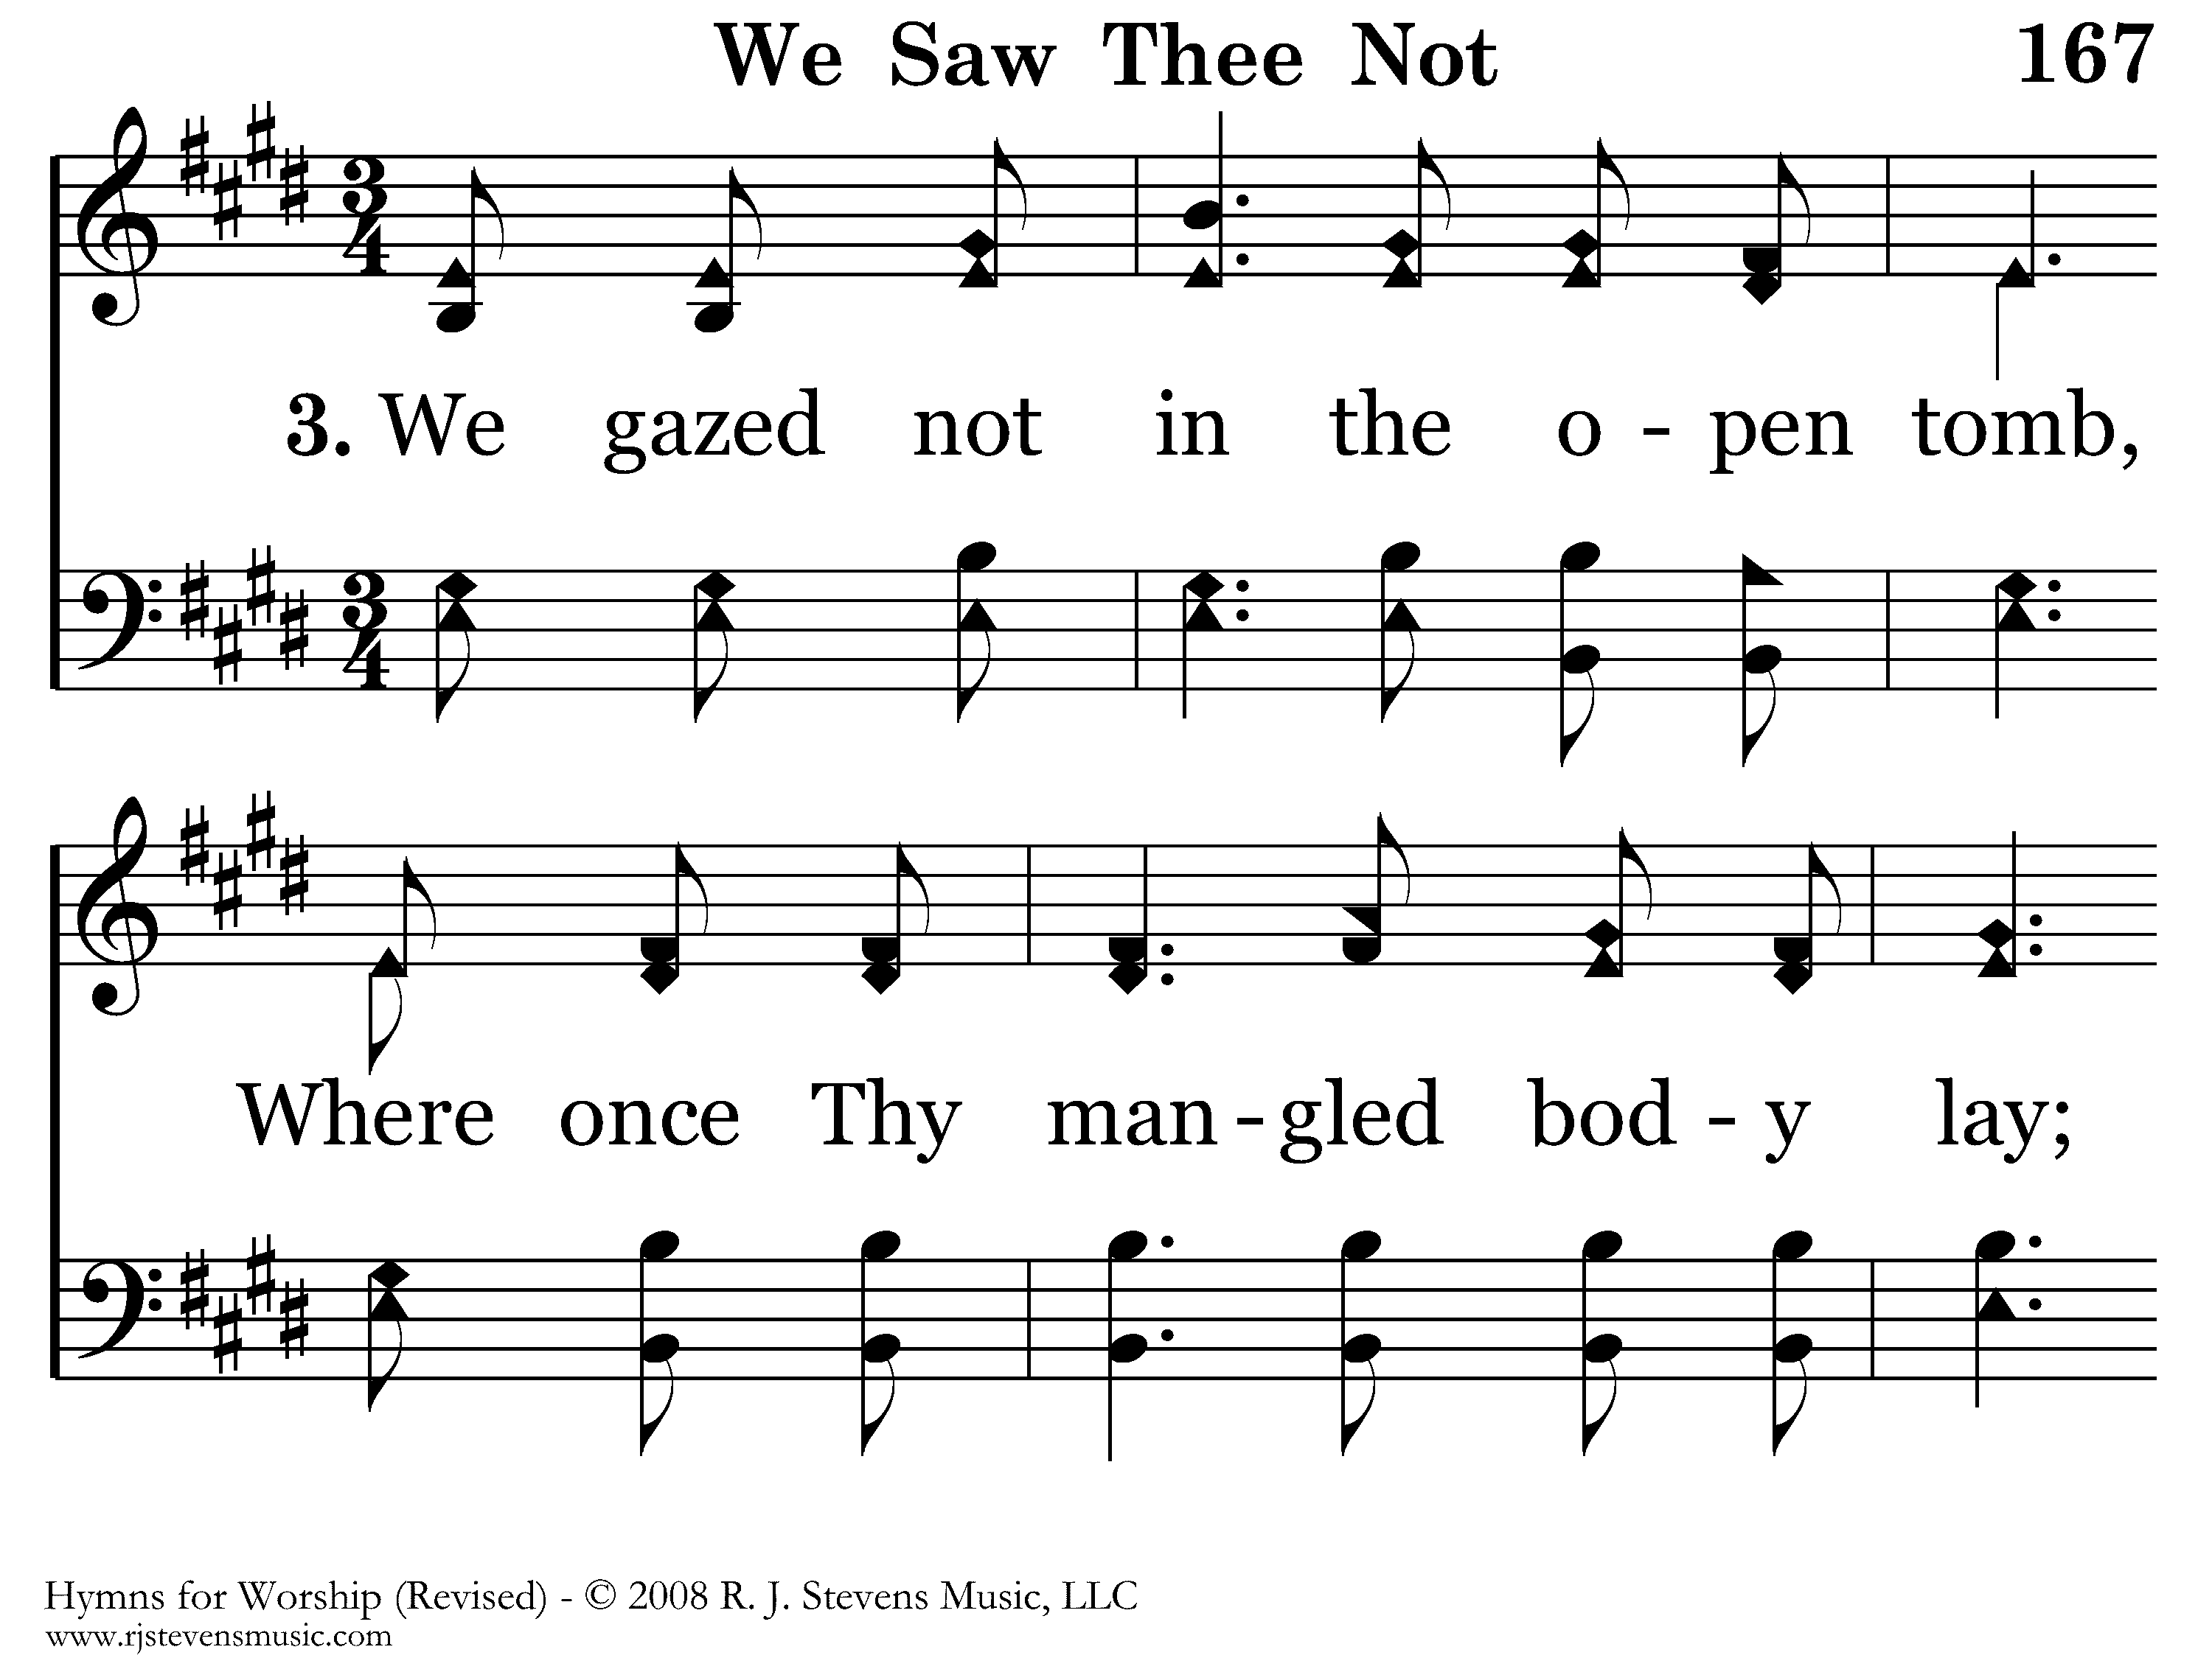
167 - We Saw Thee Not - 3.1

Slide 65
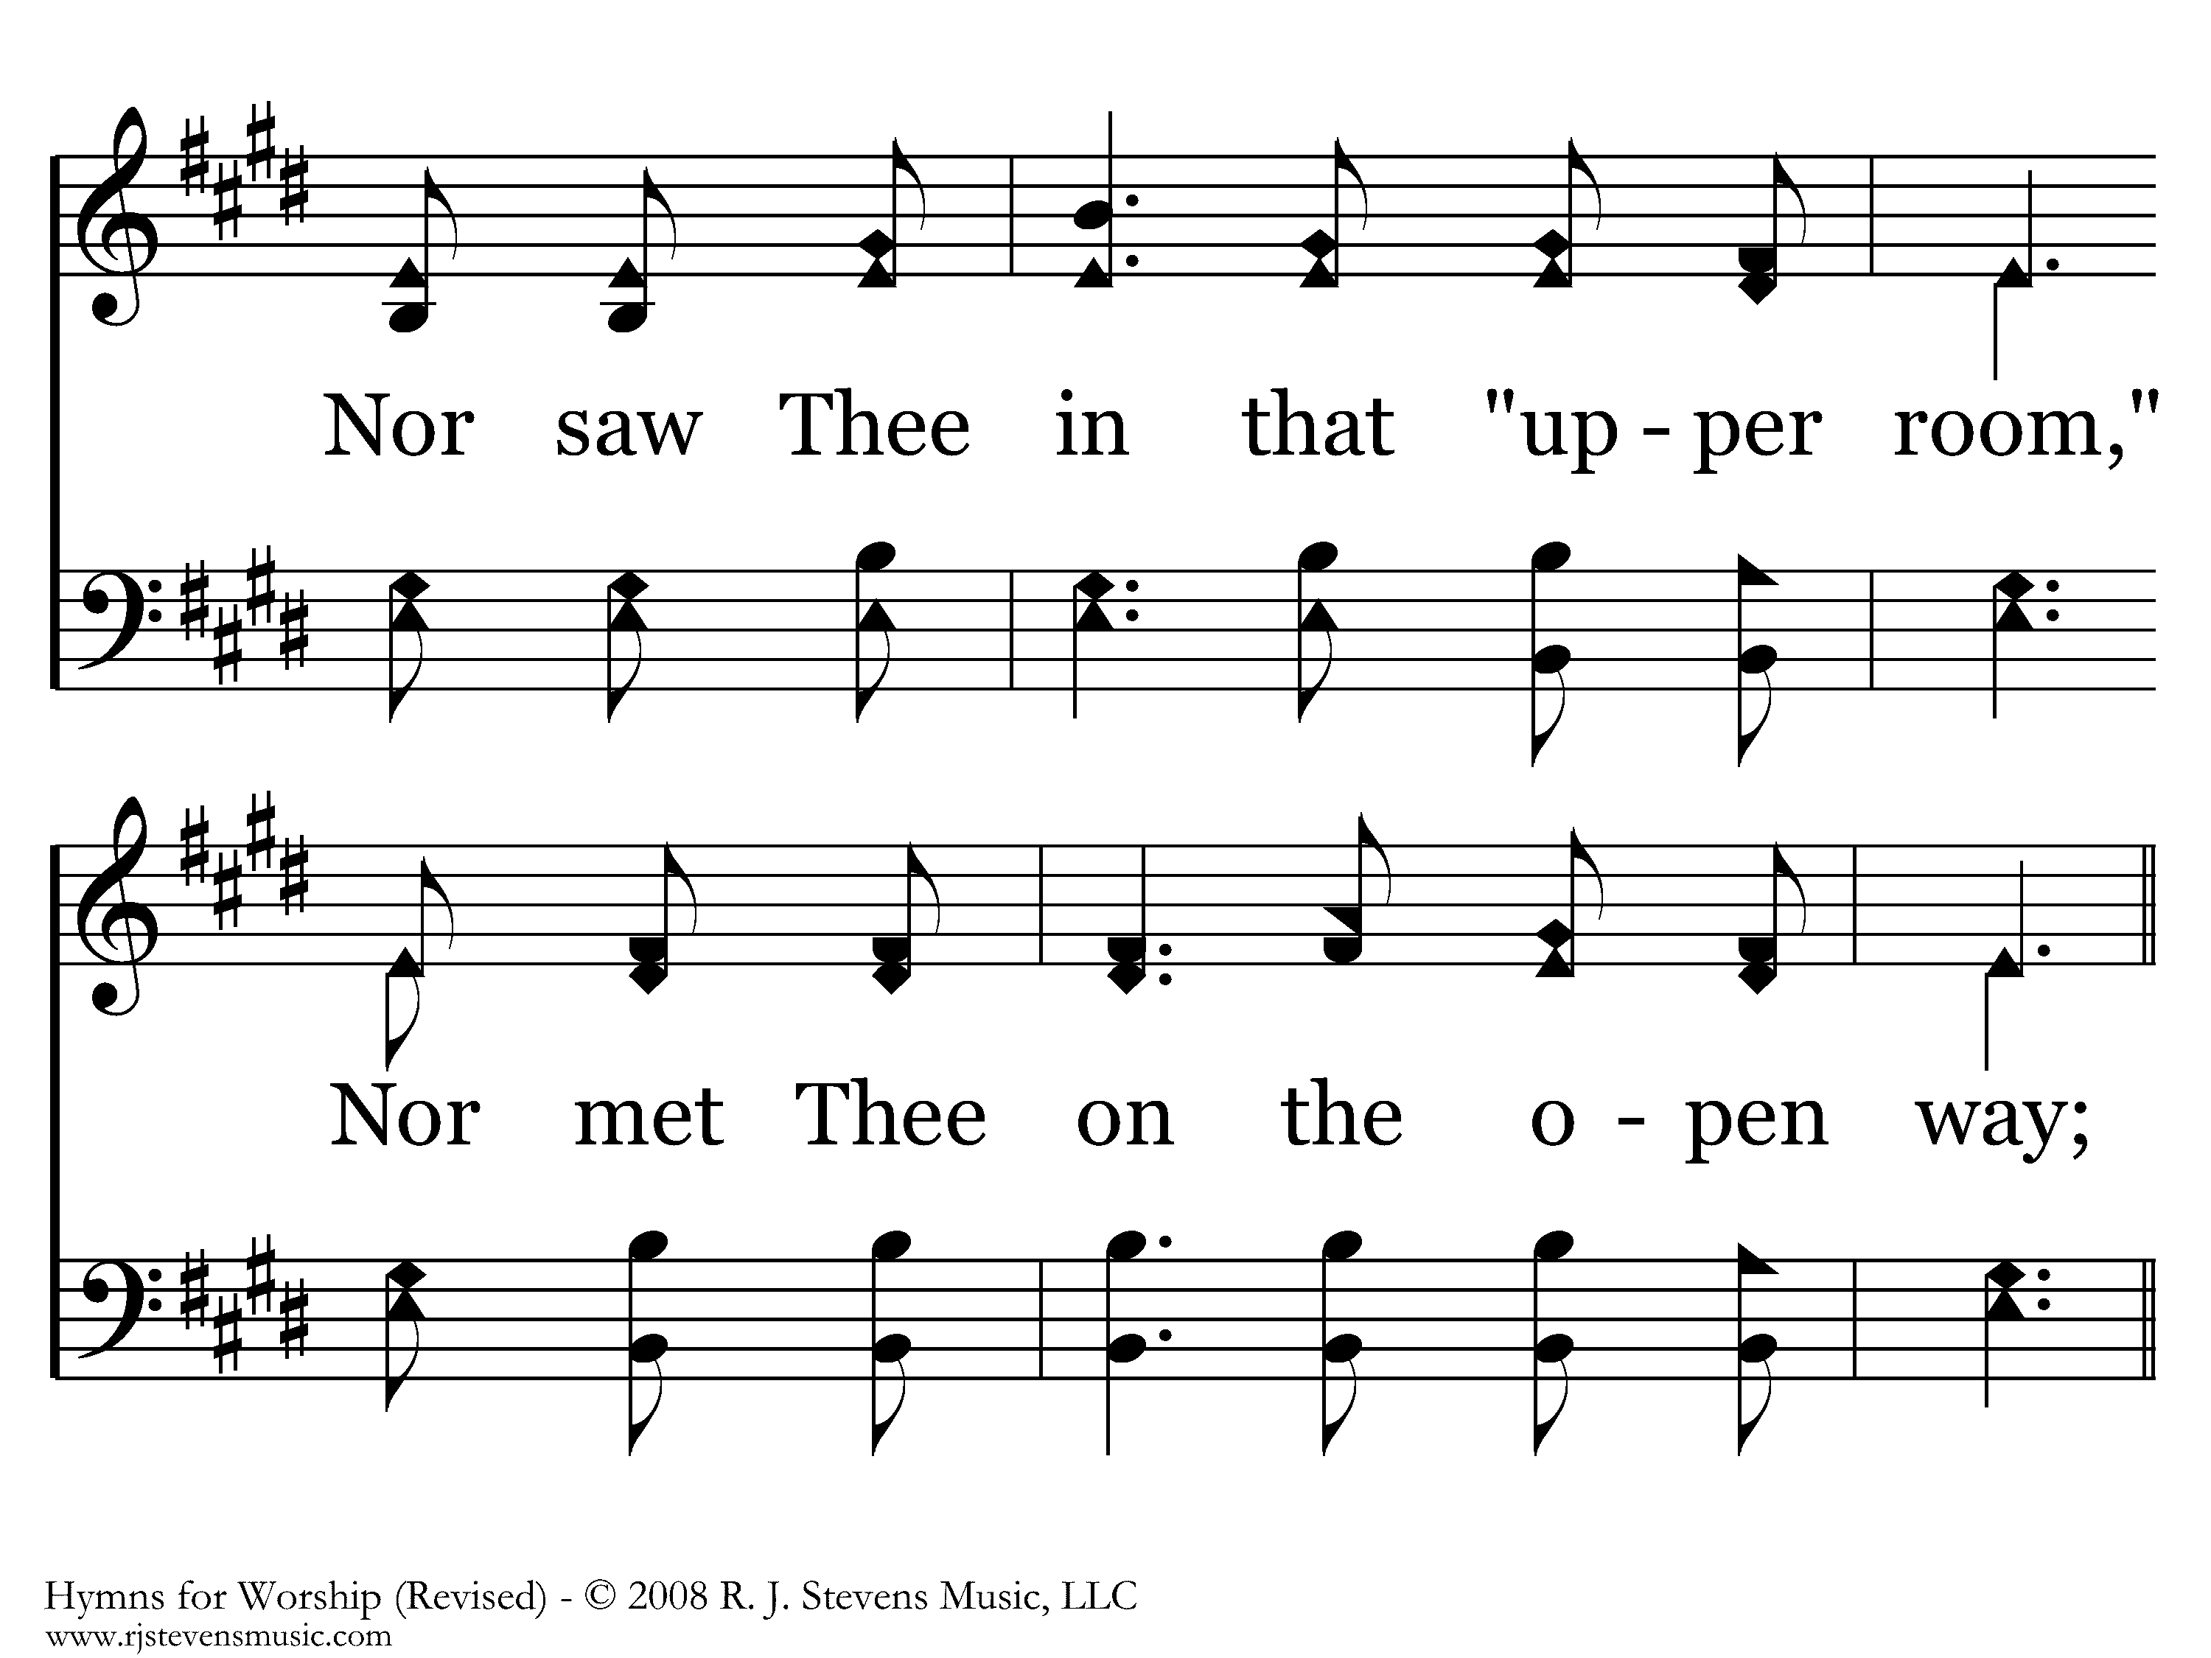
167 - We Saw Thee Not - 3.2

Slide 66
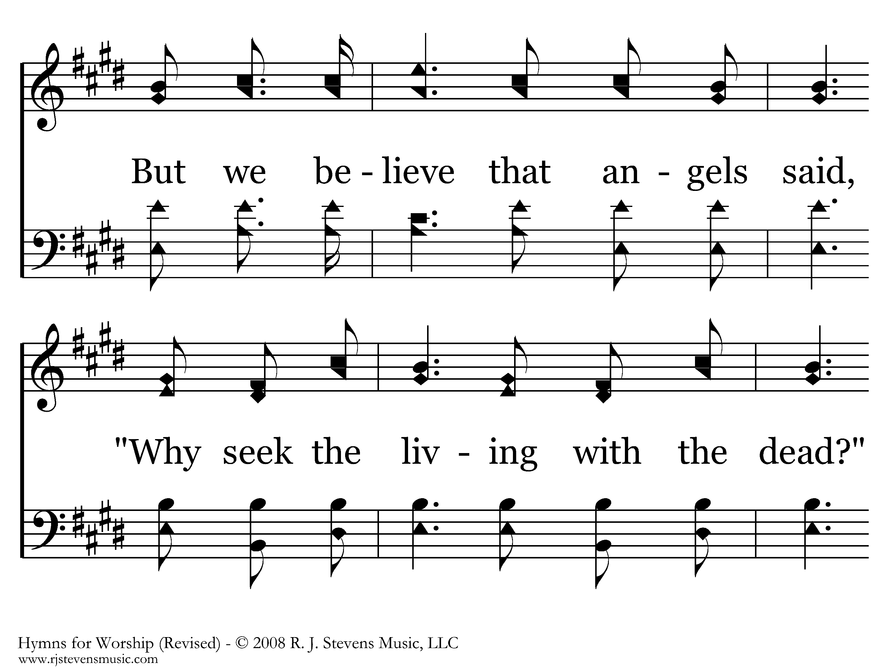
167 - We Saw Thee Not - 3.3

Slide 67
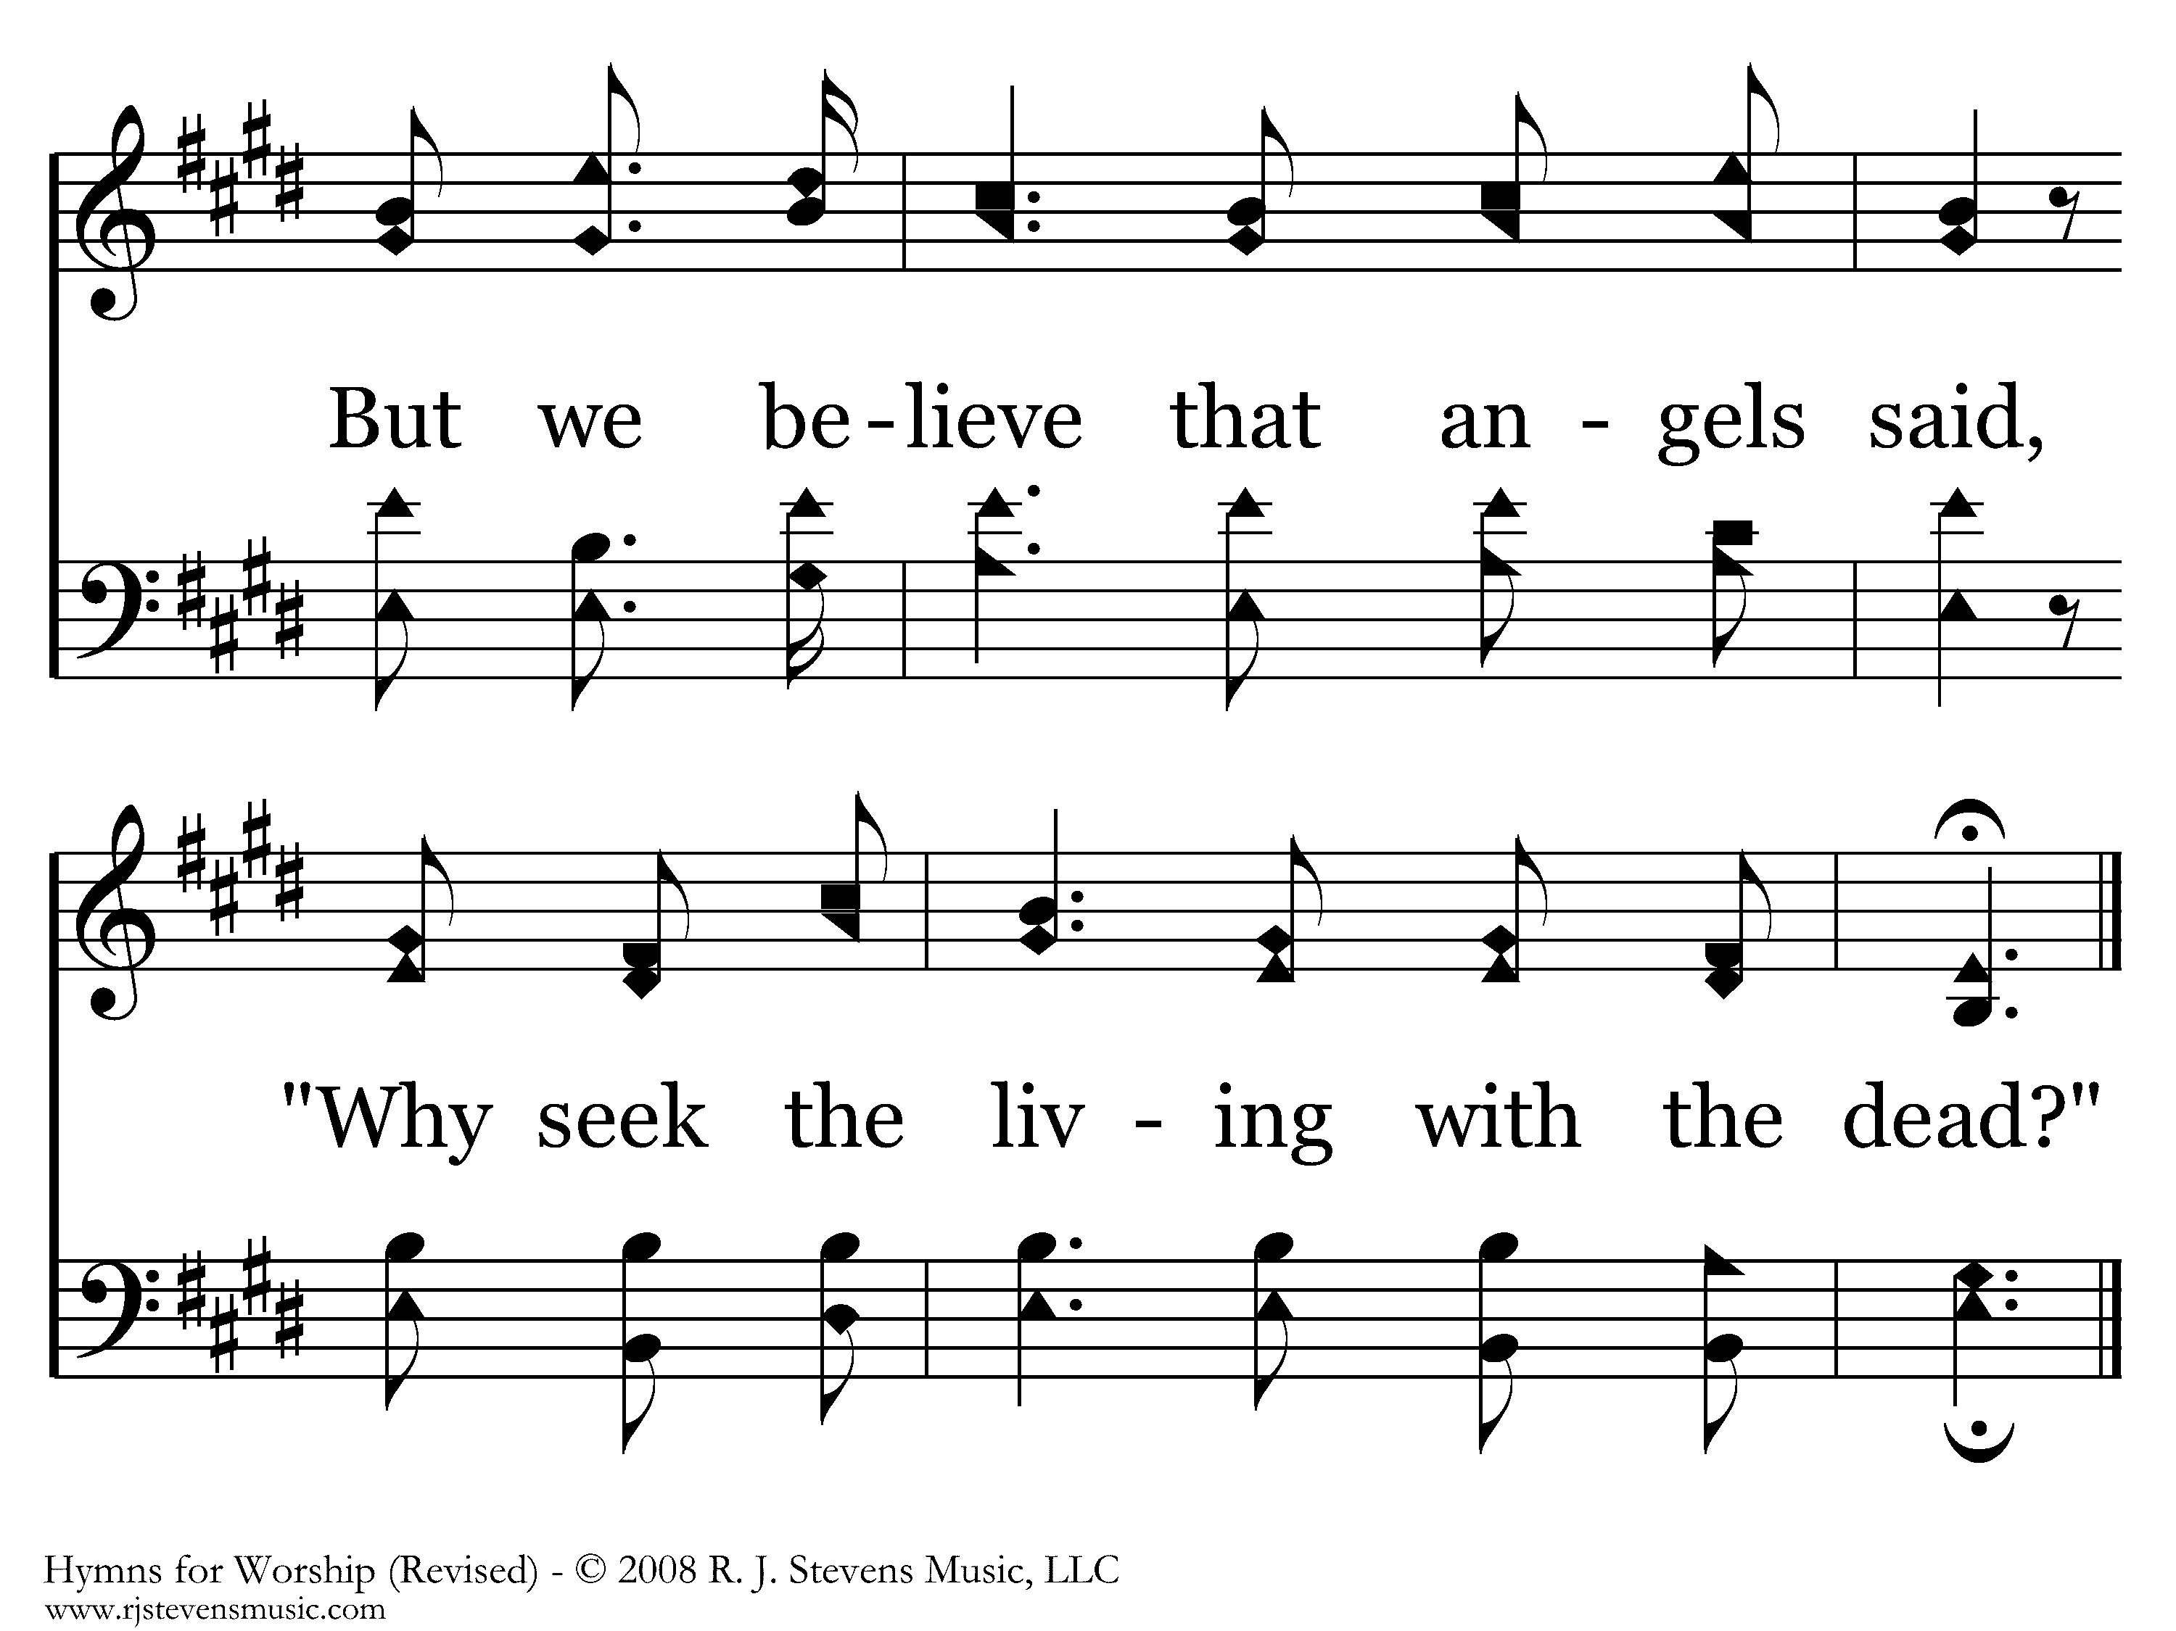
167 - We Saw Thee Not - 3.4
End of Verse 3

Slide 68
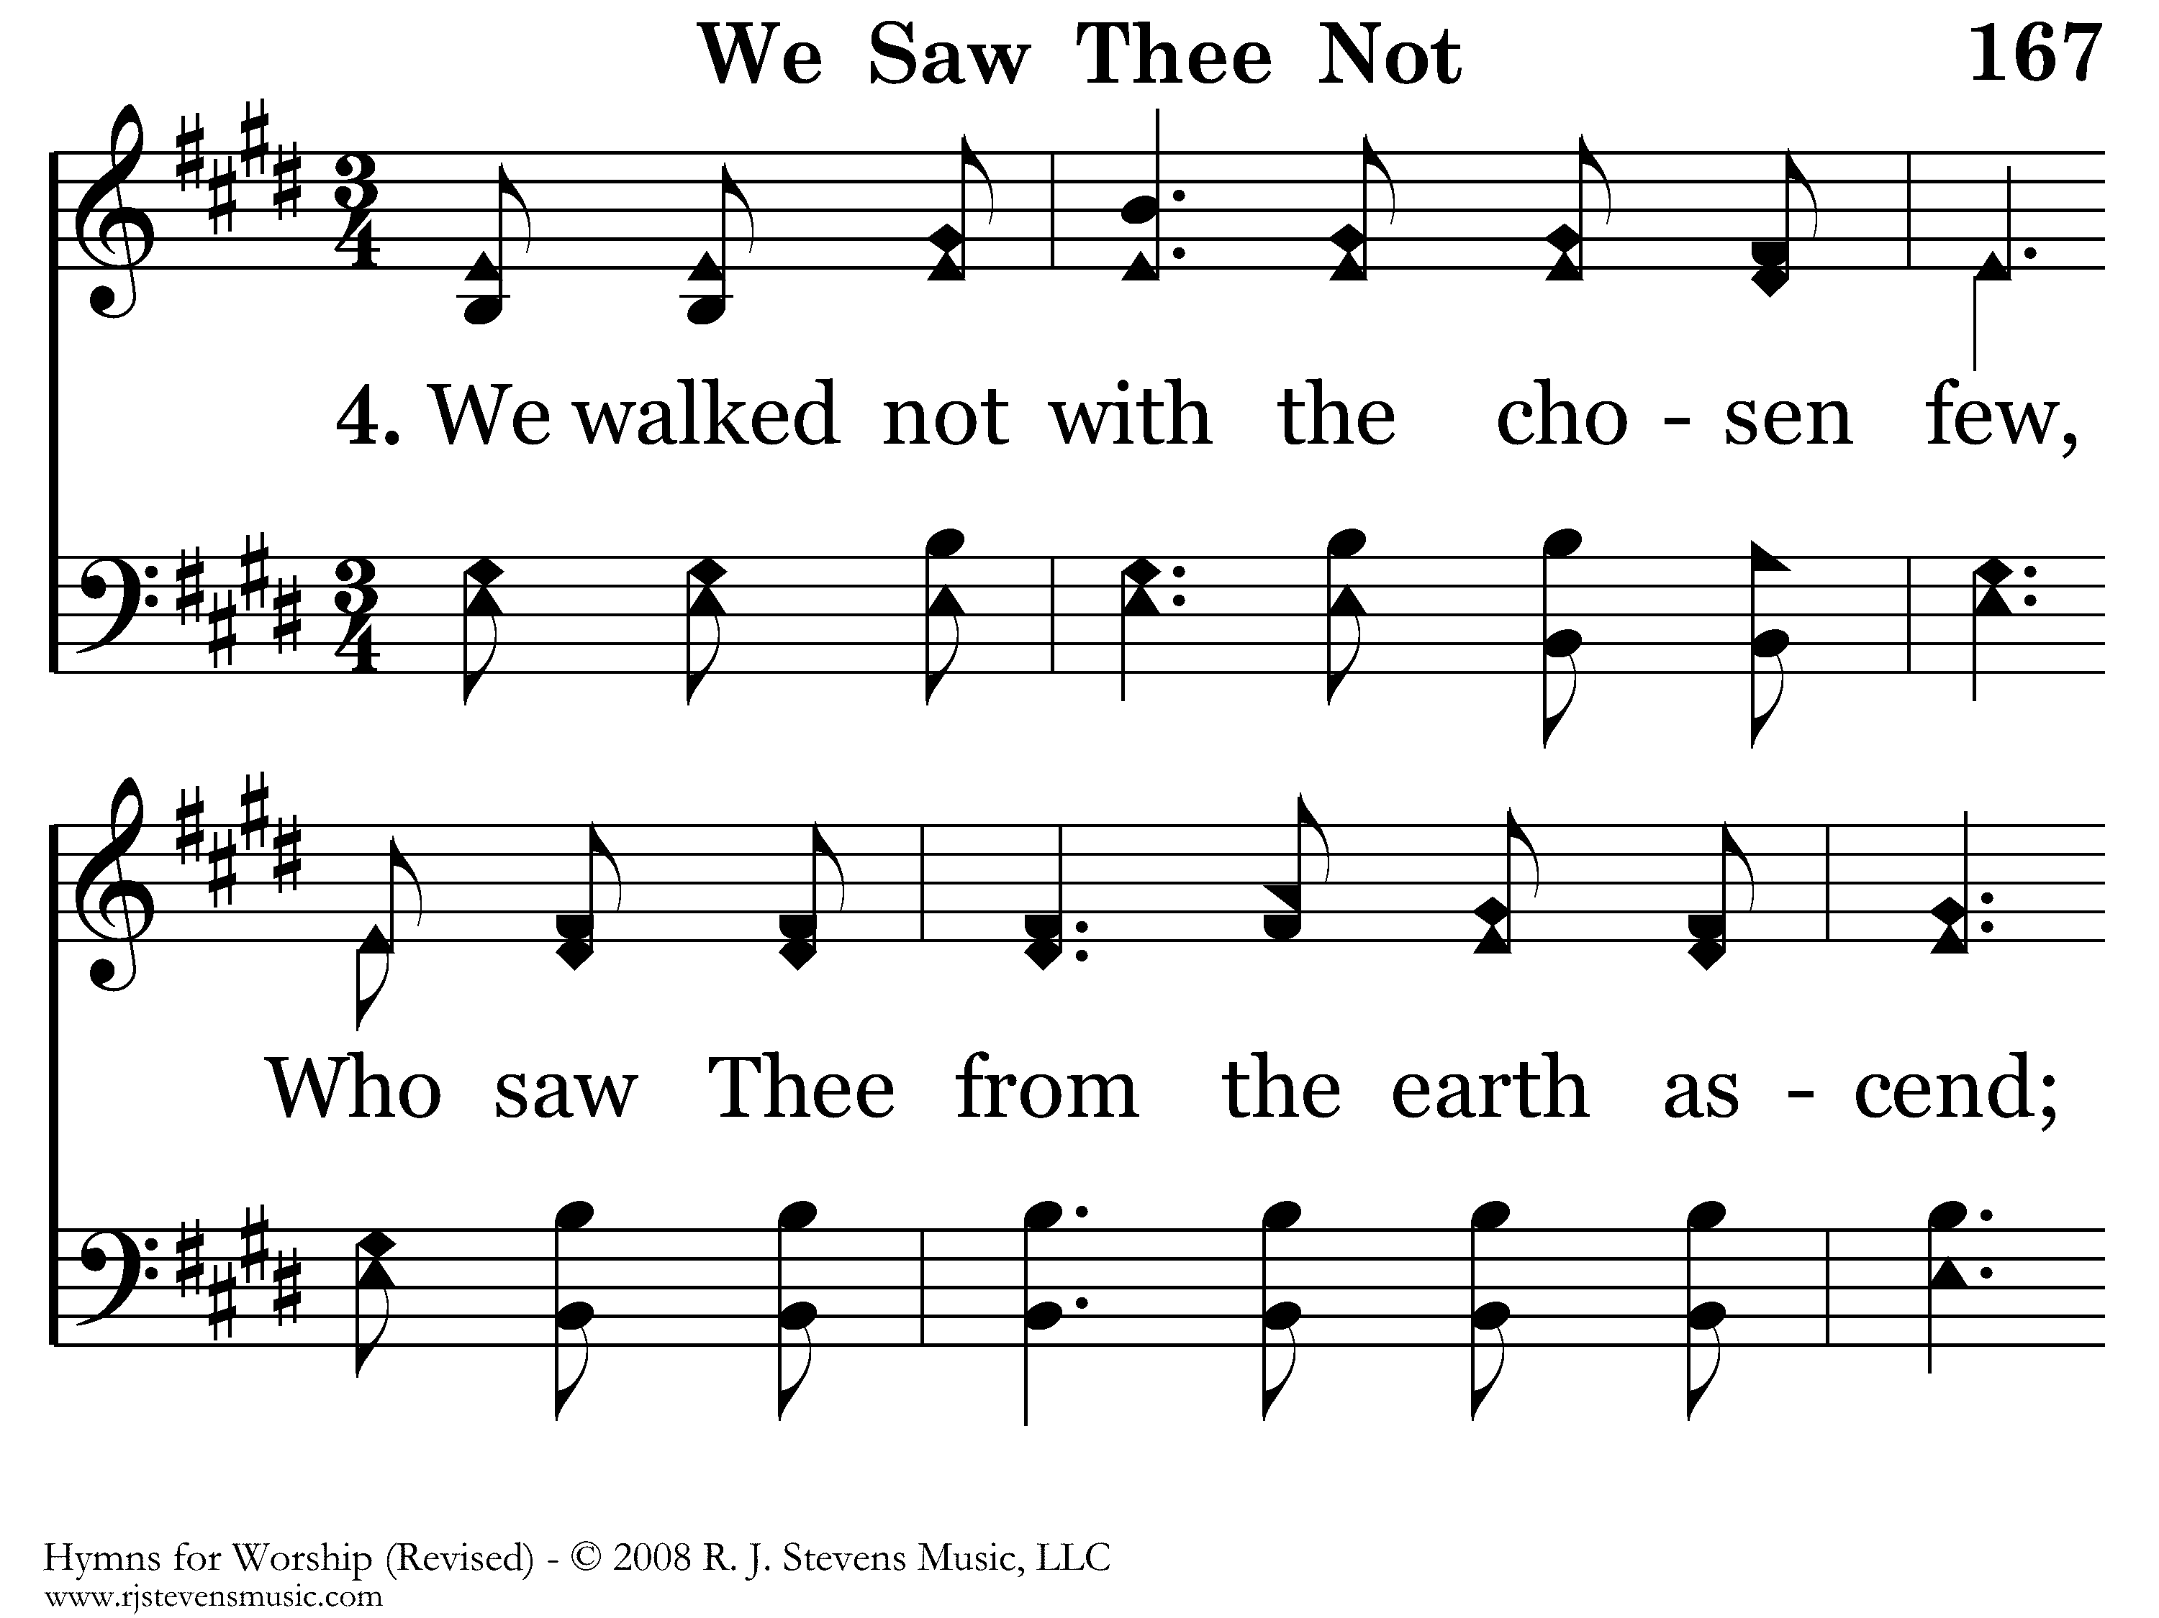
167 - We Saw Thee Not - 4.1

Slide 69
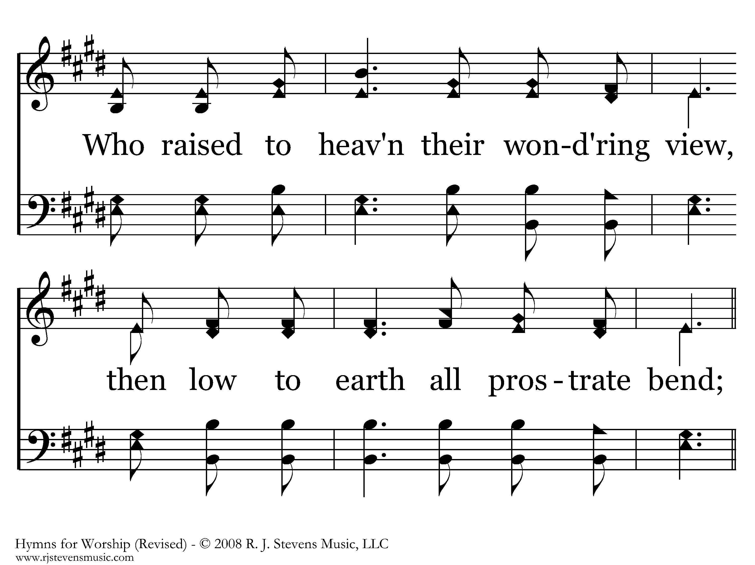
167 - We Saw Thee Not - 4.2

Slide 70
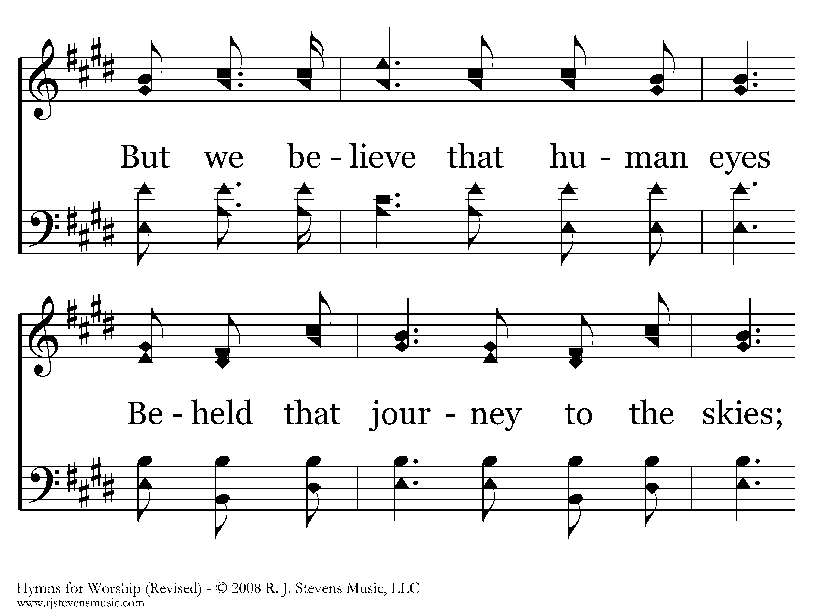
167 - We Saw Thee Not - 4.3

Slide 71
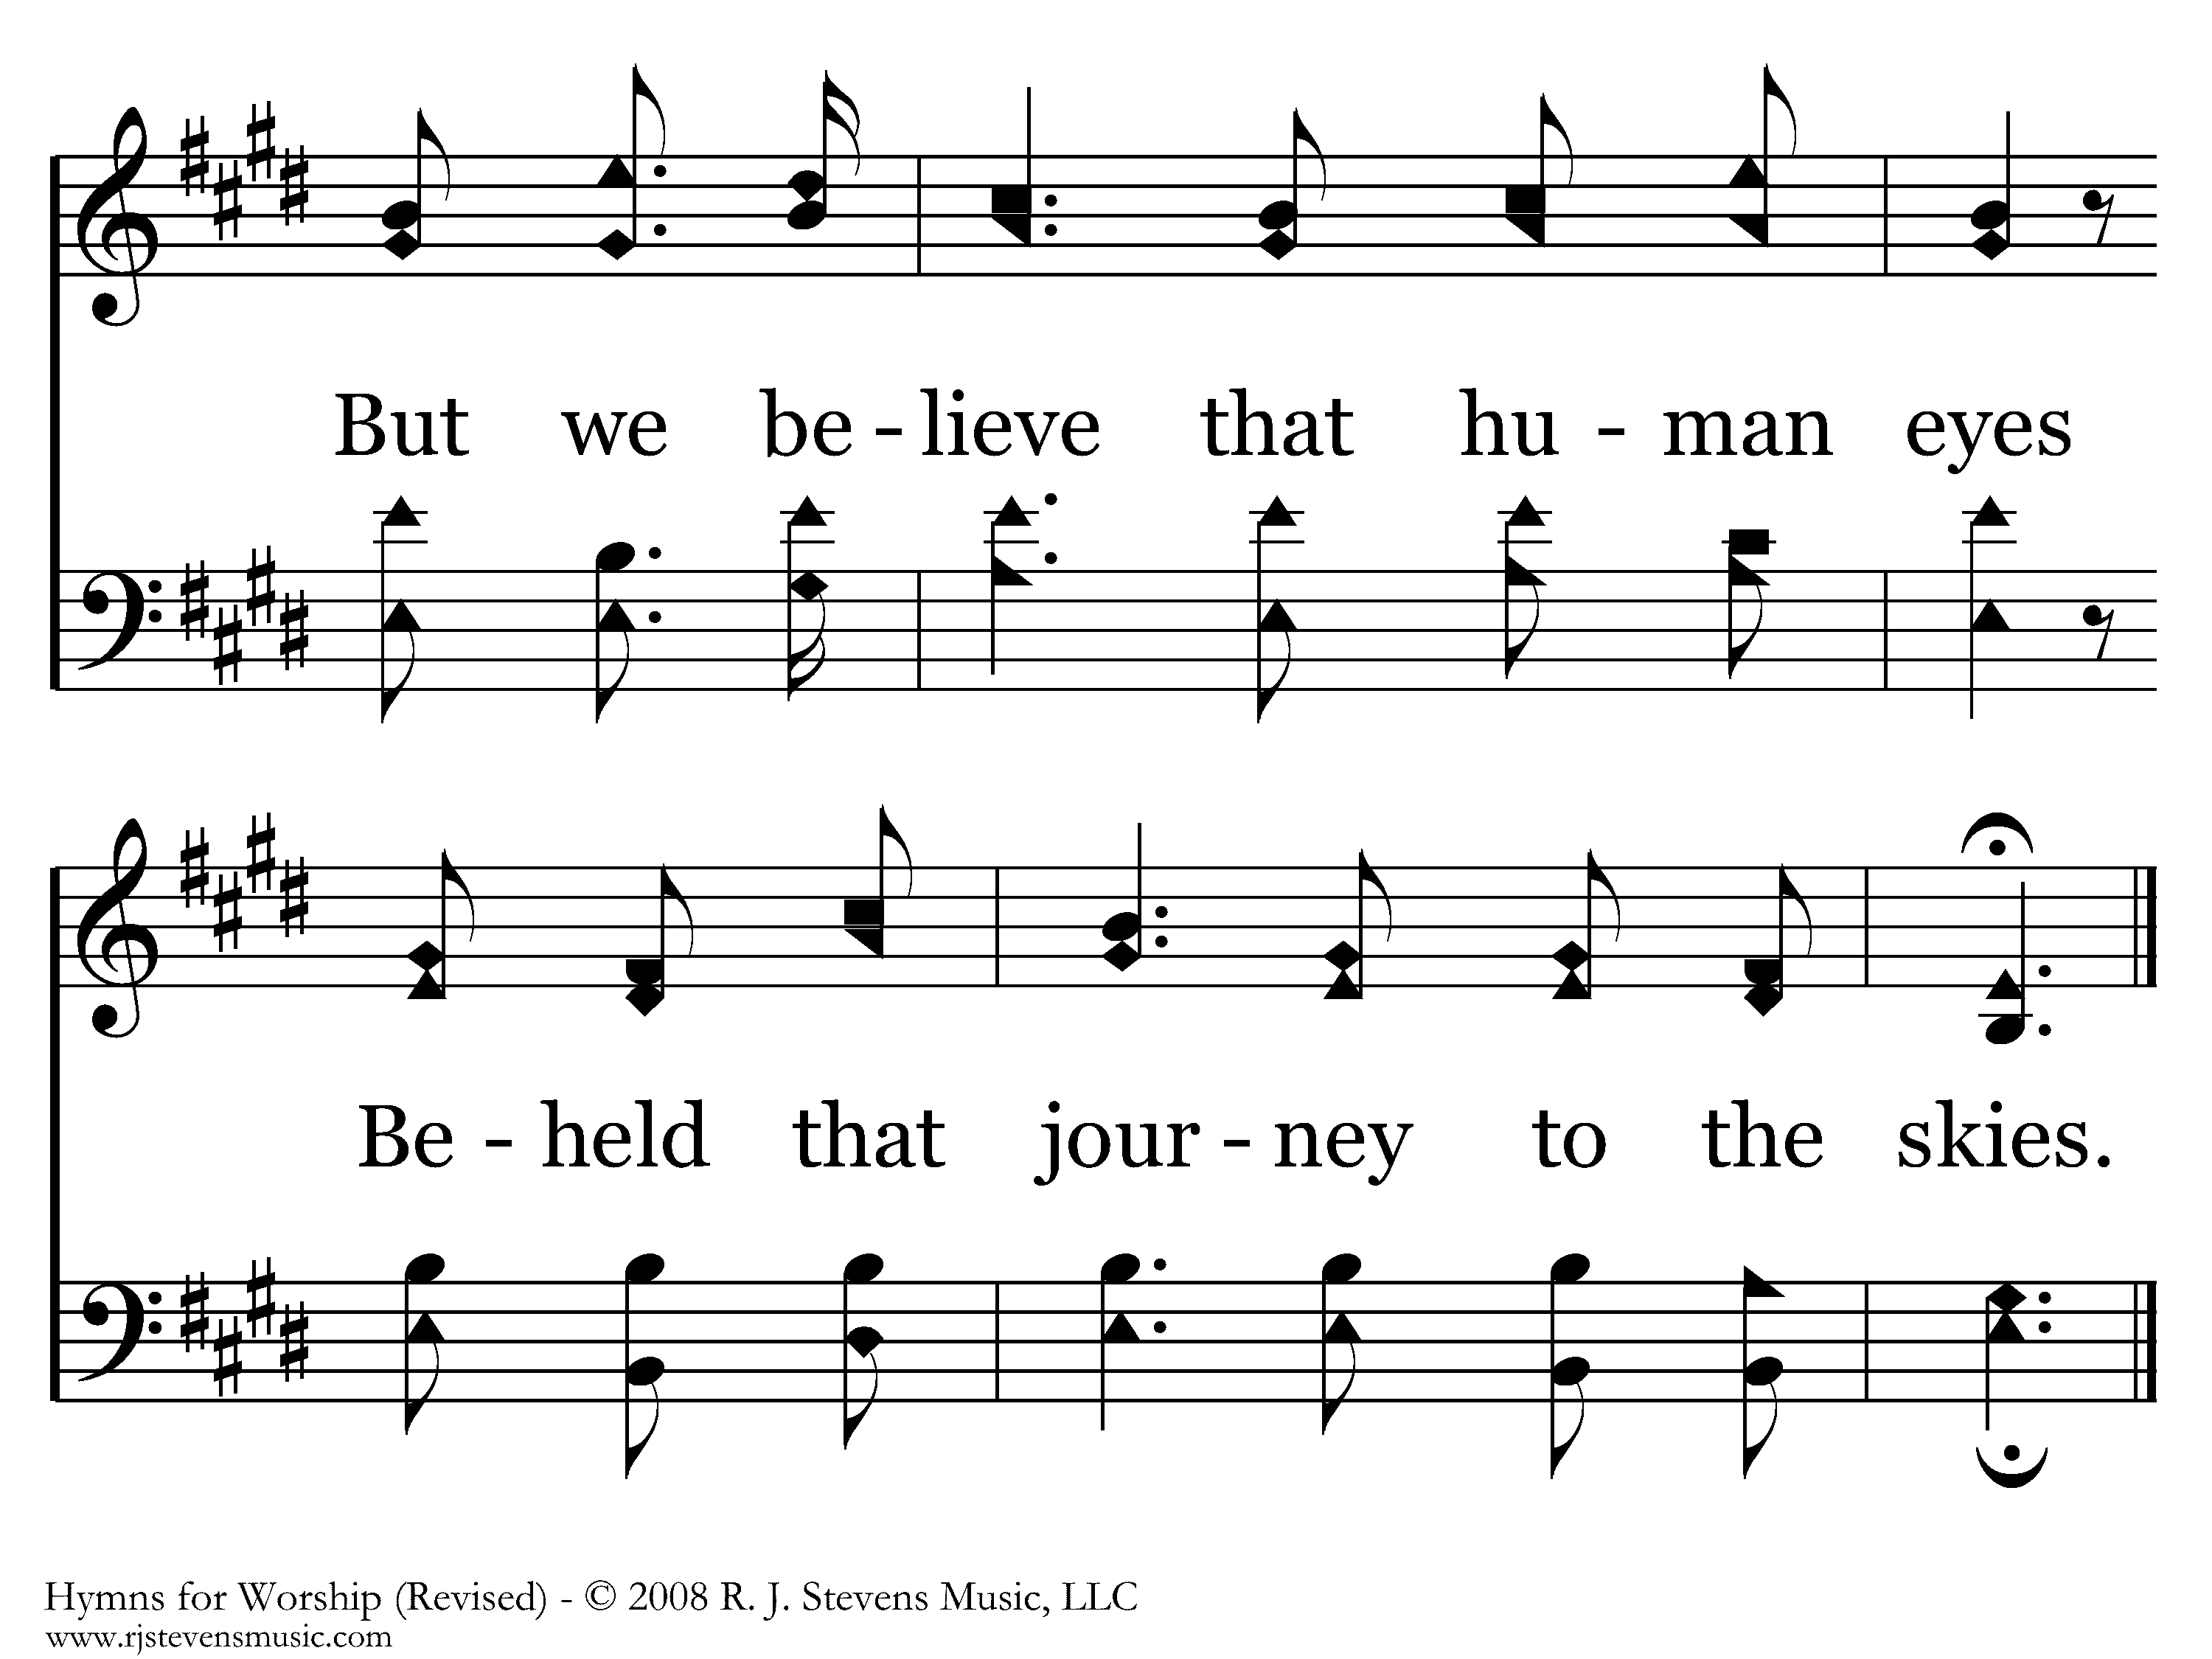
167 - We Saw Thee Not - 4.4
End of Song

